Slide 1
Plugin Community Building
European HUG 23
Deutsches Elektronen-Synchrotron DESY
Hamburg, Germany
19 September, 2023
Dana Robinson
Director of Software Engineering
The HDF Group

Slide 2
Contents
Introduction to HDF5 Filter Plugins
Existing Ecosystem
Building a Community

Slide 3
Introduction to HDF5 Filter Plugins

Slide 4
What is a filter?
H5Dwrite()
A filter transforms your data on a per-chunk basis
  (can also transform group names)
Bidirectional, arbitrary transformations
  Not just compression (e.g., Fletcher32 checksums)
Happens early in the I/O pipeline
  Before type conversion, etc.
Can be chained
  The filter order can have a HUGE effect! (e.g., shuffle + zlib)
Filter 1
Filter 2
Storage

Slide 5
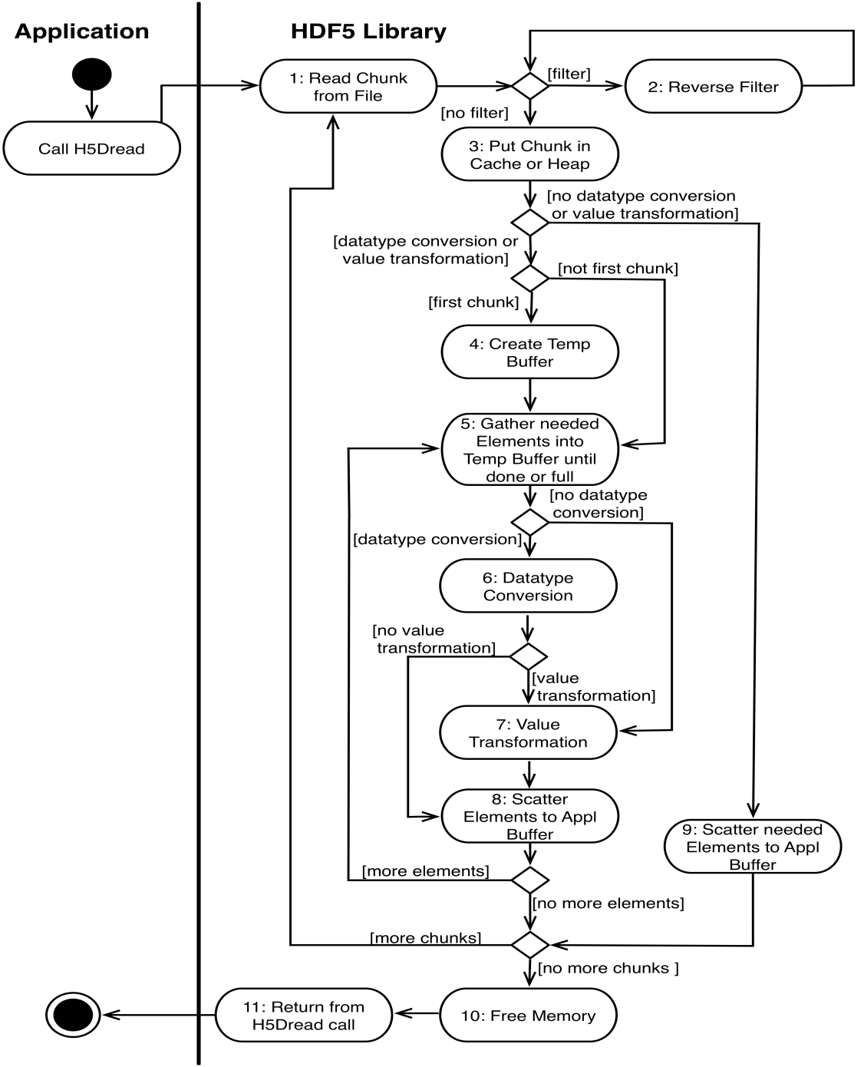
You are here…

Slide 6
Setting a filter
H5Pset_filter (hid_t plist, H5Z_filter_t filter, unsigned int flags
size_t cd_nelmts, const unsigned int cd_values[])
plist: dcpl or gcpl (filters set at creation time and cannot be changed)
filter: H5Z_filter_t is typedef'd to an integer that is the filter's assigned ID
(NOTE: filter IDs should not be confused with hid_t library IDs)
flags: Can contain H5Z_FLAG_OPTIONAL or H5Z_FLAG_MANDATORY
cd_nelmts/values: Filter parameters (depends on filter)

Slide 7
Limitations
Can only filter dataset data and group names
Datasets must be chunked
Can't filter variable-length data
Limit of 32 filters in a pipeline

Slide 8
Dynamic filter plugins
Since 1.8.11 you can use filter plugins to load 3rd party filters
Filter plugins are implemented as dynamically loaded shared libraries that use the interface defined in H5PLextern.h
If a plugin with the filter ID required by the dataset/group cannot be found, the library will check the plugin paths to see if it can find it
Filters are searched by ID
Plugins can be disabled (by plugin category - VOL/VFD/filter)

Slide 9
Supporting Architecture
Plugin cache
Plugin path list
(Per-library, shared with ALL plugins)
HDF5 Library
Loaded Plugin Cache
Plugin Search Paths
/foo
/bar
P1
P2
P3

Slide 10
H5PL API Calls
Several calls allow you to manipulate the plugin paths
H5PLappend
H5PLprepend
H5PLreplace
H5PLinsert
H5PLremove
H5PLget
H5PLsize

Slide 11
Building a Filter
Include H5PLextern.h and H5Zdevelop.h
Implement H5PLget_plugin_type() and H5PLget_plugin_info()
Fill out the H5Z_class2_t struct
Implement the filter function and some supporting things

Slide 12
Aside: The Memory Issue
Filters can reallocate memory
If a filter uses a different memory allocator than the library, this will cause problems
  Filter can't free/realloc library memory
  Library can't free/realloc filter memory
Was a huge problem when we had the memory sanity checks turned on due to canaries being clobbered
Can also be a problem on Windows when using different CRTs (e.g. Debug vs Release)

Slide 13
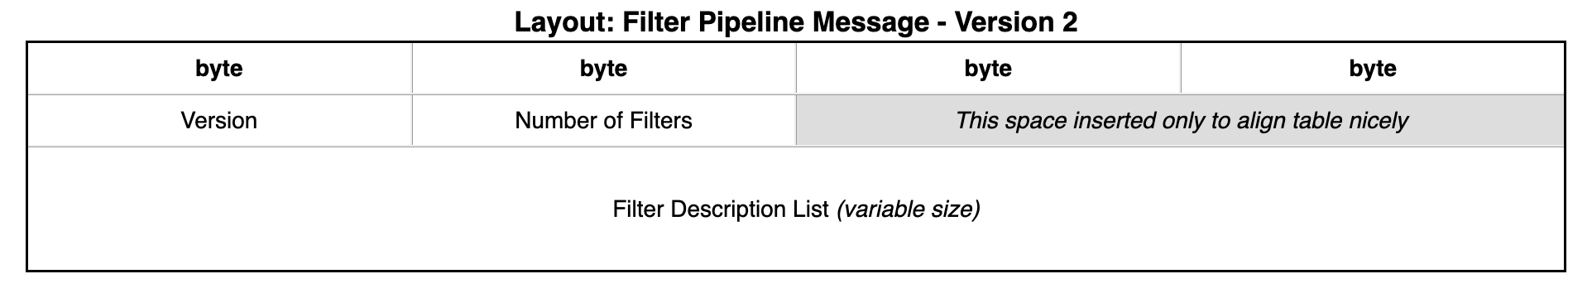
Filters in HDF5 Metadata
Filters are stored in object header messages

Slide 14
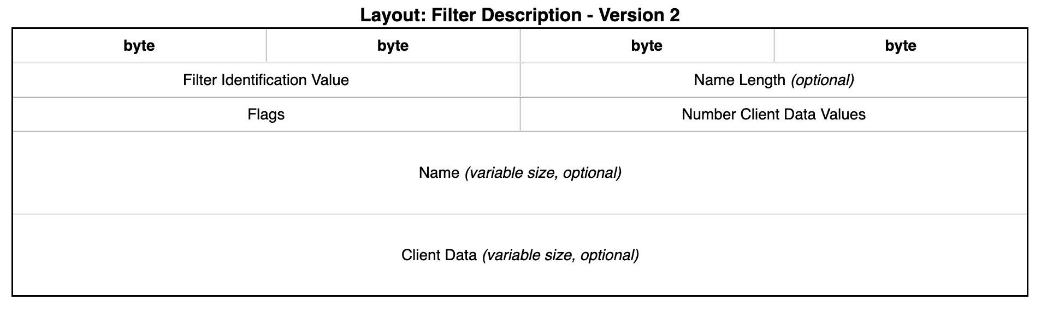
Filters in HDF5 Metadata
Filters are stored in object header messages

Slide 15
Existing Ecosystem

Slide 16
Built-in HDF5 Filters
Built with the library (szip & zlib depend on library availability)
Filters:
  zlib / deflate
  Fletcher32
  n-bit
  scale-offset
  shuffle
  szip / libaec
No new filters will be added as built-in filters

Slide 17
The HDF5 Filter Repository
https://github.com/HDFGroup/hdf5_plugins
Contains the following filter plugins:
  BLOSC
  BSHUF
  BZIP2
  JPEG
  LZ4
  LZF
  MAFISC
  SZ
  ZFP
  ZSTD

Slide 18
The HDF5 Filter Repository
Fundamentally CMake-oriented, Autotools not as well supported
Has some CI, but could use improvement and better transparency
  CI badges on README
  Possibly link HDF5 and plugin GitHub actions
  More thorough testing
Can probably be used as the home for future plugin work
doc directory contains a 2014 proposal for creating this community ☺

Slide 19
Registration
Filters can be registered with HDFG
  email help@hdfgroup.org
  We'll send you an ID for your filter
  0-255 for predefined, 256-511 for testing, 512-32,767 for 3rd party, 32,768-65,535 unused
https://portal.hdfgroup.org/display/support/Registered+Filter+Plugins
  ~30 registered filters, including HDF5's predefined filters
  (will probably change locations soon)
Registration is just about filter ID management
  Purpose is to avoid filter ID clash
  We make no claims about quality, maintenance, etc.

Slide 20
Building a Community

Slide 21
Community-Driven Maintenance & Oversight
HDFG is not here to "lay down the law"
How this will work is in our collective hands and requires input from you!
Everything that follows is just to get the conversation started
There are two afternoon sessions on Wednesday we can use for discussions

Slide 22
What is needed?
A canonical location from which to obtain filter plugins
Standards a plugin must meet to be considered for inclusion
A mechanism for the maintenance and upkeep of these plugins

Slide 23
A Canonical Location
Can probably expand on the existing filter repository
  Can document governance in the GitHub wiki
Pre-built binaries?
Is just CMake okay? Do we need the Autotools?
Who maintains the code?
  Infrastructure
  Individual plugins

Slide 24
A Canonical Location (Distribution)
How do we distribute the filters?
  Linux distributions
  Anaconda
  pip
  Matlab
  lots of others
Should the filters be distributed with a default build of the library?
  We could set the filter repo up as a git submodule

Slide 25
Standards
Platform support
  Does it matter if, say, Windows isn't supported?
  What about filters that require specific hardware, like a particular GPU?
  Or platform-specific libraries?
Build files: CMake? Autotools?
Testing
  A common test suite?
  Special cases?

Slide 26
Standards
Code quality
  -fsanitize=address?
  Coverity?
  Warning free build?
  codespell
clang-format?
Documentation
  Basics
  cd_values, if any
  More?

Slide 27
Standards (security)
Do we need to do anything about security?
A filter can execute arbitrary code…
Do we need a more secure mechanism for identifying plugins?
  e.g., signing?

Slide 28
Maintenance
Who fixes problems?
  Infrastructure
  Specific filters
What happens when filter maintainers disappear?
What happens when the underlying libraries are no longer maintained?
What happens when the filter API changes?
Who pays for all this?

Slide 29
Maintenance (Community)
Who makes up the community?
How often do we need to meet?
Do we need to meet in person? Maybe as a part of the HUG?

Slide 30
Performance
It would probably be useful to create a test suite that will store your data using the available compression methods
  Compression ratio
  Encode/decode speed
  Weissman score (https://en.wikipedia.org/wiki/Weissman_score)
Could also track absolute speed of a test dataset as a red flag for decreased library performance

Slide 31

THANK YOU!
Questions & Comments?

Slide 32
HDF5 BOF at SC23
Denver, Colorado
Wednesday, 15 November: 5:15pm - 6:45 pm MST, room 401-402
"HDF5: Building on 25 years of success"
Looking for presenters to present short case studies on current and future HDF5 uses
https://sc23.supercomputing.org/attend/schedule/

Slide 33
Support Our Non-Profit Mission
To ensure efficient and equitable access to science and engineering data across platforms and environments, now and forever.
THESE DON'T COST YOU A DIME
🙋 Help Desk Support
🛠️ Sustaining Engineering
🩺 HDF Clinic, Working Group
📅 Webinars, User Events
🤝 HDF User Forum
📢 Community Outreach
🛡️ Assured Longevity of HDF Technologies
HELP US TO KEEP IT THAT WAY
Become a Code Owner
Consult with Us
Purchase Custom Development
Get HDF Software Priority Support
Donate or be a Sponsor
Collaborate with Us on a Proposal
Become an HDF Advocate
Contact: info@hdfgroup.org
https://www.hdfgroup.org/donate
Notes:
Briefly explain each of the free services that The HDF Group provides (table on the left) and where to get more information/access those services (www.hdfgroup.org). Next, discuss how the activities/services listed in the table on the right help us to continue to support and provide the free services. If they have any questions they can send an email to info@hdfgroup.org.

