Slide 1
The State of HDF5 European HUG 23
Deutsches Elektronen-Synchrotron DESY
Hamburg, Germany
19 September, 2023
Dana Robinson
Director of Software Engineering
The HDF Group

Slide 2
Contents
HDF Product Status
Community Engagement
Future Plans

Slide 3
HDF Product Status

Slide 4
HDF5 Release Schedule
Latest release: 1.14.2
In-place type conversion
Selection I/O enabled w/ MPI-I/O VFD
ros3 VFD supports temporary security tokens
Bug and CVE fixes (Only one known CVE issue remaining!)

Slide 5
HDF5 Release Schedule
1.14.3 will release in October
Incorporated into the last E4S release for the Exascale Computing Project
CVE-free!
Focus will be on addressing any remaining ECP-related issues for E4S
1.14.4 release tentative H1 2024 (plan for two 1.14 releases / year)

Slide 6
HDF5 Release Schedule
1.8 line ended in January with 1.8.23
1.10.11 (September) - end of 1.10 line
1.12.3 (November, possibly sooner) - end of 1.12 line

Slide 7
HDF5 Release Schedule
Major 1.14.0 features (reminder)
Subfiling
Multi-dataset I/O
Selection I/O
Onion VFD
VFD SWMR is still TBD
Looking for resources to finish this up

Slide 8
HDF4 Release Schedule
Latest release: 4.2.16-2 (June 2023)
Patch release (fixes a critical Java issue that affected HDFView)
A few other minor bug fixes
Build system improvements

Slide 9
HDF4 Release Schedule
4.2.16 (Feb 2023)
Significant code cleanup
Build system overhaul (no longer dependent on hard-coded machine values)
Many bug fixes

Slide 10
HDF4 Release Schedule

Slide 11
HDF4 Release Schedule
Next release: 4.3.0 (February 2024)
Defined public API (no longer release internal header files / API calls)
Remove XDR dependency
Bug fixes, etc.

Slide 12
HDFView Release Schedule
Current version: 3.3.1 (September 2023)
HDF5 1.14.2
HDF4 4.2.16.-2
No longer maintain versions based on older versions of the library

Slide 13
About release versions…
A product's release schedule is posted via README.md on GitHub
We are trying to minimize the number of versions we support
1 maintenance branch per product
Releases are often driven by features and key projects, but we'll also try to settle in on a schedule, to make planning more predictable
HDF4 - 1x per year, in the spring
HDF5 - 2x per year, spring and fall
HDFView - 1x per year, after HDF4 releases
We're working on automating as much of the process as possible

Slide 14
Community Engagement

Slide 15
Engineer of the Week
We have a dedicated engineer whose job it is to monitor key products on GitHub (HDF5, HDF4, HDFView, HSDS)
Rotates weekly through all HDFG engineers
Issues and pull requests get tagged, assigned, discussed and the engineer helps push things forward
Will add HDF Group forum monitoring going forward

Slide 16
HDF5 Working Group Meeting
Purpose is to discuss HDF5 library development
RFCs
Go over recent PRs / issues / discussions in GitHub
Other technical development discussion
Not for support
Every Thursday at 10 am central time
Open to anyone. Send email to derobins@hdfgroup.org for an invite to the Teams meeting.

Slide 17
Everything is moving to GitHub
Releases
Bug reports --> GitHub issues
Will move existing Jira issues to GitHub
Exception: Some issues with private data will stay private
New feature requests --> GitHub Discussions
Support questions --> help@hdfgroup.org or HDF Group forum
Development documentation, HDF5 WG info, etc. --> GitHub wiki
Some things are not great on GitHub (e.g. code review, roadmaps), so this will be a work in progress while we look for good solutions.

Slide 18
Code Owners
We're looking for people outside of The HDF Group to take a more active role in HDF product development
Still working on what this looks like, from an organizational perspective
I don't want to make too many demands on volunteers
Have already added some external users to the CODEOWNERS files in HDF5 and HDF4
Contact me if you are interested!

Slide 19
Change Management
Aside from binary, file format, API, etc. compatibility, there are gray areas
Build system options
Tool options
Semantics
We're implementing a policy for how we will handle things like this

Slide 20
Change Management
Before making a change that faces users, we will…
Create a discussion post on GitHub
Create a sticky post in the HDF Forum
Make an announcement in the newsletter
Bring the issue up at an HDF5 WG meeting (HDF5)
Allow at least 30 days for comments

Slide 21
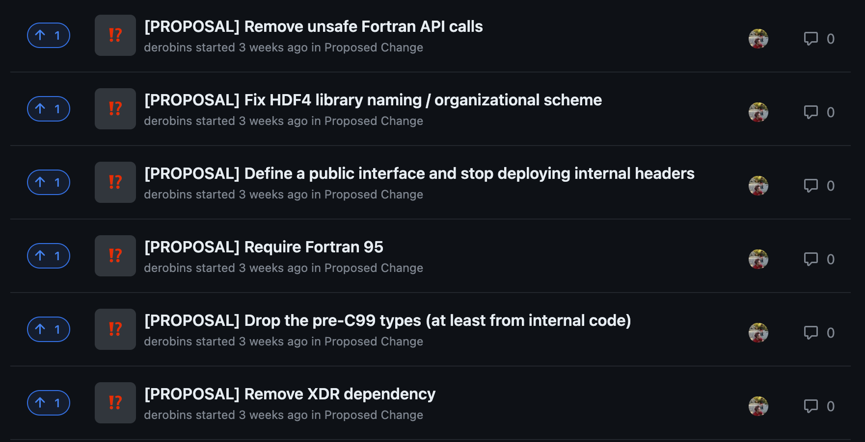
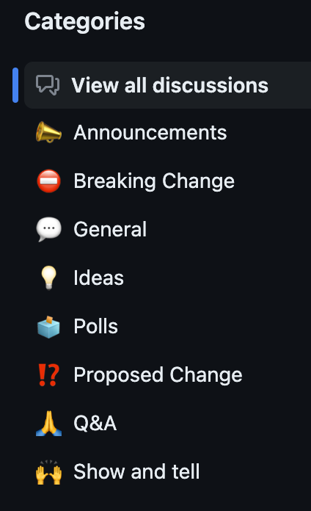
Change Management
In place in HDF4 and HDF5, will move to other products soon

Slide 22
Future Plans

Slide 23
What are we going to work on in H2 2023?
Take security seriously
Provide the best possible HDF5 library for the final E4S release
Make the ros3 VFD a first-class citizen
Discuss the next major features that we'll work on in 2024 (HDF5 2.0?)

Slide 24
Take Security Seriously
Fix remaining security issues
All CVE issues fixed, but Coverity and oss-fuzz have identified other issues
Final releases of 1.10, 1.12 will be CVE-free
More improvement of the CVE test repo
https://github.com/HDFGroup/cve_hdf5
Need to specifically address GIF tool issues
Better integration with OSS-fuzz, OpenSSF Scorecard, etc. and fix identified issues
Fix Coverity issues

Slide 25
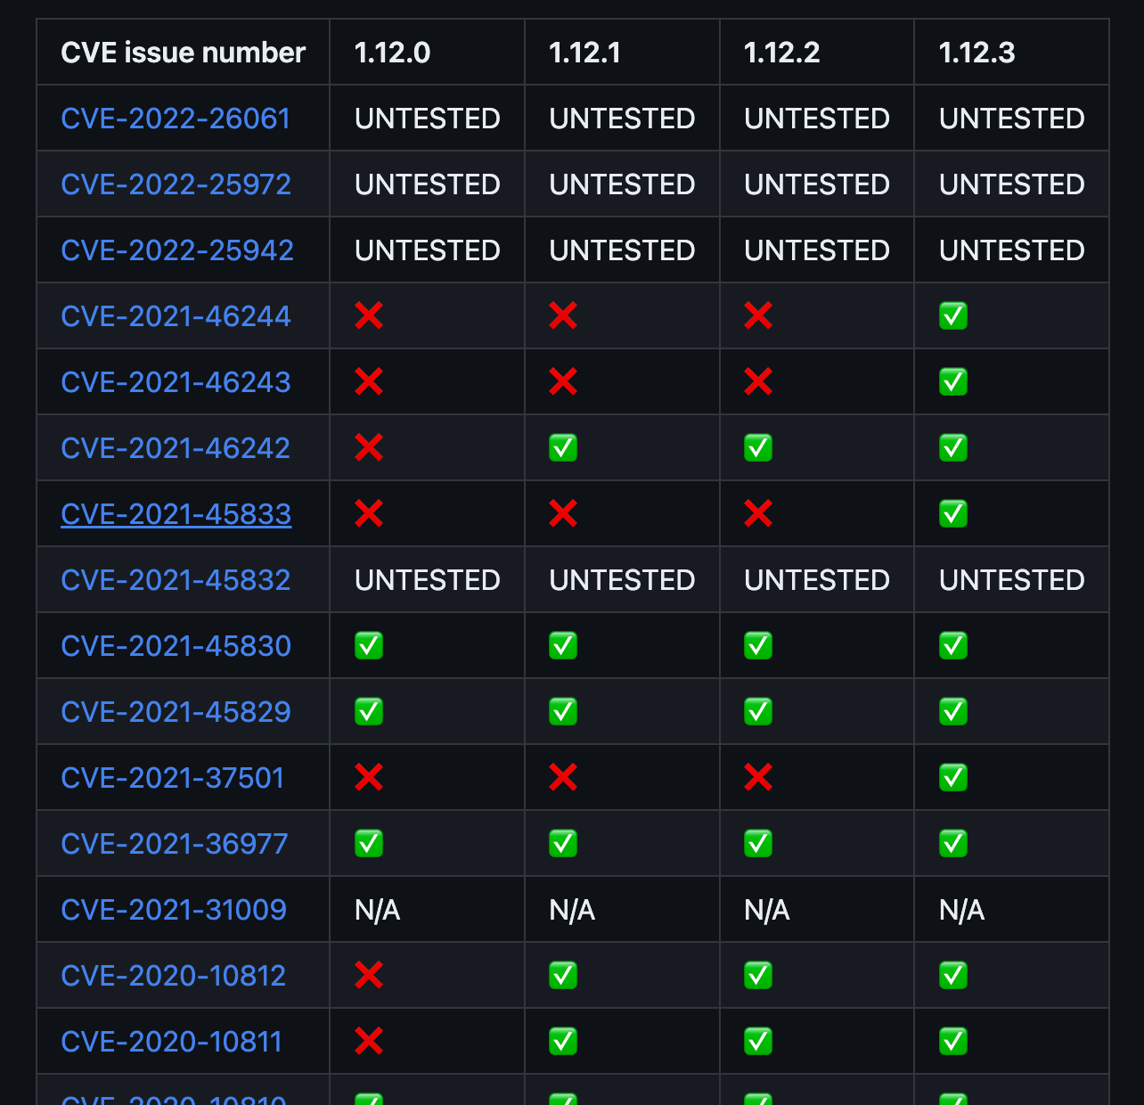
CVEs
CVE = Common Vulnerability and Exposure
https://en.wikipedia.org/wiki/Common_Vulnerabilities_and_Exposures
Tracked by mitre.org
https://www.cve.org/
There are 60+ filed against HDF5 since 2016 (some are duplicates)
https://cve.mitre.org/cgi-bin/cvekey.cgi?keyword=HDF5
We track these and now publish a table with each HDF5 release
https://github.com/HDFGroup/hdf5/blob/hdf5_1_14_2/CVE_list_1_14.md

Slide 26
Provide the Best HDF5 Library for E4S
More ECP VOL connector integration testing (async, etc.) via GitHub actions
Fix as many parallel/HPC-related Jira/GitHub issues as possible
Move everything in Jira that can't be fixed to GitHub
HPC CDash results linked via GitHub README.md
Finish VOL test suite work
Work with VOL connector authors to address failing tests
Better documentation for recent ECP features
Internal MPI-related code cleanup

Slide 27
The ros3 VFD Becomes a First-Class Citizen
Expand to Google, Azure
Investigate performance
Look into replacing cURL with the S3 C library
Think about making cloud-optimized values the library defaults
Update the HDF5 User's Guide
Better testing (expanded test suite, GitHub actions)
Update to use selection I/O
Better tools support (especially HDFView)
Look into improving h5repack performance

Slide 28
HDF5 2.0 / Future Major Work
TBD!
These meetings are for us to get feedback from the community about what will go into HDF5 in the future
Will put the US HUG idea list on the HDF5 GitHub wiki

Slide 29
HDF5 BOF at SC23
Denver, Colorado
Wednesday, 15 November: 5:15pm - 6:45 pm MST, room 401-402
"HDF5: Building on 25 years of success"
Looking for presenters to present short case studies on current and future HDF5 uses
https://sc23.supercomputing.org/attend/schedule/

Slide 30
Support Our Non-Profit Mission
To ensure efficient and equitable access to science and engineering data across platforms and environments, now and forever.
THESE DON'T COST YOU A DIME
🙋 Help Desk Support
🛠️ Sustaining Engineering
🩺 HDF Clinic, Working Group
📅 Webinars, User Events
🤝 HDF User Forum
📢 Community Outreach
🛡️ Assured Longevity of HDF Technologies
HELP US TO KEEP IT THAT WAY
Become a Code Owner
Consult with Us
Purchase Custom Development
Get HDF Software Priority Support
Donate or be a Sponsor
Collaborate with Us on a Proposal
Become an HDF Advocate
Contact: info@hdfgroup.org
https://www.hdfgroup.org/donate
Notes:
Briefly explain each of the free services that The HDF Group provides (table on the left) and where to get more information/access those services (www.hdfgroup.org). Next, discuss how the activities/services listed in the table on the right help us to continue to support and provide the free services. If they have any questions they can send an email to info@hdfgroup.org.

Slide 31
THANK YOU!
Questions & Comments?

