Slide 1
Expanding HDF5 Capabilities
Elena Pourmal elena.pourmal@lifeboat.llc
John Mainzer john.mainzer@lifeboat.llc

Slide 2
Outline
Introduction to Lifeboat, LLC
Multi-threaded access to data in HDF5
Support for sparse and variable-length data in HDF5

Slide 3
Lifeboat, LLC
We don’t make HDF5… we make HDF5 better
Goal: Sustain and enhance open source HDF5
Founded in August 2021
Located in Champaign, IL and Laramie, WY
www.lifeboat.llc
info@lifeboat.llc
Funded by DOE SBIR/STTR Program
Phase I and Phase II: “Toward multi-threaded concurrency in HDF5”
Phase I: “Supporting sparse data in HDF5”

Slide 4
Multi-threaded access to data in HDF5
S

Slide 5
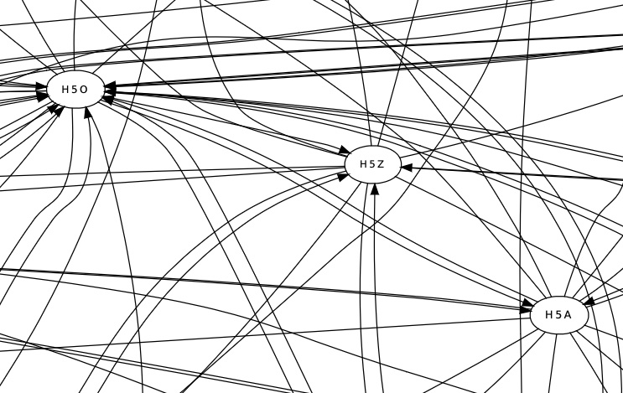
Feasibility of Multi-Threaded HDF5 library
Calling graph of a CGNS library test shows interdependencies between HDF5 packages.
Is multi-threading even possible?

Slide 6
HDF5 Architecture
HDF5 Application
Global lock
HDF5 C API
VOL Layer
Legend
Plugins
Filter, VFD, VOL
Pass-through VOL connector
Filter plugins (e.g., compression)
HDF5 Library
proper (Native VOL)
Terminal
VOL
Connector
Library component
Filters
new
VFD Layer
Library component
ROS3
POSIX
MPI I/O
GPU
…
…
…
Connector specific API
S3 API
POSIX API
File System
Storage
S3 Cloud

Slide 7
Bypass VOL Connector
HDF5 Application
Bypass VOL Concept
Initially will support I/O for contiguous and chunked datasets; no data filtering
Checks if I/O is supported; routs to native VOL or to connector proper (hits mutex)
Queries HDF5 library for the location of raw data (hits mutex)
Executes raw data I/O in parallel in multiple threads
Functionality will be extended as parts of the HDF5 library (e.g., metadata cache) are converted
See documentation https://github.com/LifeboatLLC/MT-HDF5
Check HUG23 “Toward Multi-Threaded Concurrency in HDF5” talk by John Mainzer
HDF5 C API
VOL Layer
Multi-threaded HDF5 modules required by VOL connectors
MT Bypass VOL connector
H5I, H5E, H5P, H5CX, H5VL,
H5S, H5FD
HDF5 Library
proper (Native VOL)
Work in progress
Low priority for the first release
VFD Layer
new
File System

Slide 8
Bypass VOL Connector (cont’d)
Prototyped VOL connector functionality was implemented by Luc Grosheintz, EPFL, Blue Brain Project in collaboration with John Mainzer and Elena Pourmal
Next slides show achieved performance improvements

Slide 9
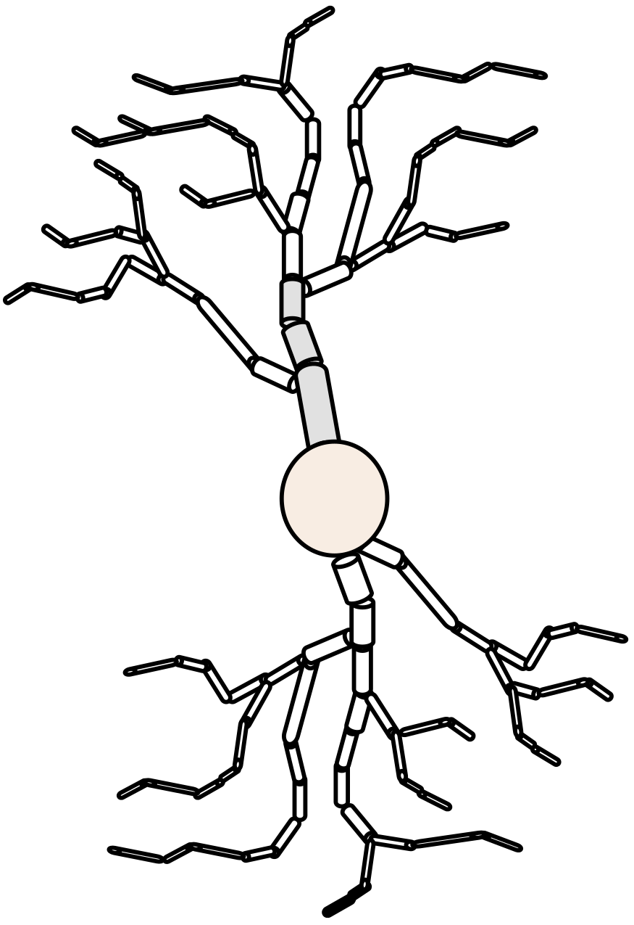
Digitally Reconstructed Neurons – Blue Brain Project
{
"0000": {
"points”: np.empty((9610, 3), np.float32),
“offsets": np.empty(21, np.uint64)
},
"0001": {
"points": np.empty((14983, 3), np.float32),
"offsets": np.empty(48, np.uint64)
},
...
}
1k - 100M neurons
Hardware:
Intel Xeon Gold 6140
2x 18 cores
6 memory channels
100 Gb/s InfiniBand
SpectreScale/GPFS:
2x GS14KX
8x EDR
HDD
Synthetic Data Presented:
Datasets: 20'000
Total size: 17 GB
File Space Strategy: Paged allocation
Page size: 64 kB
Slide courtesy of Luc Grosheintz, Blue Brain Project, EPFL
Blue
Brain
Project

Slide 10
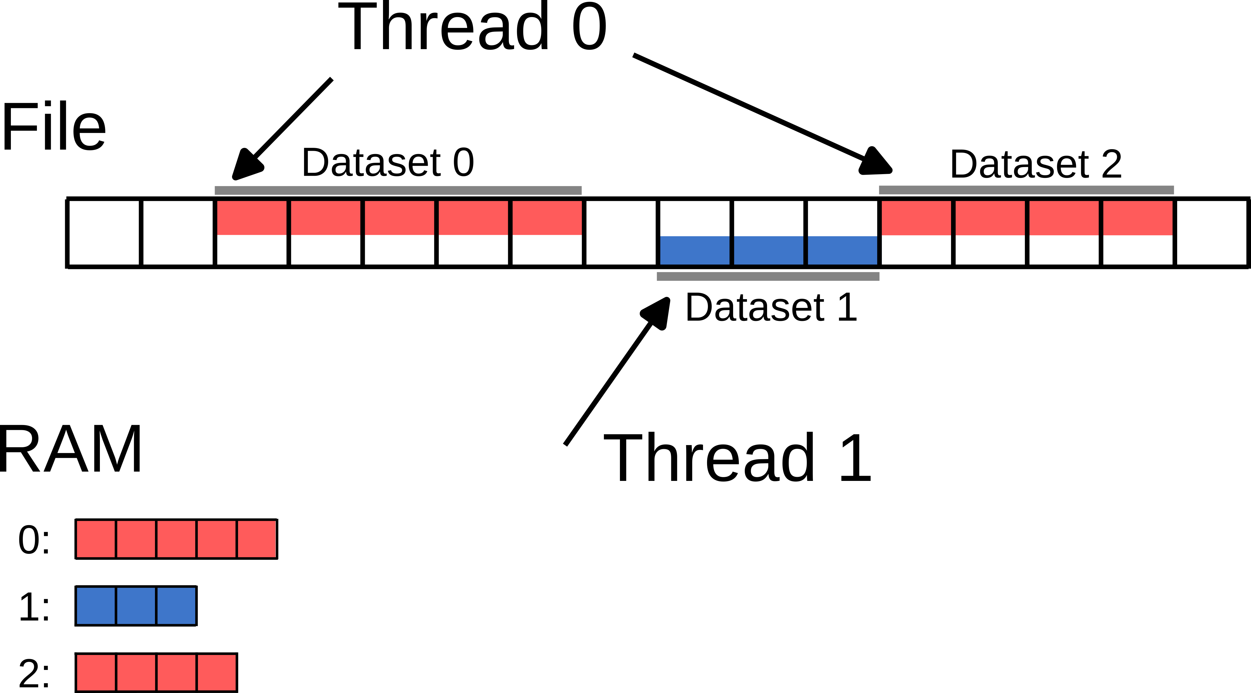
Direct OpenMP HDF5 Prototype
Sequentially, read shape/size and offset from beginning of the file for each dataset.
Concurrently, `std::fseek` & `std::fread` individual datasets.
Slide courtesy of Luc Grosheintz, Blue Brain Project, EPFL
Blue
Brain
Project

Slide 11
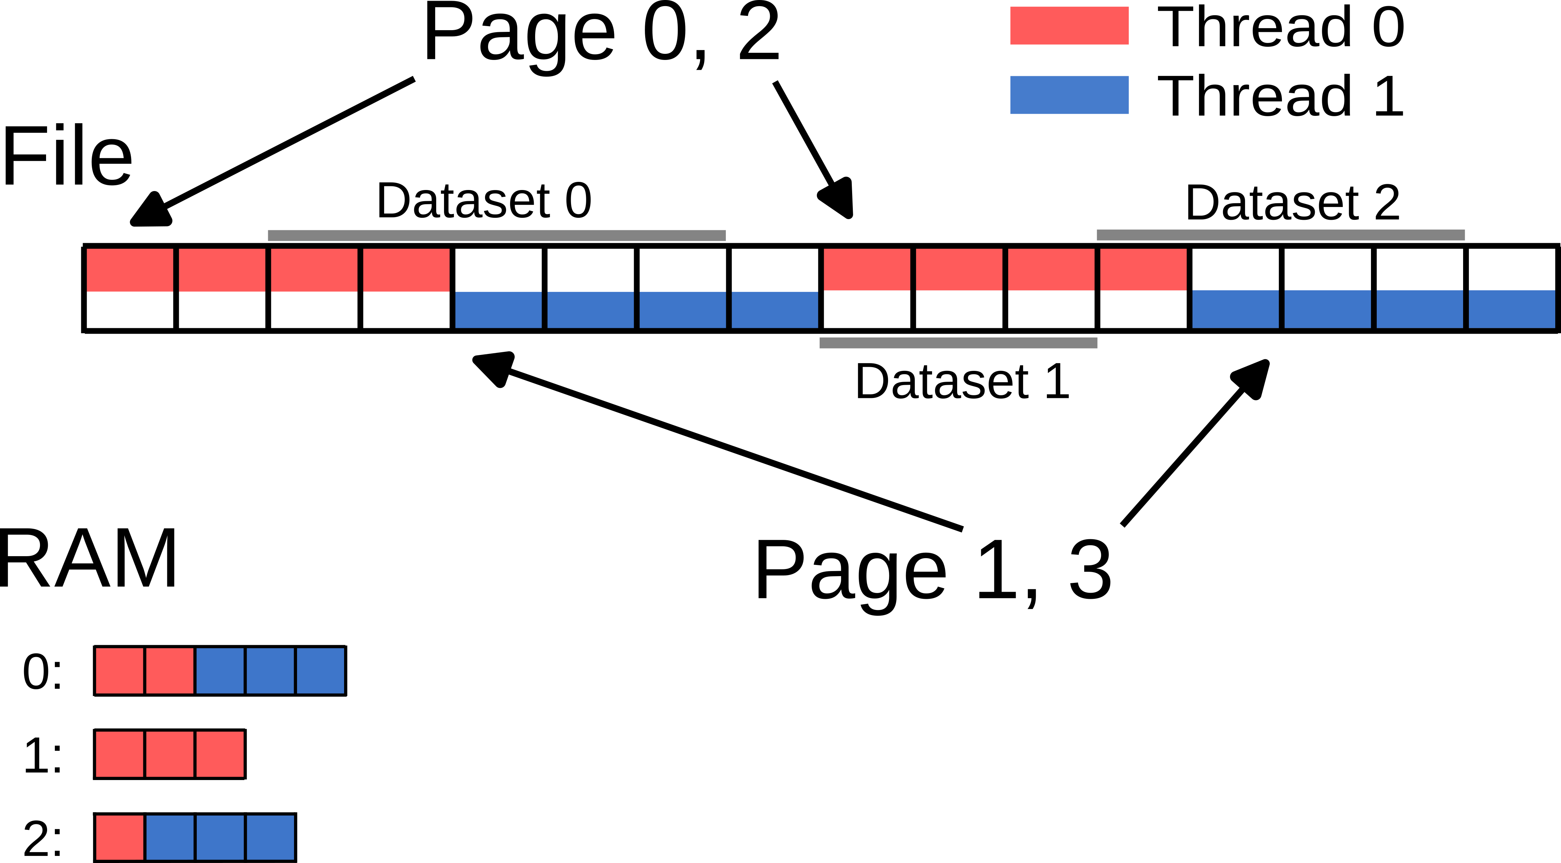
Page-aware OpenMP HDF5 Prototype
Sequentially, read shape/size and offset from beginning of the file for each dataset.
Pre-allocate datasets.
Sort by page.
Concurrently loop over pages.
Slide courtesy of Luc Grosheintz, Blue Brain Project, EPFL
Blue
Brain
Project

Slide 12
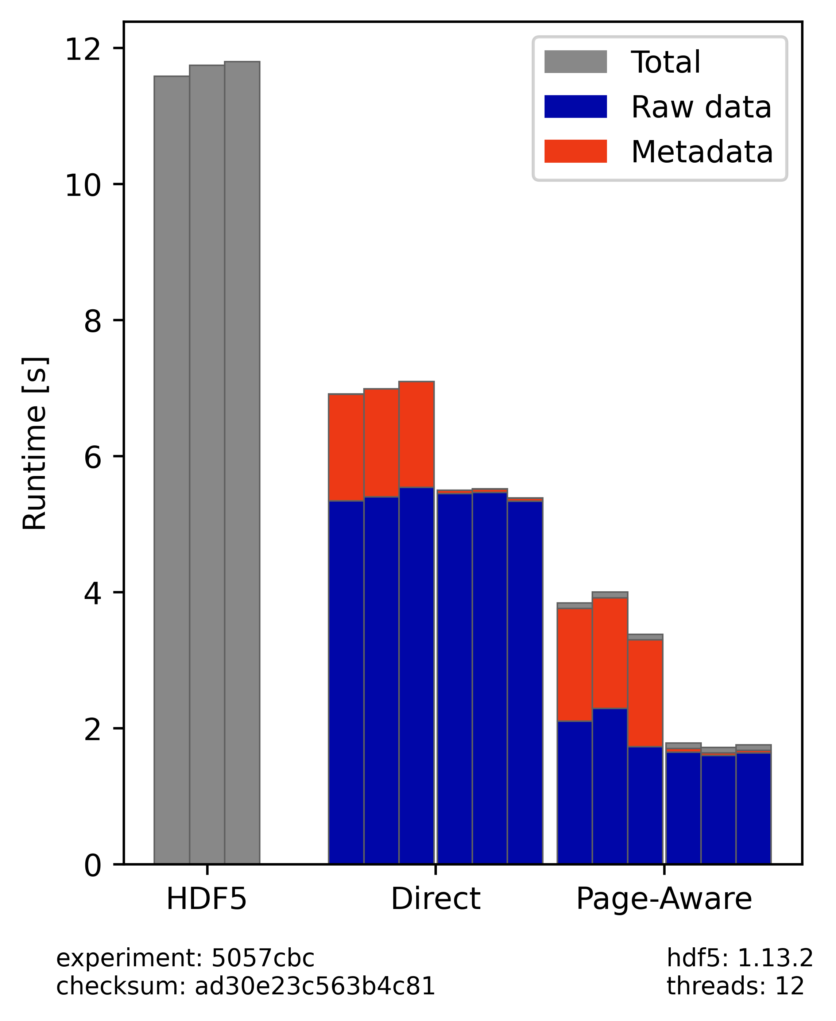
Results HDF5 VOL Connector Prototype
Experimental Setup:
12 Threads
3 measurements
HDF5: Plain HDF5 with 512 MB page buffer, 75% reserved for raw data.
Direct / Page-Aware: The two variants of the prototype.
Left: Read metadata using HDF5
Right: Read metadata from JSON
Best result achieves the effective single node bandwidth of GPFS over InfiniBand.
Slide courtesy of Luc Grosheintz, Blue Brain Project, EPFL
Blue
Brain
Project

Slide 13
Support for sparse and variable-length data in HDF5

Slide 14
What is Sparse Data?
Sparse data is ubiquitous; examples come from the experimental sciences and computer modeling:
High Energy Physics (HEP); Neutron and X-Ray scattering; Mass Spectrometry experiments; Transmission electron microscopy; Genomics; AMR
There is no ”standard” definition of “sparse data”.
Linear algebra – data is considered sparse if less than 30% of matrix elements are non-zeros.
Experimental sciences - only 0.1% to 10% of gathered data is of interest, but it may contain a bigger percentage.

Slide 15
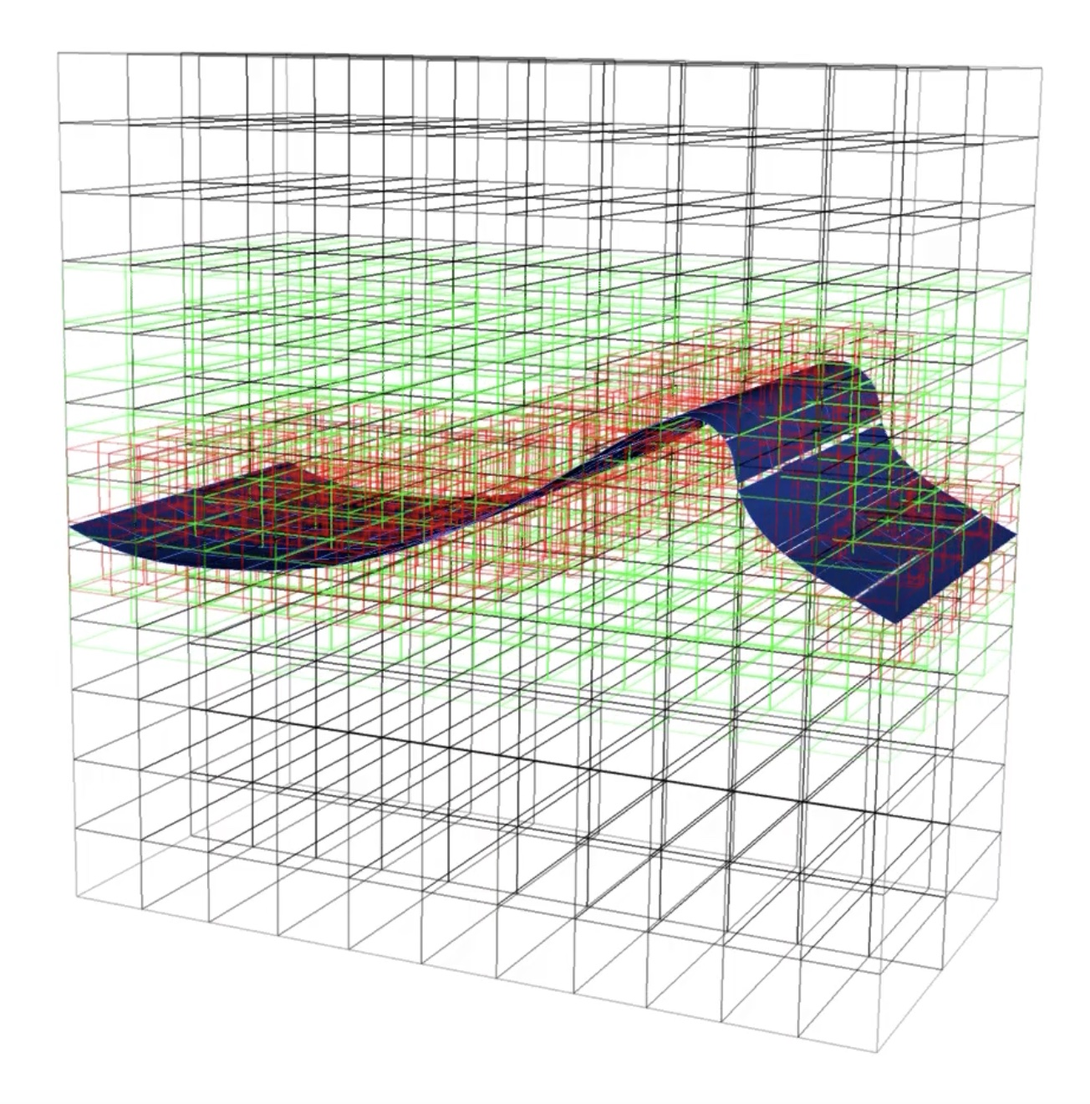
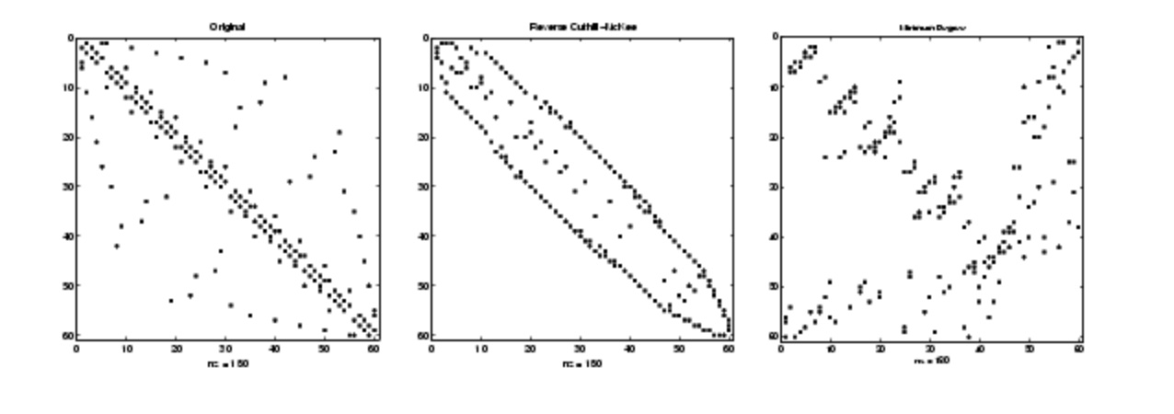
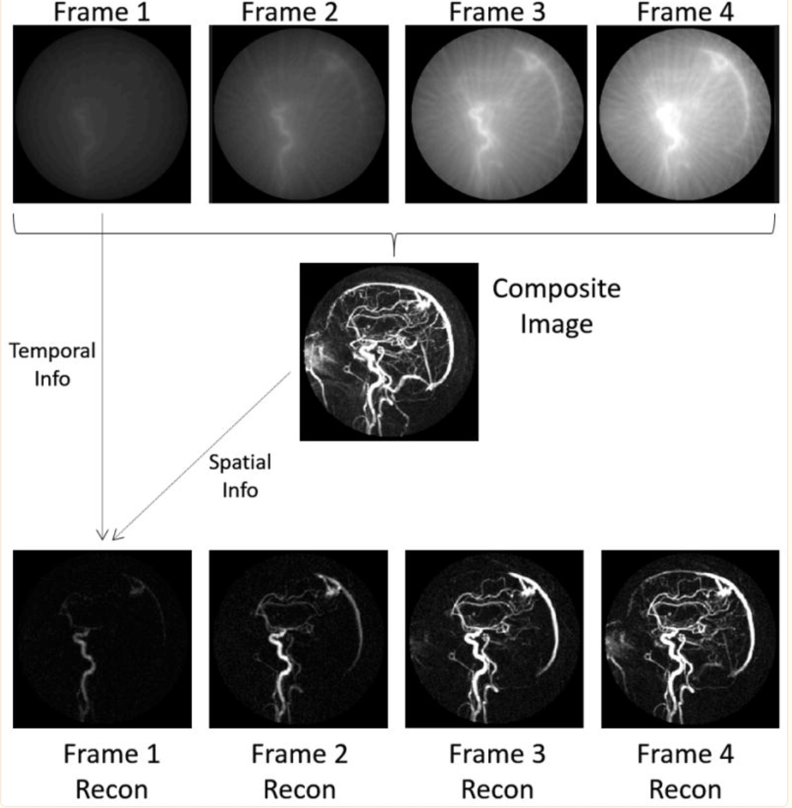
Use Cases
Computer modeling
Linear algebra
See notes for references
AMR
Sparse Reconstruction in MRI
SLAC use case: LCLS-II images
Notes:
Sparse matrices are matrices that have mostly zero entries, and they often arise in numerical linear algebra when dealing with large-scale problems. For example, you might encounter sparse matrices when solving partial differential equations, graph theory, network analysis, or data compression.
LA http://www.ece.northwestern.edu/local-apps/matlabhelp/techdoc/math_anal/sparse18.html. HDF5 sparse storage is independent from memory representation of sparse data thus it is portable between different apps. One would need a convenience AP to translate selection of defined elements into required memory representation and vice versa.
Unstructured mesh https://en.wikipedia.org/wiki/Unstructured_grid
AMR https://amrex-codes.github.io/amrex/gallery_images/breaking_wave.mp4
https://www.pnnl.gov/available-technologies/improving-electron-microscopy-using-sparse-data-sets
Sparse Reconstruction Techniques in MRI: Methods, Applications, and Challenges to Clinical Adoption
https://www.ncbi.nlm.nih.gov/pmc/articles/PMC4948115/

Slide 16
Motivation for Sparse Storage: LCLS-II Use Case
Experiments produce a stream of two-dimensional images.
For each image it is possible to automatically identify either:
A rectangular Region of Interest (ROI) in each image which will typically comprise about 10% of the image, or
50 – 100 small subsections in each image (typically 5 to 10 contiguous points or pixels).
The number, size, configurations, and locations of ROI or the small subsections change over time.
For each image in the stream it is desired to store
Only the ROI or the point list in a three-dimensional HDF5 dataset
One must be able to recover both the location and contents of the ROI and/or the elements of the point list.
Every N^{th} two-dimensional image in full, where N is constant over any given experiment. Note that the ROI or point list of each “full” two-dimensional image must be recoverable as well.

Slide 17
LCLS-II Use Case (cont’d)
To meet this requirement, we propose to implement sparse datasets:
Only the entries that have been written explicitly are defined.
The defined entries can be readily identified, and read. To the above minimal requirement, we also add:
Compatibility with dense datasets – thus code designed for the existing dense datasets will still work, reading defined values if available, and the fill value (default 0) where not.
Ability to use filtering (compression).
Ability to erase defined values – that is to remove them from the set of defined values.
Data is portable, i.e., doesn’t depend on data storage in memory
See Reference slide for pointers to RFCs

Slide 18
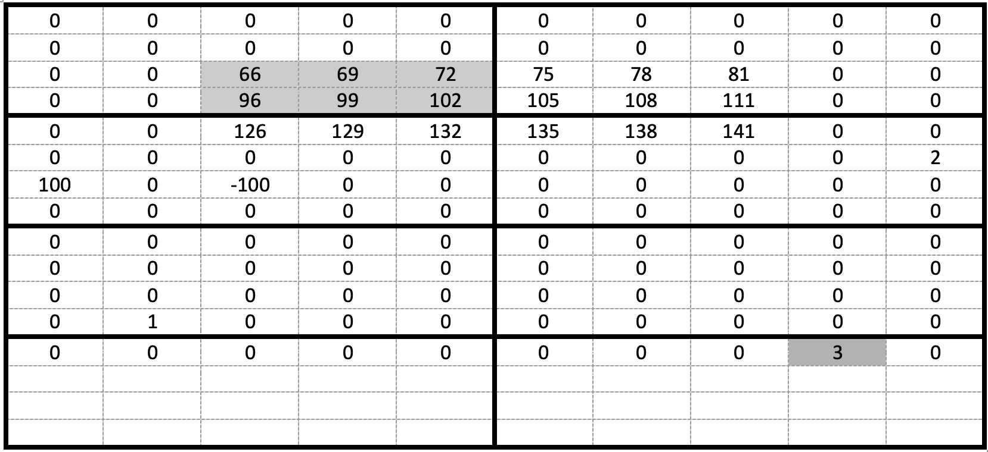
New Storage Paradigm: Idea of Structured Chunk
Chunked dataset
Chunked storage: all chunk elements are stored
0 0 0 0 0 0 0 0 0 0 0 0 66 69 72 0 0 96 99 96 102
Structured Chunk storage:
Locations and values of defined elements
specified by the hyperslab selection
are stored in different sections of the chunk
0 may represent a value that is not-defined
Section 0
Encoded selection
If we write a shown sub-array using
hyperslab selection how the chunk will
be stored in the file?
Section 1
66 69 72 96 99 96 102

Slide 19
Structured Chunk for Fixed and Variable-size Data
Fixed-size
datatype
VL-size
datatype

Slide 20
Programming Model
/*
* Create the dataset creation property list, add the gzip filter to compress all
* sections of the sparse chunk using DEFLATE filter.
*/
dcpl = H5Pcreate (H5P_DATASET_CREATE);
status = H5Pset_layout (dcpl, H5D_SPARSE_CHUNK);
status = H5Pset_chunk (dcpl, 2, chunk_dims);
status = H5Pset_deflate (dcpl, 9);
/* Create the dataset */
dset = H5Dcreate (file, DATASET, H5T_STD_I32LE, space, H5P_DEFAULT, dcpl, H5P_DEFAULT);
/* Create hyperslab selection in memory and in the file */
…..
/* Write the data to the dataset */
status = H5Dwrite (dset, H5T_NATIVE_INT, mspace_id, fspace_id, H5P_DEFAULT, buf[0]);

Slide 21
Proposed New APIs
Function Name | Short Description
H5Dget_defined | Retrieves a dataspace object with the defined elements
H5Derase | Deletes elements from a dataset
H5Dwrite_struct_chunk | Writes structured chunk
H5Dread_struct_chunk | Reads structured chunk
H5Dget_struct_chunk_info | Gets structured chunk info
H5Dget_struct_chunk_info_by_coord | Retrieves the structured chunk information
H5Dstruct_chunk_iter | Iterates over all structured chunks in the dataset
H5Pset_filter2 | Adds a filter to a filter pipeline for a specified section of sparse structured chunk
H5Pget_nfilter2 | Returns the number of filters in the pipeline for a section of structured chunk
More filter functions | ….

Slide 22
H5Pset_filter2
We want to address deficiency of the current API for passing filter’s data
herr_t H5Pset_filter2 (hid_t plist_id,
uint64_t section_number,
H5Z_filter_t filter,
uint64_t flags,
size_t buf_size,
const void *buf)
new parameter
new datatype

Slide 23
Programming model (cont’d)
/* Apply compression methods to different sections of
* a structured chunk. In this example, sparse chunk has two sections.
* We are using gzip compression on the encoded selection section
* and szip on the fixed-size data section.
*/
flags = H5Z_FLAG_OPTIONAL;
status = H5Pset_filter2 (dcpl, H5Z_FLAG_SPARSE_SELECTION,
H5Z_FILTER_DEFALTE, flags, nelem, &data);
status = H5Pset_filter2 (dcpl, H5Z_FLAG_SPARSE_FIXED_DATA,
H5Z_FILTER_SZIP, flags, …);

Slide 24
Acknowledgement
This work is supported by the U.S. Department of Energy, Office of Science under Award number DE-SC0023583 and "Toward multi-threaded concurrency in HDF5”.
This work is supported by the U.S. Department of Energy, Office of Science under Award number DE-SC0023583 for SBIR project “Supporting Sparse Data in HDF5”.
We thank The HDF Group developers and Quincey Koziol, Principal Engineer, AWS HPC for reviewing our technical proposal and for providing a constructive feedback.

Slide 25
References
https://github.com/LifeboatLLC/MT-HDF5/tree/main/design_docs
https://github.com/LifeboatLLC/MT-HDF5/tree/main/LFHT
https://github.com/HDFGroup/hdf5/discussions/3257
John Mainzer, Elena Pourmal, “RFC: File Format Changes for Enabling Sparse Storage in HDF5”. Available from https://github.com/LifeboatLLC/SparseHDF5/
John Mainzer, Elena Pourmal, “RFC: Programming Model to Support Sparse Data in HDF5” Available from https://github.com/LifeboatLLC/SparseHDF5/
J. Mainzer et al., "Sparse Data Management in HDF5," 2019 IEEE/ACM 1st Annual Workshop on Large-scale Experiment-in-the-Loop Computing (XLOOP), Denver, CO, USA, 2019, pp. 20-25, doi: 10.1109/XLOOP49562.2019.00009
The HDF Group, “Draft RFC: Sparse Chunks” https://docs.hdfgroup.org/hdf5/rfc/RFC_Sparse_Chunks180830.pdf
The HDF Group, Variable-Length Data in HDF5 Sketch Design, https://docs.hdfgroup.org/hdf5/rfc/var_len_data_sketch_design_190715.pdf

Slide 26
Thank you!
Questions?

