Slide 1
NetCDF Compression Improvements
Edward Hartnett (CIRES/NOAA)
HDF5 User Group Meeting 2023
Hamburg, Germany, 9/18/23
Acknowledgments:
Charles S. Zender (U of C, Irvine),
Ward Fisher, Dennis Heimbigner (Unidata),
Hang Lei, Brian Curtis, Kyle Gerheiser (NOAA)

Slide 2
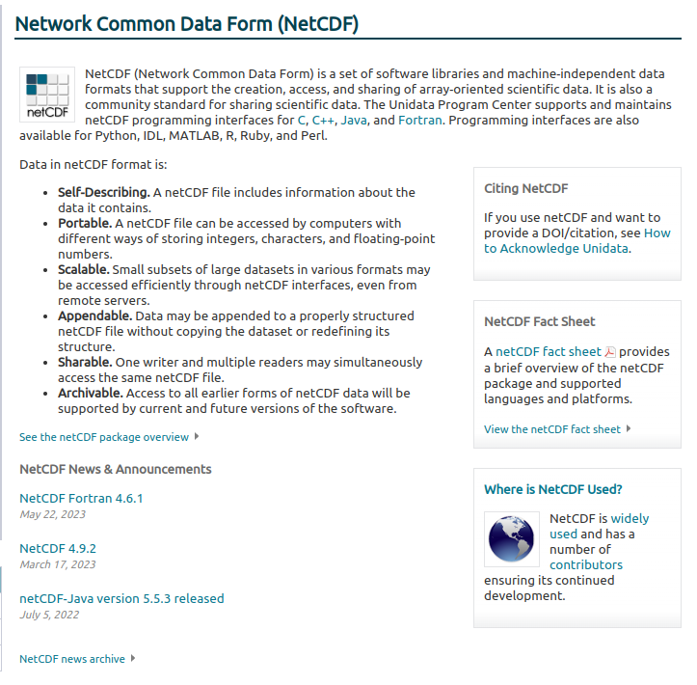
What is NetCDF?

Slide 3
HDF5 + NetCDF
25 years of successful collaboration!

Slide 4
Zstandard Compression
Zstandard compression is an open-source compression/decompression algorithm from Facebook, available in many programming languages.
At netcdf-c configure:
zstandard library must be present.
HDF5 filter directory specified.
Has outperformed other compression methods in most tests.
Supported by new functions nc_def_var_zstandard/nc_inq_var_zstandard.

Slide 5
Lossy Compression with Quantization
32 and 64 bit floating points can carry 7/14 significant digits - more than is generally required for science needs. When compressing the data, we spend much time compressing bits we don’t care about.
By setting unused bits to constant value we make compression work better.
This changes the data enabling lossy compression.
Setting of number of significant digits for variables turns on quantize.
Now supported in C and Fortran.
Ignores Fill Values.
Only works with NC_FLOAT/NC_DOUBLE.

Slide 6
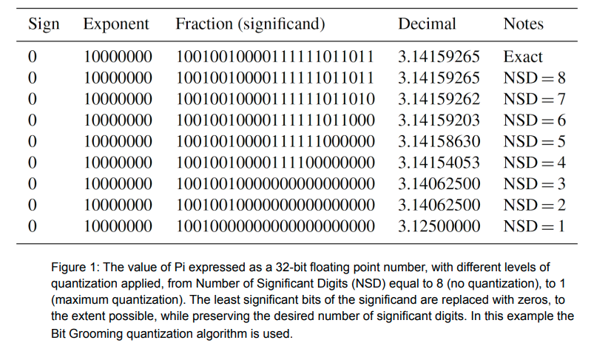
Quantization of Pi
Hartnett, Zender, EGU22-13259, Adding Quantization to the NetCDF C and Fortran Libraries to Enable Lossy Compression

Slide 7
Quantize Algorithms
Three algorithms are provided for quantization, BitGroom, Granular BitRound, and BitRound. Most users should start with Granular BitRound.
BitGroom - Determines rounding bitmask for all data which preserves NSD (decimal digits). Alternate values have extra bits set to 0/1. Fast, conservative algorithm.
Granular BitRound - Determines rounding bitmask for each value which preserves NSD (decimal digits). IEEE rounding. Slightly slower, more aggressive algorithm.
BitRound - Allows user to specify number of bits to be retained. IEEE rounding. Allows user to specify bits instead of decimal digits.

Slide 8
Quantize Example in C
/* Create two variables, one float, one double. Quantization
* may only be applied to floating point data. */
if (nc_def_var(ncid, "var1", NC_FLOAT, NDIM1, &dimid, &varid1)) ERR;
if (nc_def_var(ncid, "var2", NC_DOUBLE, NDIM1, &dimid, &varid2)) ERR;
/* Set up quantization. This will not make the data any
* smaller, unless compression is also turned on. In this
* case, we will set 3 significant digits. */
if (nc_def_var_quantize(ncid, varid1, NC_QUANTIZE_BITGROOM, NSD_3)) ERR;
if (nc_def_var_quantize(ncid, varid2, NC_QUANTIZE_BITGROOM, NSD_3)) ERR;
/* Set up zlib compression. This will work better because the
* data are quantized, yielding a smaller output file. We will
* set compression level to 1, which is usually the best
* choice. */
if (nc_def_var_deflate(ncid, varid1, 0, 1, 1)) ERR;
if (nc_def_var_deflate(ncid, varid2, 0, 1, 1)) ERR;

Slide 9
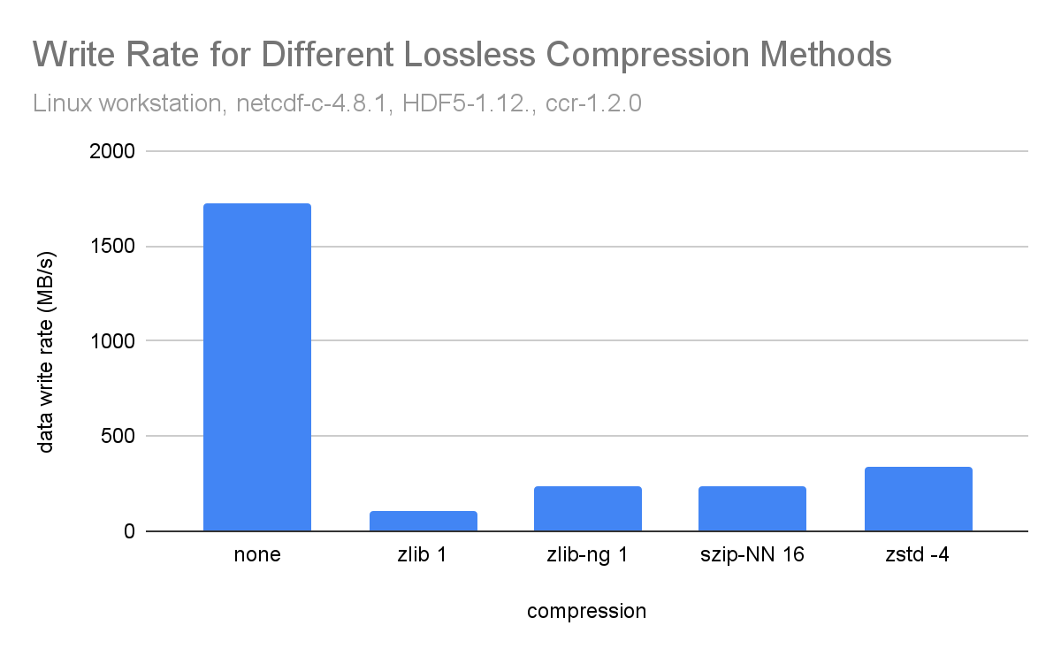
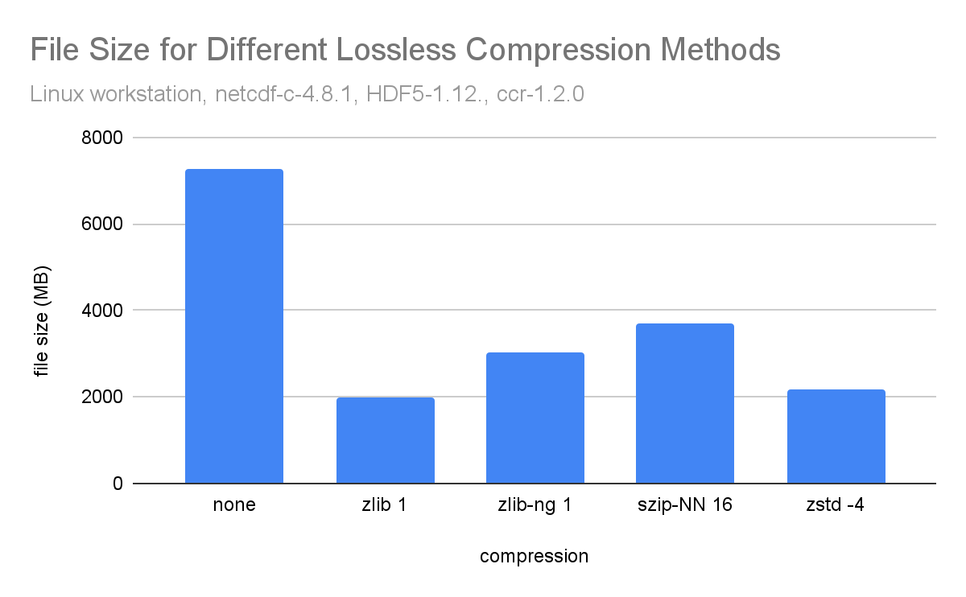
Different Lossless Compression Methods

Slide 10
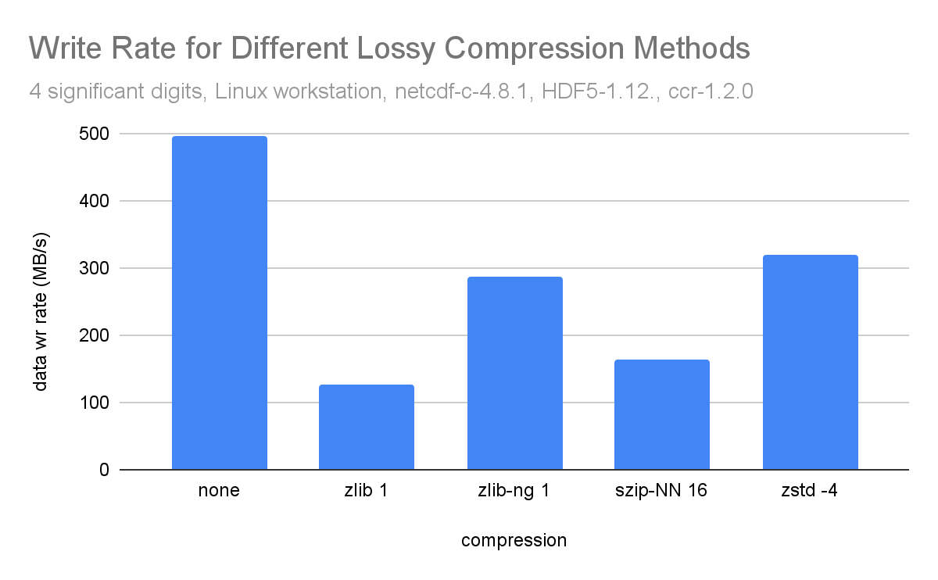
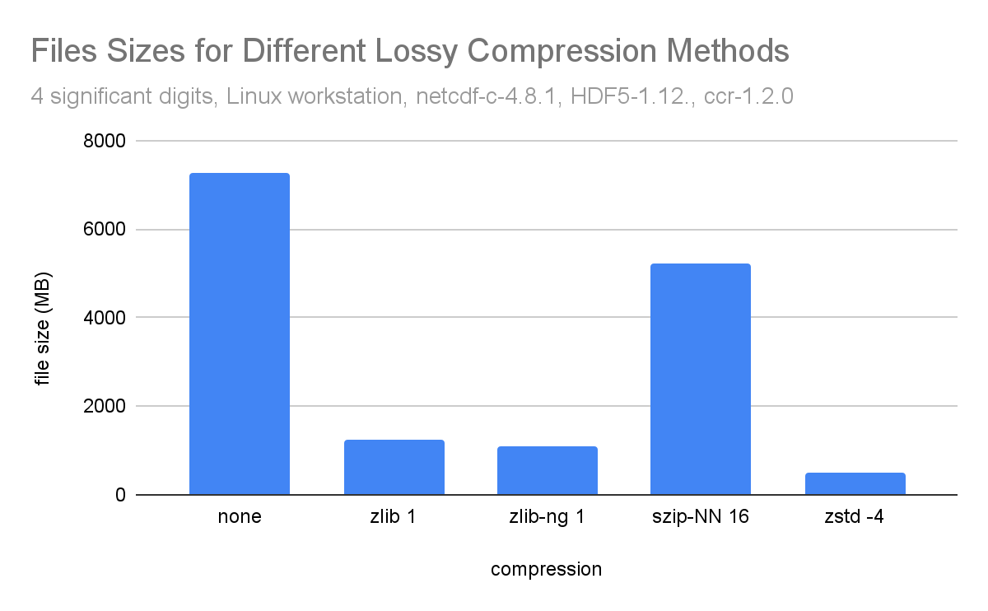
Different Lossy Compression Methods

Slide 11
Quantize is Not a Filter
The quantize feature was initially implemented as a filter, but this required all readers to also have the filter.
Using a filter also require an extra pass through the data, changing values before writing.
Instead, we inserted the quantize code in the netcdf-4 code which translates types and checks for out of range errors.
This solution is fully backward compatible and does not require the reader to install a filter.
The HDF5 team may consider adding quantize as well.
We would be happy to work with HDF5 implementers to ensure compatibility and stay current on CF Conventions work in this area.

Slide 12
Should HDF5 do Quantization?
Quantization is simple, and gives scientists control over loss of precision on a variable-by-variable basis.
Quantization is not really suitable as a filter.
Should it be built into HDF5?

Slide 13
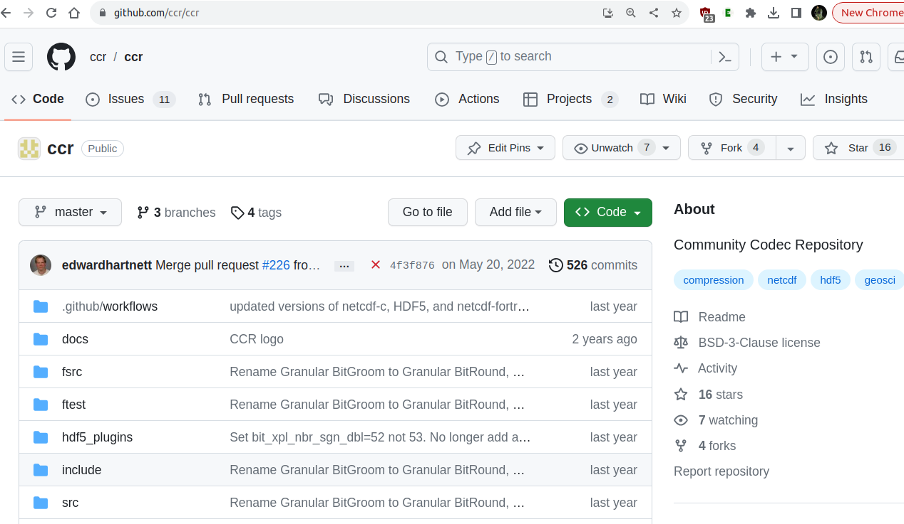
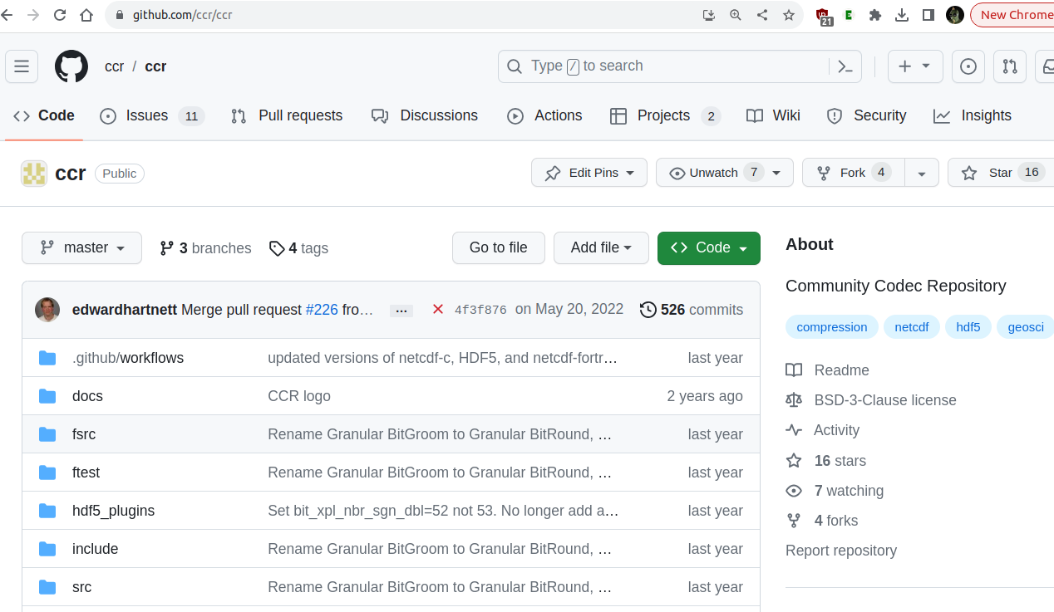
Existing Project: CCR

Slide 14
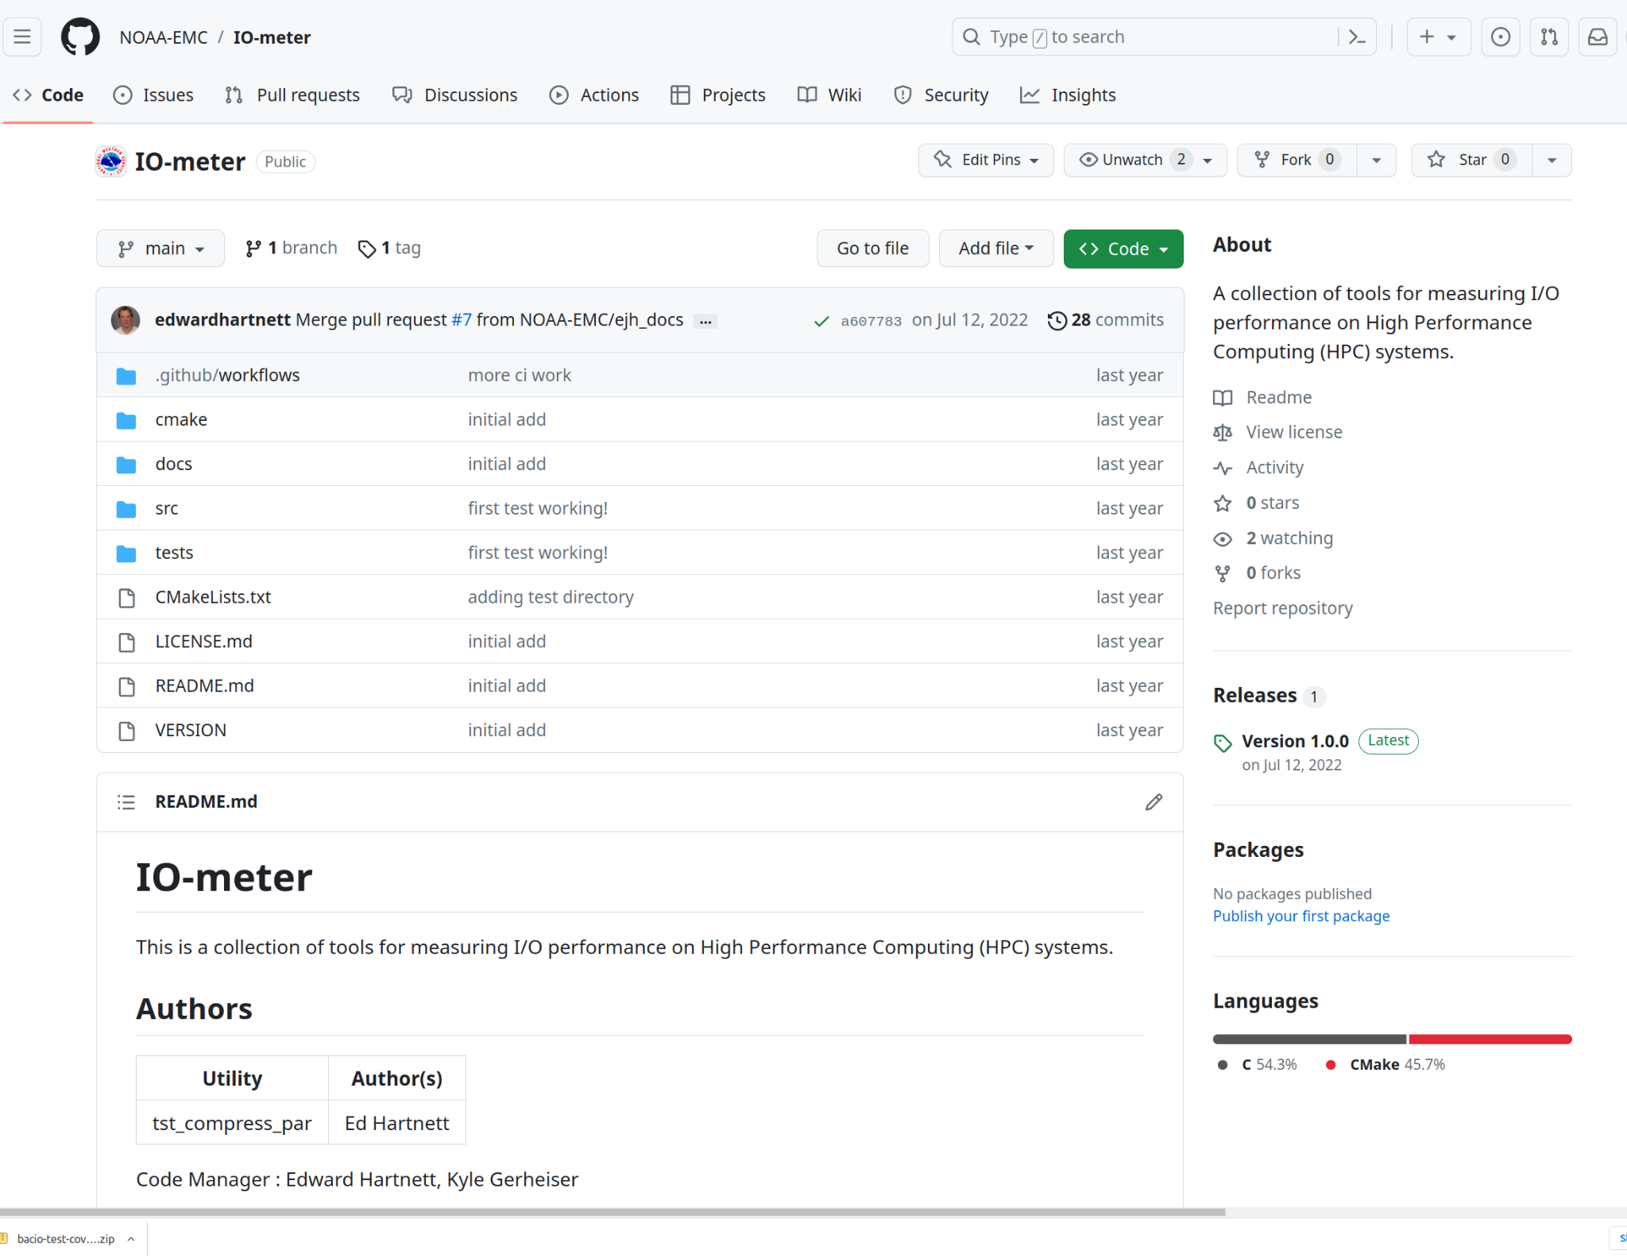
New Project: I/O Benchmarking

Slide 15
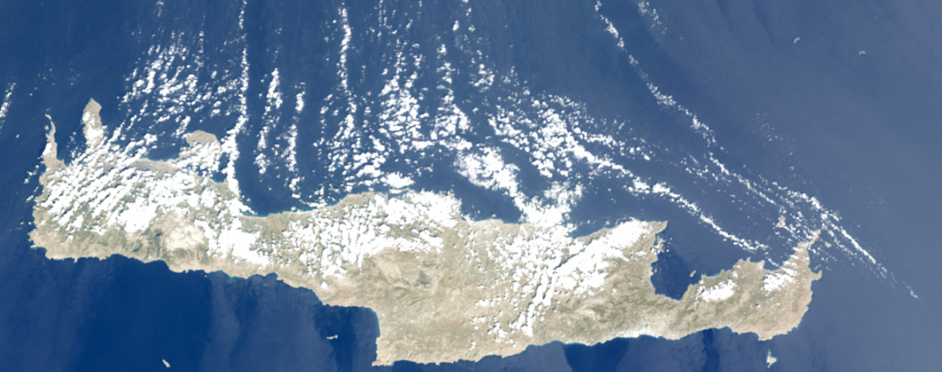
Thanks!
Crete, 9/18/23, true color OLCI, Sentinel-3, ESA
Presentation template: Slidesgo.

