Slide 1
TOWARDS FAIR DATA
Contact: Dr. Perez Ponce, Hector: hector.perez_ponce@helmholtz-berlin.de
Mrs. Görzig, Heike: heike.goerzig@helmholtz-berlin.de
Gitlab: (Javascript) https://gitlab.com/helmholtz-berlin/nexuscreator
(Python) https://gitlab.com/helmholtz-berlin/nexuscreatorpy
FAIR-tools: NexusCreator
Example: Beamline U-41 PEAXIS
Hector Perez Ponce, Rolf Krahl, Heike Görzig
HUG
20.09.2023
2023 European HDF5 User Group Meeting

Slide 2
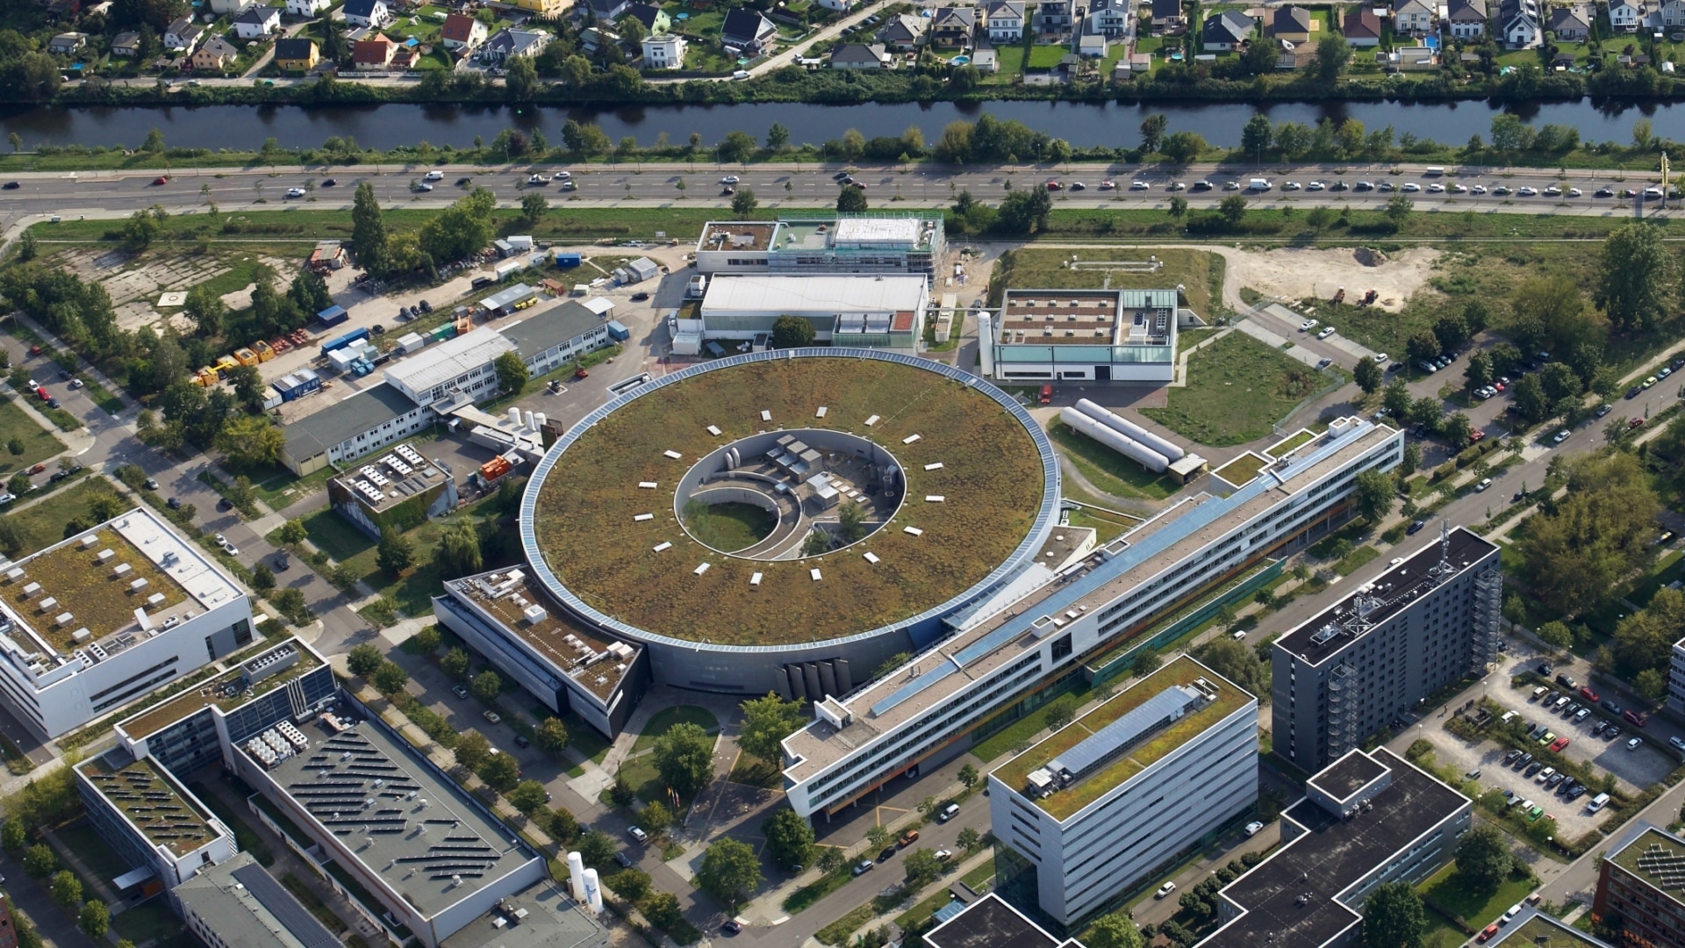
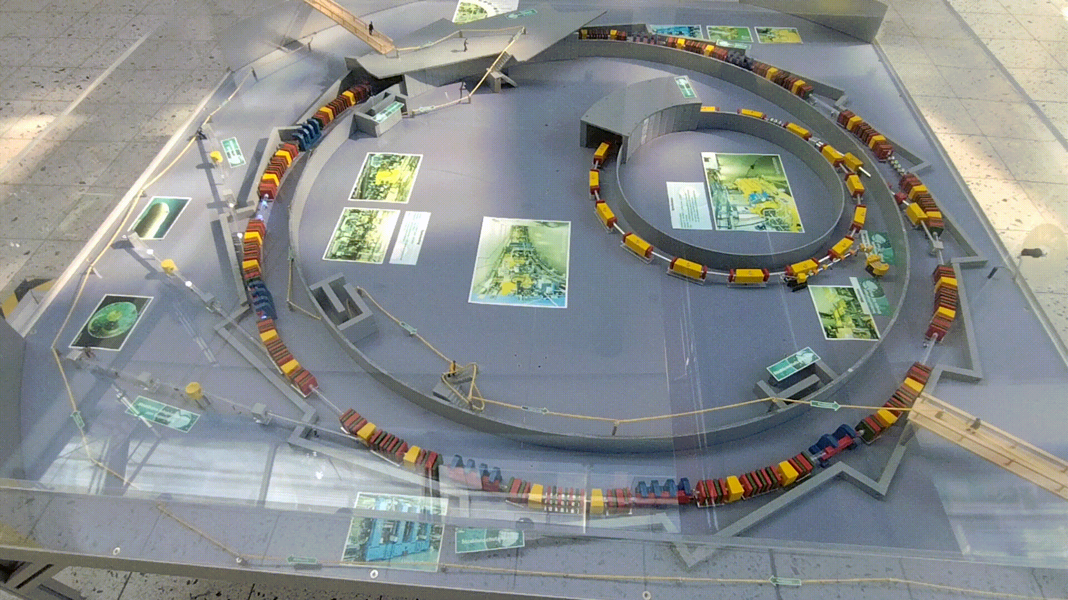
Where are we working?
Linac - injection
Storage Ring
Synchrotron
1.7GeB acceleration
Beamline
Beamlines
BESSY II @ Helmholtz-Zentrum Berlin (HZB)
http://www.helmholtz-berlin.de/

Slide 3
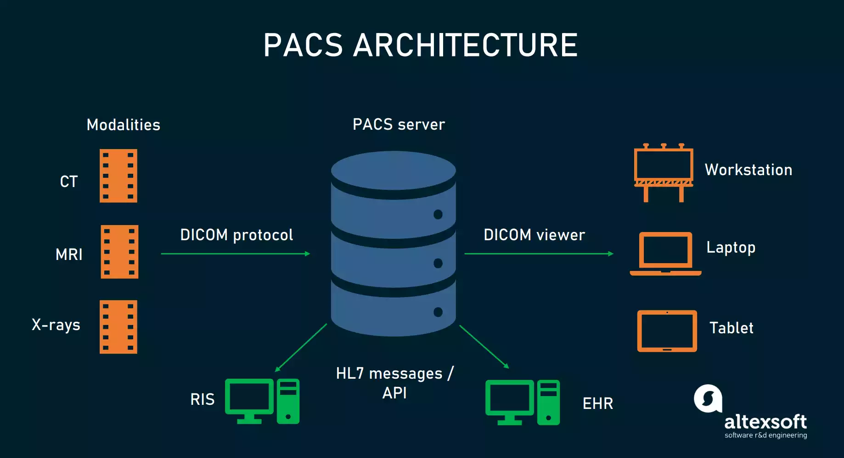
3
Towards FAIR data @ BESSY II
ICAT Architecture
ICAT server is a metadata catalogue to support Large Facility experimental data
Beamlines
ICAT server
NeXus is a common data format for neutron, x-ray, and muon science.
U41-PEAXIS
NeXus files
NeXus viewer
FEMTOSPEX
Raw data
Current analysis tools
EMIL
1. Conversion of raw data to NeXus format
2. Move NeXus and raw data to ICAT
https://www.altexsoft.com/blog/pacs-vna/
NexusCreator
ICAT-ingest &
ICATxmlGenerator
Beamline Standardisation: U41- PEAXIS

Slide 4
NexusCreator
Conversion of raw data to NeXus
HUG
20.09.2023
2023 European HDF5 User Group Meeting

Slide 5
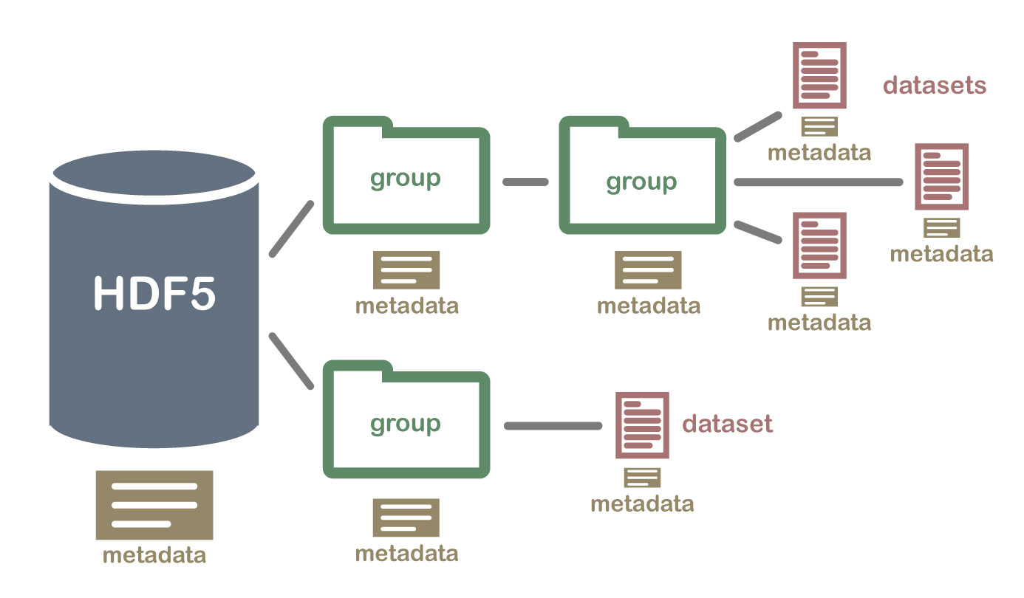
What is a NeXus File?
https://www.neonscience.org/
NeXus files are HDF5 files with content using NeXus Ontology/Vocabulary

Slide 6
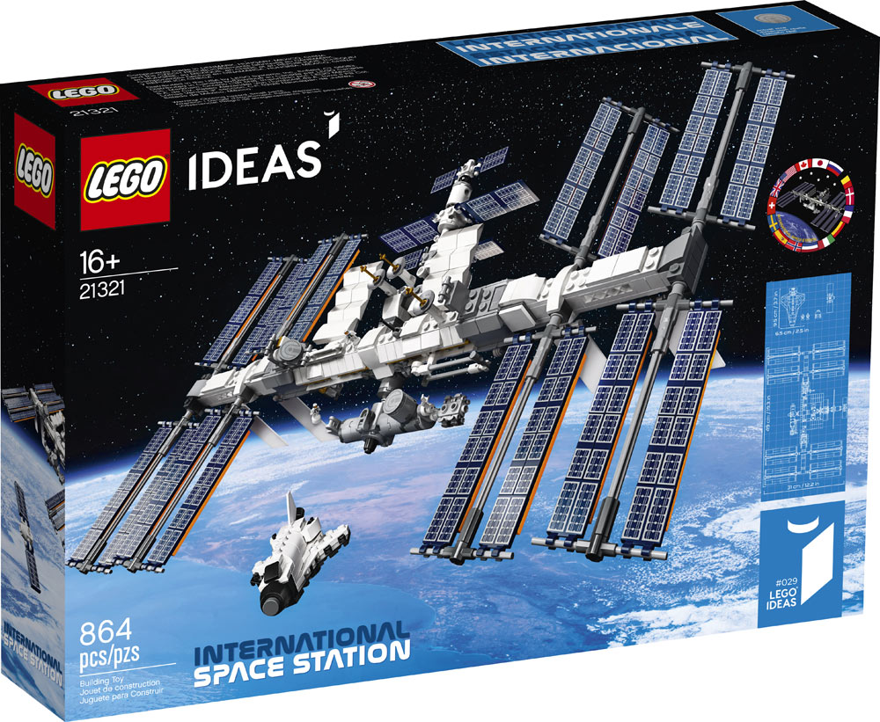
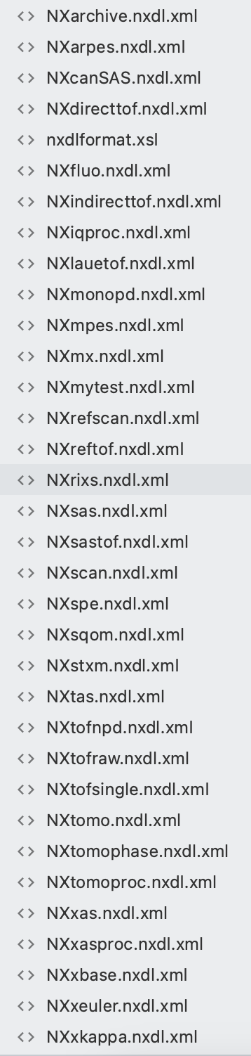
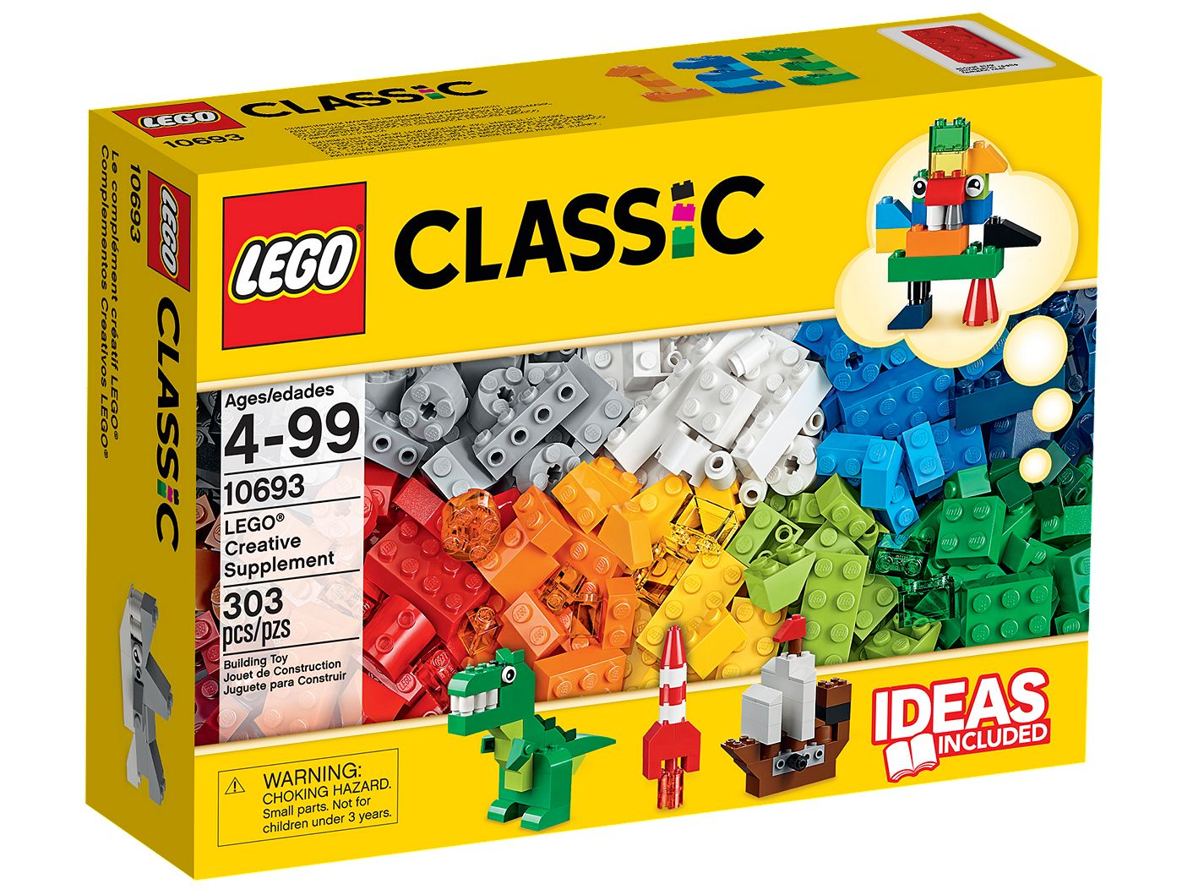
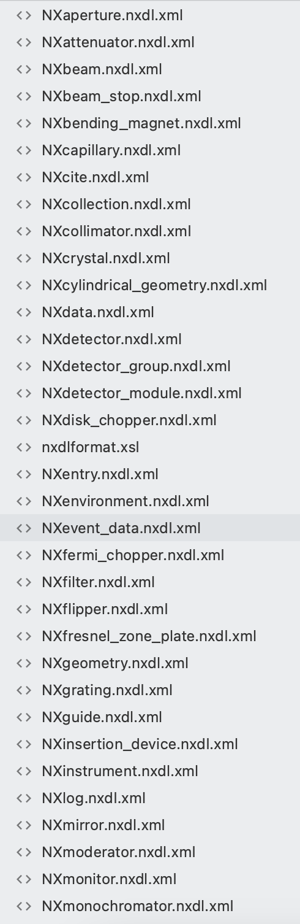


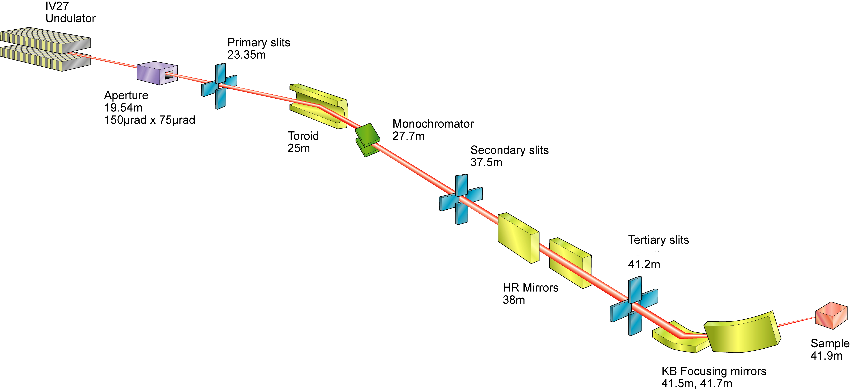
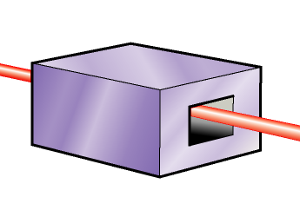
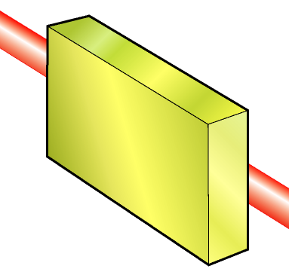
NeXus Ontology
https://www.lego.com
https://www.lego.com
Base Classes
Application Definitions
https://www.diamond.ac.uk/
NXslit
NXmonochromator
X-ray absorption Spectroscopy NXxas
NXaperture
NXmirror
NeXus ontology define base classes, application definitions and contributed definitions.

Slide 7
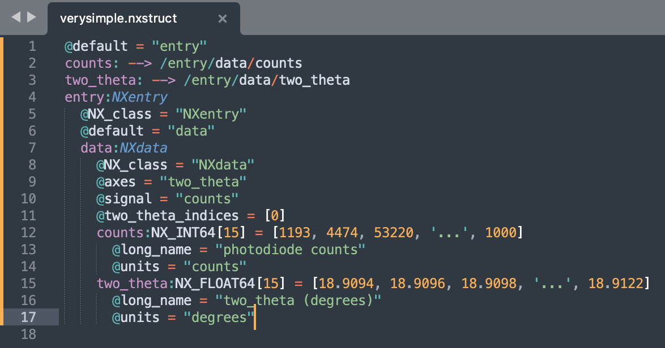
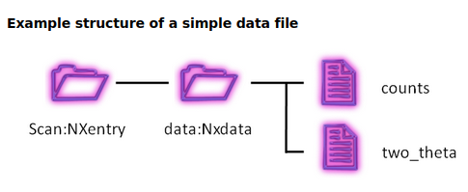
NeXus examples from nexusformat.org
NXstruct syntax
https://manual.nexusformat.org/introduction.html

Slide 8
What am I expected to achieve?
Tasks:
Convert existing data into NeXus.
Connect existing infrastructure to create NeXus:
  EPICS, Bluesky, MongoDB, Tiled
Save data in ICAT.
Criteria for Software Design from user perspective:
  Easy to use.
  No programming involved.
  No complicated environments to maintain (self-contained).
Criteria for Software Design from programmer perspective:
  Python compatible.
  Possibility to use a Front-End/Back-End development approach:
    Front-End:
      Generate the structure (NXstruct ) of instruments.
    Back-End:
      Create Readers/Converters to NeXus
      Connect to EPICS/Bluesky
  Compatible with web applications for future development.

Slide 9
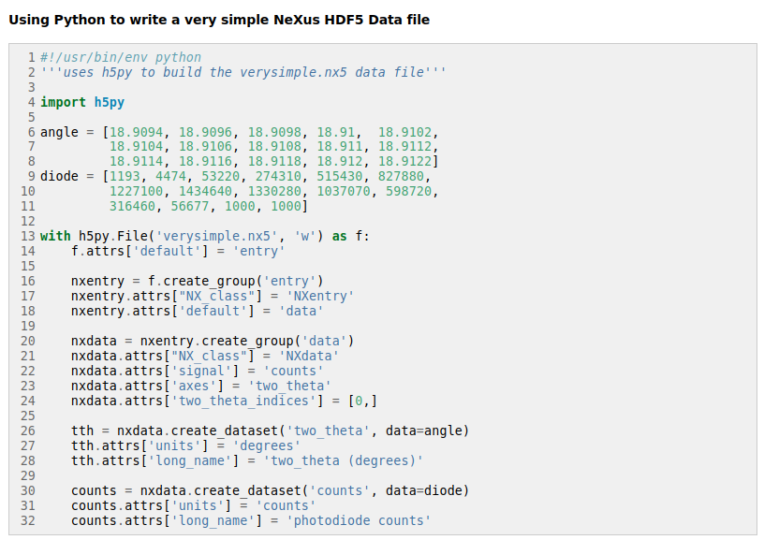
NeXus examples from nexusformat.org
https://manual.nexusformat.org/introduction.html

Slide 10
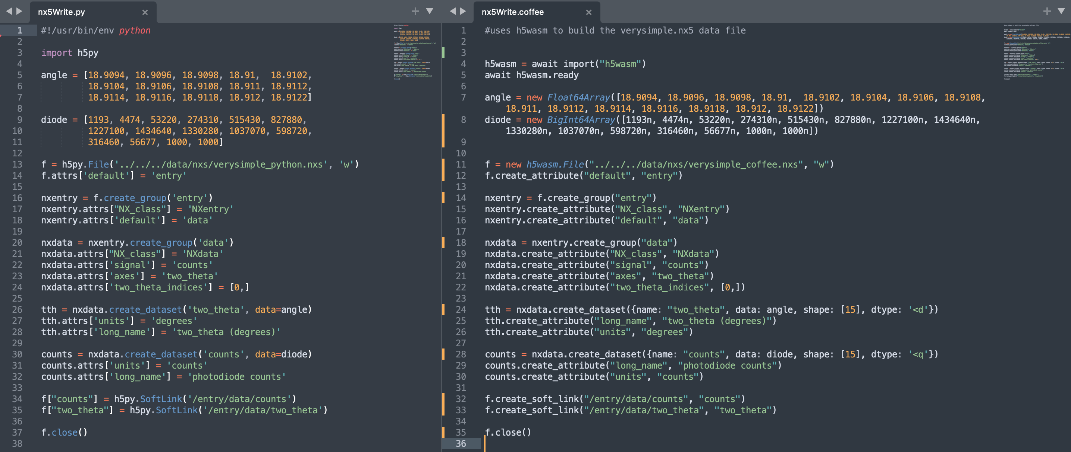
Alternative to H5Py, H5wasm.
H5Py - Python
H5wasm - Coffeescript/Javascript
Programming possible in Python or Javascript (Coffeescript).

Slide 11
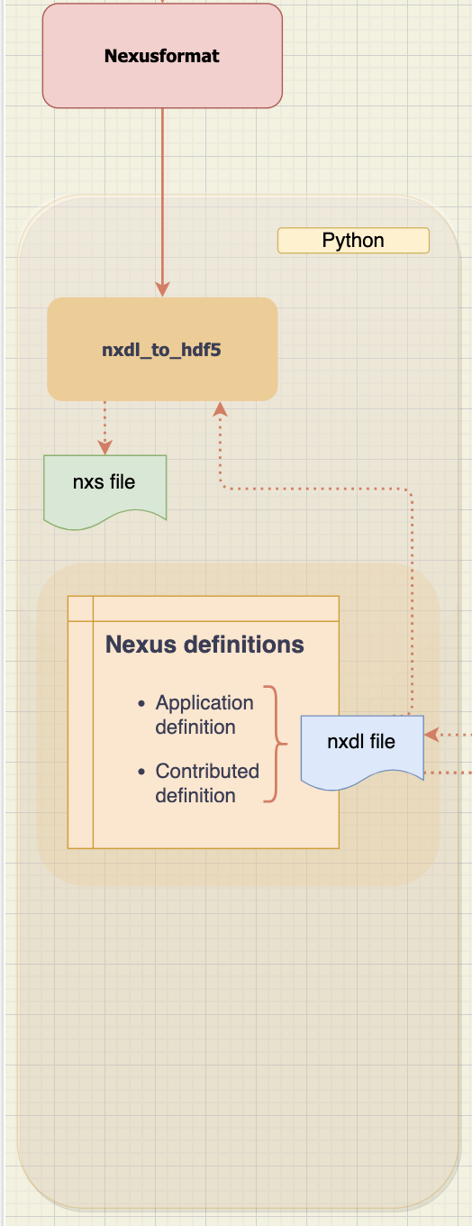
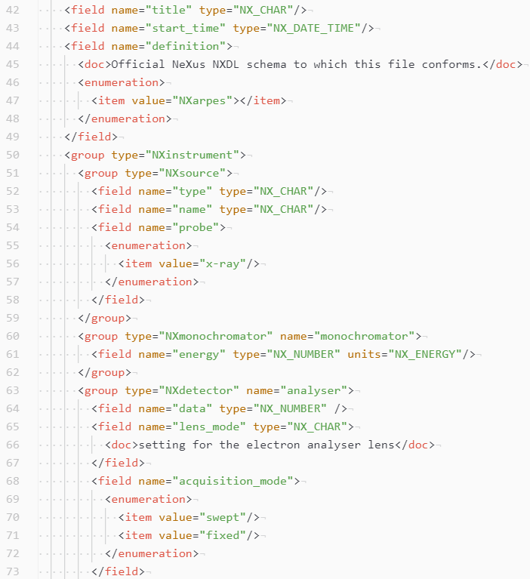
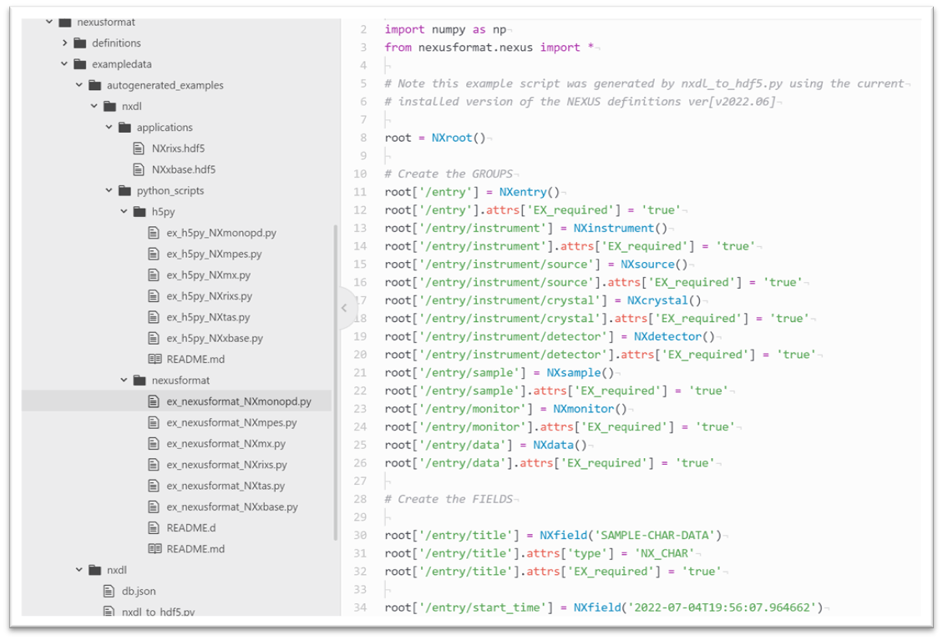
Existing tools to create NeXus files
Input:
XML Application Definition
Output:
Python script & HDF5

Slide 12
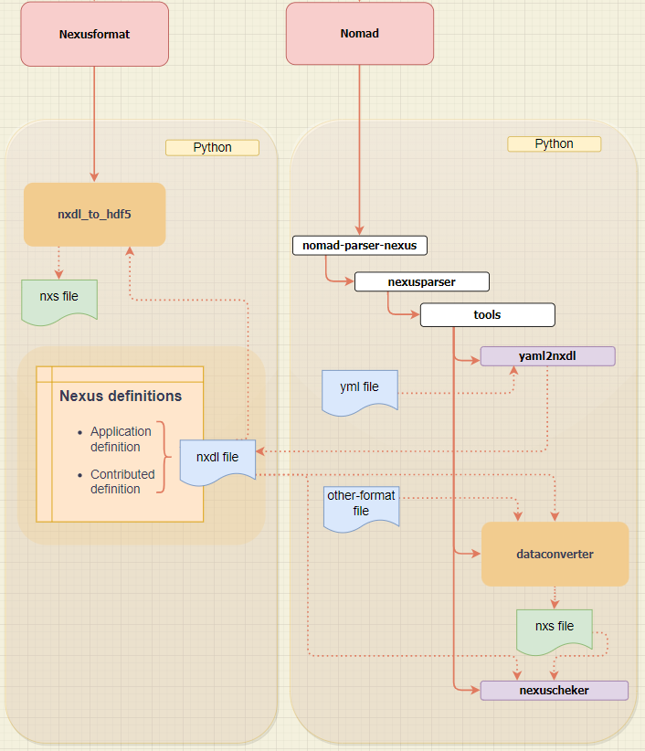
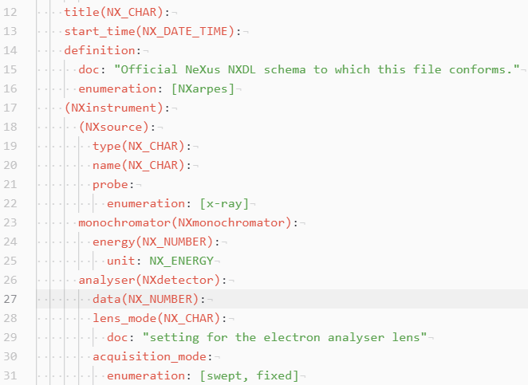
NOMAD-Parser NeXus
Output:
XML Application Definition -> NeXus file
Input:
YAML Application Definition

Slide 13
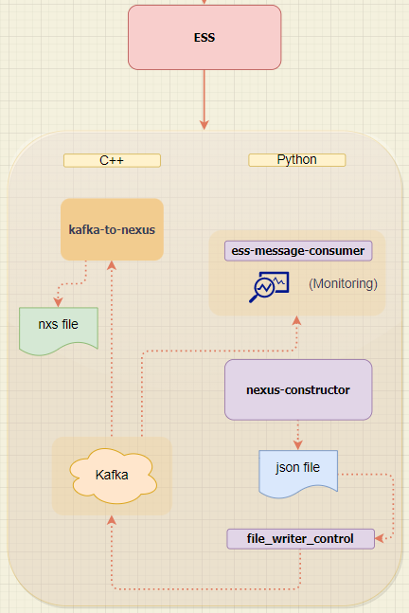
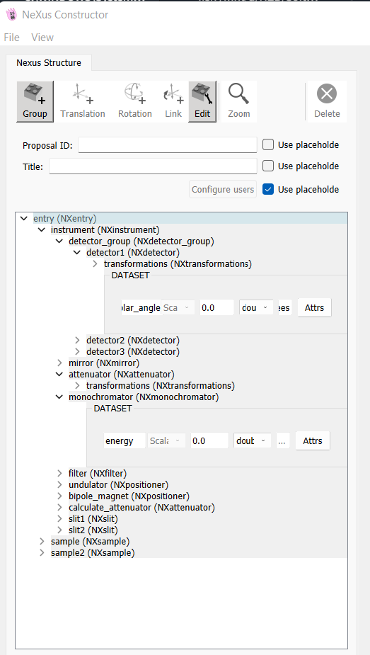
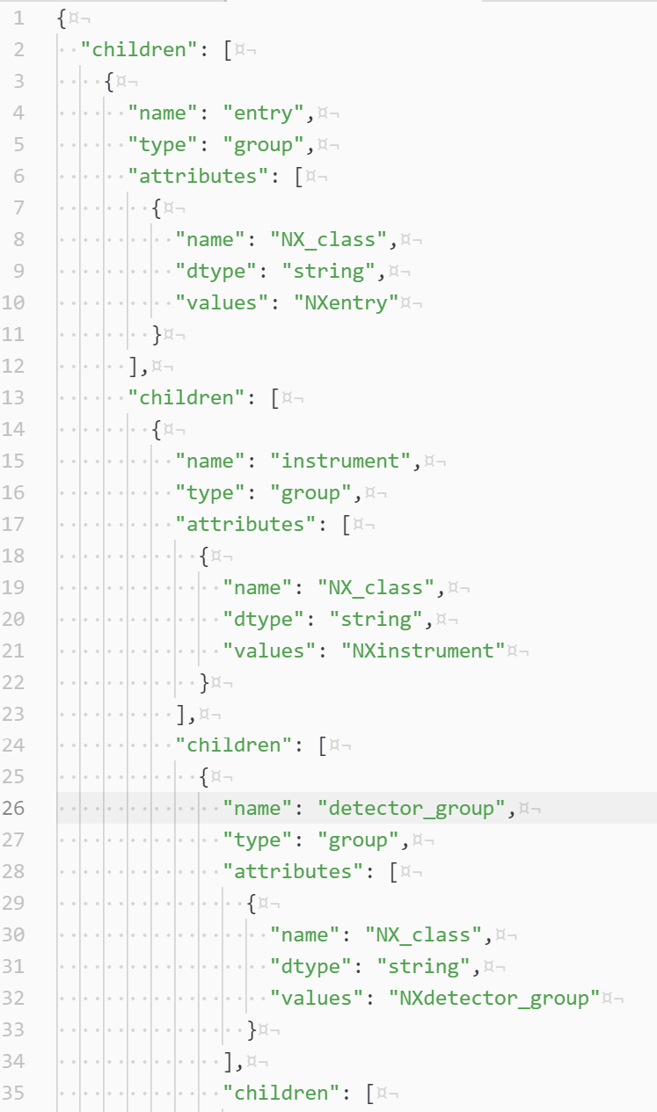
Kafka-to-NeXus
Output: JSON -> Nexus file

Slide 14
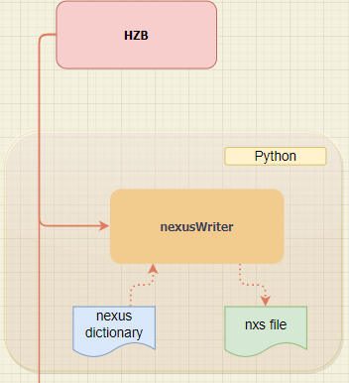
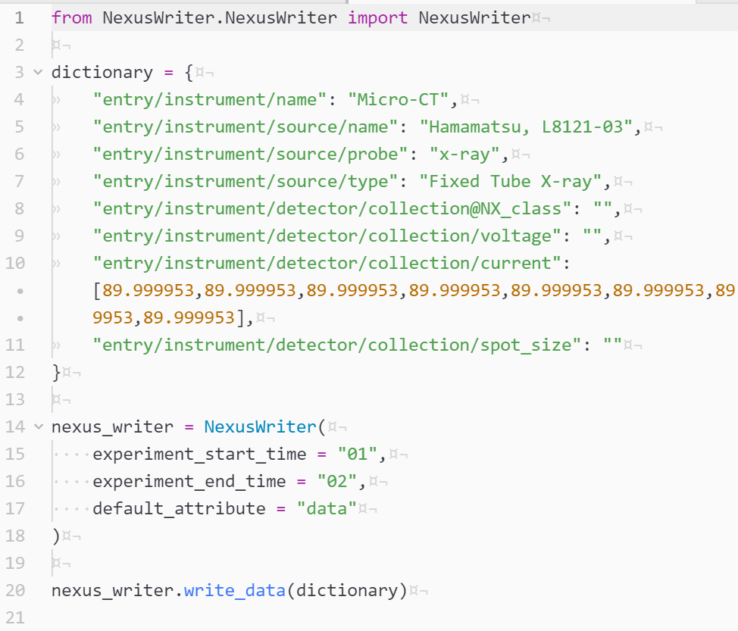
NexusWriter
It converts a Python dictionary into NeXus.

Slide 15
File_format | Software | File_format | Software | File_format
NXDL | nxdl_to_hdf5 | NeXus | ? | NXDL | Use of a ASCII file as input
YAML | yaml2nxdl / dataconverter | NeXus | ? | YAML | Possibility to insert dataset from other file formats
JSON | nexus-constructor / kafka-to-nexus | NeXus | nexus-json | JSON | Nice graphical view of NXstruct syntax
Python dictionary | NexusWriter | NeXus | ? | Python dictionary | Simple operation
NXDL -> Nexus
YAML -> NXDL -> Nexus
JSON -> Nexus
Python dictionary -> Nexus
NXstruct -> Nexus -> NXstruct
NexusCreator punx
NeXus
NXstruct
NXstruct
NexusCreator
punx

Slide 16
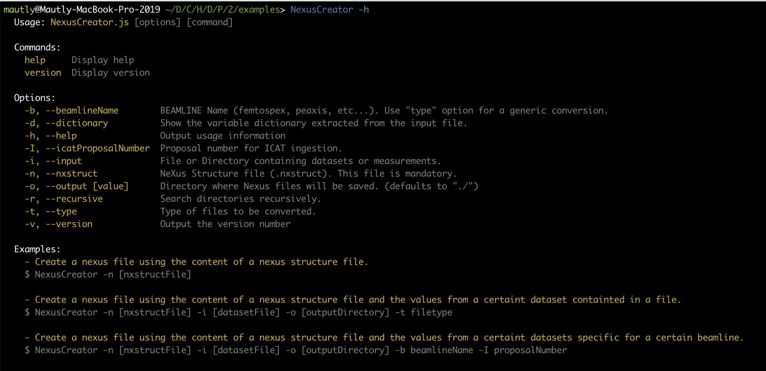
How NexusCreator works?

Slide 17
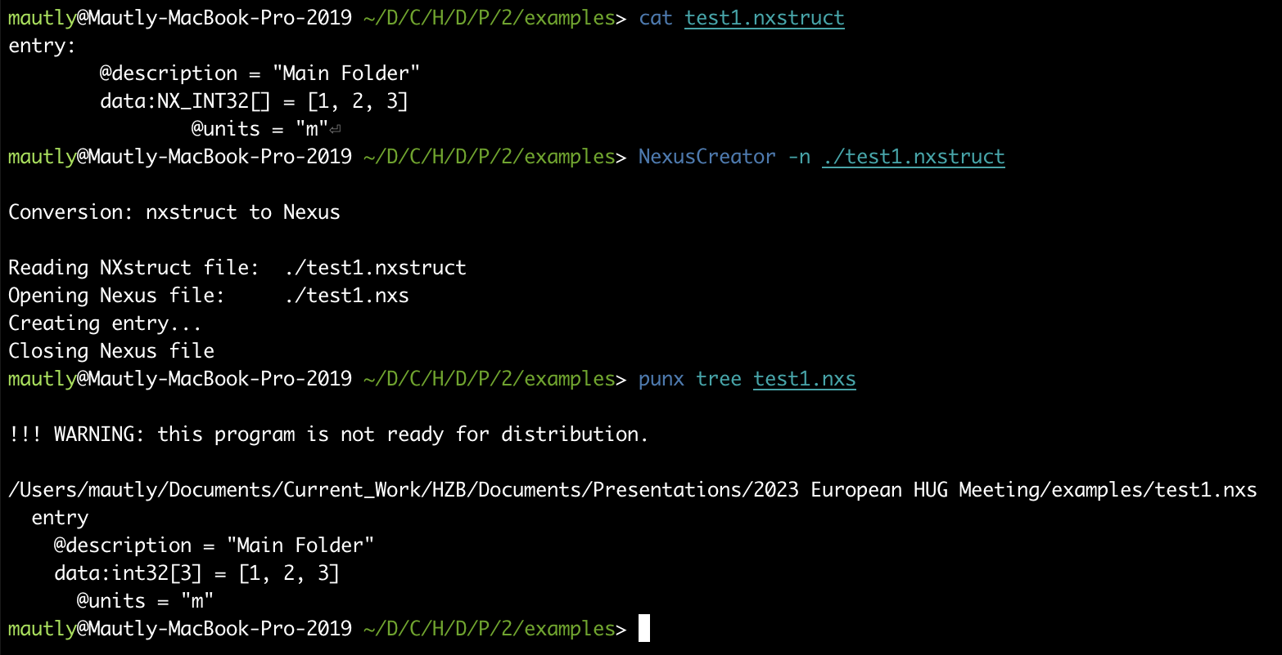
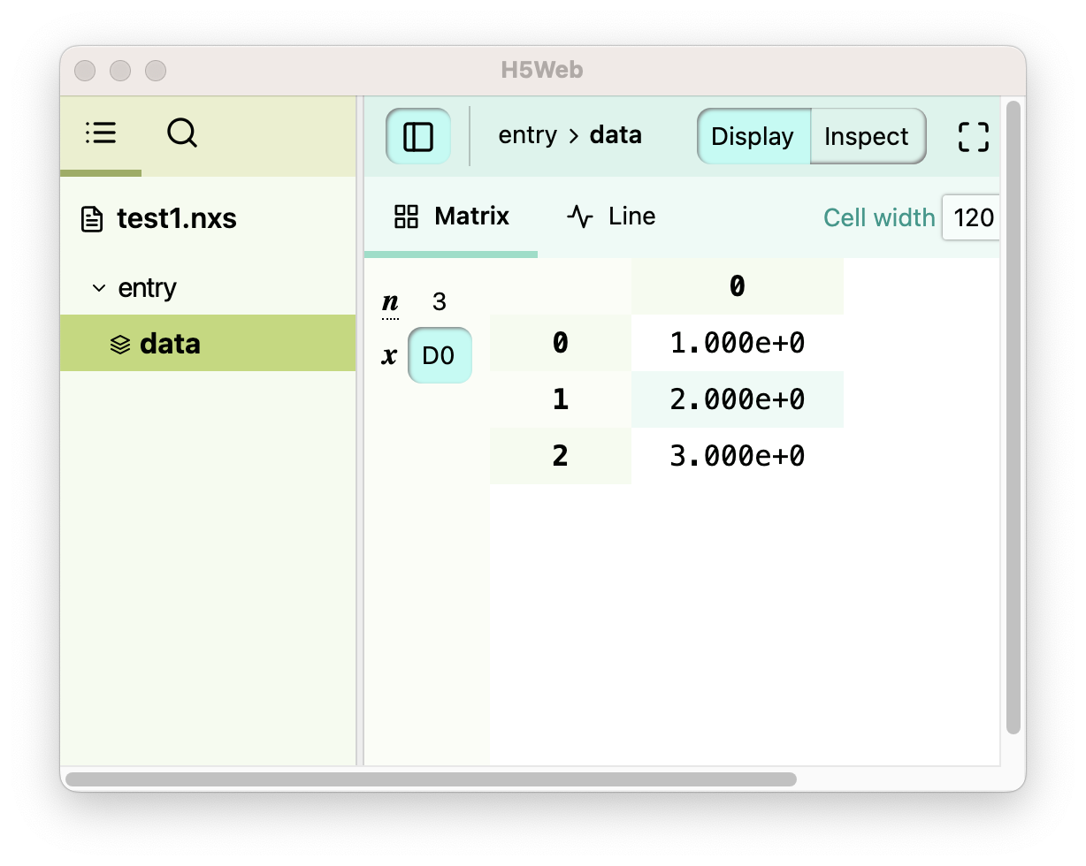
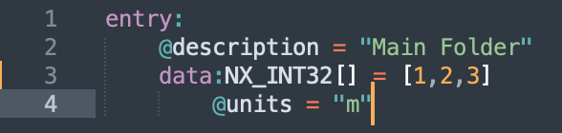
Creating NeXus file from NXstruct file.
NXstruct file
NexusCreator

Slide 18
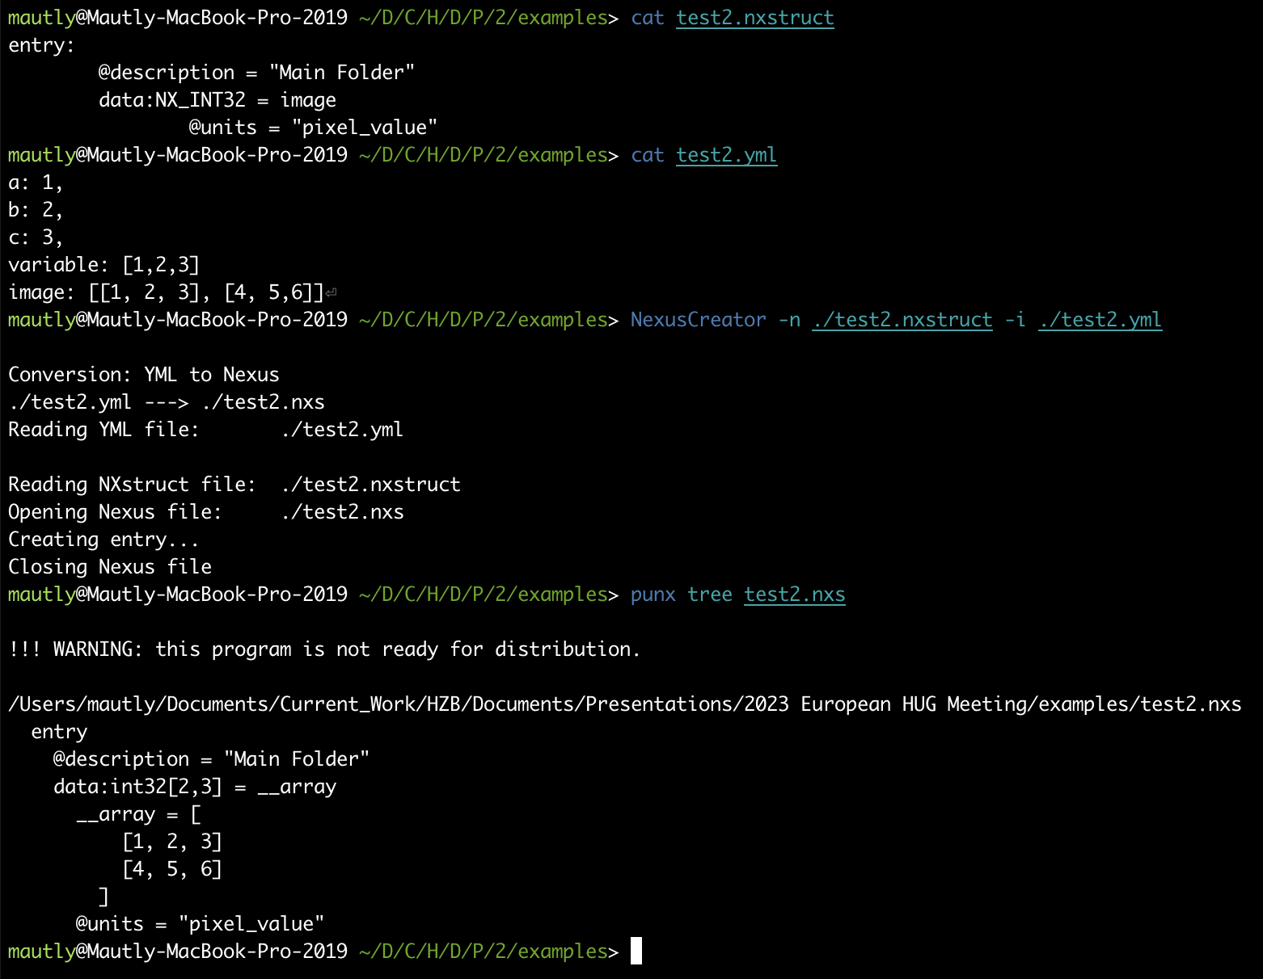
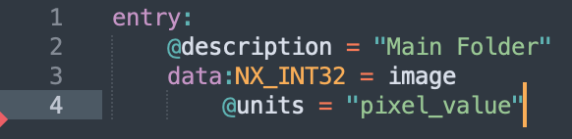
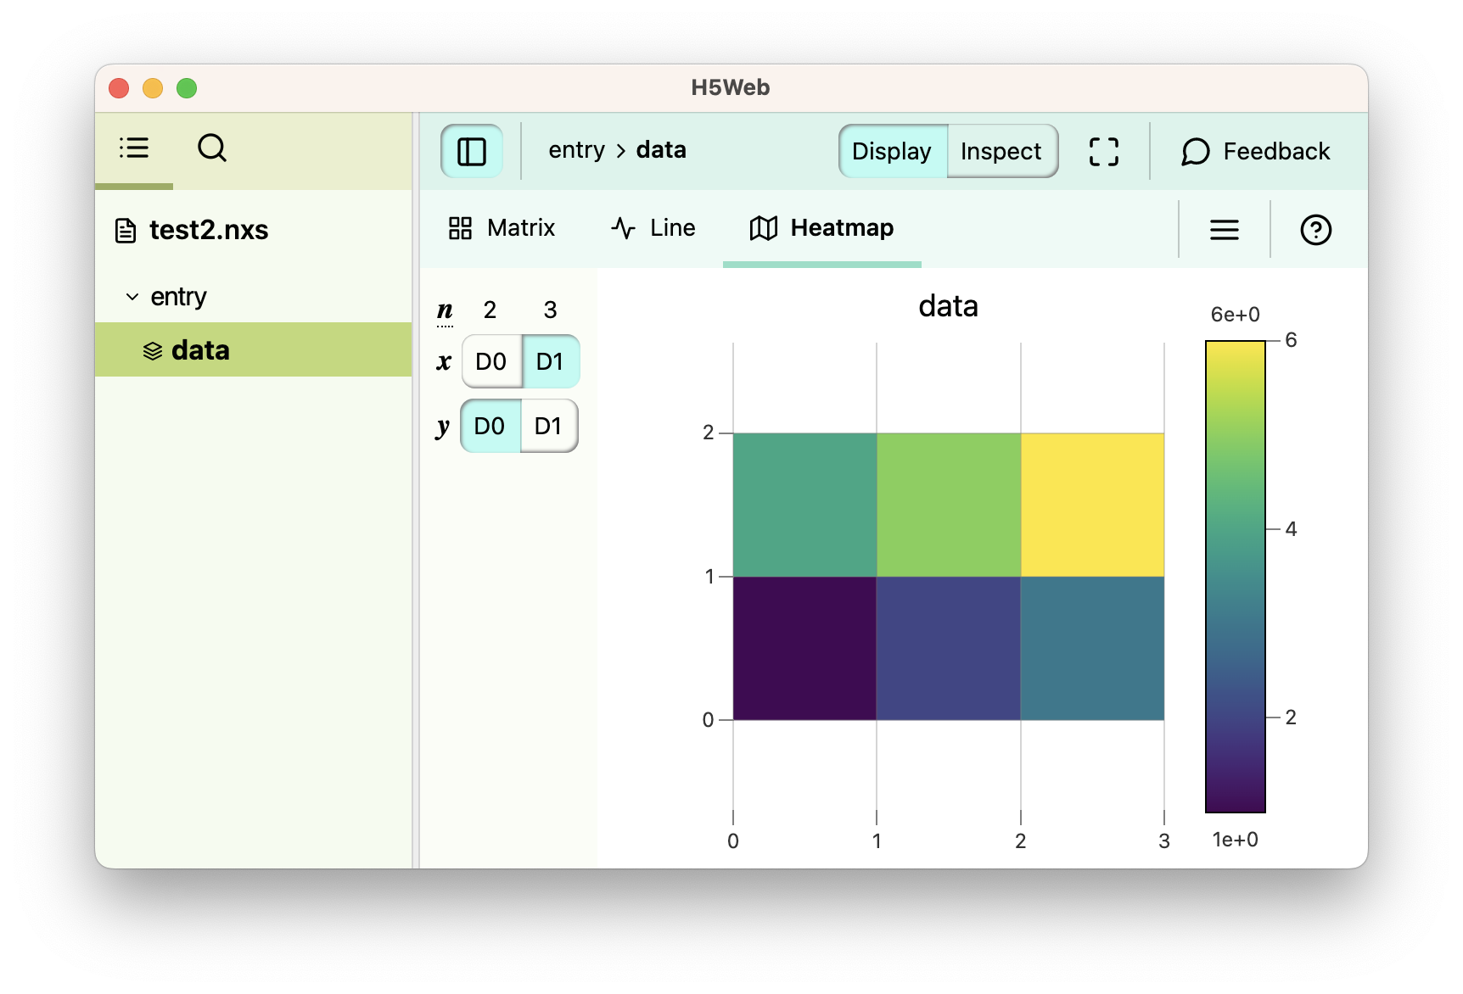

Converting YML file to NeXus.
NXStruct file
NexusCreator
YAML file
Format actually supported: SPEC, SIF, DAT, XAS, YAML.

Slide 19
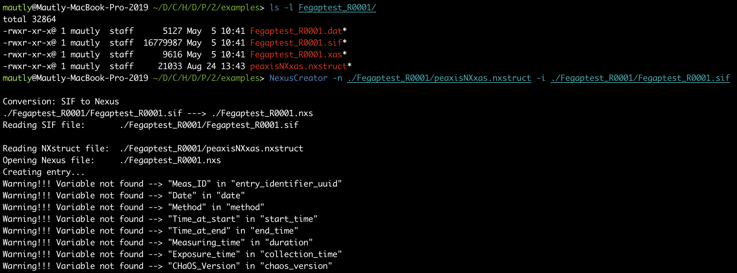
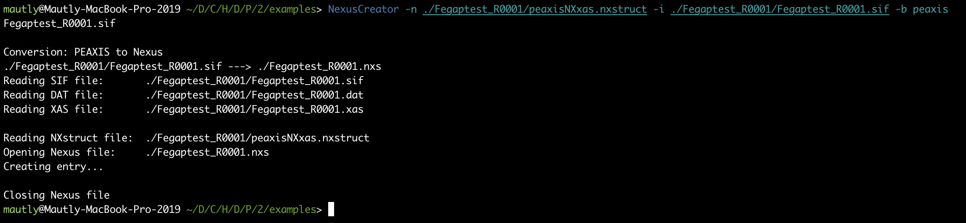
Converting SIF, DAT and XAS to NeXus.

Slide 20
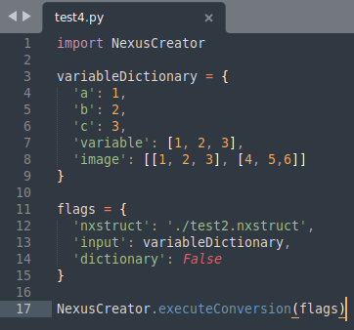
Python Library for automation with Bluesky
Python script
1) Create datasets as Python dictionary
2) Specify entries
NXstruct file
Python dictionary
3) Execute conversion

Slide 21
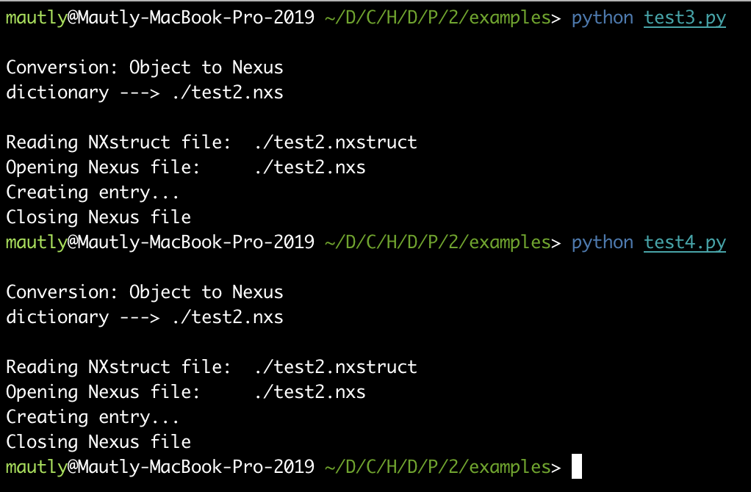
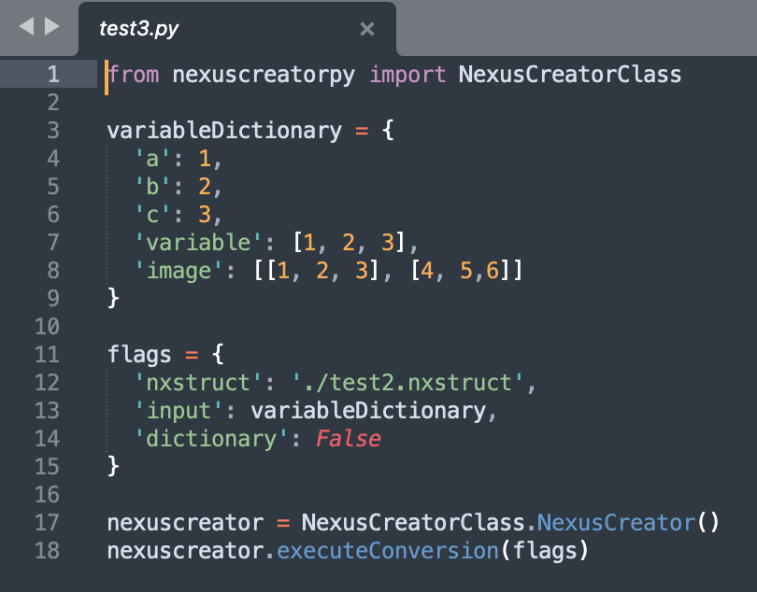
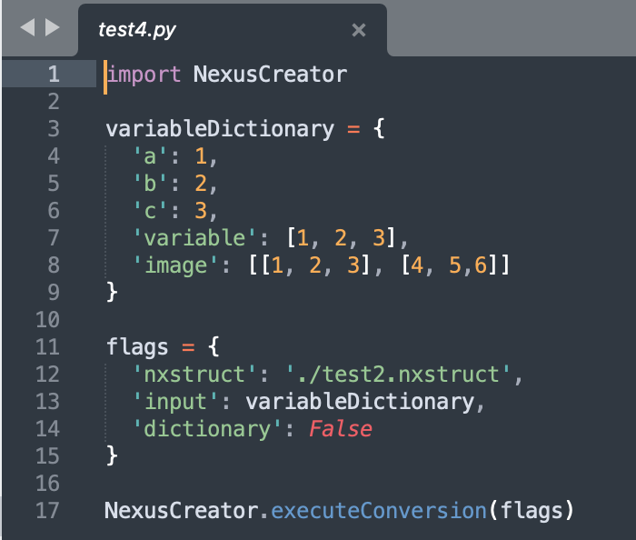
Python library using H5Py or H5Wasm
H5Py - Python
H5wasm - Javascript
Limit size for a dataset: 4Mb

Slide 22
Beamline U41-PEAXIS
Conversion of RAW data to NeXus
HUG
20.09.2023
2023 European HDF5 User Group Meeting

Slide 23
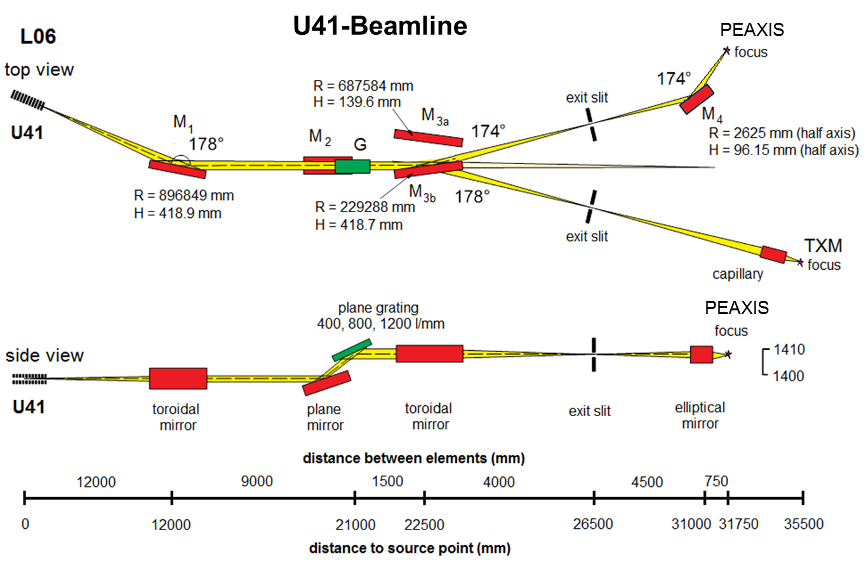
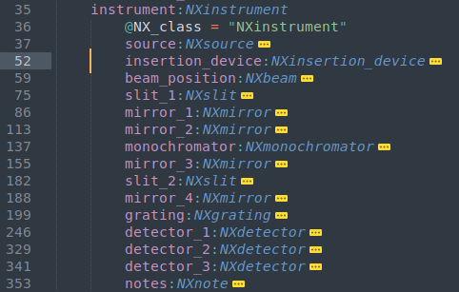
Photo-Electron Analysis and Resonant Inelastic X-ray Spectroscopy (RIXS)
FAIR TOOLS - NexusCreator & ICATxmlGenerator
Instrument Definition using Base Classes
NXslit
NXaperture
NXmonochromator
NXmirror
Layout of the U41-PEAXIS beamline @ BESSY II

Slide 24
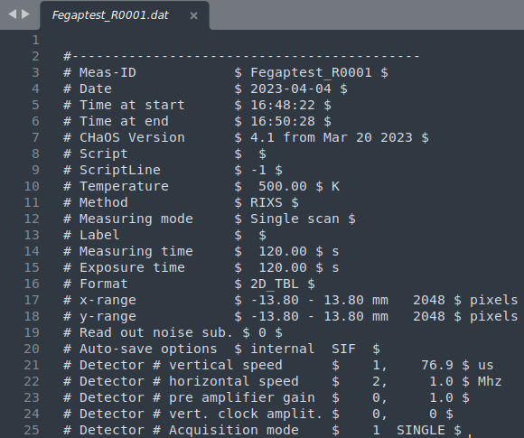
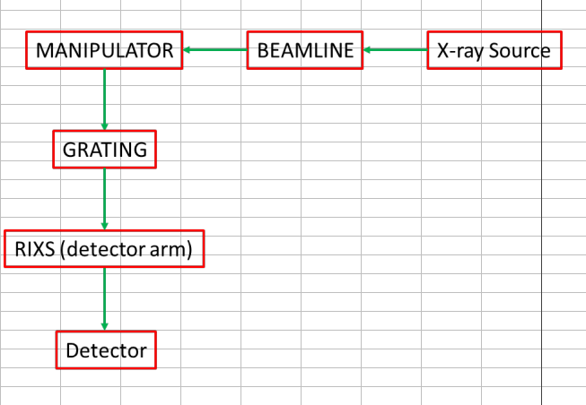
How raw data looks for U41-PEAXIS?
DAT file - ASCII file
Diagram given by PEAXIS to understand the content of DAT and XAS files.

Slide 25
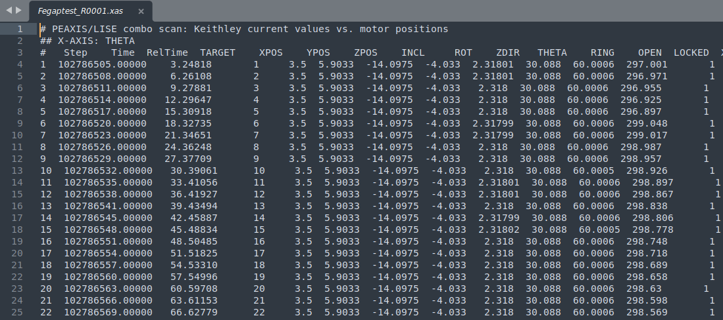
How raw data looks for U41-PEAXIS?
XAS file - ASCII file

Slide 26
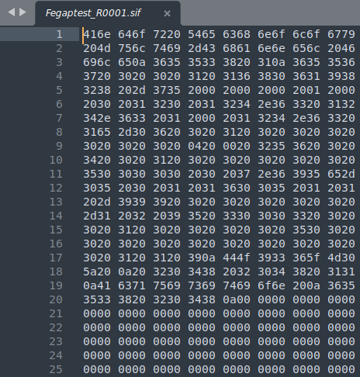
How raw data looks for U41-PEAXIS?
SIF file - Binary file
U41-PEAXIS raw data:
ASCII DAT file with single measurements.
ASCII XAS file with scans.
Binary SIF image.
Header
Image

Slide 27
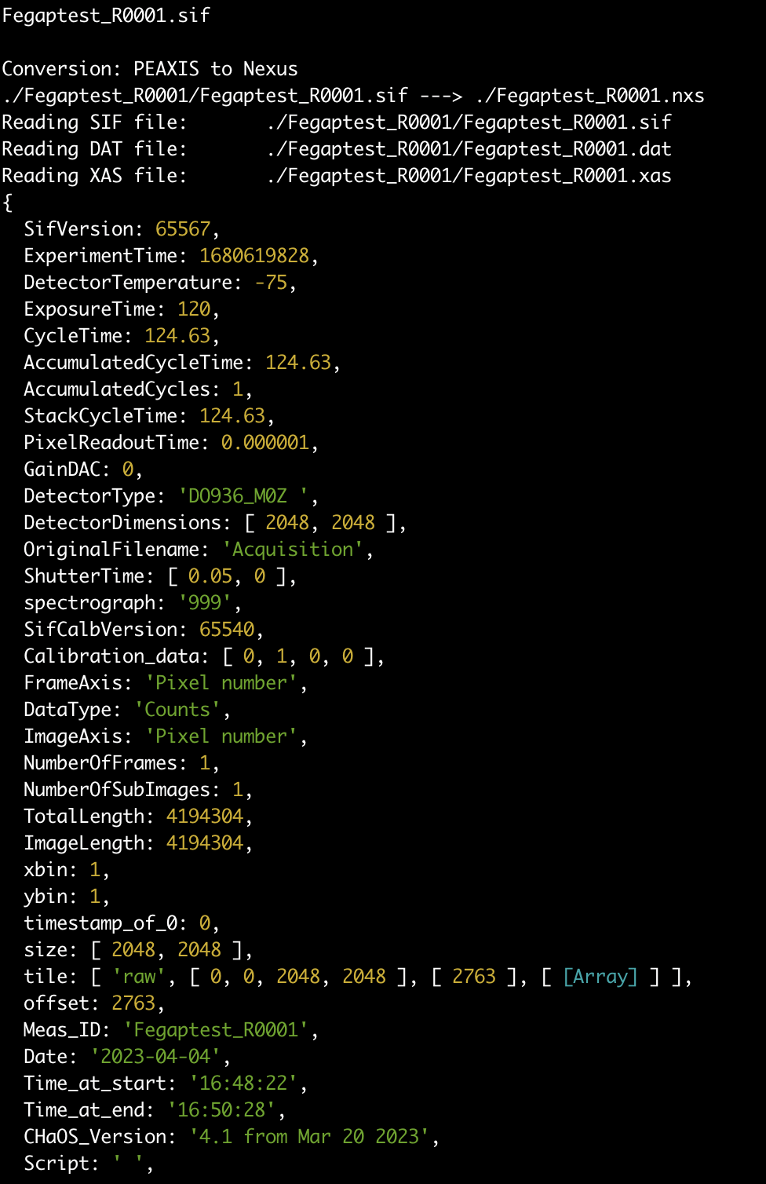
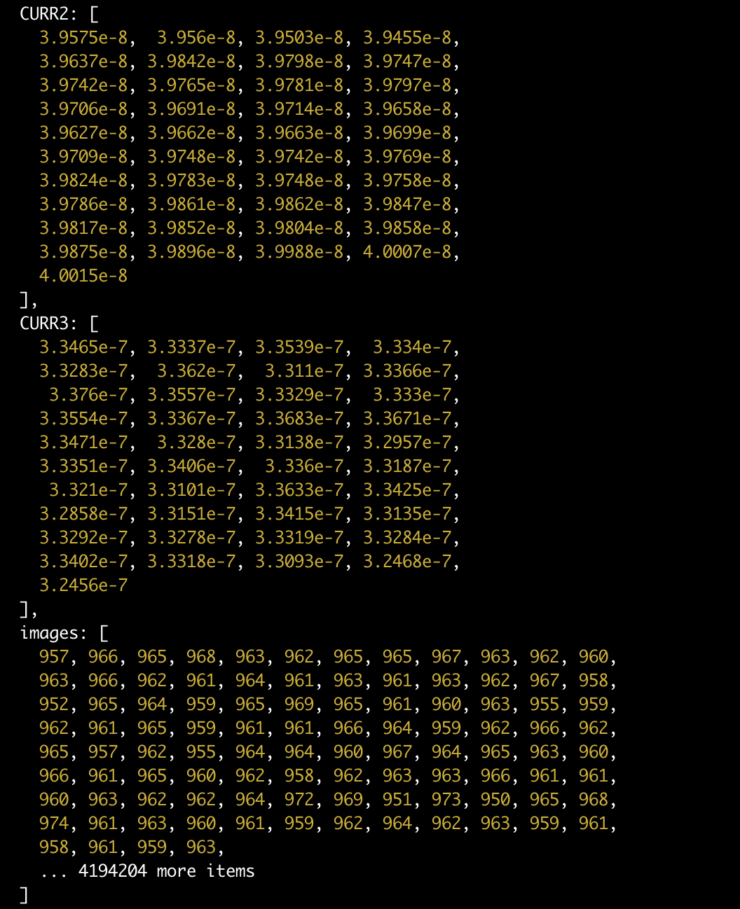
Dictionary from DAT, XAS and SIF

Slide 28
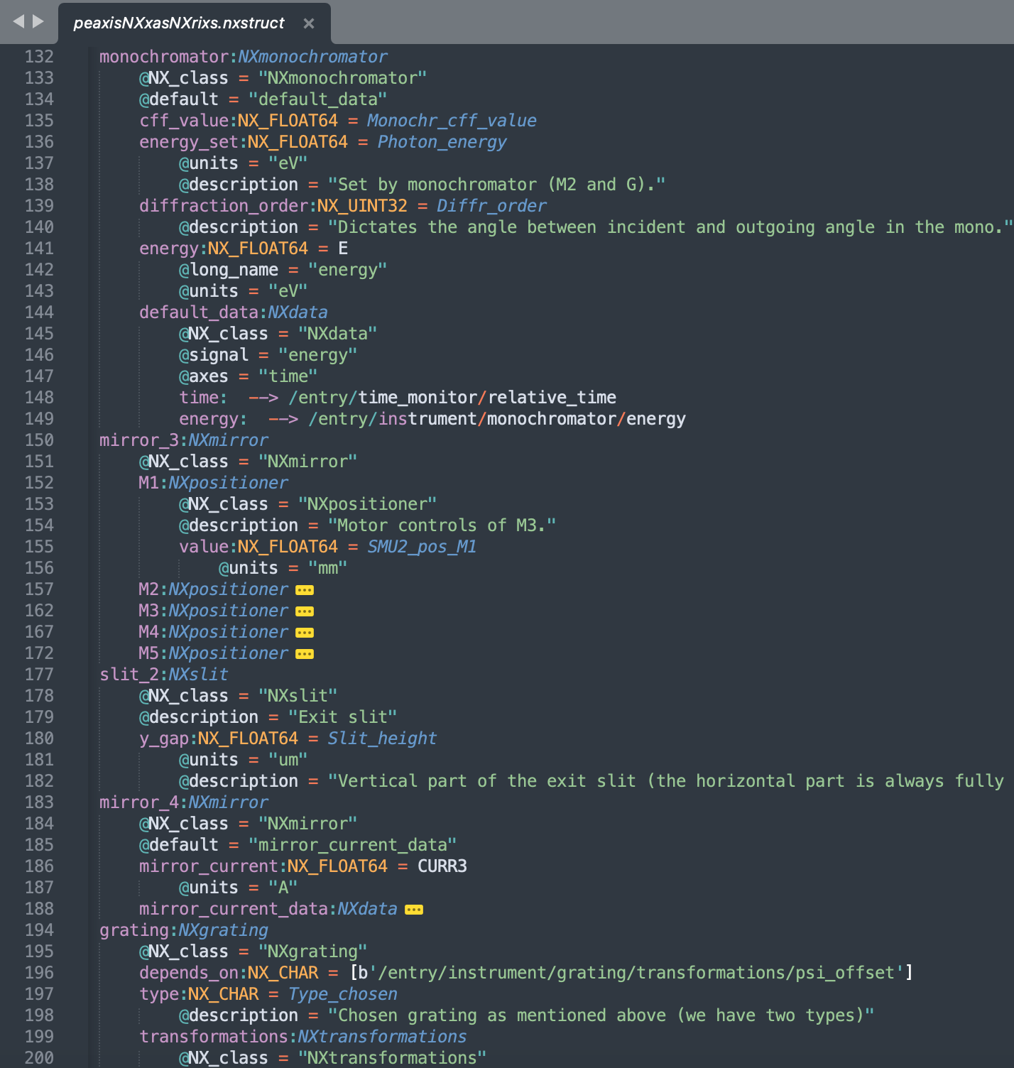
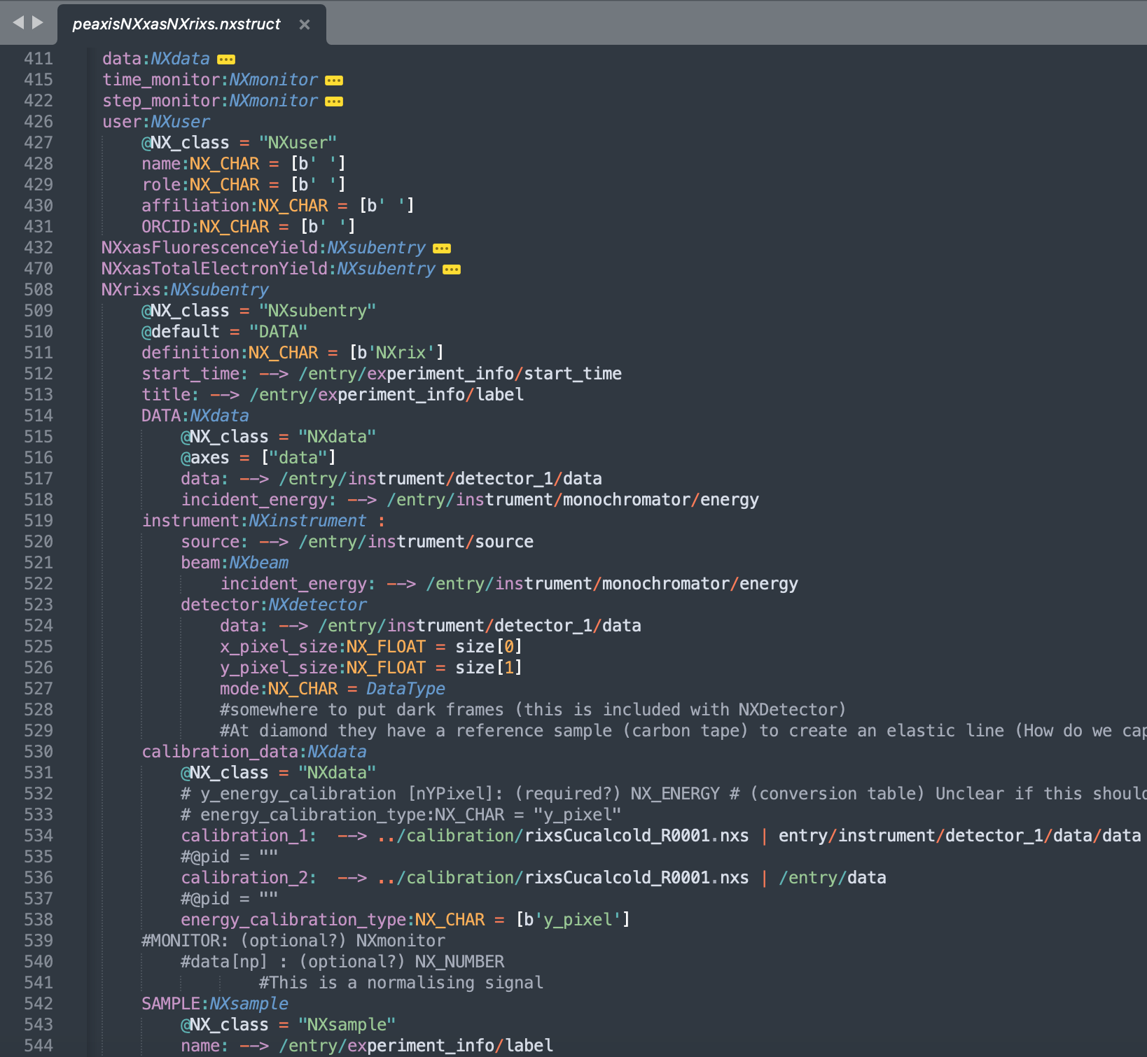
Instrument Definition
Application Definition

Slide 29
Current Status
PEAXIS beamline is FAIR-ready and has uploaded data to ICAT.
FEMPTOSPEX beamline converter is ready and instrument definition in progress.
EMIL(Lab) with connection to Bluesky is in progress.
To do:
  Implement compression.
  Save datasets via chunks (stream).

Slide 30
Thank you!
Thanks to:
Dr. Wong, Deniz (Instrument Scientist at PEAXIS beamline )
Contact:
Dr. Perez Ponce, Hector: hector.perez_ponce@helmholtz-berlin.de
Mrs. Görzig, Heike: heike.goerzig@helmholtz-berlin.de
Gitlab:
(Javascript) https://gitlab.com/helmholtz-berlin/nexuscreator
(Python) https://gitlab.com/helmholtz-berlin/nexuscreatorpy

