Slide 1
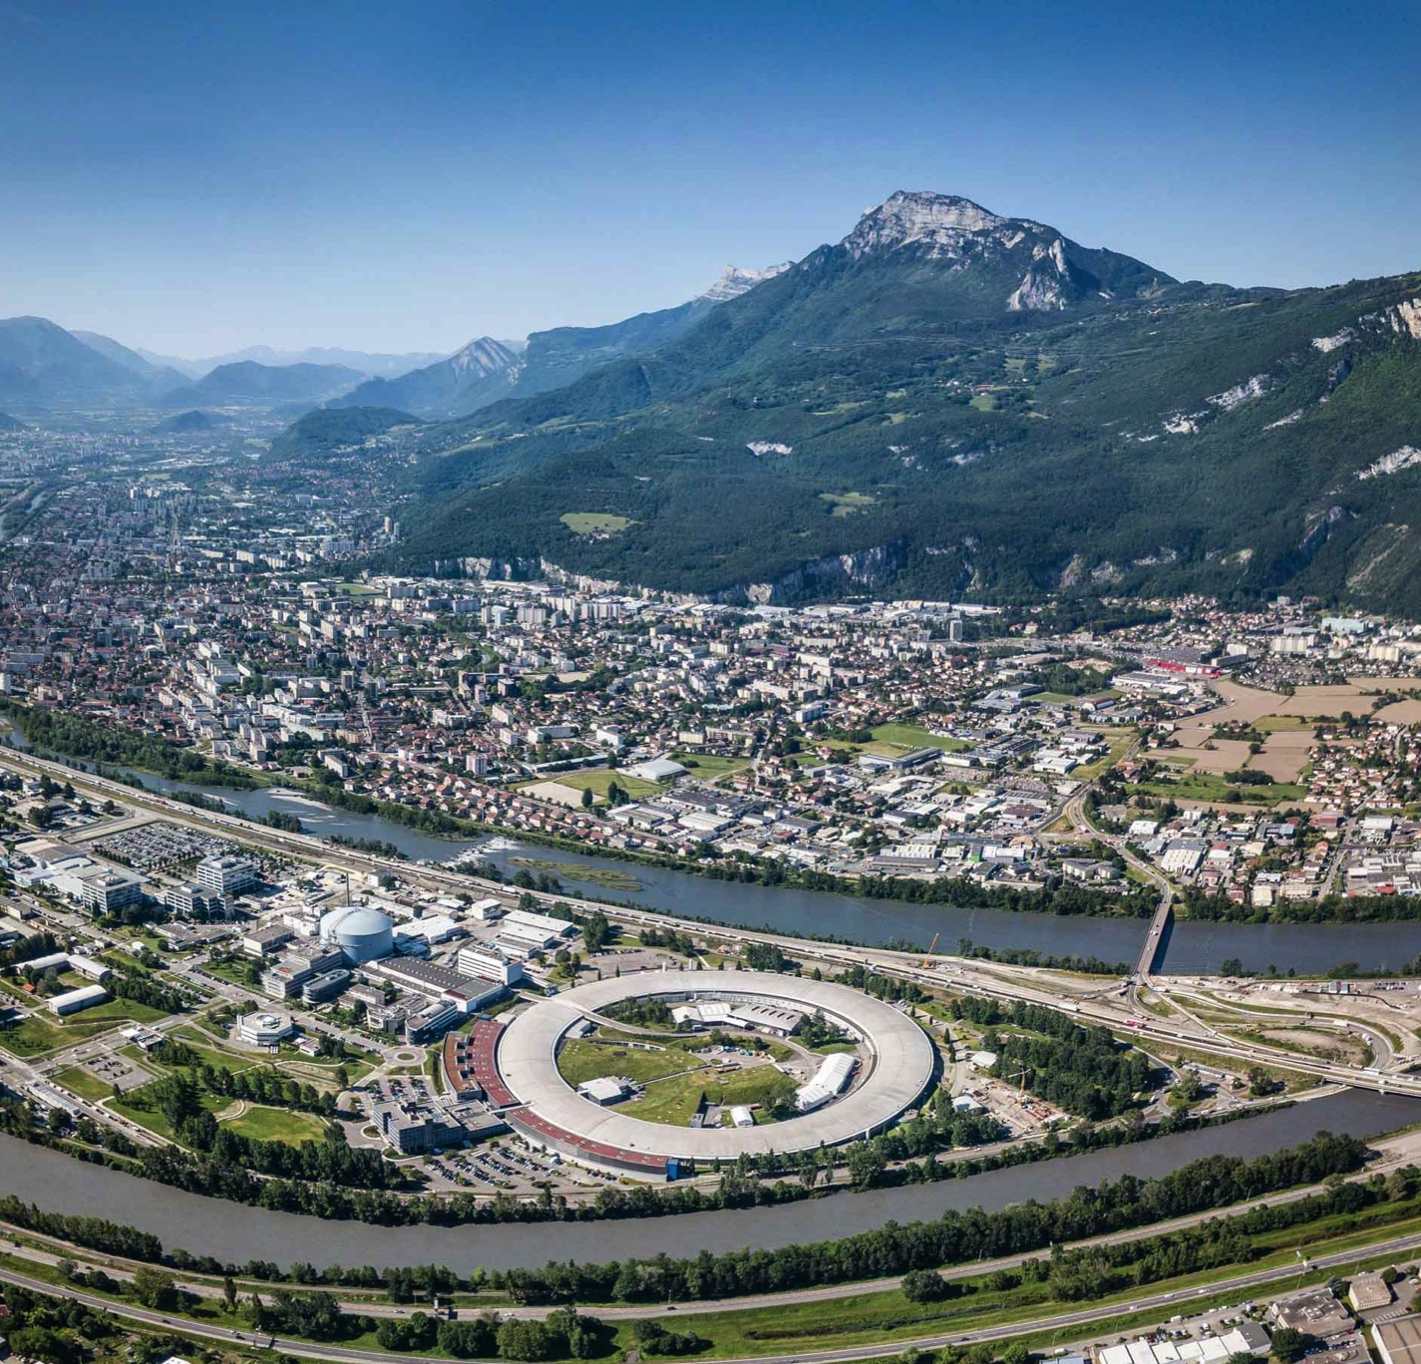
Using Sparse Arrays for Synchrotron 3DXRD-CT Data Reduction
Jon WRIGHT
2023 European HDF User Group (HUG) Plugins and data compression summit
PIONEERING SYNCHROTRON SCIENCE
Notes:
Thanks to Andy Goetz for the invitation

Slide 2
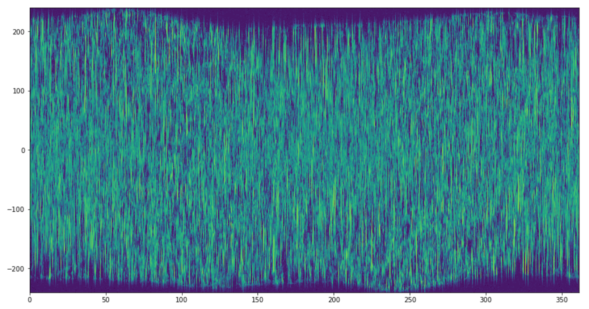
Scientific case : Imaging materials in color
2D scan over motors
XRD image at each point
Strain (distance between atoms)
Chemistry / atomic structures
Microstructure, grain boundaries
Slip + deformation
Beam Position / microns
Sample Rotation / deg
[2401,7220]
[2401,2401]
Notes:
I am a beamline scientist.
We are doing X-ray diffraction and using this for imaging in materials

Slide 3
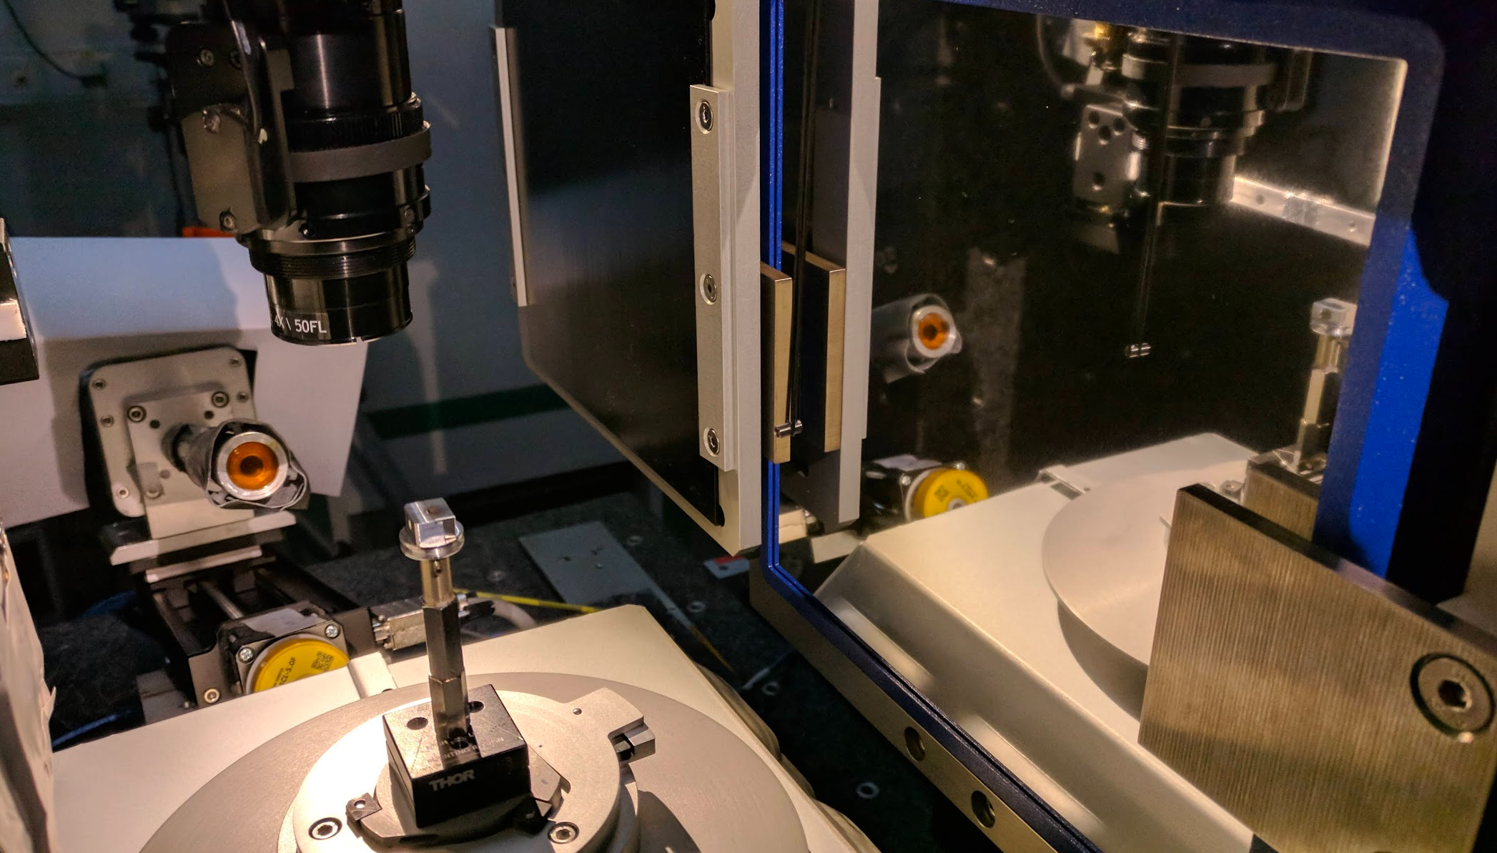
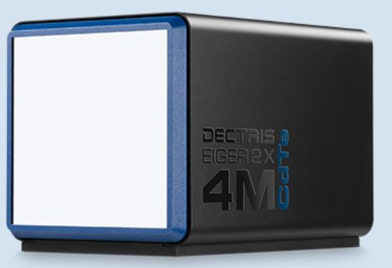
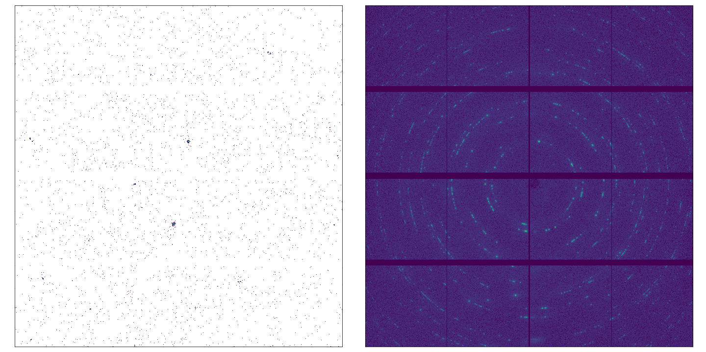
The scientific method: scanning 3D-XRD-CT
[30] [201] [7200] [2162] [2068]
Z, Y
15 seconds
1 frame
500 frames summed
500 fps
Data rate (raw)
… 4 GB/s
… 14 TB / hour
… 345 TB / day
Notes:
I am not looking at a general case!
We want to optimize our specific case, which is a Dectris Eiger 4M

Slide 4
Use of HDF5 : Dectris (bitshuffle+lz4) + ESRF (lima + nexuswriter)
Beamline
Lima
bslz4
ROI counters
Data
Center
bslz4
Motor positions + counters
DATATYPE H5T_STD_U16LE
DATASPACE SIMPLE
{ ( 7200, 2162, 2068 ) / ( H5S_UNLIMITED, 2162, 2068 ) }
STORAGE_LAYOUT { CHUNKED ( 1, 2162, 2068 )
SIZE 1851712748 (34.769:1 COMPRESSION) }
FILTERS { USER_DEFINED_FILTER { FILTER_ID 32008
COMMENT bitshuffle; see https://github.com/kiyo-masui/bitshuffle
PARAMS { 0 3 2 0 2 } } }
scan0001/
eiger_0000.h5
Master.h5
scan0002/
eiger_0000.h5
VDS
Notes:
Infrastructure was put in place by the engineering expert teams.
Similar to other facilities, I will skip some details.
We get ROI counters live during scans and the data are in bslz4 format.

Slide 5
HDF5_USE_FILE_LOCKING
FAQ: Why the ESRF does not use SWMR…
…the only way to read an HDF5 file during the acquisition is to disable HDF5 file locking.
This has consequences
Scientist
NexusWriter
Notes:
Things could have been done differently.
If you try to read without file locking you can run into problems.
So we are waiting for a measurement to finish, then process all the data

Slide 6
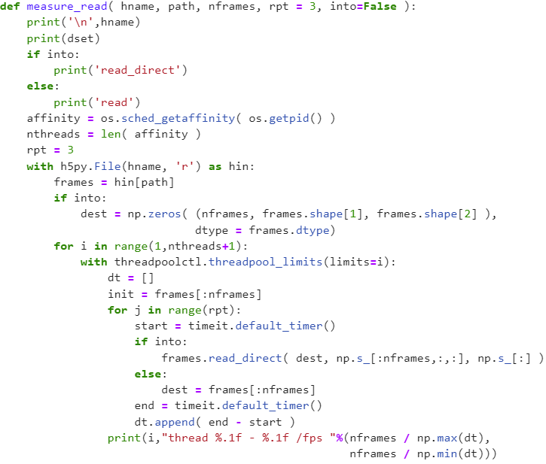
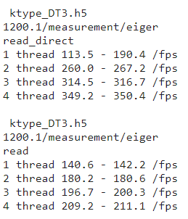
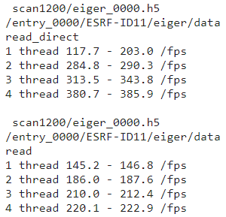
Goal : process a scan quickly, but only after the scan ends
Using plugins, standard reads :
VDS adds overhead (5%)
Threading is sub-linear
read_direct might help
Notes:
How fast can we read our scan?
“Convenience features” reduce performance.

Slide 7
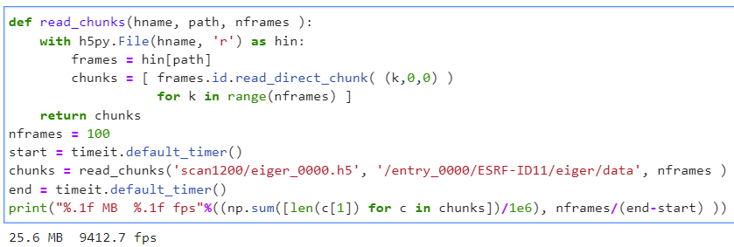
Long Detour : read chunks and decompress these
Best case was about
3 kHz using a GPU
See J. Kieffer’s talk
Yesterday: 11h30
1 frame is about 256 kB
Notes:
We decided the standard reading path was not fast enough.
Attempted to decompress on a GPU – Jerome talked more about this yesterday.
Put this on the back burner while waiting for GPU’s to be purchased + installed + configured

Slide 8
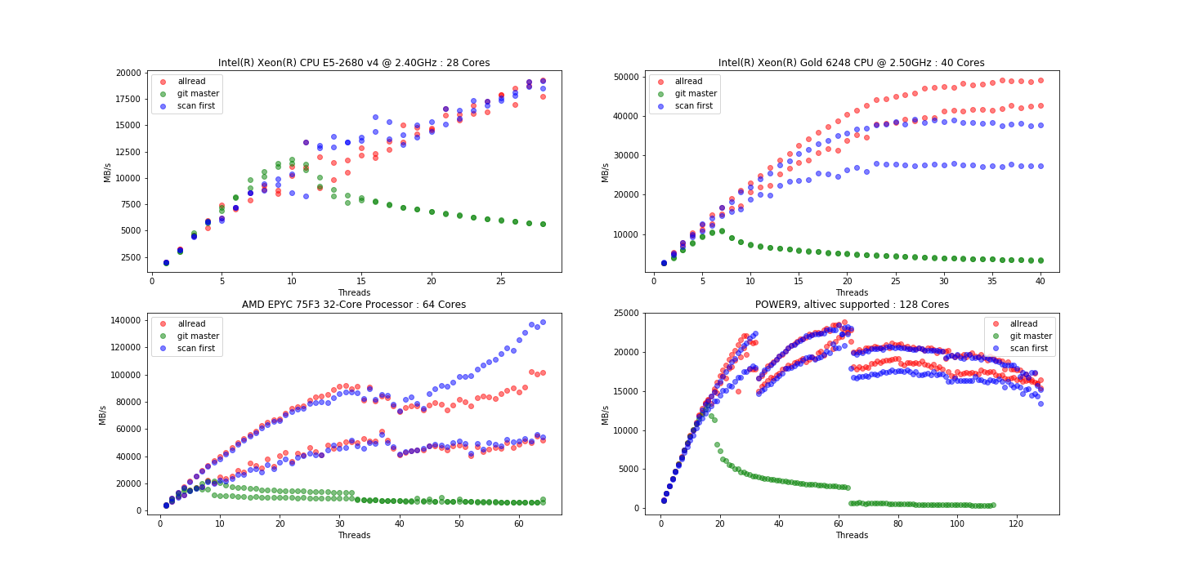
Sub-linear threading …
[[offset, blob], [offset, blob], …]
Offset reading is shared between threads in the bitshuffle plugin.
It is quicker to have all threads reading all offsets…
… or one thread scanning all offsets.
Although you can gain here: it is still hard to keep pixels local to cores for subsequent processing. Decoding a whole image is not needed.
(6 February)
Notes:
The threading in the bitshuffle plugin does not scale very well on larger machines.
Pull request open that makes all threads read all offsets when decompressing.

Slide 9
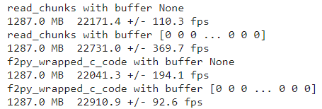
Long Detour: avoid a malloc and copy
(note: bytestring in python2.7 was/is also a problem).
Notes:
Thanks to Thomas Vincent for getting this patch into h5py.

Slide 10
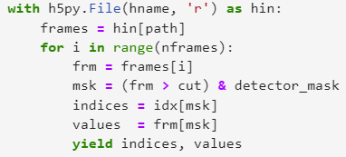
Conversion to sparse – Currently running 1 frame = 1 core
HDF5
MasterFile
81 fps for 30,000 pixels
113 fps for 850 pixels
LIMA
8.9 MB
Chunks
Index Value
(126, 47) 1
(212, 1923) 1
…
257 kB
4kB blocks inside
block-local thresholding (4 kB at a time)
bslz4_to_sparse codes
167 fps for 30,000 pixels
173 fps for 850 pixels
Notes:
Current stopping point. Running on CPU.
Write out sparse data as it comes out of the bslz4 stream (4 kB chunks), filtering the zeros (or 1’s too)

Slide 11
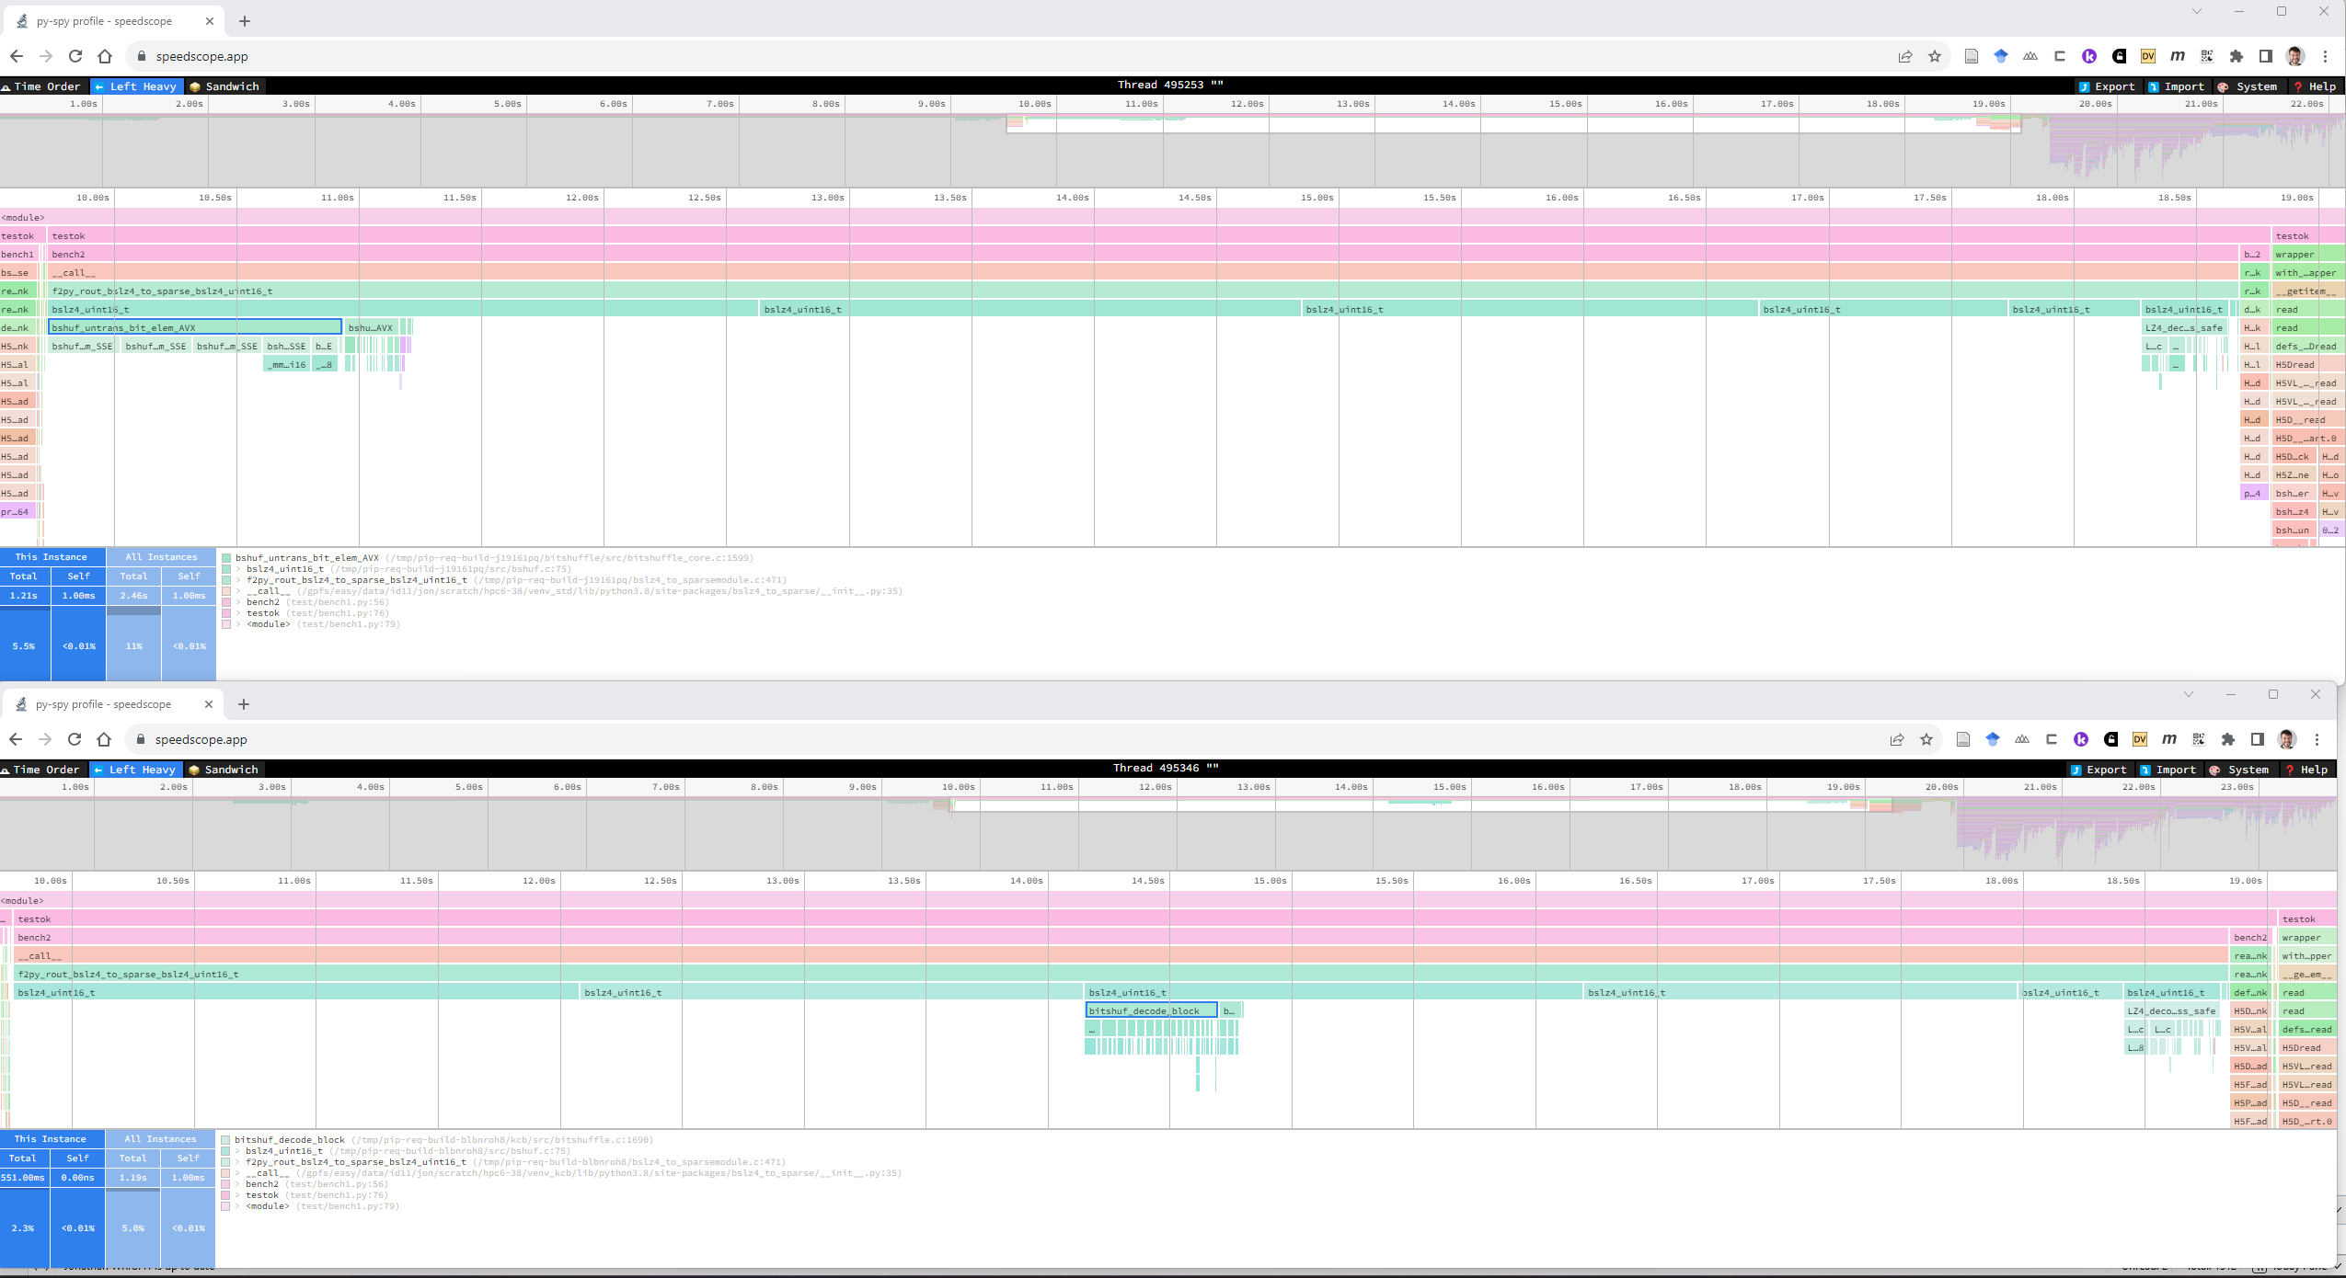
pyspy sampling profiler
@kalcuttler (Dectris) CPU optimized shuffles also help
https://github.com/jonwright/bslz4_to_sparse/issues/1
Notes:
Faster CPU shuffle code recently shared by Kal Conley from Dectris

Slide 12
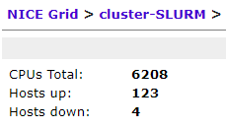
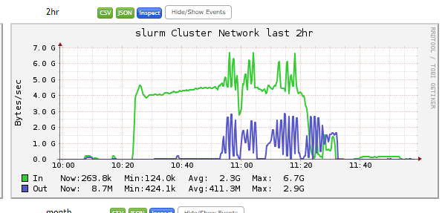
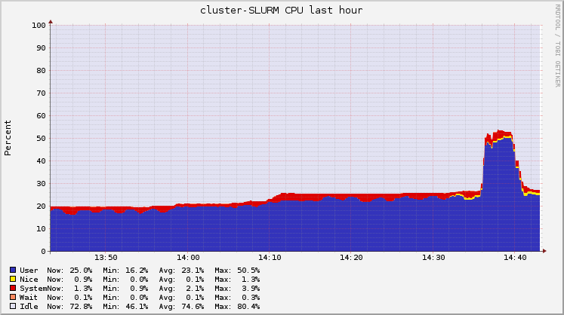
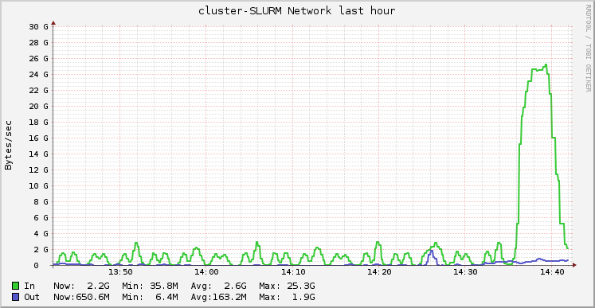
Conversion to sparse – Currently running 1 frame = 1 core
2 years ago
2 weeks ago
1 Hour
Many nodes
Much easier to get CPU cores that GPU
Jobs scale better (less use of L2/L3 cache)
I/O got faster?
25 GB/s

Slide 13
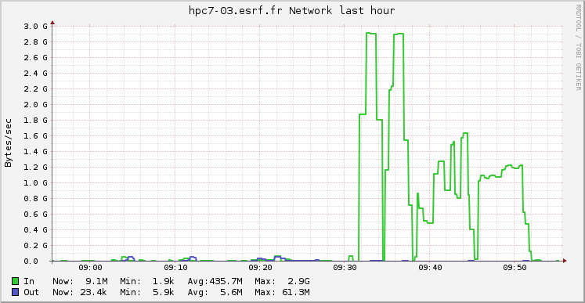
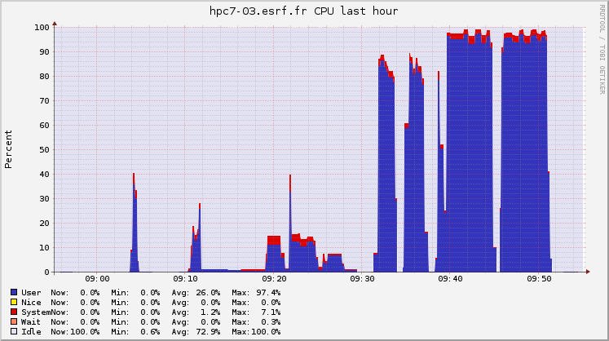
Single node – tested yesterday - I/O limited (at last!)
hpc7 nodes installed. (2x48)=96 cores. AMD EPYC 9454.
Testcase : 96 * 4 * 7200 = 2,764,800 frames
376 GB compressed
24.7 TB raw
Standard plugin: 340 seconds = 8,131 fps = 96 fps/thread
bslz4_to_sparse: 137 seconds = 20,181 fps = 210 fps/thread
Standard
plugin
Killed
OpenMP
96*96
Blocked
4kB
25 Gb link
(3.125 GB?)
2 runs repeated for each method:
Notes:
Now reached a situation where the disk + network IO is the bottleneck rather than the decompression.
Huge machine found in the cluster yesterday. Nice surprise. 20 kHz for the real work, which includes filtering to get peaks and writing results.

Slide 14
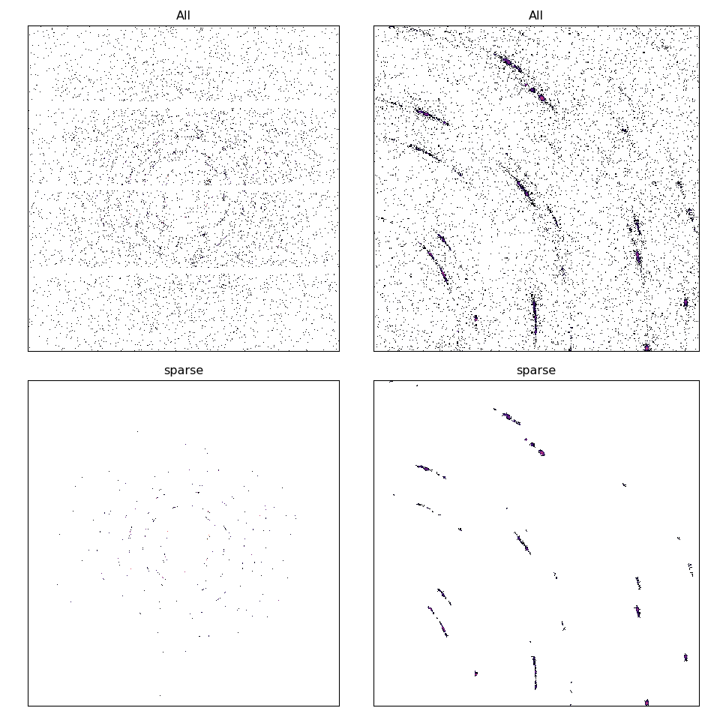
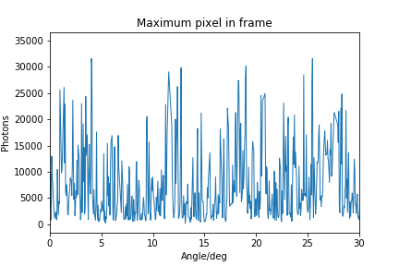
Lossy vs lossless
Diffraction data can have very strong spots
and low background
Delete the “1”. Lost photons and information.
Accumulation of low counts: no photons are lost
For grain mapping : only photons in peaks are used
Notes:
For our experiment we are interested in the strong diffraction spots.
We are deleting the pixels with only 1 count.
Also filtering out pixels that do not form connected blobs.
A strong peak is many thousands of photons, so OK to delete the ones.

Slide 15
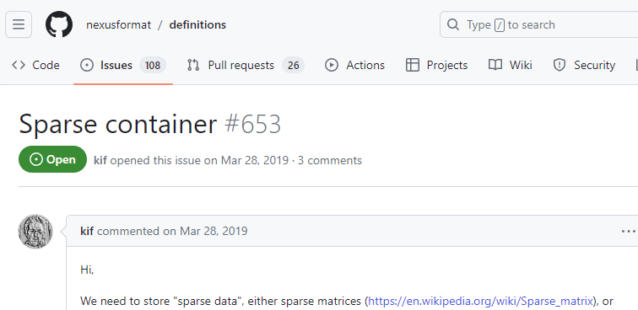
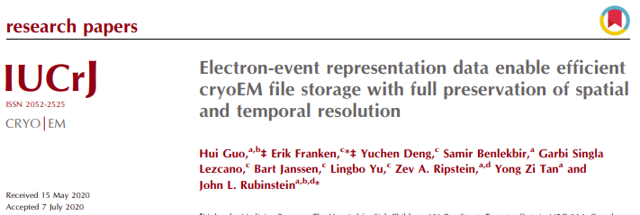
Writing HDF5 files with sparse pixels …
Scipy : CSC / CSR / COO etc (h5sparse, etc)
Using :
row uint16
column uint16
intensity [as read]
nnz = pixels per frame
Value, step to next
Value, step to next
Notes:
How shall we save the results of our sparse matrix?
Various options – we picked something.

Slide 16
Writing HDF5 files with sparse pixels …
How does this (fail to) run in parallel?
Lima files are blocked in 7200 frames
One process -> one file
Thousands of files created, and then merged
Storage : without compression
3X active pixels
30,000 pixels: 172 kB
850 pixels: 5 kB
(8.9 MB raw, 257 kB for bitshuffle)
Indices compress well.
COO format selected so that we can later sort pixels into a different order.
Using h5py standard?? fast integer:
lzf + byte-shuffle
Lima
FUTURE:
Save data directly as sparse ?
Choice of compression depending on frame?
Notes:
I did not look into writing in parallel. Maybe it is already possible?
So there are many files created.
It would make sense to save directly into a sparse array.
Can you decide the plugin chunk-by-chunk?

Slide 17
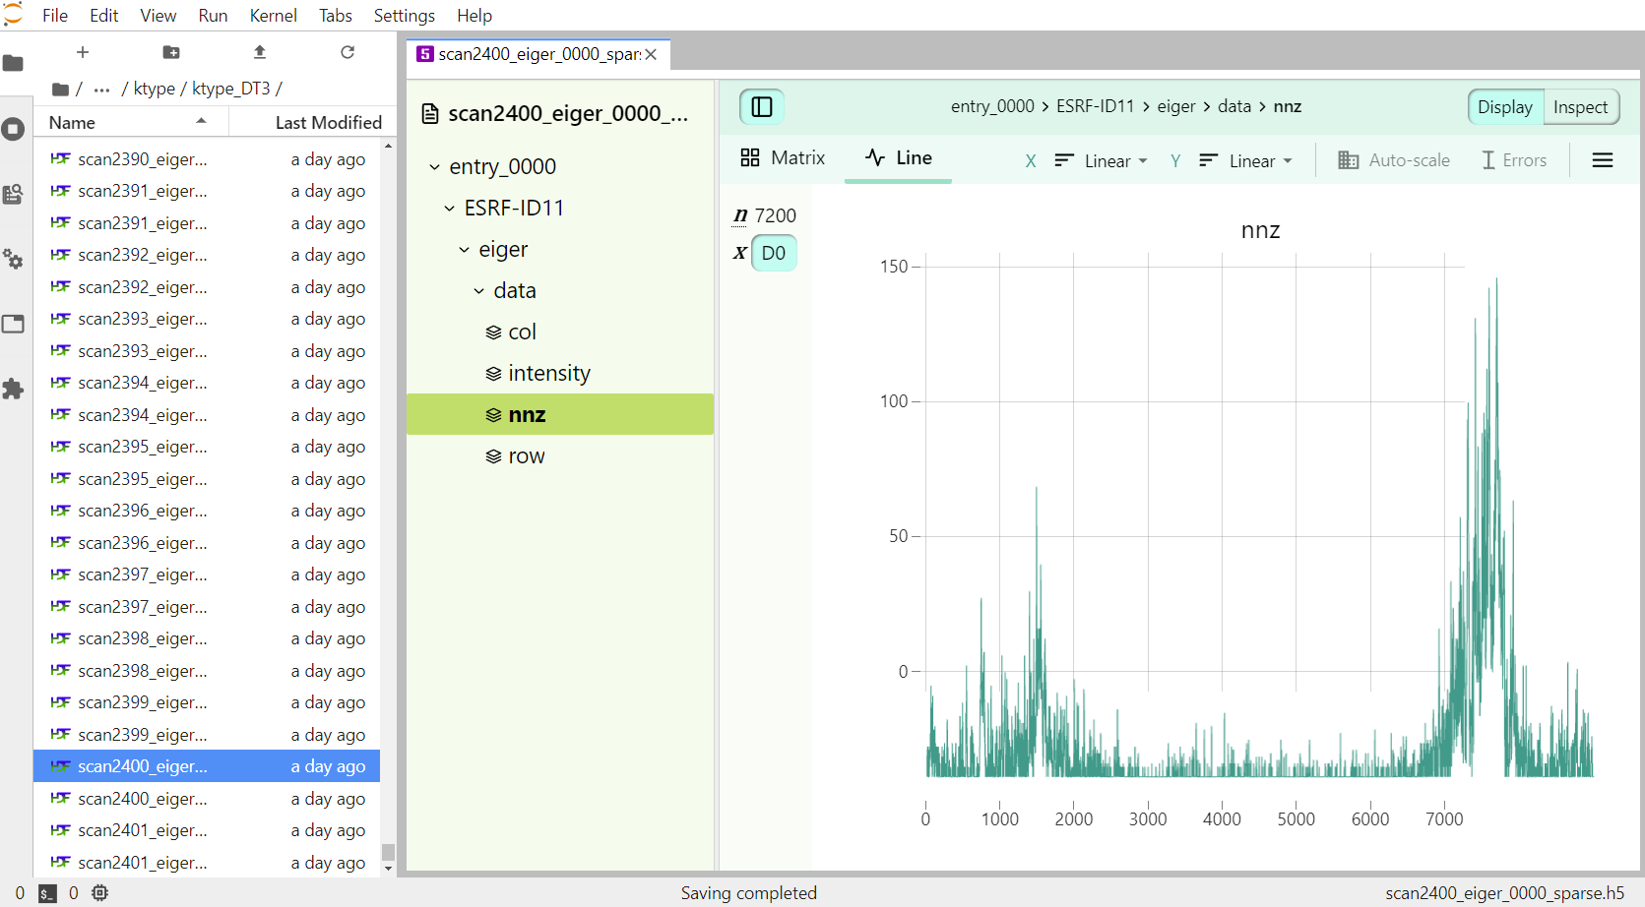
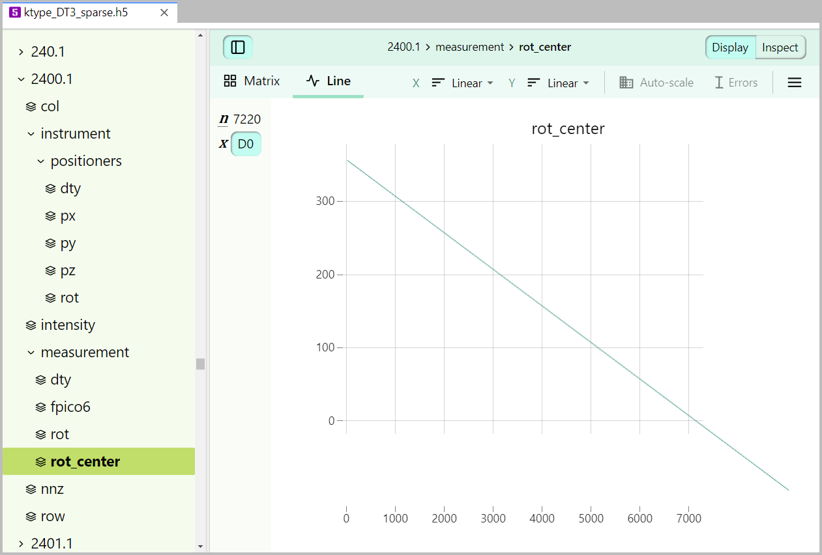
Notes:
This is what you get before merging files.
Click for next : and now with motor positions.

Slide 18
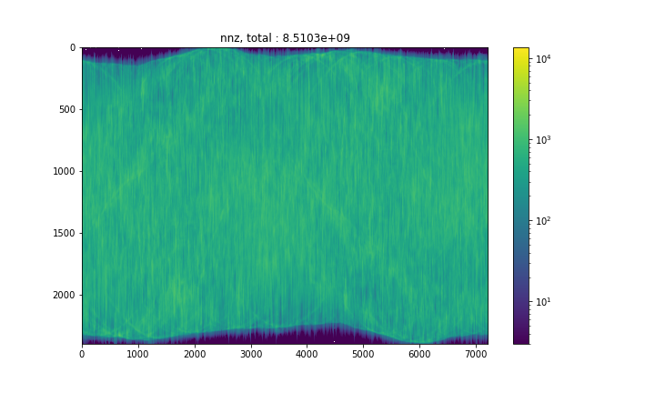
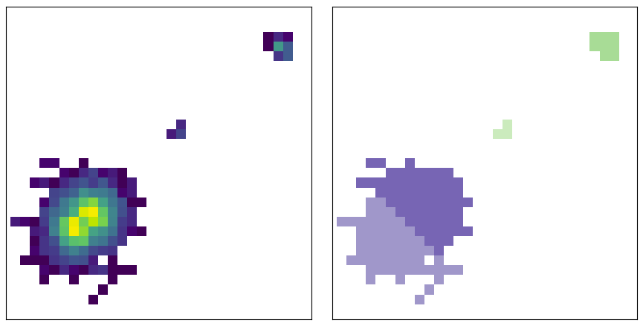
Labelling pixels
This example : ~ 8.5 Giga-pixels (sum nnz)
10 bytes / pixel (frame, row, col, value)
~ 85 GB
Peaks on 2D frames : 423 million
Uphill / local max assignment (directed graph)
Connected components (undirected graph)
Intensity
Label (uphill)
Split / overlapping peaks are common
Notes:
Keeping the pixels rather than spot positions is because you cannot figure out spots in a simple and unique way.
Also the pixels don’t take much more space than the spots.
Labelling code uses sparse array format directly (this helps as an optimization, but nasty to debug).

Slide 19
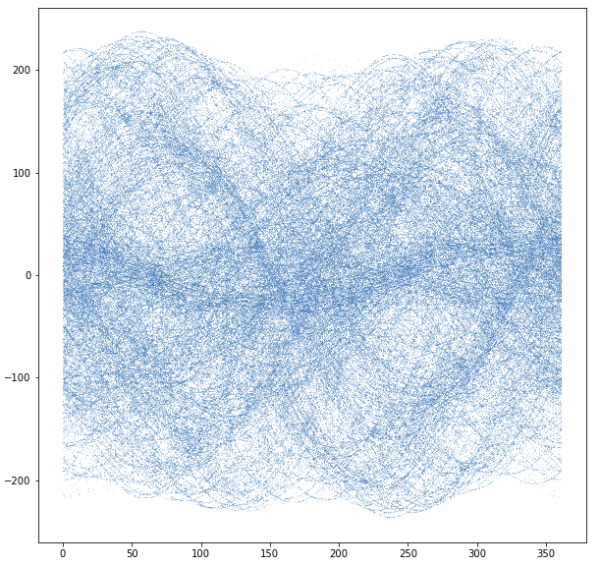
Labelling peaks across frames
Centroid
“The same” peak on adjacent frames
Connected components of a graph
On average: ~2 links per peak
… cannot pre-allocate edge list
Build sparse matrix in parallel
shared memory
OOM – crash - /dev/shm is left full !!
Angle
Notes:
Merging peaks across frames in a scan.
Same problem that I did not figure out how to create + append sparse arrays in parallel.

Slide 20
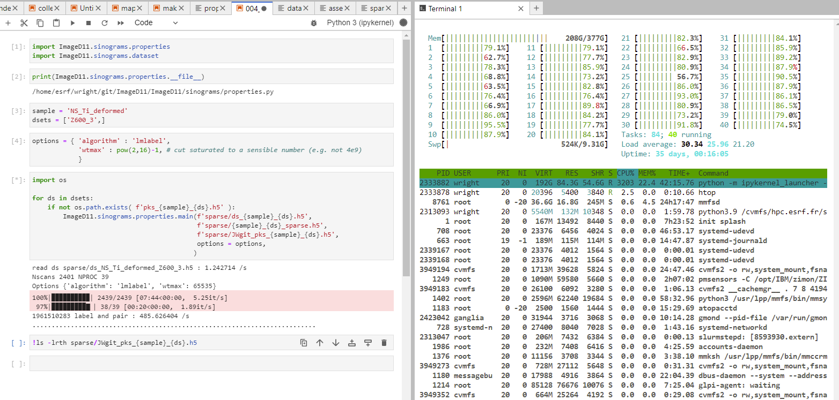
Labelling still manageable for now …
17,287,200
frames
About 35 kHz on this dataset (2D + graph)
Faster detectors coming?
Notes:
485 seconds is about 8 minutes,
17,287,200 million frames
Something like 35 kHz in labelling peaks on frames.
Total peaks found is nearly 2 billion : 1,961,510,283.

Slide 21
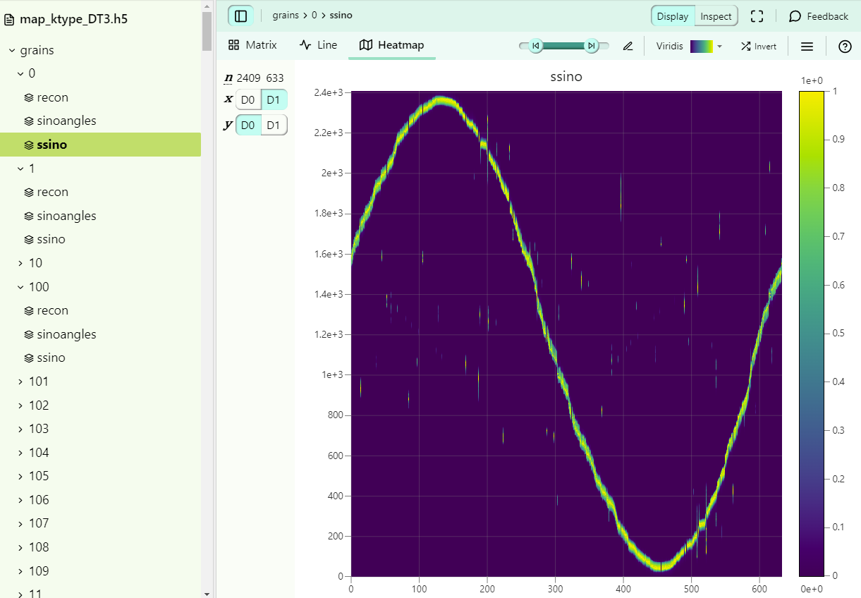
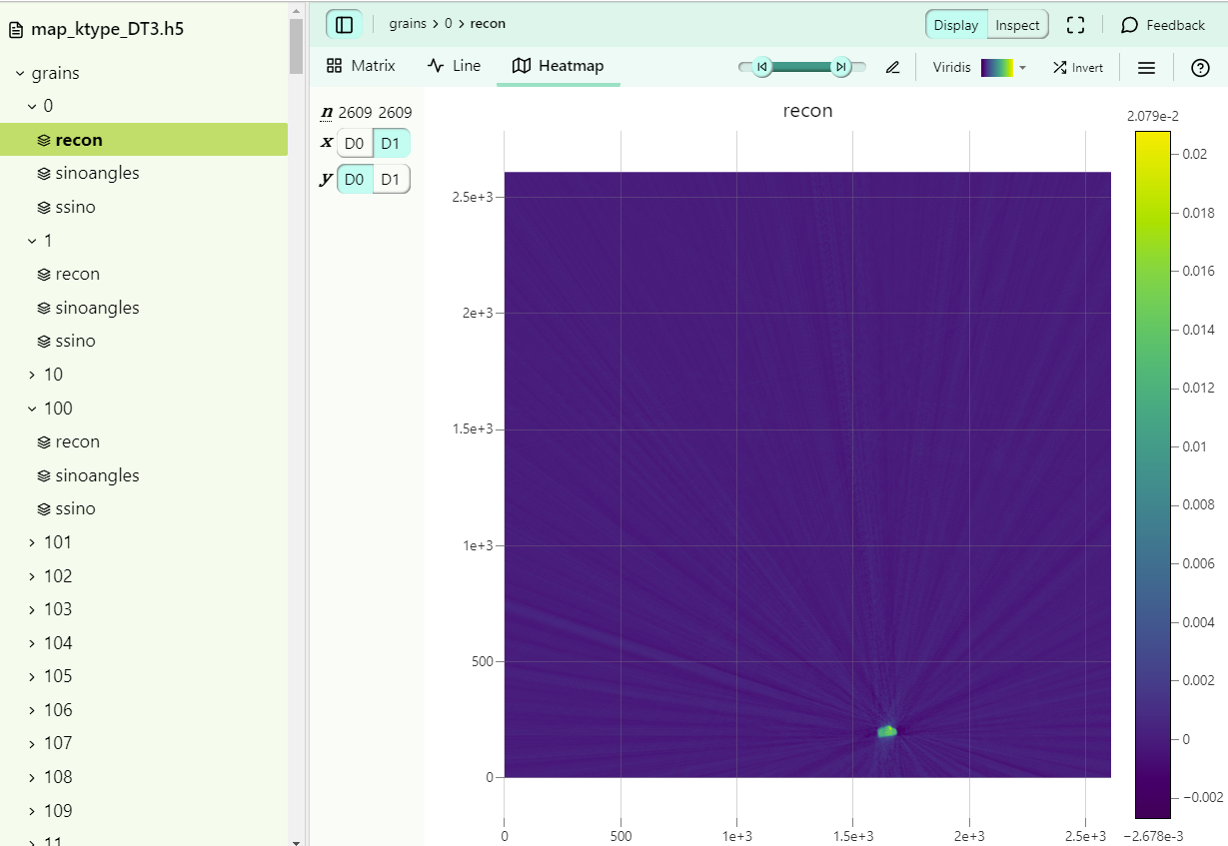
Reconstruction problem is sparse
Pixels on detector
Peak position, intensity on 2D frame
Diffraction spot projections
Crystals in the sample
“Made up formats”
Performance is often very bad !
(Future:
Structured Chunks?)
Notes:
After we find the peaks we label to diffraction spots and crystals in the sample.
The sinogram from one crystal and the reconstruction are also sparse (not used yet).
The challenge is to map from one file to the next.
Track a pixel to the grain or grains
Get back all the pixels for one grain

Slide 22
Thanks!
Expert Colleagues
Thomas Vincent
Jerome Kieffer
Emmanuel Papillon
Alejandro Homs
Sebastien Petitdemange
Marie Ruat
TID/computing team
Dectris
Kal Conley
ID11 Team
Wolfgang Ludwig
Haixing Fang
Pierre Olivier Autran
Henri Gleyzolle
Pedro Damas Resende
Scientific
collaborators
Axel Henningsson
Many patient user groups!

Slide 23
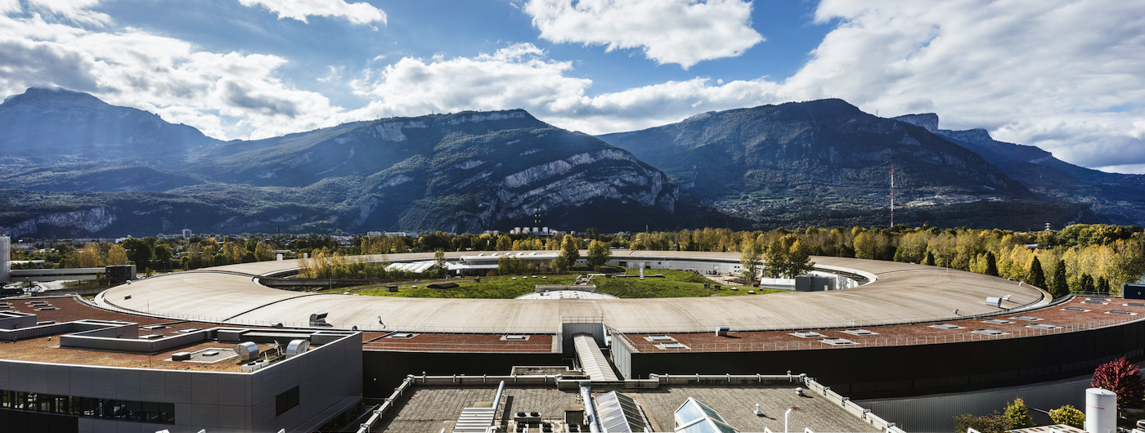
THANK YOU FOR YOUR ATTENTION
https://www.linkedin.com/posts/institutcarnotchimiebalardcirimat_pdoc-intercarnot-%C3%A0-lesrf-activity-7108378276108062720-Ktbi/

