Slide 1

Compression and data reduction in serial crystallography
M. Galchenkova, A. Tolstikova, O.M. Yefanov,
CFEL @ DESY

Slide 2
Questions will be answered
Do we need to reduce data?
What if you have to pay by yourself?
What must we consider when applying compression algorithms?
The nature of data matters
No, a quality check is crucial
Can we not evaluate data quality afterwards?
Our work showcases the application for serial crystallography
Do we have solutions?
Are they universal?
Some of them can be used in other fields

Slide 3
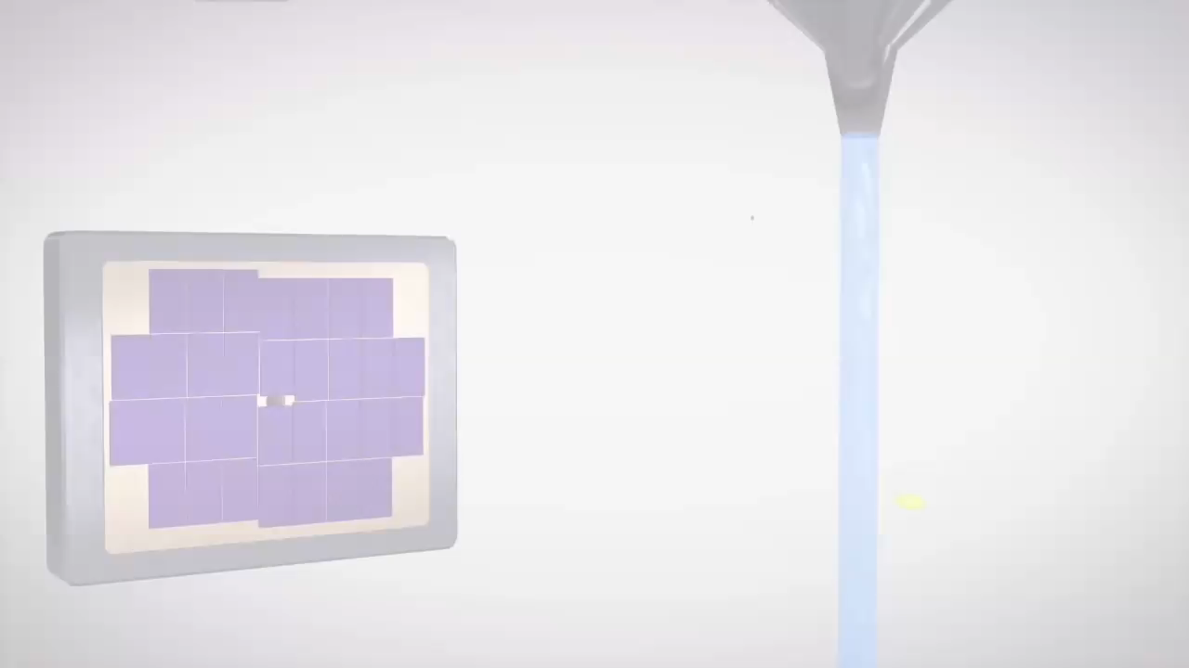

Slide 4
RAW data volume per experiment
Calculations done by O. Yefanov
LCLS (CS-PAD) from 2011:
4.6Mb * 120Hz * 3600sec * 10hours * 5days = 95Tb
PINK beam at APS (JoungFrau 1M):
2Mb * 1000Hz * 3600sec * 20hours * 5days = 860Tb
Modern synchrotron (Eiger2 XE 16M, compressed!):
16Mb * 400Hz * 3600sec * 20hours * 5days = 2.1Pb
eXFEL now (AGIPD):
(2+2)Mb * 3520Hz * 3600sec * 10hours * 5days = 2.5Pb
eXFEL soon (AGIPD 4M, 2023+):
(8+8)Mb * 3520Hz * 3600sec * 10hours * 5days = 10Pb
LCLS2 soon (ePix10k-HR, 2023+):
8.4Mb * 10000Hz * 3600sec * 10hours * 5days = 14Pb
Do we need to reduce data?
The storage costs will not let us to store all collected data

Slide 5
Possible strategies for data reduction
Lossless compression
Lossy with lossless compression
Saving the 1/2/3 significant bit/s.
Binning
Rounding with constant step (incl. integer and photon conversion)
Measuring less data
Non-hits rejection
**CR = compression rate = (uncompressed data)/(compressed data)
*Tests were performed for various detectors (CS-PAD, JungFrau, AGIPD, Eiger) and data from different facilities.
Lossless compression gives low CR,
Meanwhile lossy compression requires proper data quality check

Slide 6
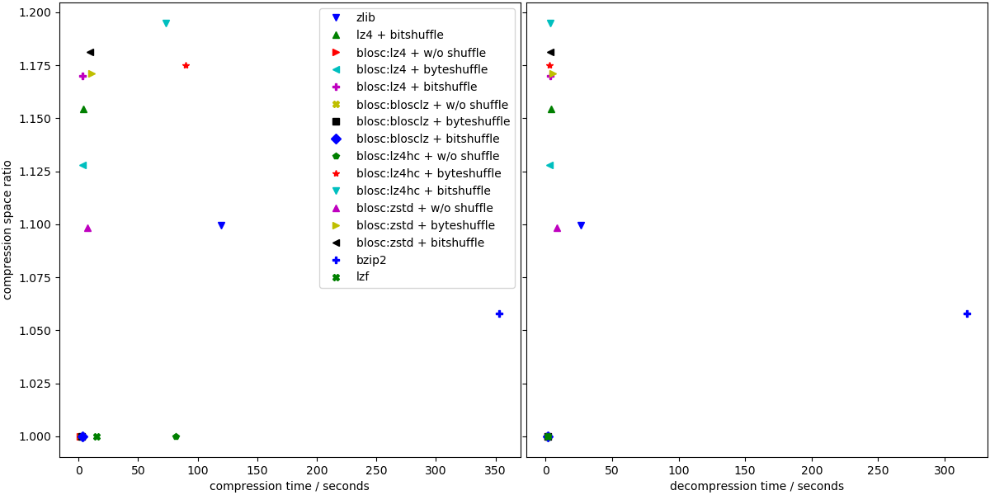
Lossless compression
 | CR | type | CR | type | CR | type | CR | type | CR | type | CR | type
Bitshuffle with lz4 | 1.103 | F32 | 3.345 | I32 | 8.25 | I32 | 3.581 | U16 | 9.939 | I32 | 7.805 | I32
Bitshuffle without lz4 | 1 | F32 | 1 | I32 | 1 | I32 | 1 | U16 | 1 | I32 | 1 | I32
Blosc,blosclz,level = 6,with bitshuffle | 1.118 | F32 | 2.837 | I32 | 6.361 | I32 | 3.571 | U16 | 10.476 | I32 | 7.897 | I32
Blosc,blosclz,level = 6,with shuffle | 1.095 | F32 | 1.88 | I32 | 3.453 | I32 | 2.194 | U16 | 8.388 | I32 | 5.325 | I32
Blosc,blosclz,level = 6,without shuffle | 1 | F32 | 2.335 | I32 | 2.091 | I32 | 1.986 | U16 | 3.781 | I32 | 2.48 | I32
Blosc,blosclz,level = 9,with bitshuffle | 1.118 | F32 | 2.837 | I32 | 6.361 | I32 | 3.571 | U16 | 10.476 | I32 | 7.897 | I32
Blosc,blosclz,level = 9,with shuffle | 1.095 | F32 | 1.927 | I32 | 3.453 | I32 | 2.267 | U16 | 8.388 | I32 | 5.325 | I32
Blosc,blosclz,level = 9,without shuffle | 1 | F32 | 2.335 | I32 | 2.091 | I32 | 1.986 | U16 | 3.781 | I32 | 2.48 | I32
Blosc,lz4hc,level = 6,with bitshuffle | 1.138 | F32 | 3.038 | I32 | 7.295 | I32 | 3.784 | U16 | 11.502 | I32 | 8.29 | I32
Blosc,lz4hc,level = 6,with shuffle | 1.156 | F32 | 2.379 | I32 | 5.181 | I32 | 2.671 | U16 | 11.453 | I32 | 6.464 | I32
Blosc,lz4hc,level = 6,without shuffle | 1 | F32 | 3.06 | I32 | 5.298 | I32 | 2.275 | U16 | 7.235 | I32 | 4.147 | I32
Blosc,lz4hc,level = 9,with bitshuffle | 1.139 | F32 | 3.044 | I32 | 7.34 | I32 | 3.788 | U16 | 11.573 | I32 | 8.303 | I32
Blosc,lz4hc,level = 9,with shuffle | 1.162 | F32 | 2.471 | I32 | 5.744 | I32 | 2.672 | U16 | 12.636 | I32 | 6.479 | I32
Blosc,lz4hc,level = 9,without shuffle | 1 | F32 | 3.285 | I32 | 6.232 | I32 | 2.371 | U16 | 8.477 | I32 | 4.707 | I32
Blosc,lz4,level = 6,with bitshuffle | 1.119 | F32 | 2.907 | I32 | 6.424 | I32 | 3.654 | U16 | 10.453 | I32 | 8.019 | I32
Blosc,lz4,level = 6,with shuffle | 1.094 | F32 | 1.889 | I32 | 3.185 | I32 | 2.313 | U16 | 7.143 | I32 | 5.243 | I32
Blosc,lz4,level = 6,without shuffle | 1 | F32 | 1.639 | I32 | 2.374 | I32 | 1.508 | U16 | 2.872 | I32 | 1.726 | I32
Blosc,lz4,level = 9,with bitshuffle | 1.122 | F32 | 2.977 | I32 | 6.683 | I32 | 3.664 | U16 | 10.572 | I32 | 8.05 | I32
Blosc,lz4,level = 9,with shuffle | 1.096 | F32 | 1.9 | I32 | 3.196 | I32 | 2.411 | U16 | 7.16 | I32 | 5.508 | I32
Blosc,lz4,level = 9,without shuffle | 1 | F32 | 1.638 | I32 | 2.374 | I32 | 1.512 | U16 | 2.872 | I32 | 1.726 | I32
Blosc,snappy,level = 6,with bitshuffle | 1 | F32 | 1 | I32 | 1 | I32 | 1 | U16 | 1 | I32 | 1 | I32
Blosc,snappy,level = 6,with shuffle | 1 | F32 | 1 | I32 | 1 | I32 | 1 | U16 | 1 | I32 | 1 | I32
Blosc,snappy,level = 6,without shuffle | 1 | F32 | 1 | I32 | 1 | I32 | 1 | U16 | 1 | I32 | 1 | I32
Blosc,snappy,level = 9,with bitshuffle | 1 | F32 | 1 | I32 | 1 | I32 | 1 | U16 | 1 | I32 | 1 | I32
Blosc,snappy,level = 9,with shuffle | 1 | F32 | 1 | I32 | 1 | I32 | 1 | U16 | 1 | I32 | 1 | I32
Blosc,snappy,level = 9,without shuffle | 1 | F32 | 1 | I32 | 1 | I32 | 1 | U16 | 1 | I32 | 1 | I32
Blosc,zlib,level = 6,with bitshuffle | 1.155 | F32 | 3.096 | I32 | 8 | I32 | 3.785 | U16 | 12.524 | I32 | 8.561 | I32
Blosc,zlib,level = 6,with shuffle | 1.281 | F32 | 3.461 | I32 | 7.918 | I32 | 3.673 | U16 | 17.007 | I32 | 8.952 | I32
Blosc,zlib,level = 6,without shuffle | 1.14 | F32 | 4.339 | I32 | 8.461 | I32 | 3.094 | U16 | 12.958 | I32 | 6.809 | I32
Blosc,zlib,level = 9,with bitshuffle | 1.156 | F32 | 3.109 | I32 | 8.144 | I32 | 3.826 | U16 | 12.732 | I32 | 8.613 | I32
Blosc,zlib,level = 9,with shuffle | 1.284 | F32 | 3.504 | I32 | 8.416 | I32 | 3.676 | U16 | 17.613 | I32 | 8.954 | I32
Blosc,zlib,level = 9,without shuffle | 1.14 | F32 | 4.244 | I32 | 9.353 | I32 | 3.126 | U16 | 13.978 | I32 | 6.989 | I32
Blosc,zstd,level = 6,with bitshuffle | 1.155 | F32 | 3.608 | I32 | 11.201 | I32 | 3.887 | U16 | 13.253 | I32 | 8.753 | I32
Blosc,zstd,level = 6,with shuffle | 1.279 | F32 | 3.453 | I32 | 8.235 | I32 | 3.841 | U16 | 17.568 | I32 | 9.409 | I32
Blosc,zstd,level = 6,without shuffle | 1.121 | F32 | 4.412 | I32 | 8.346 | I32 | 3.291 | U16 | 12.729 | I32 | 7.004 | I32
Blosc,zstd,level = 9,with bitshuffle | 1.161 | F32 | 3.63 | I32 | 11.449 | I32 | 3.943 | U16 | 13.547 | I32 | 8.855 | I32
Blosc,zstd,level = 9,with shuffle | 1.283 | F32 | 3.871 | I32 | 9.439 | I32 | 3.935 | U16 | 20.276 | I32 | 9.929 | I32
Blosc,zstd,level = 9,without shuffle | 1.193 | F32 | 5.022 | I32 | 10.972 | I32 | 3.619 | U16 | 16.87 | I32 | 8.547 | I32
bzip2,level = 6,with shuffle | 1.266 | F32 | 3.579 | I32 | 9.368 | I32 | 4.233 | U16 | 20.355 | I32 | 10.472 | I32
bzip2,level = 6,without shuffle | 1.227 | F32 | 5.918 | I32 | 12.006 | I32 | 4.209 | U16 | 19.7 | I32 | 10.352 | I32
bzip2,level = 9,with shuffle | 1.265 | F32 | 3.643 | I32 | 9.355 | I32 | 4.236 | U16 | 20.405 | I32 | 10.485 | I32
bzip2,level = 9,without shuffle | 1.235 | F32 | 5.923 | I32 | 12.029 | I32 | 4.216 | U16 | 19.752 | I32 | 10.377 | I32
gzip,level = 6,with shuffle | 1.28 | F32 | 3.448 | I32 | 7.887 | I32 | 3.726 | U16 | 17.214 | I32 | 9.233 | I32
gzip,level = 6,without shuffle | 1.14 | F32 | 4.506 | I32 | 8.465 | I32 | 3.182 | U16 | 13.077 | I32 | 6.865 | I32
gzip,level = 9,with shuffle | 1.283 | F32 | 3.504 | I32 | 8.439 | I32 | 3.729 | U16 | 18.264 | I32 | 9.243 | I32
gzip,level = 9,without shuffle | 1.14 | F32 | 4.408 | I32 | 9.542 | I32 | 3.229 | U16 | 14.427 | I32 | 7.169 | I32
lz4,nbytes0 | 1 | F32 | 1 | I32 | 1 | I32 | 1 | U16 | 1 | I32 | 1 | I32
lz4,nbytes = 16384 | 1 | F32 | 1 | I32 | 1 | I32 | 1 | U16 | 2.867 | I32 | 1.726 | I32
lz4,nbytes = 2048 | 0.998 | F32 | 1.621 | I32 | 2.335 | I32 | 1.474 | U16 | 2.824 | I32 | 1.721 | I32
lzf,with shuffle | 1.106 | F32 | 2.028 | I32 | 3.747 | I32 | 2.509 | U16 | 8.051 | I32 | 5.662 | I32
lzf,without shuffle | 1 | F32 | 2.429 | I32 | 3.162 | I32 | 2.078 | U16 | 3.951 | I32 | 2.541 | I32
zfp,reversible | 1 | F32 | 1 | I32 | 1 | I32 | 1 | U16 | 1 | I32 | 1 | I32
zstd | 1.12 | F32 | 4.41 | I32 | 6.893 | I32 | 3.276 | U16 | 10.546 | I32 | 5.97 | I32
>200 tests
CR up to 4 for int (noisy data)
CR up to 1.3 for float
Doesn’t solve the problem!
The best CR is usually Bzip2 and zstd, but gzip (lev6) is a good compromise.

Slide 7
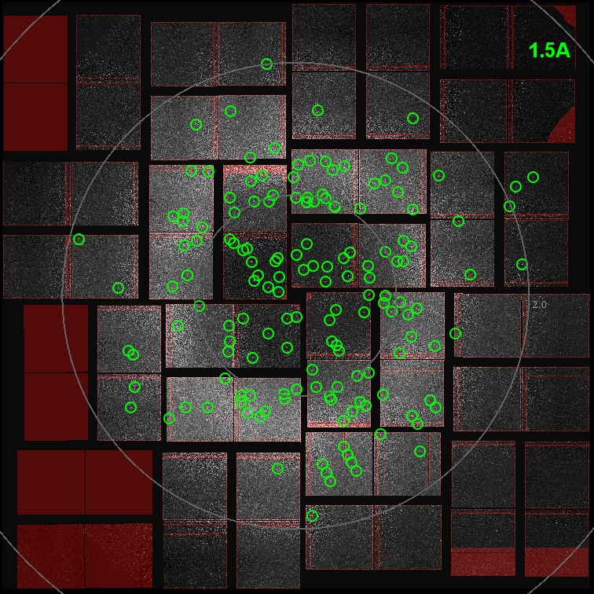
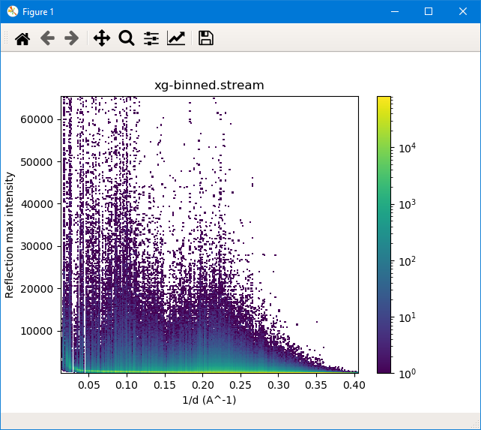
What must we consider when applying compression algorithms?
The nature of data matters
We have to deal with the sparse nature, high dynamic range, high noise level, and sharp intensity changes observed in diffraction patterns
Notes:
Typical features of the diffraction pattern:
It compromises bright and sharply defined Bragg peaks (greed circles)
It has a relatively smooth background
the sample delivery medium
disordered structure
solvent within the crystal
parasitic scattering from the beamline
The Bragg peaks at high scattering angles may be comparable to the background noise

Slide 8
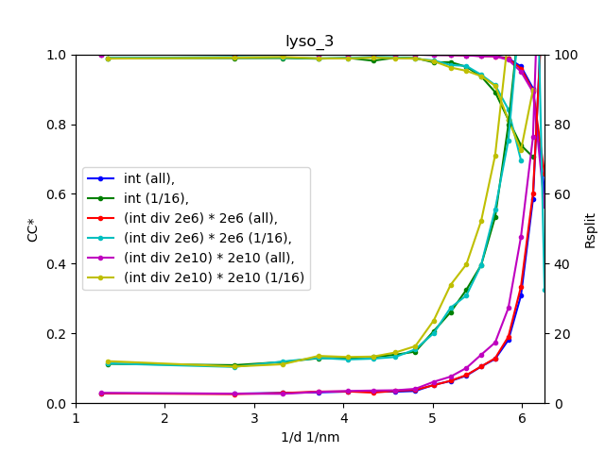
Quality check for lossy compression
Does not matter, how you reduce data,
Checking data quality is the key!
Can we not evaluate data quality afterwards?
Quality checks for SX/MX:
1. Data quality: Rsplit,CC*
2. Model quality: Rfree/Rwork
3. Anomalous signal (SAD/MAD)
4. Electron density maps
Should be not worse than original
Highly sensitive to data quality
For checking the limitation of lossy compression application
But the checks have to be done properly!
Typical errors:
Using overall CC*/Rsplit → use a plot instead (at least the last shell)
Resolution is limited by the detector → use weakly scattering data
Very good statistics for anomalous data → use a small subset (just sufficient for the pipeline to work)

Slide 9
Ultimate data reduction in SX
LCLS 2011 reprocessing
On-the-fly processing (under development)
No intermediate data is stored
Short time storage → .mtz (possible)
Reduction from 100Tb to 1Mb
Storing hits (for now the best)
Reduction from 100Tb to 1-10Tb
but only for strong datasets
data | Rwork/Rfree | Resolution, Å
Published 66k patterns | 0.196/0.229 | 1.9
Reprocessed 66k patterns | 0.172/0.195 | 1.51
Reprocessed from raw 108k | 0.168/0.189 | 1.49*
*it is the detector corner limit
Why do we need to store hits?

Slide 10
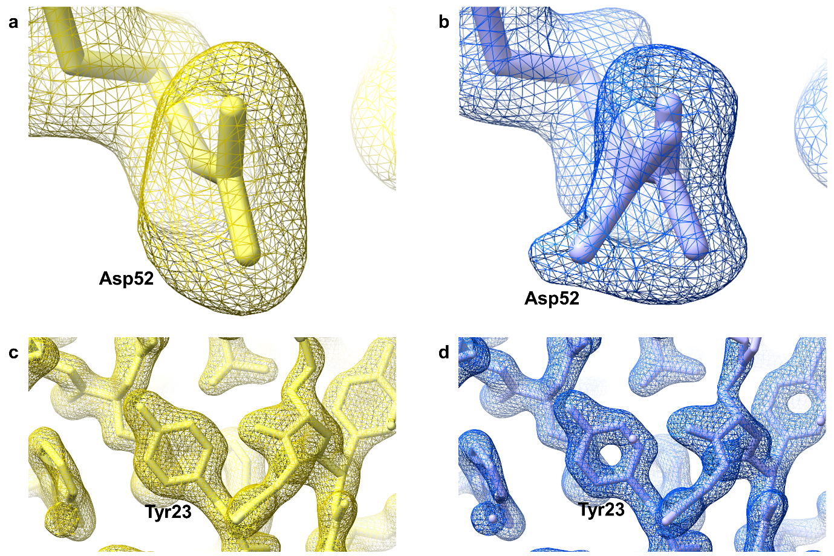
Electron density
We have some solutions, but
can we compress even better?
Old
New

Slide 11
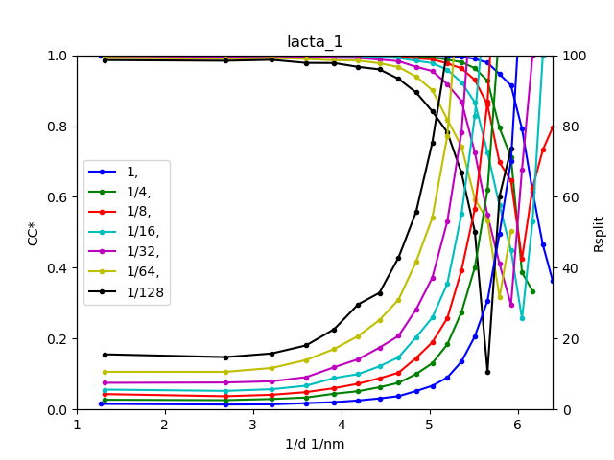
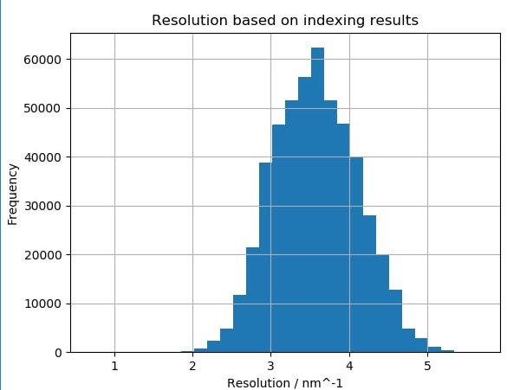
Measuring less
Best per pattern resolution
2.0A
Max resolution
1.58A
The resolution cutoff was 1.81Å
Saving only found peaks – also a bad idea!
Refinement by D. Oberthuer
Less data – worse quality

Slide 12
But why cannot we store only found peaks?
From Gati, et al, PNAS 114(9), 2017

Slide 13
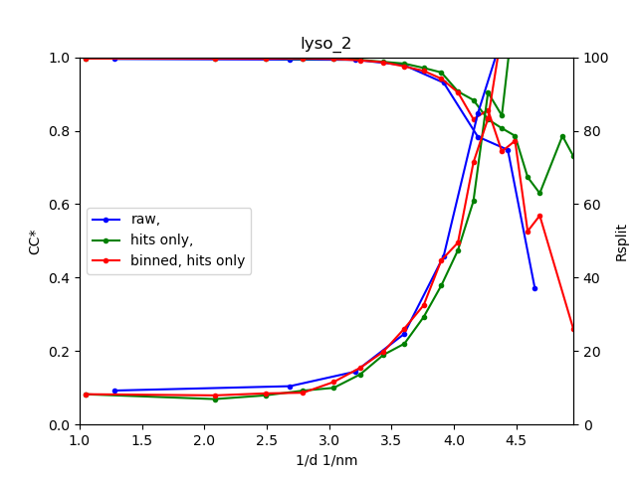
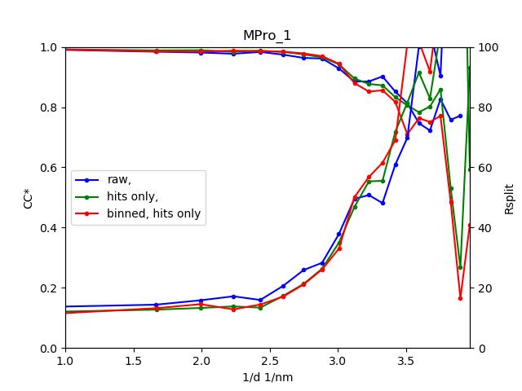
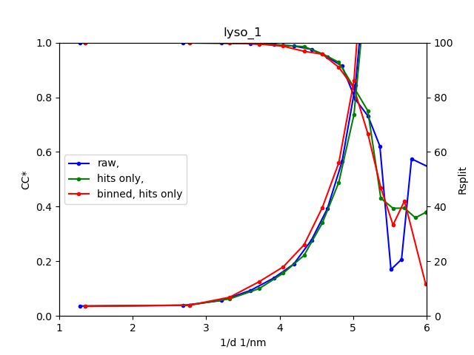
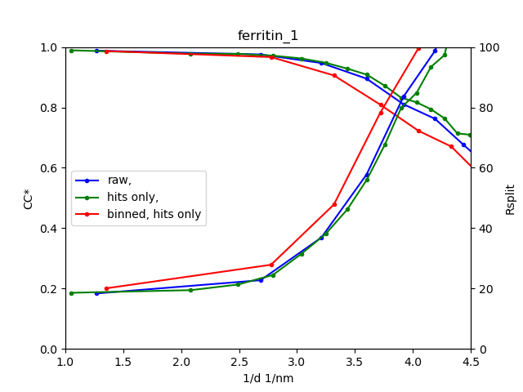
Binning (2x2) and non-hits rejection data from Eiger 16M
Subset of sample | Raw, only hits | Binned, only hits
 | CR | CR
ferritin_1 | 66.08 | 105.32
lyso_1 | 5.25 | 12.22
MPro_1 | 19.73 | 90.21
lyso_2 | 1.35 | 3.06
lacta_1 | 1.06 | 2.74
We can binn data if the spacing between Bragg peaks at least 5 pixels

Slide 14
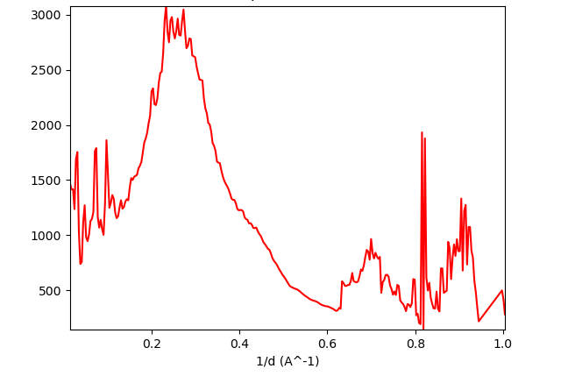
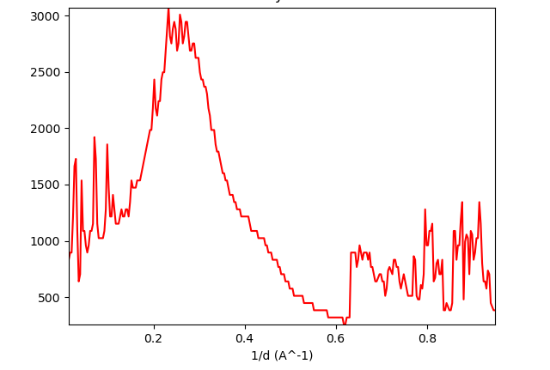
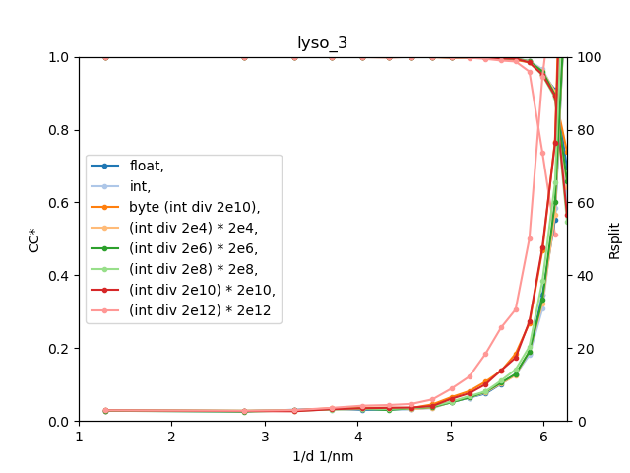
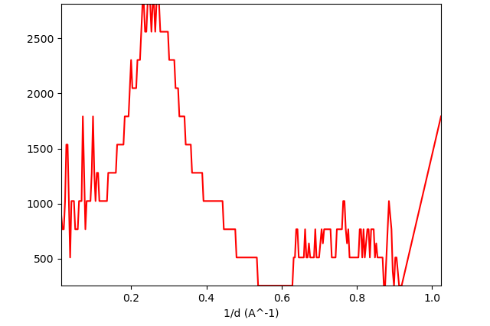
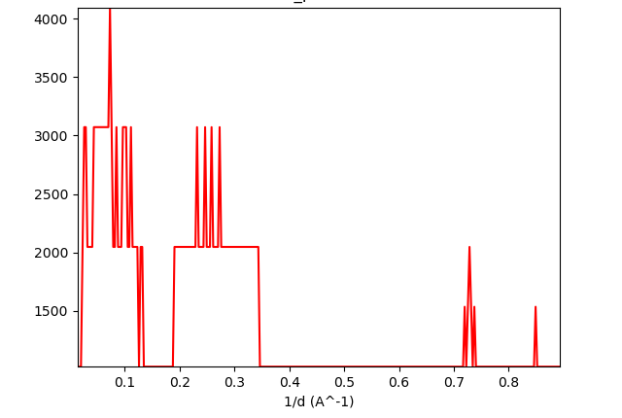
Quantization to different levels
(AGIPD dataset)
int
(int div 2e6) * 2e6
(int div 2e8) * 2e8
(int div 2e10) * 2e10
Even this crap still works (thanks to statistics)!
Truncating to several photons can work, but it is not applicable all the time

Slide 15
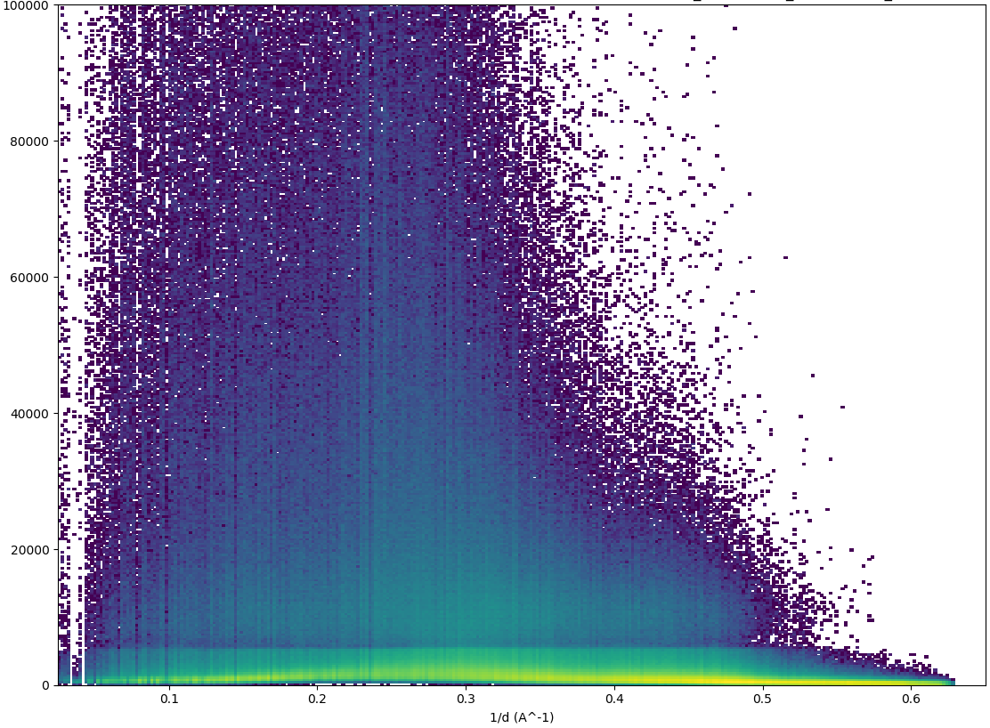
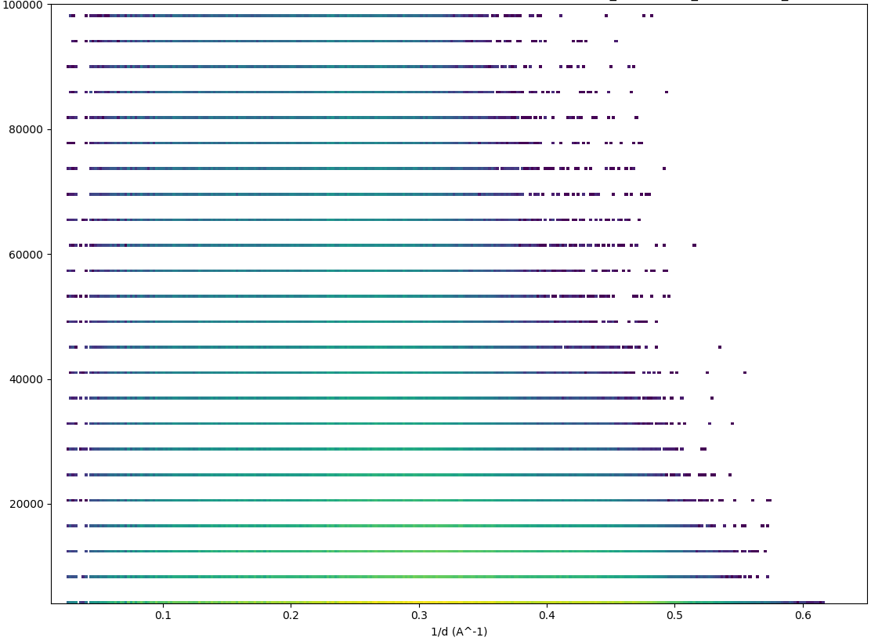
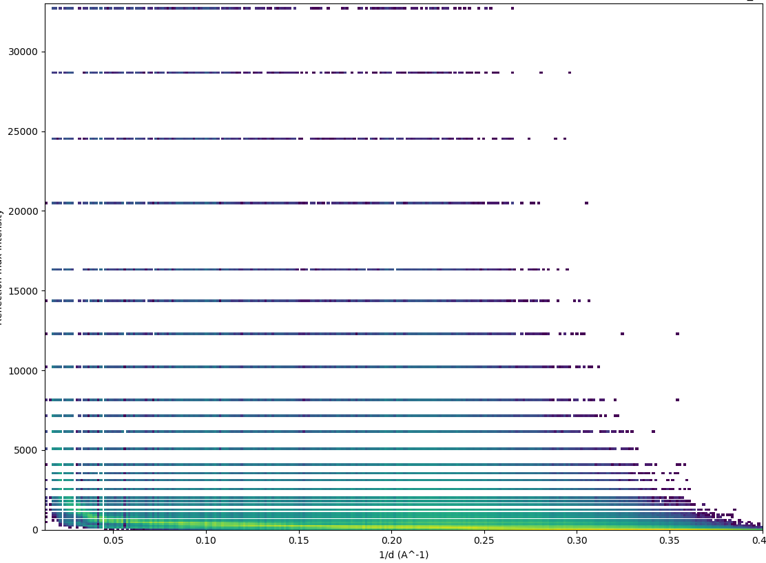
Non-uniform quantization
Original Uniform quantization Non-uniform quantization
The easiest way – save just a few significant bits!
Low intensity data is more important
Example: multi-gain detectors

Slide 16
Initial number
Binary representation of the initial number
Binary representation of the resulting number
8-bit floating-like representation
Resulting
number
8
1
0
1
0
1
0
0
0
1
0
1
0
1
0
0
0
0
0
0
0
1
1
1
0
1
8
0
8
7
0
1
0
1
0
1
1
1
0
1
0
1
0
0
0
0
0
0
0
1
1
1
0
1
8
0
8
8
0
1
0
1
1
0
0
0
0
1
1
0
0
0
0
0
0
0
0
1
1
1
1
0
9
6
2
5
8
0
1
0
0
0
0
0
0
1
0
0
1
0
0
0
0
0
0
0
0
0
0
1
0
0
1
0
0
2
5
6
1
3
1
6
0
1
0
1
0
0
1
0
0
1
0
0
0
0
1
0
1
1
0
1
1
2
8
0
1
4
5
0
0
1
0
1
1
0
1
0
1
0
1
0
0
0
1
0
1
1
1
0
1
5
3
6
Do we need to store all bits?
In this way 3.5 bits are store
The best way to implement – HDF5 plugin.

Slide 17
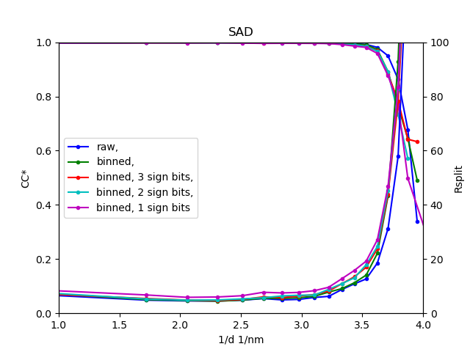
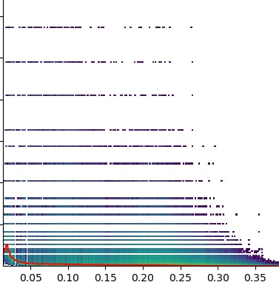
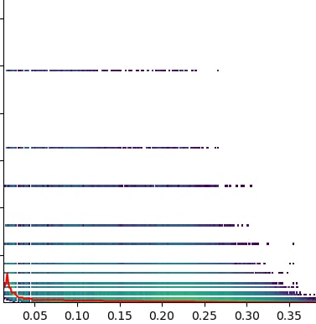
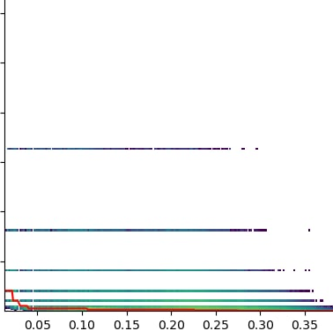
Anomalous dataset for lossy compression evaluation
Type | Rwork/Rfree | N. of residues | CR | CR after 8bit compressor
raw | 0.2232/0.2821 | 209 | 1 | -
binned | 0.2165/0.2831 | 208 | 5 | -
binned, 3 sign bits | 0.2379/0.2993 | 205 | 32.2 | 36.3
binned, 2 sign bits | 0.2700/0.3337 | 205 | 38.8 | 45.1
binned, 1 sign bit | 0.5314/0.5514 | 181 | 49 | 59.3
binned
binned, 3 sign bits
binned, 2 sign bits
binned, 1 sign bits
For proper evaluation of your compression technique, use the data sensitive to any distortions
Data from Nass, Karol, et al., IUCrJ 7.6 (2020): 965-975. (JF 16M, SwissFEL)

Slide 18
What has been done already?
Conferences, workshops, discussions
User Meeting at EuXFEL (poster 2021, poster and talk 2022)
LCLS User Meeting (poster 2021)
BioEXFEL 9th International Conference (2022 poster)
SRI (poster 2022), CDCS workshop (poster 2022)
local meeting with DA groups from EuXFEL and LCLS (February, 2022)
Apply lossy compression (non-hits rejection and/or binning) at P11, Petra III (SX) -> check data quality ->
delete raw data and substitute it with reduced data!
26.11.2020 (11010575): 89Tb -> 34Tb: CR ≈ 2.62 (no binning, only hits)
25.03.2021 (11010929): 116Tb -> 18Tb : CR ≈ 6.44 (binning, only hits)
07.07.2021 (11010938): 95Tb -> 13Tb : CR ≈ 7.31 (binning, only hits)
16.09.2021 (11010507): 130Tb to 23Tb: CR = 5.87 (binning, only hits)
Multiple experiments with pink beam and JF detector at ESRF and APS
RAW data was not even backed up to tape!

Slide 19
Conclusions
Modern detectors generate too much data to store
But old data can be still useful
Lossless compression not enough: up to 4 (int) and 1.3 (float)
Non-hits are not needed if enough strong hits are present. But hits should be stored in “raw” format for future improvement
Many Mpix detectors are not always needed, so some data can be binned (more than 10pixels between Bragg peaks are usually useless)
SX is more sensitive to the number of measurements than the precision, so quantization can be used
Additional lossless compression has to be be applied
Data quality has to be carefully checked!
Not recommended: “measuring less” and “storing only peaks”

Slide 20
Acknowledgements
Alexandra Tolstikova
Bjarne Klopprogge
Janina Sprenger
Dominik Oberthuer
Wolfgang Brehm
Thomas A. White
Anton Barty
Henry N. Chapman
Oleksandr M. Yefanov
Yaroslav Gevorkov
Valerio Mariani
Karol Nass
Dmitry Ozerov
Thank you!

Slide 21




Data quality metrics
CC* measures the correlation between measured data and hypothetical noise-free signal. Values close to 1 indicate good agreement.
Rsplit evaluates the agreement between two halves of the dataset merged independently. Lower values around 0.05 indicate higher precision.
Rfree measures how well the model predicts a subset of data not used in refinement. Lower values mean better agreement between model and data.
Rwork measures how well the refined model fits the measured data. Lower values indicate a better fit between observed and calculated data.
Notes:
Since we want to check whether masking does not make things worse, we need to check the quality somehow. There are many figures of merit that can be used to check data quality at the different steps of the processing pipeline, for example: СС*, Rsplit, Rwork and R free and many others. In this studies we focused only on this metrics. Each metric is applicable for a specific step of data processing. Here on this slide you can see the formula for this metrics.
СС* is Coefficient derived from CC1/2 in order to estimate the correlation of the merged dataset with the true intensities using the assumption that errors in the subsets are random. R-values measure the agreement between observed and calculated structure factors moduli. CC1\2 is Pearson correlation coefficient.

Slide 22
Initial number
Binary representation of the initial number
Binary representation of the resulting number
8-bit floating-like representation
Resulting
number
8
1
0
1
0
1
0
0
0
1
0
1
0
1
0
0
0
0
0
0
0
1
1
1
0
1
8
0
8
7
0
1
0
1
0
1
1
1
0
1
0
1
0
0
0
0
0
0
0
1
1
1
0
1
8
0
8
8
0
1
0
1
1
0
0
0
0
1
1
0
0
0
0
0
0
0
0
1
1
1
1
0
9
6
2
5
8
0
0
0
1
0
0
0
0
0
0
1
0
0
0
0
1
0
0
0
0
0
0
0
0
0
0
1
0
0
1
0
0
2
5
6
1
3
1
6
0
1
0
1
0
0
1
0
0
1
0
0
0
0
1
0
1
1
0
1
1
2
8
0
1
4
5
0
0
1
0
1
1
0
1
0
1
0
1
0
0
0
1
0
1
1
1
0
1
5
3
6
Do we need to store all bits?

