Slide 1


eHUG 2023:
HDF Compression for Data Service Architectures
John Readey
jreadey@hdfgroup.org

Slide 2
Overview
Overview of HSDS
Importing HDF5 files
Compression in HSDS
Demo
Conclusions & Next Steps
Questions

Slide 3
HDF5 for the Cloud
The HDF5 library has been around 20+ years, but is not optimized for cloud-native applications
  Expects to access a filesystem (doesn’t work well with object storage)
  No remote API
  No way to scale beyond one-thread/one-process (other than using MPI)
  No support for multi-writer/multi-reader

Slide 4
Cloud Storage Models
AWS S3 (or Azure Blob Storage, or Google Cloud Store) is natural choice for large data collections
  Redundant
  Can be accessed by multiple clients (compared with EBS Volumes)
  Pay as you go pricing (pay for just what you use)
  Low Cost – Compare 500 TB for one month:
    S3 - $11K
    EBS (EC2 attached volume, non-ssd) - $23K
    EBS (EC2 attached volume, ssd) - $51K
    EFS (sharable Posix compatible storage) - $41K

Slide 5
S3 Challenges for HDF5 data
HDF5 Library either doesn’t work at all (for writing) or can be very slow (for reading)
  Library was designed assuming POSIX compatibility & low latency
  I/O operations for read can read small blocks of data at random locations
    Latency Costs add up
    Writing to S3 requires entire file to be updated (not practical for files of any size)
Best throughput with S3 is with ~ 16 inflight requests with relatively large sizes
These considerations led us to develop an entirely paradigm for persisting HDF5 data – the HDF object storage schema

Slide 6
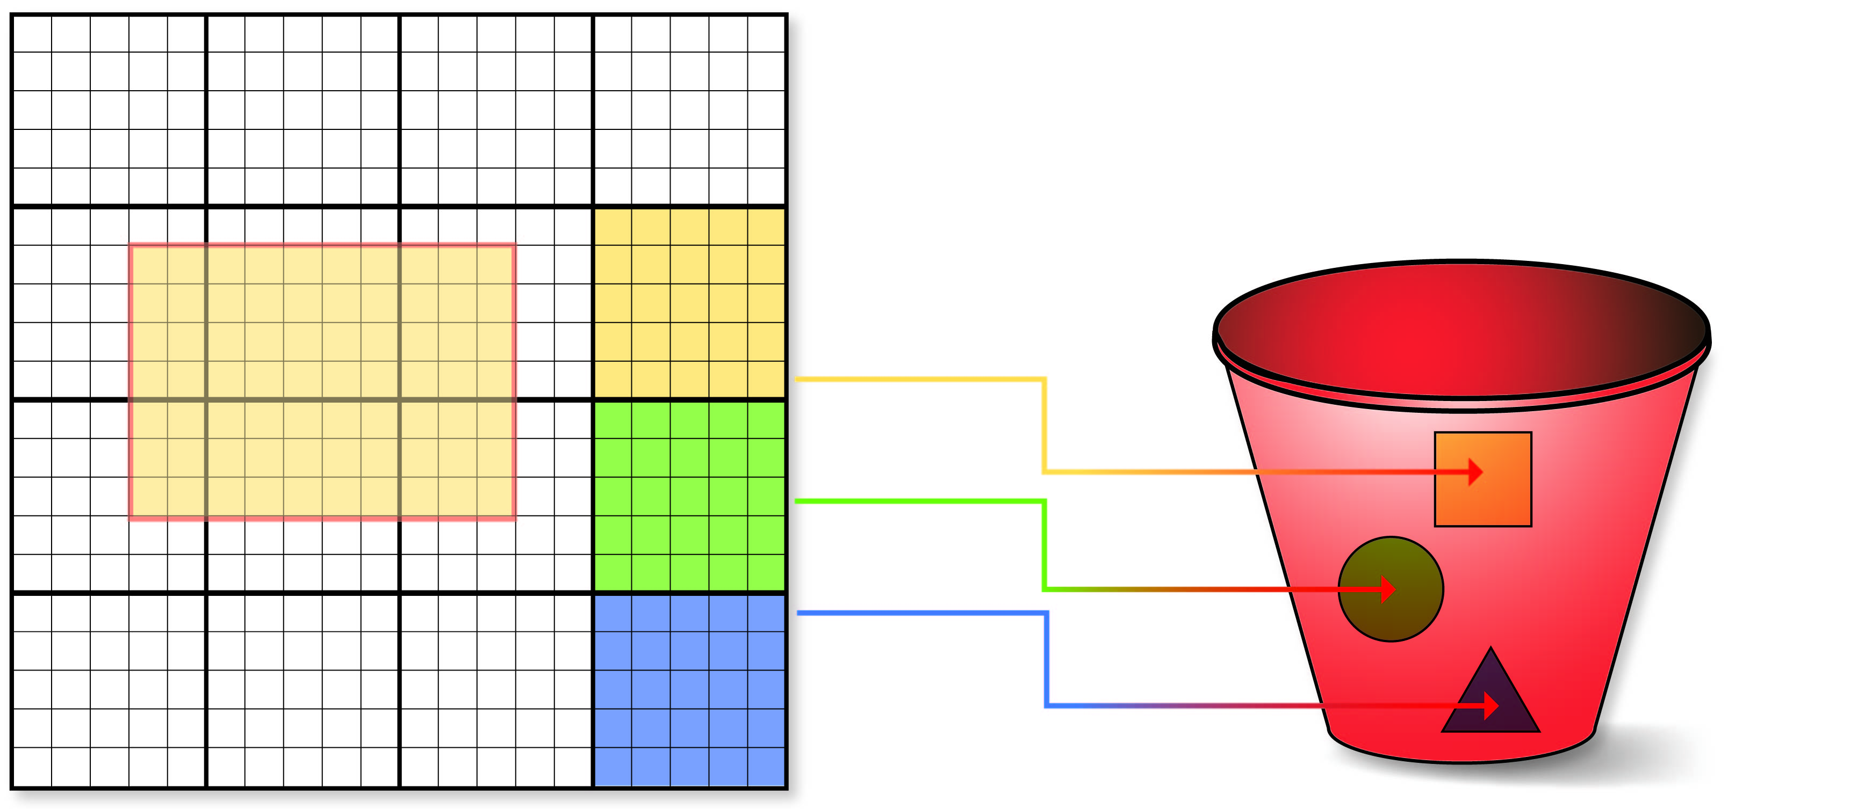



HDF Cloud Native Schema
Big Idea: Map individual HDF5 objects (datasets, groups, chunks) as Object Storage Objects
Why a sharded data format?
Limit maximum size of any object
Support parallelism for read/write
Only data that is modified needs to be updated
Multiple clients can be reading/updating the same “file”
Don’t need to manage free space
Each chunk (heavy outlines) get persisted as a separate object
Legend:
Dataset is partitioned into chunks
Each chunk stored as an object (file)
Dataset meta data (type, shape, attributes, etc.) stored in a separate object (as JSON text)

Slide 7
Sharded format example
root_obj_id/
group.json
obj1_id/
group.json
obj2_id/
dataset.json
0_0
0_1
obj3_id/
dataset.json
0_0_2
0_0_3
Observations:
Metadata is stored as JSON
Chunk data stored as binary blobs
Self-explanatory
One HDF5 file can translate to lots of objects
Flat hierarchy – supports HDF5 multilinking
Can limit maximum size of an object
Can be used with Posix or object storage
Schema is documented here: https://github.com/HDFGroup/hsds/blob/master/docs/design/obj_store_schema/obj_store_schema_v2.md

Slide 8
Introduction to HSDS
While it's possible to read/write the storage format directly, it's easier and more performant to use the HSDS (Highly Scalable Data Service). A REST based service for HDF.
Note: in addition, there are serverless options for accessing the cloud native format, but we'll focus on HSDS for this talk
Software is available at: https://github.com/HDFGroup/hsds

Slide 9
Server Features
Simple + familiar API
  Clients can interact with service using REST API
  SDKs provide language specific interface (e.g. h5pyd for Python)
  Can read/write just the data they need (as opposed to transferring entire files)
  Support for compression
Container based
  Run in Docker or Kubernetes
Scalable performance:
  Can cache recently accessed data in RAM
  Can parallelize requests across multiple nodes
  More nodes ➔ better performance
  Cluster based – any number of machines can be used to constitute the server
  Multiple clients can read/write to same data source
  No limit to the amount of data that can be stored by the service

Slide 10
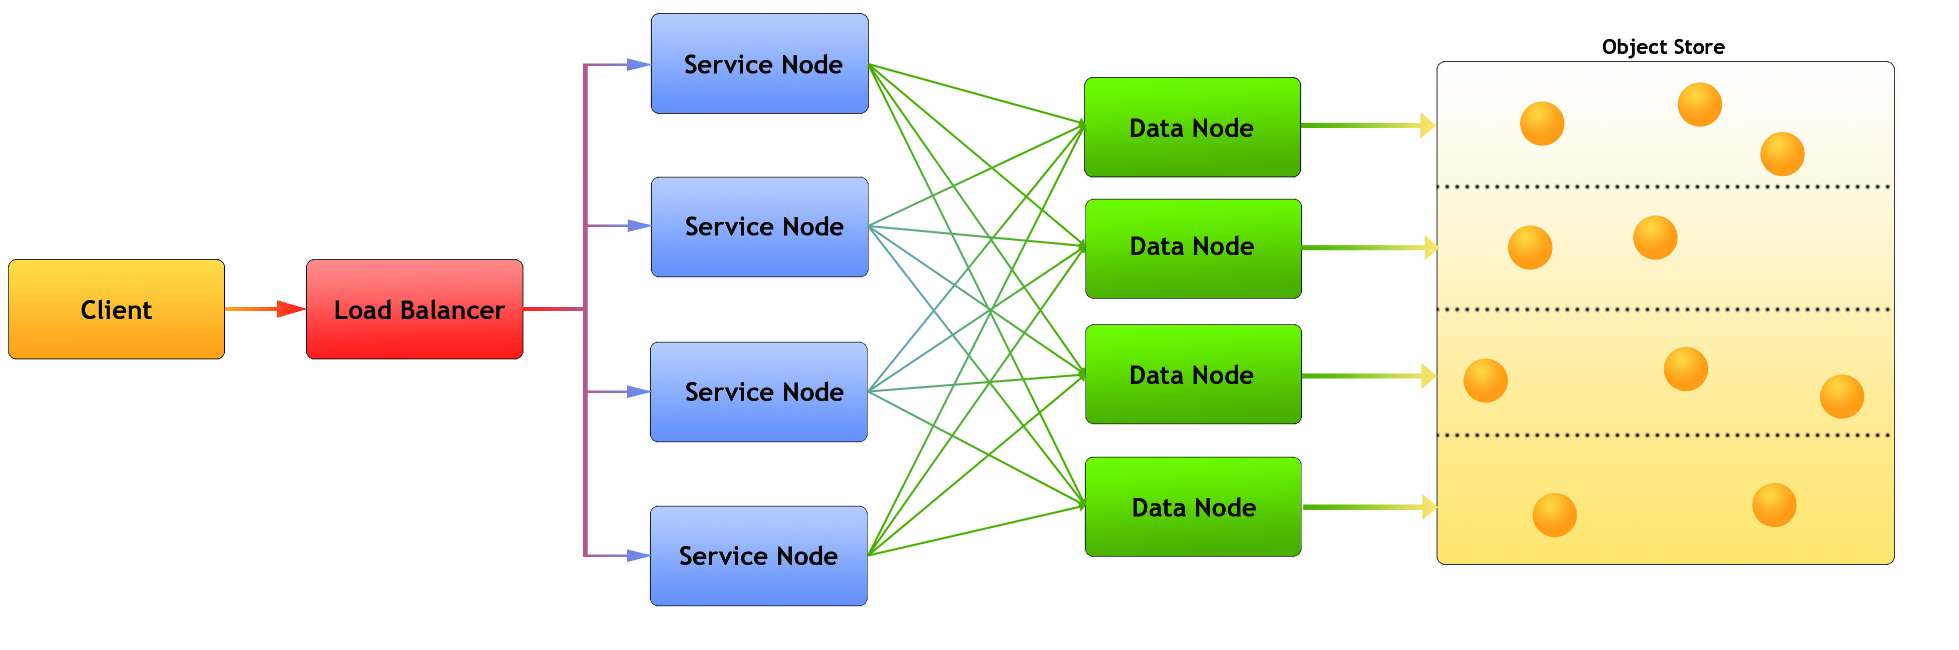
Architecture
Legend:
Client: Any user of the service
Load balancer – distributes requests to Service nodes
Service Nodes – processes requests from clients (with help from Data Nodes)
Data Nodes – responsible for partition of Object Store
Object Store: Base storage service (e.g. AWS S3)
Notes:
Each node is implemented as a docker container

Slide 11










HSDS Platforms
HSDS can be run on most container management systems:
Using different supported storage systems:
POSIX Filesystem

Slide 12
Accessing HSDS
REST API
  Language neutral
  Support parallel and async
H5pyd
  Python 3.8 and up
  Compatible with h5py
  No parallel/async support
HDF5 Library + REST VOL
  C/C++
  Parallel ops via H5DRead/Write multi call

Slide 13
Command Line Interface (CLI)
Accessing HDF via a service means one can’t utilize usual shell commands: ls, rm, chmod, etc.
Command line tools are a set of simple apps to use instead:
  hsinfo: display server version, connect info
  hsls: list content of folder or file
  hstouch: create folder or file
  hsdel: delete a file
  hsload: upload an HDF5 file
  hsget: download content from server to an HDF5 file
  hsacl: create/list/update ACLs (Access Control Lists)
  Hsdiff: compare HDF5 file with sharded representation
Implemented in Python & uses h5pyd
Note: data is round-trip-able:
  HDF5 File -> hsload -> HSDS store -> hsget -> (equivalent) HDF5 file

Slide 14
Enabling HSDS access to HDF5 files
Using hsload, HDF5 files can be transcoded to sharded schema
  Will need roughly same amount of storage as original file(s)
  Multiple files can be aggregated into one HSDS "file"
  Chunk shape will be optimized for cloud access (1-4 MB/per chunk)
  Compression filter can be changed at load time
To save time and extra storage costs, use "hsload –link". This will copy just the metadata and create pointers to each chunk in the source file. The storage needed for metadata is typically <1% of the overall file size
When chunk data is needed, HSDS sends a "rangeget" request to the storage system
  Read a contiguous set of bytes from the file

Slide 15

Chunk Linking
.
HSDS Domain
HDF5 File
Dataset Metadata
0
1
Rangeget Requests
2
3

Slide 16
Compression in HSDS
Dataset metadata defines filters and filter options to be used
No dynamic filter plugins – set of available filters defined at build time
  Blosclz, lz4, lz4hc, gzip, zstd, shuffle
DN process applies compression filters on each chunk as read/written
Compression is run in parallel
  one active compression operation per DN at any one time
  N threads per compression (set by blosc_nthreads, default: 2)
Recommendation: Run number of DN processes equal to number of cores
  Gives best utilization of CPU

Slide 17
Compression with variable length data
HSDS doesn't use a heap for variable length data
Rather chunks of variable length types are stored as:
  4 byte int giving the number of bytes of the first element
  First element
  4 byte int giving number of bytes for second element
  Etc.
Resulting buffer can be compressed like any other chunk
Dset[0] = 'h5'
Dset[1] = … (10 bytes)
02 | 00 | 00 | 00 | 69 | 35 | A0 | 00 | 00 | 00

Slide 18
HSDS Chunk Cache
Un-compression (and fetch from storage) can be avoided when chunk is cached
HSDS Chunk Cache is a LRU mem-cache of uncompressed chunks
Default size is 128 MB per DN (but can be made larger as desired)
Differs from HDF5 Lib Chunk Cache in that:
  Cache items persisted between file opens
  Cache items shared among all clients
Selection requests can be 2-4 x faster when all chunks required are cached

Slide 19
HTTP Compression
Dataset compression settings don't affect how bytes are transferred between client and server
HTTP Compression is a standard protocol for decreasing bandwidth in http requests
Applies gzip compression on each http response body
Can be enabled in HSDS by setting "http_compression" config to true
Esp. useful if you expect to see a lot of easily compressed data (e.g. sparse dataset sets)

Slide 20
Demo

Slide 21
Conclusions
  HSDS filters compatible with HDF5 Lib
  Provides standard HDF5 filters plus blosclz, zstd, etc.
  Parallel compression by design
  All compression code defined in one place – the server
  Support for compression of variable length types
  HTTP Compression might be useful – test with your specific workload
  HSDS Chunk cache really speeds things up!
    Unlike library chunk cache it's shared among all clients and persistent
    For applications with a fixed working set, would be useful to configure HSDS to keep most data cached

Slide 22
Next Steps
Add additional filters – e.g. bitshuffle
  PR's welcome!
Auto-tune logic similar to BTune?
  Have HSDS use idle time to experiment with best compression method
GPU-based compression

Slide 23
Questions?

Slide 24
Acknowledgement
This work was supported by NASA contract: 80NSSC22K1744

