Slide 1
EvalSpek-ML
Disassembling linear combinations into their constituent parts

Slide 2
Overview
Overview of EvalSpek-ML
Generation of the Spectra
  PGAA
  Crystallography
Available Data
ML-Approach and Results
  Linear Regression
  Random Forest
  Feed-Forward Network
  1D-Convolutional Network
Outline for PGAA
Outline General
Q&A

Slide 3
Goals of EvalSpek-ML
Automatisation:
  Robust and efficient evaluation of spectral data
Interpretability:
  Showcasing the relevant decision criteria for the analysis and uncertainties
Generalisation:
  Adaptability to other measurement techniques
Reuse:
  Building on existing knowledge and providing the the software, training data and trained networks
Notes:
High-Performance Data Analysis: Addressing the challenges in analyzing spectra and similar measurement data from modern research infrastructures (FIS).
Automated Evaluation: Developing methods for automated evaluation of spectral data sets across various physical measurement techniques (e.g., X-ray or neutron diffraction, neutron spectroscopy, elemental analysis using nuclear radiation, astrospectroscopy).
Machine Learning (ML) Integration: Utilizing ML to manage the complexity of large parameter spaces in spectral analysis.
Generic ML Approach: Establishing a generic ML framework adaptable to multiple techniques and extendable to other measurement methods.

Slide 4
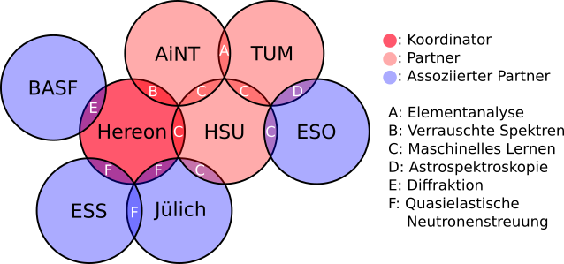
EvalSpek-ML Partners

Slide 5
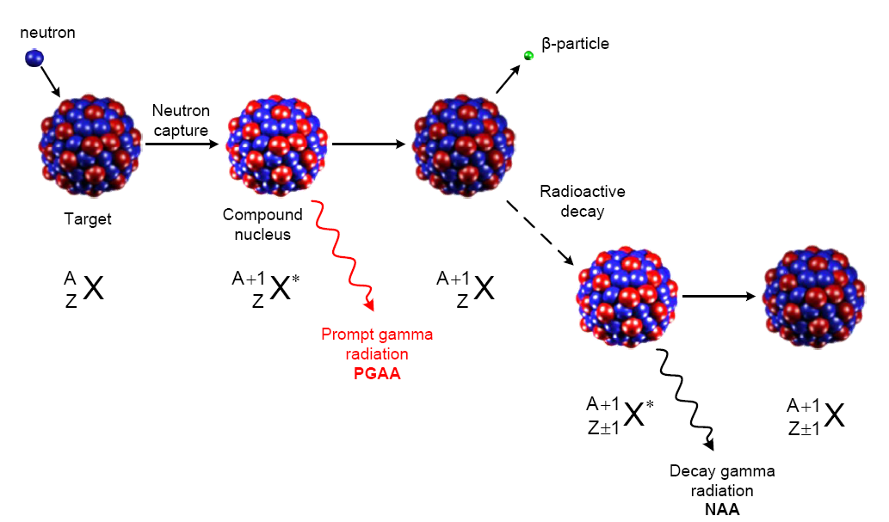
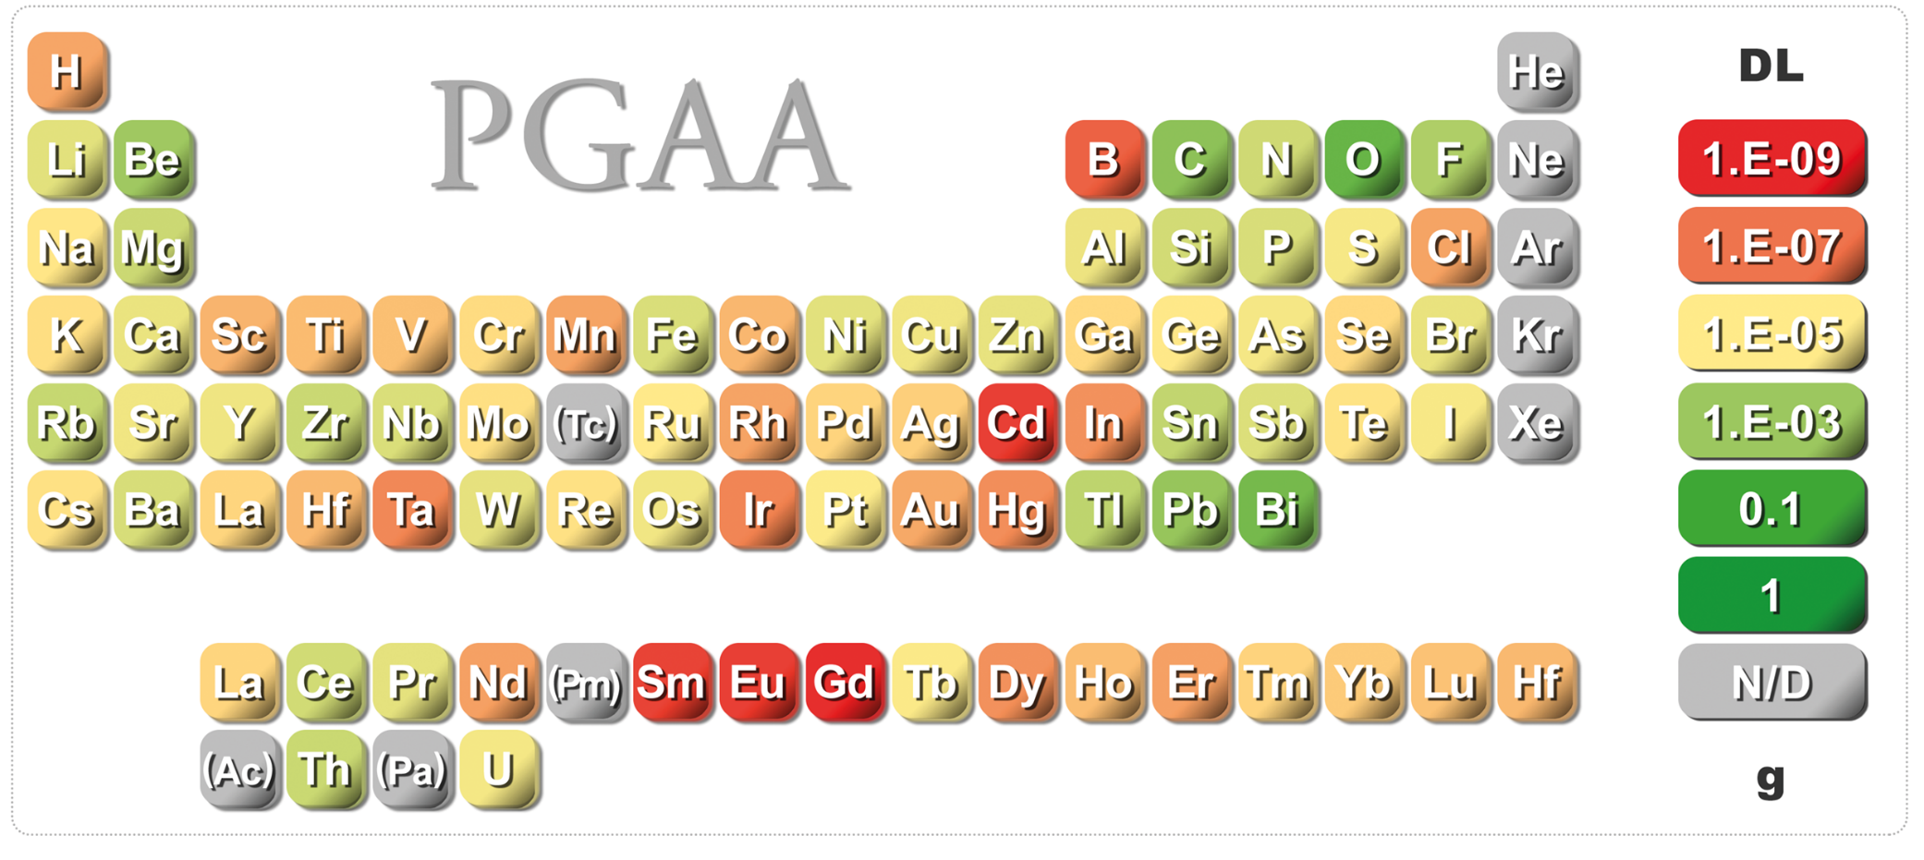
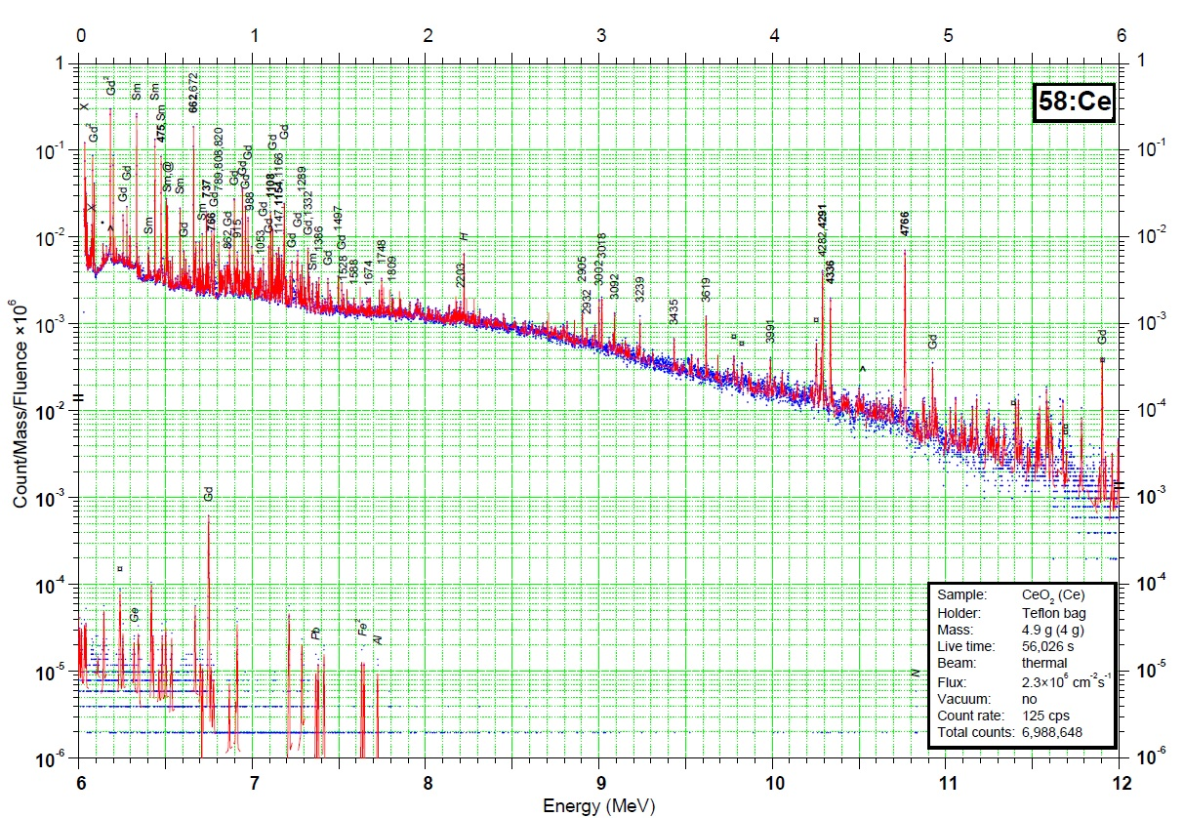
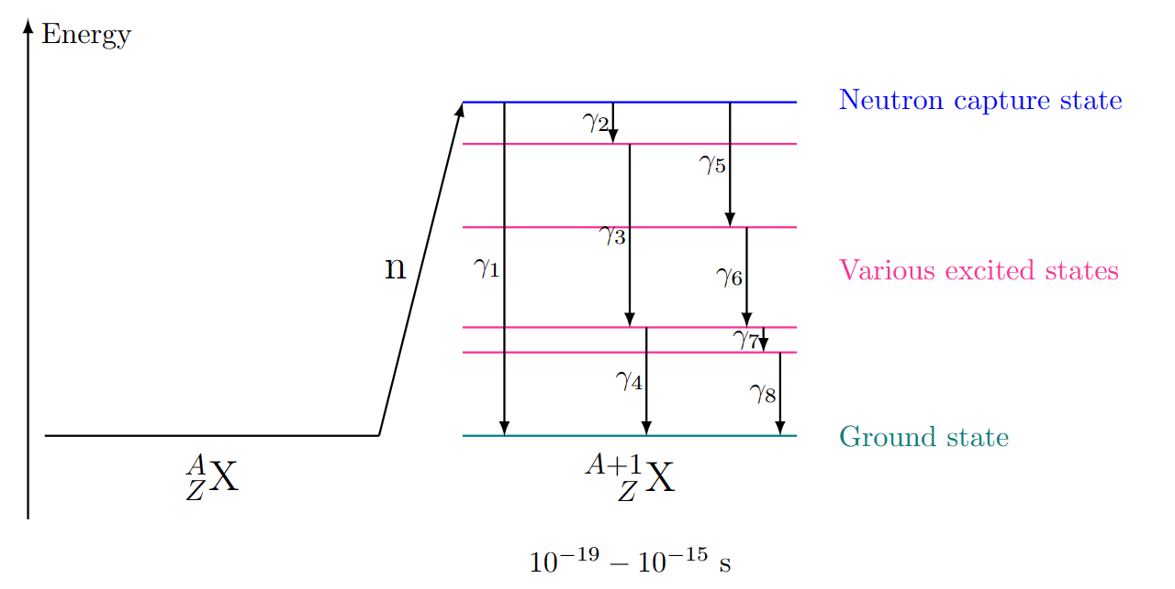
PGAA Spectra (Prompt Gamma Activation Analysis)

Slide 6
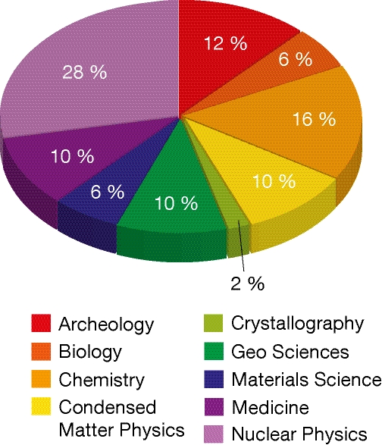
PGAA
Advantages:
Panoramic analysis with very low DLs for many elements.
No (or not much) sample preparation / non- or low-destructive
Bulk samples analysis.
The sample can be, in principle, in any physical form
Chemical form of the sample has no influence on the analysis.
the result of the non-destructive analysis is an averaged concentration (mass fraction) over the irradiated sample volume, i.e. a bulk analysis.

Slide 7
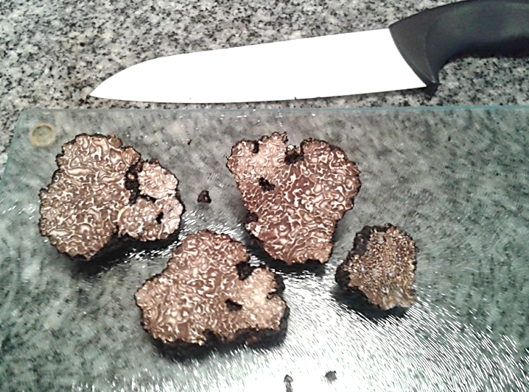
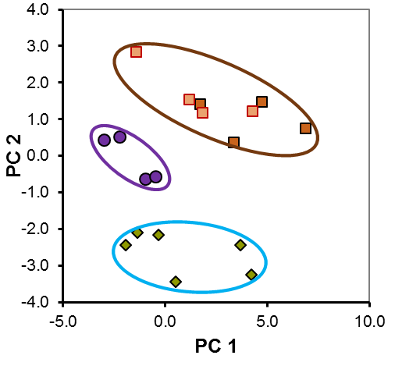
Examples for PGAA use
Summer truffles (Tuber aestivum) collected from different German regions.
PGAA (TUM instr.) were combined with NAA + ICP-MS conducted at IChTJ in Warsaw
→ ~30 major, minor and trace elements.
Multivariate statistics applied to log-normal filtered data for provenance analysis.
Result 1:
Clustering clearly possible in most cases
→ can be used to determine the origin / detect food mislabeling.
Result 2:
Enrichment factors different in outer and inner parts of the fruit body (peridium and gleba)
→ info about element-selective activity of the fungus.
TH
NW
BY
Fig.:Principle component analysis:
clustering of different provenances.

Slide 8
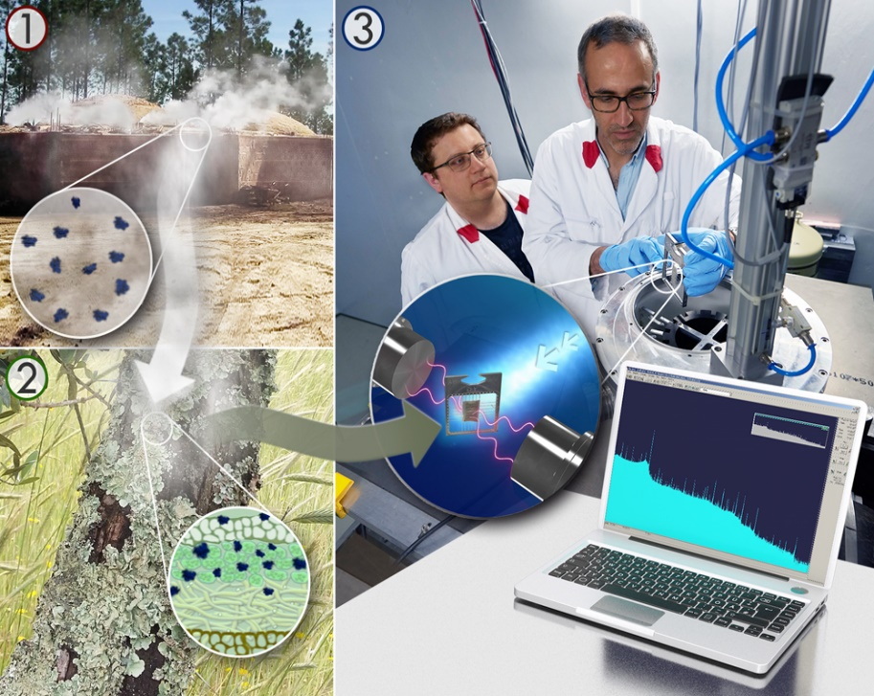

Examples for PGAA use: Analysis of Air Pollution
PGAA + ib-NAA: Lichens used as biomonitors.
Heating (coal)
Industry
Industry
Traffic
→ Retrospective monitoring possible.
→ Important information for authorities.
N. Canha, A.R. Justino, C. Galinha, J. Lage, C. Stieghorst, Z. Revay, C. Alves, S. M. Almeida: Elemental characterisation of native lichens collected in an area affected by traditional charcoal production. J Radioanal Nucl Chem 325:293–302 (2020). DOI:10.1007/s10967-020-07224-3

Slide 9
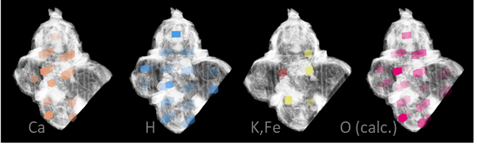
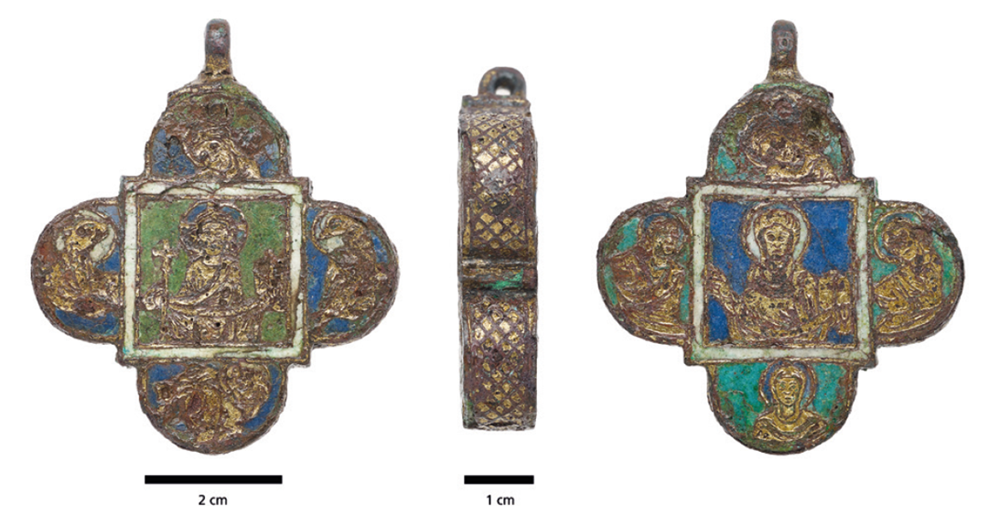
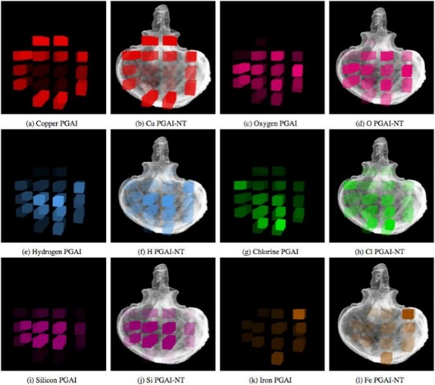
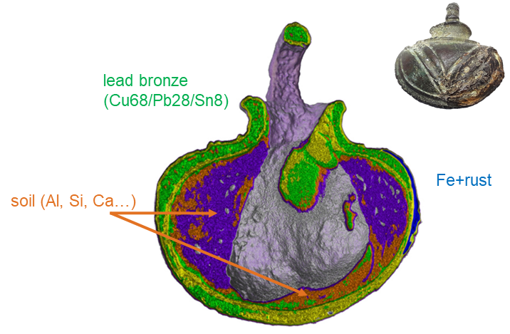
Examples for PGAA use: Analysis of Archeological Objects
Spatially resolved prompt gamma ray activation imaging (PGAI) in combination with neutron tomography (NT)
enables non-destructive view inside ancient objects
element distribution and structure
rare piece: only 3 other phylacteries of this type known
measurements revealed
e.g. bone material (Ca content + structure)
Fig: E. Kluge, IKP Köln

Slide 10

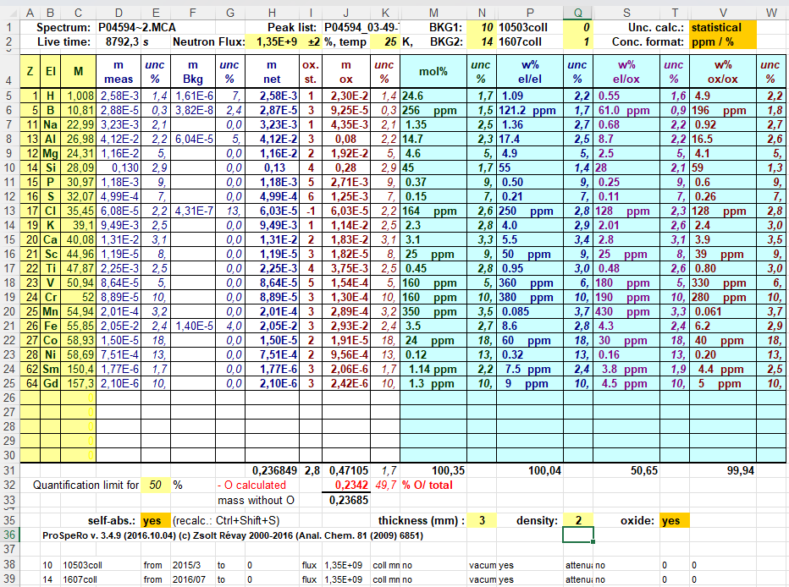
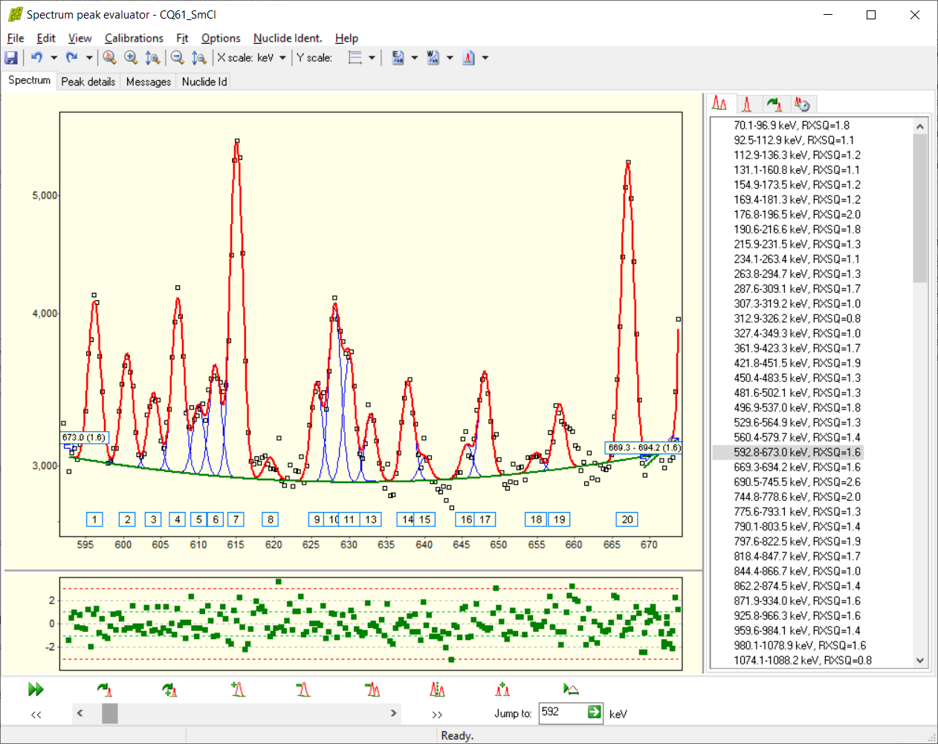
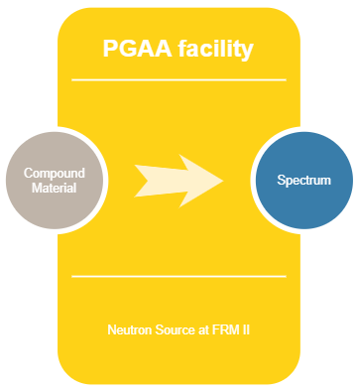
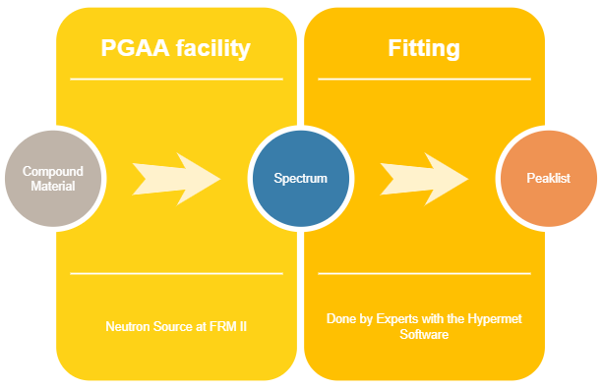
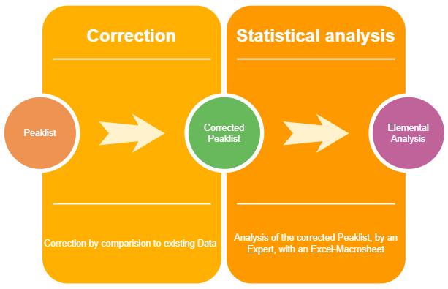
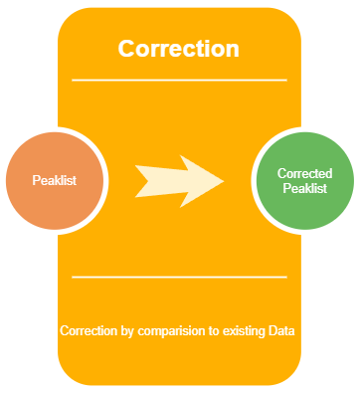
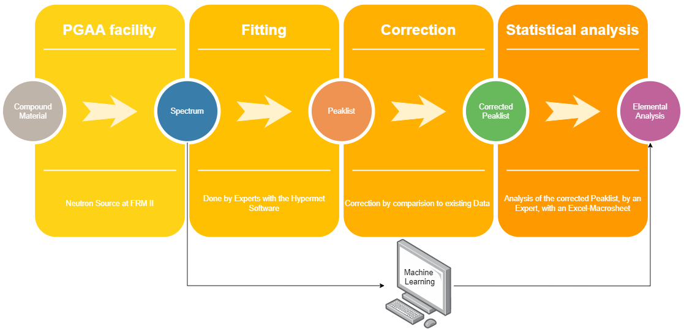
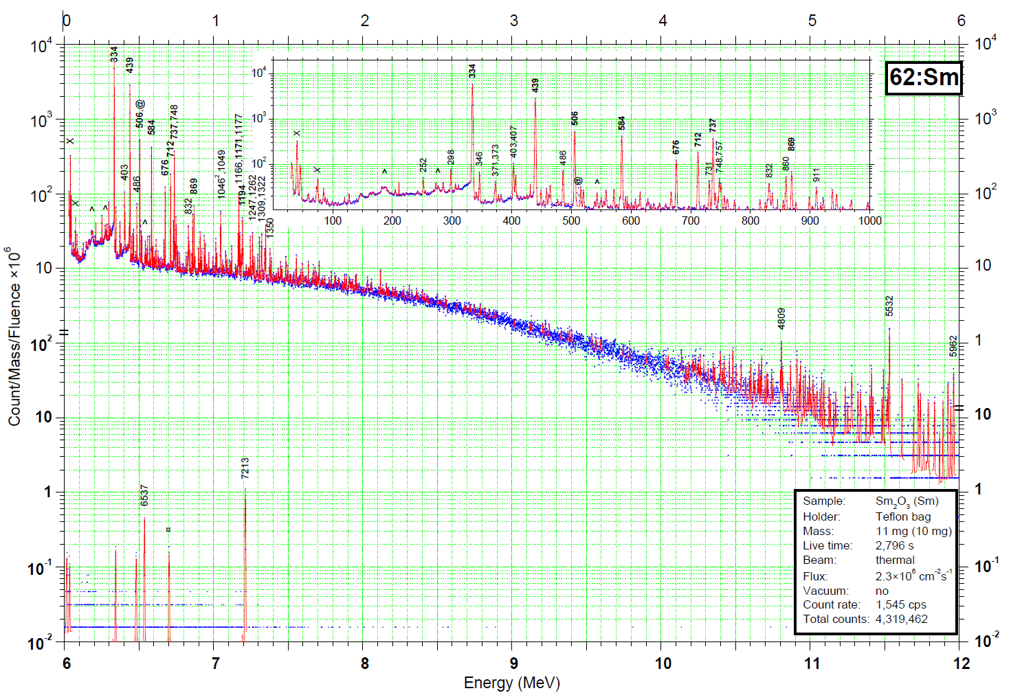
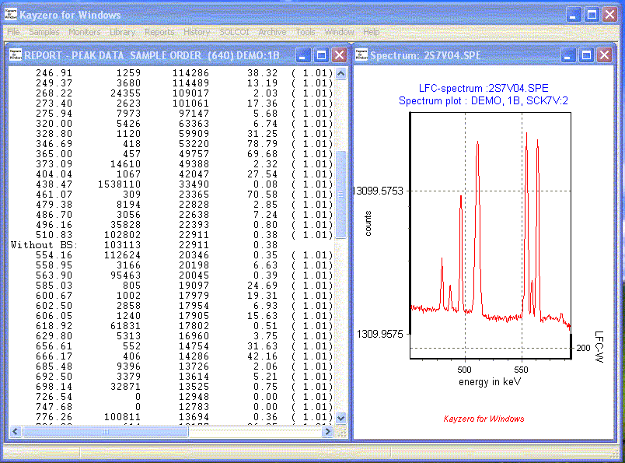
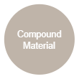
Process of PGAA-Analysis

Slide 11
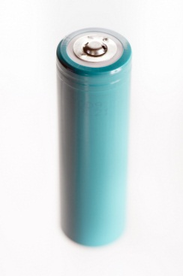
Crystallography
Source of neutrons or Xrays
Object: sample
Detector: collecting neutrons / x-rays
n
Neutrons:
1) Go through → Transmission
2) Are captured → Absroption
3) Change direction → Scattering
n
Scattering:
- No exchanged of E → elastic
- Exchanged of E → inelastic
© A. Heddergott, TUM
Diffraction
→ Information about where atoms sit (structure)
→ how they move (dynamics)
Spectroscopy

Slide 12
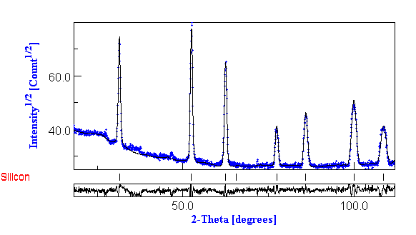
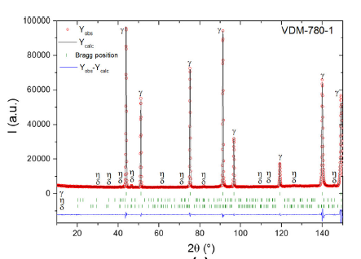
Cristalography
Single phase material
Multiple phase material
Si powder
Points: measured data
Line: fitting
Theoretical positions of the different peaks
Info of the diffraction pattern:
Position and intensities of the peaks → crystal structure and chemical composition
Small changes in positions → changes in lattice parameters (estructure)
Small changes in relative intensities → changes in composition

Slide 13
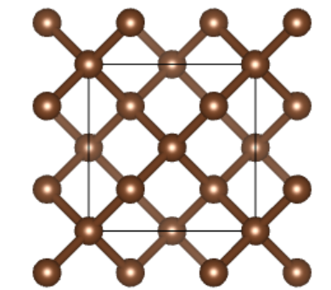
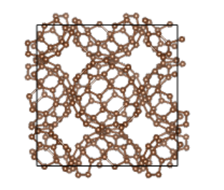
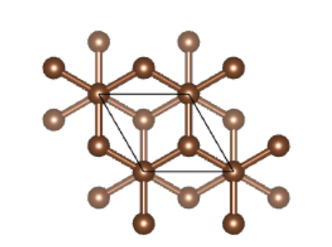
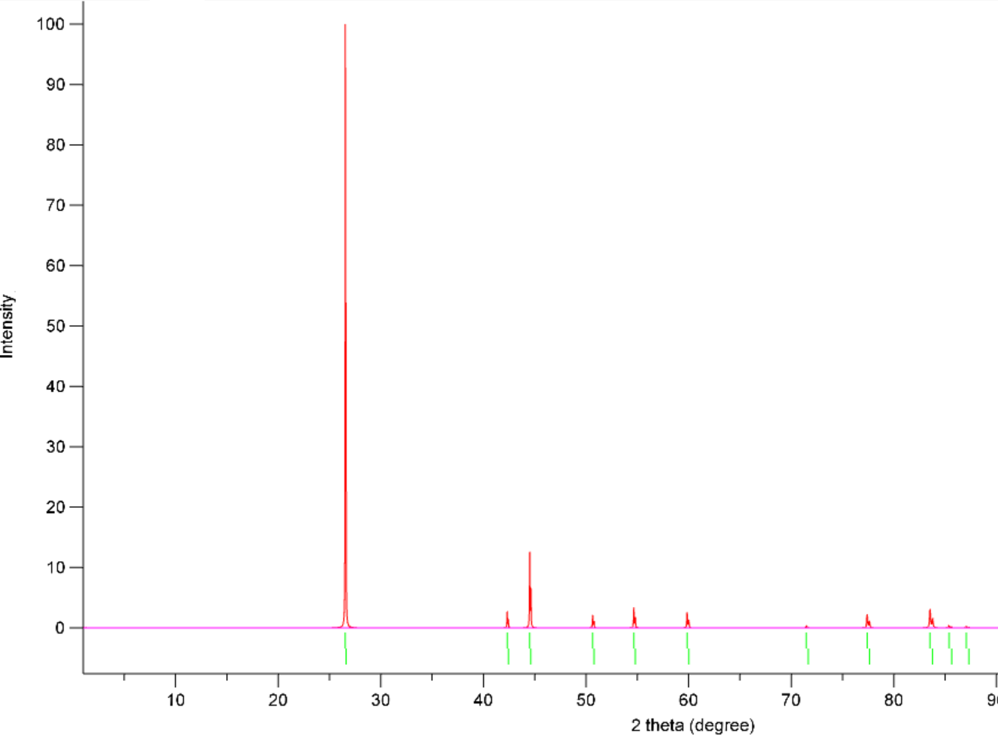
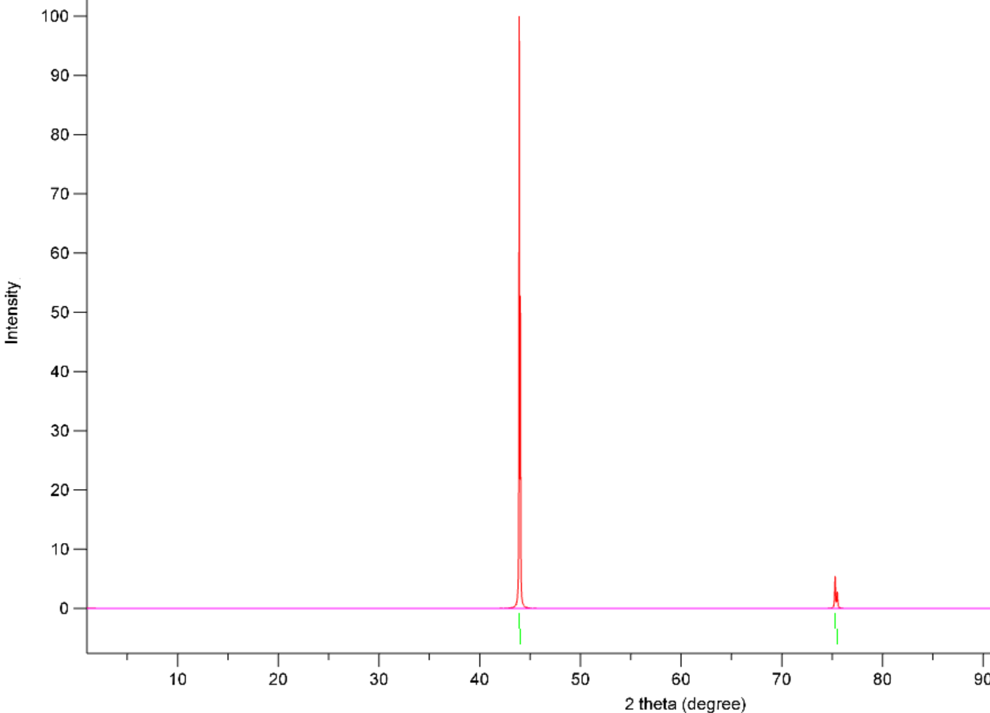
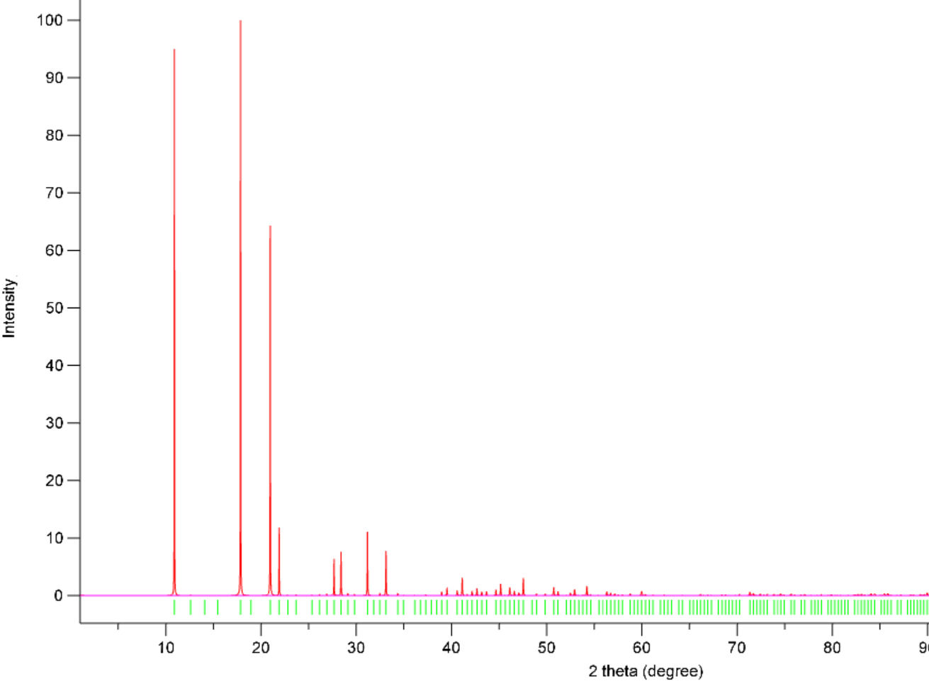
Crystallography: Same Chemistry (C) but different structures
Graphite:
Diamond:
C60:

Slide 14
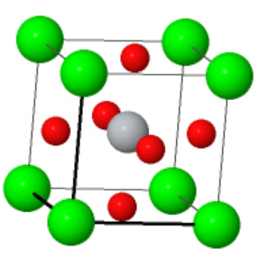
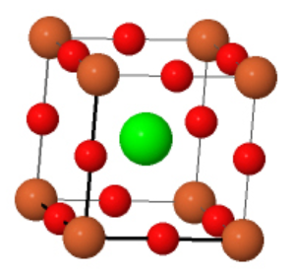
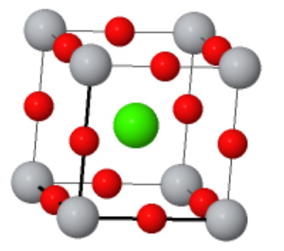
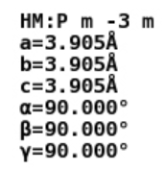
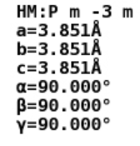
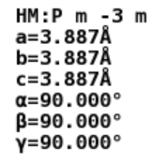
Cristalography: Same structure (cubic perovskite) but different chemistry
SrTiO₃
SrFeO₃
CaTiO₃
X-rays
Neutrons
13

Slide 15
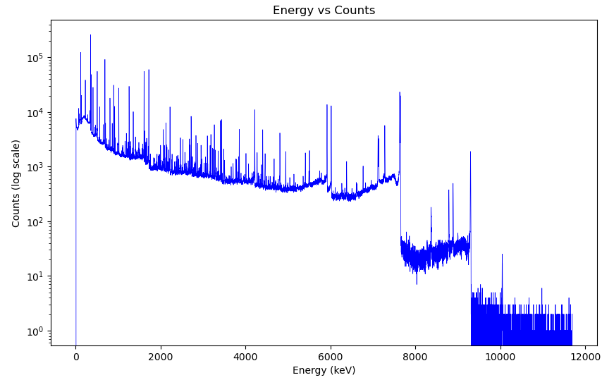
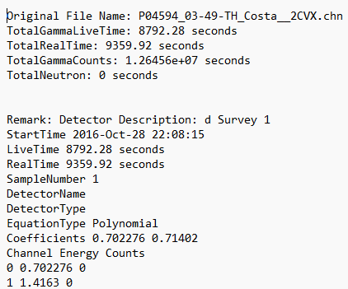
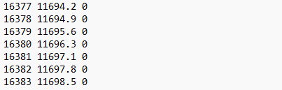

PGAA Data
Spectra are given as txt or xls file
Every Spectra has $2^{14}$ energy channels in which the total amount of Energy Counts are measured
The energy channels start at 0.7 keV and go up to 11732 keV
The TotalGammaLiveTime is used as one of the normalization factors
The Flux and weight are not given in the spectra, but can be calculated and are therefore expected to be known.
The results are given as xls files
The results contain the elemental compositon of the analyzed compound.
The analysis contains information about the element, the mass, amount of Oxygen and different weigth and composition factors.
  At the moment only the weigth % is used as result.
  Missing Metric to compare different types of result.

Slide 16
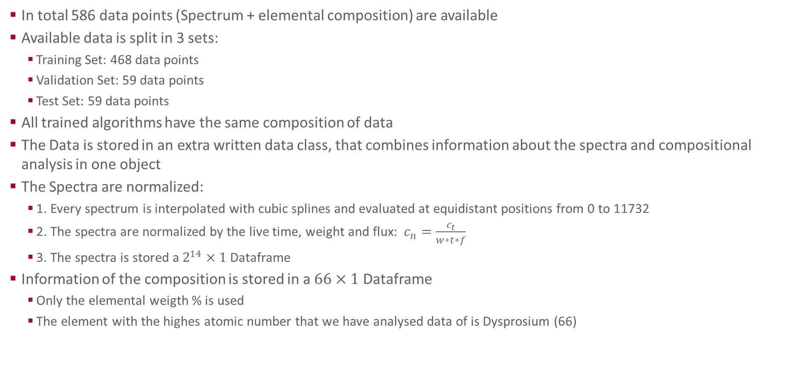
Available Data
In total 586 data points (Spectrum + elemental composition) are available
Available data is split in 3 sets:
  Training Set: 468 data points
  Validation Set: 59 data points
  Test Set: 59 data points
All trained algorithms have the same composition of data
The Data is stored in an extra written data class, that combines information about the spectra and compositional analysis in one object
The Spectra are normalized:
  1. Every spectrum is interpolated with cubic splines and evaluated at equidistant positions from 0 to 11732
  2. The spectra are normalized by the live time, weight and flux: $c_{n}=\frac{c_{t}}{w∗t∗f}$
  3. The spectra is stored a $2^{14}×1$ Dataframe
Information of the composition is stored in a $66×1$ Dataframe
  Only the elemental weigth % is used
  The element with the highes atomic number that we have analysed data of is Dysprosium (66)

Slide 17
Algorithms
Idea: Start with basic ML tools and establish a baseline!
Trained Algorithm:
  The RandomForestRegressor module of sklearn is used
  Hyperparameter tuning with Optuna
  The Random Forest uses 128 Decision Trees
    The max depth of a Tree is 16
    The minimal sample split is 4
  The results below 0 are clipped
1Dimensional-Convolutional Neural Network:
  Pytroch Lightning is used for the implementation
  Hyperparameter tuning with Optuna
  ***
    ***
    ***
  The 1D-CNN is trained until 50000 epochs without improvement
Linear Regression:
  The LinearRegression module of sklearn is used
  The resulting linear function is only allowed to have positive coefficients
  The results below 0 are clipped
  The results are scaled to add up to 100
Feed Forward Neural Network:
  Pytroch Lightning is used for the implementation
  Hyperparameter tuning with Optuna
  FFN consists of 5 hidden layers
    Every layer consists 1024 nodes
    Every layer has a skip connection
  The FNN is trained until 50000 epochs without improvement

Slide 18
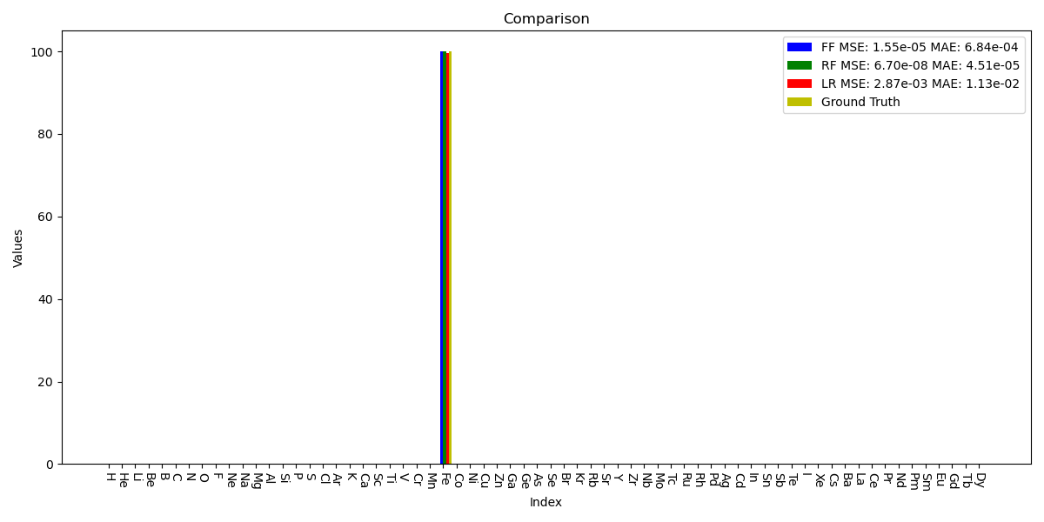
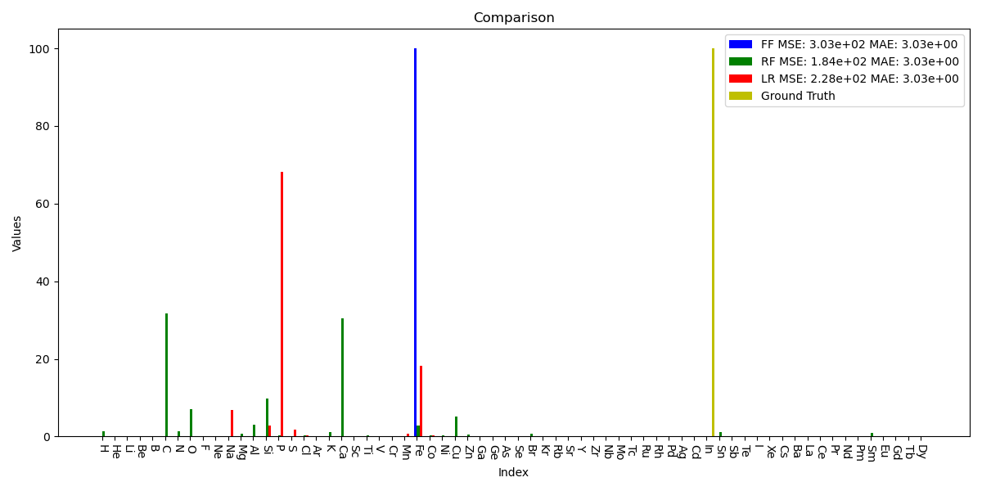
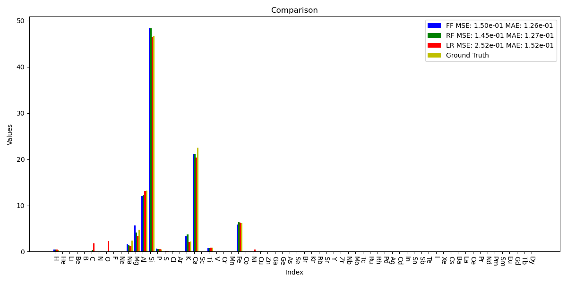
Results
Algorithm | Mean square error | Mean absolute error | MSE (without sample 22) | MAE (without sample 22)
Feed Forward NN | 7.23 | 0.13 | 2.13 | 0.079
Random Forest | 4.65 | 0.17 | 1.56 | 0.12
Linear Regression | 5.46 | 0.22 | 1.62 | 0.17
  Average sample
  Good sample
  Sample 22

Slide 19
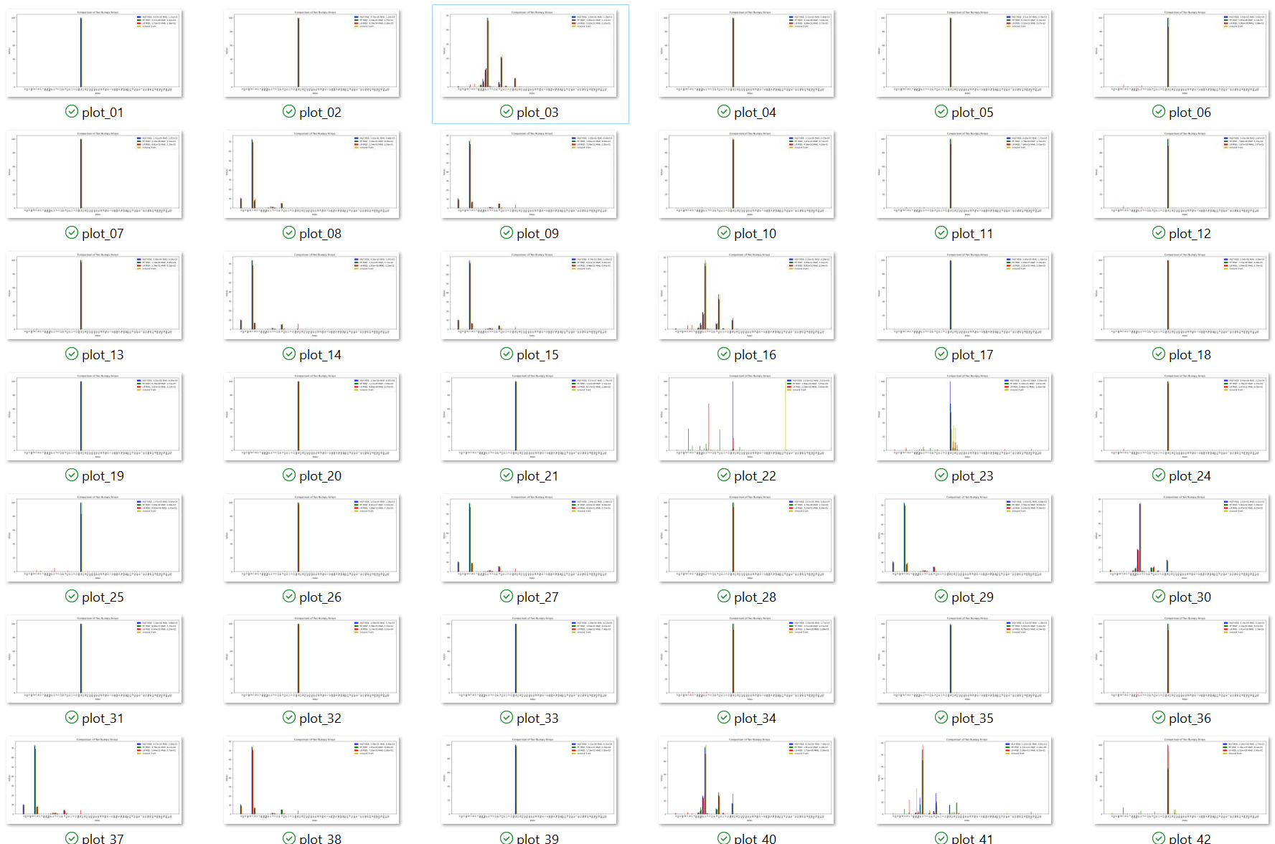

Slide 20
Outline for PGAA
    First results promising, but there are many further tasks:
      Up till now:
        training data like test data
        good statistics, but no physical knowledge implemented
      Next steps:
        more general training data set with “semi-real” dataset, generation of data (convex combines Data does not help the training process)
          Examples of non-linear effects:
            beam background → dependent on scattering in individual samples
            corrections for short-lived decay products (e.g. Al)
            geometry-dependent summing effects, pile-up
            gamma self-absorption
            peak shape distortion (high activity, neutron damage)
        more complex data, “noisy” data
        physics informed approach (PINNs)
        Design a metric to predict all needed information
        Include uncertainties

Slide 21
Outline EvalSpek-ML
Improvement:
  Improving the ML approach for the analysis of the spectra, or
  Tring a reduced approach for better results (i.e. Spectra to peak list, peak list to composition)
Generalization:
  Generalize the approach to work with other types of spectra:
    PGAA with less Channels and short lifetime (seconds instead of hours)
    Crystallography
    And more
Interpretability:
  Analyzing the relevant decision criteria

Slide 22
Questions & Answers

Slide 23
Optuna data
Optuna for Random Forest:
  Trees: 64, 128, 512, 1024, 2048
  Max Depth: 2, 8, 16, 64
  Min sample split: 1, 4, 16, 64
  10 Trials
Optuna for MLP (with and without changing layer size):
  Learning Rate: 1e-5 – 1e-1 (logarithmic scale)
  Layer Count: 4, 16, 64
    Layer Size: 64, 128, 256, 512, 1024, 2048
Optuna for CNN:
  Learning Rate: 1e-5 – 1e-1 (logarithmic scale)
  Layer Count: 4, 16, 64
    Output Channels: 4, 8, 16
    Kernel Size: 1, 3, 5, 7
    Pool Size: 1, 3, 5, 7,
    Stride: 1, 2, 3
    Padding: 1, 2, 3

