Slide 1
A View into ML Techniques for FPGA Platforms. FINN, PYNQ, & Vitis AI PUNCH4NFDI-XFEL Workshop
Haris Habibullah
FPGA Engineer
Group: EEE (Fast Electronics Team)
EU-XFEL
Hamburg, 15.06.2023

Slide 2
OBJECTIVES
Look into various FPGA platforms and tested ML solutions.
Find a simple entrance point to test the subject depth.
Go from simpler neural networks and frameworks to more complex ones.
Notes:
Find a simple entrance point to test the subject depth: This was important as the FPGA-based solutions had to be proposed to researchers and scientists, who might not have a working knowledge of FPGAs.

Slide 3
CONTENTS OF THE PRESENTATION
PART # 01:
The basic building blocks of FPGAs.
The PYNQ platform by Xilinx
BNN & FINN Libraries
Demonstration lab for BNN
PART # 02:
Looking into Vitis AI
Deep Learning Processing Unit (DPU)
Going back to PYNQ for Vitis AI

Slide 4
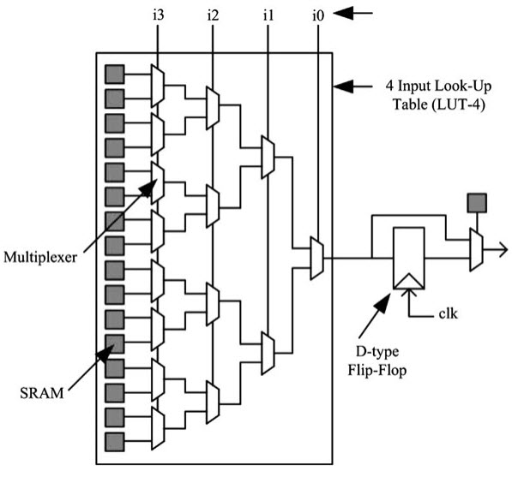
A TYPICAL FPGA ARCHITECTURE
An FPGA is an array of the three building blocks:
Programmable I/O Cells
Programmable Interconnect
Configurable Logic Cells / Block (CLB)
CLB
Can be configured to logic cells for computations or memory.
CLBs are where the ML algorithm resides.
Notes:
i/o cells which interact with the outer worlds, sensor input etc.
Interconnect allows connectivity between modules and with the memory lines.
Logic cells are for computations. Can be as simple as a logical gate or a multiplexer
A configurable logic block can consist of a single basic logic element or a group of interconnected basic logic elements, where the basic logic elements are lookup tables (which in turn consist of SRAM and multiplexers) and flip-flops.

Slide 5
AN AERIAL PERSPECTIVE OF THE FRAMEWORKS
VITIS AI
PYNQ
FINN
BNN

Slide 6
FINN :
FRAMEWORK FOR FAST, SCALABLE BINARIZED NEURAL NETWORK INFERENCE
Going from Floating Point Parameters → Fixed Point Parameters
→ Low-Precision Parameters (Binary Precision).
It has been observed that low-precision arithmetic can have a small impact on accuracy, but a significant reduction of memory and compute power.
FINN-generated accelerators can perform millions of classifications per second with sub-microsecond latency.
Notes:
FINN put forward in 2016
Although floating point numbers are a natural choice for handling the small updates that occur during neural network training, the resulting parameters can contain a lot of redundant information
Go back to the FPGA architecture slide, show how 16-bit variable would take upto 4 LUTs and adding 2 4-bit variables could take 4 LUTs.
If changed to 1-bit weights, then one single LUT could perform the addition operation.
If you go from a 2-layer CNN to a 3-layer CNN, it would not exponentially increase your weights.

Slide 7
BINARIZED NEURAL NETWORK
BNN was introduced as 1-bit weights and activations, but later 2-bits , 4-bits, and 8-bits variants were also added.
Each CNN layer is mapped onto a separate compute array, which makes it easy to reconfigure size and depth of layers.
The compact size of BNN allows to put all neural network parameters on-chip. Off-chip memory accesses are minimized.
BNN has the potential to attain Tera operations per second (TOPS) on FPGAs.
Notes:
FINN QNN: BNN , LSTM etc. .
P_wall is the total board consumption. A typical GPU consumption is in the range of 100W- 200W for neural networks
LFC and SFC are both 3-layer fully-connected networks. Small and Large
CNV-max indicated operations in TOPS range.

Slide 8
FINN ACCELERATORS

Slide 9
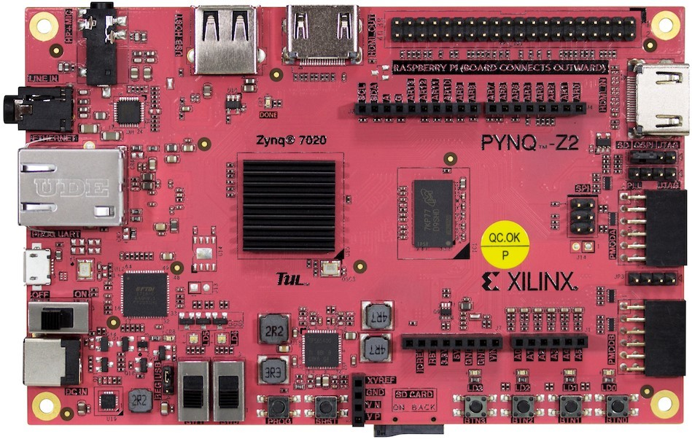
THE PYNQ BOARD (PYTHON + ZYNQ)
The PYNQ board provides an inexpensive and easy entrance to try ML / DL with FPGAs.
Comes with a (Python) Jupyter-Notebook interface and a Base overlay.
Tested Deep Learning overlays. For e.g. FINN and DPU.
IPs and Overlays designed for PYNQ can be migrated on Kria and
other AI-supported FPGA boards (from Xilinx).
Try the Hello World Example to get started with
Hardware Acceleration with PYNQ.
https://github.com/Xilinx/PYNQ-HelloWorld
Notes:
Base Overlay: The purpose of the base overlay design is to allow PYNQ to use peripherals on a board out-of-the-box.
If a base overlay is available for a board, peripherals can be used from the Python environment immediately after the system boots.

Slide 10
PLAY TIME

Slide 11
LAB: BNN on PYNQ
OVERVIEW
Repository: https://github.com/Xilinx/BNN-PYNQ/tree/master/notebooks
CNV-QNN_Cifar10
Example Network: Convolutional Network Topology (CNV)
Inspired by VGG Network.
Contains a succession of (3x3 convolution, 3x3 convolution, 2x2 Maxpool) layers repeated three times with 64-128-256 channels, followed by two fully connected layers of 512 neurons each.
The CIFAR-10 dataset consists of 60,000 32x32 color images in 10 classes, with 6,000 images per class. There are 50,000 training images and 10000 test images.
Classes: Airplane, Automobile, Bird, Cat, Deer, Dog, Frog, Horse, Ship, and Truck

Slide 12
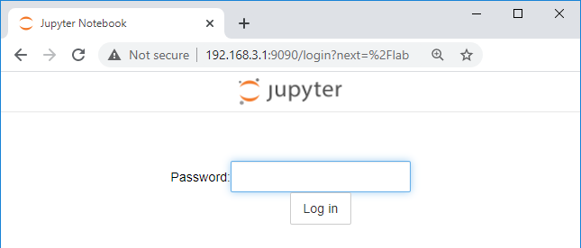
LAB: BNN on PYNQ
Configuring the Board
Download the PYNQ (Z1, Z2, or ZU) image onto an SD card.
Connect the PYNQ board to the internet and install the BNN library via pip.
Configure your PC‘s IPv4 setting to connect to the PYNQ – Jupyter environment.
Run the provided Notebooks or build the IP manually.

Slide 13
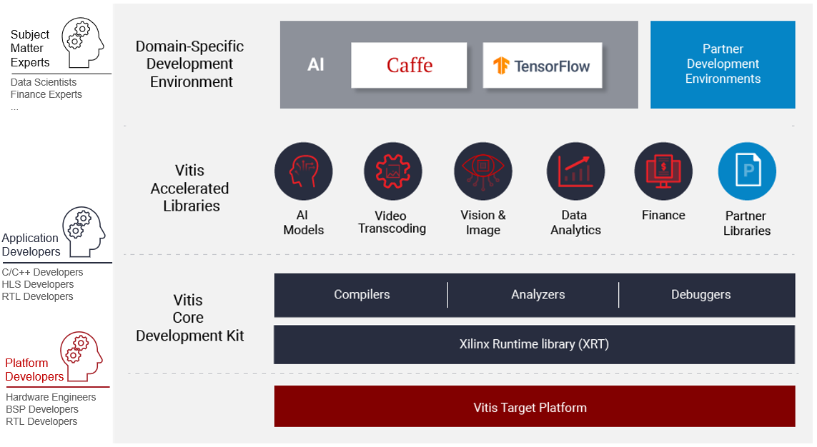
Vitis AI
Vitis AI is a Docker-based Deep Learning environment for Xilinx devices:
- Alveo, Versal, Zynq Ultrascale etc.
It is not part of the Vitis IDE, and user need to setup their own environment.
Machine learning engineers can work on domain-specific applications by adapting Xilinx accelerated libraries.
Model Zoo with more than 130 pre-trained models for CNN, RNN, etc.
Notes:
Vision and Image libraries are part of the Vitis vision repo, which is built over the OpenCV framework.
Xilinx Runtime library (XRT) is an open-source standardized software interface that facilitates communication between the application code and the accelerated-kernels
XRT is a software stack that facilitates management and usage of FPGA/ACAP devices… tasks like instruction scheduling and memory management.

Slide 14
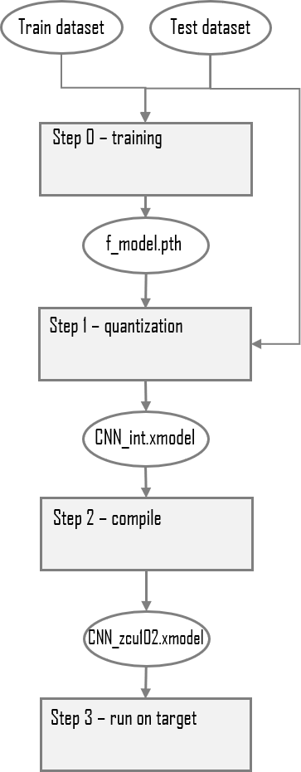
Vitis AI (cont…)
If everything works fine then, you will see something like this:
The link to training database is already provided in the scripts.
Quantization and pruning libraries are built on PyTorch or Tensorflow libraries.
Depending on what workflow you have chosen.
The Training part is done on the GPU, while Inference is done on the FPGA board.
Problem: For testing, you will need to prepare a Target device setup.
Notes:
Iterative pruning with fine-tuning : it removes redundant connections and fine-tune the weights by a few more epochs of training with the lowest learning rate.

Slide 15
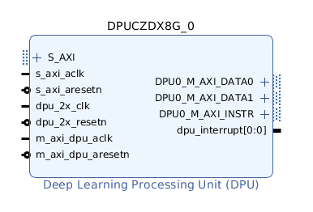
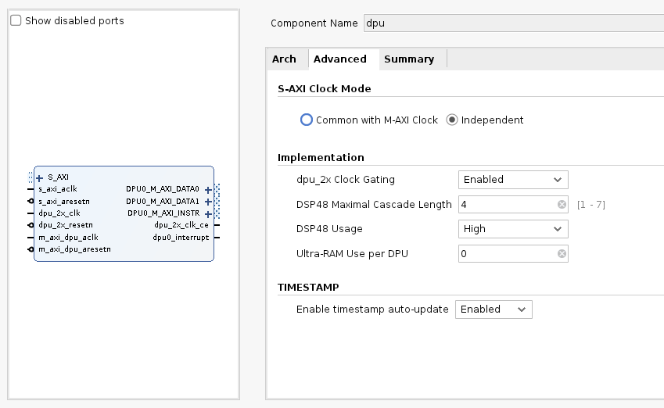
DEEP-LEARNING PROECSSING UNIT (DPU)
DPU is a programmable engine optimized for deep neural networks.
It includes a set of highly optimized instructions, and supports most convolutional neural networks such as: VGG, ResNet, GoogLeNet, YOLO, SSD, MobileNet, FPN, and others.
A DPU comprises of elements available in the Xilinx programmable logic fabric,
such as DSP, BlockRAM, UltraRAM, LUTs, Flip-Flops, or Xilinx AI Engine.
The DPU IP controls the usage of DSP slices and LUTs in a Convolution Operation.
Notes:
To facilitate the DPU integration, Xilinx provides the DPU TRD and XVDPU TRD in which you can configure the DPU with different parameters to meet the performance and resource utilization requirements.
Visual Geometry Group : VGG

Slide 16
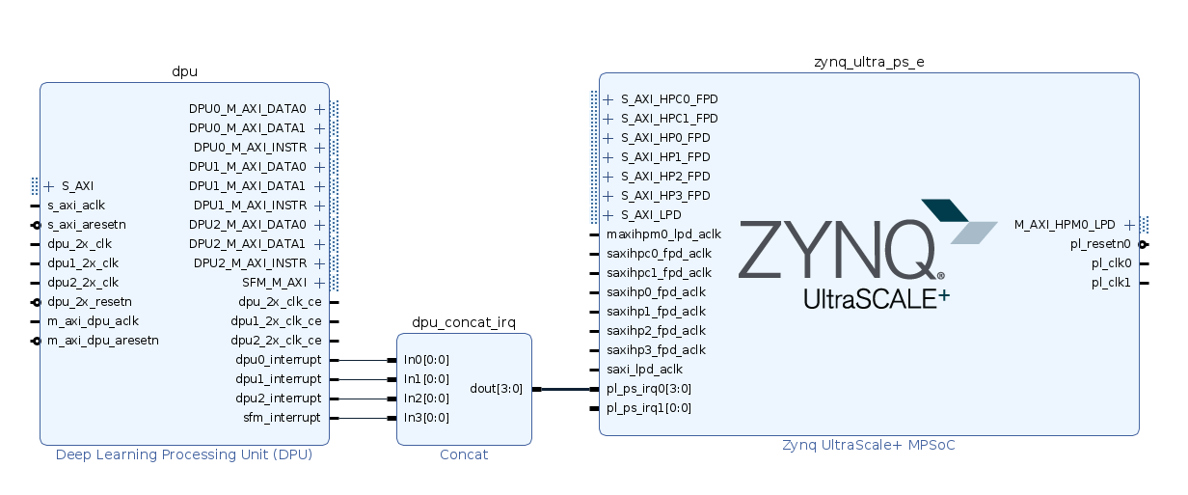
PYNQ FOR VITIS AI
The DPU requires instructions to implement a neural network and accessible memory locations for input images as well as temporary and output data.
A program running on the application processing unit (APU) is also required to service interrupts and coordinate data transfers.
A Zynq Processing unit can provide this functionality → In this way, a DPU IP can be created for a custom-design platform.
PYNQ ZU (Zynq Ultrascale) can be used for this purpose.

Slide 17
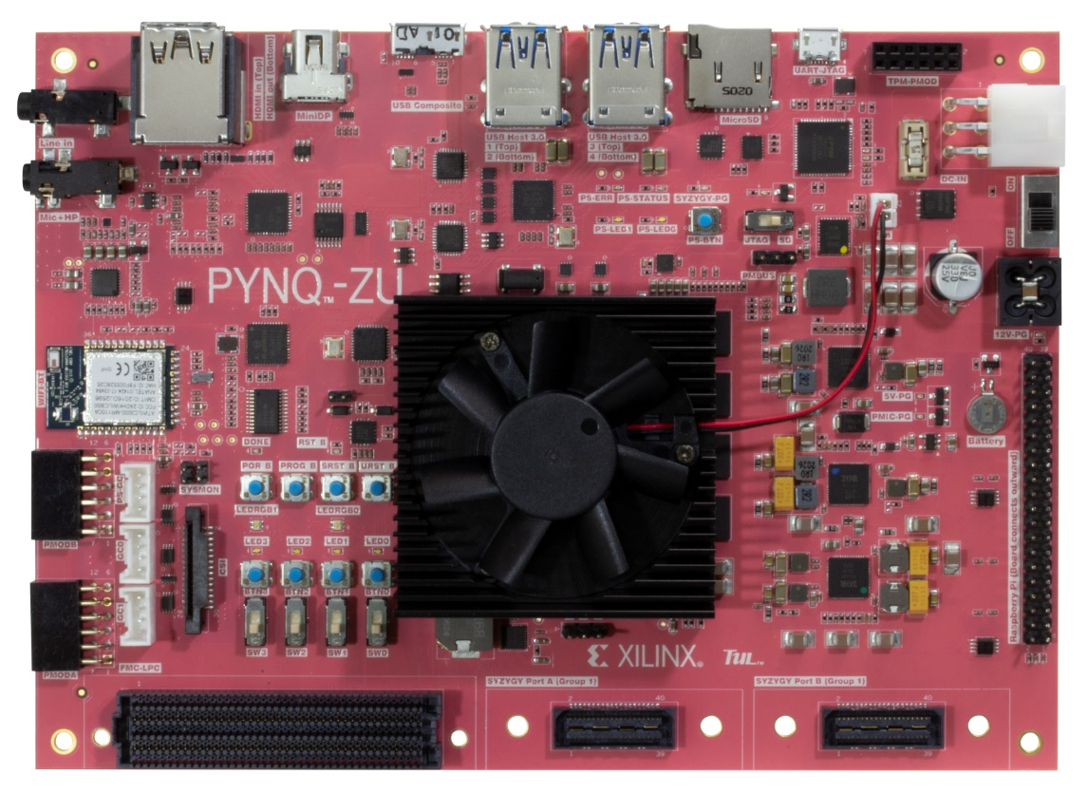
PYNQ FOR VITIS AI
Product Specifications 650MHz dual-core Cortex-A9 processor DDR3 memory controller with 8 DMA channels and 4 High Performance AXI3 Slave ports High-bandwidth peripheral controllers: 1G Ethernet, USB 2.0, SDIO Low-bandwidth peripheral controller: SPI, UART, CAN, I2C Programmable from JTAG, Quad-SPI flash and MicroSD card Programmable logic equivalent to Artix-7 FPGA - 13,300 logic slices, each with four 6-input LUTs - 630 KB of fast block RAM - 220 DSP slices Memory - 512MB DDR3 with 16-bit bus @ 1050Mbps - MicroSD slot
Product Specifications Quad core ARM Cortex-A53, Dual R5 processors DDR4 memory controller with 8 DMA channels and 4 High Performance AXI3 Slave ports High-bandwidth peripheral controllers: 1G Ethernet, 2x USB 3.0, DisplayPort Low-bandwidth peripheral controllers: 2x each SPI, UART, I2C Programmable from JTAG and MicroSD card Featuring ZYNQ-Ultrascale - 256,200 system logic cells, 234,240 Flip-Flop and 117,120 LUTs - 5.1 Mb total block RAM, 18.0 Mb ultra RAM - 1,248 DSP slices Memory - 4GB DDR4 2400R (64 bits wide) - MicroSD slot

Slide 19
REFERENCES
FINN: A Framework for Fast, Scalable Binarized Neural Network Inference. Yaman Umuroglu*† , Nicholas J. Fraser*‡ , et al.
BNN: Scaling Binarized Neural Networks on Reconfigurable Logic. Nicholas J. Fraser, Yaman Umuroglu, Giulio Gambardella, Michaela Blott, Philip Leong, Magnus Jahre, Kees Vissers
Model Zoo: https://xilinx.github.io/Vitis-AI/docs/reference/ModelZoo_VAI3.0_Github_web.htm
BNN-PYNQ: https://github.com/Xilinx/BNN-PYNQ
DPU-PYNQ: https://github.com/Xilinx/DPU-PYNQ/tree/master/host#train-your-own-dpu-models-from-scratch
PYNQ- Hello World: https://github.com/Xilinx/PYNQ-HelloWorld

