Slide 1
TB 2022
Automatic Alignment Update
Michal Elad
09 / 05 / 23

Slide 2
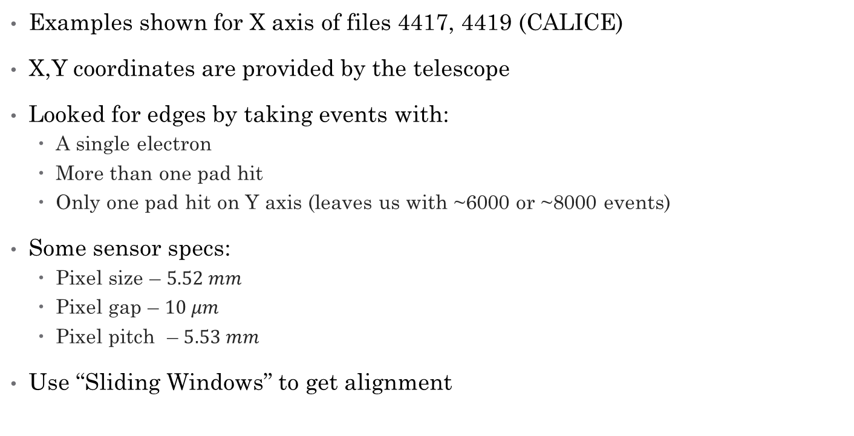
Introduction
Examples shown for X axis of files 4417, 4419 (CALICE)
X,Y coordinates are provided by the telescope
Looked for edges by taking events with:
  A single electron
  More than one pad hit
  Only one pad hit on Y axis (leaves us with ~6000 or ~8000 events)
Some sensor specs:
  Pixel size – $5.52 mm$
  Pixel gap – $10 μm$
  Pixel pitch – $5.53 mm$
Use “Sliding Windows” to get alignment

Slide 3
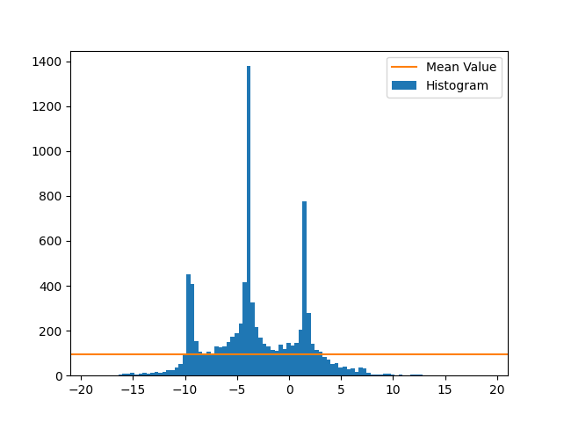
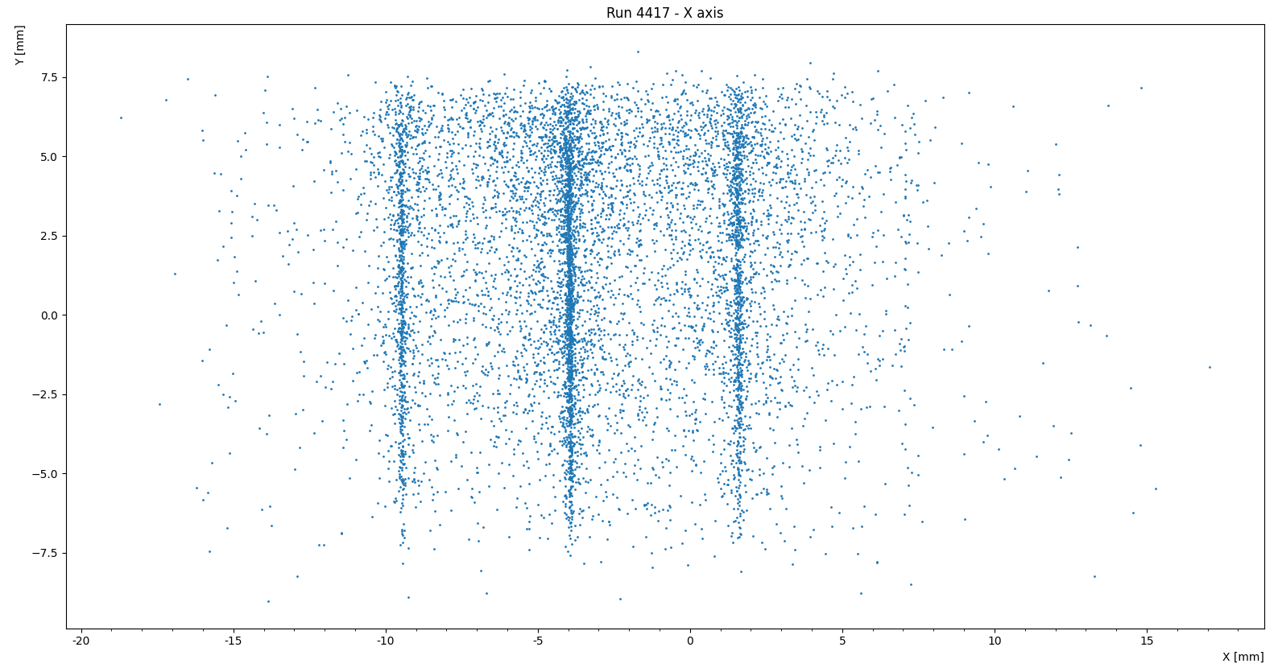
Step #1 – create a histogram (4417)
Run 4417
Entries
x [mm]

Slide 4
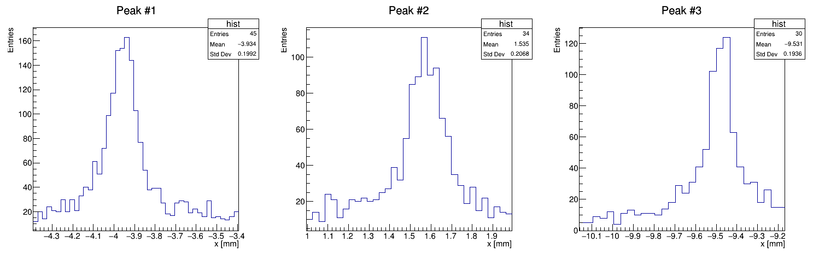
Run 4417 – a close up on the peaks

Slide 5
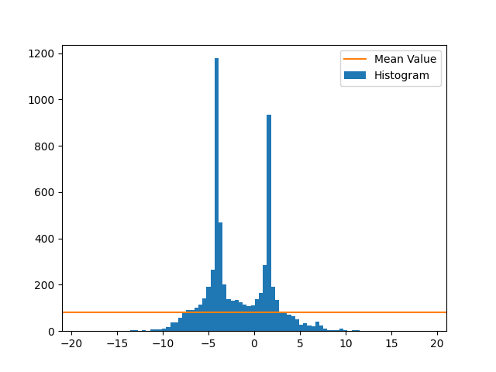
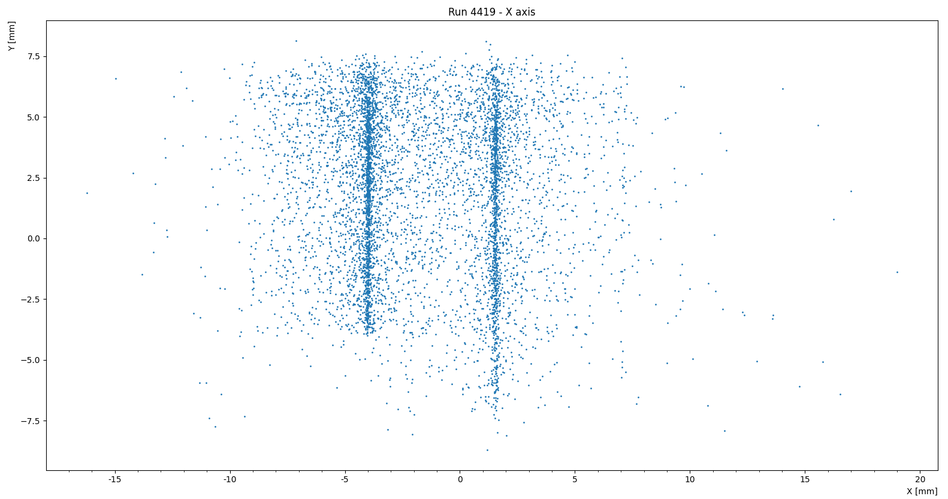
Step #1 – create a histogram (4419)
Run 4419
Entries
x [mm]

Slide 6
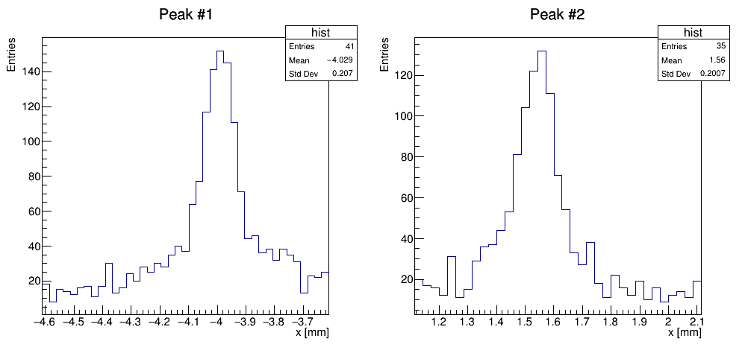
Run 4419 – a close up on the peaks

Slide 7
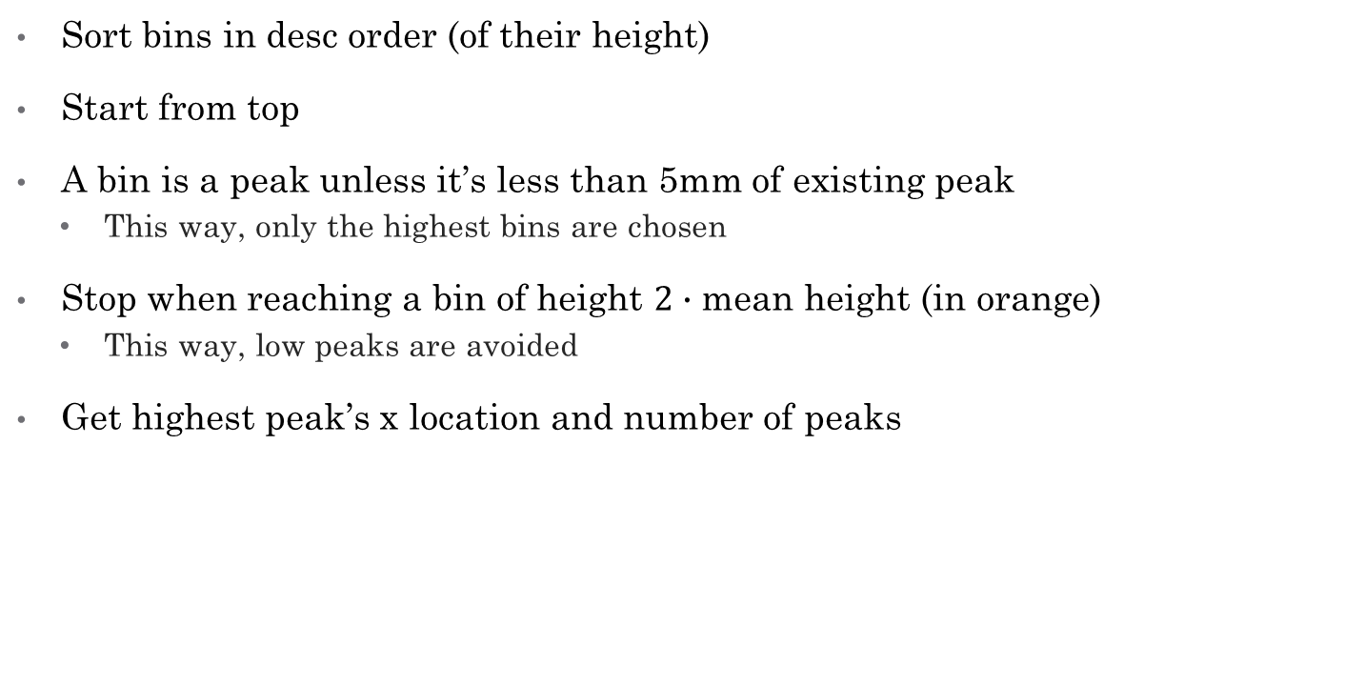
Step #2 – find the number of peaks
Sort bins in desc order (of their height)
Start from top
A bin is a peak unless it’s less than 5mm of existing peak
  This way, only the highest bins are chosen
Stop when reaching a bin of height $2∙$ mean height (in orange)
  This way, low peaks are avoided
Get highest peak’s x location and number of peaks

Slide 8

Step #2 – set windows
Setting a template of the edges:
  Get x location of highest peak, denoted $x_{max}$
  Set a window size and denote its location as $x_{0}$
  “Place” that window on x such that $x_{0}=x_{max}$
  Set additional windows such that the distance between their centers is constant and equals 5.53 mm.

Slide 9
Visualization
v
v
5.53 mm
Sliding direction

Slide 10
Step #3 – slide windows
Count the number of points within those windows
Move the template at small steps
Each time, count the number of points within the windows
Stopped after moving 0.5 mm to each side, covering a total of 1 mm

Slide 11
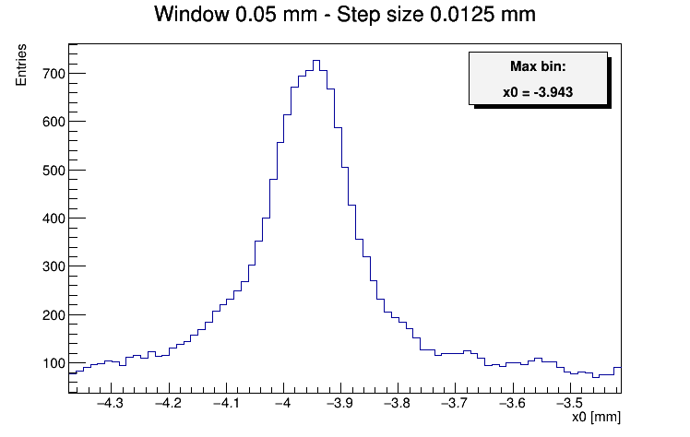
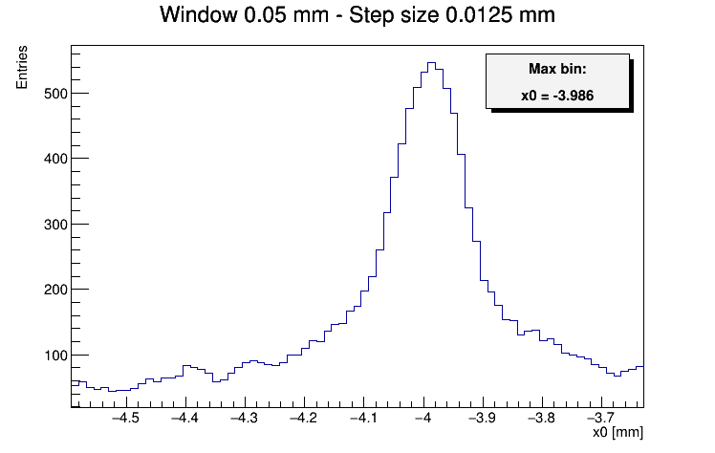


Step #4 – find optimal $x_{0}$
Create a histogram of those counts (bin size = step size)
Get $x_{0}$ for which the bin is highest
Run 4417
Run 4419

Slide 12

Step #5 – set edges
Set $x_{0}$ as an edge of a pad
Set other edges at $x_{0}±5.3n$ where $n∈ℕ$

Slide 13
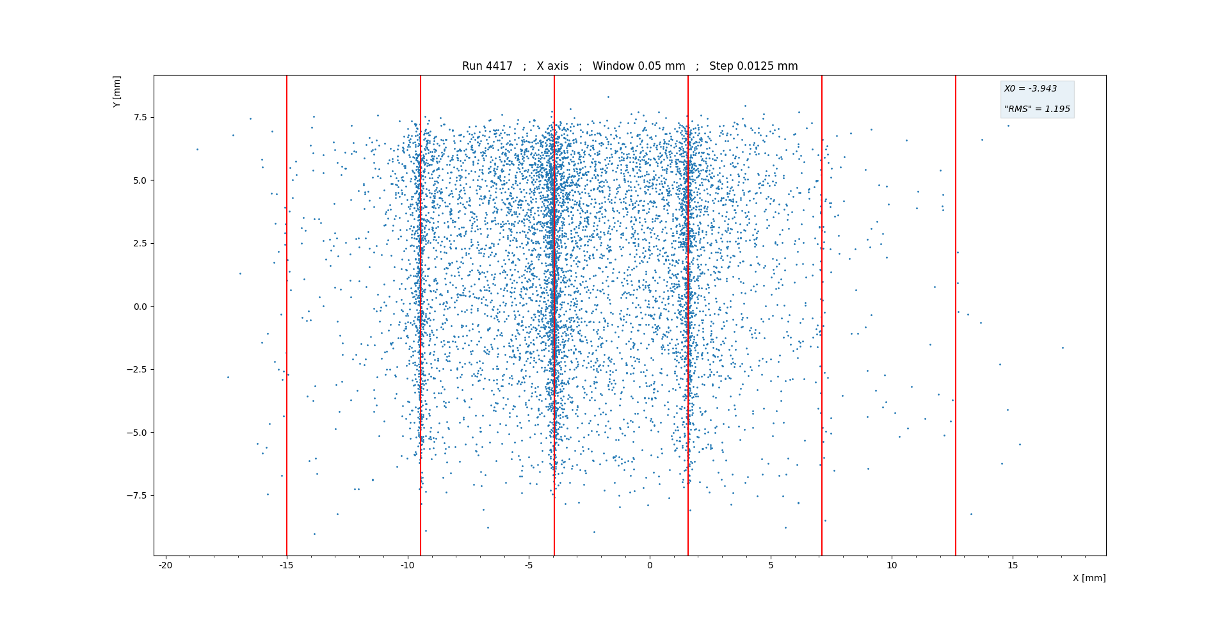

Slide 14
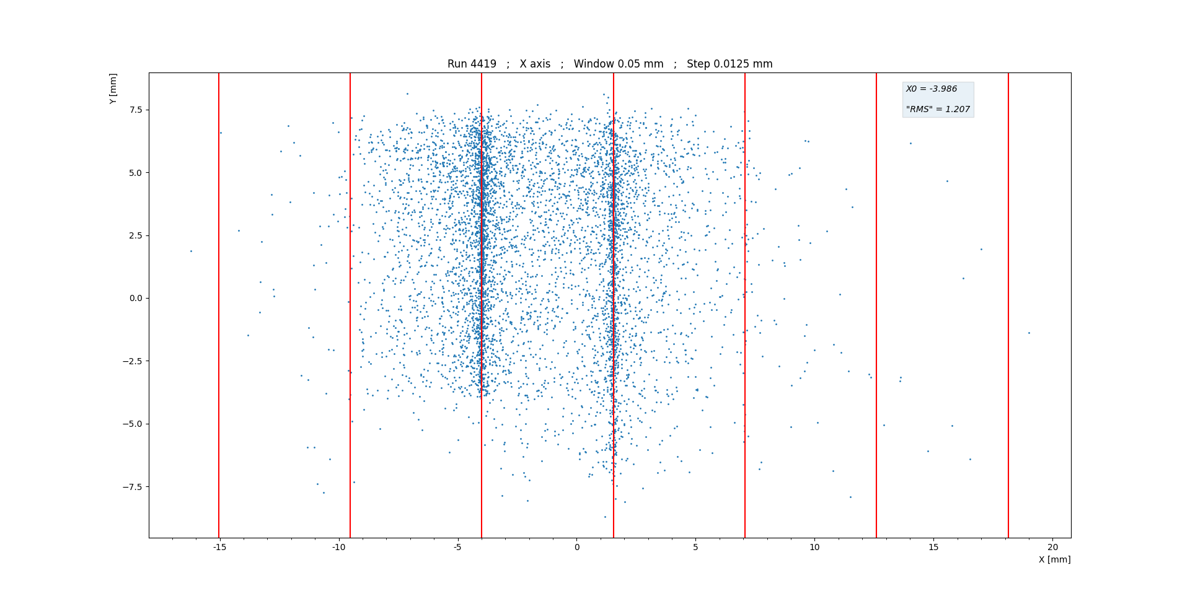

Slide 15
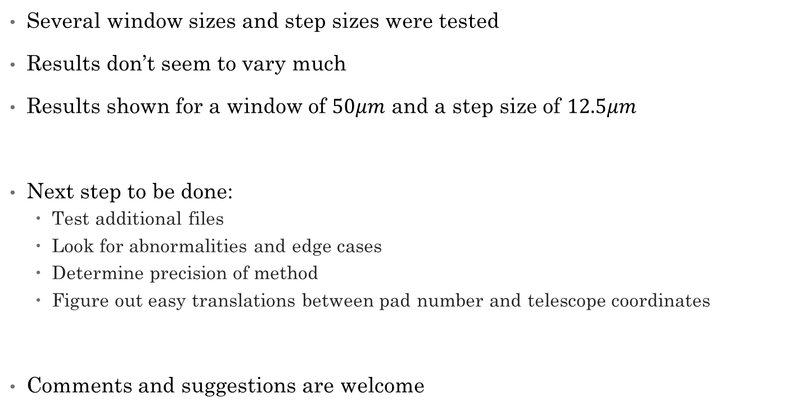
Some remarks
Several window sizes and step sizes were tested
Results don’t seem to vary much
Results shown for a window of $50μm$ and a step size of $12.5μm$
Next step to be done:
  Test additional files
  Look for abnormalities and edge cases
  Determine precision of method
  Figure out easy translations between pad number and telescope coordinates
Comments and suggestions are welcome

