Slide 1
KRANOS: K40 Radiations for Advanced Neuroimaging of Stroke
Sana Tabbassum, Priscilla Pani, Caludia Seitz, Laura Franconi
12th June 2023
DESY Zeuthen Particle Physics Mini-Retreat

Slide 2
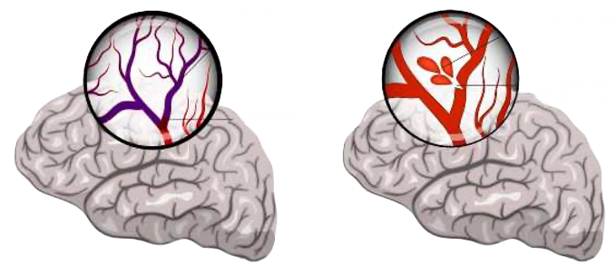
),
Stroke
Types of Stroke
anoxia
hemorrahage
A neurological disorder , sudden loss of brain function
Permanent brain tissue damage
12.2 million strokes per year (one every 3 seconds)
Leading cause of death and disability
Estimated global burden 451 billion $.
a rupture of the vessel
thrombus
Ischemic stroke: Blockage of blood flow to the brain due to a clot.
Hemorrhagic stroke: Bleeding in or around the brain from a ruptured blood vessel.
Stroke Complications and Implications
Pneumonia
Depression
Trouble walking
Brain edema
Urinary tract infection
Seizures
Vision changes
Difficulty speaking

Slide 3
Current Diagnostic Methods and their Limitations
Limited time window for accurate diagnosis
Often starts after stroke symptoms appear
Neurological Exam
Physician
Computed Tomography
(CT)
Magnetic Resonance Image
(MRI)
1
2
3
True positive 82%, True negative 83%
Standard method
Often starts after stroke symptoms appear
True positive 58%, True negative 85%
Radiation Dose
Sees tissues not elements
High Cost (~0.5 M)
Not Portable (typical)
Trained professionals
True positive 80-90%,
True negative 97%
Long acquisition time
High Cost (>1M Euro)
Not Portable, heavy
Specialized professionals
Notes:
limited time window for accurate diagnosis, high cost, and reliance on specialized equipment and trained professionals. Additionally, they may not provide real-time monitoring or offer portable options for early diagnosis and intervention.

Slide 4
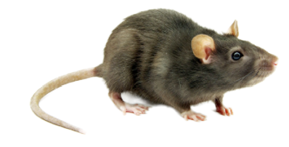
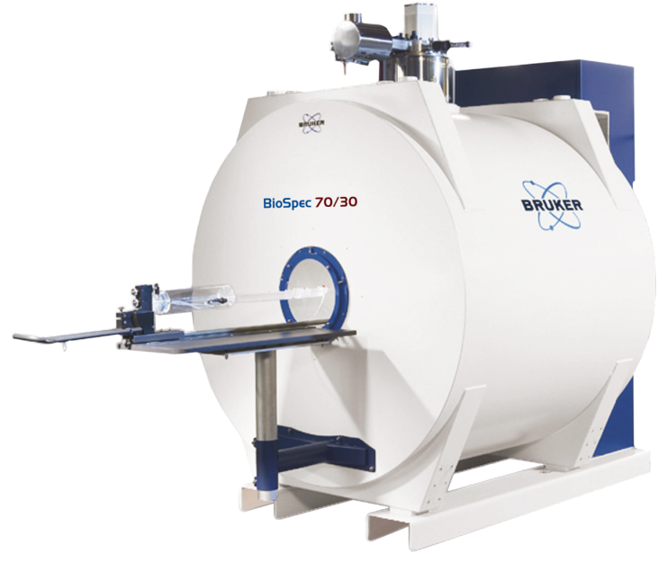
Potassium and Stroke Correlation
Naturally Occurring Isotopes of Potassium
Isotope Notation | Natural Abundance (%) | Atomic Mass | State
K-39 | 93 | 38.96 | stable
K-40 | 0.01 | 39.96 | 1.28 × 10^9 years
K-41 | 6.7 | 40.96 | stable
the area of significantly-decreased K signal corelated with stroke
The “natural” solution
9.4T MRI system (BioSpec, Bruker Biospin GmbH, Germany)
MRI Rat brain study showed that potassium distribution in the brain can be used as a biomarker for strokes
KRANOS: Non invasive imaging of Potassium in the brain but instead of K39 will use the naturally radioactive K40 1.46MeV photons
Notes:
Impaired energy metabolism is a key pathological hallmark of ischemic stroke. A reduction in glucose and oxygen supply results in severe loss of ATP production in an ischemic brain. Cerebral ischemia disrupts mitochondrial oxidative metabolism and enhances mitochondria-mediated oxidative stress. ADC is Apparent Diffusion Coefficient

Slide 5
Advantages, Objectives and Challenges of KRANOS
1.Advantages
Quick diagnostic – within window of recovery
Inexpensive (Low income Countries)
Portable
Radiation free
Future – population at risk
Screeing
personalised medicine
2. Objectives
Timely intervention during asphyxia to minimize the loss of brain cells
High detection efficiency ( = speed)
Portability ( = compact dimensions)
Background rejection
Notes:
ust to put times into perspective, in this reference an imaging of potassium in brain and arm muscle is obtained with a 7T MRI with an acquisition time of 30minutes and a spatial resolution of 1 mL voxel size. In this reference they acquire a rat image at 21T for 75 minutes with a nominal spatial resolution of 1mm3 (but lower effective one looking at the images). In this reference they show the performance of 10mm3 voxel imaging, 10min acquisition time at 9.4T. They obtain a SNR of 2.7 in these conditions.

Slide 6
Advantages, Objectives and Challenges of KRANOS
Sample 40K Event Counts in brain
Size of human brain in reference adult male ICRP23 (70kg):
brain wight 1400 g
Amount of potassium:
4g potassium
Activity concentration of K40 in the brain:
The average specific activity of K40 is approximately 32 Bq/g
which converts into 3 Bq per gram
The total activity/counts in the brain:
K40 (3 Bq/kg)*4*60
720 counts /min
3.Challenges
K40 potassium in the human body is very low.
Factors impacting counts
High sensitivity & Efficiency
Interaction probablity
Background radiation
Speed?
Price?
4.Tech Choices
Scintillation Crystal: Chosen as primary detection material
Idea ?? Maybe Compton Camera Technology in Later Stages
Notes:
ust to put times into perspective, in this reference an imaging of potassium in brain and arm muscle is obtained with a 7T MRI with an acquisition time of 30minutes and a spatial resolution of 1 mL voxel size. In this reference they acquire a rat image at 21T for 75 minutes with a nominal spatial resolution of 1mm3 (but lower effective one looking at the images). In this reference they show the performance of 10mm3 voxel imaging, 10min acquisition time at 9.4T. They obtain a SNR of 2.7 in these conditions.

Slide 7
Technology Selection: Navigating the Choices
Considered Factors
Sensitivity
Acquision time
Design Parameters
Material composition
Material Form
System’s Total structure
Background radiations
Price
# | Detectors | # PE events | Energy Resolution (E=1.46MeV) | (PE events) *(Light Yield) (photons / MeV) | Price
1 | NaI | 12 | 7-8% | 456,000 | low
2 | BGO | 87 | 8.5% | 783,000 | high
3 | LYSO | 56 | 8.2% | 1,848,000 | high
4 | GYGAG | 18 | 3-5% | 828,000 | high
5 | CeBr3 | 14 | 3.0% | 840,000 | Very high
Competitive Semiconductors
6 | CdZnTe | 16 | 1.5%
7 | CdTe | 19 | 5.5%
PE = Photoelectric events
Detectors | Readout | Material Form
Scintillator | SiPM | Monolithic Microcolumnar array (CsI) Pixeleted (Array)

Slide 8
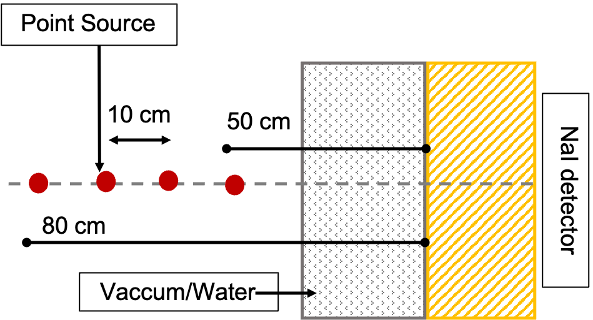
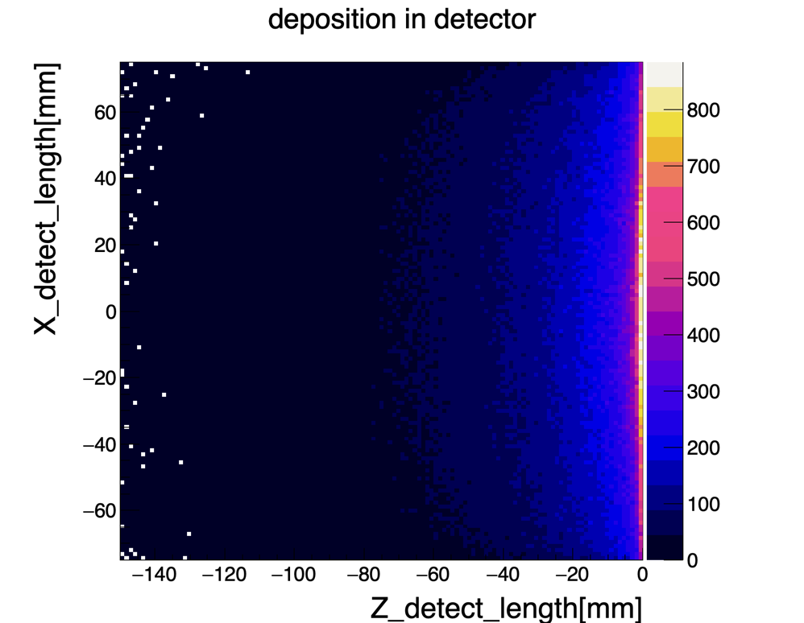
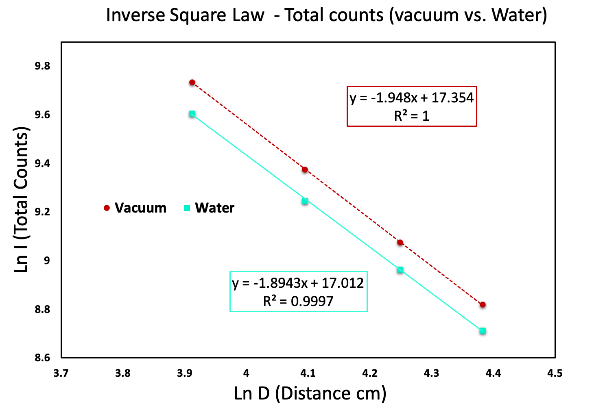
pw_m5025_top.._0000.png
Simulations and Validation Studies
Validating gamma source
Scintillation Crystal Geometry
2.5cm
# of photon deposition
Point Source
Increased the distance of the point source from the detector
Variation in observed counts fall as Inverse square of the distance
Conclusions:
Optimal thickness of detector was found to be 2.5cm with >95% absorptions of gamma

Slide 9
KRANOS Pathways
Optimization of design
Development of reconstruction algorithms
Development of background management algorithms
Proof of Principles
(Lab Setup)
Pending Applications:
- Tschira Boost Fund (80K - lab setup)
- Add-On Hertz Fellowship (12K – interdiscip- training)
- ILB Brandenburg Funding (50K - lab infrastructure)
Secured funding:
- Desy Generator Program (1 postdoc)
GoBio Initial (100K)
Close collaboration with Technology Transfer group to secure further fundings

Slide 10
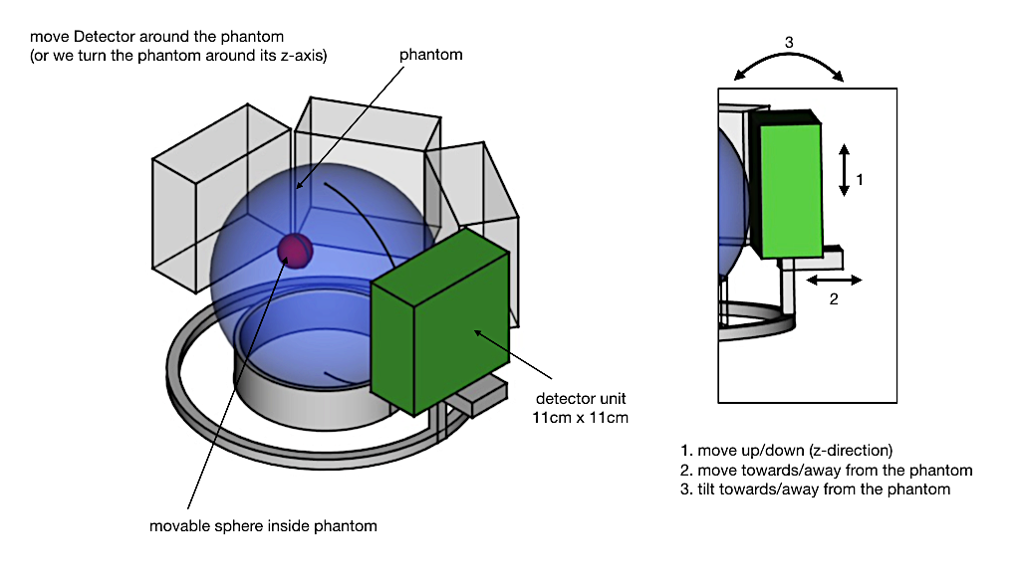
Support Needed for Lab Establishment and Validation
Additional funding required for lab setup and system validation
To conduct tests and to validate the functionality and performance of the imaging system
Potential impact of our research in advancing brain imaging technology

Slide 11
Thank You

Slide 12
Backup

Slide 13
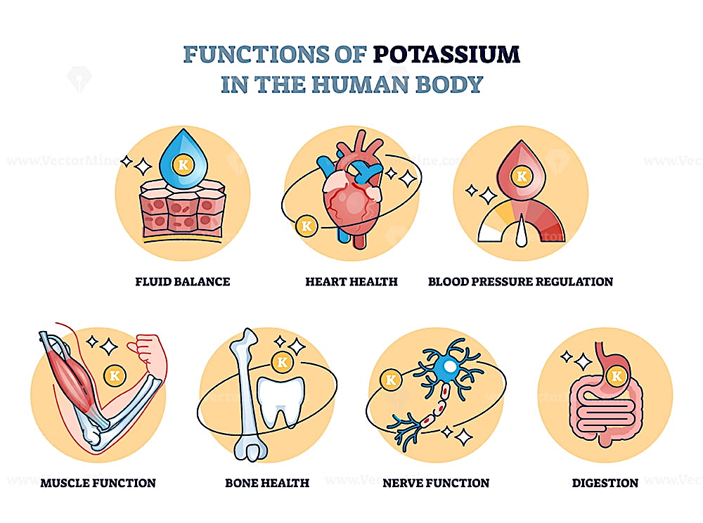
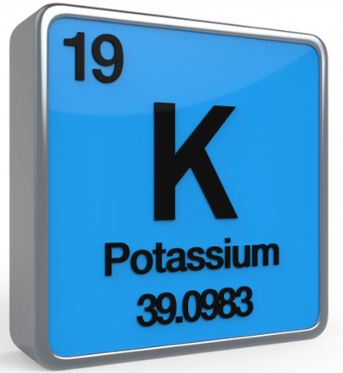
Potassium is the most abundant intracellular ion and essential mineral in the human body
Vital element physiological functions : ➤Fluid balance ➤ Muscle contraction ➤Heart function ➤ Regulation of blood pressure ➤ nerve function
Potassium homeostasis is crucial , excessive and insufficient levels
KRANOS: Non invasive imaging of Potassium in the brain
Notes:
If needed we can split this slide ito two slides

Slide 14
),
Stroke
Types of Stroke
Stroke is a neurological disorder
Sudden loss of brain function and permanent brain tissue damage
12.2 million strokes per year (one every 3 second)
Leading cause of death and disability
Estimated global burden 451 billion $.
anoxia
hemorrahage
Ischemic stroke: Blockage of blood flow to the brain due to a clot.
Hemorrhagic stroke: Bleeding in or around the brain from a ruptured blood vessel.
a rupture of the vessel
thrombus
Stroke Complications and Implications
Brain edema — swelling of the brain after a stroke.
Pneumonia — causes breathing problems, a complication of many major illnesses.
Clinical depression — a treatable illness that often occurs with stroke
Urinary tract infection — (UTI) and/or bladder control.
Vision changes, Dizziness, Difficulty speaking,
Trouble walking/Moving— shortened muscles in an arm or leg from reduced ability to move
Seizures — abnormal electrical activity in the brain causing convulsions

Slide 15
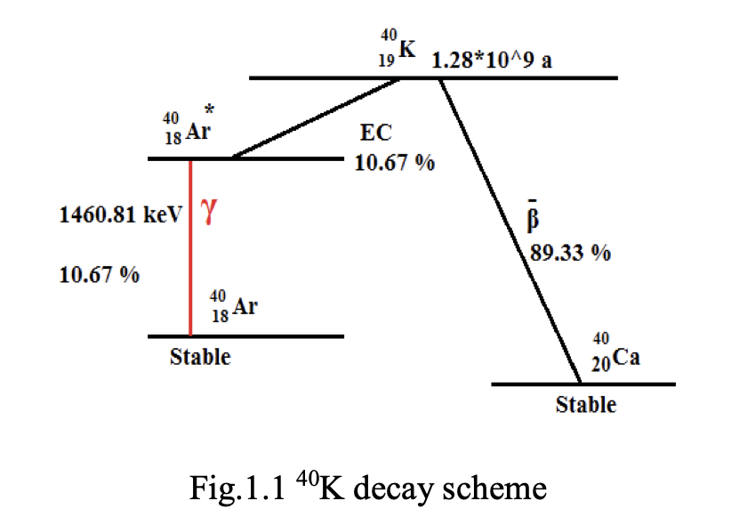
Potassium decay scheme

Slide 16
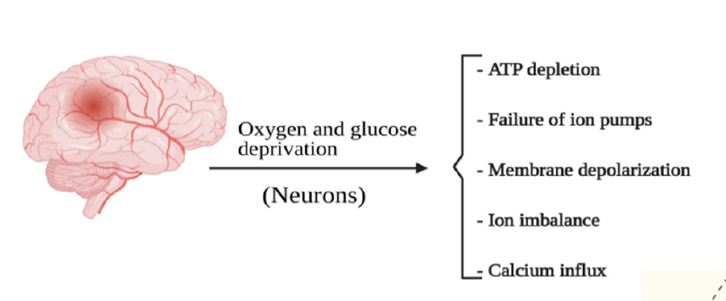
Impaired Energy Metabolism
Impaired energy metabolism is a key pathological hallmark of ischemic stroke.
A reduction in glucose and oxygen supply results in severe loss of ATP production in an ischemic brain.
Cerebral ischemia disrupts mitochondrial oxidative metabolism and enhances mitochondria-mediated oxidative stress.

