Slide 1
Dosimetry for FLASH Radiotherapy
Felix Riemer
Ph.D student
Detector development
DESY Zeuthen Particle Physics Mini-Retreat, 12 June 2023

Slide 2
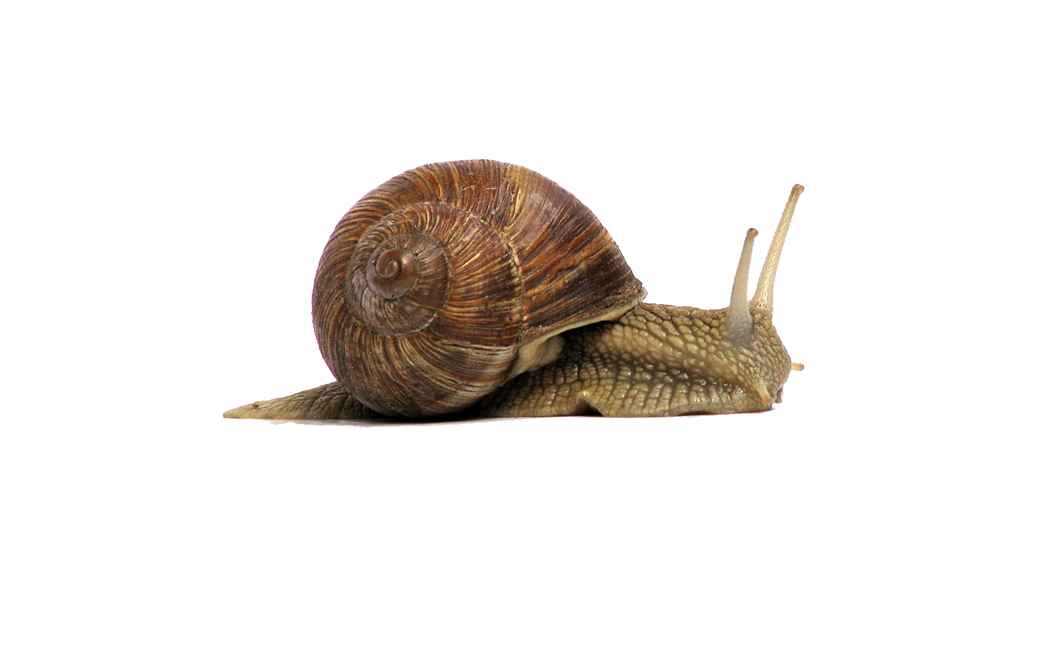

FLASH radiation therapy
The future of cancer treatment?
Conventional RT
Multiple sessions
(2 Gy per session)
Usual dose rate:
2 Gy/min
Dose: 30 – 60 Gy
FLASH RT
Dose: 30 – 60 Gy
Less than 200 ms of total irradiation
Dose rate:
> 30 Gy/s
Years of experience
Tumor control
FLASH RT
Large community working on that
Same tumor control
Less damage to normal tissue
Conv. RT

Slide 3
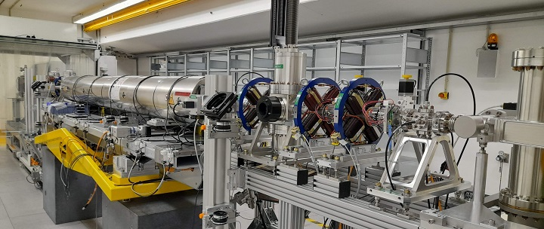
Research linac at DESY Zeuthen
New challenge: Dosimetry
Detection of a huge amount of particles in a very short amount of time
PITZ:
Up to 3x10¹⁰ particles within 30 ps
22 MeV electron beam
Gun development & optimization
PITZ
High Temporal resolution
Perfect detector
Production
of high charge & small emittance beam
High Spatial resolution
Dose rate linearity
Perfectly suitable for FLASH RT experiments

Slide 4
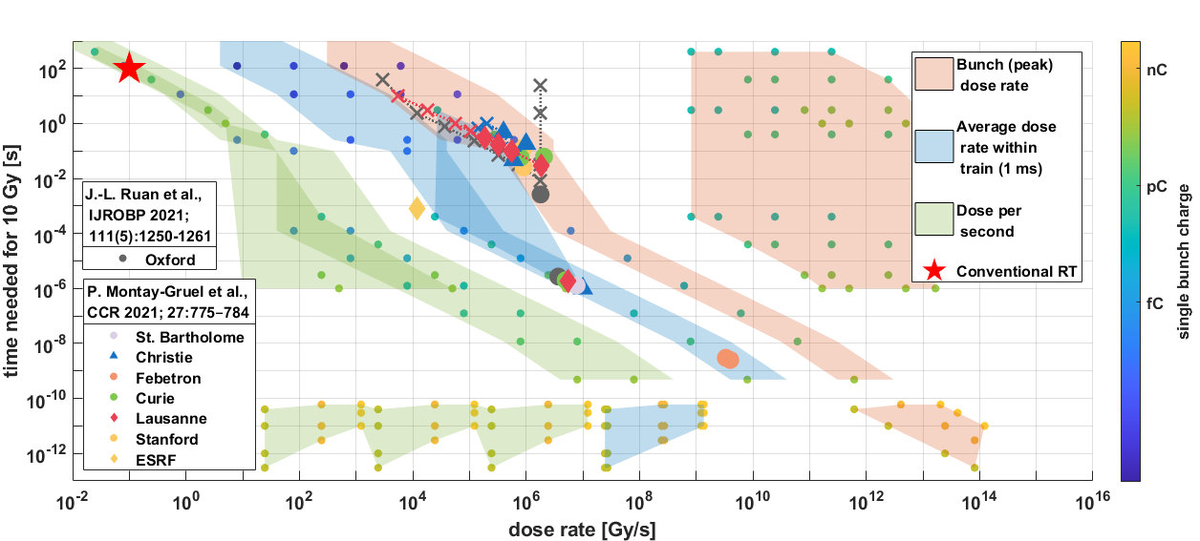
Parameter range available at PITZ
Courtesy of James David Good,
Marie-Catherine Vozenin, Jean-Francois Germond

Slide 5
Challenges of FLASH dosimetry: 3 critical parameters
Three different categories of detectors:
There is no perfect dosimeter for FLASH RT available now.
[arXiv:2006.03755 Dosimetry for FLASH Radiotherapy]

Slide 6
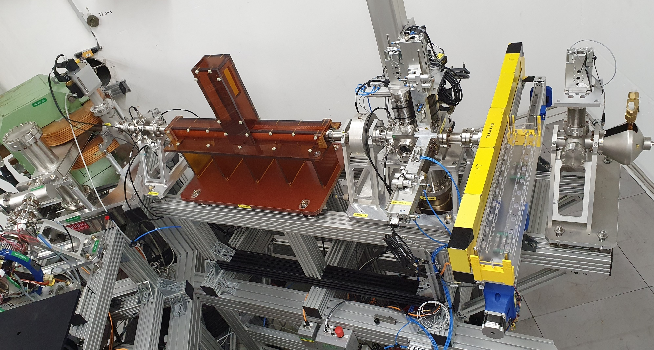
Preliminary setup of FLASHlab@PITZ
Dipole deflects the beam by 60° to the left
beam direction
ICT
Ti window
Vertical kicker
FC
Dipole
Screen
BPMs
Screen + Faraday cup
1. exp. area
➔ THz beamline
Courtesy of Frank Stephan

Slide 7
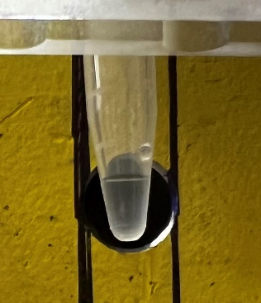
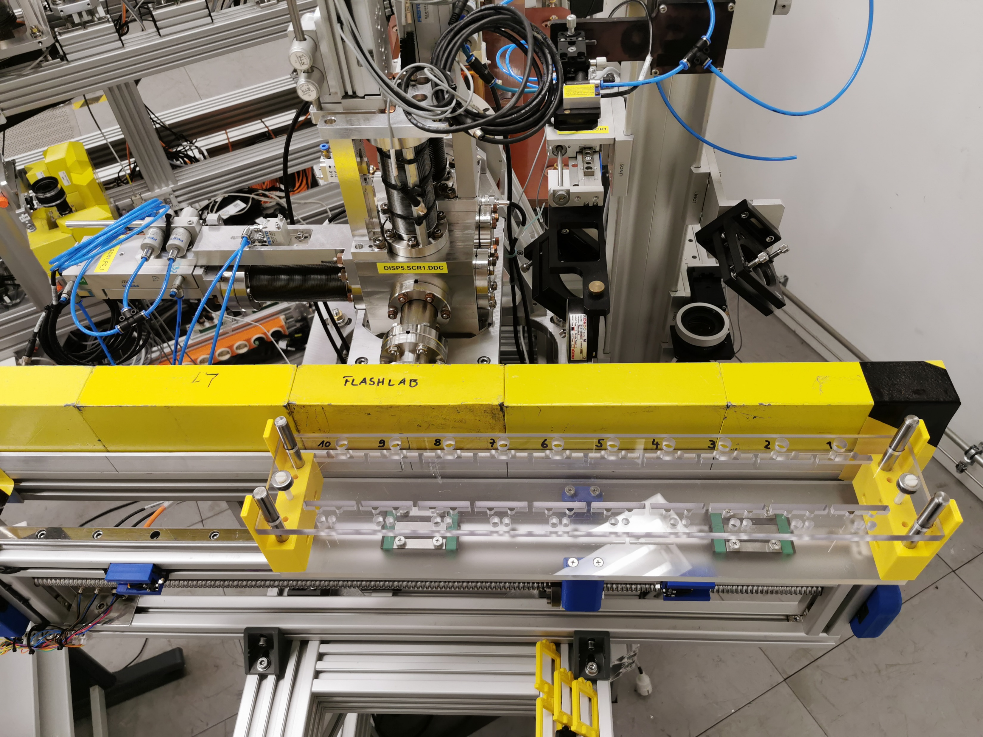
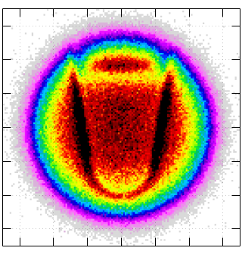
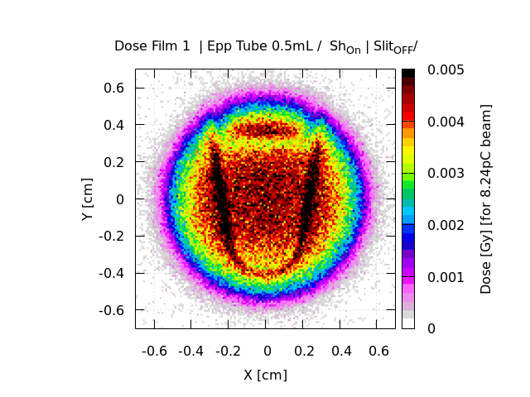
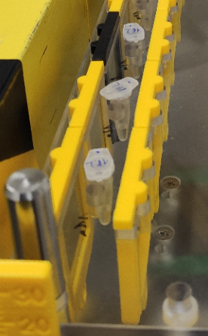
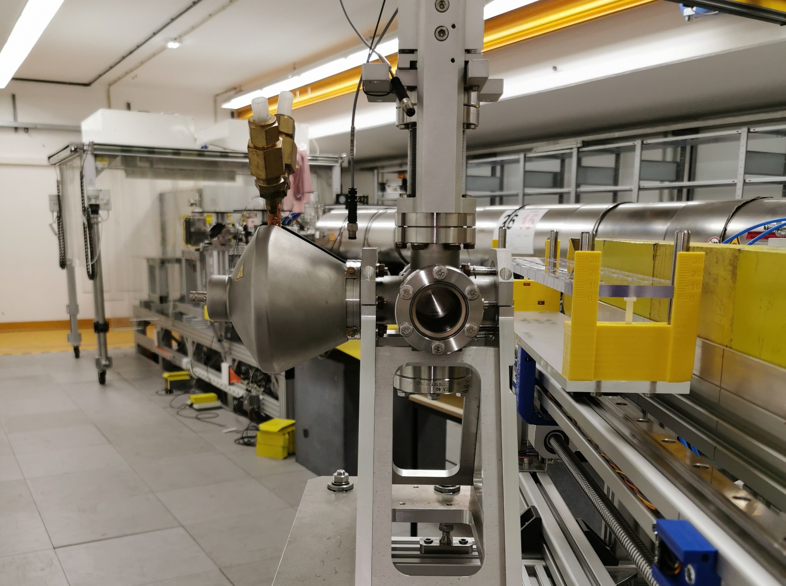


Start-up setup for radiation beamline
Courtesy of Anna Grebinyk
Sample in holder on motorized transverse stage
Dose simulation
Tube $0.5mL | Vol.:50μL$
$Dose [Gy$]
$$5∙10^{−3}$$
$$4∙10^{−3}$$
$$3∙10^{−3}$$
$$2∙10^{−3}$$
$$1∙10^{−3}$$
electrons
Courtesy of Zohrab Amirkhanyan
Dose measurement with gafchromic films
Film before tube
Film after tube
2 nC
1 b.train with 91 bunches
1 b.train with 91 bunches
Courtesy of Frank Stephan

Slide 8
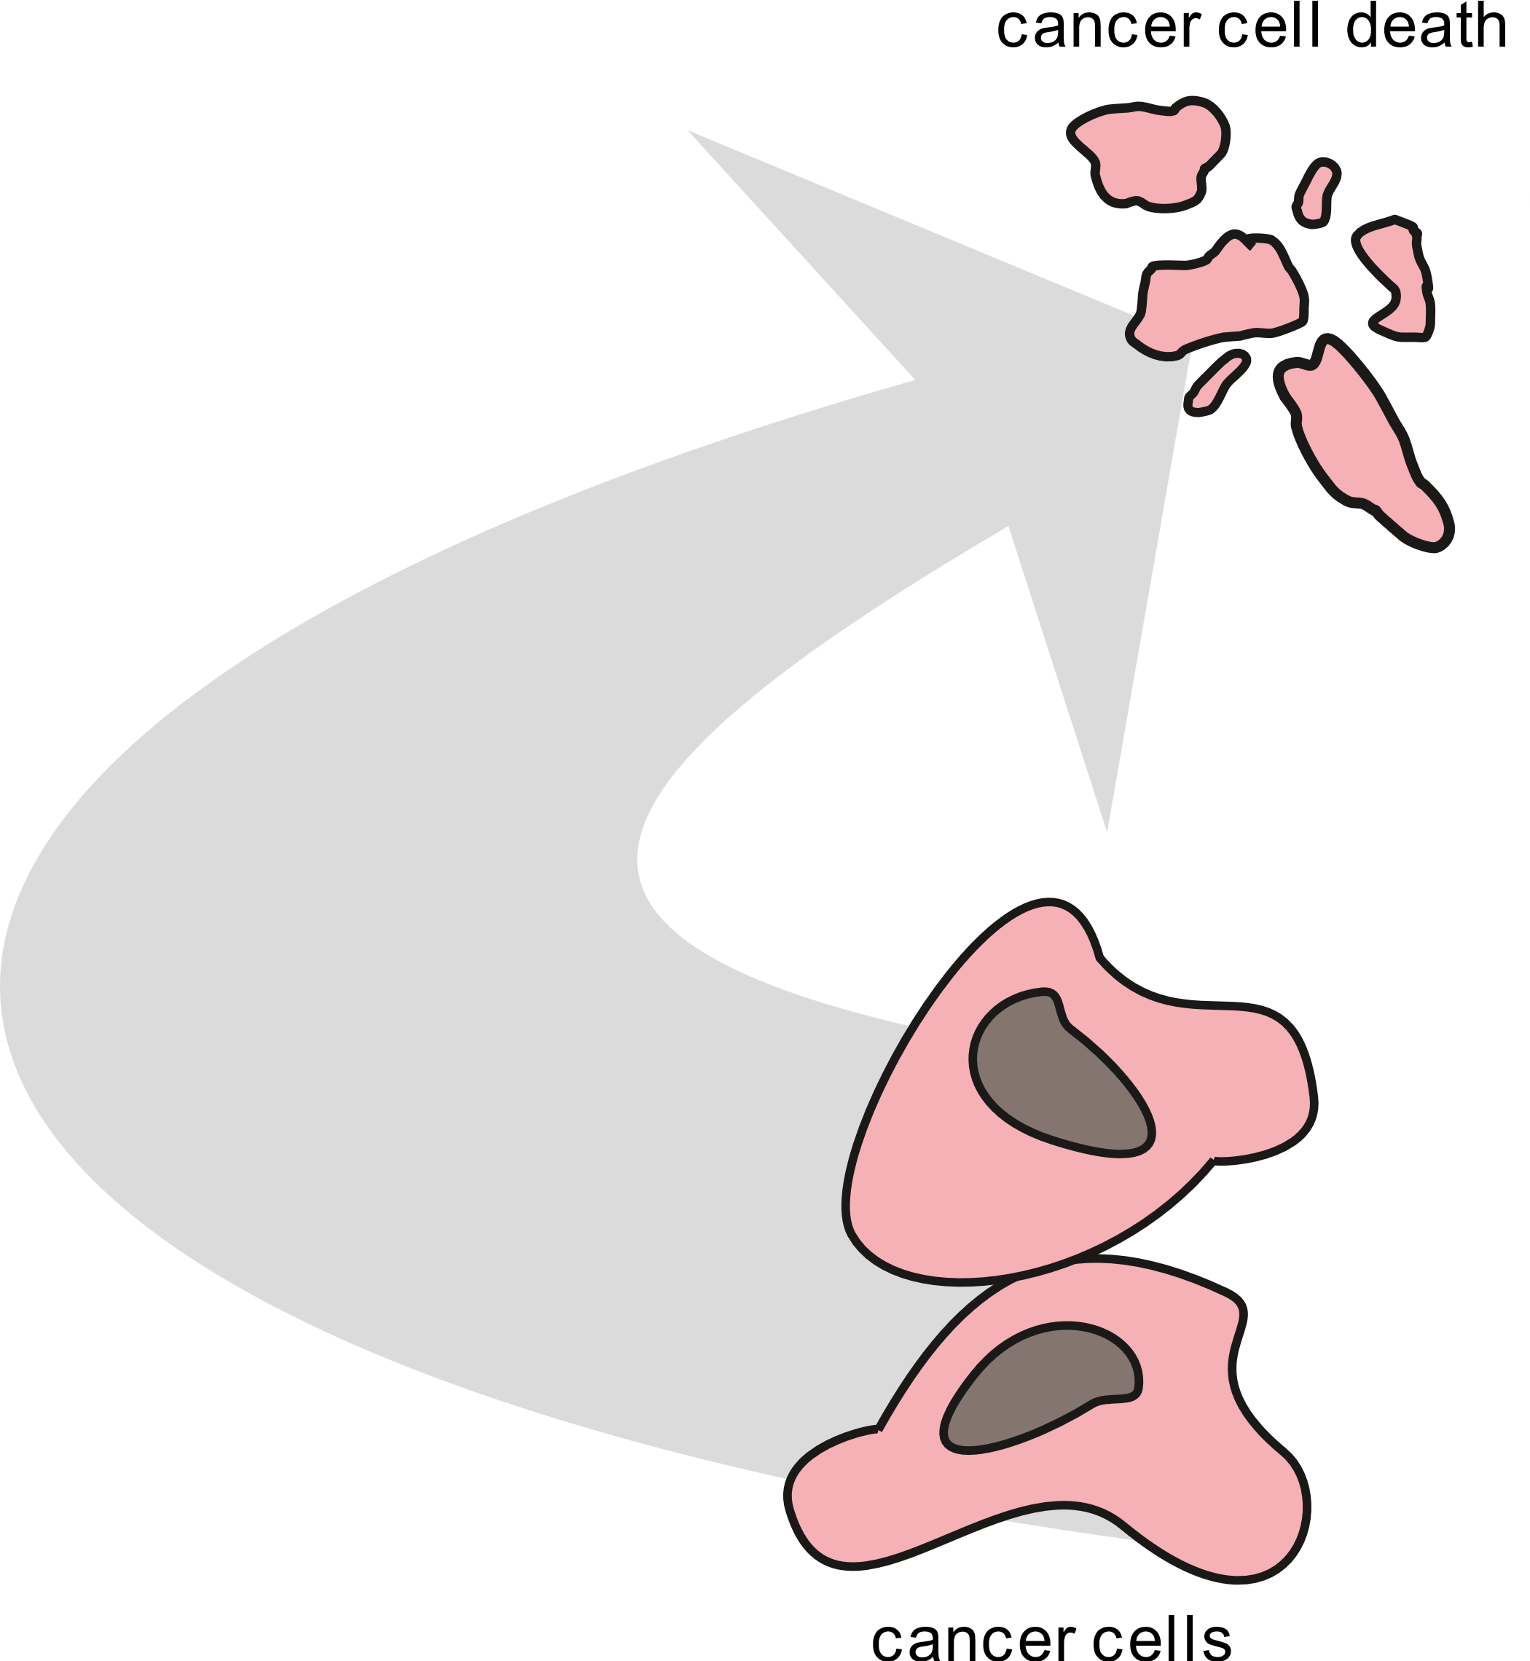

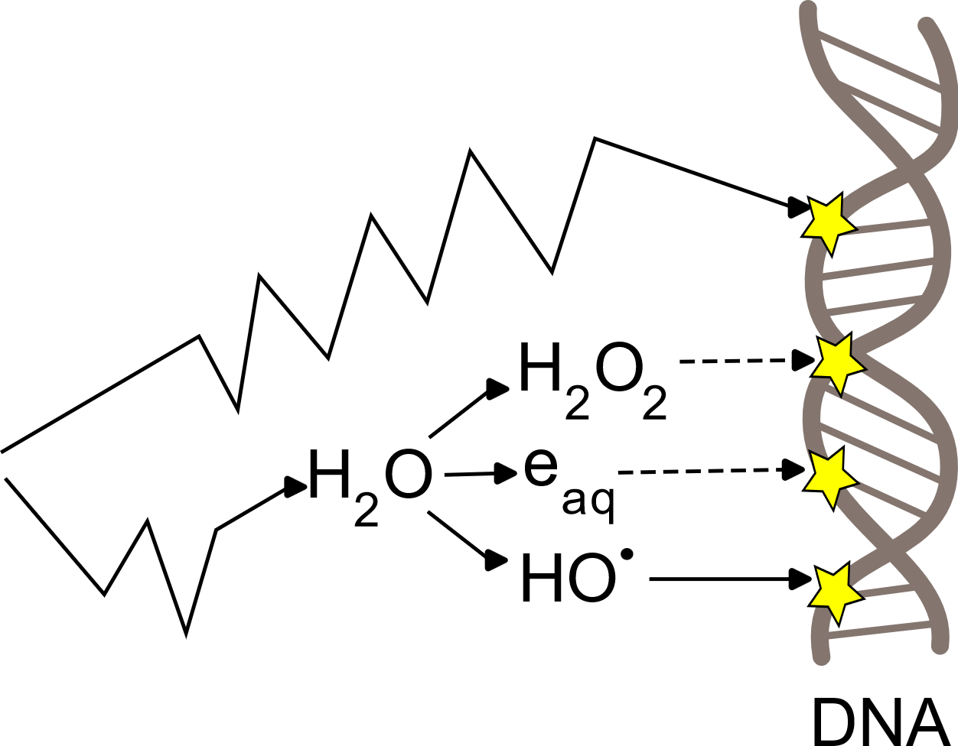
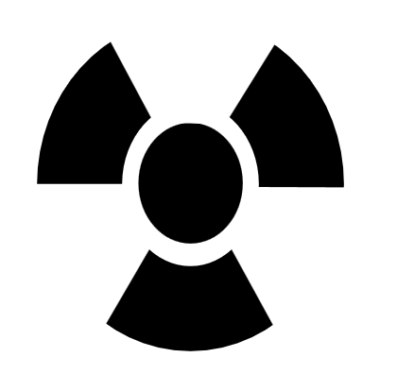


FLASHlab@PITZ: first in vitro experiments
Courtesy of Anna Grebinyk
Investigation of:
Hydrogen peroxide production
Hydroxide production
Direct damage to DNA
Experiments
Irradiation of water
Irradiation of DNA plasmid
Irradiation of cancer cells

Slide 9

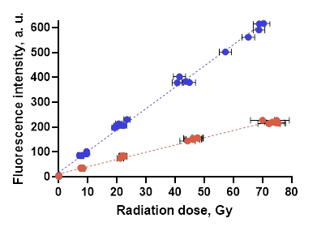
H₂O₂ & HO generation
Courtesy of Anna Grebinyk
●
●
●
H₂O
H₂O₂
H₂O
HO●

Slide 10

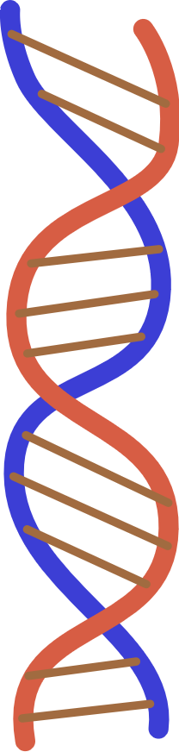
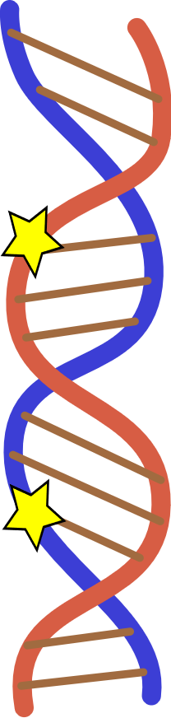
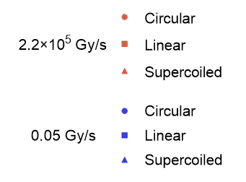
DNA damage & cancer cells
Courtesy of Anna Grebinyk
in water
DNA strand breaks
lung carcinoma cells

Slide 11
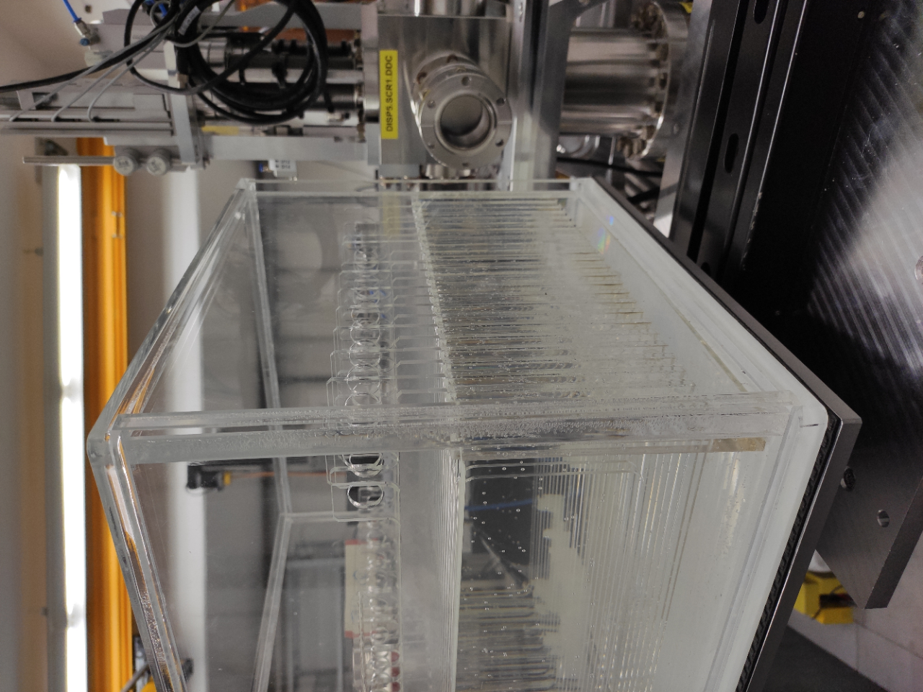
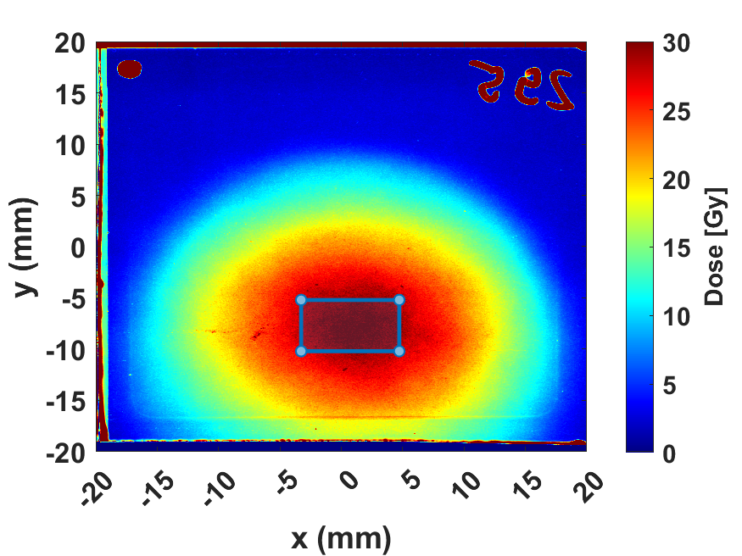
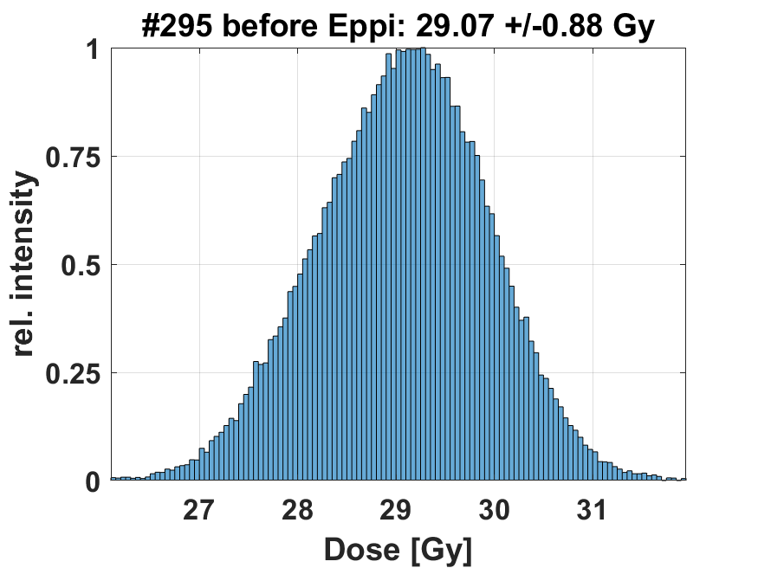
Depth dose profile and dosimetry for HZDR measurements
Preparatory dosimetry for later measurement with zebra fish embryos from Helmholtz centrum Dresden-Rossendorf
Uni Manchester/Daresbury provided water tank for depth dose profile measurements
Depth dose profile for 4 different beam parameters
Goal for HZDR: 90% homogeneity in 5x8 mm rectangle,
max dose 30 Gy
Plexiglass plates were introduced to get a more homogeneous beam: 5 & 10 mm were tested.
Result: Homogeneity was achieved with 10mm scattering plate
defocussed
Setup
Low charge beam on the outside of the phantom
Homogeneity:
90.2 %
(Definition: Deviation of max/min in ROI from average in ROI)
Result
focussed
Preliminary!
Analysis ongoing

Slide 12
Conclusion
The PITZ accelerator at DESY Zeuthen can provide conv. dose rate up to ultra high dose rate.
Setups: Water phantom & movable stage for irradiation of samples in tubes
Dosimetry: Reference dosimetry was established, more detector tests planned
Biological experiments started
  Irradiation of water: Difference between low and high dose rate
  Irradiation of DNA & cells: No difference
  Next step: Irradiation under hypoxic (less O₂) conditions

Slide 13
Publications
Paper: F. Stephan et al.: “Progress on the R&D platform FLASHlab@PITZ”, https://doi.org/10.1016/j.ejmp.2022.10.026
Poster: F. Riemer: “First dosimetry tests at PITZ”, FRPT 2022, Barcelona
Paper: Cristina Oancea et al: “Thermal neutron detection and track recognition method in reference and out-of-field radiotherapy FLASH electron fields using Timepix3 detectors”, under review (Physics in Medicine and Biology)
Talk: F. Riemer: “First dosimetry tests at PITZ”, UHDpulse meeting 2023, Prague
Talk: F. Riemer: “Dosimetry tests for FLASH RT at PITZ”, DPG meeting 2023, Dresden
Talk: F. Riemer: “Flashlab@PITZ”, Beam telescopes and test beam workshop 2023, Hamburg
Paper & Poster: Z. Amirkhanyan et al.: “Comparison of measurements and simulation results of dose for the FLASH radiation therapy beamline at PITZ”, submitted for LPR, IPAC 2023, Venice
Paper & Poster: Z. Amirkhanyan et al.: “An alternative beamline setup for FLASH radiation therapy with focused electron beams at the PITZ facility at DESY in Zeuthen: basic concept and dosimetry simulations”, submitted for LPR, IPAC 2023, Venice
Abstracts submitted:
Invited talk: F. Riemer: “Dosimetric experiments at high and low dose rates at FLASHlab@PITZ”, VHEE23, Hamburg
Talk: F. Riemer: “Dosimetrie bei FLASHlab@PITZ”, DGMP meeting 2023, Magdeburg
Talk: F. Riemer: “UHDR Dosimetry at the PITZ accelerator”, FRPT 2023, Toronto

Slide 14


Acknowledgment
DESY & PITZ team:
Zohrab Amirkhanyan, Namra Aftab, Prach Boonpornprasert, Dmytro Dmytriiev,
Anna Grebinyk, Andreas Hoffmann, Ekkachai Kongmon, Mikhail Krasilnikov, Xiangkun Li,
Frieder Mueller, Anne Oppelt, Chris Richard, Frank Stephan, Grygorii Vashchenko, Daniel
Villani, Steven Worm

Slide 15
Thank you

