Slide 1
ARES Operation Meeting
Summary of week 19 / 2023
Willi Kuropka, on behalf of the ARES crew

Slide 2
Summary of week 19
Mon. 08.05. | Tue. 09.05. | Wed. 10.05. | Thu. 11.05. | Fri. 12.05.
Tunnel cleaning FL section pin hole collimator and stages installed | X-band conditioning on load FL section collimator tests Tunnel closed | Moderate charge beam transport to FL section FL collimator tests Tested pulse shot mode and charge counter tools Further X-band conditioning | Dosimetry irradiation run with UKE using the FL section collimator more X-band conditioning | Setting up maximum charge beam transport Even more X-band conditioning
 |  |  |  | “High oil level” error on the X-band RF station
Tunnel open |  |  |  | X-band conditioning over the weekend
Achievements
Difficulties
Notes

Slide 3
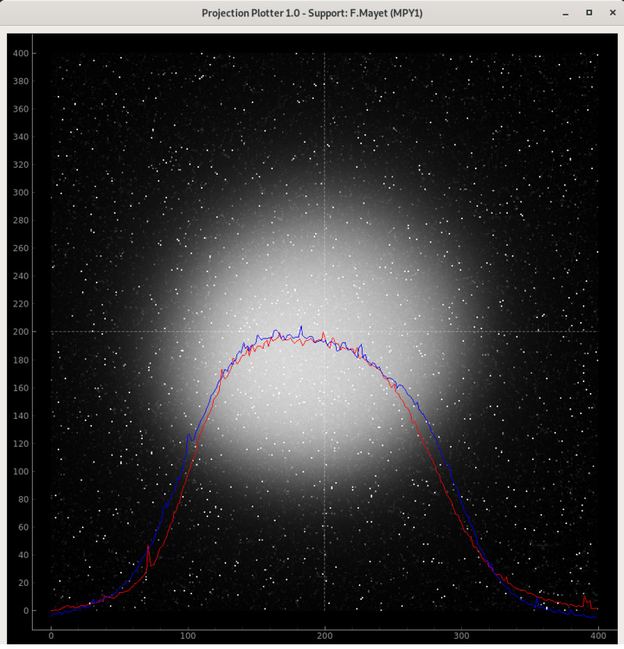
Using FL section collimator
FL.I1 in air screen station

Slide 4
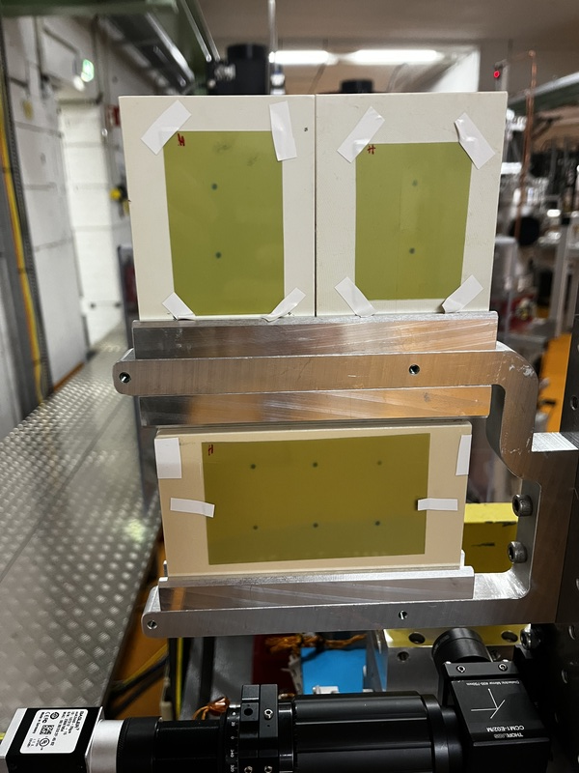
Irradiation with gaf-chromatic films with UKE

Slide 5
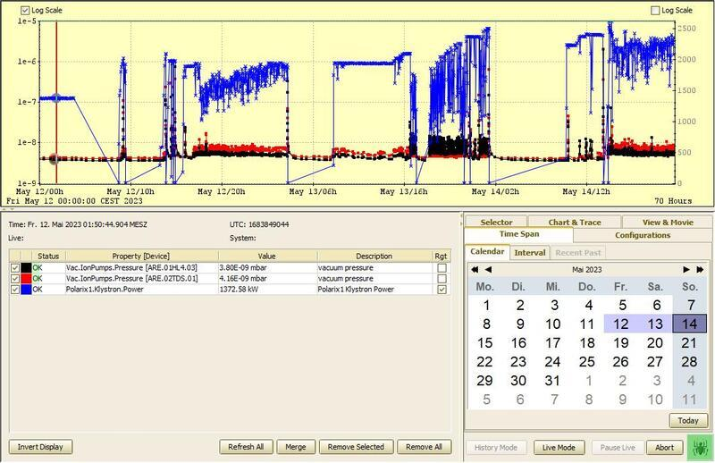
X-band conditioning on load

Slide 6
Schedule
Week 20
Date | Shift Leader
15.05. | -
16.05. | Frank (high charge setup)
17.05. | Willi (UKE dosimetry run, D3)
18.05. | Holiday
19.05. | Max (prep. For Manchester run)
If you want to learn or join the shift: please give the shift leader a call (BKR 2840 / SINBAD Box 2454)

