Slide 2
Compute/Storage at CERN What lessons for Cuba?
Humboldt Highway II - computer cluster on renewable energies Tony Cass, 2nd August 2023

Slide 3
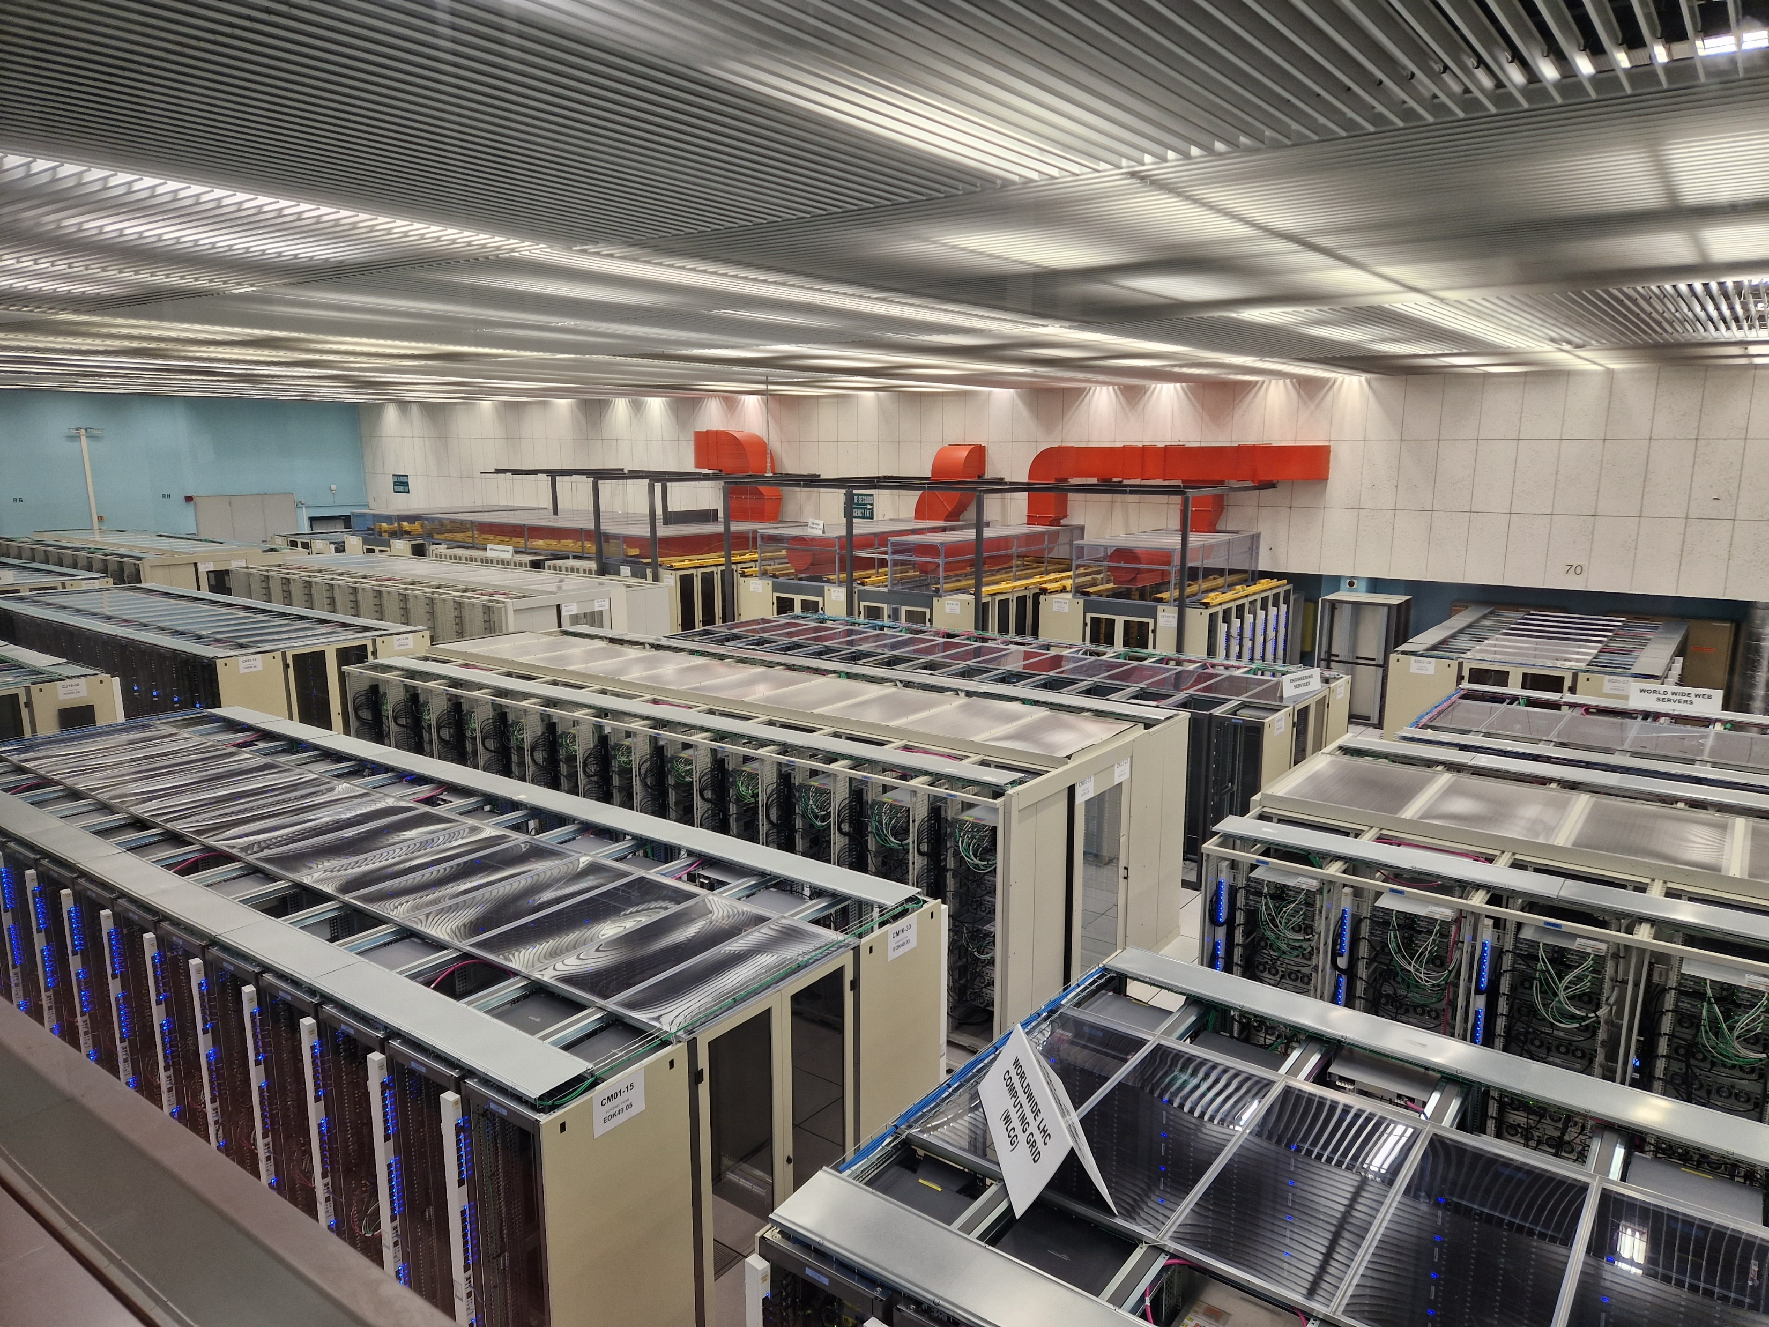
CERN clusters are big!

Slide 4
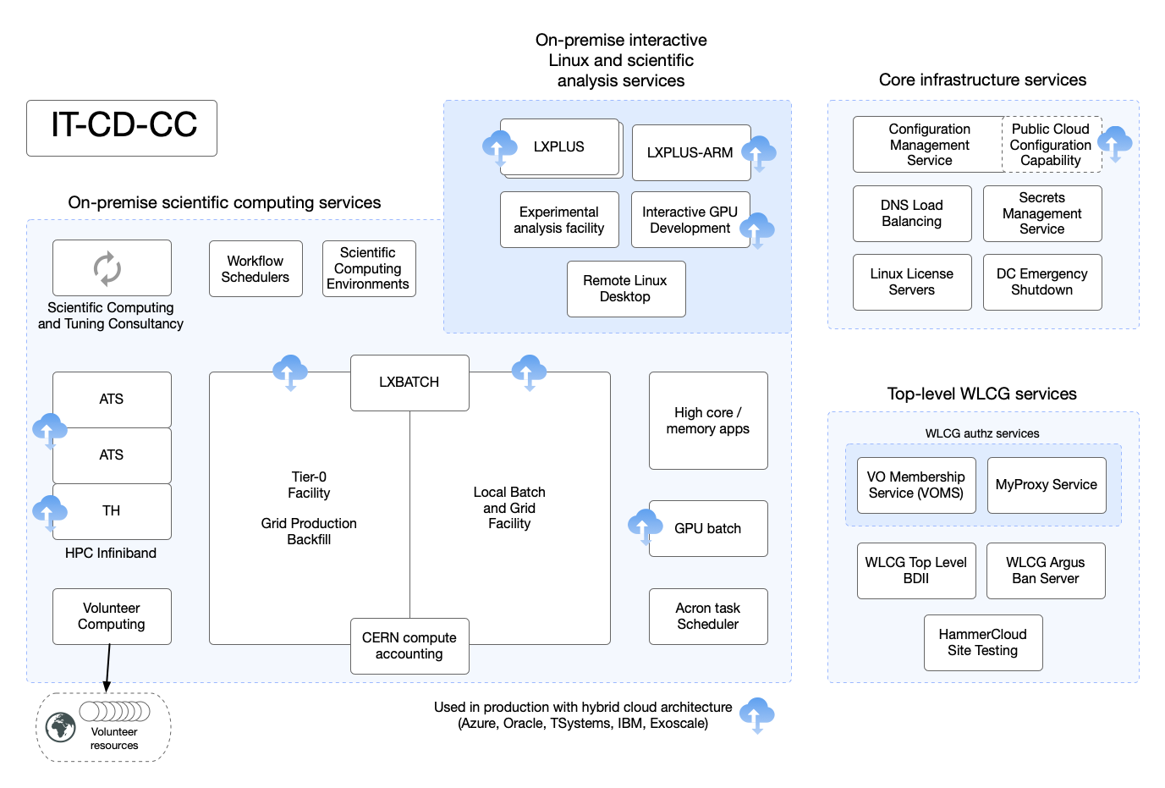
Compute and Config

Slide 5
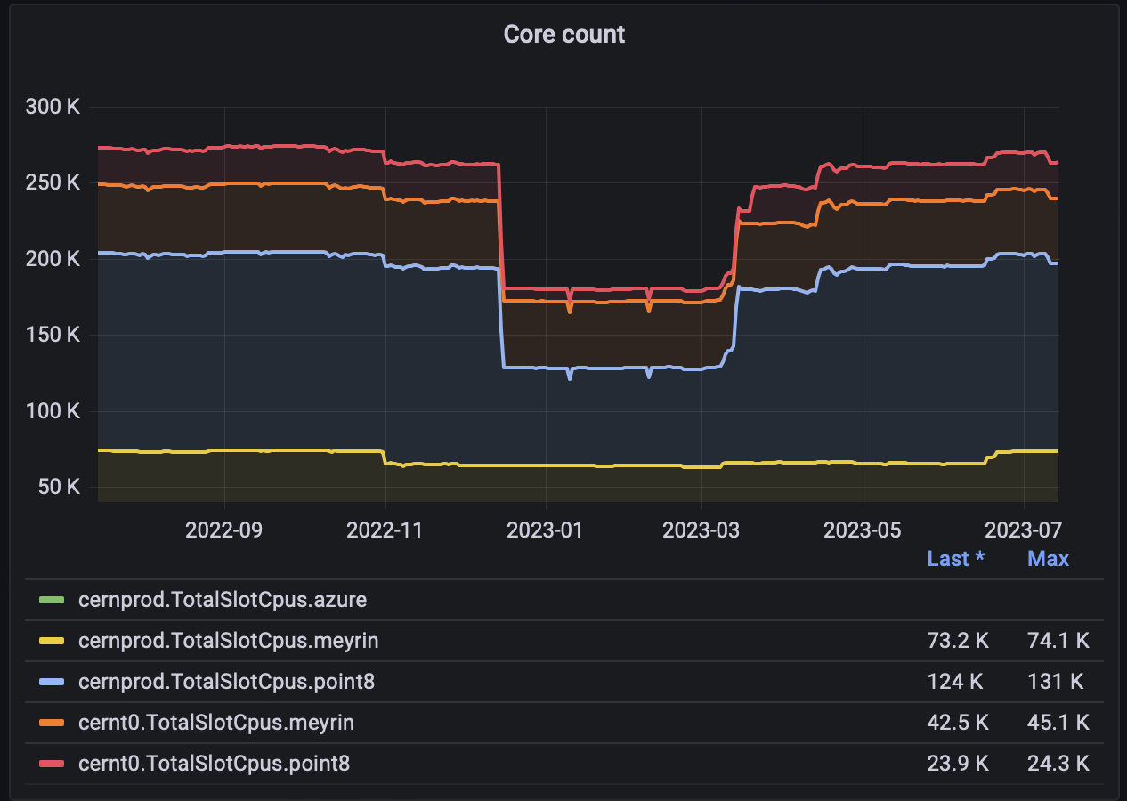
CPU type in LxBatch

Slide 6
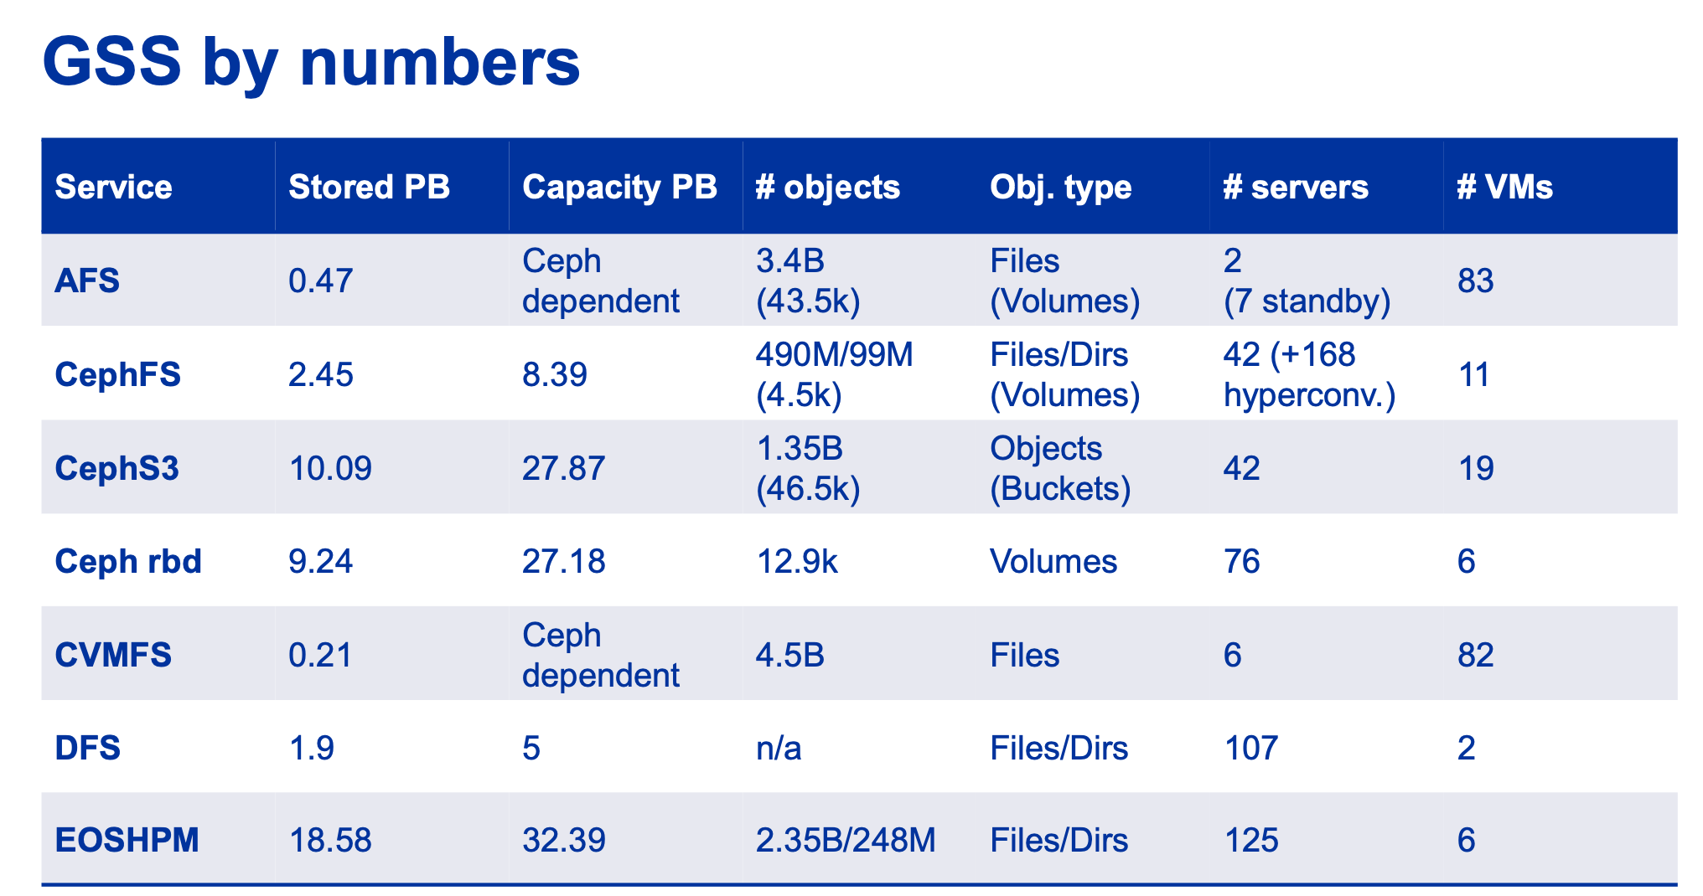

Slide 7
But…
… is any of this useful if you are planning a solar powered cluster?

Slide 8
Energy Efficient Procurement
Our tenders require
80 PLUS Platinum certified PSU
efficient power supplies with a power factor >= 0.9 for a fully loaded system
power consumption < 0.8W per HEPSPEC06
and
adjudication is on a “4-year TCO price”, so expensive power-efficient servers can beat cheap power-hungry ones.
Recently purchased systems are at ~0.32-0.37W/HS06

Slide 9
Intel/AMD or ARM?
https://indico.cern.ch/event/1106990/contributions/4991256/
https://indico.jlab.org/event/459/contributions/11823/

Slide 10
Multi-tasking storage servers
https://indico.cern.ch/event/730908/contributions/3153390/attachments/1731269/2798159/beer_k8s_bcn.pdf

Slide 11
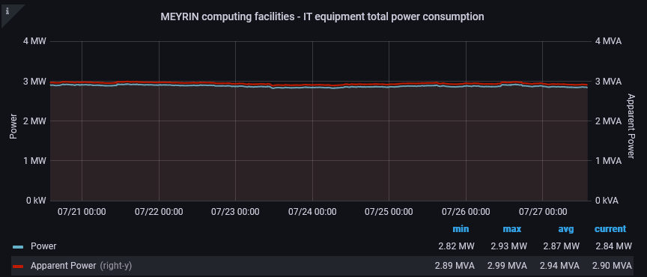
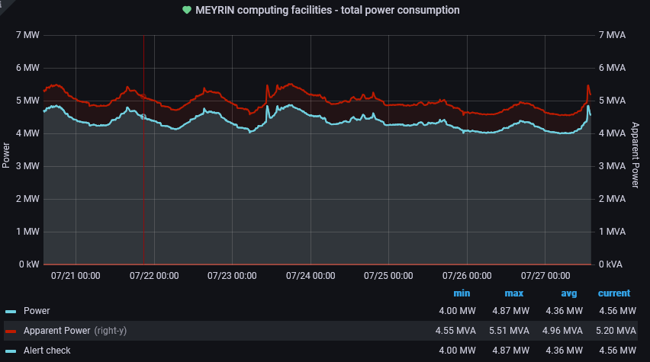
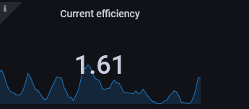
Where does that power go?
HEAT!
And cooling uses still more power:
This for a 1970s building. 1.1 or better is the target for data centres today.

Slide 12
Do you need cooling?
Parameters for CERN’s new data centre
Inlet air temperature: 25°C
ΔT: 12 °C
So, can you throttle CPU power to reduce ΔT if ambient air temperature is above 25°C?
And will servers survive if the outlet temperature exceeds 37°C?
Remember: keep inlet air and outlet air apart!

Slide 13
Summary
Consider power consumption when selecting equipment.
ARM seems the right way to go…
… but benchmark your workloads
Keep machines busy!
An idle machine is wasting precious power!
Consider (not) cooling.

