Slide 1
Compute Cluster Energy Optimization
Better Utilizing Clusters with Grid Production or Local User Jobs
Thomas Hartmann DESY IT

Slide 2
Main Cluster Flavours HPC vs. HTC

Slide 3
Job Types in the HEP Community
HTC and HPC clusters
CPU oriented scheduling
High-Throughput Clusters prevalent
HEP events can be processed embarrassingly parallel
Optimal utilization of resources
High-Performance Clusters opportunistically used by some groups
“Memory Scheduling” like Apache Spark or DASK might become more complementary
Avoiding idling CPUs with Memory focused application might be an issue
DE T2s & National Analysis Facility

Slide 4
HPC

Slide 5
HPC Cluster
HPC Cluster
Node
Node
Full Node Scheduling
End users: direct submission to compute cluster
Job scheduling per node granularity
Full node available to a job
Reasonable utilization left to the user/application
Efficient utilization of resources not (necessarily) primary goal
Job
User 1
Node
Node
User 2
Job
DE T2s & National Analysis Facility

Slide 6
HTC

Slide 7
HTC Cluster
HTC Cluster
Node
Node
Granular Job Scheduling
End users: direct submission to compute cluster
Jobs as requirements of subset of nodes, e.g., 1 core & 2GB mem
Full utilization of clusters possible
Job upstart latency can increase
8 core 16GB
User 1
1 core 2GB
User 2
Node
Node
8 core 16GB
User 3
8 core 16GB
8 core 16GB
DE T2s & National Analysis Facility

Slide 8
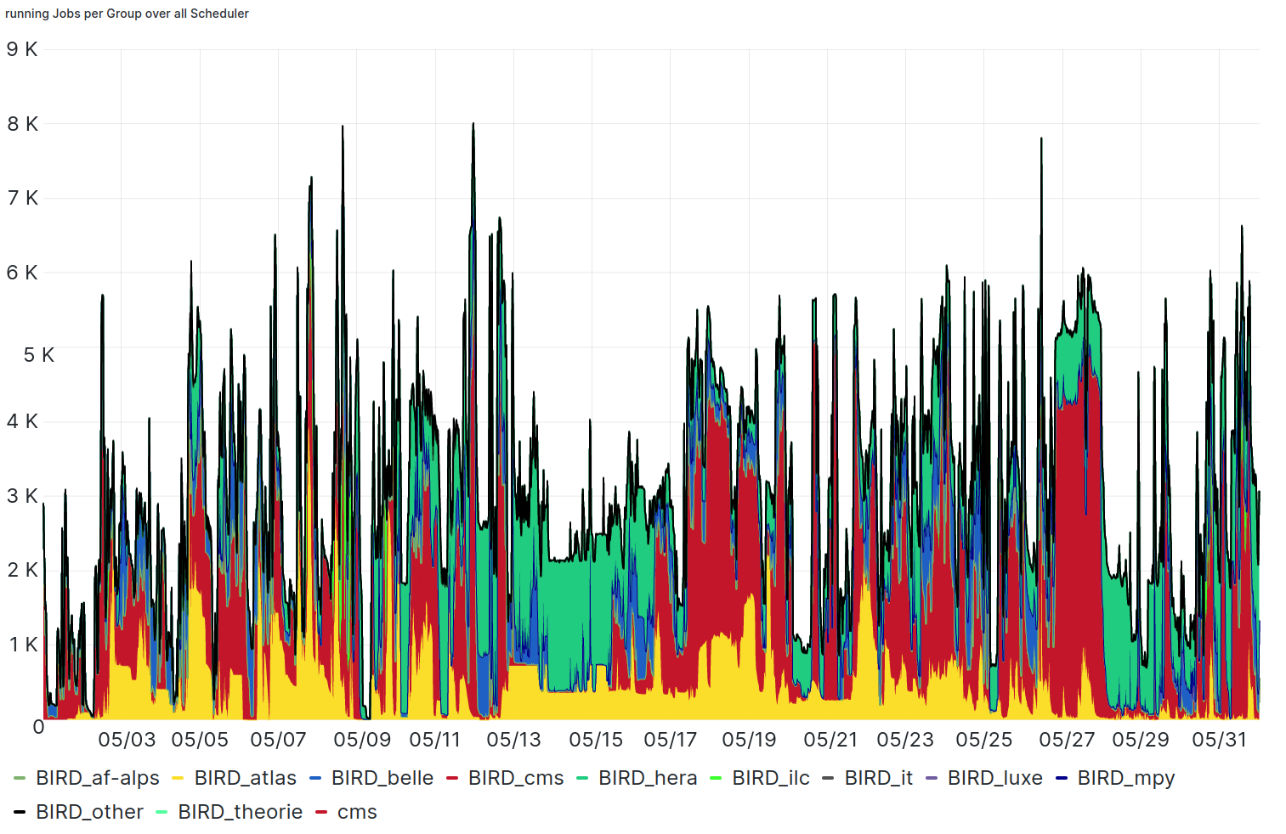
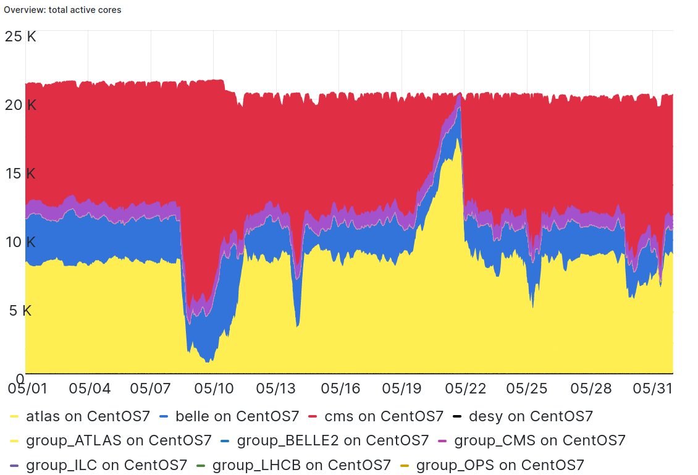
HTC Clusters
User/Job Flavours at DESY
2 HTC clusters
User jobs: NAF
Group Production: Grid
Logical separated
Same code and admin base
Differing workloads
Different energy saving options
User Jobs
Group Prod
DE T2s & National Analysis Facility

Slide 9
User Cluster: National Analysis Facility
HTCondor Cluster for German HEP Users
Individual users
Utilization dynamic
Overall utilization depends on work hours, holidays, ..., deadlines, conferences
Job start up latency relevant for user satisfaction
DE T2s & National Analysis Facility

Slide 10
Grid Cluster at DESY-HH
HTCondor Cluster for HEP Communities
Primarily HEP Groups
Centralized pilot jobs
Group Production Payloads
Goal: Full utilization 24/7/365
Job start up latency not critical
Submission indirect via “CE”
DE T2s & National Analysis Facility

Slide 11
HEP Grid Type jobs
HTC Cluster
Node
Pilot/Payload jobs
Remote (pilot) job submission through Compute Element gateways
Pilot jobs not actual physics payload
Actual payload pulled from group job factories & executed by pilot job
Final payload run by pilots potentially unknown during pilot job start
Timing dependent cluster job scheduling difficult
pilot
pilot job
...
CECA
CE
Payload
remote
remote
CECA
Group 1 Job Factory
Group 1
Group 2
DE T2s & National Analysis Facility

Slide 12
Cluster Power Shaping

Slide 13
Power Shaping per Node
Workload dependent Power Saving: Grid
Power consumption optimization depending on usage patterns
Production Workload/Cluster
Job-Life-Time dependent scheduling difficult (payload run time potentially unknown to pilots)
Cluster external power shaping
Node/kernel power shaping transparent to payloads
CPU Governor stepping driven by Green Energy availability
Node
Node
node freq ~ power usage
job run time
job run time’
DE T2s & National Analysis Facility

Slide 14
Cluster-wide Power Shaping
Workload dependent Power Saving: Users
User Clusters with more dynamic utilization
Potentially higher job entropy
Cluster intrinsic power shaping
Horizontal vs. vertical scheduling
Cluster compression
price: higher job upstart latency/entropy
More aggressive node shedding
Opportunistic node ramp up with backfill workloads on standby
DE T2s & National Analysis Facility

Slide 15
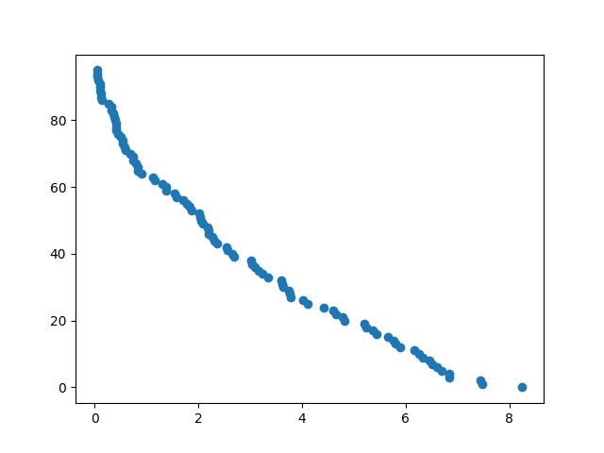
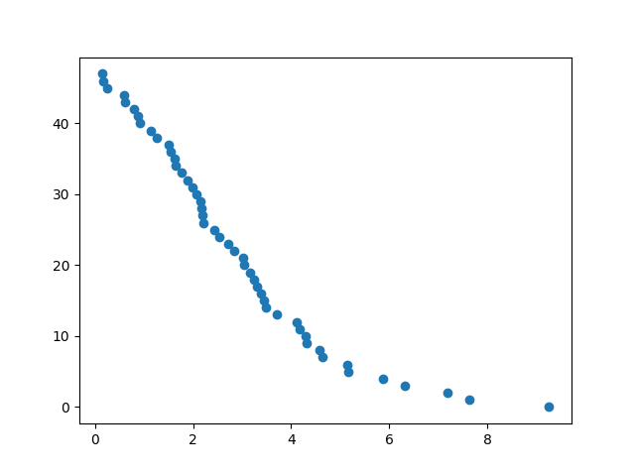
Preemption: Job Shedding minimizing Cycle Waste
User Side Implementation Necessary
96 Core
Draining Cluster/Nodes
Wasting idle CPU cycles
Hard Node shedding
Wastes all CPU cycles so far of active jobs
Ideally: Pre-emptable Jobs
Grace Period SIGTERM ⟶ SIGKILL
Snapshot/Stage results so far
Requires: User Side Implementation...
A_{Ineff}
A_{util}
48 Core
B_{cutt}
Simulation: Node Utilization while Draining
DE T2s & National Analysis Facility

Slide 16
Green Energy Driven Computing

Slide 17
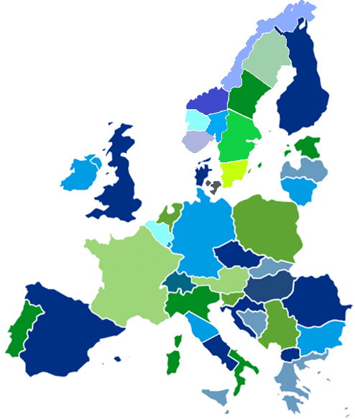
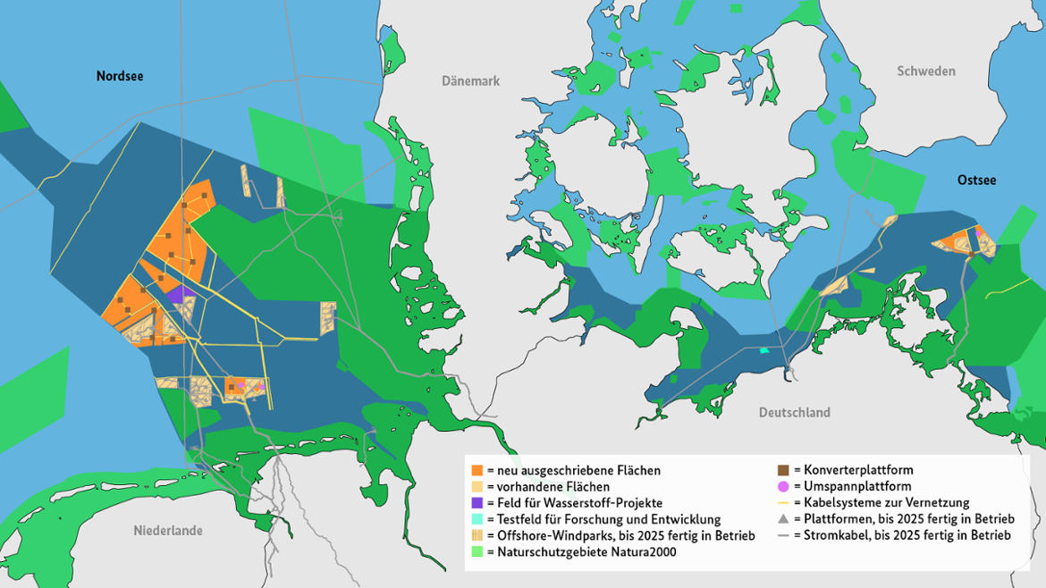
Cluster Power Shaping
European energy market bidding zones https://fsr.eui.eu/electricity-markets-in-the-eu/
Positive/Negative external energy incentives
Positive Incentive: Surplus of green energy, i.e., depressed prices
Job fan out to opportunistic resources
Opportunistic green energy sink with opportunistic computing
Offshore wind farms (general weather patterns)
Photovoltaics (night/day cycle + general weather patterns)
limited transport capacity to southern Germany
Negative Incentive: Lulls of green energy resources
CPU frequency throttling
High responsiveness, smaller savings (baseline power consumption)
Node shedding
Low responsiveness, larger savings (depending on draining efficiencies)
HH
ZN
https://www.offshore-windindustrie.de/windparks/deutschland

Slide 18
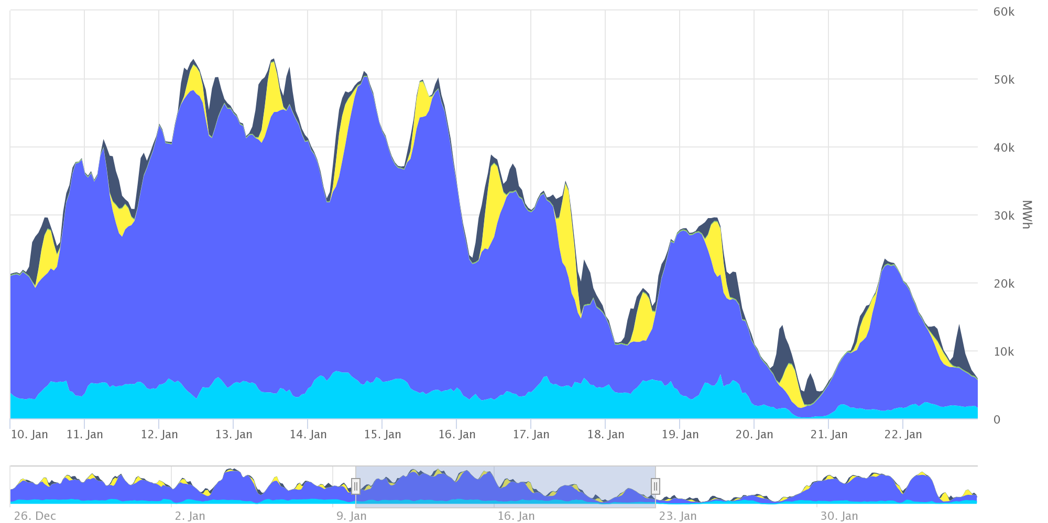
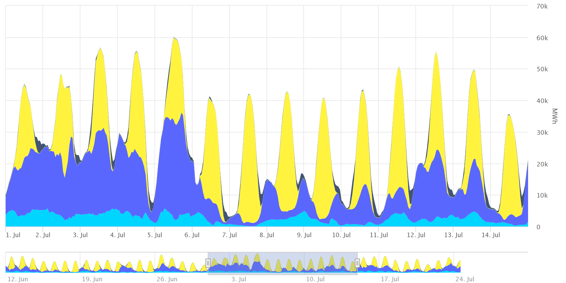
Green Energy driven Cluster Shaping
https://www.smard.de/en/marktdaten?marketDataAttributes=%7B%22resolution%22:%22day%22,%22from%22:1672527600000,%22to%22:1675205999999,%22moduleIds%22:%5B1004066,1001226,1004067,1004068,1001228,1001224,1001223,1004069,1004071,1004070,1001227,1001225%5D,%22selectedCategory%22:null,%22activeChart%22:true,%22style%22:%22color%22,%22categoriesModuleOrder%22:%7B%7D,%22region%22:%22DE%22%7D
Short & mid-term green energy variations
Winter ~= Wind
Northern Germany: offshore wind farms nearby + photovoltaics
Green Energy with seasonal variations
Winter ~= Wind ~= mid-term variation O(days)
Summer ~= Solar ~= short-term variation O(interday)
~~> adaptable compute cluster wrt. Green Energy patterns/frequencies
Short-term ~ throttling/short term
Mid-term ~ shedding/ramp-up
🌬
🌞
Summer ~= Photovoltaics
🌞
🌬
Green Energy Contributions: January / July
DE T2s & National Analysis Facility

Slide 19
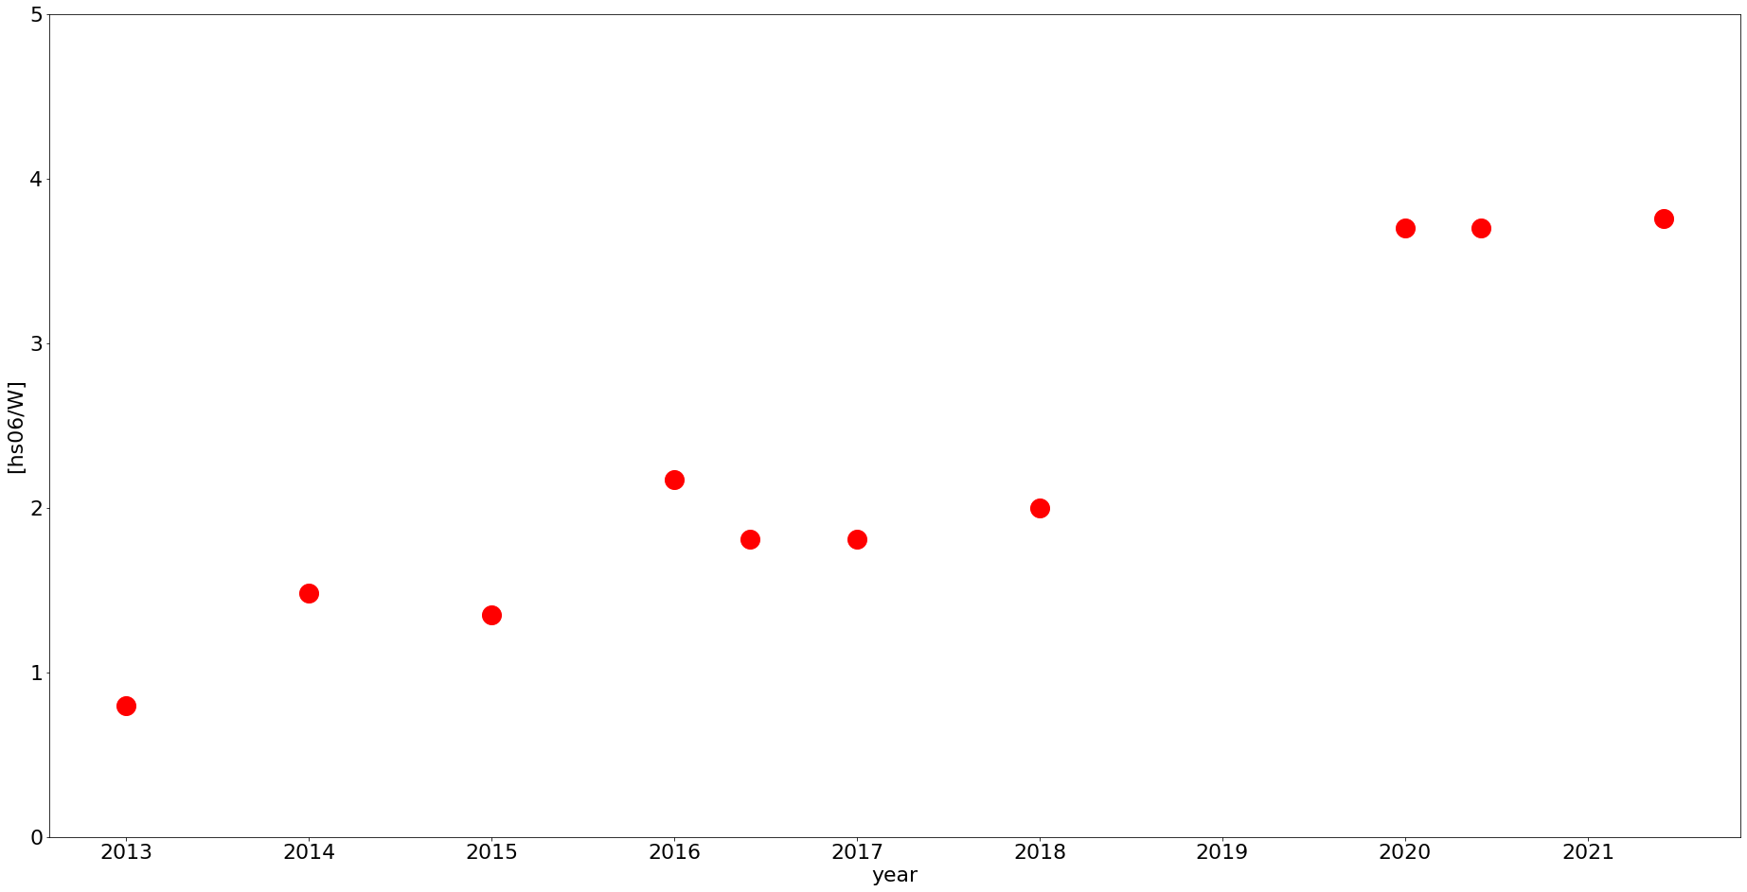
Architecture/Generation Energy Efficiency
CPU Efficiency per Electric Power Consumption
Significant efficiency gains with recent microarchs (aka Zen)
CPU compute power per Watt gain ~4x from oldest workers still in production
Old, energy inefficient nodes as dynamic moderators for shedding/fan out
Shaping Frequency depending on production job run time/draining rate
hs06 per Watt
year/microarch

Slide 20
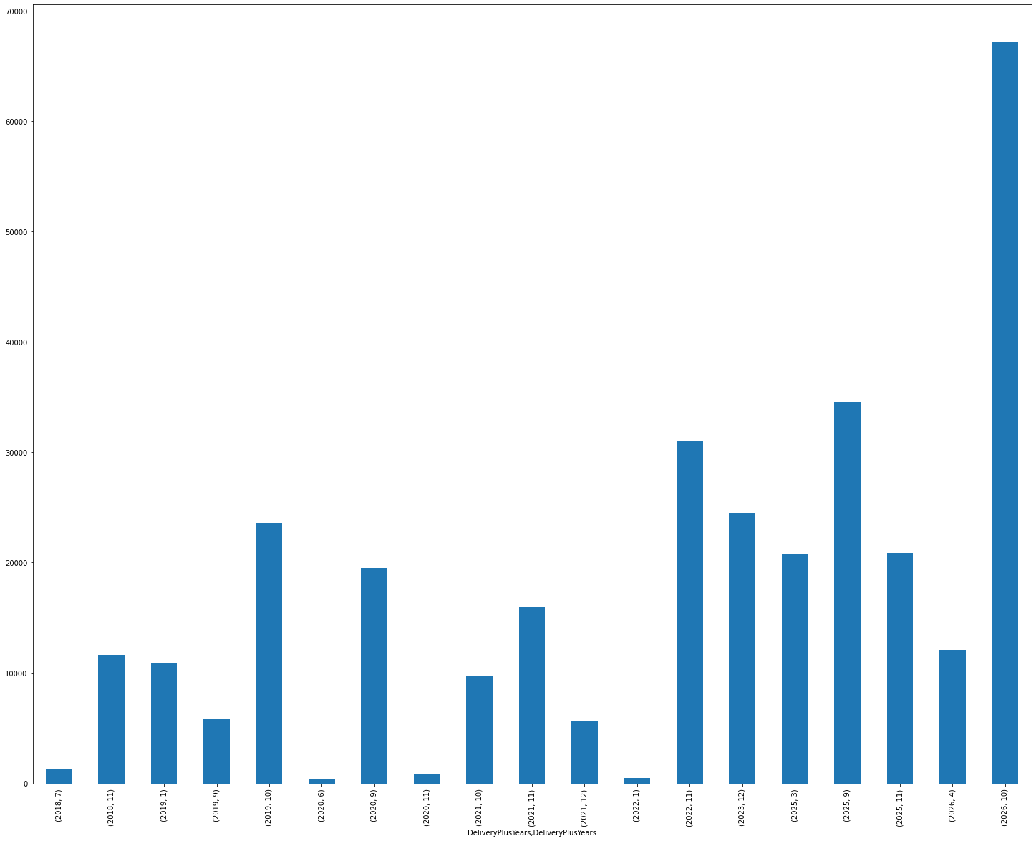
Production Cluster Energy Efficiency
pledge high efficiency cluster
WattHours consumed for HS06 delivered
E.g.
target deliverable: 1000 kHS06
“combo” cluster: ~410 kWh
“high efficiency” cluster: ~298 kWh
“low efficiency” cluster: ~587 kWh
Low efficiency cluster as opportunistic resource
Load shedding when necessary
Scheduling has to be adapted
opportunistic low efficiency cluster
DE T2s & National Analysis Facility

Slide 21
Opportunistic Resource Utilization
Utilizing surplus green energy
Complementary to load shedding
Node ramp up O(~minutes)
O(shedding)? Depends on payload runtimes and overall cluster job entropy
Need interface to weather/green energy pricing forecasts
helper HTCondor Daemon with external input for cluster shaping?
Damping wavelengths by payloads
How to avoid significant draining idle waste cycles
Backfilling short jobs?
Assist users implementing preemption?

Slide 22
Final Thoughts

Slide 23
Final Thoughts
Utilizing surplus green energy
Green Energy will bring down compute costs
When done right!
Compute as flexible sponge for Green Energy
Have to become more flexible & dynamic
Dynamic cluster requires the input and input processing
Better monitor the clusters themselves
Monitor external factors
Green Energy Feedback Cluster Control

Slide 24
Appendix

Slide 25
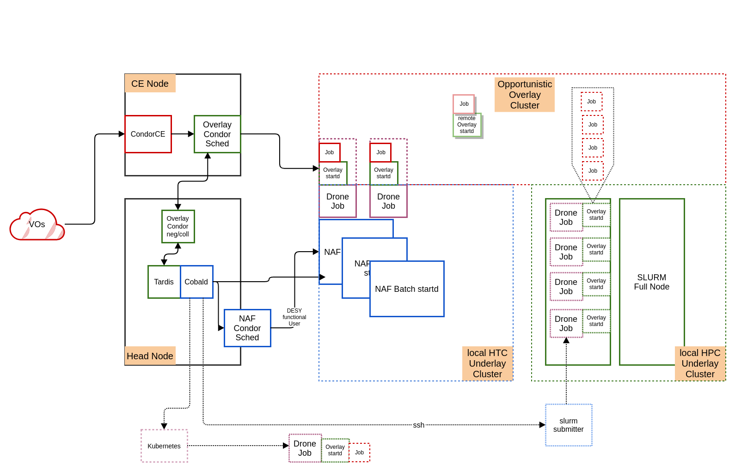
Opportunistic Resource Utilization
Dynamic Overlay Cluster ~ Breathing Scale up/down

Slide 26
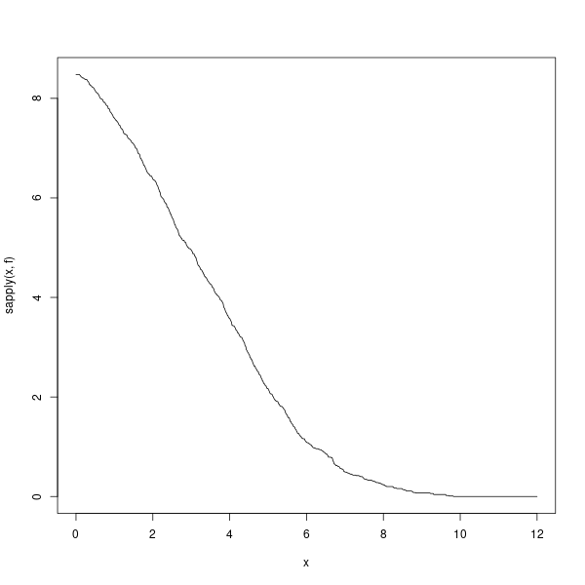
Load Shedding: Worker Draining
Worker Draining Projections
Without scheduling information only statistic estimates
Efficiency stochastic draining vs. scheduled draining
Load shedding efficiency
Utilization drain start and shut/cutt off
Simulation + analytic projections (K. Severin, L. Mansur, L. Janssen)
ATLAS jobs ~= 6h lifetime Gaussian + 2h width
Old 48 core workers & new 96 core workers
What draining inefficiency acceptable?
Going more for vertical scheduling?
96 Core
A_{Ineff}
A_{util}
48 Core
B_{cutt}

Slide 27
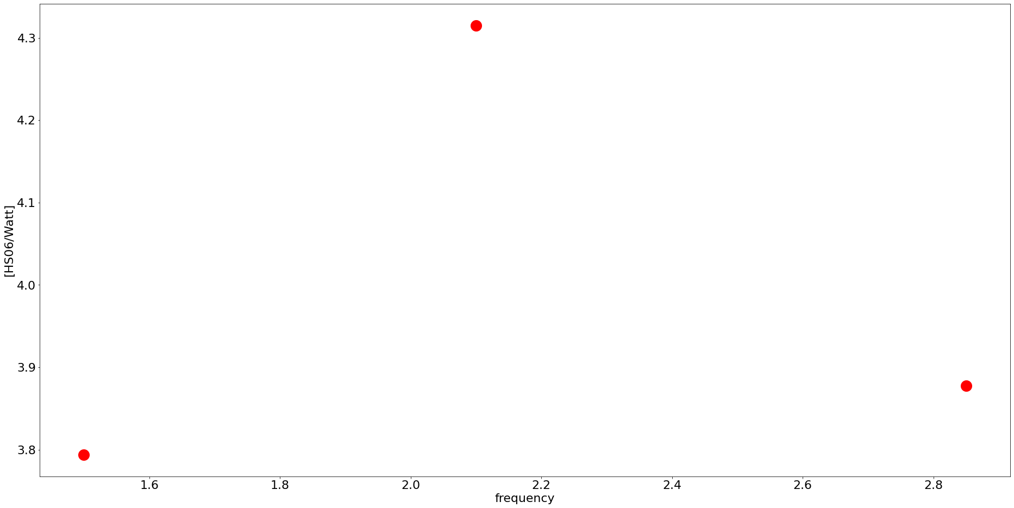
Worker Frequency Scaling
CPU Govenor Scaling vs/ Sub-Clusters
Zen only three freqs with 3.10
Idle offset ~150W
Normalized to HS06 benchmark runs
Efficiency sweet spot at mid freq
recap: 1000 kHS06 delivered
“uncapped combo” cluster: ~410 kWh
“min freq combo” cluster: ~419 kWh
“high efficiency” cluster: ~298 kWh
HS06/Watt
fix base frequency

Slide 28
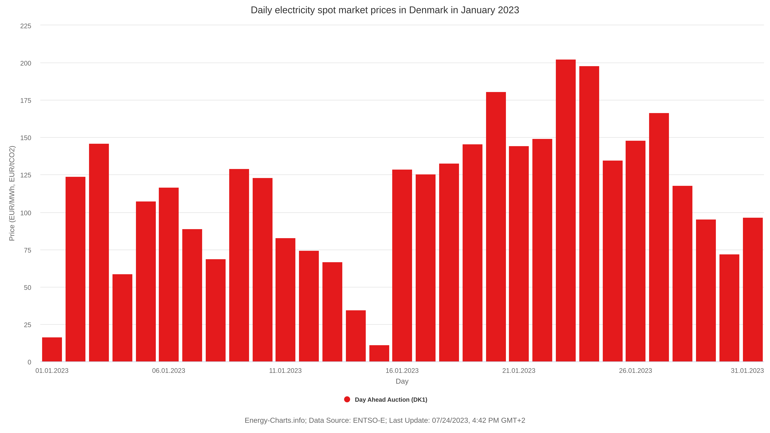
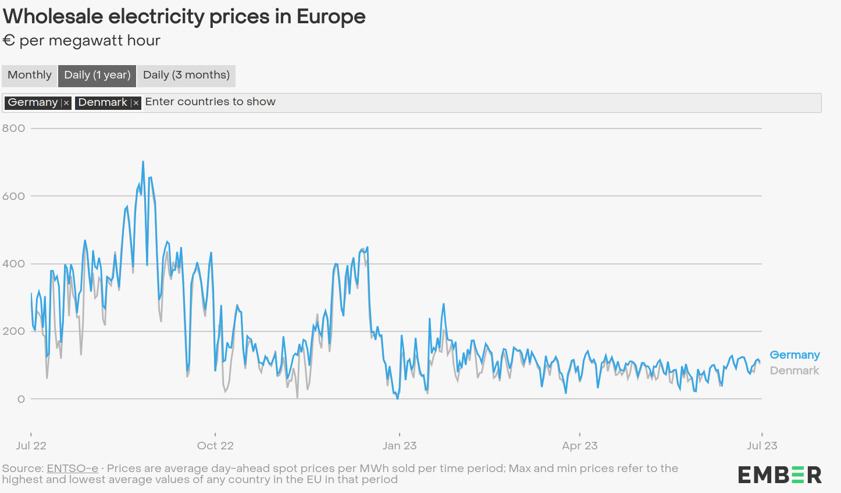
Energy Prices
Germany/Denmark
https://energy-charts.info/charts/price_average/chart.htm?l=en&c=DK&chartColumnSorting=default&interval=day&day=m01&legendItems=100
https://ember-climate.org/data/data-tools/europe-power-prices/
https://energy-charts.info/charts/price_average/chart.htm?l=en&c=DE&chartColumnSorting=default&interval=day&day=m01
DE T2s & National Analysis Facility

Slide 29
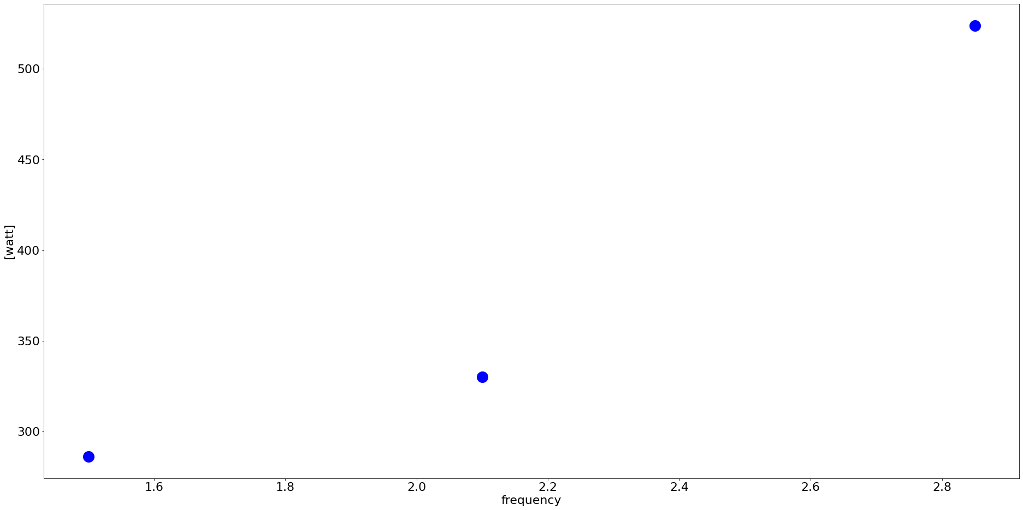
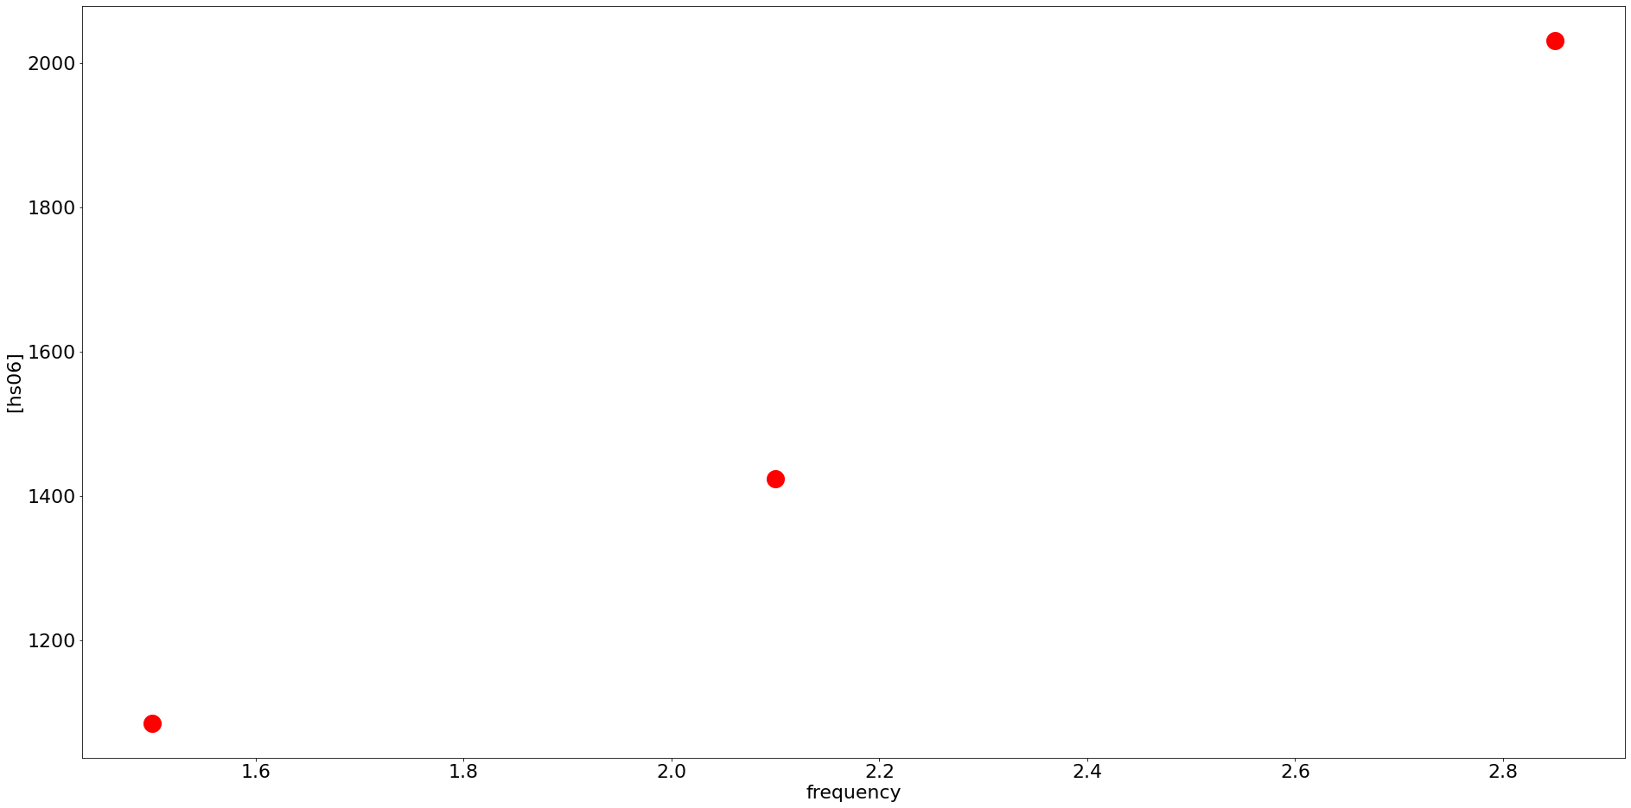
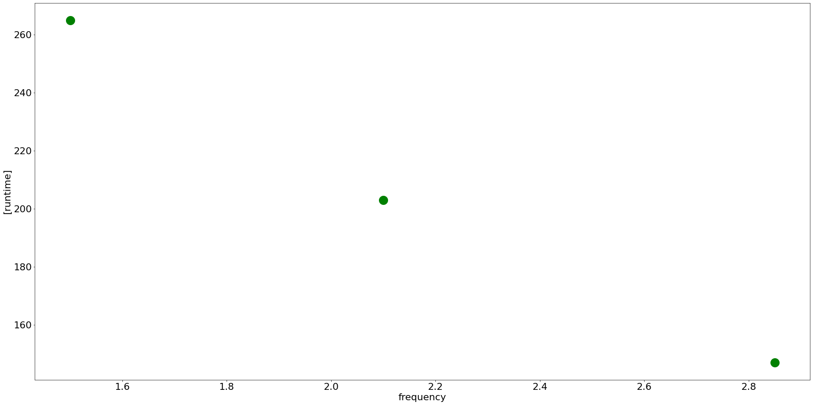
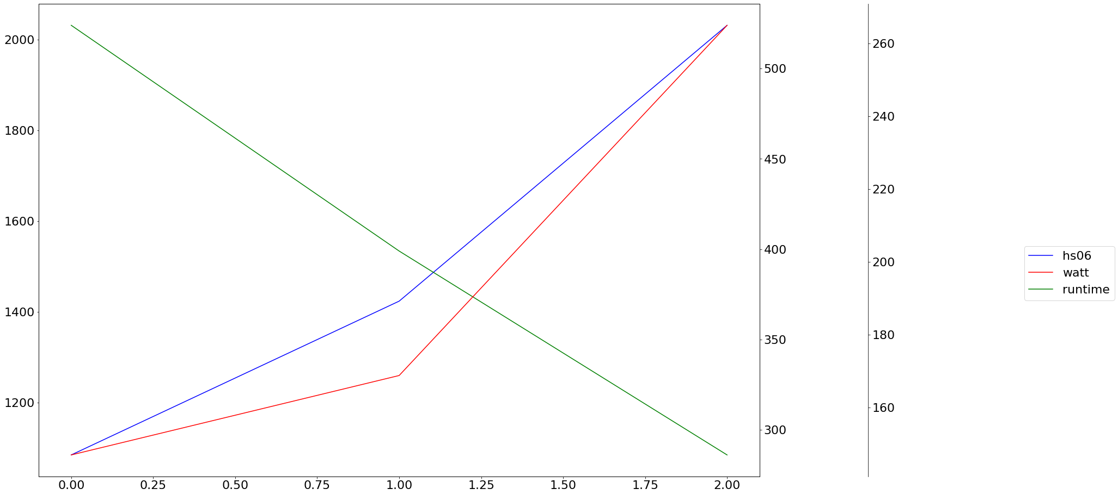
Worker Frequency Scaling
Appendix

Slide 30
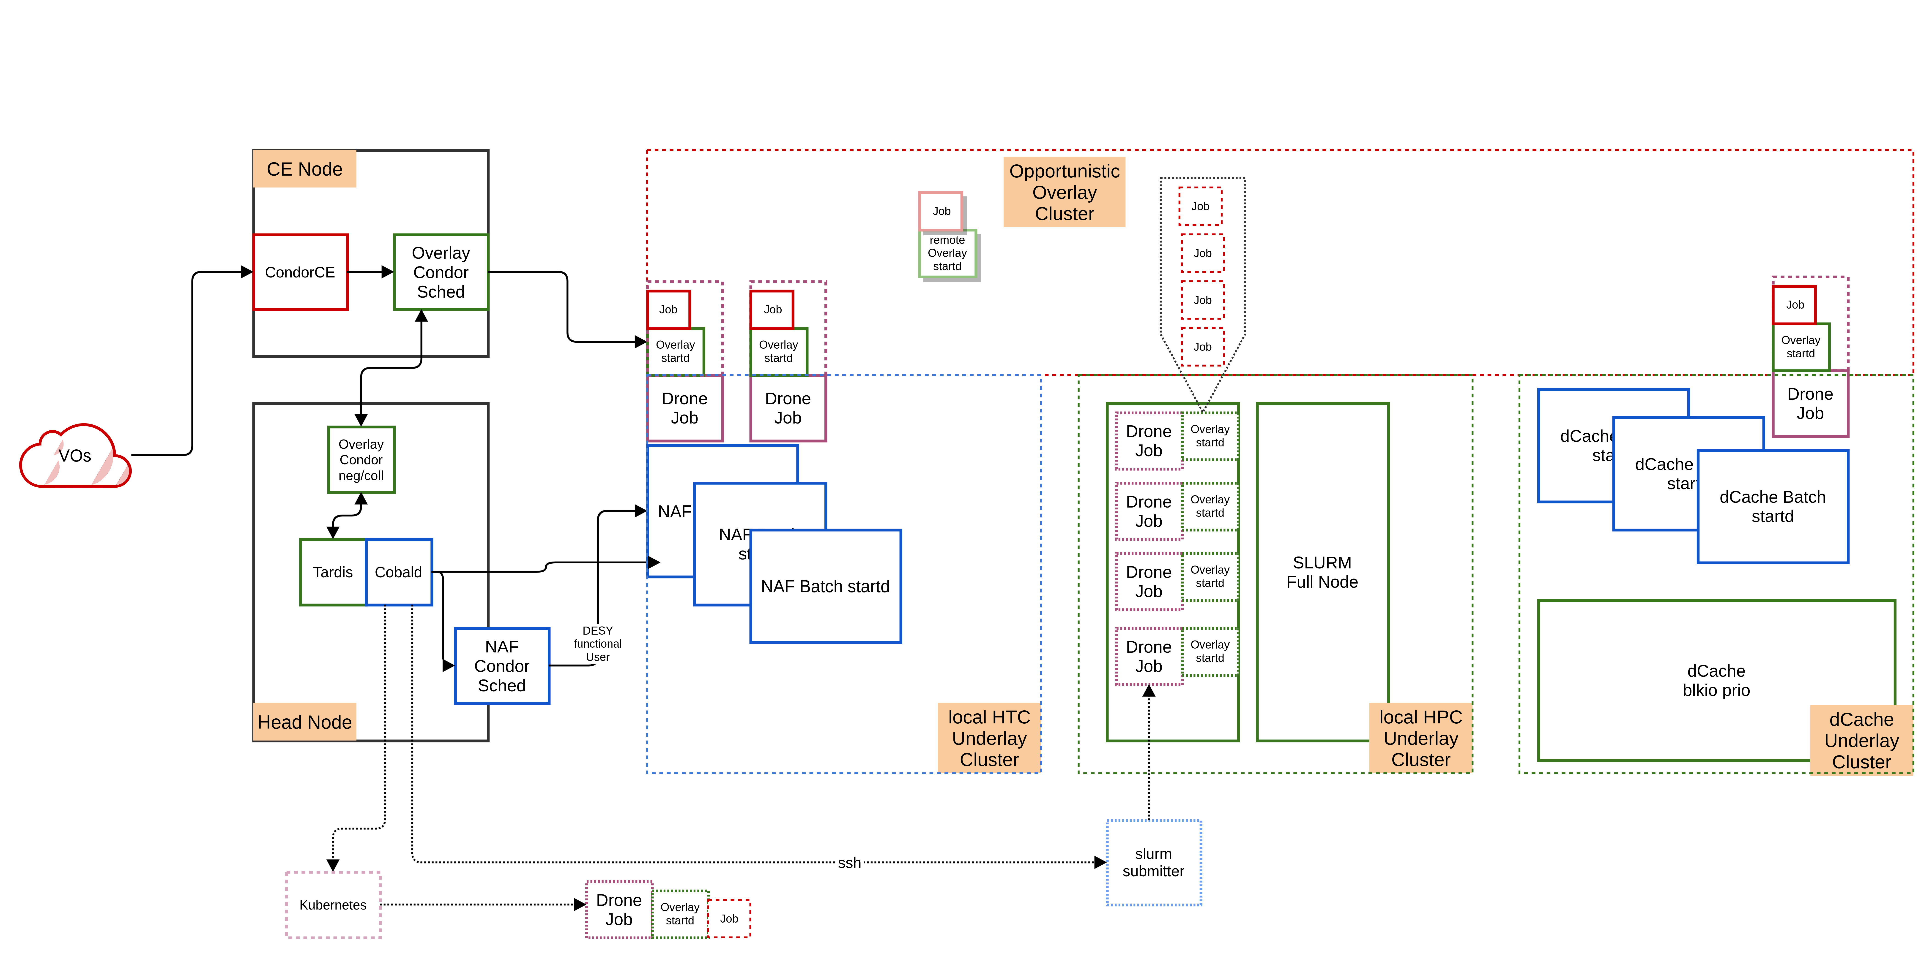
Worker Frequency Scaling

