Slide 1
ARES Operation Meeting
Summary of week 20 / 2023
Max Kellermeier, on behalf of the ARES crew

Slide 2
Summary of week 20
Mon. 13th February | Tue. | Wed. | Thu. | Fri.
Collimator installed | High charge, flattop beam set up (12% transmission) | Tweaked beam shape slightly Irradiation of UKE dosimetry films with uniform beam Preliminary setup of WP for Hannah’s cell irradiation Further investigations of position oscillations |  | FL Quads adjusted for desired beam size dosimetry film irradiation with rectangular patch
 | Position oscillations lead to intensity fluctuations after the collimator |  | Water flow needs to be adjusted (during ZZ next day)
Tunnel open |  |  | Public holiday | X-Band conditioning over the weekend
Achievements
Difficulties
Notes

Slide 3
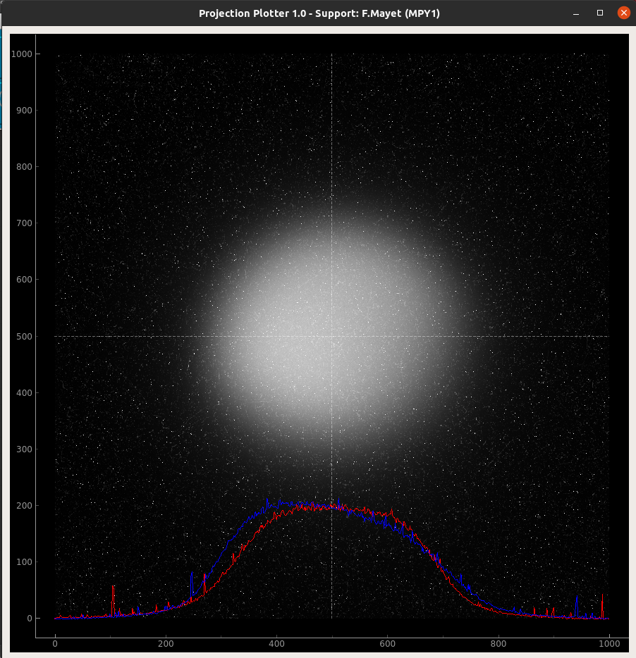
Flattop beam via lead collimator
Transmitted charge estimated from image intensity, calibrated with T-ICT → ~ 21 pC

Slide 4
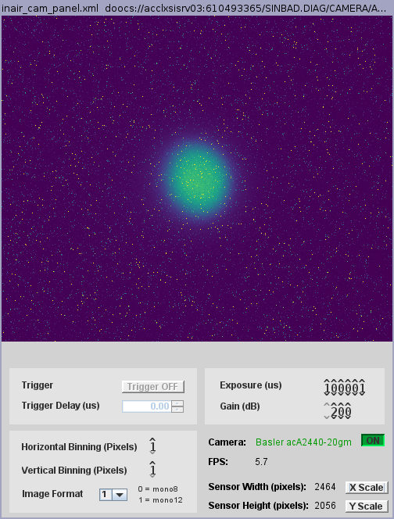
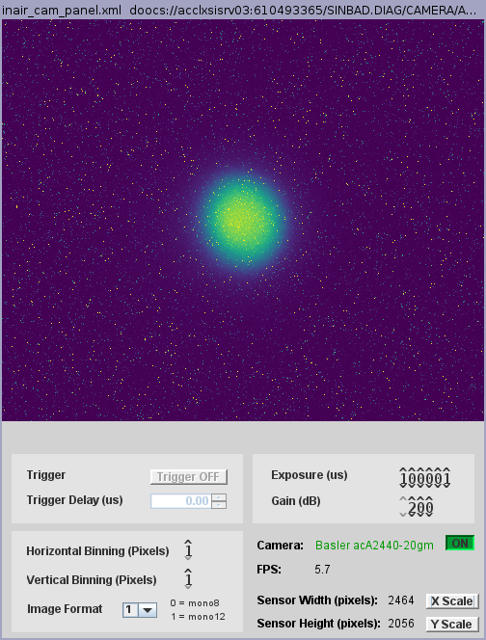
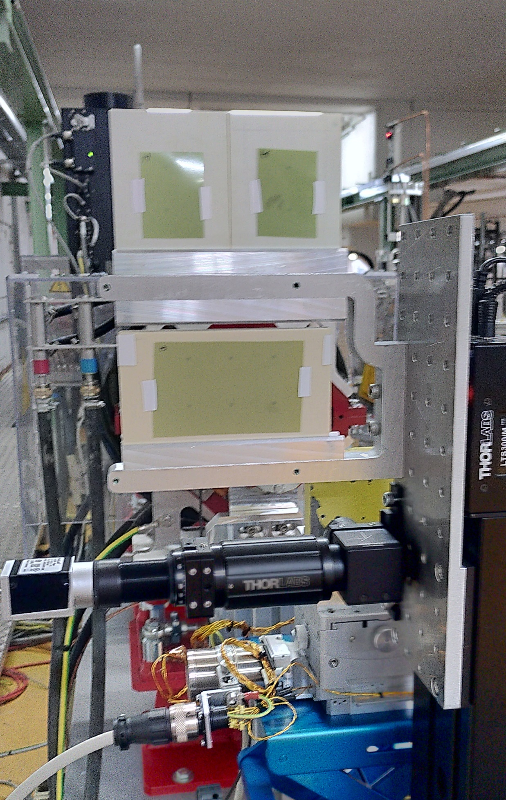
Irradiation of dosimetry films for UKE
10 spots per run with varied number of pulse exposure
intensity fluctuations, probably due to the position oscillation of the beam

Slide 5
Correlation of Position Oscillations
Visible on BPM MR.G2, but not so clear on BPM LI.G2
Seems like MR.QZM1 shows a correlation with BPM signal, but is not the origin of those oscillations → potential leakage current in the machine?

Slide 6
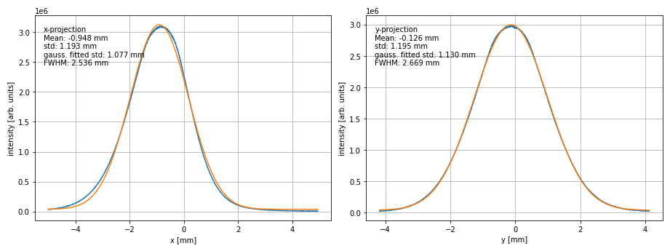
Beam adjusted for snake patterns in dosimetry irradiation

Slide 7
Plan for the week
Irradiations of dosimetry films
  Different pulse spacings
  Orbit feedback tests
Cell irradiation towards end of the week

Slide 8
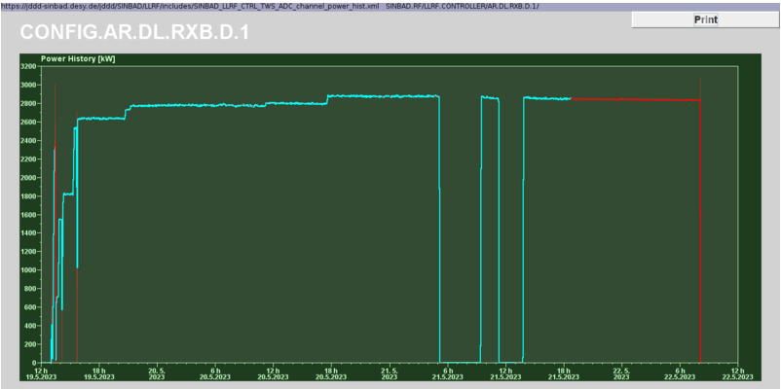
Xband RF conditioning – stable at 2.9 MW

Slide 9
Schedule
Week 21
Date | Shift Leader
22.05. | -
23.05. | Hannes, Frank
24.05. | Hannes, Blae
25.05. | Max, Willi
26.05. | Thomas, Willi, Max
If you want to learn or join the shift: please give the shift leader a call (BKR 2840 / SINBAD Box 2454)

