Slide 1
Magnetic characterization of ALD coated thin films
Lea Preece
May 31, 2023

Slide 2
My work
S-I-S Multilayer
Measurement of London penetration depth @ PSI
H_{C1} measurement
@ KEK
Flux Expulsion measurement
@ CERN
XRR measurement @ DESY
Plasma Enhanced ALD
Annealing

Slide 3
Flux Expulsion Measurement @ CERN
Idea - Setup - Method - Results - Outlook

Slide 4
Flux Expulsion - Idea
Magnetic field lines get trapped at pinning sites
  Increasing dissipation
Collimate expelled flux at controlled cool down conditions
Material qualification prior to cavity fabrication
Notes:
Happens during superconductive transition -> when cooling down to meissner state
Trapped flux causes LOCAL HEATING -> contributes to residual surface resistance

Slide 5
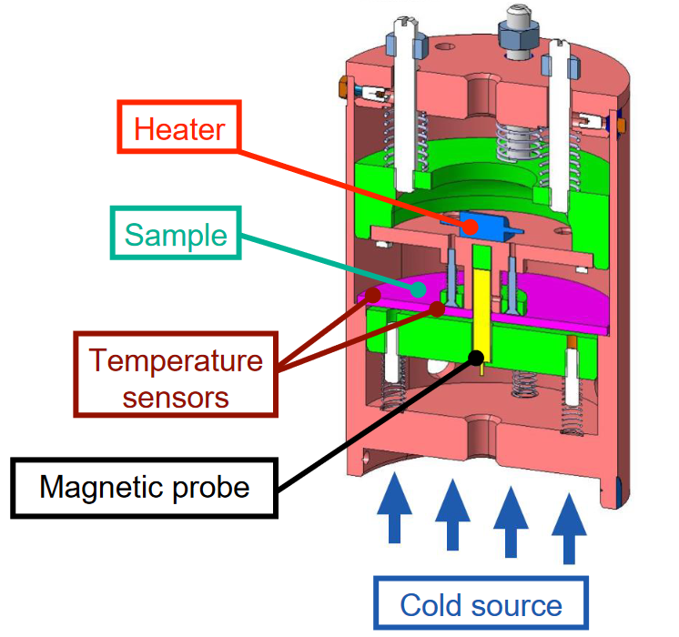
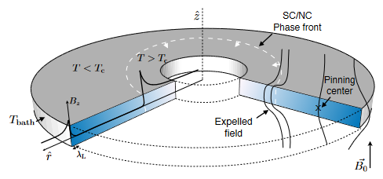
Flux Expulsion - Setup
Bartolome et al. „Flux expulsion lens“ CERN SRF Workshop 2022

Slide 6
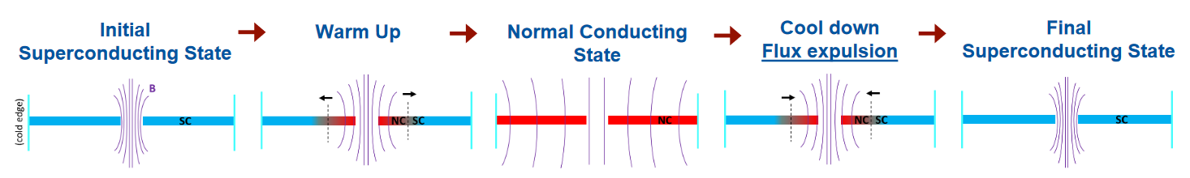

Flux Expulsion - Method
Bartolome et al. „Flux expulsion lens“ CERN SRF Workshop 2022
Notes:
SC to NC transition: due to short heating pulse the collimated b field radially (closed loop ring) propagates from inside to outside
NC to SC transition: front propagates radially inside, Flux condensates in the form of vortices arising in the mixed state interface, either flux is transported or trapped locally

Slide 7
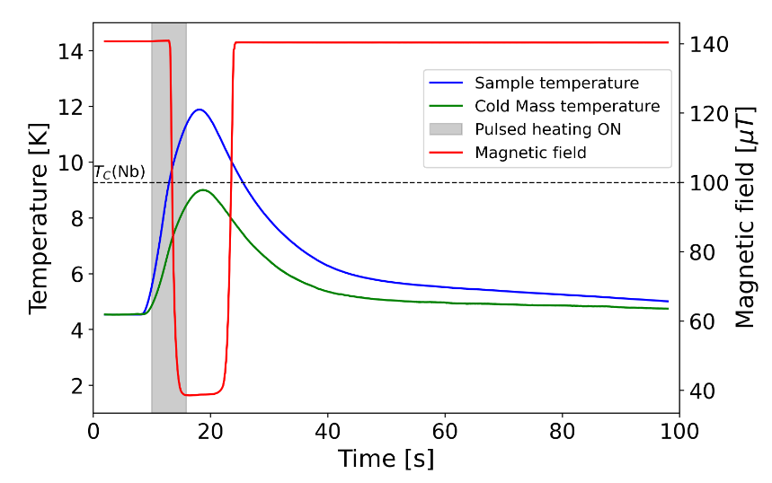
Flux Expulsion - Method
t=10s heating pulse
T_{sample} crosses T_{C} following transition to NC state
Re-transition within seconds
Measure change in flux density integrated over aperture area
Bartolome et al. „Flux expulsion lens“ CERN SRF Workshop 2022
Notes:
t

Slide 8
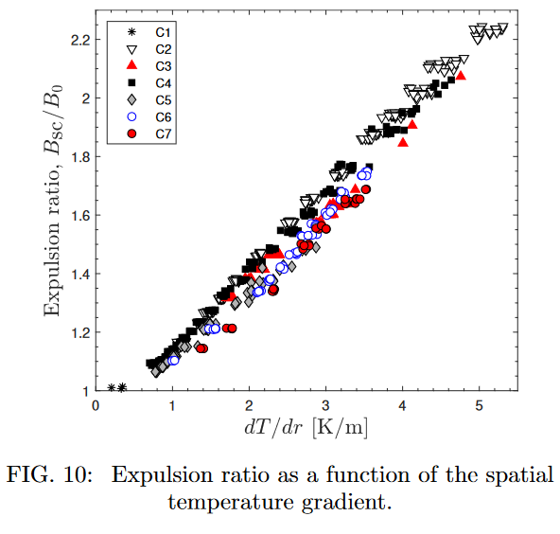
Flux Expulsion – Examplary Results
Expulsion improves with spatial temperature gradient
Reproducible percision measurment of expulsion efficiency
Ivanov, A. [arXiv: 2103.06697v1] (2021)
Notes:
7 measurement campaigns
Varying delta T
Low gradient -> ER~ 1 -> almost all was trapped
High gradient -> ER~ 2.24 -> nearly all was expelled
NO saturation -> full expulsion not reached (low spatial resolution?)

Slide 9
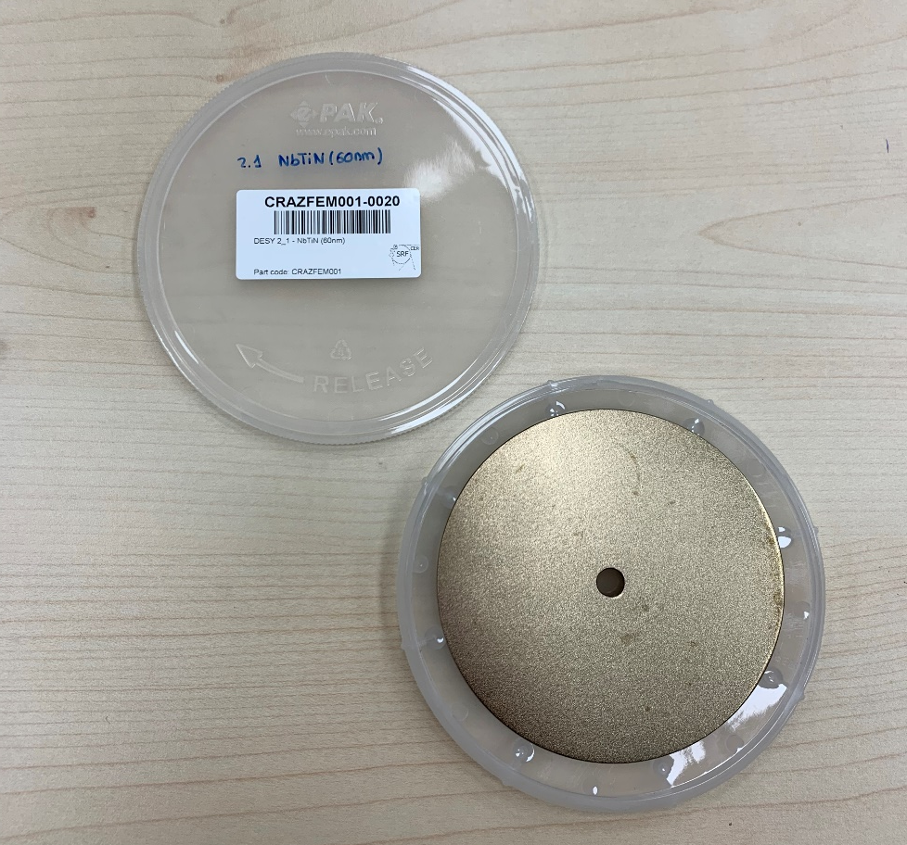
Flux Expulsion - Outlook
Flux expulsion R&D on multilayer samples
3 mm Nb + 15 nm AlN + 60 nm thin film

Slide 10
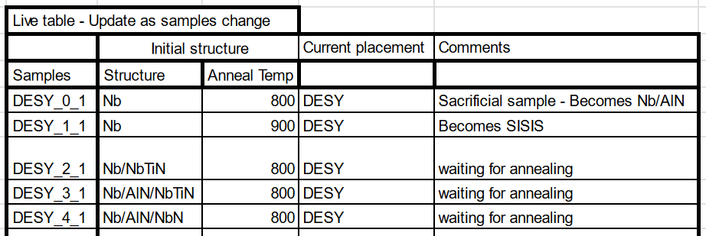
Flux Expulsion - Outlook

Slide 11
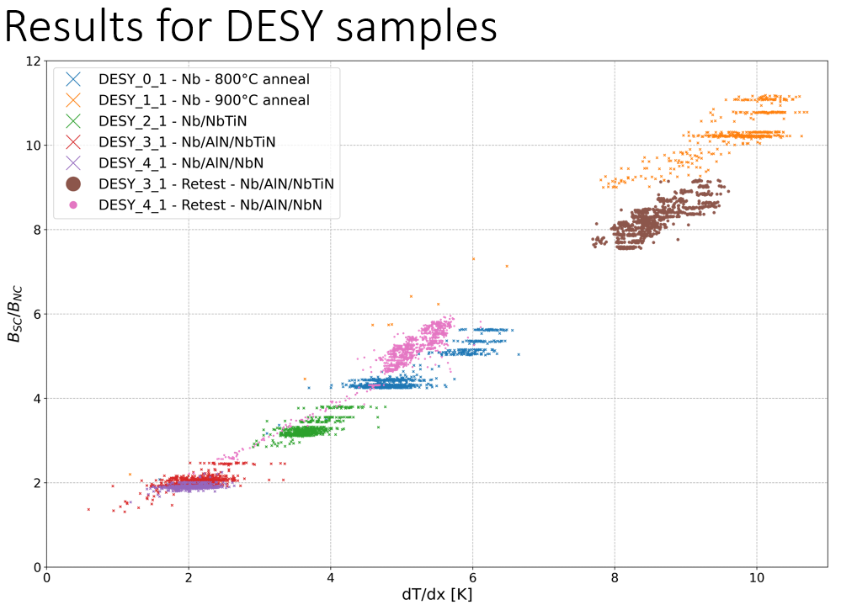
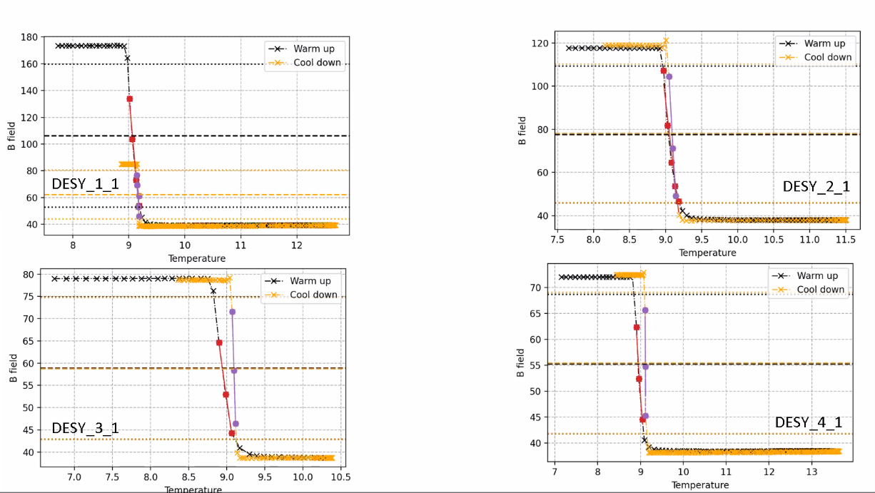
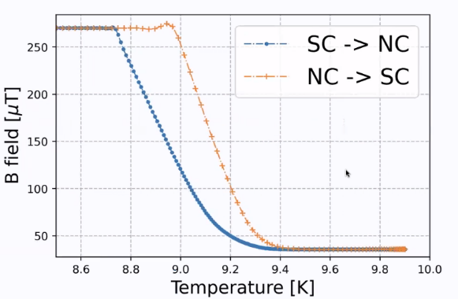
Flux Expulsion – Preliminary Results
Thermal effects?
Bare Nb
Nb - NbTiN
Nb – AlN – NbTiN
REMËASURED
Nb - AlN - NbN
Notes:
Couldn‘t achieve same spatial gradient on all samples → problem with contact of cold finger, remeasured 3_1
Layers dont seem to affect flux trapping!

Slide 12
H_{C1} measurement @ KEK
Method - Setup – Examplary Results

Slide 13
H_{C1} @ KEK
H_{C} key parameter of superconducting material
Third harmonic voltage method
Local magnetometry
No egde effects and no demagnetization
Notes:
Hc is critical field at which the vortex starts penetrating the superconducting material
Third harmonic voltage method:
Measure transition to mixed state under cavity operation conditions

Slide 14
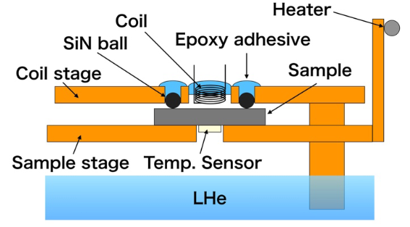
H_{C1} @ KEK - Setup
Cool down sample below T_{C}
Apply constant current to coil H_{app} and hold it
Increase T_{sample}
Measure nonlinear response from shielding current
Ito, H. et al. [arXiv: 1907.03410] (2019)
Notes:
Vacuum tank
Cold sink, good uniformity in temperature
Heater + 4 temp sensors to regulate temp
Soleniod (copper?) coil of high conductivity (5mm outer diameter, samples are 20mm)
Superconducting wires would have too much dissipation at operating frequency
Coil stages adapt to thickness of sample
Measure signal using FFT until odd harmonics occure -> thats when transition temperature is reached and vortices enter sample

Slide 15
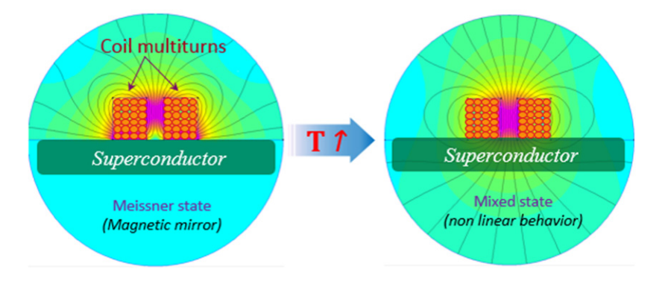
H_{C1} @ KEK - Method
H_{app} < H_{C1}(T)
H_{app} > H_{C1}(T)
Aburas, M. et al. [THPB038] (SRF2017)
Notes:
Coil for excitation and detection at the same time
Coil much smaller than sample and magnetic field decreases away from coil -> no edge or demagnetization effect
AC magnetic field parallel to surface only on one side (as in real cavities)
Meissner state: sample is perfect magnetic mirror (magnetic mirror opposed to vertical component of applied b field), current and voltage of coil behave linear visible in sinusodial reference signal with certain frequency
RISING TEMPARTURE (OR CURRENT IN COIL).....
Mixed state: vortices enter, get pinned, current/voltage shows non-linearities because of electrons experience dragging force
Visible as higher harmonics in reference signal (3rd one is most intense one)
Monitoring vortex penetration with rising temperature
COIL DOES NOT TOUCH THE SAMPLE -> 9 SiN balls as Spacer

Slide 16
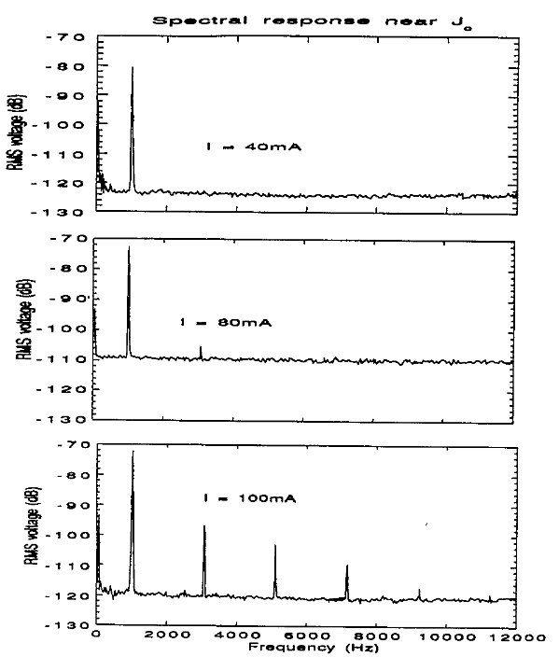
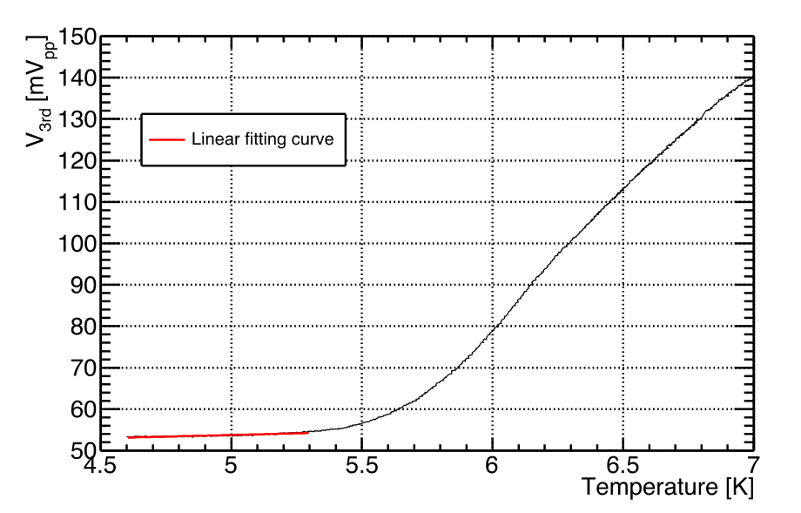
H_{C1} @ KEK - Examplary Results
Linear fit to determine vortex penetration temperature:
Ito, H. et al. [arXiv: 1907.03410] (2019)
Claassen, J.H. et al. [Rev Sci Instrum 62, 996–1004] (1991)
Notes:
determine the temperature at which the vortex starts to penetrate the sample, we applied the linear fitting to the third harmonic signal in the temperature region lower than the left onset
Bulk Nb 4.4 A and 5.3 K
first point
which has the distance of 3σ from the linear fitting function was taken as the vortex penetration temperature
Vertical axis is intesity of third harmonic signal after FFT
Perform this measurement at various currents, get relation between AC current and vortex penetration temperature
Obtain temperature dependence of Hc1 by seting calibration factor of AC current that relates to Hc1(0)=180mT for Nb

Slide 17
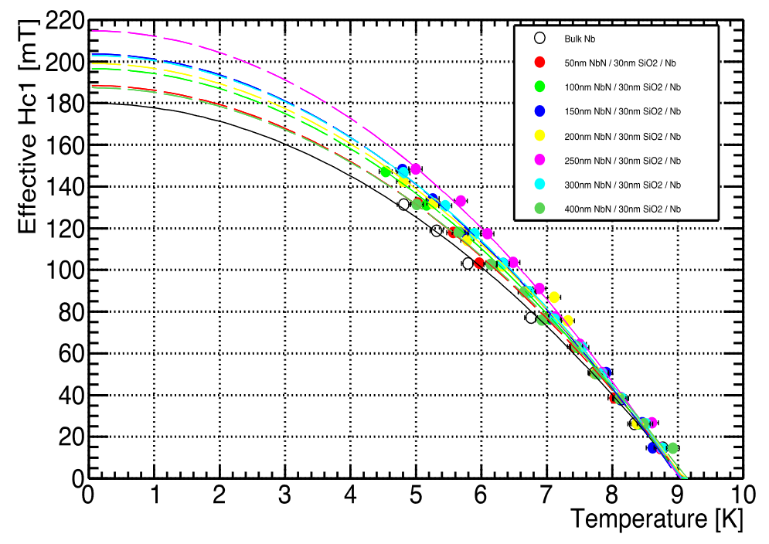
H_{C1} @ KEK - Examplary Results
Temperature dependence of effective H_{C1} for SIS layer
Ito, H. et al. [arXiv: 1907.03410] (2019)

Slide 18
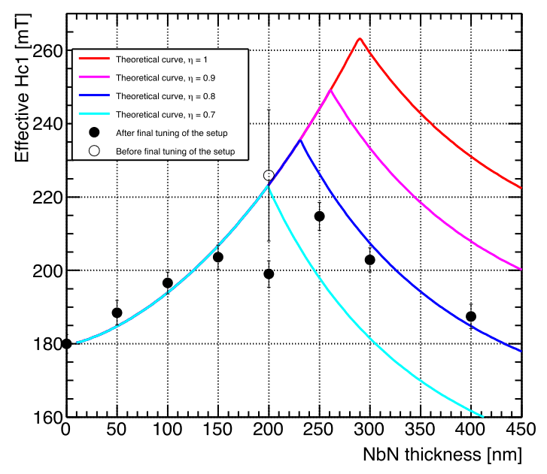
H_{C1} @ KEK - Examplary Results
Effective H_{C1} of SIS samples at 0 K
Comparison of theoretical prediction and measurement
Ito, H. et al. [arXiv: 1907.03410] (2019)
Notes:
200nm sample:
Before fine tuning big error because of lowest measurable temperature of 8K
Value drops, this sample was produced 4 months earlier than others for first tests with setup
Kept in air for longer
Overused(?)
Solid lines -> theoretical curve:
Eta Phenomenological factor describing condition of sample surface
1 => ideal, smooth
Smaller => defects, impurities => peak value for Hc1 decreases and so does the effective Hc1
-> there is an optimum thickness of layer which achieves maximum effective Hc1
GOOD AGREEMENT WITH THEORY FOR ETA BETWEEN 0.7 AND 0.8 => MAXIMUM IMPROVEMENT OF 24 TO 31% FOR SIS SAMPLES COMPARED TO BULK
POTENTIAL TO ACHIEVE HIGHER ACCELERATION GRADIENTS

Slide 19
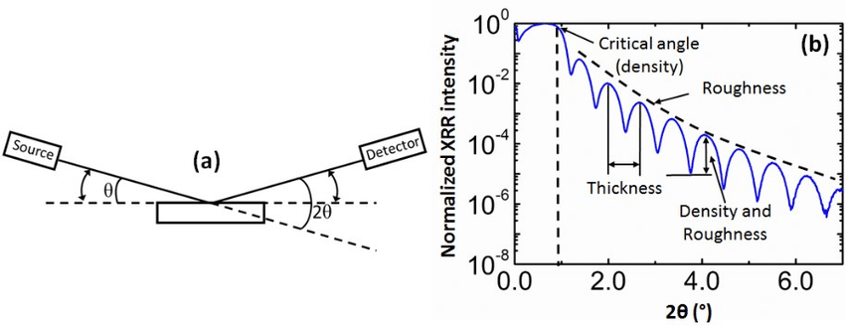
X-Ray Reflectivity measurement @ DESY
Coating happens in supercycles
  Thickness in nm?
PEALD growth per cycle
Ribera, R. [DOI:10.3990/1.9789036543101] (2017)
Notes:
(a) Scheme of XRR measurement geometry. (b) Example of XRR spectrum for an as deposited ~12 nm-thick Ru layer on ~16 nm-thick SiO2 layer on Si wafer (example of an as deposited sample of Chapters 3 and 4). The critical angle and the information (density, thickness and roughness) extracted from the XRR spectrum are also pointed out in (b).

Slide 20
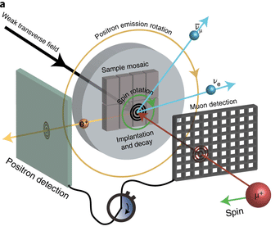
Measurement of London penetration depth @ PSI
Low-energy muon spin rotation (LE-𝜇SR) technique
depth-resolved measurements of their Meissner screening profile
Fowlie, J. et al. [DOI:10.1038/s41567-022-01684-y] (2022)
Notes:
By fitting magnetic flux profile with according model including london theory and appropriate boundary/continuity conditions one achieves the field screening profile
London Penetration Depth:
In superconductors, the London penetration depth (usually denoted as λ or λL) characterizes the distance to which a magnetic field penetrates into a superconductor and becomes equal to e − 1 e^{-1} times that of the magnetic field at the surface of the superconductor.

Slide 21
What's the point?

Slide 22
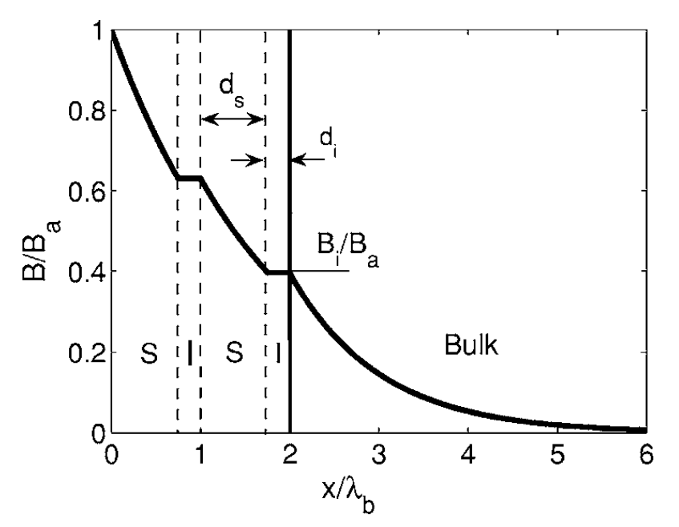
S-I-S Multilayer for SRF Cavities
Increase RF breakdown field
Cavity can withstand higher fields
Higher accelerating gradients
  Higher energy gain per unit length
A. Gurevich, Appl. Phys. Lett. 88, 012511 (2006)
Notes:
Thick films -> usual bulk rf dissipation ->different for thin films delta < lambda with high H_{C}
A thin film on the inner surface of a cavity carries a net sheet current which pushes a vortex across the film
INSULATING LAYER TO DECOUPLE SUPERCONDUCTING LAYERS, intercept propagating vortex and localizing dissipation in s layer
- mehr Grenzflächen erzeugen mehr “screening” oder “counter current”
- Verhindert Diffusion zwischen Layers / stabilisiert Phasen / glättet Übergänge zwischen Gitterstrukturen
FOR THIN LAYERS LESS THAN LAMDA L NUCLEATION OF PARALLEL VORTICES BECOME ONLY FAVORABLE AT FIELDS LARGER THAN Hc1 OF LAYER MATERIAL

Slide 23
Backup

Slide 24
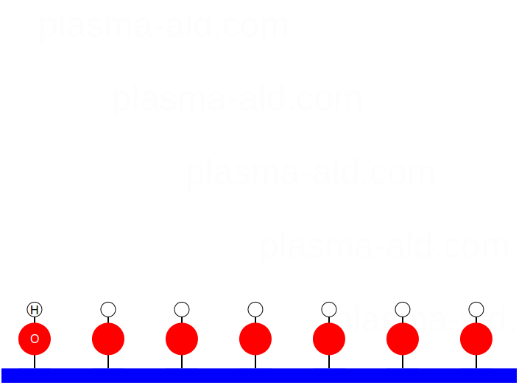
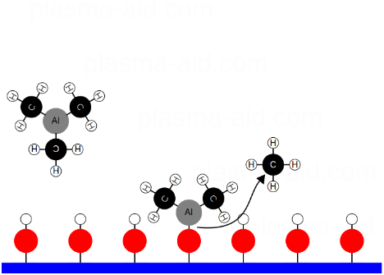
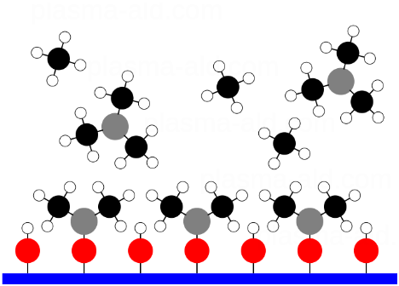
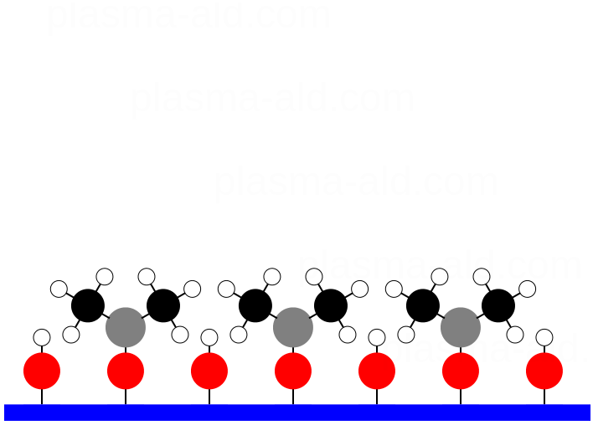
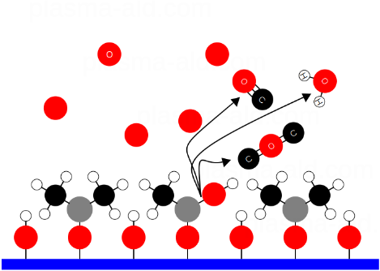
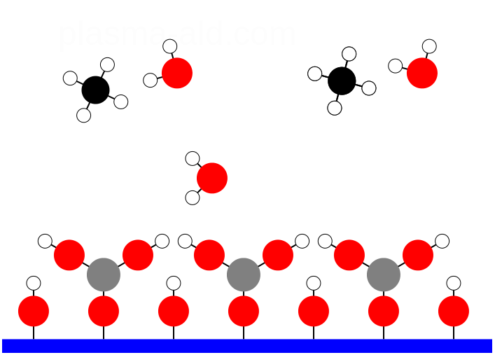
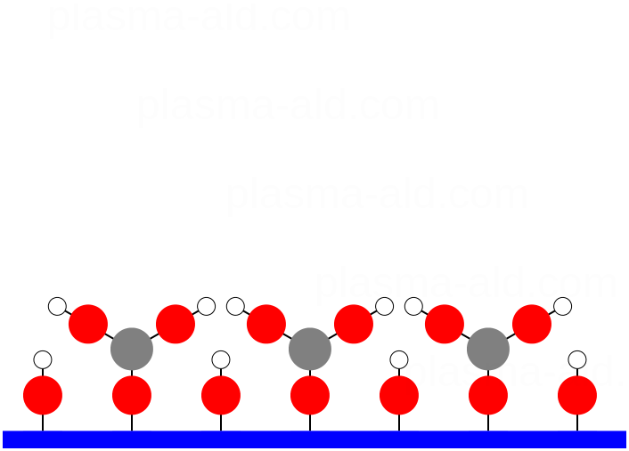
Plasma Enhanced ALD
0. Substrate Surface
1. Precursor A Pulse
2. Precursor A Purge
3. After Precursor A Purge
Plasma-enhanced ALD (PEALD) offers:
lower deposition temperature (< 300 °C)
more precursor options
higher film quality, e.g. less impurity content
4. Plasma
5. Co-reactant Purge
6. After Co-reactant Purge

Slide 25
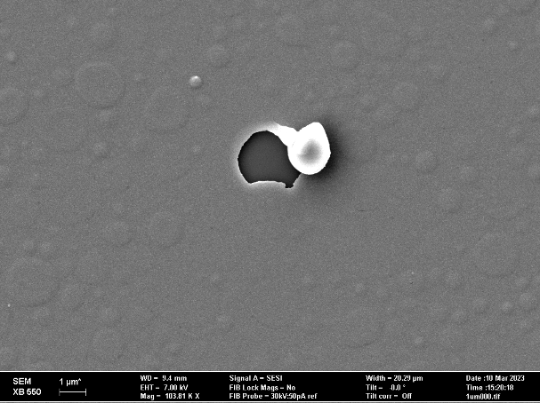
Annealing and Blister Study
Heat treatment mandatory to improve deposited thin films
Newly discovered delamination, blisters and peel-off
10 nm AlN + 60nm NbTiN annealed @ 800°C
Notes:
Blisters
As deposited and after annealing, distinguishable in their different in shapes, come from different effect (plasma, thermal)
Peel-off
100% related to Annealing, possibly because there were blisters before? When no blisters before, no peel off?
Only in Single cell furnace -> should be because of pressure or cool down rate (thermal issues)

Slide 26
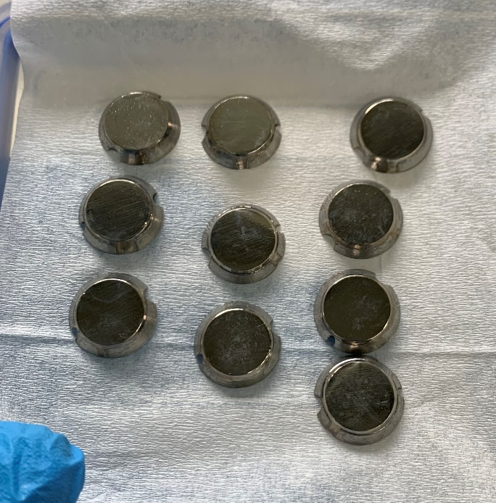
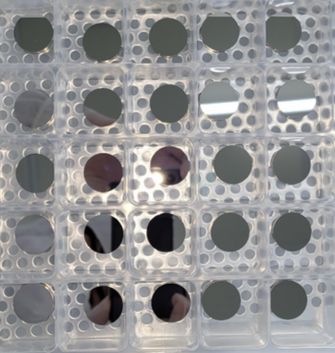
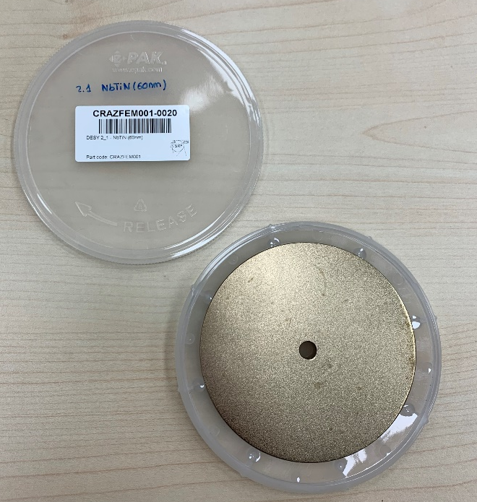
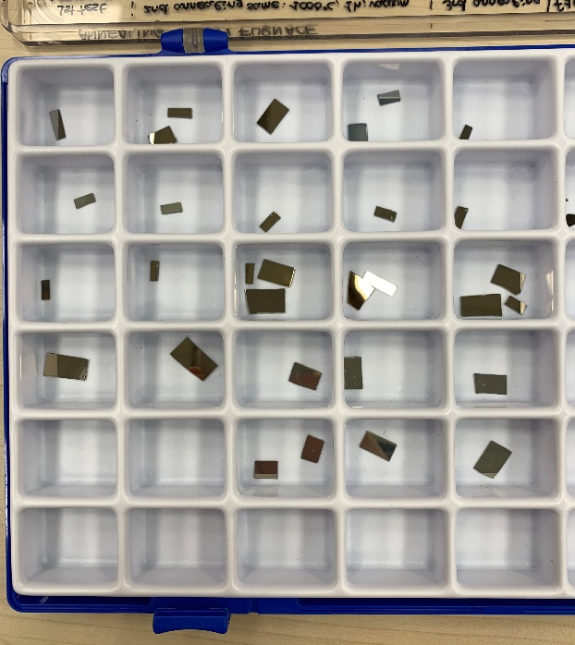
Samples
Picture by Ryo Kataya
Si waver
Nb conical
CERN Nb sheet
KEK Nb coins

Slide 27
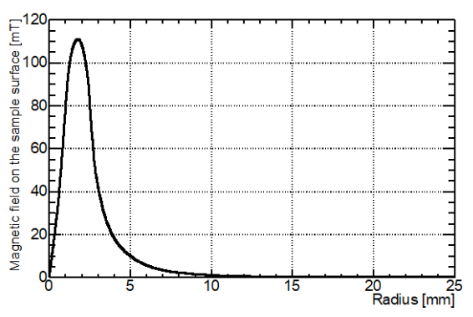
H_{C1} measurement @ KEK
Simulated magnetic field from solenoid coil on sample surface along radial direction:
0.4% of peak value
Ito, H. et al. [arXiv: 1907.03410] (2019)

Slide 28
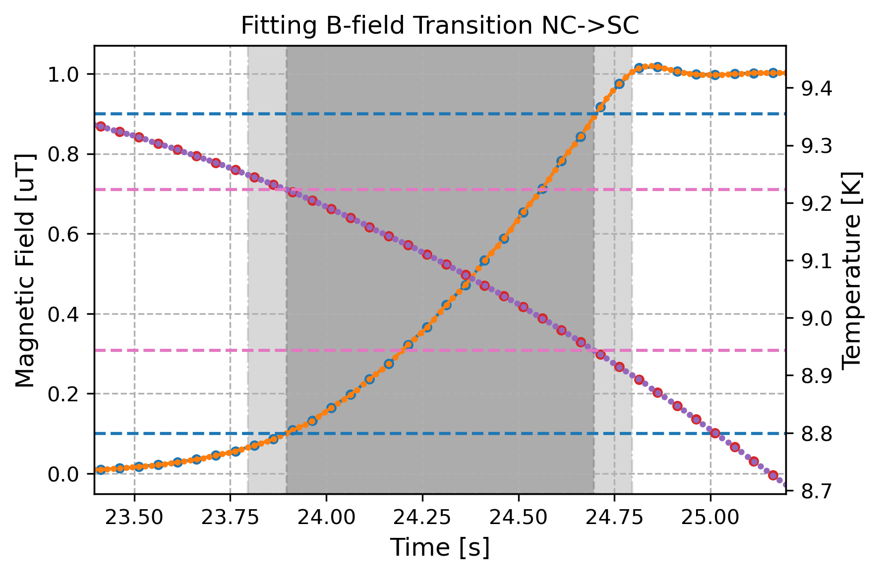
Measured data points are 20 points every second.
Now there are 20 interpolated points (spline-cubic) between each measured point.
This allows a more accurate representation of the transition to be taken.
The analysis is preformed as previously, taking t at the B threshold and t’ to find the start and end temperature.
Normalised magnetic field

