Slide 1
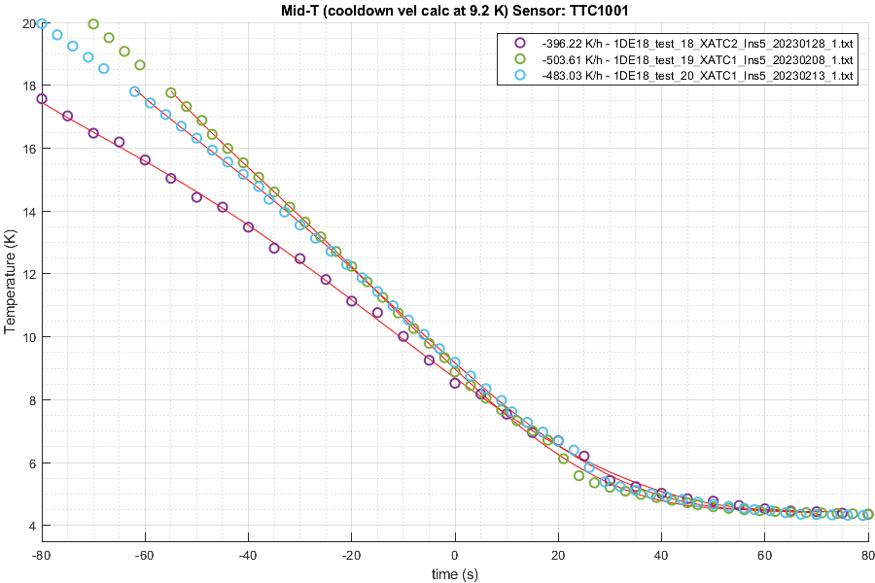

Slide 2
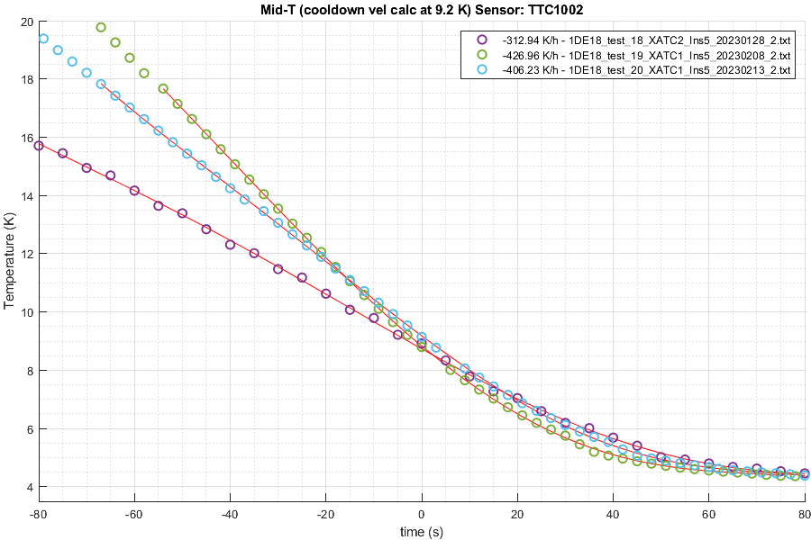

Slide 3
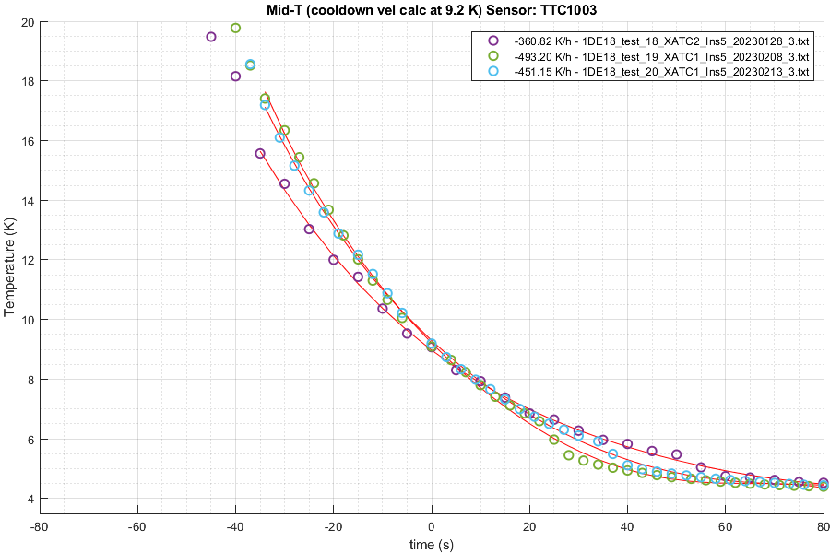

Slide 4
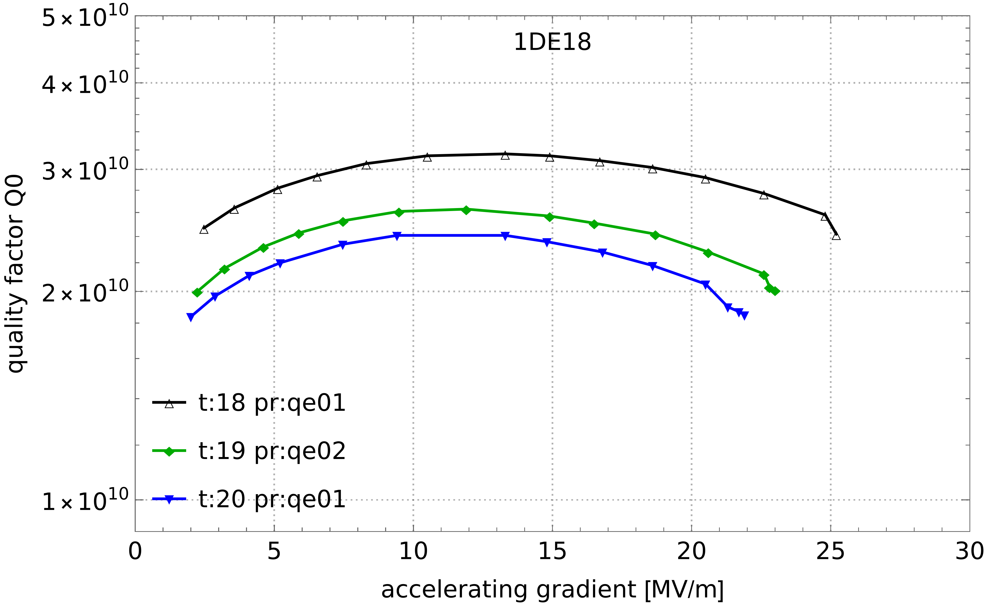
Cooldown velocities at 9.2K:
1DE18 Test | Teststand | Insert | Sensor 1 K/h | Sensor 2 K/h | Sensor 3 K/h
18 | XATC2 | 5 | -396,22 | -312,94 | -360,82
19 | XATC1 | 5 | -503,61 | -426,96 | -493,2
20 | XATC1 | 5 | -483,03 | -406,23 | -451,15

