Slide 1
ARES Operation Meeting
Summary of week 22 / 2023
Hannes Dinter, on behalf of the ARES crew

Slide 2
Summary of week 22
 | Mon. 29th May | Tue. | Wed. | Thu. | Fri.
Achievements |  | ACHIP 2 piezo stage tests AutoACC ICT installed Stability data analysis | MDI charge monitors Doocs server and machine state GUI development X-band Modulator 1 repaired (power supply replaced) EA.R1 field of view shifted (to be tested with beam) STRIDENAS tests | MPS X-band cabling Doocs servers development Preparations for STRIDENAS week | TÜV rehearsal Doocs server development Displays for additional BKR console installed
Difficulties |  | PHAROS RA stopped working (X2timer issue, fixed, but came back with 100% transmission) Beam not in field of view of EA.R1 (fixed on Wed., to be tested) Oscilloscope PC network issues (fixed)
Notes | Public holiday

Slide 3
AutoACC shift
Tested RL agents with new EA geometry and on BC screen:
  New EA geometry does not seem to degrade performance
  EA RL agent (polished donkey) does not work on BC screen (also bug suspected with magnet reordering)
For time reasons we were neither to test the agent on the in-air screen nor the lattice agnostic agents. Given the results on the BC screen, the former is expected to fail.

Slide 4
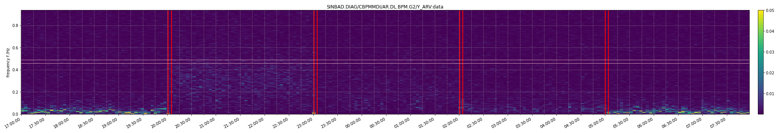
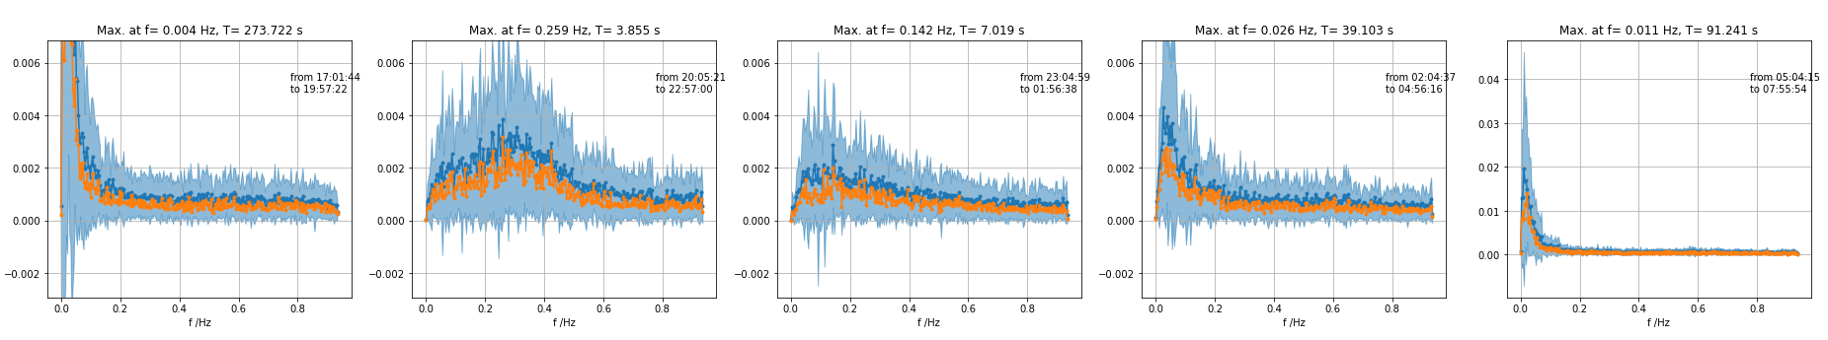
Stability data analysis (vertical)
BPM DL.G2 was measured in overnight stability run on 2023.03.09
No feedback (zero gains) vertical and horizontal
Willi's gains vertical and horizontal
Vertical gains from 9 February and horizontal gains from 2 March
Vertical gains from 23 February and horizontal gains from 9 March
Both feedbacks off (repeat)

Slide 5
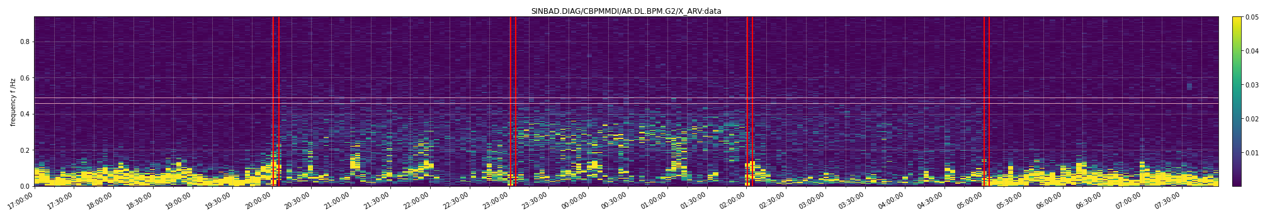
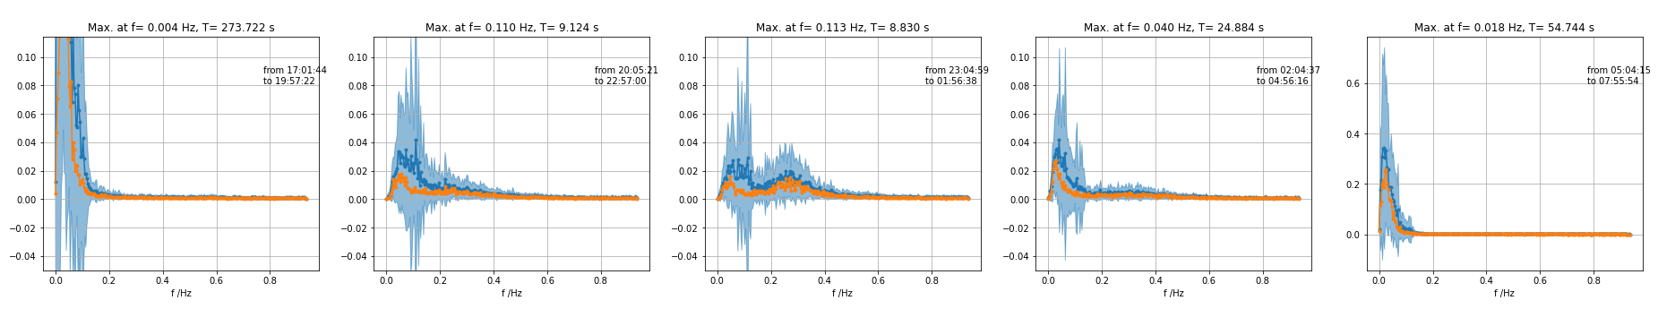
Stability data analysis (horizontal)
BPM DL.G2 was measured in overnight stability run on 2023.03.09
No feedback (zero gains) vertical and horizontal
Willi's gains vertical and horizontal
Vertical gains from 9 February and horizontal gains from 2 March
Vertical gains from 23 February and horizontal gains from 9 March
Both feedbacks off (repeat)

Slide 6
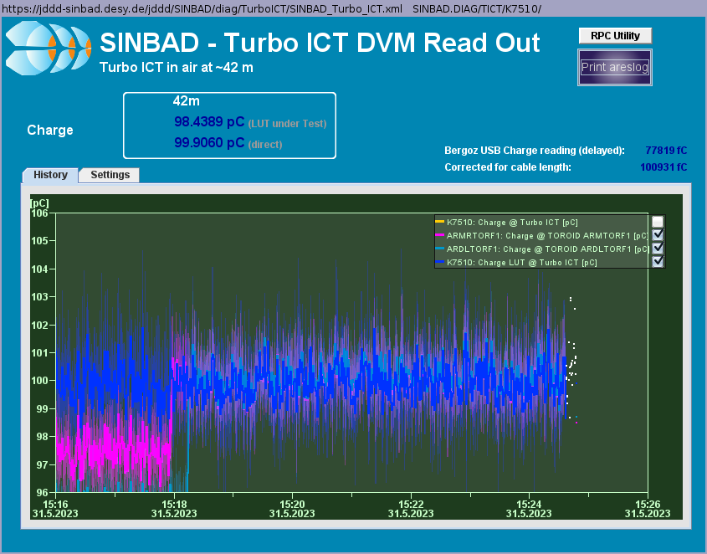
MDI charge monitors
Recorded all charge monitors between 0.2pC and 200pC (machine state file saved)
Changed Toroid scales to Turbo-ICT (look-up table)

Slide 7
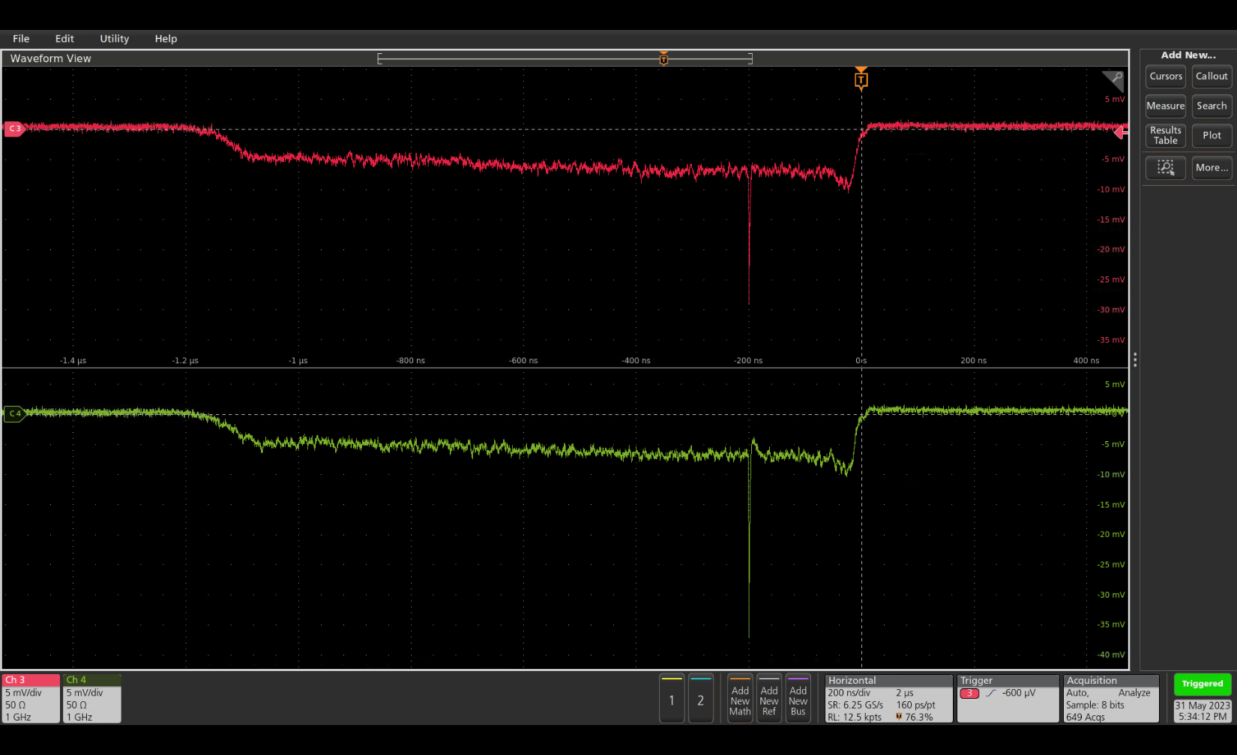
STRIDENAS tests
Preparations for STRIDENAS week
Cabling
HV
Oscilloscope read-out
  Network
  Doocs server
Leakage current via doocs
Measurement script preparation

Slide 8
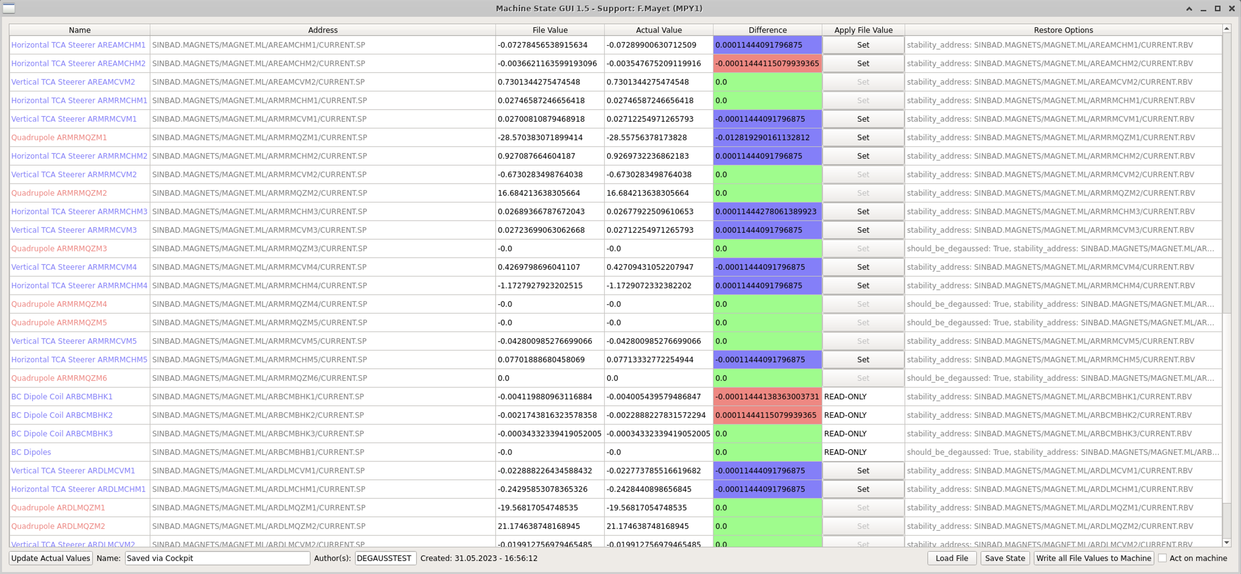
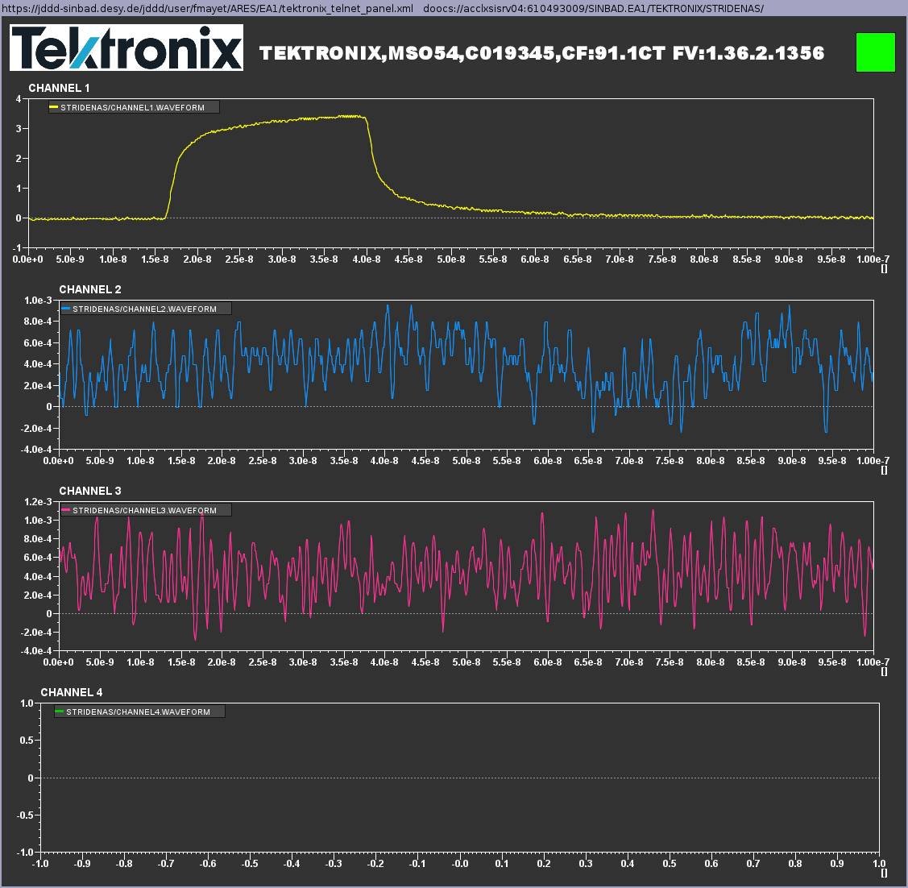
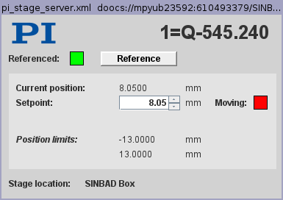
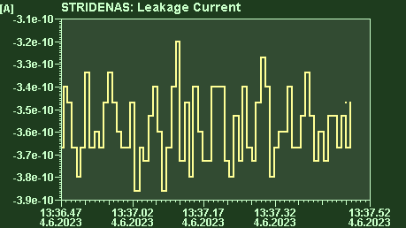
Doocs servers and tools development

Slide 9
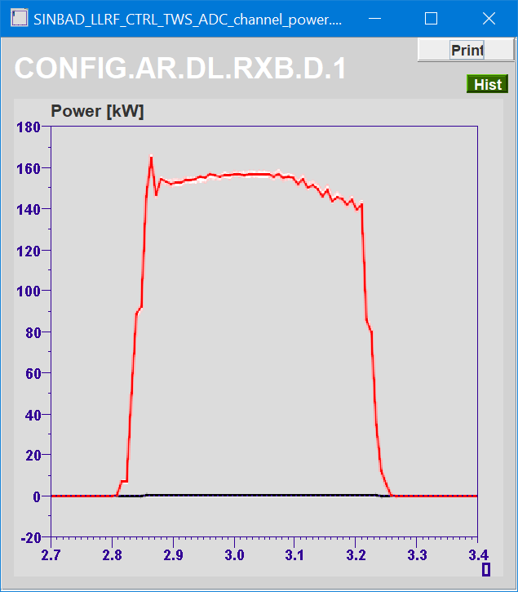
POLARIX Modulator1 online again (required for TÜV)
Three phase power relay replaced, problem solved.

Slide 10
Plan for this week
MON:
  TÜV including X-band
  STRIDENAS preparations
TUE: STRIDENAS
WED: STRIDENAS
THU: STRIDENAS
FRI: STRIDENAS

Slide 11
Schedule
Week 23
Date | Shift Leader
5.06. | -
6.06. | Sonja, Willi
7.06. | Willi, Sonja
8.06. | Frank, Sonja
9.06. | Thomas, Sonja
If you want to learn or join the shift: please give the shift leader a call (BKR 2840 / SINBAD Box 2454)

