Slide 1
WP-3 Special technologies, devices and systems performance
N. Fuster (IFIC, CSIC-UV)
20th June 2023
EAJADE WP1&WP3 information meeting

Slide 2
Outline
WP-3 overview
WP-3 tasks and deliverables
WP-3 group by group activities

Slide 3
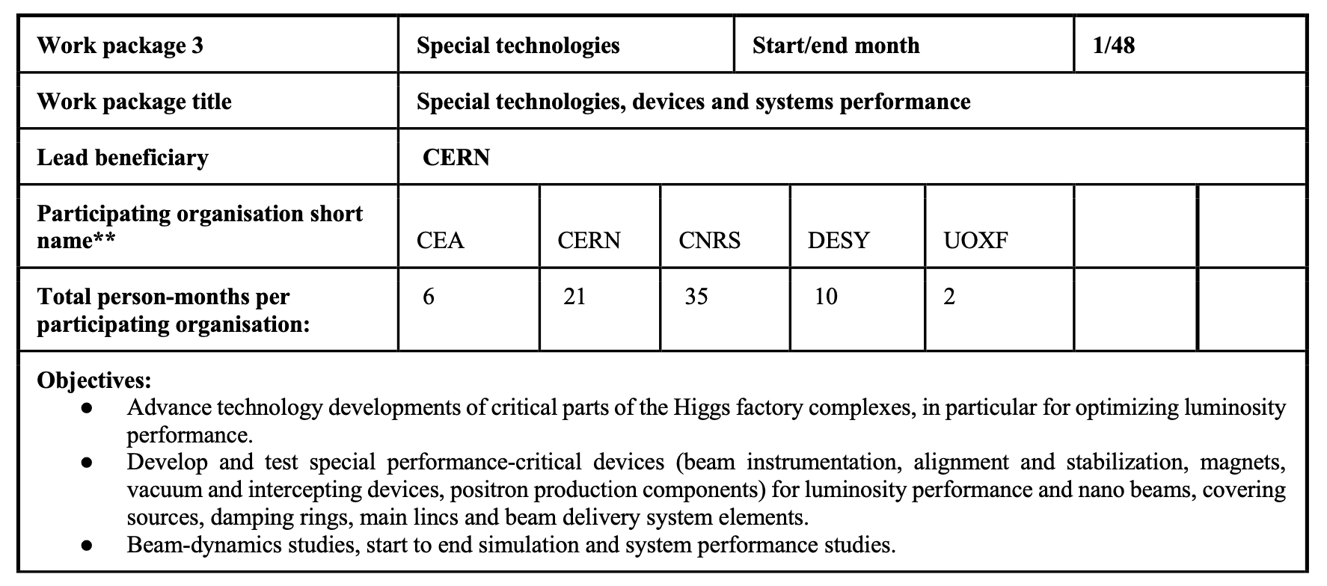
WP-3 overview
Updated after the discussion on the first EAJADE kick-off meeting (30th March 2023).
IFIC/CSIC
TOTAL
7
81
6 DESY, 4 UHH

Slide 4
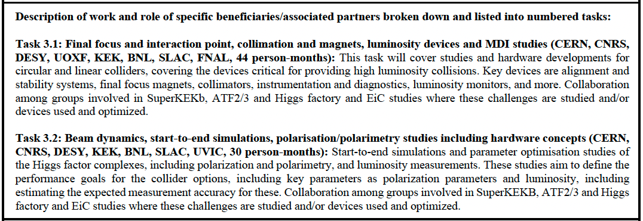
WP-3 tasks and deliverables
+ IFIC/CSIC 7 person-months
3.2 LumiPerfFCCRep (month 42, task 3.2): Report on luminosity performance and margins for the Higgs factory proposals
3.1 OptParHiggsRep (month 36, task 3.2): Optimized parameters for Higgs factories including polarization studies
**CEA assigned 6 months within WP3 but no task specified so far.

Slide 5
WP-3 Group by group activities
CEA (6 PM)
Activities:
Machine learning studies for BPMs improved performance (SuperKEKB data, ATF2/3?).
Other possible activities within WP3 are being discussed.
Estimated data sets for DMP:
BPMs beam data.
Simulations data.
Secondments planned for 2023/2024:
Under discussion.

Slide 6
WP-3 Group by group activities
CERN (21PM)
Activities:
FCC-ee at SuperKEKB (KEK), including machine detector interface, background control, and collimation.
IOTA (FNAL) and EiC (BNL), focus on MDI, collimation, background control, optics and polarisation (“software” studies).
Estimated data sets for DMP:
SuperKEKB sudden beam loss data from loss monitors, bunch-by-bunch turn-by-turn BPM data, feedback data, low-level RF data, SR monitor data.
SuperKEKB turn-by-turn bunch-by-bunch data for optics studies.
EiC hardware design data, e.g. for electron collimator, polarimeter, vacuum system, etc. if/as available.
Secondments planned for 2023/2024:
1 month x1 at KEK (SuperKEKB) after summer.
1 month x1 at BNL end of 2023?

Slide 7
WP-3 Group by group activities
CNRS (35 PM)
Activities:
Specialised magnet development and related techniques (BNL).
Laser design and real time monitoring of the laser polarization for the Compton polarimeter (UVIC).
Monitoring and optimization of beam parameters and luminosity, and modelling, measurements and mitigation of beam loss induced background (SuperKEKB).
Vibration and girders and luminosity impact studies (KEK, ATF2/3, SuperKEKB).
Estimated data sets for DMP:
For activities at KEK: "SuperKEKB beam data" and "Design simulations data”.
For activities at Victoria: "Design simulations data”.
Secondments planned for 2023/2024
2 weeks in Oct. 2023 + 2 weeks in Feb. 2024 + 2 weeks in Oct. 2024 x2 (SuperKEKB).
1 month Feb. 2024 + 1 month Oct. 2024 x1 (SuperKEB).
2 weeks x3 at the end of 2023 or first half of 2024 (UVIC).
3 weeks x2 in February-March 2024 at KEK (SuperKEKB)

Slide 8
WP-3 Group by group activities
DESY (6 PM)
Activities:
Start-to-end simulations, polarization, operation, sustainability and plasma lenses studies (ATF3/BNL/UVIC).
MDI studies (BNL).
Estimated data sets for DMP:
No specific data sets.
Secondments planned for 2023/2024:
Under discussion.
UHH (4 PM)
Activities:
Design and performance optimization studies and linear and non-linear beam dynamics studies (KEK).
Estimated data sets for DMP:
No specific data sets.
Secondments planned for 2023/2024:
Under discussion.

Slide 9
WP-3 Group by group activities
IFIC (7 PM)
Activities:
Cold-cavity BPM R&D for the ILC main linac cryomodules (KEK, ATF).
Estimated data sets for DMP:
Cold cavity-BPM data.
Secondments planned for 2023/2024:
Under discussion.
UOXF (2 PM):
Activities:
Hardware for LCs (KEK, ATF2/3).
Estimated data sets for DMP:
No specific data sets.
Secondments planned for 2023/2024:
Under discussion.

Slide 10
Thank you very much for your collaboration!

