Slide 1
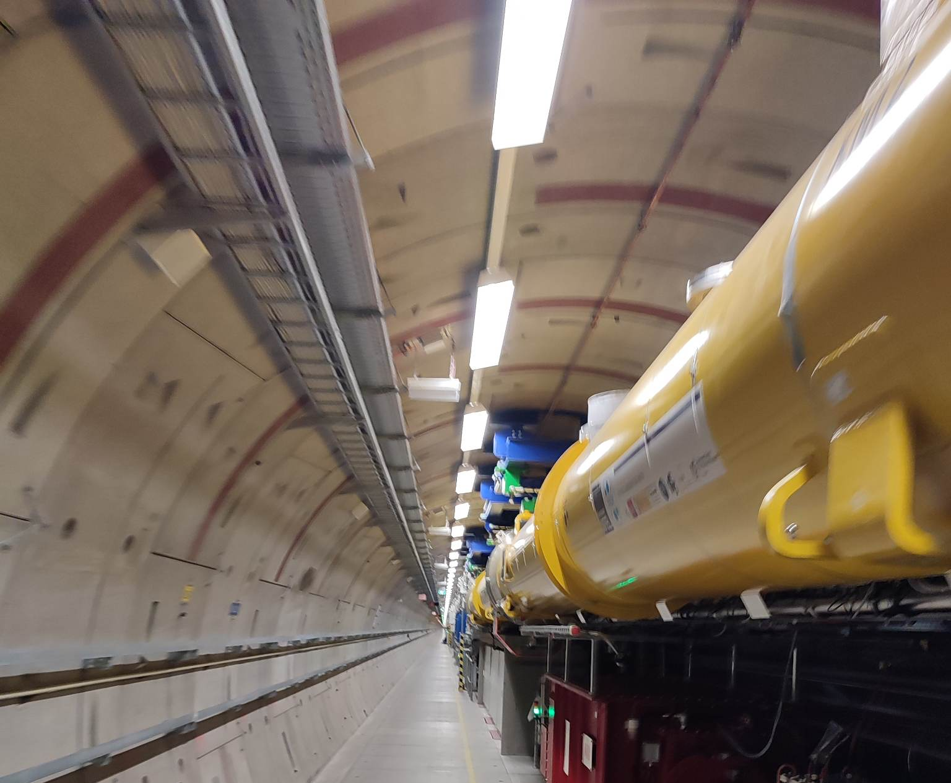
XFEL Accelerator R&D // RP 419 ASPECT Laser R&D (ALRD) Proposal
Victor Hariton
27 June 2023
I. Hartl
M. Guetg
C. Heyl
G. Geloni

Slide 2
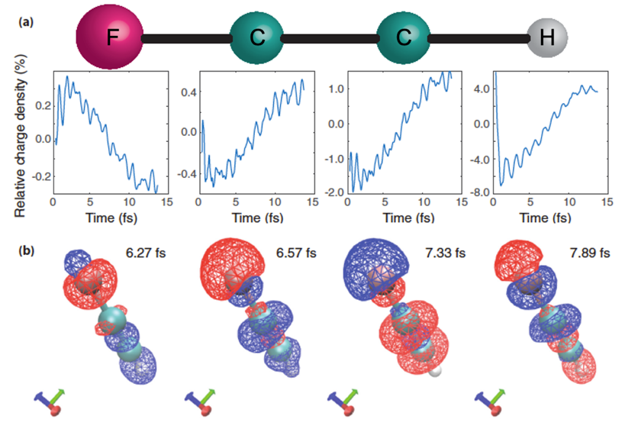
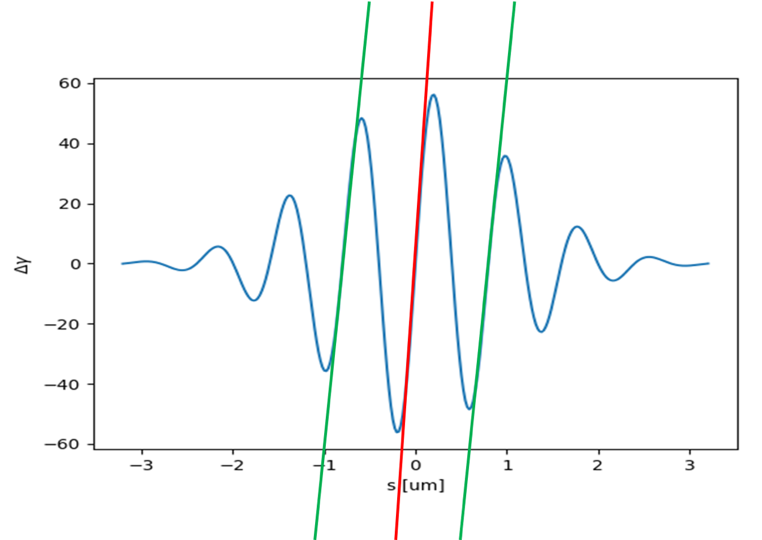
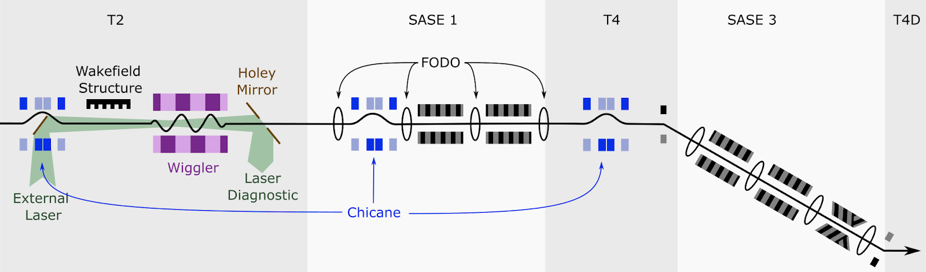
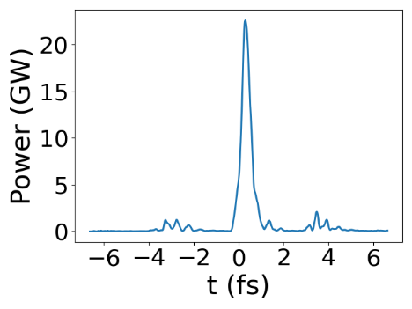
EuXFEL priority project: Generation of tunable attosecond X-ray pulses (ASPECT)
Attosecond X-rays will be used for imaging, magnetism, chemical interactions
and for charge migration studies in molecules
Modulate the electron beam with an external IR few-cycle laser, followed
by reverse tapering.
Laser
X-ray
R&D project
The CDR (conceptual design report) for ASPECT has been finalized and is under discussion.
It is a challenging project (laser) and this R&D proposal will address the main technological constrains!

Slide 3
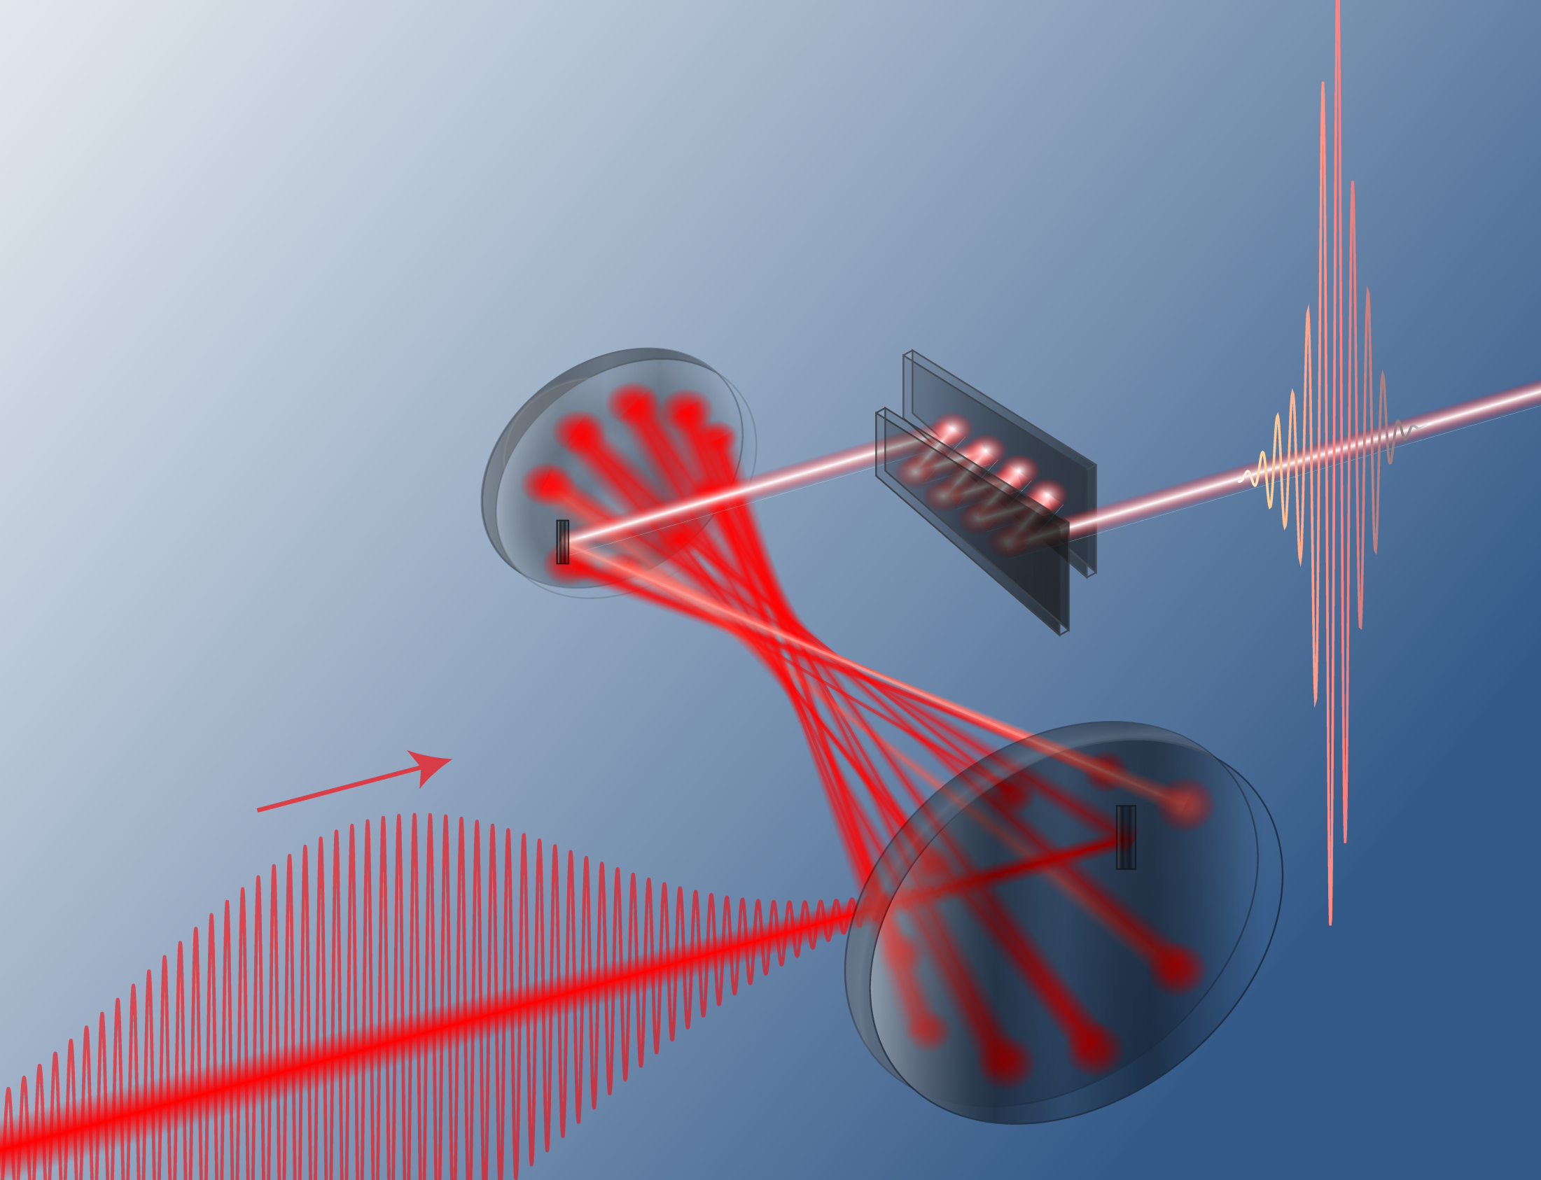
Laser requirements for ASPECT are beyond state-of-the-art (commercial and research)
Phase | Rep. rate | Pulse Energy | Pulse duration | Stability
User | 200 kHz | 5 mJ (on target) | 4-5 fs | Carrier-envelope phase (CEP) stable
Post-compressed Ytterbium laser system is the only viable option to generate CEP stable multi-mJ few-cycle pulses at 200 kHz or higher.
R&D Goals:
(1) Develop the missing laser technology for ASPECT.
(2) Deliver a 1 mJ 5 fs CEP stable laser synchronized to EuXFEL (sufficient for eSASE).
Further10-15x energy scaling has low/moderate risk, but it is expensive (multi M€ laser).

Slide 4
Challenges we want to address for each step of the proposal
ALRD I – Oscillator + Front-end development
ALRD II – Post-compressed Ytterbium laser system
ALRD II – Beam transport
Develop a CEP stable oscillator, front-end and power amplifier (200W).
Synchronization and timing with EuXFEL facility.
Multi-mJ, compressed to sub-5 fs (not achieved yet).
Develop broadband mirrors with suitable dispersion control (beyond state-of-the-art).
CEP drift control.
Develop large bandwidth laser transport.
Solve spatio-temporal overlaping problems with e-beam.
Thermal and fluence management on mirrors.
Upgrade to 10 mJ 10 Hz and hardware installation in Osdorfer Born for first ASPECT tests is feasible with moderate costs.

Slide 5
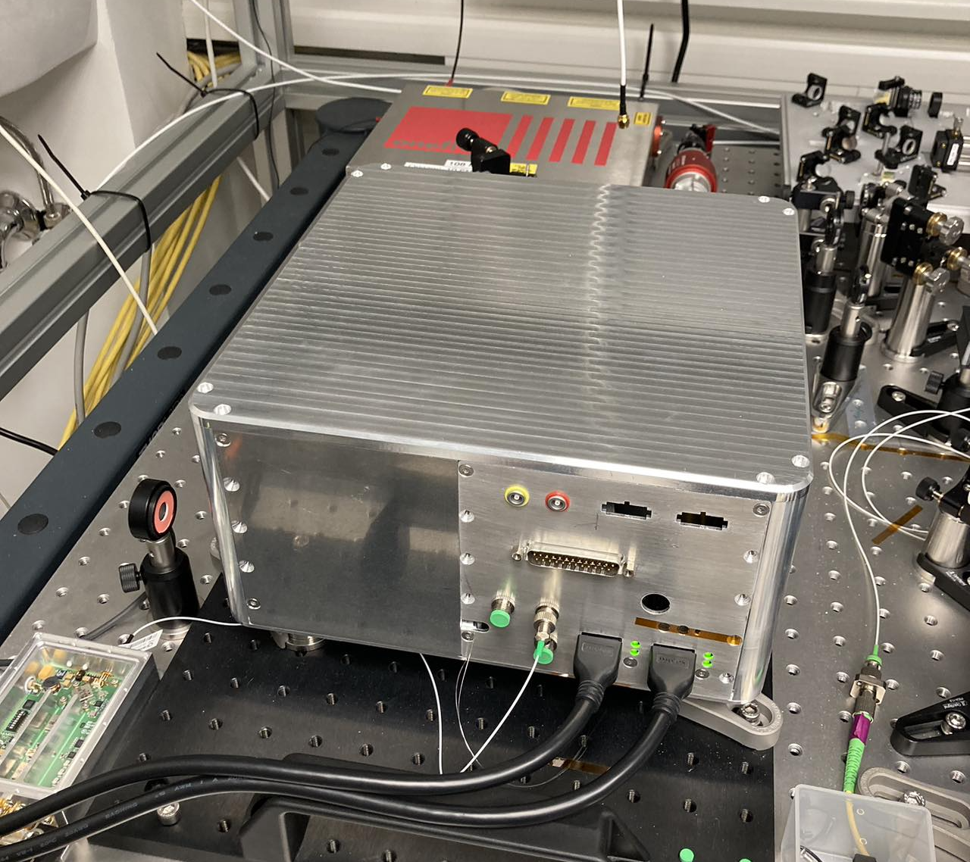
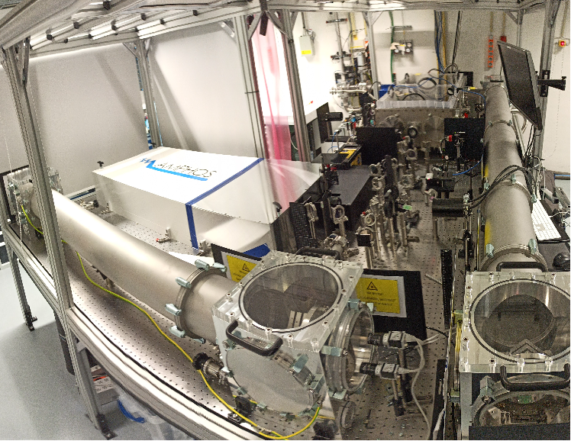
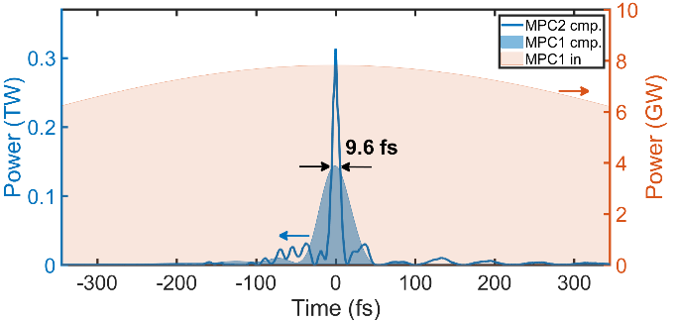

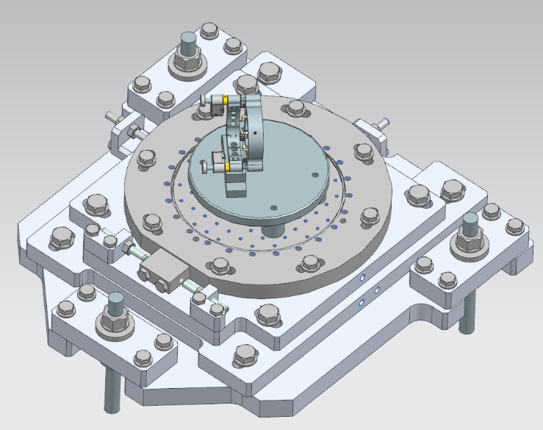
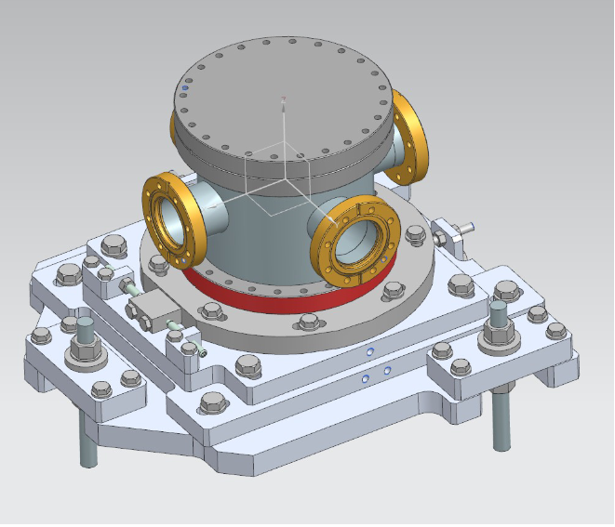
DESY is at the forefront of the technology and this project relies on existing expertise
In-house developed oscillator (EuXFEL funded).
CEP stability experimentally achieved.
Similar Yb-doped amplifiers used in several existing projects (EuXFEL photocatode).
Experimental post-compression achieved to approx. ~10 fs at 10 mJ (VERA).
Feasibility proved by using simulations.
Diagnostics tools already tested.
Coupling to e-beam developed for previous projects
(laser heater FLASH, EuXFEL and seeding laser).
Mirror mounts and chamber design based on previous implementations.

Slide 6
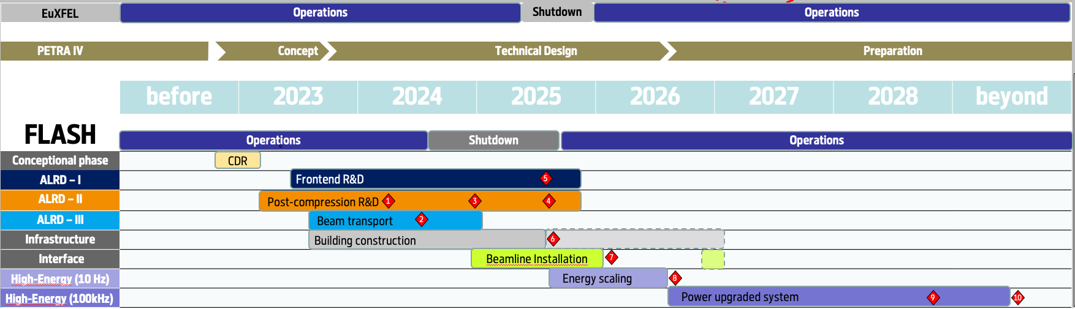
Timeline of this R&D Activity and Personnel
Skill or Task Description | FTE | from | to
Oscillator and front-end development | 1 | mid. 2023 | 2026
Post-compression implementation | 1 | 2023 | 2026
Beam line transport development | 1 | 2024 | 2026

Slide 7
Milestones of this R&D Activity
Milestone Description | Target MTH / QTR
Simulations for 5fs compression performed, ready for MPC-2 coating | 10/2023
Packaged oscillator complete | 12/2023
>= 1mJ, < 10 fs FWHM pulses (burst mode, 200kHz using NEPAL-D) | 06/2024
Beam transport and in-coupling design ready for review | 07/2024
Packaged front-end ready | 07/2024
CEP stabilization of oscillator completed | 01/2025
Beam transport and focusing validated | 04/2025
5fs, 500µJ measured after transport and focus ( burst-mode, using NEPAL-D + validation beamline) | 04/2025
CEP stable 1mJ, dual-stage compressed, 200kHz (100W) | 09/2025
5fs, 1mJ, 200kHz (100W) | 10/2025
CEP stable, 5fs, 1mJ, 200kHz laser | 12/2025

Slide 8
Expenditure
Items to be purchased / Task Name | When | Cost/k€
Yb:YAG amplifier (1- 1.5mJ, 200W) | 2023 | 110
2 dielectric compressor gratings | 2023 | 70
Pulse characterization equipment for 5 fs | 2024 | 50
Year | FTE | FTE Cost / k€ | Invest + Recurrent / k€ | Total Cost / k€
2023 | 1.5 | - (available) | 320 | 320
2024 | 3 | 100 | 400 | 500
2025 | 3 | 100 | 170 | 270
2026 | 1 | (beam installation, outside ALRD)
Total cost of this activity |  |  |  | 1090

Slide 9
Delivery: 1 mJ, 200 kHz, 5 fs, CEP stable source
ASPECT project is on the roadmap towards the generation of attosecond X-ray pulses.
The major laser technological challenges will be addressed, enabling the feasibility of ASPECT.
The MPC technique is the cornerstone technology for many DESY/EuXFEL activities (laser-plasma acceleration and high-flux table-top soft X-ray sources).

Slide 10
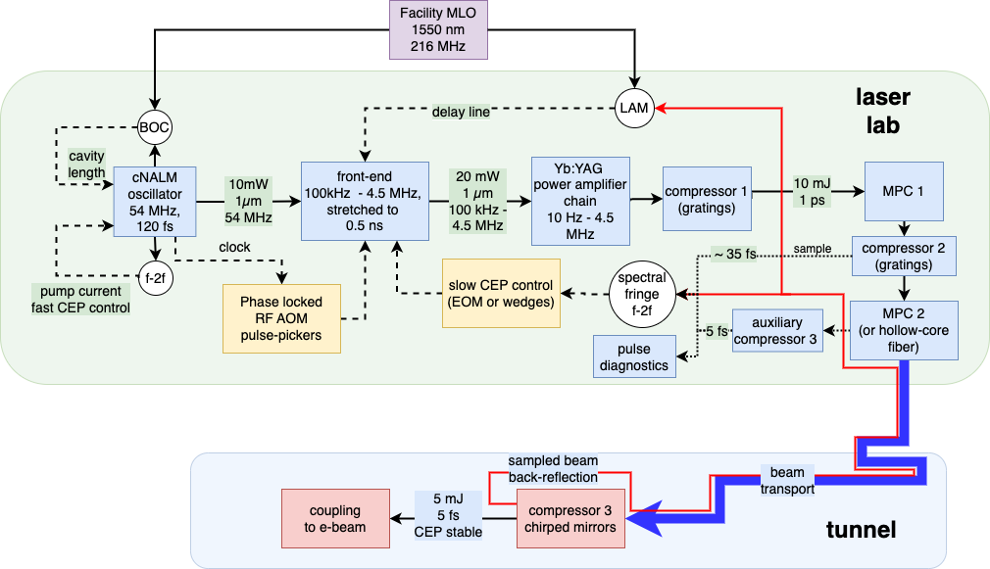
Detailed schematics of the delivarble

Slide 11
Detailed budget

