Slide 1
XFEL Accelerator R&D Proposal
Understanding and Controlling Beam Losses in High-Power XFELs
Shan Liu, Nick Walker, Prof. Andy Wolski* (University of Liverpool), Frank Jackson* (STFC/ASTeC)
27.06.2023
*also at Cockcroft Institute, UK

Slide 2
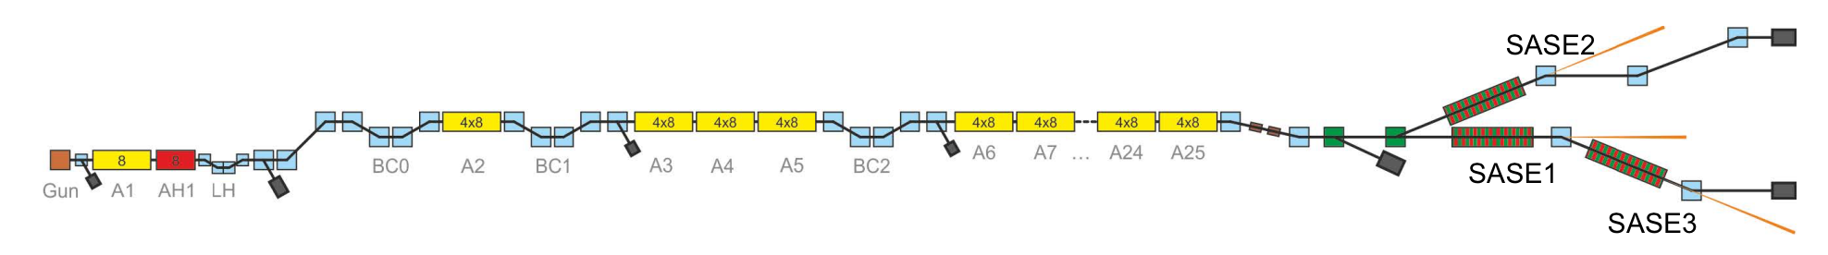
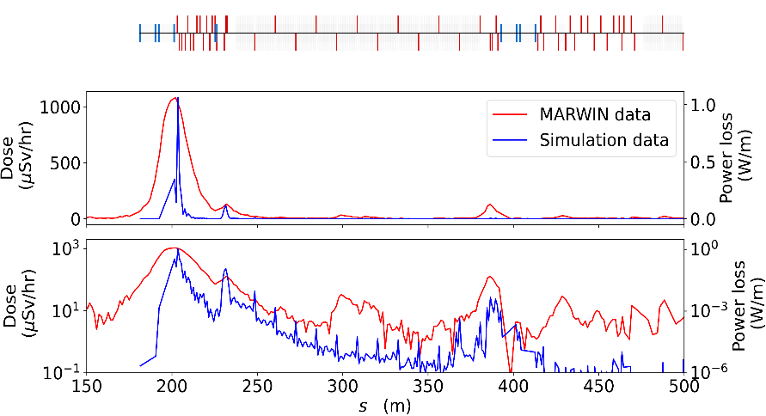
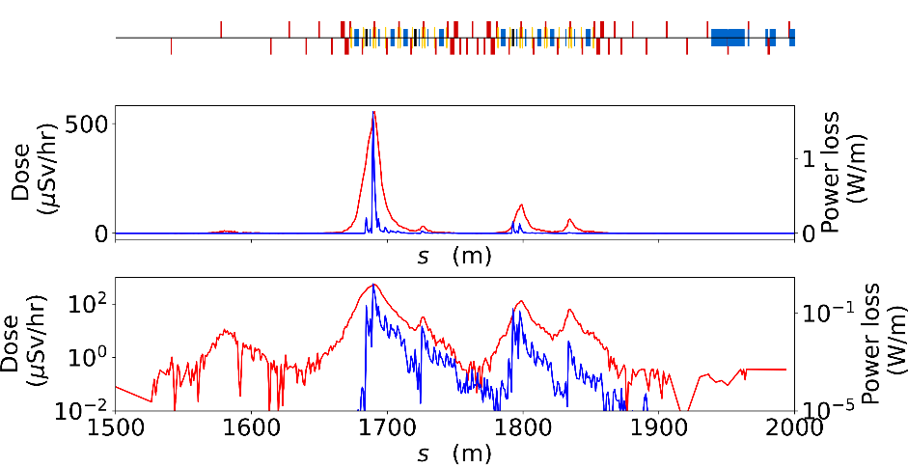
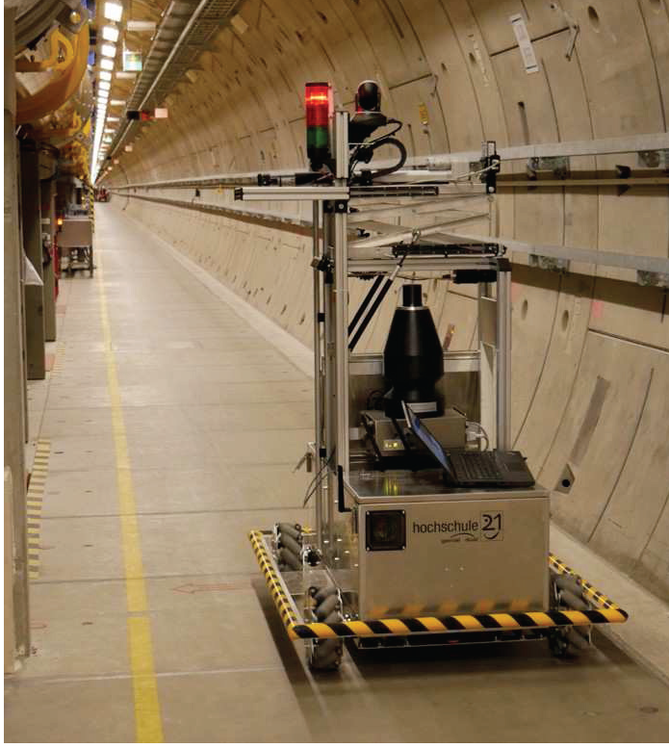
Scope of the R&D Activity
superconducting undulator (5 mm aperture)
dechirper
(0.7 mm to beam core)
slotted foil (180 um gap)
Apple-X undulator
Beam loss studies are important for the operation of high-power XFELs, especially for advanced operation modes which may require devices inserted into the beam like slotted foil or narrow vacuum chambers such as for the dechirper, the Apple-X undulator, and the superconducting undulator.
Beam loss simulations using BDSIM (Beam Delivery SIMulation) showed nice agreements with MARWIN measurements

Slide 3
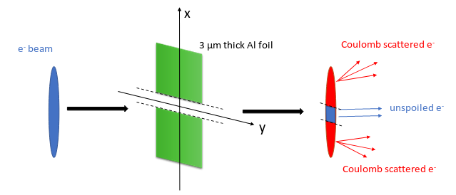
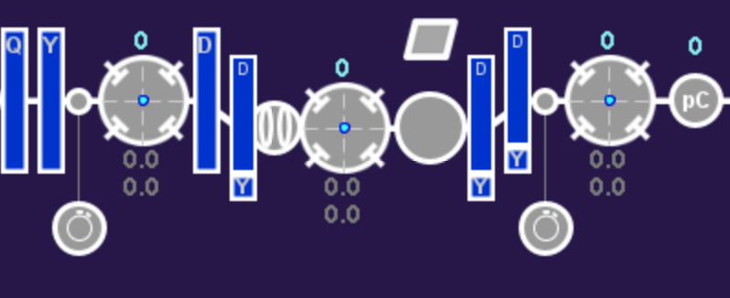
Deliverable of the R&D Proposal and its benefit for the XFEL
superconducting undulator (5 mm aperture)
dechirper
(0.7 mm to beam core)
slotted foil (180 um gap)
Apple-X undulator
Upgrade of BDSIM simulation in the undulator section by including synchrotron radiation
  in collaboration with the BDSIM team (now including members based at the Cockcroft Institute)
Up-to-date beam loss simulations and measurements for different applications
  find different causes of beam losses
  develop quantitative understanding of beam losses
  develop and explore possible control and mitigation methods
Implementation of the slotted foil for short pulse generation
  straightforward method w/o tuning effort
y
x

Slide 4
Timeline of this R&D Activity
Milestone Description | Target MTH / QTR
Establish simulations of beam losses with up-to-date model of Eu-XFEL | Month 8
Finalize the design of the slotted foil for ultra-short photon pulse generation | Month 12
Extension of BDSIM to include synchrotron radiation | Month 18
Installation and commissioning of the slotted foil | Month 24
Collection and analysis of signals from a variety of beam loss diagnostics | Month 30
Comparison of measurements with simulations | Month 36
Exploration and evaluation of potential techniques for control and mitigation of beam losses | Month 42

Slide 5
Personnel Resource Needs of the R&D Project
Skill or Task Description | FTE | from | to
new: PhD student | 1 | 2024 | 2028
The student will be registered as a PhD student at the University of Liverpool, the official supervisor in the university will be Prof. Andy Wolski. Dr. Frank Jackson from STFC/ASTeC will be the 2nd supervisor from the UK side.
Shan Liu and Nick Walker will host the student at DESY in Hamburg, where the work of the student will be carried out.

Slide 6
Expenditure
List individual items 50 k€ and above (if any)
indicate when the purchase in planned, quarter would be nice, year is necessary
Items to be purchased / Task Name | When | Cost/k€

Slide 7
Resource and Cost Profile of Proposal
The registration fees for international students at Liverpool University are much higher than for UK student - this is generally the case at UK universities.
Year | FTE | FTE Cost / k€ | Invest + Recurrent / k€ | Total Cost / k€
1 | Full-time PhD | Registration fees: 6.5 (UK) or 29.0 (International) Living allowance: 25.0 (UK and International) | Computer/laptop and software: 2.5 | 34 (UK) or 57 (International)
2 | Full-time PhD | Registration fees: 7.0 (UK) or 31.0 (International) Living allowance: 26.8 (UK and International) |  | 34 (UK) or 58 (International)
3 | Full-time PhD | Registration fees: 7.4 (UK) or 33.2 (International) Living allowance: 28.6 (UK and International) | Travel to conferences/workshops/accelerator schools: 10.0 | 46 (UK) or 72 (International)
4 | Full-time PhD 6 months | Registration fees: 4.0 (UK) or 35.5 (International) Living allowance: 30.6 (UK and International) |  | 35 (UK) or 65 (International)
 |  |  |  | 149 (UK) or 252 (International)

Slide 8
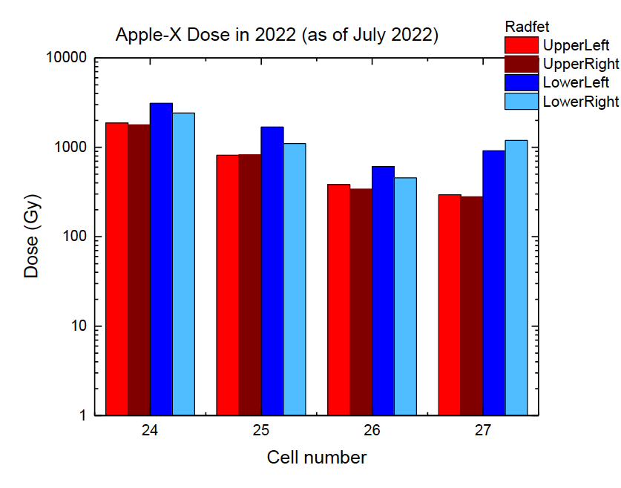
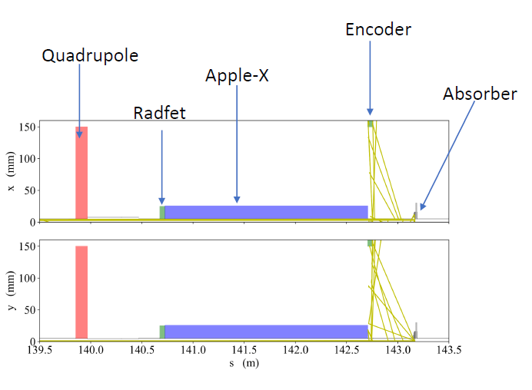
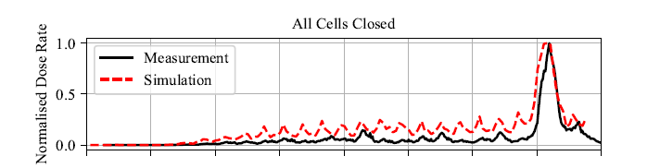
Summary
Level of beam losses can effectively affect the life time of different components in high power FELs
Understanding and controlling of beam losses is the key to protect the machine while implementing advanced operation schemes
BDSIM simulations and MARWIN measurements already showed nice agreements
Work will be continued by a new PhD student hired via this proposal

