Slide 1
XFEL Accelerator R&D Proposal
Virtual diagnostics
Sergey Tomin
27.06.2023

Slide 2
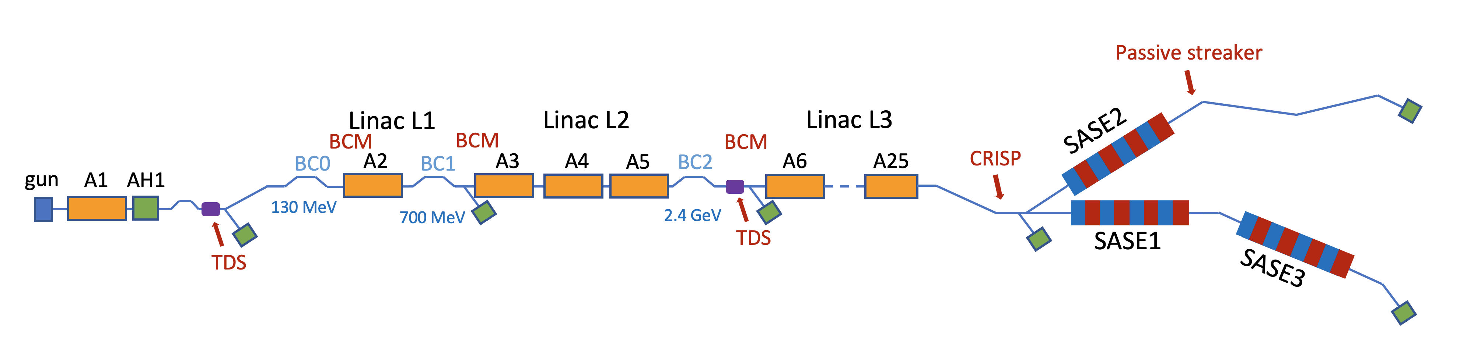
Virtual diagnostics. Motivation
Standard SASE operation and advanced FEL schemes require precise control of longitudinal electron beam dynamics
It requires appropriate online longitudinal phase space (LPS) diagnostics
Non-invasive diagnostics
  BCMs after bunch compressors
  THz diagnostic – CRISP
Always online but provide limiting information
Invasive diagnostics
  TDS in injector and after BC2
  Diagnostic corrugated structure after SA2
Provide more information but not compatible with photon delivery or with online tuning

Slide 3
Virtual diagnostics. Motivation
Ideal LPS diagnostics: Non-invasive 4.5 MHz TDS after each BC and each undulator with sub-fs resolution and a screen in the dispersive section.
While the ideal LPS diagnostic remains a dream, we can still obtain all the necessary information about the electron beam properties through S2E simulations.
However, do S2E simulations accurately reflect reality?

Slide 4
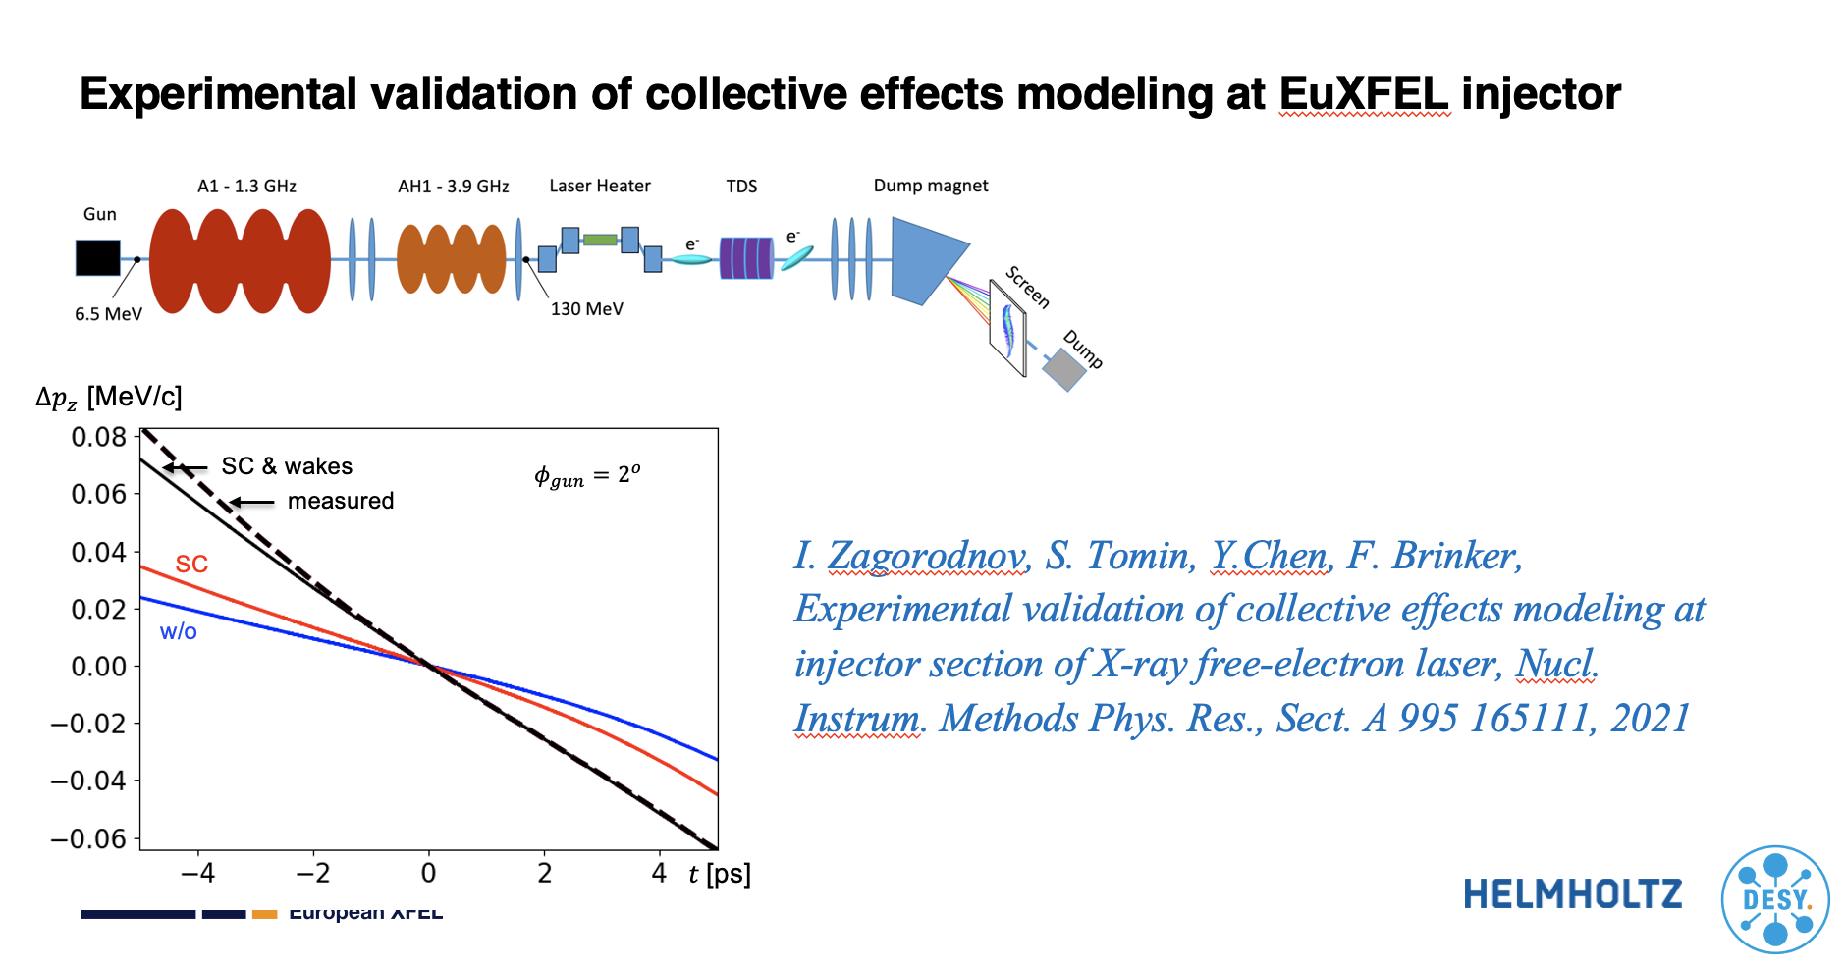
Virtual diagnostics. Motivation
Ideal LPS diagnostics: Non-invasive 4.5 MHz TDS after each BC and each undulator with sub-fs resolution and a screen in the dispersive section.
While the ideal LPS diagnostic remains a dream, we can still obtain all the necessary information about the electron beam properties through S2E simulations.
However, do S2E simulations accurately reflect reality?
✅

Slide 5
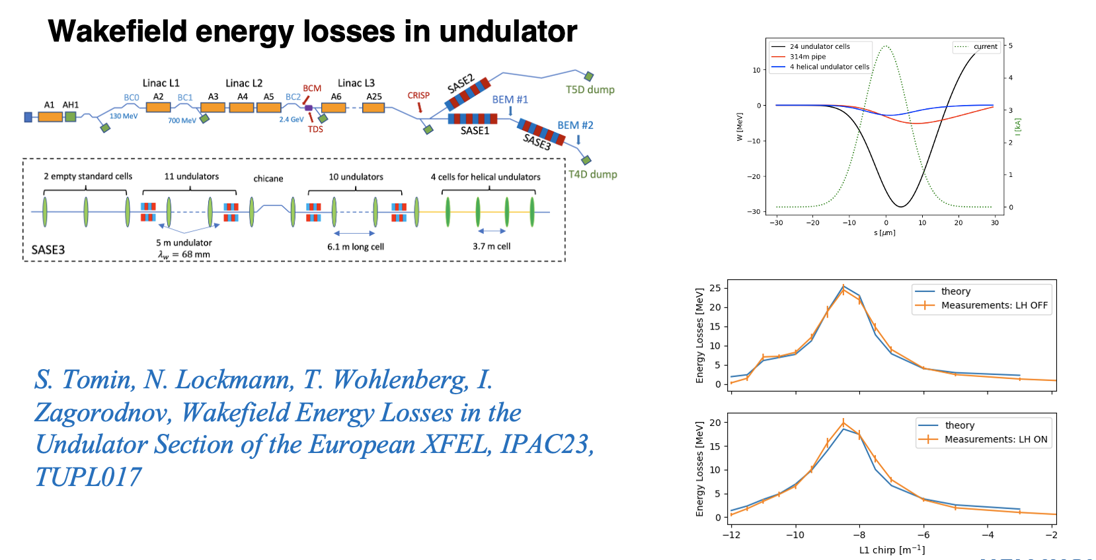
Virtual diagnostics. Motivation
Ideal LPS diagnostics: Non-invasive 4.5 MHz TDS after each BC and each undulator with sub-fs resolution and a screen in the dispersive section.
While the ideal LPS diagnostic remains a dream, we can still obtain all the necessary information about the electron beam properties through S2E simulations.
However, do S2E simulations accurately reflect reality?
✅
✅

Slide 6
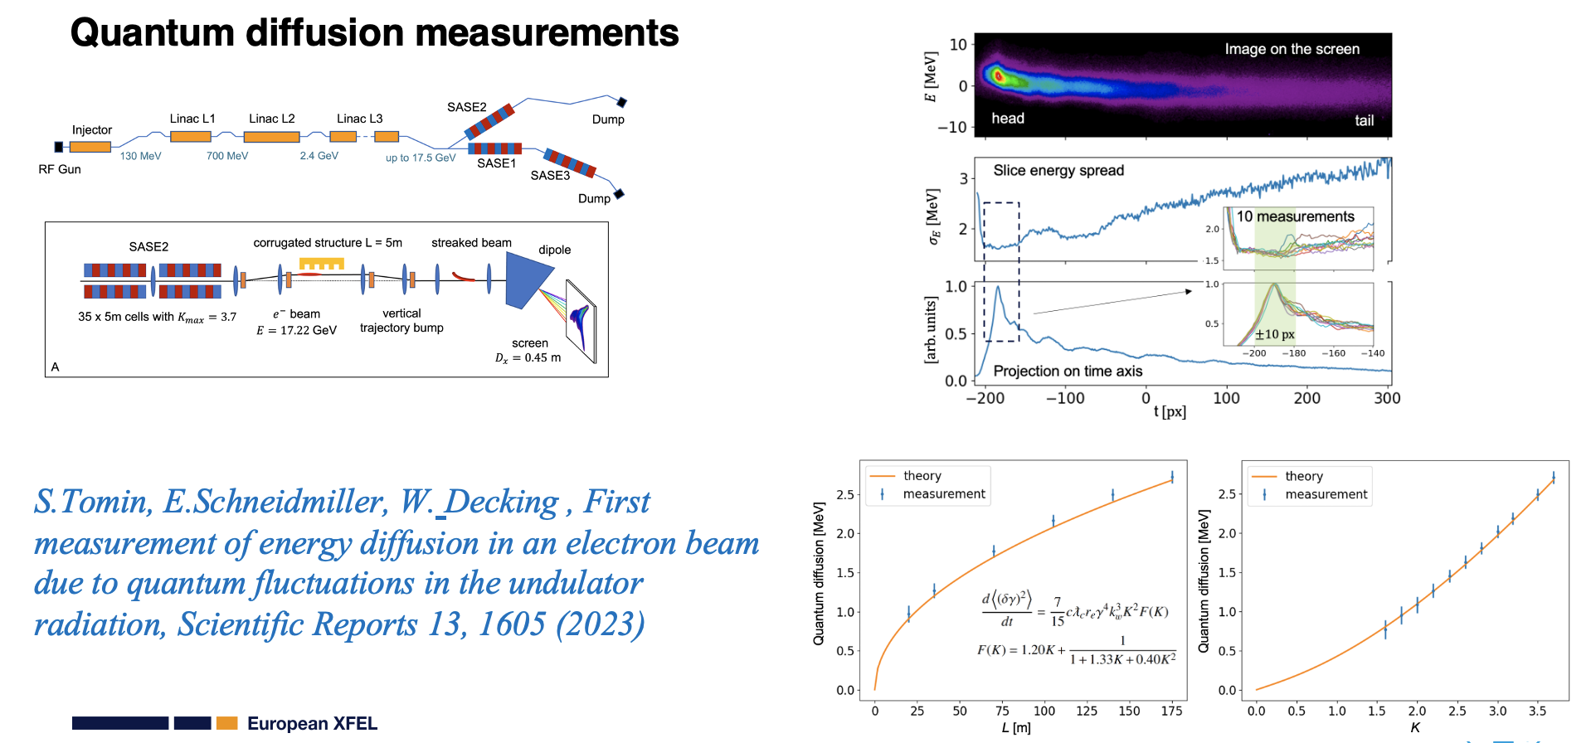
Virtual diagnostics. Motivation
Ideal LPS diagnostics: Non-invasive 4.5 MHz TDS after each BC and each undulator with sub-fs resolution and a screen in the dispersive section.
While the ideal LPS diagnostic remains a dream, we can still obtain all the necessary information about the electron beam properties through S2E simulations.
However, do S2E simulations accurately reflect reality?
✅
✅
✅

Slide 7
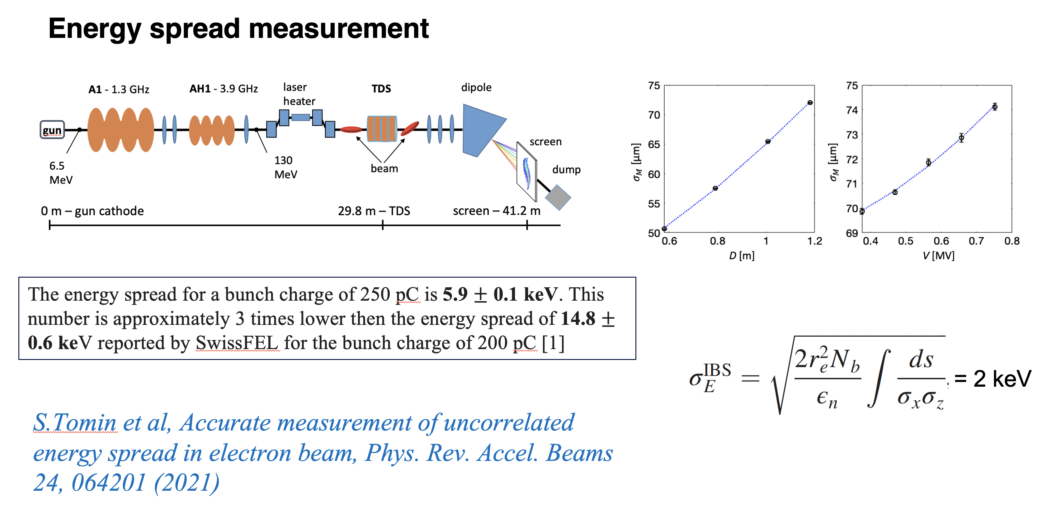
Virtual diagnostics. Motivation
Ideal LPS diagnostics: Non-invasive 4.5 MHz TDS after each BC and each undulator with sub-fs resolution and a screen in the dispersive section.
While the ideal LPS diagnostic remains a dream, we can still obtain all the necessary information about the electron beam properties through S2E simulations.
However, do S2E simulations accurately reflect reality?
✅
✅
✅
⚠️

Slide 8
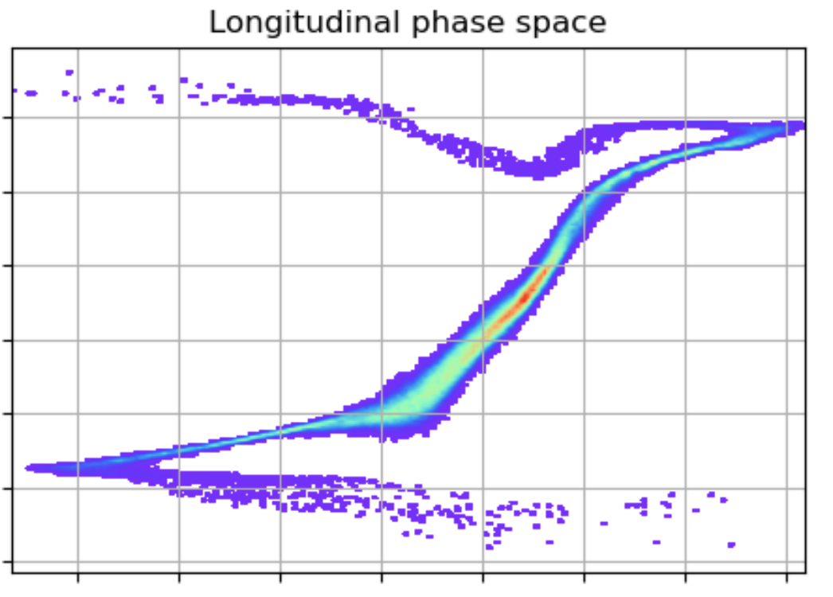


Virtual diagnostics. Is S2E simulation enough?
Initial beam distribution from the gun
RF settings, BCs settings, beam energy…
from the accelerator
Theoretical simulation model (OCELOT)
$$\frac{δE}{E}$$
$$t [fs]$$

Slide 9
Virtual diagnostics. Is S2E simulation enough?
Initial beam distribution from the gun
RF settings, BCs settings, beam energy…
from the accelerator
Theoretical simulation model (OCELOT)
Most likely, the LPS distribution will differ from reality
  Initial distribution is unknown
  RF settings have drifted
  Simulation model not taking into account all the physics
  ….
Simulations are slow
$$\frac{δE}{E}$$
$$t [fs]$$

Slide 10
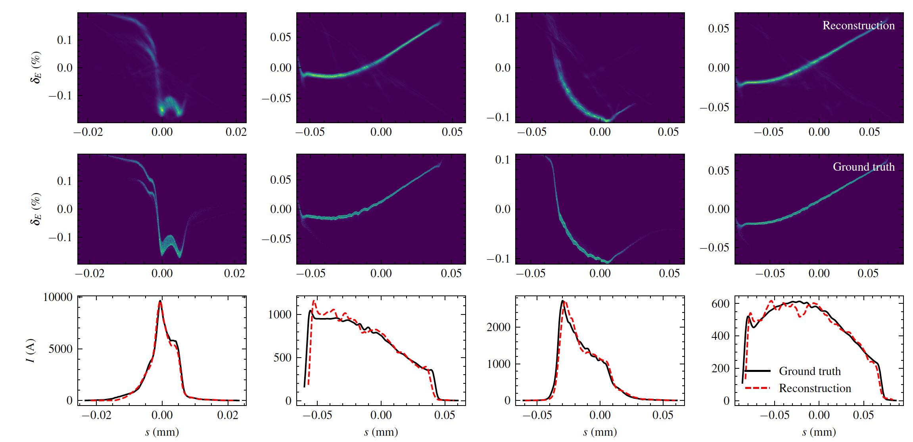
Virtual diagnostics. How it works
Initial beam distributions from the gun
Range of RF settings, BCs settings, beam energy…
from the accelerator
Non-invasive diagnostics
Theoretical simulation model (OCELOT)
Surrogate model
Collaboration with Annika and Jan (MSK)
Data set
(many S2E simulations on DESY cluster)
J. Kaiser, A. Eichler, S. Tomin, Z. Zhu, Machine Learning for Combined Scalar and Spectral Longitudinal Phase Space Reconstruction, IPAC23.

Slide 11
Deliverable of the R&D Proposal and it‘s benefit for the XFEL
Why should this proposal be funded?
  We spend hours on accelerator tuning, including tweaking the longitudinal beam dynamics. By implementing this virtual diagnostic, we can predict the LPS of the electron beam, which will speeding up the tuning process and improving reproducibility of the accelerator.
Final deliverables upon completion of Virtual Diagnostic Project:
  Complete OCELOT accelerator model crosschecked with measurements. 3-4 beam time shifts/year
  EuXFEL accelerator surrogate model(s) for
    the fast S2E simulations
    serving as a part of the Virtual diagnostics
    fast computational engine for “Learning-based Methods Towards an Autonomous European XFEL”
  Virtual diagnostic tool capable of predicting the LPS of the electron beam. We anticipate collaboration with the "Mixed Longitudinal Diagnostic for EuXFEL" project
In case of success of this project:
  Virtual Diagnostic - LPS prediction
  Surrogate model(s) of the accelerator
  Better understanding of the machine

Slide 12
Timeline of this R&D Activity
Milestone Description | Target MTH / QTR
PostDoc hired | Q3/2023
Generation of Start-to-End Data on DESY Cluster for Surrogate Model Training. | Q1/2024
Development of the first prototype of the surrogate model for accelerator modeling | Q3/2024
Cross-Checking the ML Surrogate Model (Theoretical Model) with measurements | Q1/2025
Integration of Surrogate Models with Non-Invasive Diagnostics | Q3/2025
Published the results | Q1/2026

Slide 13
Personnel Resource Needs of the R&D Project
Give an overview about the personnel resource needed for this activity
  Accelerator physicist with ML learning background will be preferable
Skill or Task Description | FTE | from | to
new: postdoc | 1 | 2023 | 2026
Available -

Slide 14
Resource and Cost Profile of Proposal
Give here to total investments and FTEs per year
  Invest + Recurrent cost can be different from slide 6, if smaller (<50 k€) expenditurs are expected
for the sake of this table, assume 100 k€ / FTE for full FTE, 2/3 for a PostDoc, 1/2 PhD student
Year | FTE | FTE Cost / k€ | Invest + Recurrent / k€ | Total Cost / k€
2023 | 0.5 | 33 | 5 | 38
2024 | 1 | 66 | 15 | 81
2025 | 1 | 66 | 15 | 81
2026 | 0.5 | 33 | 5 | 38
Total cost of this activity |  |  |  | 238

