Slide 1
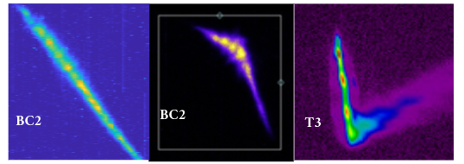
XFEL Accelerator R&D Proposal:
Characterization and Control of Microbunching Instability at European XFEL (CCMBI)
Najmeh Mirian
By help of M. Czwalinna (MSK) R. Wichmann (MXL)
27/06/2023
What is MBI? Longitudinal electron beam distortion : Energy distortion and/or density distortion
For what prepose? This project is for Tuning and operation
Brings? Diagnostic tool and optimization tool

Slide 2
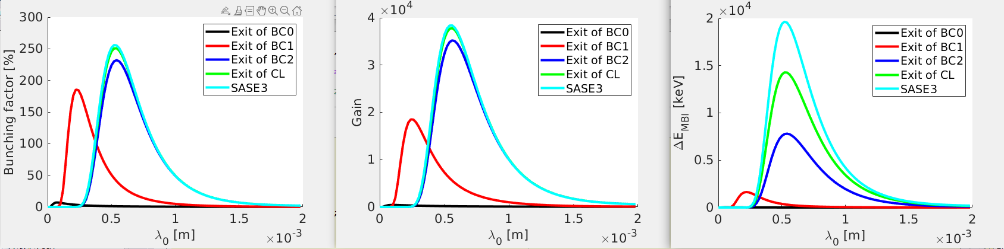
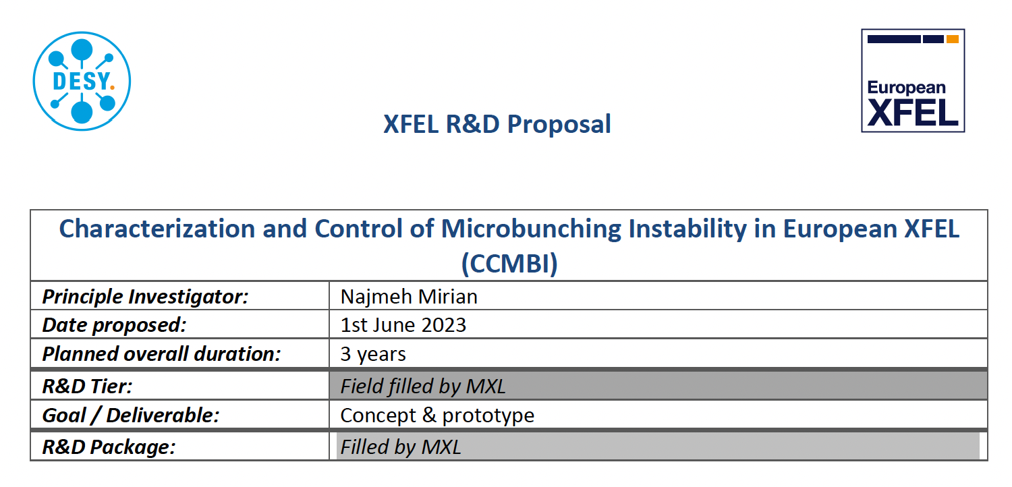
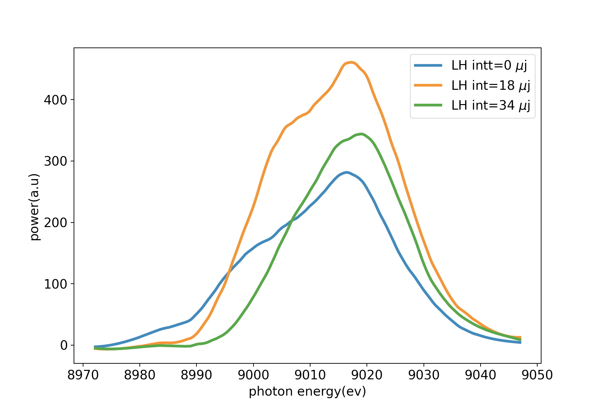
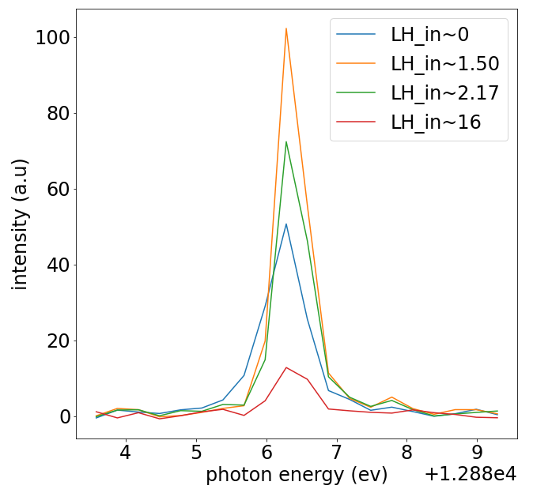
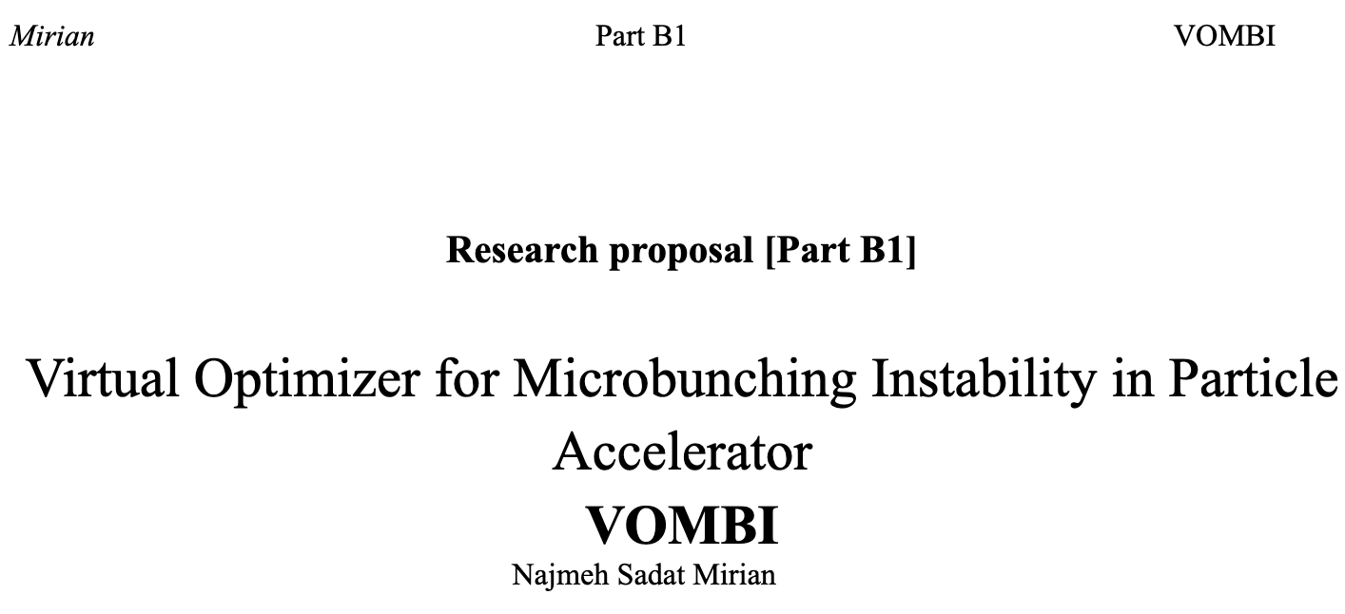
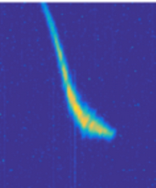
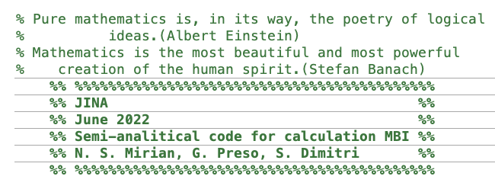
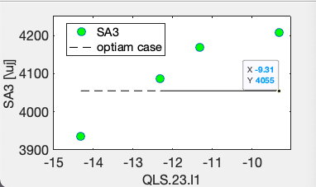
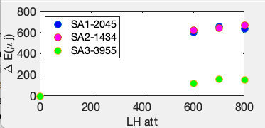
Scope of the R&D Activity: Review of literature
2
I started the MBI study with a longitudinal phase space study after BC2. I considered SC, CSR, and restive wall wake field and calculated the energy and density modulation. Then, I investigated the EuXFEL machine with a cold beam (almost 2 hours operation)! in cooperation with the HXRSS operation team, I showed the MBI impact on the spectrum of SASE2. I modeled MBI in the whole EuXFEL machine. In cooperation with S. Dimitri and G. Perosa (Eletrra), I created ‘JINA’ Semi-analytical MBI code. After that I initiated VOMBI and CCMBI.

Slide 3
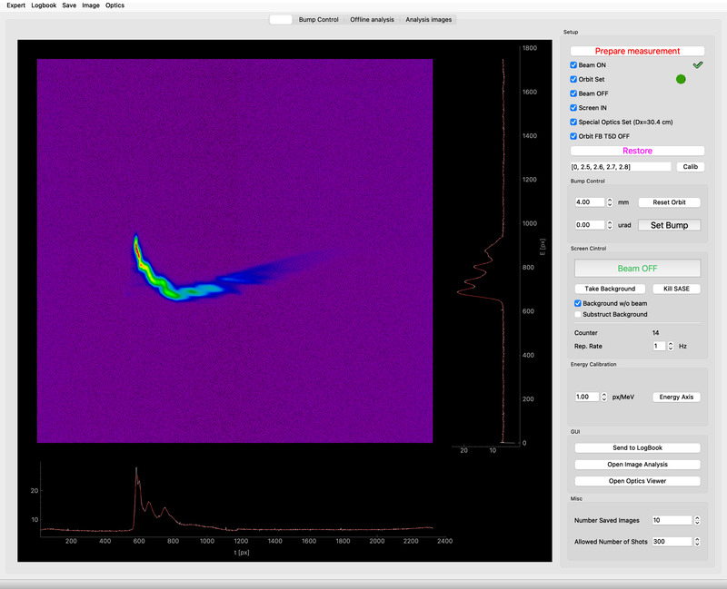
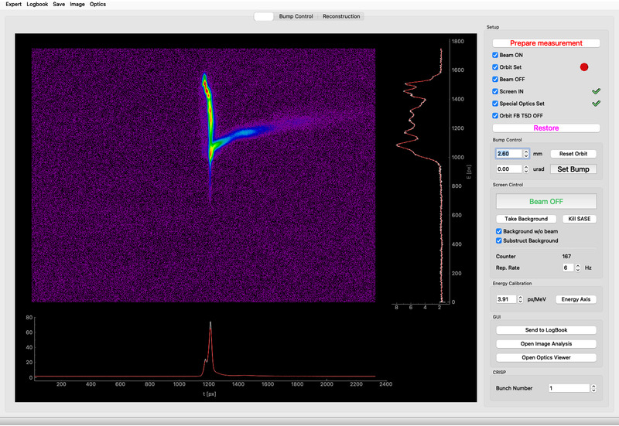
Scope of the R&D Activity : Why do we have to concern about MBI ?
3
MBI challenge has been observed frequently in FEL tuning and in FEL performance.
After changing the gun cathode, tuning of FEL was quite puzzling and the operation of high photon energy >30 kev was so challenging. Energy modulation is proofed.
HXRSS performance extremely depends on the level of MBI; both phase and amplitude of the MBI interfere to the performance of HXRSS. SXRSS can be even more difficult.
The idea of using a cold beam at EuXFEL is still attractive.
The Future of EuXFEL with SASE5 and SASE4 in the presence of MBI can be worrying.
The spectrum of EuXFEL is 50% larger, why? Beside of other reasons, Energy spread, MBI, nonlinear effects.

Slide 4
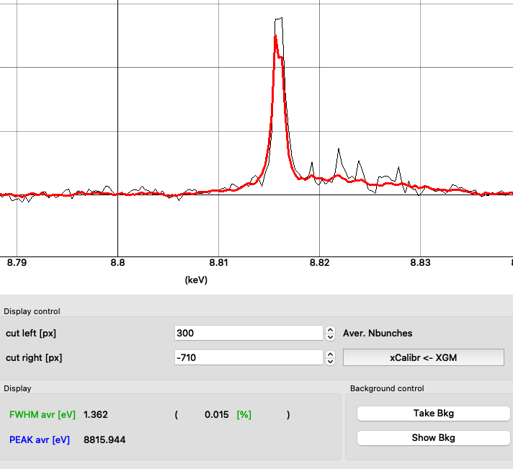

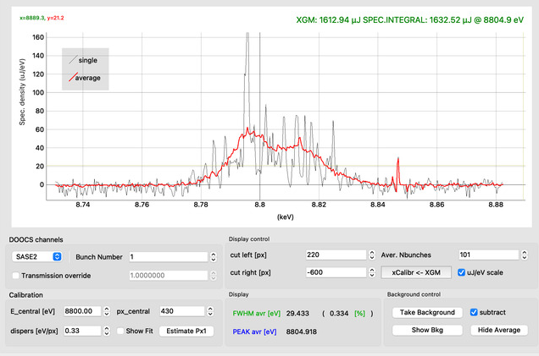
What are the reasons for the large bandwidth at EuXFEL?
4a
The energy spread is high and we are running the machine in nonlinear region (after saturation ).
The MBIs (energy modulations) increase the bandwidth …
SASE 3 situation is not optimal; can be better
We do not expect a nice situation in SASE4 and SASE5.
What will happen for high photon energy amplification?
This puzzle will get bigger in the future!

Slide 5
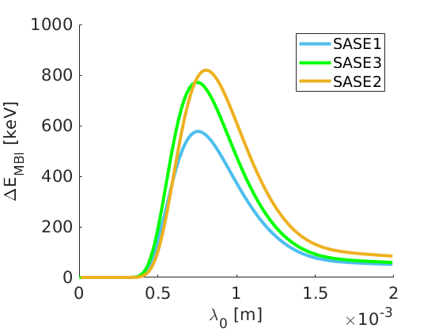
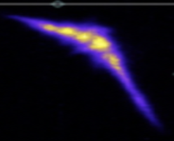
MBI at EuXFEL
4b
Density modulations enter to the FEL performance as a perturbation and energy modulation directly in gain and spectrum
MBI in the machine increases the energy spread.

Slide 6

Scope of the R&D Activity: Our solution about MBI at EuXFEL
5
How to overcome MBI trouble with low energy spread?
We need an optimization idea that reduces the role of the LH and increases the role of phase mixing!
But how?
EuXFEL is a big machine. We need few diagnostic instruments at some investigation points. First, density modulations in machine and energy modulations in undulator lines should be measured then based on our observations we can optimise MBI.
We need a clear and powerful plan!

Slide 7

Scope of the R&D Activity: CCMBI in general
6
CCMBI brings new diagnostic tools based on coherent transmission radiation and … (?) to measure the MBI spectrum at EuXFEL.
The main goal of CCMBI at European XFEL is to upgrade the quality of electron beam at the EuXFEL and give a model for the commissioning of the XFEL with lower MBI impacts.
CCMBI brings a sort of idea to how to optimize the electron beam and FEL radiation based on Beam dynamics of electron beam. CCMBI aims to achieve a new theoretical optimization model and optimise the microbunching instability at EuXFEL with an efficient artificial intelligence idea. CCMBI will use impedance matrix multiplication to make a model for microbunching instability and will invent a new optimization tool based on a semi-analytical code.
To strat: COTR spectrum instrument after BC1 (first step)

Slide 8
Deliverable of the R&D Proposal and it‘s benefit for the XFEL
7
What is the final deliverable with completion of this R&D activity?
  In the first step: prototype, implemented measurement technique: COTR spectrum after BC1 (in this proposal) Before we optimize it, we have to measure it and characterize it.
  In the next steps: more diagnostic tools, concepts, and new optimization methods, (in the future)
Is the deliverable of the proposal already beneficial for the XFEL or is an extension proposal needed?
  CCMBI requires several COTR spectrum implementations. In this proposal, here is the first step which is the hardest stage because it includes the whole MBI simulations and variation of simulations till BC1 station. The next steps require more effort and more time. We have a plan to show energy modulation at the undulator sections.. Without future plan a COTR spectrum after BC1 is not enough for controlling the MBI in XFEL
Clearly outline the benefit of this proposal ... Why should this proposal be funded?
  CCMBI deals with important challenges in machine operation and light delivery! It is a big, important, and affordable project. It requires support.

Slide 9
Timeline of this R&D Activity
8
Milestone Description | Target MTH / QTR
The group will be completed | 2023/Q3
The concept of the diagnostic setup will be fully elaborated, MBI study in EuXFEL injector section will be done, | 2023/Q4
Simulation for the spectrometer station will be completed | 2024/Q1
the parameters for spectrum design will be confirmed. | 2024/Q2
Start-to-end simulation of MBI with IMPACT /OPAL code will be finished, Confirmation of the beamline modification (Design & Construction) will be done | 2024/Q3
Design of Diagnostic devices will be completed | 2024/Q4
Comparison of Start to end IMPACT simulation with theory and possible energy spread measurement in longitudinal phase space diagnostic instruments will be done, | 2025/Q2
Preparation and Installation of Diagnostic instruments (COTR spectrometers) will be finished. | 2025/Q4
First measurement of MBI spectrums will be presented, | 2026/Q2
Comparison of COTR spectrum measurement and simulations will be demonstrated, | 2026/Q3

Slide 10
Timeline of this R&D Activity
9
IMPACT (Pd)
OPAL (st)
JINA(PI)
Range of spectrum
Design of the spectrometer setup
Before shut down 2025
Installation of spectrum during shut down
during shut down 2025
Measurements, simulation confirmation and clarify the next steps
after shut down 2025

Slide 11
Personnel Resource Needs of the R&D Project
10
This activity includes simulation, theoretical calculation and measurement, COTR spectrum design, installation and operation. So we need two post-docs and 1 PhD student for three years.
  I need help in simulation and measurements.
  We have to find agreement between simulation codes and our measurement .
  MSK group can support us in COTR spectrometer, however they need also manpower help
Skill or Task Description | FTE | from | to
new: Impact simulation for ‘Systematic study of MBI and further development of the theory and MBI code’ (task 1) post-doc | 1 | 2023/Q4 | 2026/Q3
new: OPAL simulation for ‘Systematic study of MBI and further development of the theory and MBI code’ (task 1) student | 1 | 2023/Q4 | 2026/Q3
new: ‘Benchmarking and baselining the performance of the code by beam properties measurements in Eu-XFEL’ (task 2) post-doc | 1 | 2023/Q4 | 2026/Q3
Available : MSK group for COTR Spectrum, design, Installation and operation

Slide 12
Expenditure
11
COTR spectrum equipment, listed by Marie Czwalinna (MSK).
This proposal was fully supported by MSK group (Thanks).
Items to be purchased / Task Name | When | Cost/k€
Screen station (chamber, mover, optical quality COTR screen) | 2023-2025 | 16
Mechanics + THz optics (prisms, mirrors) for spectrometer | 2023-2025 | 12
Electronics for readout + control (MTCA, Beckhoff) | 2023-2025 | 25
Line detector | 2023-2025 | 25
Diamond window (if needed) | 2023-2025 | 12
sum |  | 90

Slide 13
Resource and Cost Profile of Proposal
12
One post-doc to take care of IMPACT simulation
One post-doc to take care of measurments, design of spectrumeter, working on simulation of COTR …
One PhD student to do the OPAL simulation
Year | FTE | FTE Cost / k€ | Invest + Recurrent / k€ | Total Cost / k€
2023 | 1.5 | 91,7 | 25 | 116,7
2024 | 3 | 243,3 | 60 | 243,3
2025 | 3 | 213,3 | 30 | 213,3
2026 | 1.5 | 91,7 |  | 91,7
Total cost of this activity |  |  |  | 665,0
Cost per FTE incl. FTE Overhead 100 k€/FTE
Thanks to Riko Wichmann, he counted the costs

Slide 14

Summary
13
CCMBI is a project to help machine operation with low energy spread and low MBI levels. It brings a concept and diagnostic instruments to overcome the MBI trouble at EuXFEL.
For the first step, the COTR spectrometer will be located after BC1 in the nonlinear point (90 k€); can be hard to be used for optimization. And this is not enough for controlling MBI in XFEL. This is good for observation and for our investigation point.
The setup and operation of COTR spectrometer will be perfumed with the help of MSK group. Two post docs and 1 student are required.
It’s very important that we do the MBI simulations and design of the COTR spectrometer before shutdown 2025.
Please do consider long-term support to solve this problem. CCMBI includes simulation efforts, and diagnostic tools’ installations and initiate a optimization model and tool. We have plan for all of them. The way is clear for us.
Thanks for your attention

Slide 15
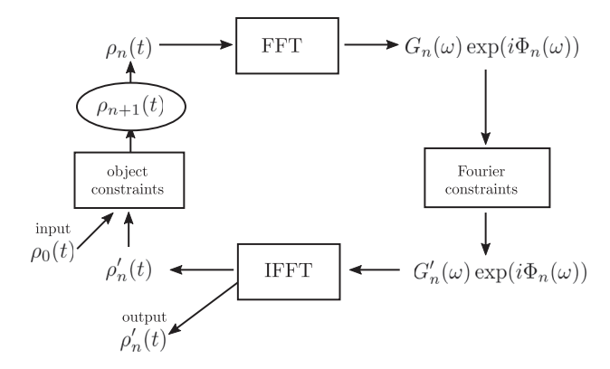
Diagnostic algorithm
file:///Users/Najmeh/Downloads/Longitudinal_Bunch_Diagnostics_using_Coherent_Tran.pdf
file:///Users/Najmeh/Downloads/Benchmarking_coherent_radiation_spectroscopy_as_a_.pdf

Slide 16
