Slide 1
XFEL Accelerator R&D Proposal
Learning-based Methods Towards an Autonomous European XFEL
Jan Kaiser, Matthias Scholz, Annika Eichler
27.6.2023

Slide 2
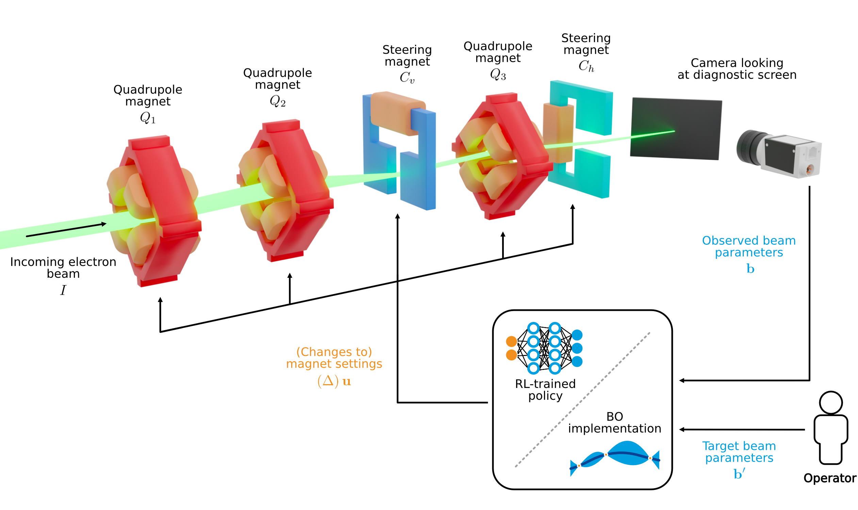
Scope of the R&D Activity
Accelerator and FEL tuning
  requires human expertise
  is lengthy and tedious,
  involves more than hundreds of tuning knobs
Where are we already:
  Tuning a particular subsystem using a limited number of actuators can already be done automatically by the use of empirical optimizers.
Next step towards autonomous operation for FELs:
  Intermediate steps: add additional automation steps to setup, run and tune XFEL.
  Aim for “global” hierarchical solutions for tuning (optimally integrating specific subtask solutions).
Interfaces with other XFEL R&D or operation activities:
  LLRF operation (as all hierarchies should be involved)
  Current XFEL R&D projects: Virtual Diagnostics and Mixed Diagnostics

Slide 3
Deliverable of the R&D Proposal
Deliverables
Key issues
Integration to existing optimization software landscape at European XFEL, in particular Ocelot Optimiser and Badger.
Surrogate models are needed for
  Training and optimization.
  Virtual diagnostics (link to Virtual Diagnostics and Mixed Diagnostics)
Transfer: Transfer existing tools to the European XFEL.
Extending: Hierarchical approaches to tackle global performance.
reuse pre-exisiting conventional algorithms for subtask optimization (exploit existing software like Ocelot Optimiser and Badger).
Choose the order of subtask optimization by an autonomous supervisor agent.
Reinforcement learning solution for autonomous online operation of the European XFEL beam dump line
Reinforcement learning for FEL intensity tuning (collaboration with SLAC is ongoing and reinforcement learning is to be tested at LCLS II within a research visit of Jan Kaiser this year)

Slide 4
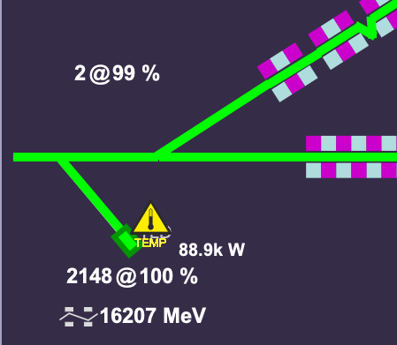
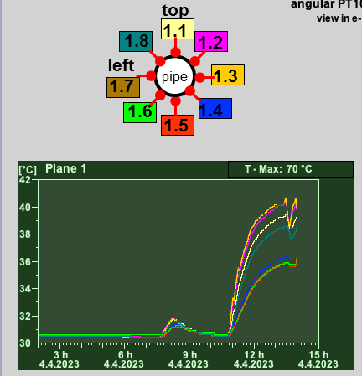
It’s benefit for the XFEL
Support operators during setup, running and tuning of European XFEL especially in preparation of user runs.
Possibly achieving a more reproducible performance in less setup time and thus improving the reliability of XFEL’s photon delivery to the instruments.
An example: XFEL can accelerate up 27.000 bunches per second with an electron beam energy of max 17.5 GeV. It is regularly observed that the majority of the bunches are directed to the TLD dump, which heats up quickly if the beam’s trajectory is not optimized.
Existing diagnostics in the TLD beamline that can be used by a RL agent to optimize the trajectory:
BPMs
BLMs with known positions along and around the beamline.
Temperature measurements along and around the dump at dedicated positions.
TLD beamline
>21000 bunches/s
Beam power ~90 kW
Temperature warning active
Time needed for trajectory correction depends on various parameters like starting setup, intra bunch train deviations, and the expertise of the operator.
Rapid temperature increase in the TLD dump beamline. If no measures are taken, the dump protection system will reduce the allowed number of bunches to TLD --> Leads to impact on users!

Slide 5
Timeline of this R&D Activity
Milestone Description | Target MTH / QTR
Postdoc hired | Q4 2023
Simulation of the European XFEL beam dump line completed | Q1 2024
RL agent trained for the beam dump line in simulation | Q2 2024
Transferred the RL agent to the beam dump line of the European XFEL | Q3 2024
Integrated the RL dump line feedback as DOOCS server | Q4 2024
Reviewed hierarchical optimization and RL | Q4 2024
FEL intensity surrogate model trained | Q1 2025
Trained RL agent for FEL intensity optimization in simulation | Q2 2025
Transferred the RL agent to FEL intensity optimization on EuXFEL | Q3 2025
Integrated FEL intensity optimisation into Ocelot Optimizer / Badger | Q4 2025
Hierarchical optimization on virtual XFEL completed | Q1 2025
Inclusion of low level control to hierarchical approach finished | Q2 2026
Inclusion of first FEL intensity tuning results to hierarchical approach finished | Q2 2026
Transferred hierarchical approach to real machine | Q3 2026
Integration of hierarchical method into Ocelot Optimiser / Badger completed | Q3 2026

Slide 6
Personnel Resource Needs of the R&D Project
Skill or Task Description | FTE | from | to
new: Postdoc Accelerator physicist Experience in accelerator operation Experience in ML for accelerator operation | 1 | Q4 2023 | Q3 2026
Available: Jan Kaiser (now PhD, then Postdoc) Computer scientist Experience in accelerator operation Experience in Reinforcement Learning | 1 | Q3 2024 | Q3 2026
Expenditure
NONE

Slide 7
Resource and Cost Profile of Proposal
Year | FTE | FTE Cost / k€ | Invest + Recurrent / k€ | Total Cost / k€
2023 | 0.25 | 16.67 |  | 16.67
2024 | 1.5 | 100 |  | 100
2025 | 2 | 133.33 |  | 133.33
2026 | 1.5 | 100 |  | 100
Total cost of this activity |  |  |  | 350

Slide 8
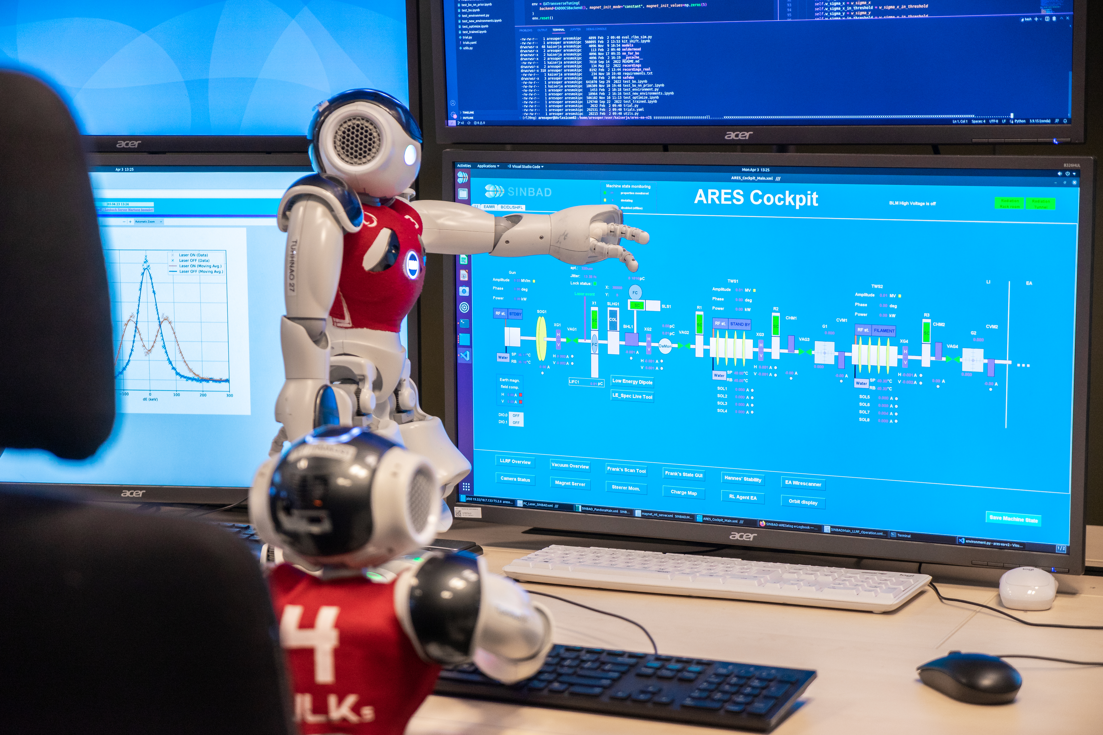
Your name could be here!

