Slide 1
ARES Operation Meeting
Summary of week 24 / 2023 – ACHIP Stage 0, acquiring additional data for paper
Willi Kuropka, on behalf of the ARES crew

Slide 2
Summary of week 24
Mon. 12.6. | Tue. 13.6. | Wed. 14.6. | Thu. 15.6. | Fri. 16.6.
TDS water cooling Reinstalling gated camera timing system in EA section Reinstalling final focus lens and camera observation system for DLA experiment Checking laser alignment to Interaction point at EA section | Triple on crest WP Stable DLA transmission with 0.5pC initial charge Investigation of the gated camera system accuracy | Checking the timing system delay generator output Checking pulse picker for the HoYLF system Investigation of the gated camera system accuracy | Investigation of the gated camera system accuracy Looking at single pixels for the timing scans Aligning laser timing to electron timing Adjust spatial alignment of the laser with the observation camera Measuring laser beam size at the IP, by scaning certain edges of the sample holders in the chamber | Activated pulse picker for the HoYLF system, picking at machine rep rate Found modulation and t0 and compared to gated camera system results
 |  | STRIDENAS oscilloscope was off | kHz laser rep rate has influence on the transmission through the DLA | Gun modulator fault
Tunnel open
Achievements
Difficulties
Notes

Slide 3
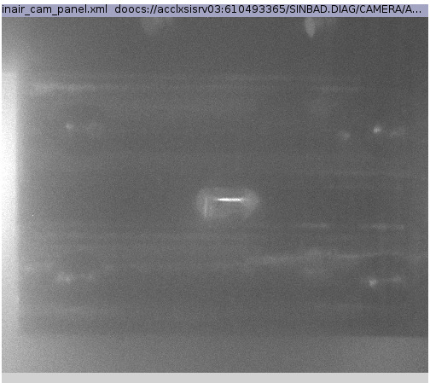
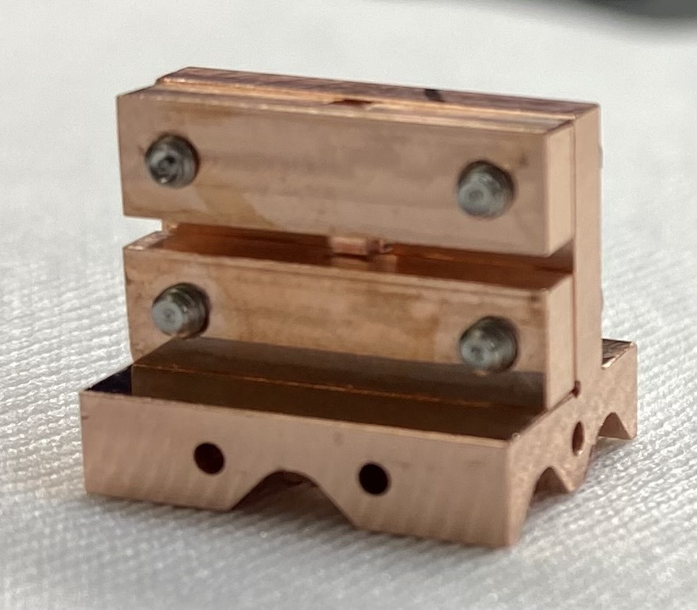
Laser on DLA after setup in tunnel

Slide 4
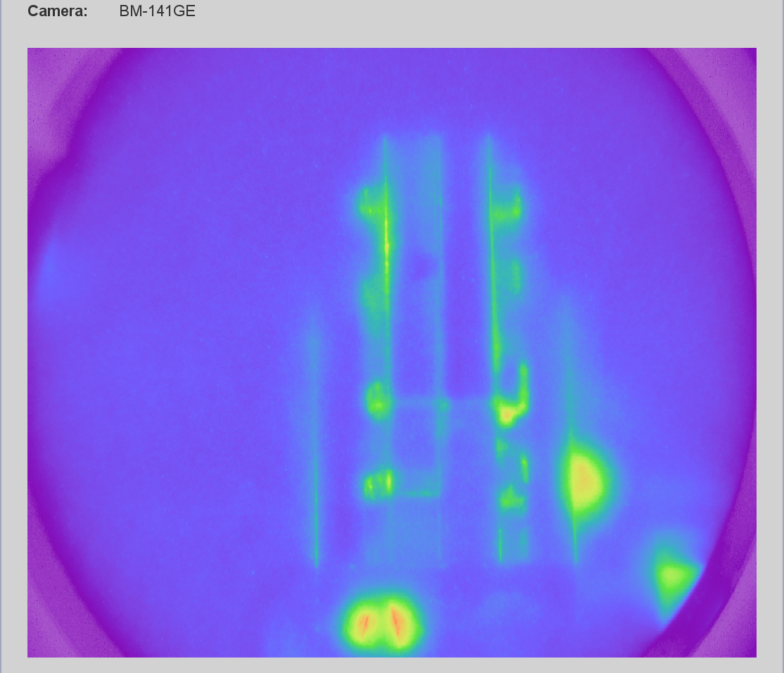
Timing setup
View of the gated camera setup
Working thesis: different areas of the multi channel plate reach their full gain at different times after switching occurs
Collected time scan data with the same feature of the Cherenkov radiation but moved the hexapod to different positions
This leads to reproducible timing offset in the hundreds of picosecond range

Slide 5
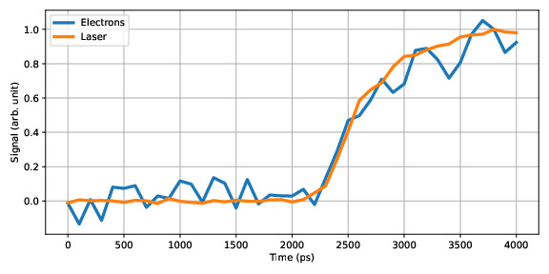
Laser – electron timing single pixel data
Control measurement after setting laser timing to t0 at maximum modulation

Slide 6
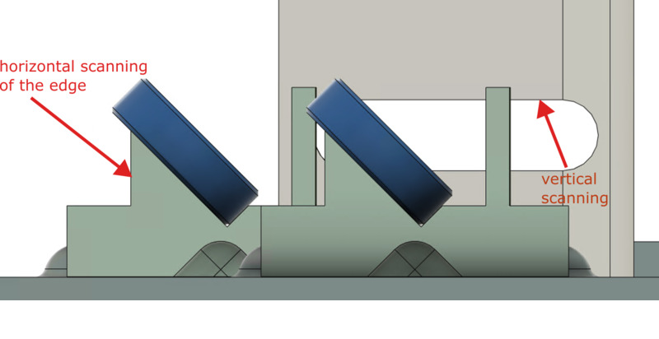
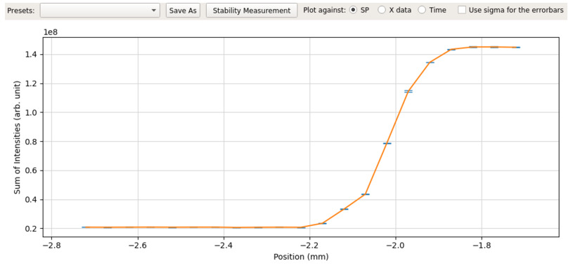
Measuring laser beam size
Collected errorfunctions along the laser beam path

Slide 7
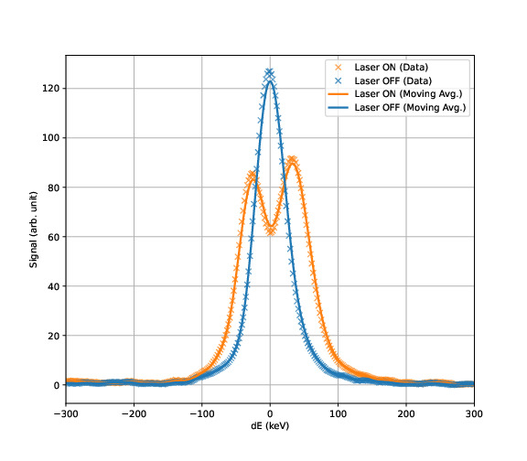
Reproducible DLA modulation
Reproducible DLA modulation
Timing between laser and electrons is reproducible to hundreds of picoseconds using the x2timer and laser synchronization
Unfortunately no further optimization was possible due to gun modulator fault
Reliable data from the gated camera system – further investigation on the activation time of multi channel plate possible
Laser beam size data at IP collected – analysis ongoing – improvement in the next setup necessary

Slide 8
Work in the Tunnel, plan for the week
Monday
  Smoke ventilation system installed
Operation
  Acquire dark charge data for big STRIDENAS board
  Configure orbit feedback server from MSK
  MDI shift for ICT measurements
  AutoAcc shift
  Adjusting field of view of several screen stations, especially find center of high energy spectrometer screen
  …we have more stuff on the list

Slide 9
Schedule
Week 09
Date | Shift Leader
19.06.
20.06. | Hannes
21.06. | Willi
22.06. | Thomas, Willi
23.06. | Thomas
If you want to learn or join the shift: please give the shift leader a call (BKR 2840 / SINBAD Box 2454)

