Slide 1

LHCONE
Michael Ernst
Brookhaven National Laboratory
WLCG Collaboration Workshop
11 - 13 July 2011, DESY, Hamburg

Slide 2
Disclaimer
In this presentation I will be using several slides created by
People working on the subject for quite some time, in particular
Network engineers from providers that serve our community
2 – 7/11/11

Slide 3
Tradeoffs of current LHC provisioning model
LHCOPN handles the T0/T1 and T1/T1 layer
  what about the T1/T2, T1/T3, T2/T2 and T2/T3 connectivity?
Network providers benefit from knowing about traffic relationships
  Predictability for paths to support
  Traffic volume
  Information they need to engineer most effective solution (at the campus, regional, backbone layer and TO layer)
Network providers have concerns
  CMS (and now ATLAS) ‘any to any’ model makes network engineers nervous
  US Sites tracking long sustained flows to sites in the EU – this puts a strain on several portions of the R&E infrastructure
3 – 7/11/11

Slide 4
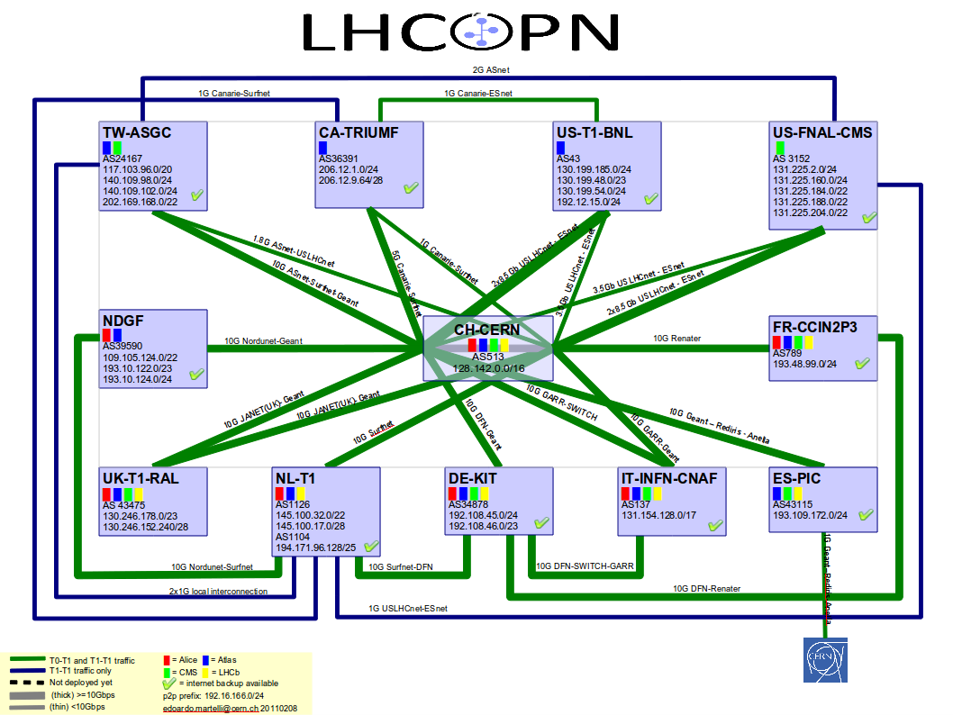
LHC Dedicated Network
4 – 7/11/11, © 2011 Internet2

Slide 5
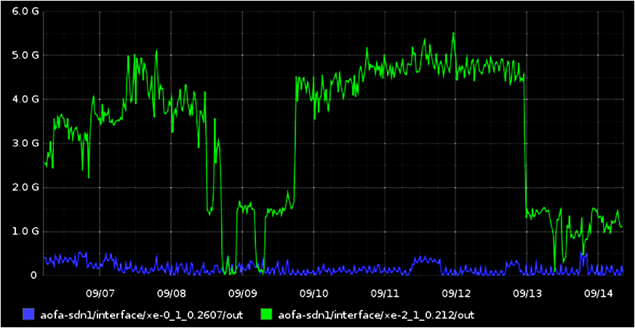
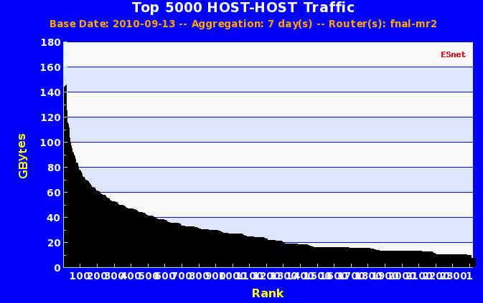
The Need for Traffic Engineering – Example
CMS site in UK was consuming 50% of the available bandwidth on the primary U.S. – Europe general R&E IP network link – for weeks at a time when pulling data from FNAL
  Thousands of low b/w flows (2Mbps/flow, 5Gbps aggregate)
Unsustainable situation from the R&E network provider’s perspective and this is the sort of thing that will force them to mark such traffic on the general IP network as scavenger to ensure other uses of the network
5 Gbps
4 days
Bill Johnston / ESnet
5 – 7/11/11

Slide 6
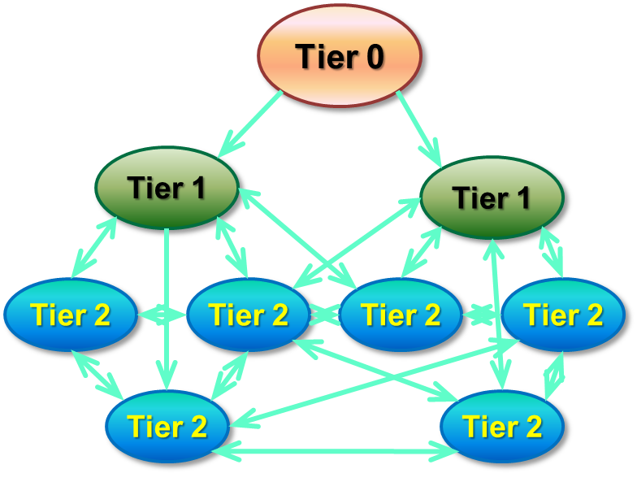
Data Models have changed
Have moved/are moving away from the strict MONARC model
3 recurring themes:
  Removing the hierarchy: Any site can replicate data from any other site
  Dynamic data caching: Analysis sites
  receive datasets from any other site
  “on demand” based on usage pattern
    Possibly in combination with pre-placement of data sets by centrally managed replication of whole datasets
  Remote data access: local jobs accessing data stored at remote sites
    Possibly in combination with
    local caching on a file or sub-file level
Experiment-specific implementations of the above
6 – 7/11/11

Slide 7
Data Placement for Analysis Daniele Bonacorsi
7 – 7/11/11

Slide 8
Reality Check
R&E Networking “works for us” (today)
  R&E network providers support LHC activities
  Do they have solutions that will scale?
  If they don’t, are they able and willing to find new ways forward?
Things to consider
  Linking in to the campus and regional networks
  Backbone capacity (lots of disciplines competing for b/w)
  Ability to expand
8 – 7/11/11

Slide 9
Rationalizing LHC Network Traffic
The question is how to optimize the use of the available capacity
  How much OPN capacity is needed in view of recent changes to the computing models, ie ATLAS
  satisfy the LHC needs on the R&E infrastructure while accommodating all other R&E traffic at the same time
    this point is critical because the available non-OPN capacity is funded for the benefit of the entire R&E community, not just the LHC
Goal from the network provider’s perspective: Provide an infrastructure that supports traffic engineering of the LHC traffic that will
  ensure continued good performance for the LHC user community and
  ensure that other traffic is not impacted
9 – 7/11/11

Slide 10
LHCONE
Network providers, jointly working with the experiments, have proposed a new network model for supporting the LHC experiments, known as the LHC Open Network Environment (LHCONE).
The goal of LHCONE is to provide a collection of access locations that are effectively entry points into a network that is reserved to the LHC T1/2/3 sites.
LHCONE is not intended to supplant the LHCOPN but rather to complement it. It is not intended to let LHCONE carry Tier 0 (T0) – T1 traffic.
Documentation available at
  http://lhcone.net
10 – 7/11/11

Slide 11
Requirements Summary
Bandwidth:
  Ranging from 1 Gbps (Minimal site) to 5-10Gbps (Nominal) to N x 10 Gbps (Large)
  No need for full-mesh at full-rate, but several full-rate connections between large sites
  Scalability is important
    (some) sites are expected to migrate Minimal -> Nominal -> Large
    Bandwidth growth: Minimal = 2x/yr, Nominal & Large = 2x/2yr
Connectivity:
  Facilitate good connectivity to so far (network-wise) under-served sites
Flexibility:
  Should be able to include or remove sites at any time
  Flexibility at the services layer (e.g. L2, L3, P2P, shared VLAN)
Budget Considerations:
  Avoid additional costs by using what’s in place (may be necessary to re-arrange parts of the existing infrastructure & funding)
11 – 7/11/11

Slide 12
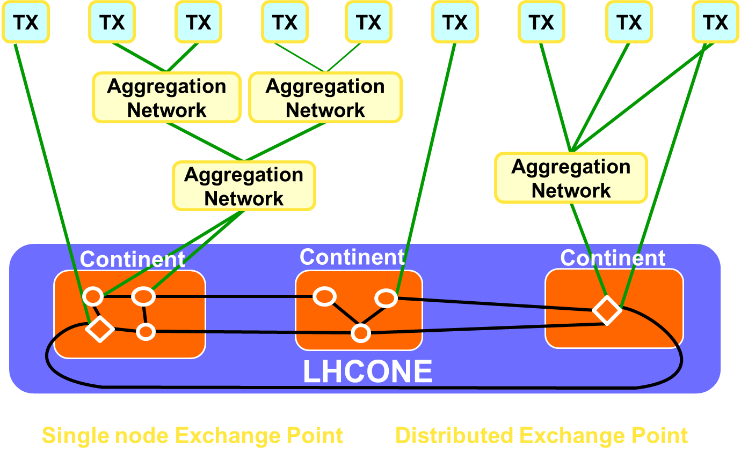
High-level Architecture Artur Barczyk
12 – 7/11/11

Slide 13
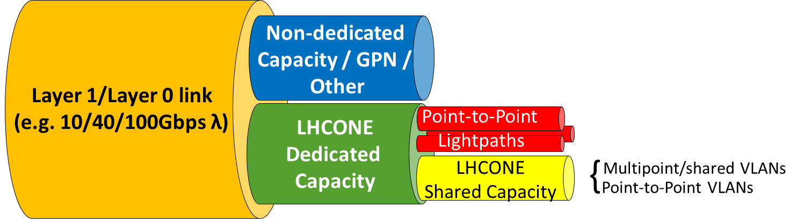
Dedicated/Shared Resources
LHCONE concept builds on traffic separation between LHC high impact flows, and non-LHC traffic
  Avoid negative impact on other research traffic
  Enable high-performance LHC data movement
Services to use resources allocated to LHCONE
Prototype might use non-dedicated resources, but need to be careful about evaluation metrics
13 – 7/11/11

Slide 14
LHCONE Status
Start with a prototype, building on a Use Case document provided by ATLAS and CMS (“Bos-Fisk document”)
  Includes a list of sites to participate in the initial stage
Teams in Asia, Europe and North America are working on the prototype design and implementation
In the meantime, a starting point has been deployed
  Multi-point service
  Open Exchange Points
    CERNLight, GEANT, Netherlight, US (MANLAN, MacLean and Starlight)
  Three LHC sites are connected
    CERN-T1, Caltech-T2 and PIC
    Several others are ready and waiting to be connected
14 – 7/11/11

Slide 15
LHCONE Status in Europe
Roberto Sabatino
Designed by DANTE according to European user requirements
  European workshop on 5th April agreed way forward
Set of Distributed Exchange Points based on GEANT infrastructure
Interconnection with Netherlight
15 – 7/11/11

Slide 16
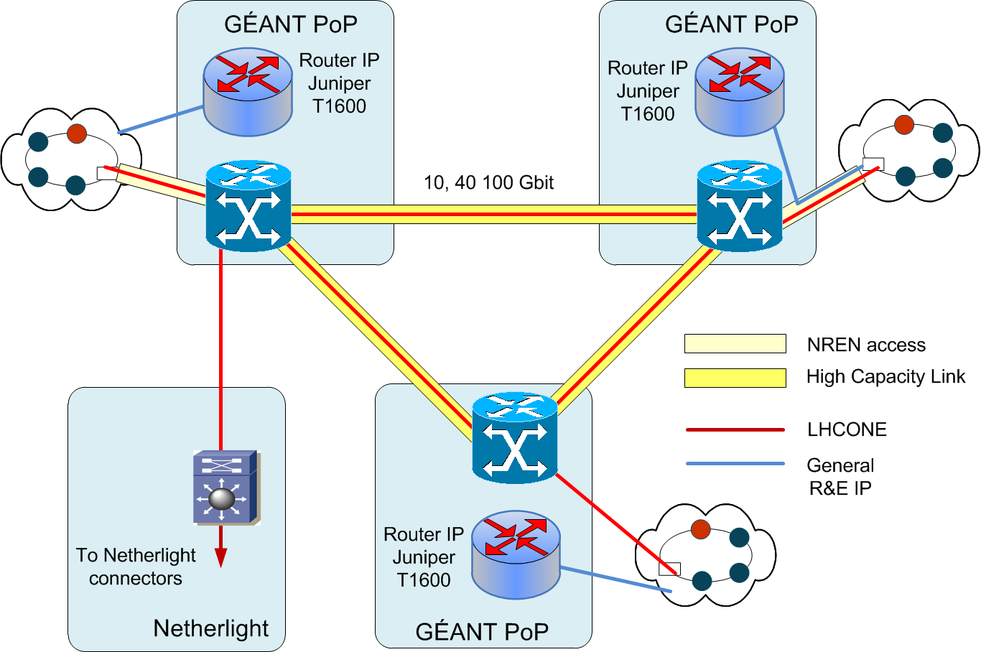
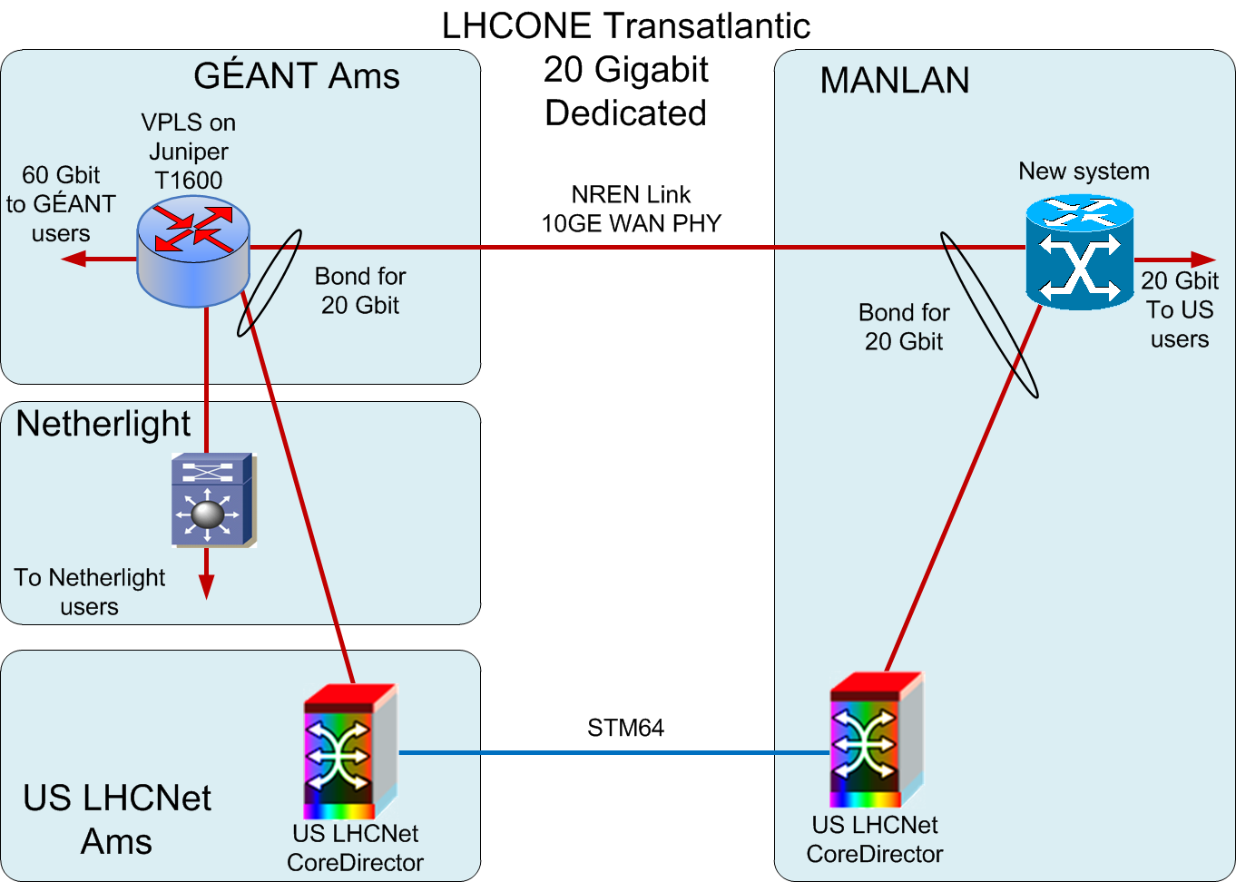
LHCONE Status in Europe
Prototype logically identical to long term solution but
  smaller in scope (# of sites connected)
  Different technology, in core and in NREN connectors
  Shared vs dedicated capacity
Use VPLS technology on existing routers to emulate a distributed LAN
Make use of existing shared (IP) capacity, with logical separation from general R&E IP traffic (with separate monitoring)
  Confidence there is enough capacity on existing backbone links
  40Gbps CH-DE-AMS
  20Gbps NL-UK-FR-CH and IT-CH
  May upgrade links if demonstrated necessary
Schedule - NREN Connections
  Intra-European part up since this week and NRENS (DE, FR, IT, …) are connected
Trans-Atlantic Connectivity
  Several proposals under discussion
  Providers need to converge on how to use existing links
NREN
A Proposal

Slide 17
LHCONE Prototype in Asia
Wenshui Chen
Exchange Point Chicago
TX
Cross Connect Link
ASGC Aggregation
Network HK
ASGC Aggregation Network Taipei
ASGC Transit Point at Chicago
TX
Access Link
Access Link
Crossing Ocean Link
Cross Connect Link
Crossing Ocean Link
TX
TX
Exchange Point Amsterdam
ASGC Transit Point at Ams.
17 – 7/11/11

Slide 18
LHCONE Status in North America
Eric Boyd
The Exchange Point prototype includes three nodes
  Chicago (Starlight)
  New York (MAN LAN)
  Washington DC (MacLean)
For the prototype, these nodes are interconnected via the existing Internet2 Network by a combination of VPLS and L2 VPN overlays on the existing backbone circuits (initially at 9 Gbps best-effort)
After roll-out of the prototype, potential to provide 10 Gbps dedicated backbone circuit, if needed
Canada will connect via MANLAN
US ATLAS and US CMS Tier-1s and a large fraction of Tier-2s will be connected in summer/fall 2011
  BNL has a dedicated 10 Gbps circuit at MANLAN
18 – 7/11/11

Slide 19
LHCONE Prototype in North America
19 – 7/11/11

Slide 20
LHCONE Prototype in Canada
Ian Gable
US/NY
Next step: aggregate the rest of T2s in Canada
20 – 7/11/11

Slide 21
Discussion at the joint LHCOPN & LHCONE Meeting in mid June in Washington DC
Governance (of what?)
  Many stakeholders – Activities have been consensus driven so far
  What is the change management process?
  What is the capacity planning process?
  Who is using what capacity
    Need information gathering on usage
    How would (dynamic) circuit reservation be balanced across users?
Agreement on committees (w/s participants signed up + experts)
  Steering
  Technical and architecture
  Operations (incl. monitoring)
  Users and stakeholders
Success criteria
  Experiments are benchmarking today’s performance - need to show improvements over LHCONE (details in D. Bonacorsi’s talk)
    Certain European sites have problems with some US sites
  How does improved network performance impact science?
Lots of discussions on technical implementation (selected points)
  Shared VLAN vs interconnected (routed) local VLAN service
  Monitoring – agreed to use perfSONAR PS (details in S. McKee’s talk)
    Developed in the US by I2 & ESnet (US ATLAS provides testbed)
    Widely deployed in US ATLAS Facilities (integrated w/ Nagios)
    Proposed to be extended to LHCOPN
21 – 7/11/11

Slide 22
LHCONE Summary & Outlook
“Prototype” implementation
  We may want to call it “initial deployment stage” because we expect LHCONE to evolve into a production service, though its shape may change over time
  Engineering groups are working on prototype in Asia, Europe, North America
    Target at DC meeting in June as to a usable infrastructure for the experiments with limited # of sites has been July 2011
    Trans-Atlantic connectivity likely to slip
Follow-up roadmap
  In parallel with prototype implementation
    Refine governance model
    Refine service and policy definitions
    Refine architecture
  Grow LHCONE to full scale
LHCONE will grow “organically”, as needs arise
22 – 7/11/11

Slide 23
Additional Material
23 – 7/11/11

Slide 24
LHCONE Architecture
Builds on the Hybrid network infrastructures and Open Exchange Points
  To build a global unified service platform for the LHC community
LHCONE’s architecture incorporates the following building blocks
  Single node Exchange Points
  Continental / regional Distributed Exchanges
  Interconnect Circuits between exchange points
    Likely by allocated bandwidth on various (possibly shared) links to form LHCONE
Access method to LHCONE is chosen by the end-site, alternatives may include
  Dynamic circuits
  Fixed lightpaths
  Connectivity at Layer 3, where/as appropriate
Envisioned that many of the Tier-1/2/3s may connect to LHCONE through aggregation networks
24 – 7/11/11

