Slide 1
WLCG T0 at CERN: Operational experience
Helge Meinhard / CERN-IT
WLCG Workshop at DESY
11 July 2011

Slide 2
Background (1)
Very smooth, successful LHC running
Record intensities, record luminosities
1 fb⁻¹ (goal for end 2011) already reached on 17-Jun
Pile-up is a problem…
Confirmation to run until end 2012 at 2 x 3.5 TeV
Shutdown in 2013
ITIL
Attempt to follow best practices
Introduced service desk and new ticketing system on 15-Feb-2011
Initially covering IT and GS departments

Slide 3
Background (2)
Monitoring: IT workshop to review situation
Plenty of monitoring done, plenty of information gathered and stored
Demands on integrating different systems, and on providing ad-hoc queries, mining, analysis, trends
Working group has been formed
More generally, revising how T0 operates
Virtualisation/clouds, configuration management

Slide 4
Background (3)
Community support
IT recommended / IT supported / community supported / unsupported / IT prohibits
Applies to smartphones, tablets, browsers, mail clients, …
Infrastructure created
Interesting times with EGI and EMI

Slide 5
Computing Facilities (1)
Stable running
... at the limit of power and cooling
In main machine room, temperature of cold air risen carefully
‘Barn’ refurbishment project
Annex to main machine room being converted into a small high-density room of 450 kW
Some infrastructure ‘oddities’ of old building being corrected as well

Slide 6
Computing Facilities (2)
External ‘local’ hosting
Part of our ‘critical machines’ are now run in hosting centre 15 km away from CERN
Remote T0
Centre in a CERN member state running part of T0 capacity
Addressing business continuity as well
Call for expressions of interest closed, analysis ongoing, formal tender in preparation

Slide 7
The CERN Data Centre in Numbers
Data Centre Operations (Tier 0)
24x7 operator support and System Administration services to support 24x7 operation of all IT services.
Hardware installation & retirement
~7,000 hardware movements/year; ~1800 disk failures/year
Management and Automation framework for large scale Linux clusters
Racks | 828
Servers | 11,728
Processors | 15,694
Cores | 64,238
HEPSpec06 | 482,507
Disks | 64,109
Raw disk capacity (TiB) | 63,289
Memory modules | 56,014
Memory capacity (TiB) | 158
RAID controllers | 3,749
Tape Drives | 160
Tape Cartridges | 45000
Tape slots | 56000
Tape Capacity (TiB) | 34000
High Speed Routers (640 Mbps → 2.4 Tbps) | 24
Ethernet Switches | 350
10 Gbps ports | 2000
Switching Capacity | 4.8 Tbps
1 Gbps ports | 16,939
10 Gbps ports | 558
IT Power Consumption | 2456 KW
Total Power Consumption | 3890 KW

Slide 8
Computing Facilities (4)
Procurement fun points
7’000 drives (2 TB) swapped out, manufacturer needed several attempts
Finally got a batch of CPU servers to work
Bad or late (or both) repair interventions by vendor agents
Discussing alternative schemes for warranty services

Slide 9
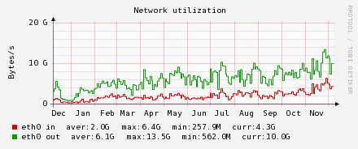
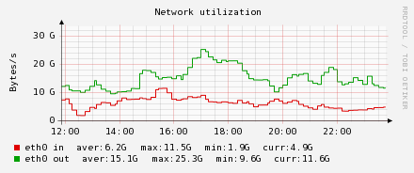
Communication Systems
Typical tier-0 bandwidth
Average in: 2 GB/s with peaks at 11.5 GB/s
Average out: 6 GB/s with peaks at 25 GB/s
Router infrastructure being migrated to new supplier
More bandwidth
Experimenting with 100 GE

Slide 10
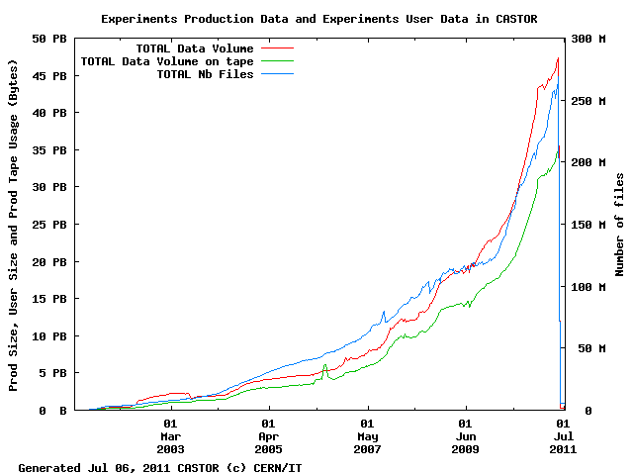
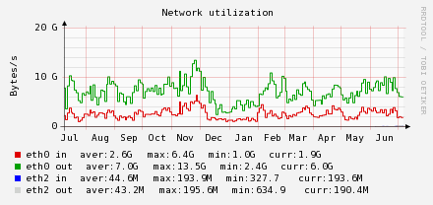
Storage (1): Castor
Bulk storage for T0: Castor
Total: ~ 47 PB On tape: ~ 36 PB
In: avg 2.6 GB/s, peak 6.4 GB/s Out: avg 7 GB/s, peak 13.5 GB/s (binning: day)

Slide 11
Storage (2): Tapes, EOS
Experience: Given the size of the system and the cost-effective components, rather smooth running
Still, storage and closely related services responsible for most problems with T0 operations
Tapes
Commissioned 5 TB drives/cartridges
Tape mark handling improved
For analysis purposes at CERN: EOS
See dedicated talk on Tuesday morning (Dirk Duellmann)

Slide 12
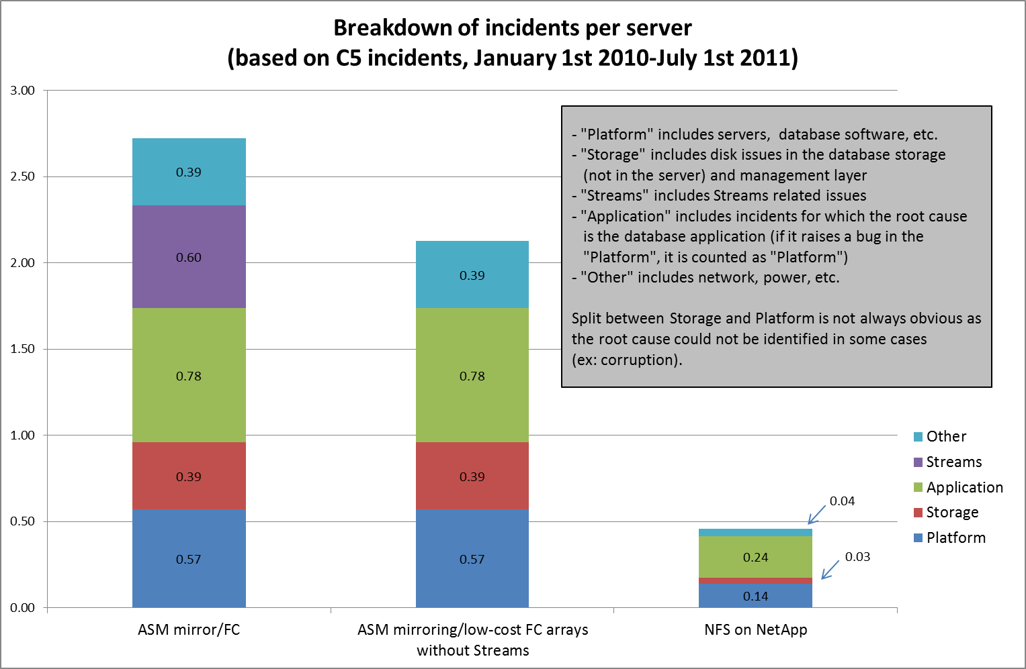
Storage (3): DB incident analysis
0.96
0.17

Slide 13
Storage (4): DB directions
DB (Oracle) storage will be consolidated on NAS rather than FC
Active DataGuard to be used instead of Streams in some places

Slide 14
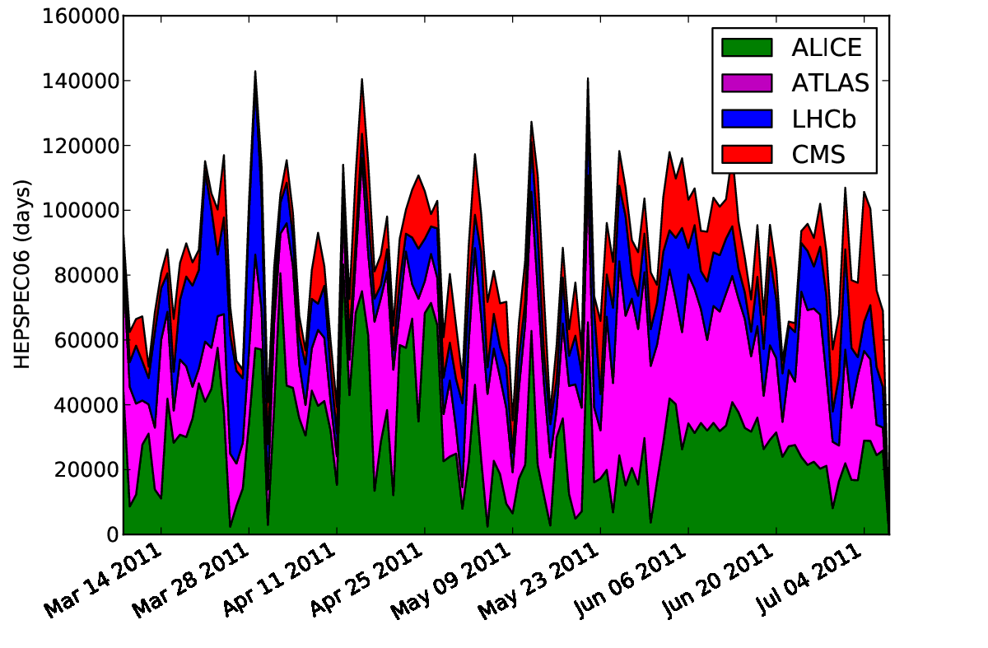
Batch services (1)

Slide 15
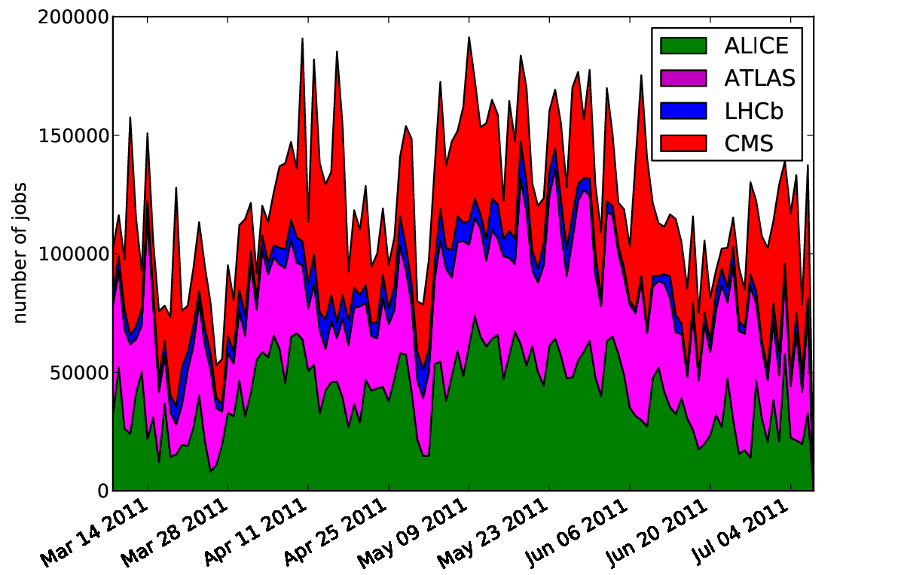
Batch Services (2)

Slide 16
Virtualisation (1): CVI
The CERN Virtual Infrastructure provides custom virtual machines in the CERN computer centre
These VMs have a long-term lifetime of months/years
User kiosk for requesting a VM in less than 30 mins
Based on Microsoft’s System Center Virtual Machine Manager (SCVMM)
Enterprise class centralized management
Rich feature set:
Allows grouping of hypervisors, with delegation of administrative privileges
VM migration, High availability
Checkpointing
PowerShell for administration / scripting

Slide 17
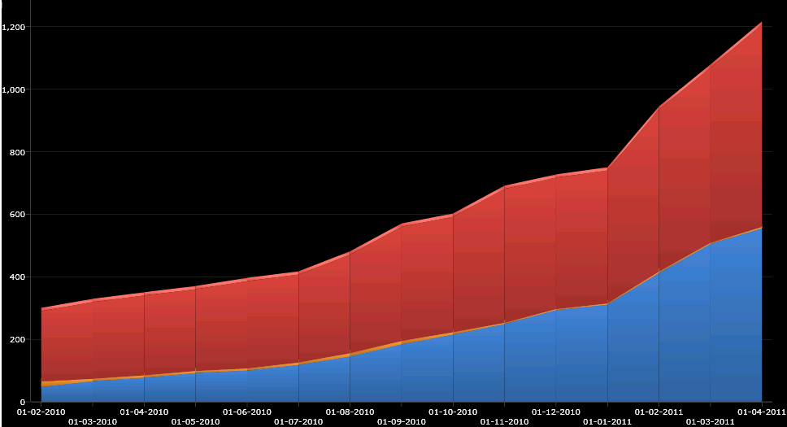
Virtualisation (2): CVI
Apr 2011: 1250 VMs on 248 hypervisors
Nov 2010: 680 VMs on 170 hypervisors
54% Windows VMs
46% Linux VMs
Number of Virtual Machines per Operating System

Slide 18
Virtualisation (3): Cloud
Quattor
Enduser
VO
CERNVM
“Golden Nodes”
Application
Manager
(lxbatch)
ONE EC2 interface
Image creation
CERN VMIC
ONE
test master
ONE
production master
VM provisioning
Lxcloud - Test
Lxcloud production
Physical Resources

Slide 19
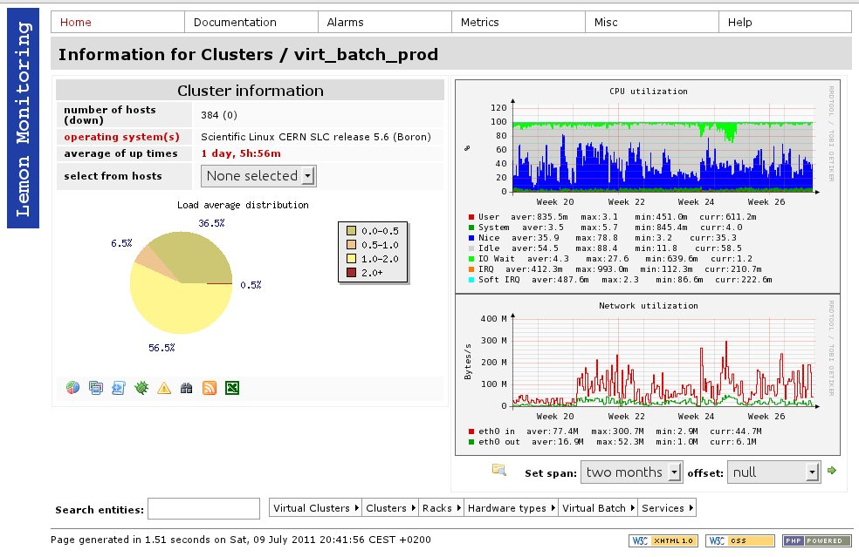
Virtualisation (4): Cloud and lxbatch
1 rack of nodes (~ 400 VMs) in production
Full Lemon monitoring, usage pattern as for public lxbatch

Slide 20
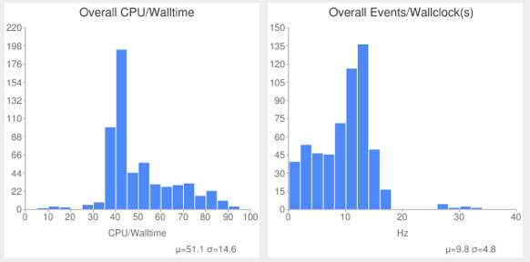
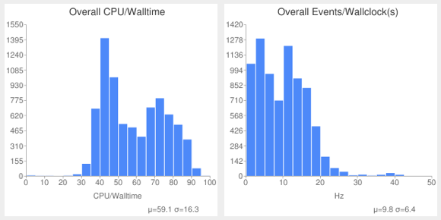
Virtualisation (5): EC2 i/f
ATLAS/CERN IT-ES are evaluating LxCloud with HammerCloud tests:
10 virtual CERNVM nodes in LxCloud accessed via PanDA (ANALY_CERNVM_test queue)
VM instances are created manually with the cvm cloud tool; the VMs start the PanDA pilot to retrieve jobs
Submitting analysis jobs to measure CPU/Walltime, Events/second and various job timing metrics; comparison with identical hardware on LSF
Data read with root:// to EOS @ CERN. Outputs lcg-cp’d to CASTOR.
Preliminary Results! Work in progress...
LxCloud raw metrics:
~51.1% mean CPU/Walltime
~9.8Hz event rate
Reference metrics:
~59.1% mean CPU/Walltime
~9.8Hz event rate

Slide 21
CVMFS at CERN (1)
Client status
CVMFS on lxbatch/lxplus since Nov 2010
LHCb fully migrated Apr 2011
ATLAS partial migration May 2011
ATLAS now in final preparations for full migration
See presentation on Wednesday
CMS working towards use of CVMFS
AFS software area could be dropped later
ALICE have their bit-torrent based system
Previously during ATLAS production AFS has been affected, impacting interactive users

Slide 22
CVMFS at CERN (2)
Client monitoring
service cvmfs probe executed once/hour /node
Executes ls /cvmfs/cms.cern.ch /cvmfs/atlas.cern.ch
Ran under lemon framework
This scale testing resolved CVMFS corruption bugs
Bugs investigated/fixed incredibly fast – thank you
Fixed with cvmfs >= 0.2.68
Number of failures out of ≈ 2600000 attempts:
Apr (part) = 9543, May = 10137, June = 803 , Jul = 64
cvmfs includes cvmfs_fsck utility:
Checksums every file on disk so quite expensive
Run once per week to identify further problems
Recent bug fixes allow cvmfs_fsck to fix what it finds

Slide 23
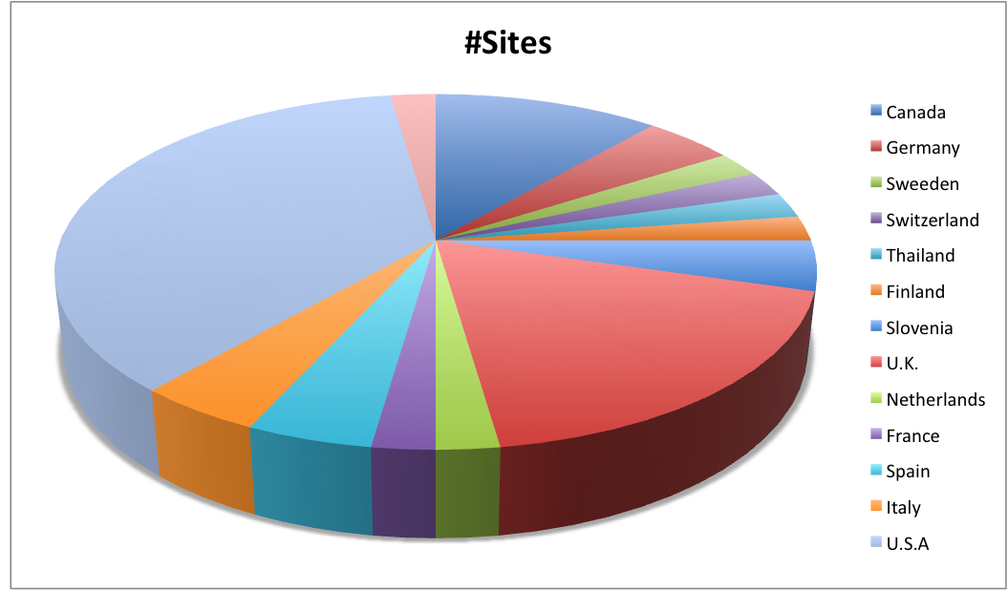
CVMFS at CERN (3)
‘Stratum 1’ service
cvmfs-stratum-one.cern.ch is one of three
BNL and RAL have near identical setup
Service comprises:
1 disk server pulling new files hourly from stratum0
2 reverse proxies “protecting” this disk server
New sites every day in last week

Slide 24
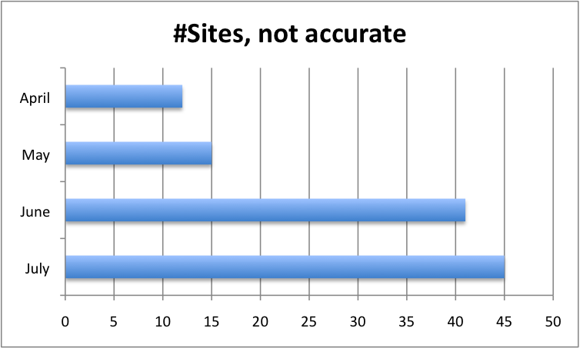
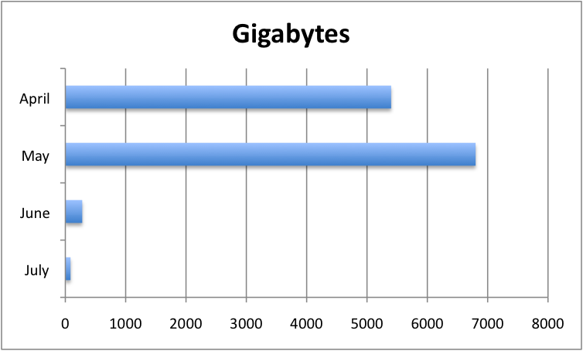
CVMFS at CERN (4)
Stratum 1 service
Stratum 1 load dependent on site squid configurations
Common configurations errors:
Default max file size to cache only 2 MB (CERN, NIKHEF)
Only 1 GB of cache on their squids (PIC)
CERN will continue to contact top subscriber
Plenty of capacity, < 1MB/s of network today per stratum1 node.

Slide 25
ActiveMQ service (1)
MQ messaging service
Provides a general asynchronous messaging service to allow applications to communicate
Decoupled architecture – the service takes care of the reliable delivery of the messages so your applications don’t have to
ActiveMQ is an open source Apache project (with a commercially supported version called Fuse)

Slide 26
ActiveMQ service (2)
Have built service for ATLAS based on the successful deployment of ActiveMQ for the WLCG SAM Nagios testing infrastructure
Atlas tracer service:
Collects file events from worldwide Atlas DDM clients (3.6 Mevents/day, bursts of 300/s)
Atlas notification service:
Broadcast notification of dataset states, data availability to interested ATLAS applications (Panda + AMI catalogue currently), 1-2 events/s
Successful pilot service: now moving to production

Slide 27
GGUS Alarms against CERN
Statistics 01-Jul-2010 to 30-Jun-2011
Source | Number
Castor | 23
Batch | 5
AFS, Kerberos | 6
LFC | 1
Power | 1
VOMS | 1
DB | 1
FTS | 2
Total | 40

