Slide 1
WLCG Storage planning
Andrea Sciabà
WLCG Collaboration Workshop 11-13 July 2011 DESY

Slide 2
Outline
Global overview of storage systems
Storage system deployment at Tier-1 sites
Storage upgrade plans at Tier-1 sites
Storage development
Short/medium term plans
Conclusions

Slide 3
Introduction
WLCG ensures a proper information flow among the project, the sites and the experiments concerning storage and data management issues
The Tier-1 Service Coordination Meeting serves this purpose
Installed software versions, recent and scheduled interventions, new middleware releases, incidents are reported and discussed

Slide 4
Storage systems in WLCG
ARC: 2
BeStMan: 40
CASTOR: 3
StoRM: 40
dCache: 63
DPM: 215
Xrootd: 6
HDFS: 1
Tier 0+1+2
DPM is still by far the most common Storage Element

Slide 5
Storage systems at the Tier-0/1 sites
Site | CASTOR | dCache | StoRM | DPM | EOS | xrootd | Lustre
CERN | 2.1.11 |  |  |  | 0.1.0
ASGC | 2.1.10 |  |  | 1.8.0-1
BNL |  | 1.9.5-23
CNAF |  |  | 1.7.0
FNAL |  | 1.9.5-23 |  |  |  | 2.9.1 | 1.8.3
IN2P3-CC |  | 1.9.5-26
KIT |  | 1.9.5-26
NDGF |  | 1.9.12
NL-T1 |  | 1.9.5-23
PIC |  | 1.9.5-26
RAL | 2.1.10
TRIUMF |  | 1.9.5-21
CASTOR sites have all very recent releases
dCache sites with the old golden release, only one with the new

Slide 6
Foreseen upgrades (I)
ASGC
CASTOR ≥ 2.1.11
DPM 1.8.2 (allows to define no. of threads for DPM and SRM servers, better filesystem selection algorithm)
Upgrade all network for disk servers to 10 Gb before Q4
BNL
migrate to Chimera on August 22
Evaluate data access via NFS 4.1 on dCache and BlueArc
CNAF
migrate all instances to StoRM 1.7.0-7 when testing completed
FNAL
new dCache golden release after Heavy Ions run; will not move to Chimera
Deploy 400 TB of EOS to move users off dCache resilient pools
Add more disk before winter
IN2P3
Upgrade non-WLCG dCache instance to new golden release on September 20th and WLCG instance in January

Slide 7
Foreseen upgrades (II)
KIT
Apply bug fixes as appropriate
New dCache golden release by beginning of next year
NDGF
Closely follow new dCache patches
Change authentication to per-DN file ownership and VOMS group ACLs in autumn
PIC
Migrate to Enstore2 (Jul 26)
Migrate to new dCache golden release (Aug 9)
RAL
SRM 2.11 upgrade (VOMS support) in August/September
CASTOR 2.1.11 (no LSF, new tape gateway) in November/December
TRIUMF
New dCache golden release after (successful) testing and increase disk from 4 to 6 PB

Slide 8
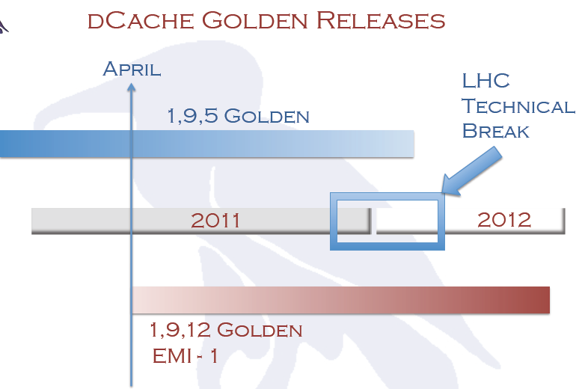
dCache “golden releases”
1.9.12 was released in April
Brings several improvements
Easier, more flexible configuration
Better xrootd and NFS 4.1 support
SRM: asynchronous getTURL
GLUE 2.0 support
Powerful migration module

Slide 9
dCache plans (I)
On-demand flush to tape by
Moving name space entry from ONLINE directory to CUSTODIAL directory
Creation of an internal copy of a file to the CUSTODIAL space, resulting in two name space entries (only one custodial)
WebDAV based storage control
Operational improvements
Random distribution of incoming data and automatic reshuffling of data when new pools are added
Easier to upgrade components without service downtimes

Slide 10
dCache plans (II)
Support for a 3-tiered industry storage model
Layer I: optimized for random I/O: SSD space, NFS4.1/pNFS
Layer II: optimized for streaming: high density disk space on HDFS, WAN /IO
Layer III: custodial storage: controlled tape access
Other stuff
Federations: NFS 4.1 (fedFS), HTTP(S) (+GridFTP, xrootd, …)
Fully secure HTTP read access to data with standard tools and browsers with X.509 certificates
“Amazon”-like browser-based console for file browsing and storage control (e.g. disk ↔ tape)
IPv6

Slide 11
BeStMan plans
Current version: 2.1.0
Development plans depend on available funding
Joint proposal submitted to NSF
BeStMan SRM server
Additional transfer protocol support
BeStMan SRM clients
Improvement in data transfer efficiency
Data channel caching with GridFTP transfers for a request with many files
Determine the transfer parameters from the previous transfer performance
E.g. number of concurrent transfer connections, number of parallel streams
Additional transfer protocol support
E.g. FDT (Fast Data Transfer)
HTTPS support

Slide 12
CASTOR disk cache evolution
Future plans driven by increasing requirements from the experiments
E.g. ATLAS trigger at 400 Hz, moving to 600 Hz
Recent changes (CASTOR 2.1.11)
Transfer Manager, replacing LSF scheduling
In production for ATLAS, to be deployed everywhere
Basic VOMS support in SRM
Future developments (CASTOR 2.1.12 and beyond)
Reduce file open latency
Garbage collector logic improvements

Slide 13
CASTOR tape interface
Recent changes
Support for 5TB tapes
In production at CERN and at RAL
One tape mark per file as opposed to three
Future developments (2.1.12 and beyond)
Towards improving support for the new tape drive families and their increased throughput
Buffered tape marks and multi-file metadata handling
Repack re-engineering to address scalability
Media migration to start next year
40PB to be moved from 1T to 5T tapes

Slide 14
EOS evolution
EOS 0.1.0
release candidate deployed in EOSCMS/EOSATLAS
EOS 0.2.0 (September/October)
Redundancy CODECs
dual parity & Reed-Solomon based give better file availability with less space usage
Client bundle (Linux + OSX)
user FUSE EOS mounting via KRB5 & X509
Performance improvements in low-level FUSE client
EOS 0.x.0 ...some ideas to follow within next year
HTTPS/HTTP Gateway
Monitoring/Web Interface
Layout Migration
convert on the fly replica to CODEC files and vice-versa
Extended FUSE Mount Daemon
move part of the server code into the client (parallel IO + lower MD latency)
policy-based persistent file page cache (for Software, Calibration, Geometry files etc...)
policy-based file backup into CASTOR
LAN/WAN Transfer Interface

Slide 15
StoRM plans
Defined in the EMI 2 work plan
WebDAV support
ARGUS integration

Slide 16
DPM
NFS 4.1 / pNFS
Now functional beta, monthly releases, can be tried
Short term: improve performance (heavy on metadata query), integration with dCache
Medium term: X.509 support, investigate federations
WebDAV
Beta release available for testing
Short term: X.509 support in browser, help to improve HTTP support in ROOT, evaluate HTTP as alternative to GridFTP
Medium term: help to improve common clients (e.g. curl)

Slide 17
DPM (II)
Simpler system administration with Puppet
Strong, widely supported solution
first release available to sites
Short term
extend Nagios performance probes, add probes as needed
Add reporting per storage area / virtual organization
Medium Term
Promote sharing of Puppet manifests among developers and site admins
DPM 1.8.2
Better file system selection
Improvements in the client connection pools for all daemons
GLUE 2.0 support
Faster draining of disk servers
SEMsg support

Slide 18
SEMsg: SE-catalogue consistency
Support integration with experiment frameworks
Support deployment of SEMsg-enabled LFC/DPM servers
Short term
investigate more advanced security features (e.g. whitelisting)
Medium term
Investigate other possible usages of the framework, e.g. sync among LFCs
Support the developers of other SE products in using it
Support Grid-wide deployment

Slide 19
Checksum support (I)
BeSTMan
MD5, ADLER32, CRC32
Supports user-provided checksum
Internal checksum calculations on-demand
srmLs expensive if it involves checksum calculation
CASTOR
Checksum recalculated by RFIO, GFTP and XROOT at each full file read/write
Cannot be calculated on demand
Stored for both disk and tape copies of files
Checksum is checked against stored tape value when file is recalled

Slide 20
Checksum support (II)
dCache
ADLER32 (and MD5)
Can be user-provided
Calculated after writing a file
Lazy checks on all files (from 1.9.13)
StoRM
Checksum calculated either on the fly by GridFTP or on demand by the Checksummer service
Checksum returned when present as file attribute

Slide 21
Conclusions
All Tier-1 sites are well aligned to the most recent versions of the storage systems
All dCache sites plan to go for the new golden release by beginning of next year at the latest
Disk-only solutions are being deployed in parallel to traditional HSM systems
The main WLCG storage systems are still very actively developed
Stronger support for common standards: NFS 4.1, HTTP support, WebDAV, etc.
Increasing performance and scalability for both disk and tape layers

Slide 22
Acknowledgements
Thanks to the Tier-1 contacts and to the storage system developers for providing the necessary input

