Slide 1



WLCG:
The 1st 18 months with data & looking to the future
Ian Bird, CERN
WLCG Collaboration Workshop;
DESY; 11th July 2011
Accelerating Science and Innovation
Notes:
1

Slide 2
Outline
Results from 1st 18 months with data
  Some lessons learned
Evolution of WLCG distributed computing
Relations with EGI & EMI
  Middleware support & etc.

Slide 3
Success !
WLCG recognised as having enabled rapid physics output
  LHCC
  CERN Scientific Policy Committee
  CERN Council
  Resource Review Boards (i.e. Funding Agencies)
  As well as many other places/articles
    http://cern.ch/lcg → Repository → Dissemination → LCGNews
Thanks to huge and sustained collaborative effort by all sites and experiments !!

Slide 4
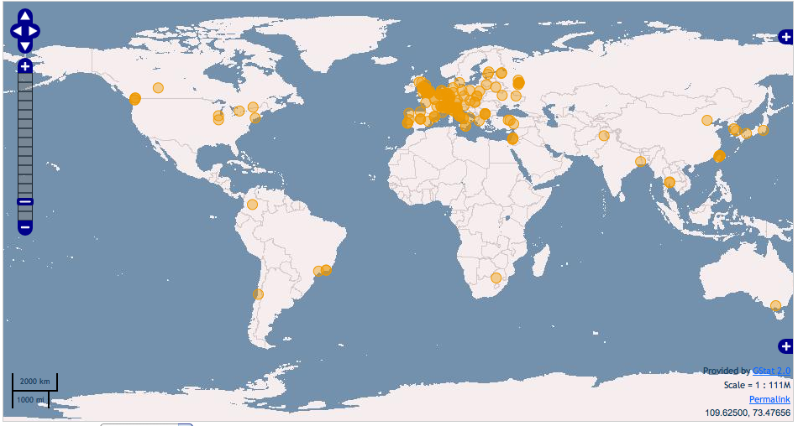
Collaboration: Worldwide resources
Additional MoU signatures
~ few per year
WLCG Collaboration Status
Tier 0; 11 Tier 1s; 68 Tier 2 federations
Today we have 49 MoU signatories, representing 34 countries:
  Australia, Austria, Belgium, Brazil, Canada, China, Czech Rep, Denmark, Estonia, Finland, France, Germany, Hungary, Italy, India, Israel, Japan, Rep. Korea, Netherlands, Norway, Pakistan, Poland, Portugal, Romania, Russia, Slovenia, Spain, Sweden, Switzerland, Taipei, Turkey, UK, Ukraine, USA.
Today >140 sites
>250k CPU cores
>150 PB disk
Notes:
This is also a truly worldwide undertaking. WLG has computing sites in almost every continent, and today provides significant levels of resources – computing clusters, storage (today we have close to 100 PB of disk available to the experiments), and networking.

Slide 5
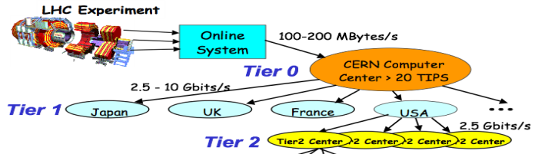
What is WLCG today?
Collaboration
Coordination & management & reporting
Coordinate resources & funding
Coordination with service & technology providers
Common requirements
Memorandum of Understanding
Framework
Service management
Service coordination
Operational security
Support processes & tools
Common tools
Monitoring & Accounting
World-wide trust federation
for CA’s and VO’s
Complete Policy framework
Evolution of implementation and technology
Distributed Computing services
Physical resources: CPU, Disk, Tape, Networks

Slide 6
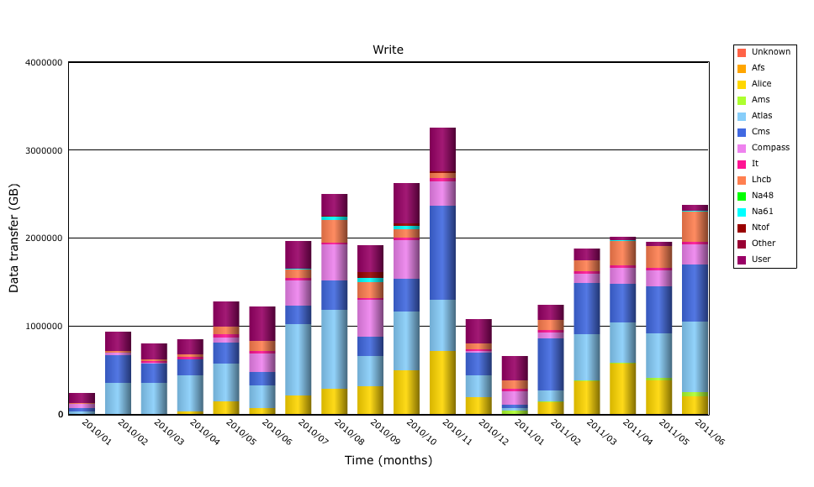
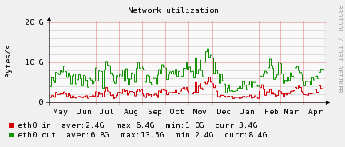
Status of Tier 0
Stored ~ 15 PB in 2010
Data to tape/month
p-p data to tape at close to 2 PB/month
HI
Peak rate: 225TB/day
2 PB/month
LHCb
Compass
CMS
ATLAS
AMS
ALICE
Data traffic in Tier 0 and to grid larger than 2010 values:
Up to 4 GB/s from DAQs to tape
Tier 0 Storage traffic (GB/s)
Tier 0 storage:
Accepts data at average of 2.6 GB/s; peaks > 11 GB/s
Serves data at average of 7 GB/s; peaks > 25 GB/s
CERN Tier 0 moves > 1 PB data per day

Slide 7
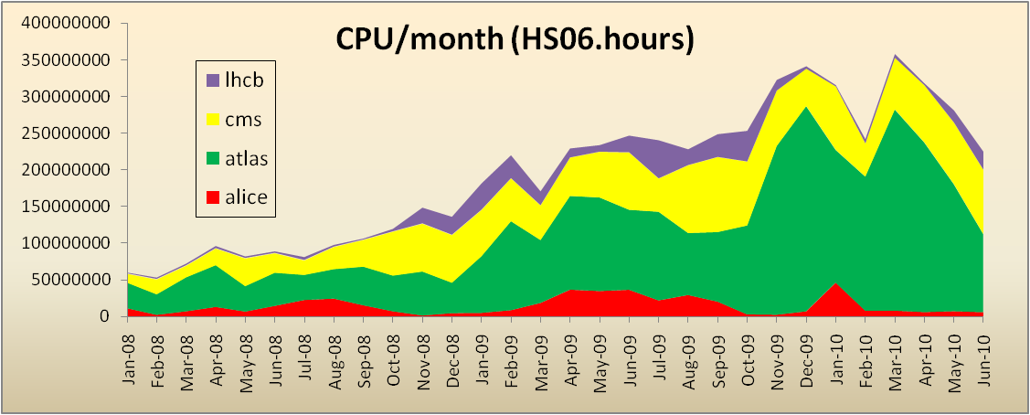
Grid Usage
Use remains consistently high:
  >1 M jobs/day;
  ~150k CPU
1 M jobs/day
CPU used at Tier 1s + Tier 2s (HS06.hrs/month) – last 12 months
100k CPU-days/day
At the end of 2010 we saw all Tier 1 and Tier 2 job slots being filled
CPU usage now >> double that of mid-2010 (inset shows build up over previous years)
Large numbers of analysis users:
ATLAS, CMS ~800
LHCb,ALICE ~250
As well as LHC data, large simulation productions always ongoing
Notes:
In terms of the workload on the grid, here we see a load of in excess of 1 million jobs per day being run (and this is still increasing). This is notable since this was the rate anticipated for a nominal year of data taking. This translates into significant amounts of computer time. In fact, towards the end of 2010 we reached the situation where all of the available resources in the Tier 1 and Tier 2 centres were often fully occupied. We anticipate this problem becoming more interesting in 2011 and 2012.
The other notable success in 2010 was the number of individuals actually using the grid to do physics. This had been a point of concern as the usability of grids has always been difficult, but the experiments had really invested a lot of effort to provide a seamless integration with their tools. We see some 800 different individuals per month using the service in the large experiments, and some 250 in each of the smaller collaborations.

Slide 8
CPU – around the Tiers
The grid really works
All sites, large and small can contribute
  And their contributions are needed!
Significant use of Tier 2s for analysis
Tier 0 usage peaks when LHC running – average is much less
Jan 2011 was highest use month ever … now exceeded
Notes:
The distribution of delivered CPU between the various tiers has also been according to the design, with tier 2s providing in excess of 50% of the total. If this is broken down we see that countries deliver close to what they pledged. Thus the grid concept really does work on this scale, and enables institutes worldwide to collaborate, share data, and provide resources to the common goals of the collaboration. Early worries that people would simply ignore the grid and use CERN for analysis were unfounded – Tier 2s are used extensively and exclusively.

Slide 9
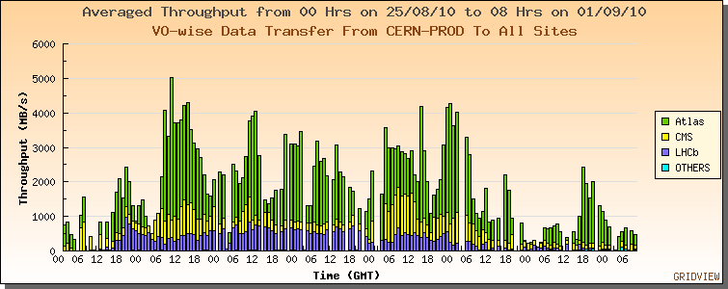
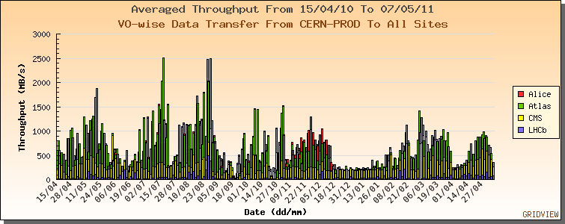
Data transfers
LHC data transfers:
April 2010 – May 2011
Rates >> higher than planned/tested
Nominal: 1.3 GB/s
Achieved: up to 5 GB/s
World-wide: ~10 GB/s per large experiment
2010 pp data → Tier 1s
& re-processing
ALICE HI data → Tier 1s
2011 data → Tier 1s
Re-processing 2010 data
CMS HI data zero suppression & → FNAL

Slide 10
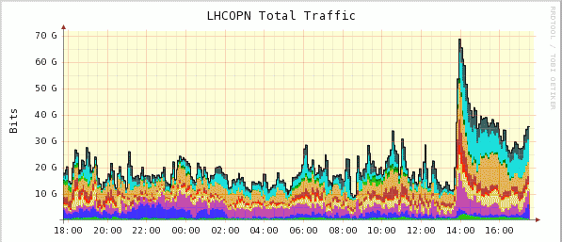
70 / 110 GB/s !
Traffic on OPN up to 70 Gb/s!
- ATLAS reprocessing campaigns
Significant levels of network traffic observed in 2010
Caused no network problems, but:
Reasons understood (mostly ATLAS data management)
Data popularity/on demand placement improve this

Slide 11
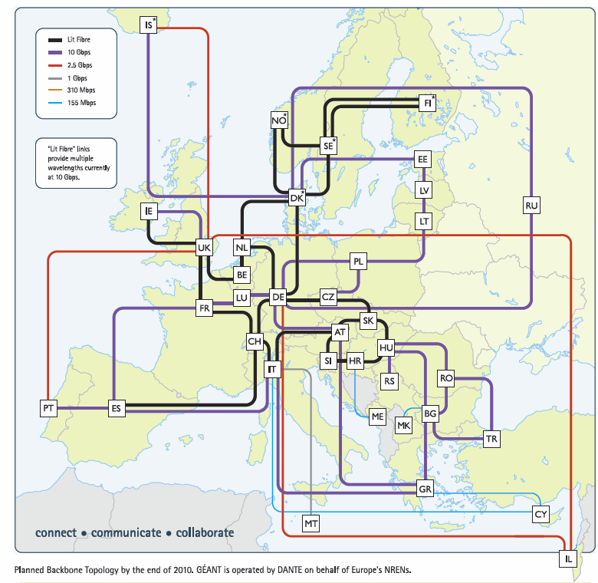
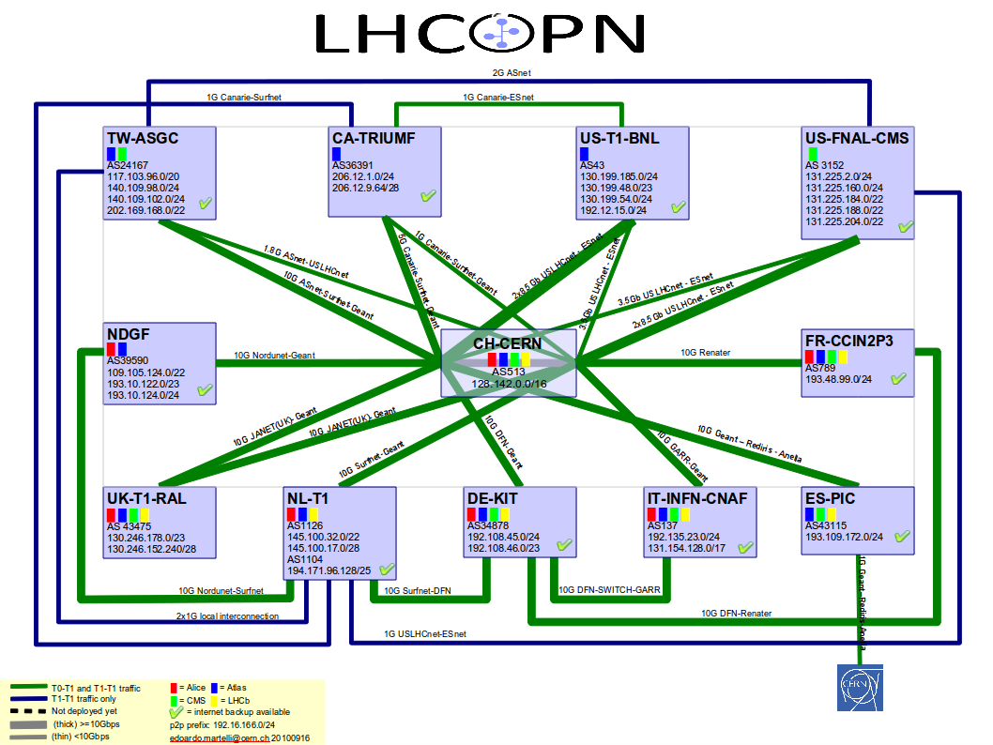
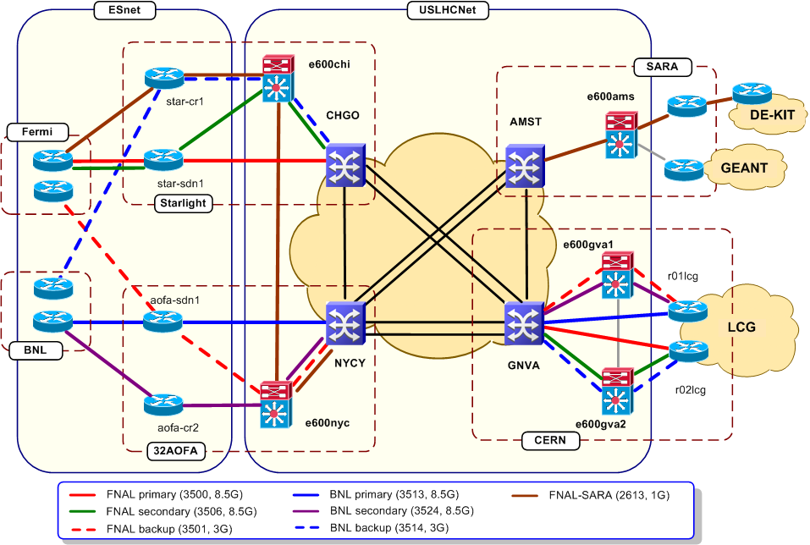
LHC Networking
Relies on
  OPN, GEANT, US-LHCNet
  NRENs & other national & international providers

Slide 12
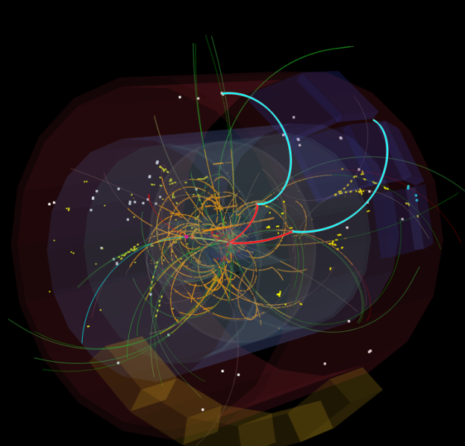
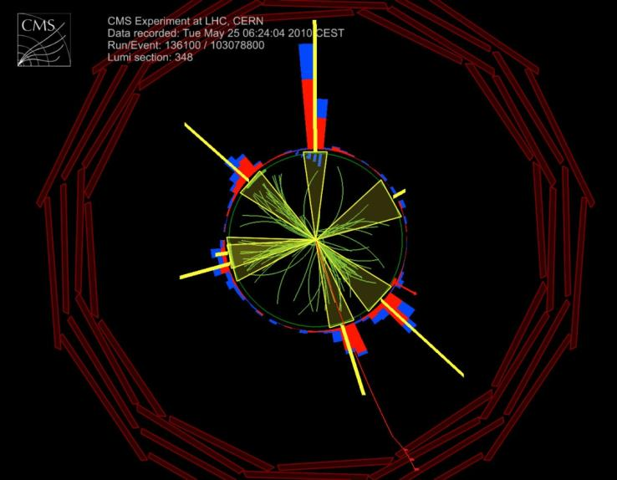
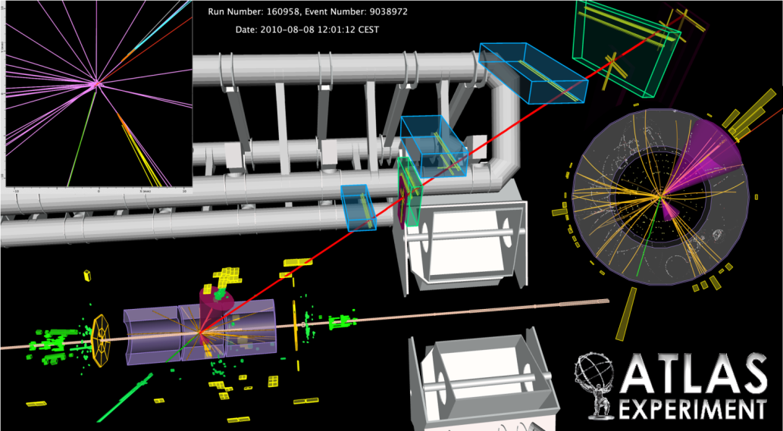
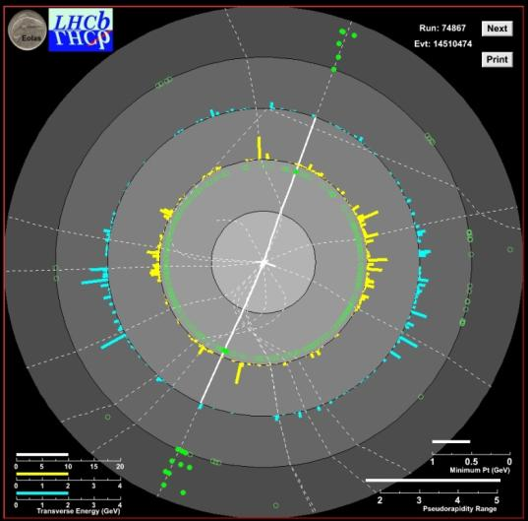
Successes:
We have a working grid infrastructure
Experiments have truly distributed models
Has enabled physics output in a very short time
Network traffic in excess of that planned –
  and the network is extremely reliable
Significant numbers of people doing analysis (at Tier 2s)
In 2010 resources were plentiful, now start to see contention …
Support levels manageable ... just

Slide 13
Lessons learned
Complexity & Sustainability
  Took a lot of effort to get to the level of today
  Ongoing effort for support is probably too high
  Experiments had to invest significant effort to hide grid complexity from users
Distributed nature of the infrastructure
  Was not really understood in the computing models
    Evolution of data distribution and management
    Evolution of networking

Slide 14
Lessons: Data
Computing models based on MONARC model of 2000 – reliance on data placement
  Jobs sent to datasets resident at a site
  Multiple copies of data hosted across the infrastructure
  Concern that the network would be insufficient or unreliable
However:
  A lot of data “placed” at sites was never touched
  Refreshing large disk caches uses a lot of networking
  The network is extremely reliable (…with redundancy)

Slide 15
Lessons: Services
Until now many services have been distributed
  Databases, Data placement, etc.
  Because of lack of trust that networks would be reliable enough
  Increased the complexity of the middleware and applications
Now we see centralization of those services again
  1 failover copy of a db is much simpler than a distributed db schema!

Slide 16
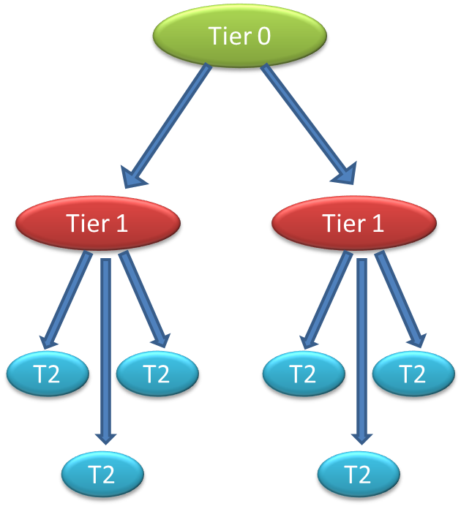
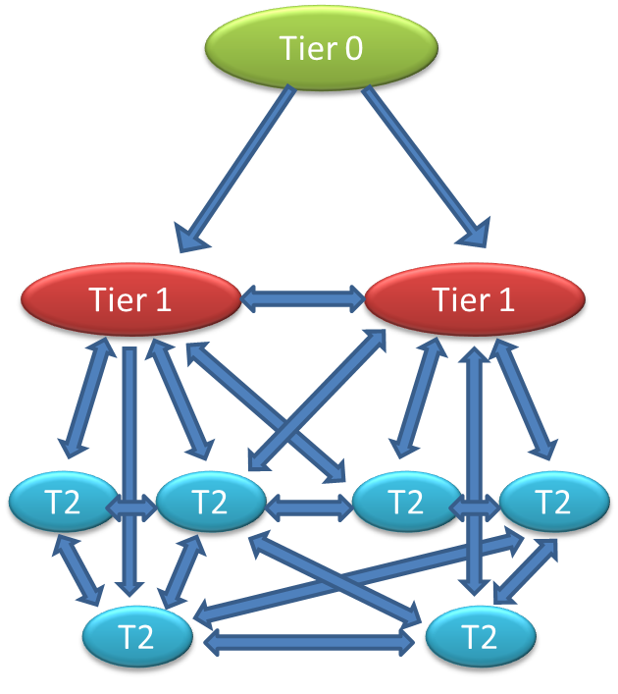
Computing model evolution
Evolution of computing models
Hierarchy
Mesh

Slide 17
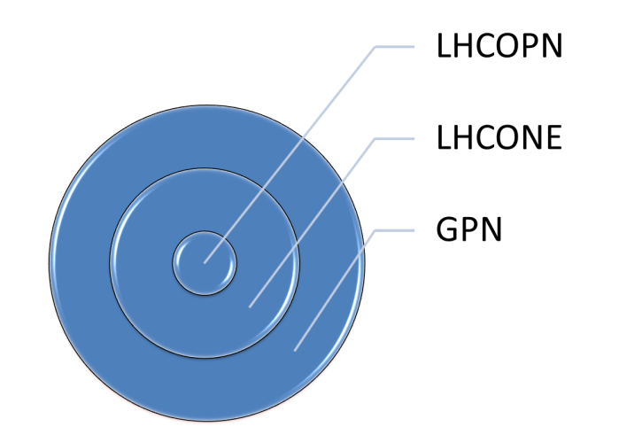


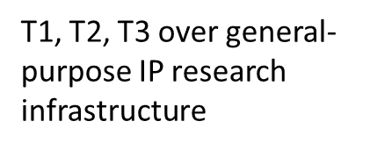
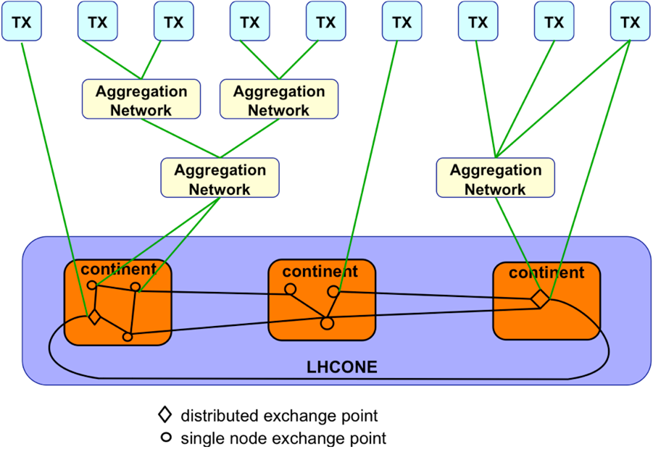
Network evolution - LHCONE
Evolution of computing models also require evolution of network infrastructure
- Enable any Tier 2, 3 to easily connect to any Tier 1 or 2
Use of Open Exchange Points
Do not overload the general R&E IP infrastructure with LHC data
Connectivity to T1s, T2s, and T3s, and to aggregation networks: NRENs, GÉANT, etc.

Slide 18
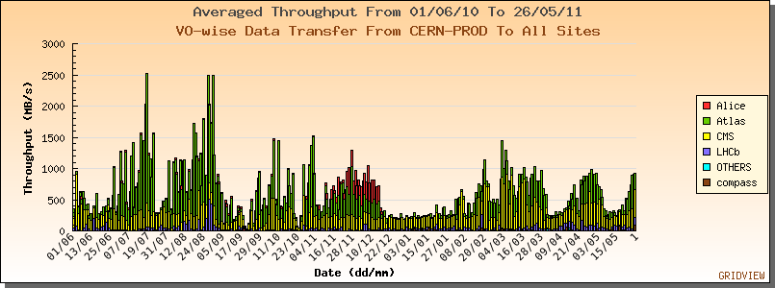
Change of the data model…
Data placement will now be based on
  Dynamic placement when jobs are sent to a site
  Data popularity – popular data is replicated – unused data is removed
Analysis disk becomes a more dynamic cache
Also start to use remote (WAN) I/O:
  Fetch a file missing from a dataset
  Read a file remotely over the network
Can be less network traffic

Slide 19
Other Challenges:
Resource efficiency
  Behaviour with resource contention
  Efficient use – experiments struggle to live within resource expectations, physics is potentially limited by resources now!
Changing models – to more effectively use what we have
  Evolving data management
  Evolving network model
  Integrating other federated identity management schemes
Sustainability
  Grid middleware – has it a future?
  Sustainability of operations
  Is (commodity) hardware reliable enough?
Changing technology
  Using “clouds”
  Other things - NoSQL, etc.
Move away from “special” solutions

Slide 20
Relationship to EGI and EMI
MoU between WLCG and EGI in progress
  Has been presented to WLCG OB
  Now with CERN legal dept.
  Initially was too complex, and had no clearly explained benefit for WLCG
Important that NGIs provide the services that WLCG needs
  EGI can help in coordinating that
But note that EGEE/EGI-style grid is only useful for certain sciences (like WLCG)
  Some communities don’t see it as appropriate
  Pressure for EGI to adapt – how does it affect WLCG?
    Thus we need a good understanding of our future needs

Slide 21
Middleware support
Process to be discussed this week …
Environment (in Europe) more complex today:
  EMI – EGI – WLCG
  Needs of WLCG vs EGI/NGIs and other scientific communities
Some caution needed …

Slide 22
Technical working group
Consider that:
Computing models have evolved
Far better understanding of requirements now than 10 years ago
  Even evolved since large scale challenges
Experiments have developed (different!) workarounds to manage weaknesses in middleware
Pilot jobs and central task queues (almost) ubiquitous
Operational effort often too high; lots of services were not designed for redundancy, fail-over, etc.
Technology evolves rapidly, rest of world also does (large scale) distributed computing – don’t need entirely home grown solutions
Must be concerned about long term support and where it will come from

Slide 23
Technical working group
But remember:
Whatever we do, we must evolve whilst not disrupting the ongoing operation
We have a grid for a very good reason – we need to integrate the resources provided to us – but we can make use of other technologies
We have the world’s largest (only?) worldwide trust federation and a single sign-on scheme covering both authentication and authorization
We have also developed a very strong set of policies that are exemplars for all other communities trying to use distributed computing
In parallel we have developed the operational security teams that have brought real benefit to the HEP community
We have also developed the operational and support frameworks and tools that are able to manage this large infrastructure

Slide 24
Technical working group
WLCG must have an agreed, clear, and documented vision for the future; to:
Better communicate needs to EMI/EGI, OSG,…
Be able to improve our middleware stack to address the concerns
Attempt to re-build common solutions where possible
Take into account lessons learned (functional, operational, deployment, management…)
Understand the long term support needs
Focus our efforts where we must (e.g. data management), use off-the-shelf solutions where possible
Must balance the needs of the experiments and the sites

Slide 25
Group proposed
To address these issues and start technical discussions on key topics
  Some first discussions already in May and June GDB’s – essentially to gauge the importance
Jointly chaired – Markus and Jeff
Membership to be discussed:
  Need to balance experiment and site views
  Not fixed – need different people for different topics
  Should not be exclusive, but need to limit size →
Should produce proposals for wider discussion and agreement
  These agreed proposals should then form the strategy document
Needs to happen quickly … taking 1 year over this will not be helpful

Slide 26
Summary
Conclusions
WLCG has built a true distributed infrastructure
The LHC experiments have used it to rapidly deliver physics results
Experience with data has initiated new models for the future
Additional technical discussions are needed to plan future evolution

