Slide 1
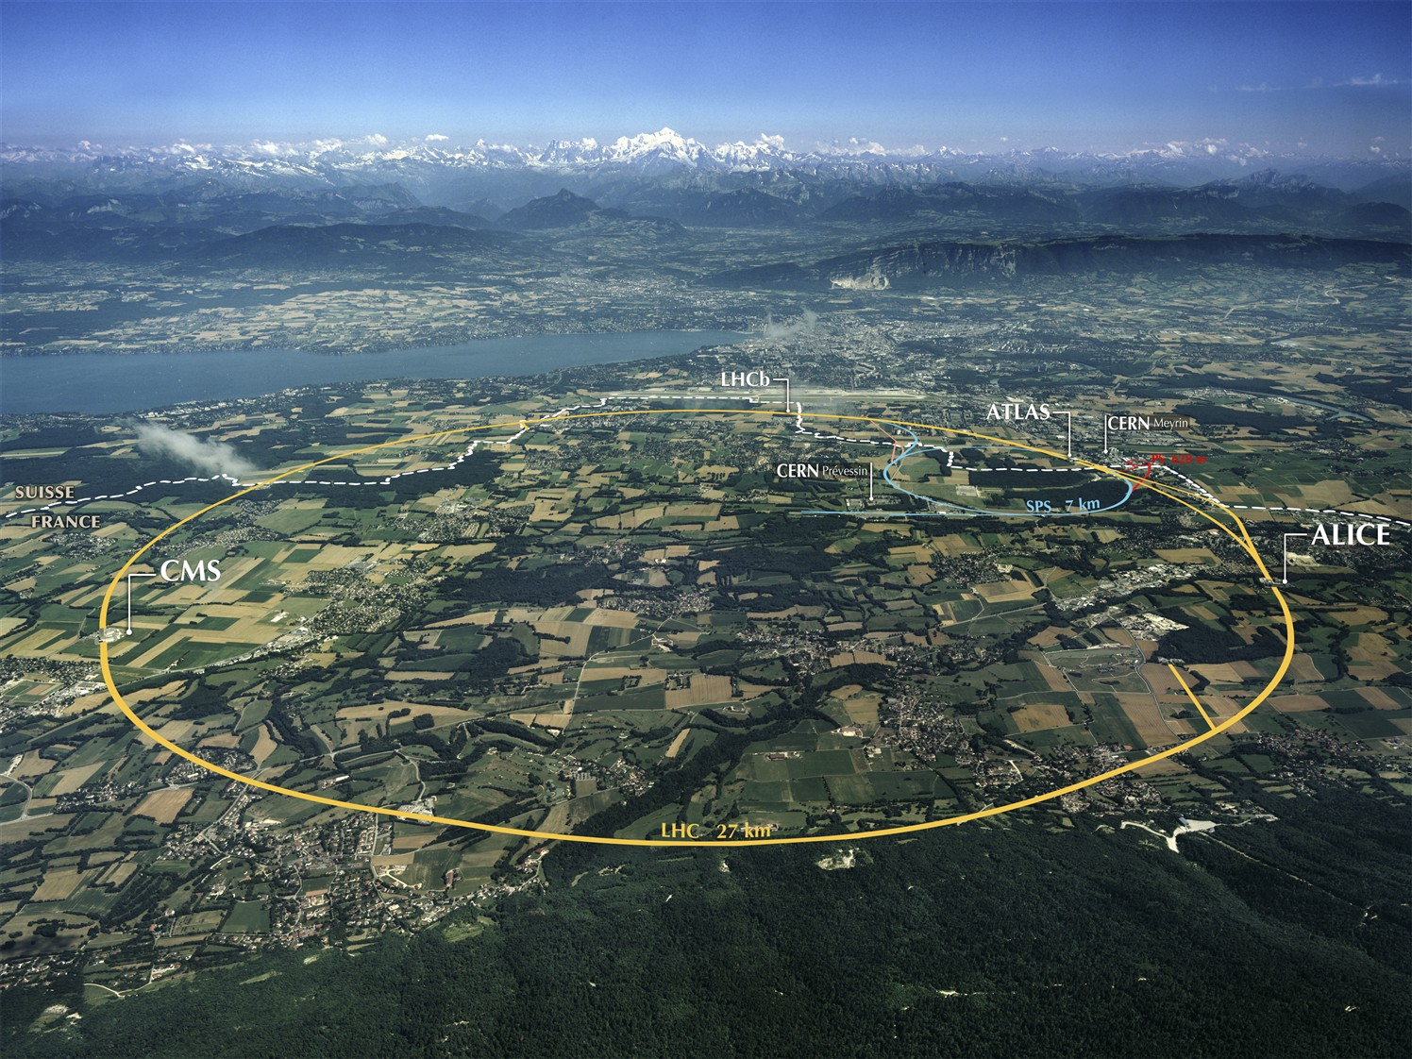
Workshop summary
Ian Bird, CERN
WLCG Workshop;
DESY, 13th July 2011
Accelerating Science and Innovation
Notes:
1

Slide 2
View from experiments
Things have gone well in 1st year
Worry over coming resource contention
Number of interesting optimizations
Xrootd for remote data acess beyond ALICE
Network improvements and more site connections with LHCOne
Better disk management and separation of disk and tape
Looking at cloud components and broader use of virtualization
etc...

Slide 3
View from the Tiers
Concern over EMI, EGI relationships
Concern over evolution and future of middleware
Concern over use of EMI-1
How will WLCG techniques evolve?
Will there be a single common computing model ?
(and how will the models evolve)
Want commonality (of WLCG) with other VOs
Whole node scheduling –
group has not reported, sites need input about how to manage this

Slide 4
Tier 3s
Should agree that very many different types, not common across experiments
WLCG should define security policy and interfaces to Tier 3s, common tools
however, they should remain independent and not under strong control
We need to understand how we approach this...
Organise a GDB discussion on Tier 3 interfaces?
Summary:
some want to be left alone - should be
some want help and suggestions, tools - can we provide such support?
Can EGI help support - yes via another volunteer NGI

Slide 5
Storage & Data
A lot of progress since Amsterdam
Dirk Duellmann:
Good list of areas where work is still needed and open questions remain
Areas for common solutions
Suggestion to have a coordination team – action for GDB?
LHCONE – significant progress
Important to make sure we have sufficient and appropriate monitoring/operations

Slide 6
Resource Efficiency
Need better monitoring to profile efficiency problems
Can we have common strategy for data access:
files copied to WN or used from SE? –
allows site to better optimise for one or the other
Whole node scheduling
need to show that real efficiency is possible before invest effort in deployment issues
memory improvements by whole node sched or move to 3 GB/core?
Is whole node sched really going to be worth the effort?

Slide 7
Middleware…
Our favourite topic … still …
No disagreement that we should
Assess where we are and what we need in the light of real experience with data
Document a vision of evolution for WLCG for the future
Use that to provide clear input to EMI/EGI, OSG, and others
NB: WLCG should have a vision of what WE need as a community: understood that sites have constraints of compatibility with other VOs/projects etc. but that should not our goals
Process:
WG proposed
Agree mandate in a MB (next week?)
Agree membership MB

Slide 8
Themes?
Experience with data has clarified many things
Good time to re-assess what works and what needs improvement/re-thinking
Opportunities for improving commonalities
Would help support load (sites & experiments)
Should take the opportunity
Sense a willingness to do this

Slide 9
Success !
WLCG recognised as having enabled rapid physics output
LHCC
CERN Scientific Policy Committee
CERN Council
Resource Review Boards (i.e. Funding Agencies)
As well as many other places/articles
http://cern.ch/lcg → Repository → Dissemination → LCGNews
Thanks to huge and sustained collaborative effort by all sites and experiments !!

Slide 10
Summary
Thank you!
Patrick for the excellent organisation and hospitality!
Not forgetting the DESY support team
EMI and DELL for their sponsorship of the workshop and social events!

