Slide 1
FCC week 2023 report London 5th 9th June 2023
Riccardo Bartolini
PETRA IV Machine Project Leader
Hamburg, June 30th, 2023

Slide 2
Outline
General remarks
Accelerators
Infrastructure

Slide 3
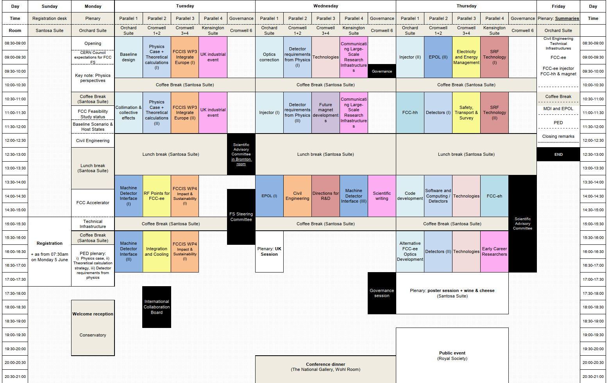
Scientific programme
SAC meeting to prepare mid-term review
Explicit request of Chair to congratulate all presenters for the excellent quality of contributions and outstanding progress made!
473 participants :
111 remote
362 on site incl. 62 ‘1-day’ passes
55 sessions, 204 presentations, 27 posters

Slide 4
F. Gianotti

Slide 7
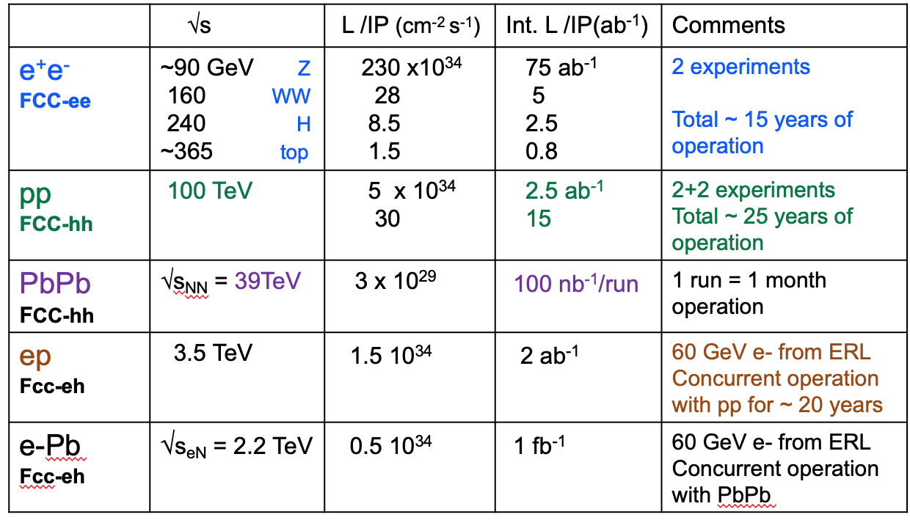
Why FCC ?
Int L/IP/y (ab⁻¹)
182 x 10³⁴
19.4
7.3
1.33
22
2.3
0.9
0.16
2-4 experiments
A multi-stage facility with immense physics potential
(energy and intensity), operating until the end of the century.
FCC-ee : highest luminosities at Z, W, ZH of all proposed Higgs
and EW factories; indirect discovery potential up to ~ 70 TeV
FCC-hh: direct exploration of next energy frontier (~ x10 LHC) and
unparalleled measurements of low-rate and “heavy” Higgs couplings (ttH, HH)
Also heavy-ion collisions and, possibly, ep/e-ion collisions
Synergistic programme exploiting common civil engineering and technical
infrastructure, building on and reusing CERN’s existing infrastructure
⇒ 4 collision points
5-30 x 10³⁴
30
20-30
2) Timeline
FCC-ee technology is mature → construction can proceed in parallet to HL-LHC operation and physics start a few years
after the end of HL-LHC operation (2045-2048 according to current schedule) → This would keep the community, in particular
the young people, engaged and motivated.
FCC-ee before FCC-hh would also allow:
- cost of the (more expensive) FCC-hh machine to be spread over more years
- 20 years of R&D work towards affordable magnets providing the highest achievable field (high-T superconductors)
- optimization of overall investment : FCC-hh will reuse same civil engineering and large part of FCC-ee technical infrastructure
3) It’s the only facility commensurate to the size of the CERN community (at least 4 experiments)
F. Gianotti

Slide 8
F. Gianotti
Notes:
Lebrun’s comment
Selected location and site
4 interaction points

Slide 9
J. Gutleber

Slide 11
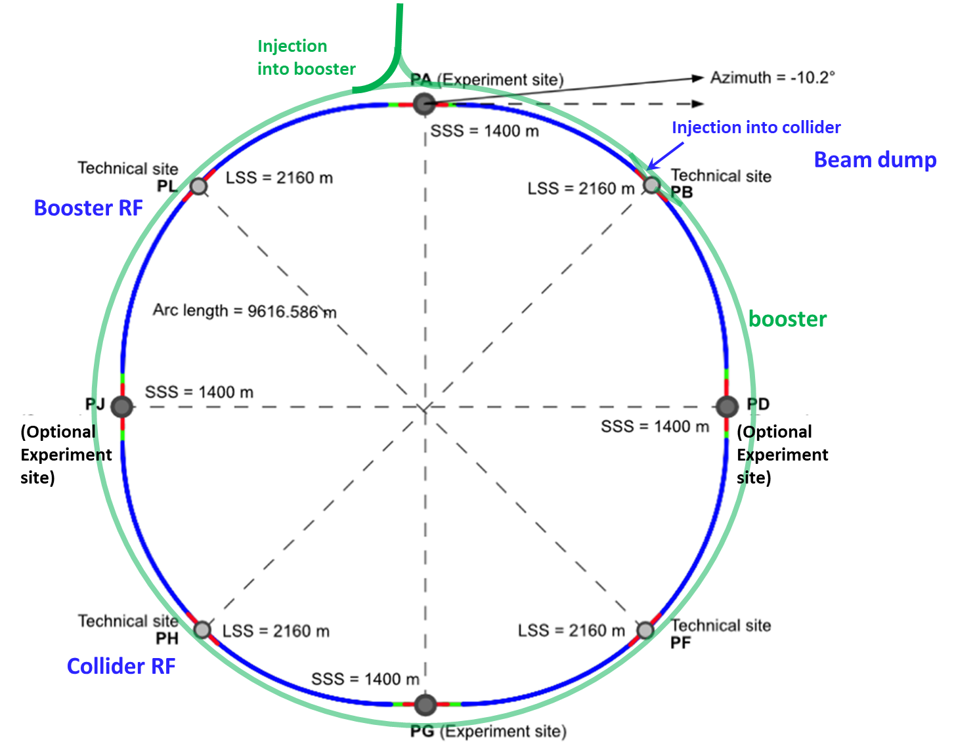
FCC-ee layout
Double ring e+e- collider with 91 km circ.
Common footprint with FCC-hh, except around IPs
Perfect 4-fold super-periodicity allowing 2 or 4 IPs; large horizontal crossing angle 30 mrad, crab-waist collision optics
Synchrotron radiation power 50 MW/beam at all beam energies
Top-up injection scheme for high luminosity Requires booster synchrotron in collider tunnel and 20 GeV e+/e- source and linac
T. Raubenheimer

Slide 12
50 MW “only” in synchrotron
radiation losses
F. Gianotti

Slide 13
F. Gianotti

Slide 14
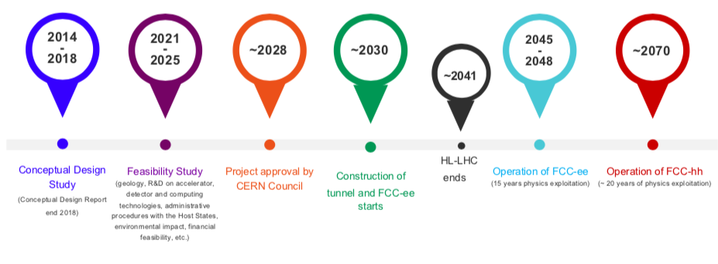
What if a Higgs factory is built elsewhere ?
1st stage collider, FCC-ee: electron-positron collisions 90-360 GeV
Construction: 2033-2045 → Physics operation: 2048-2063
2nd stage collider, FCC-hh: proton-proton collisions at ≥ 100 TeV
Construction: 2058-2070 → Physics operation: ~ 2070-2095
Assuming… FCC-ee will not happen, we may go directly to FCC-hh via the fastest path (Nb₃Sn). Timescale ~ 2060 : dictated by R&D and industrialisation of magnet technology, and cost

Slide 15
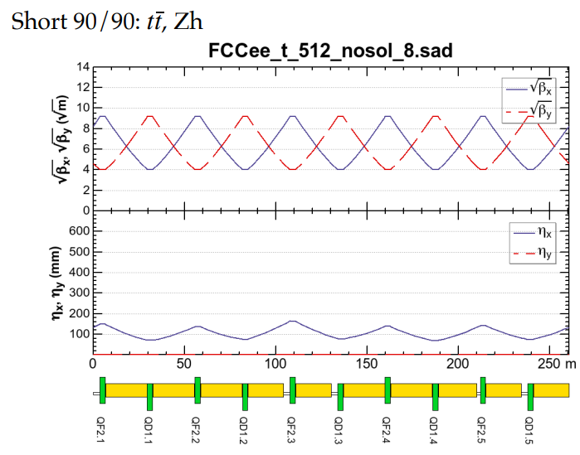
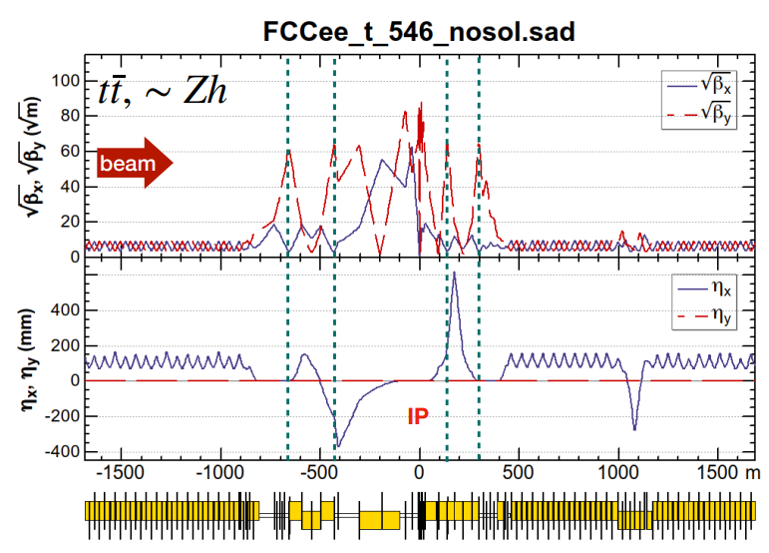
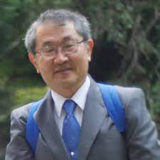
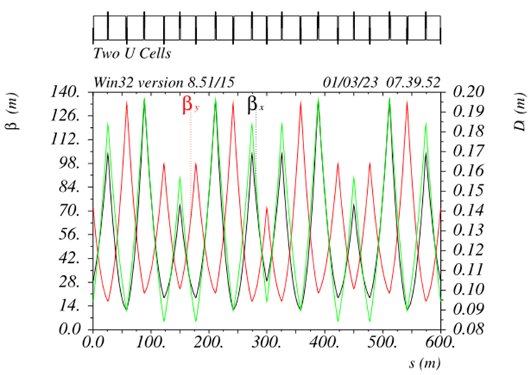
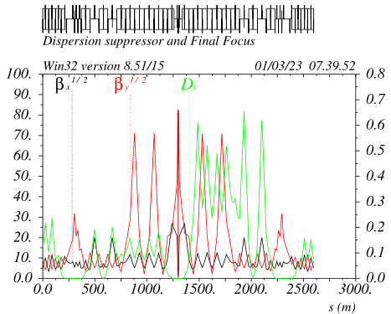
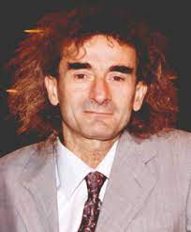
FCC-ee collider optics development: 2 options
arc
interaction region
K. Oide, 2023 EPS
Rolf Wideroe award winner
Phys. Rev. Accel. Beams 19, 111005
FODO lattice, many -I sext pairs; periodic unit cell length $\sim$260 m
baseline for 2023 FCC “mid-term” review
“1.5” sext.s per final focus,
asymmetric
P. Raimondi, 2017 EPS Gersh Budker award winner
design in progress -
further relaxed tolerances,
reduced power consumption,
larger momentum acceptance
5 sext.s per final focus, modular
hybrid FODO lattice,
with few sext. families,
periodic unit cell length
$\sim 30$0 m
Phys. Rev. Accel. Beams 26, 021601

Slide 18
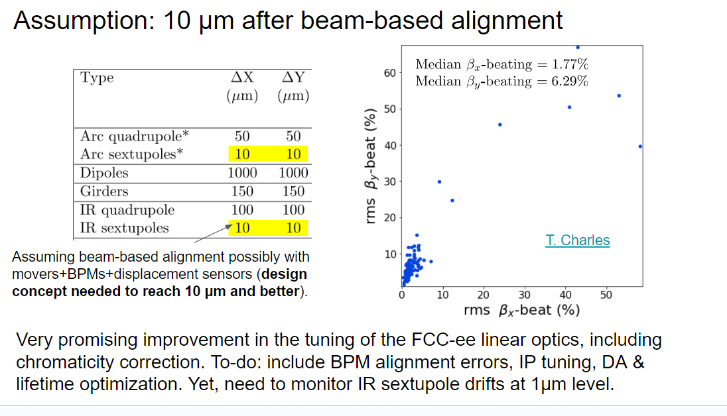
R. Tomas

Slide 19
R. Tomas

Slide 20
FCChh – Lattice
M. Giovannozzi

Slide 21
FCChh – transfer lines (permanent magnet option)
M. Giovannozzi

Slide 22
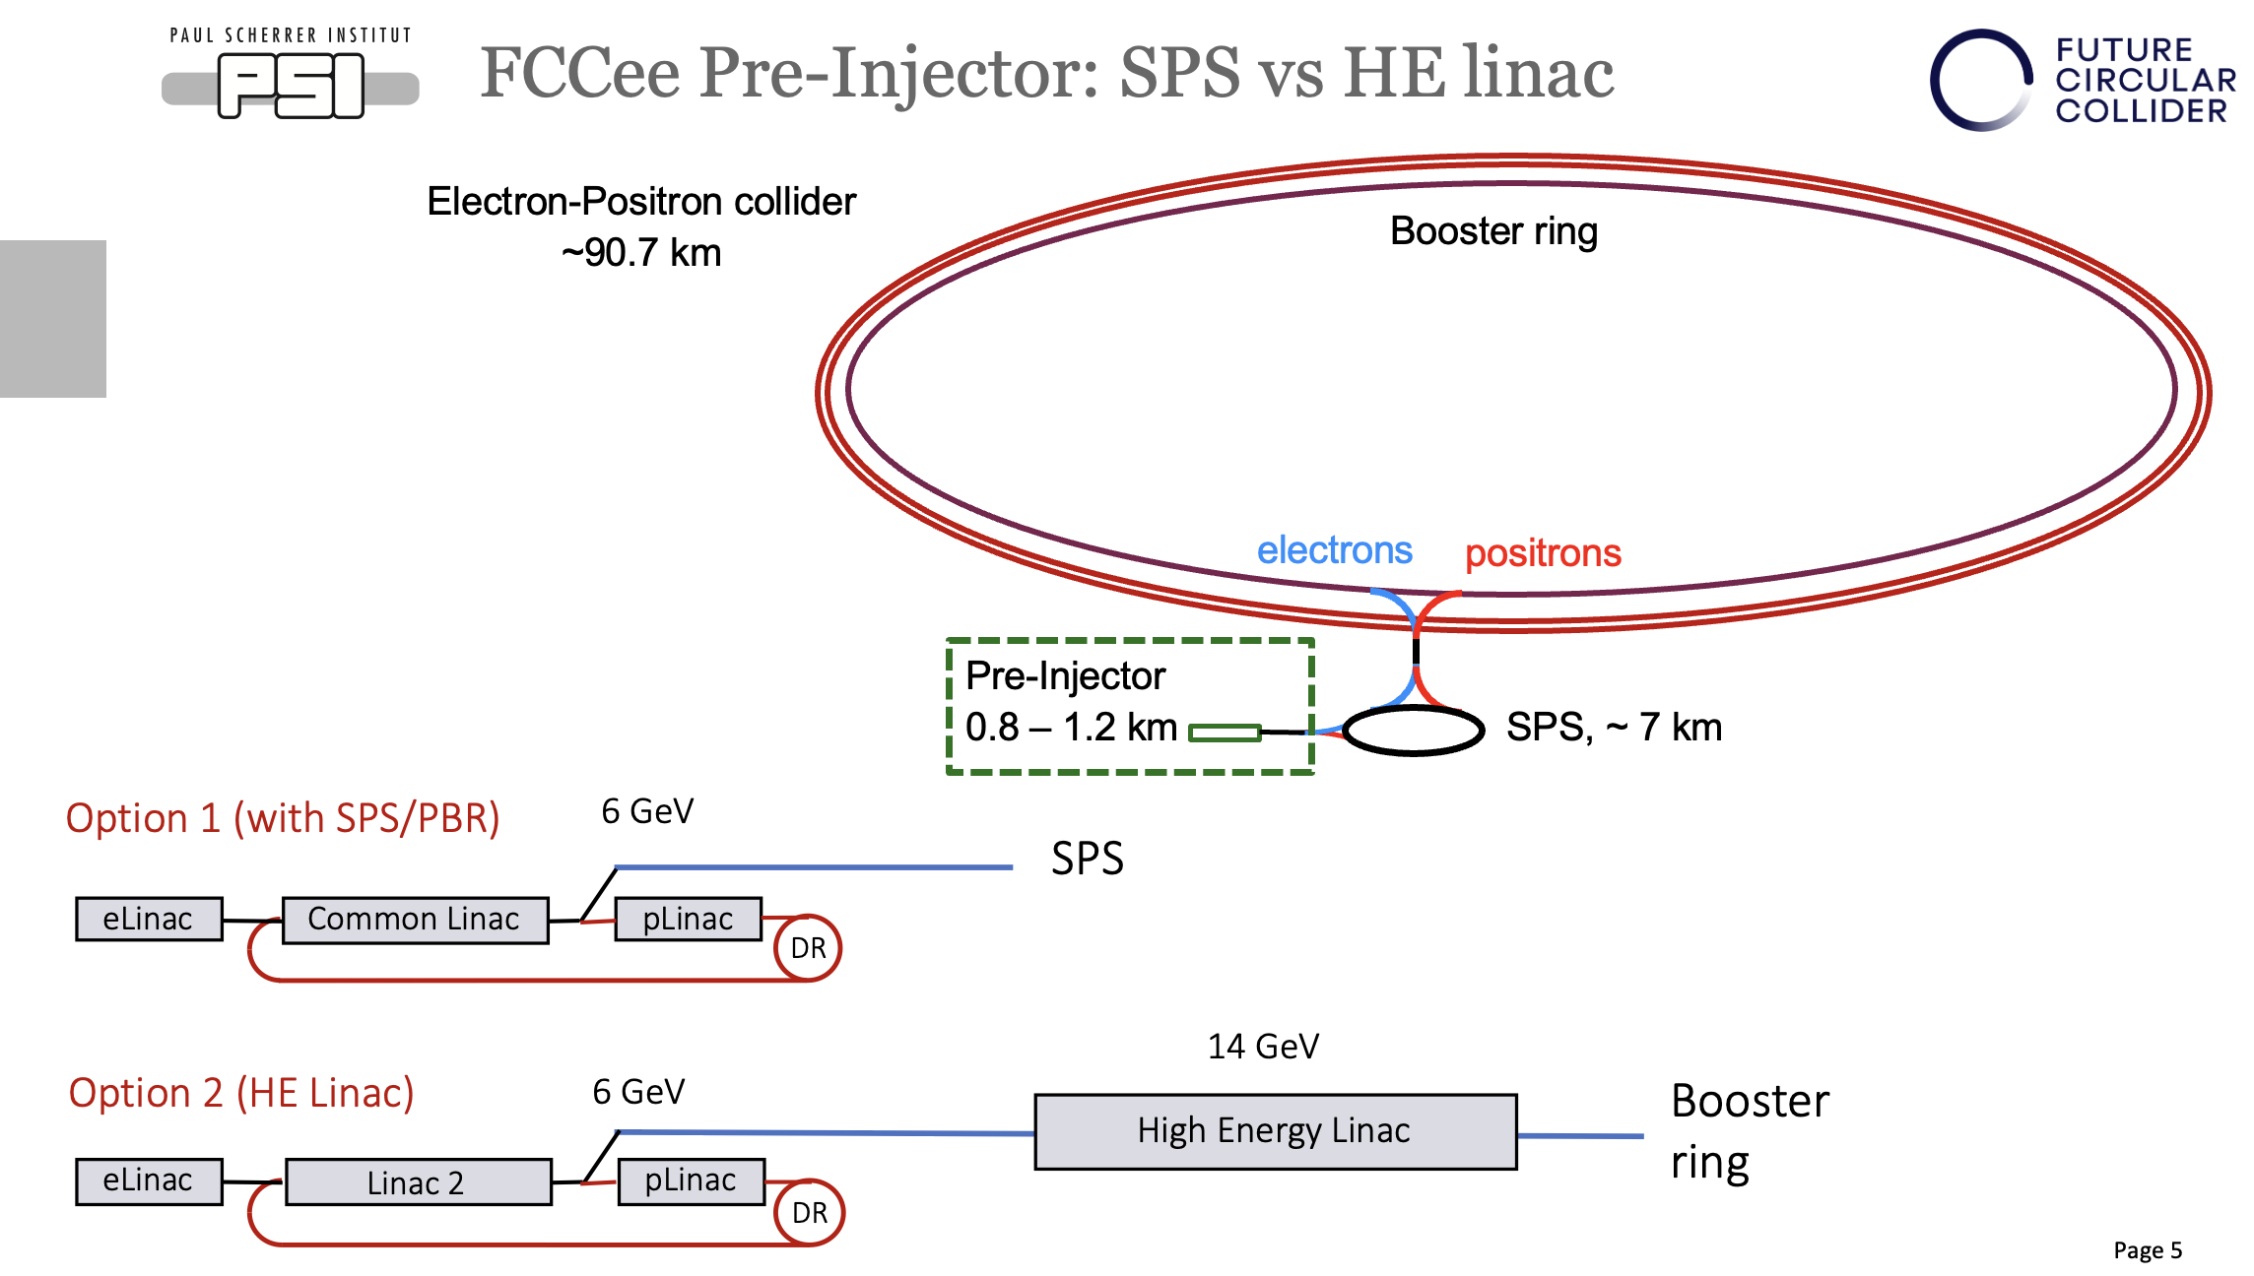
Pre-injector options
Notes:
Injector Conceptual Design and Positron Source test stand at PSI
DC/RF gun comparative studies
Positron source
RF modules design and cost (Swiss FEL)

Slide 25
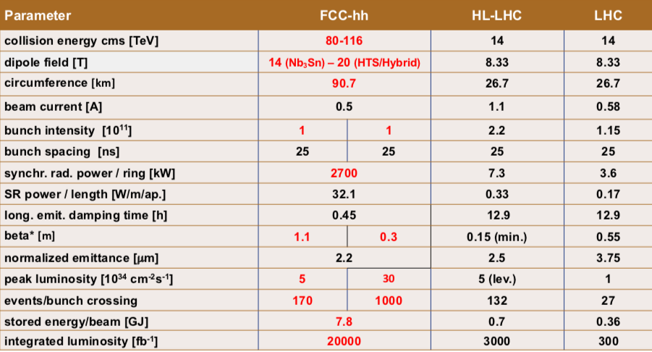
FCC-hh – Goals (Now Updated)
Michael Benedikt
1020-4250
13-54
0.77-0.26
6.1-8.9
FCChh is part of the Feasibility Study funded from CERN budget: 100 MCHF total over 5 years; in addition: ~ 20 MCHF/year for high-field magnet R&D Additional funding from the European Commission and collaborating institutes (e.g., CHART collaboration with Switzerland).

Slide 28
Superconducting RF Systems
SRF systems replenish the energy lost to synchrotron radiation in the main ring and accelerate the beam in the Booster
For Collider Z, W, H and ttbar machine all 400MHz Cryomodules will be housed at point H.
For Collider ttbar machine 800MHz Cryomodules will be housed at point H.
For Booster Z, W, H and ttbar machine all 800MHz Cryomodules will be housed at point L .
 | Point H |  | Point L
 | 400 MHz CMs | 800 MHz CMs | 400 MHz CMs | 800 MHz CMs
Z machine | 4.5K | NO CMs | NO CMs | 2K
W machine | 4.5K | 2K |  | 2K
H machine | 4.5K | 2K |  | 2K
ttbar machine | 4.5K | 2K |  | 2K
Integration study of RF scenarios and stages, selection of cavities and location of cryomodule, RF frequency and cryogenic temperature continue.

Slide 30
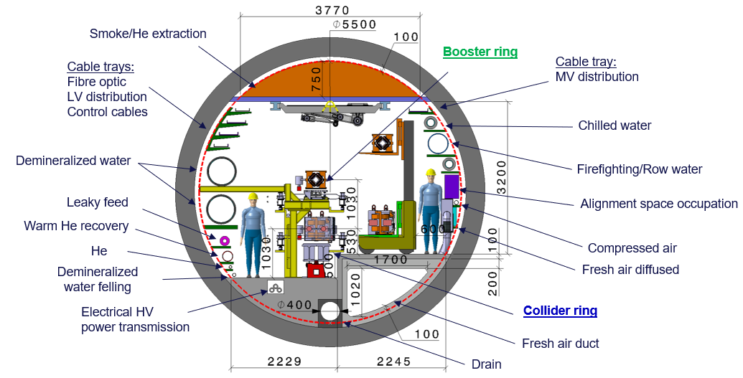
Arc Cell Integration
F. Kuncheva-Valchkova

Slide 32
Notes:
8 M^3 soil
6 Bn tunnel 6 Bn infrastructure

Slide 33
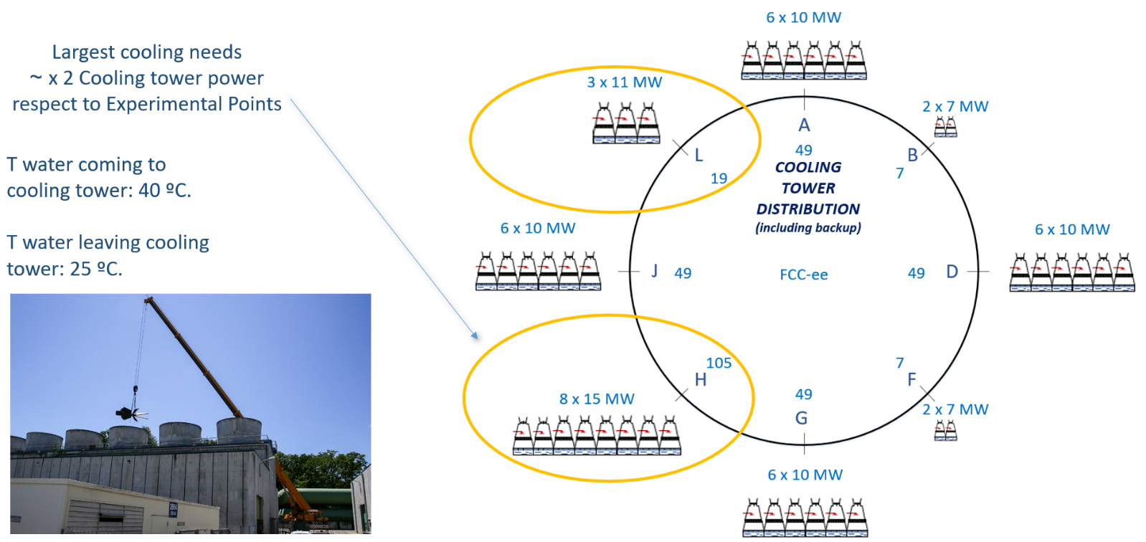
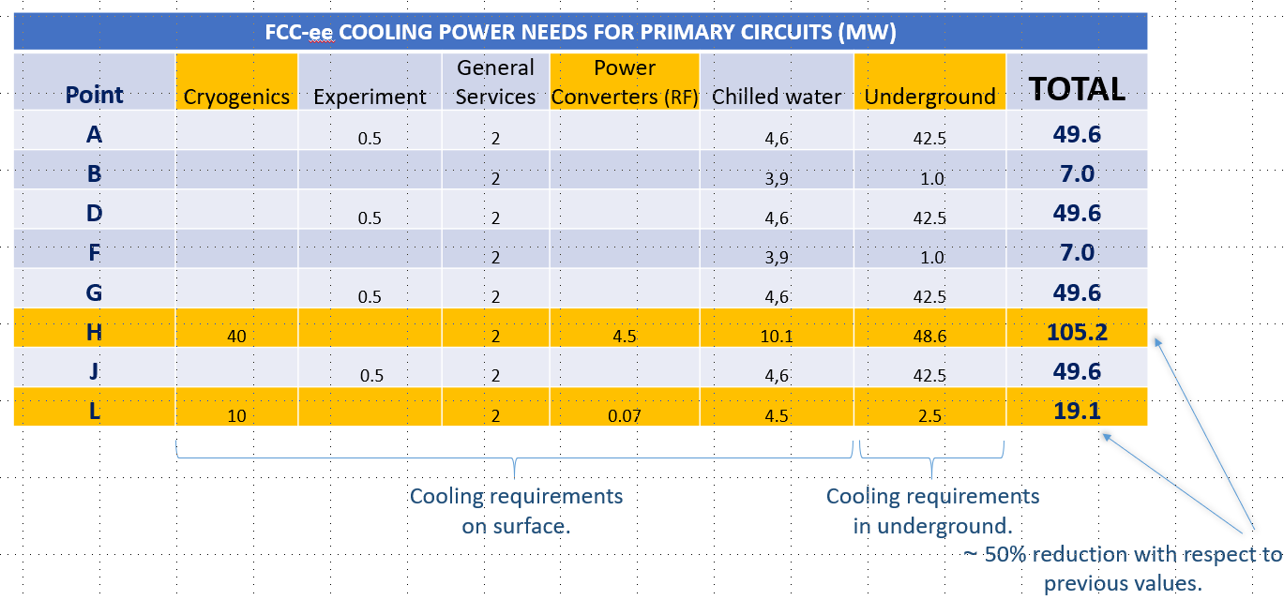
Klaus Hanke
33
Cooling & ventilation for RF systems, surface and klystron galleries
Inigo Martin Melero

Slide 34
Klaus Hanke
34
Possibilities for heat recovery analysed at all access points (e.g. B)

Slide 35
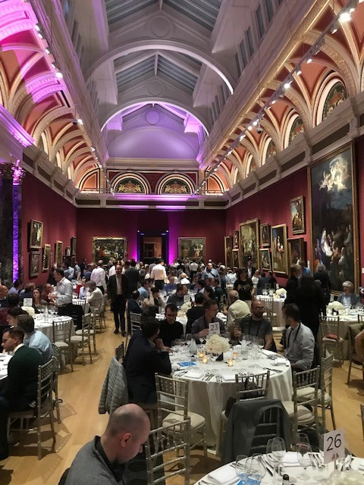
Thank you for your attention!

