Slide 1
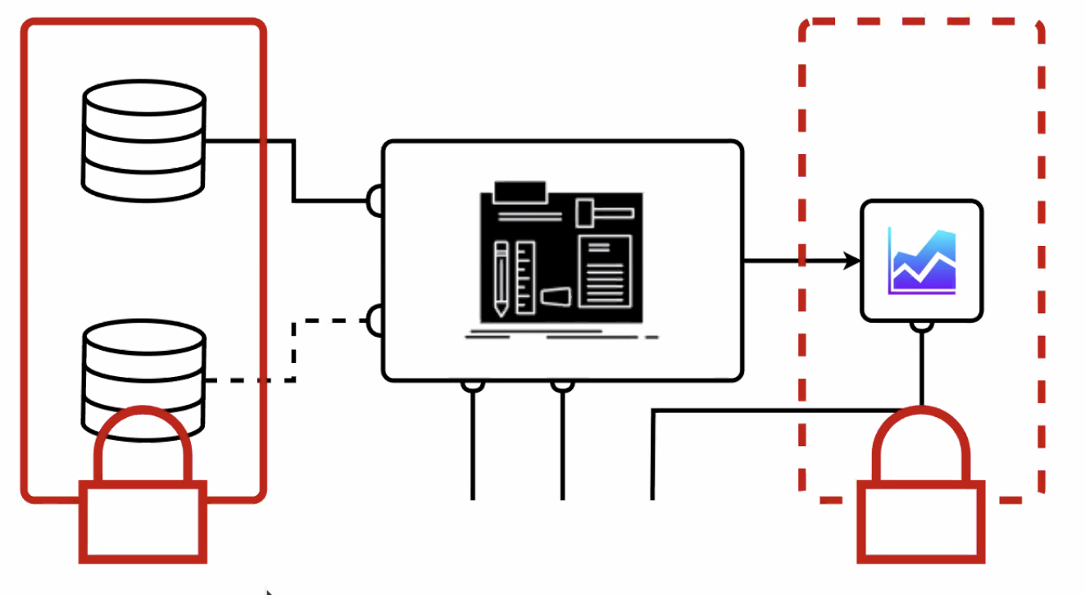
Collection of use cases TA2-4 (1)
L. Gärtner (TA3): HEP analysis use case – Belle II
HEP speciality: data and result protection pre-publication.
PB of data protected at selected spaces, connected to computing resources
Need communication between PUNCH sites and external storage / compute sites. Data pipeline can send results back to protected PUNCH result sites.
Why use PUNCH facilities? Convenience – easy access to data and easy access to software
Need to solve privacy issues and need to make software environment appealing.
Joe: perfectly aligned with astro interests (data-intensive jobs etc.)
H. Enke (TA4): TA4 Keycloak + REANA + gitlab-p4n: now keycloak as middleman in place (note difficult AAI discussion)
Used by O. Freyermuth (Bonn): ELSA – using for authentication for the Jupyter notebooks.
Potsdam SciTrace workshop 14-16 June: Use case from M. Hübner – comparison of Higgs models in HEP (HiggsTools). They can run their analysis and put things in a container.
Focus of TA4: see whether use cases from workshop can be containerised and can be executed by TA2 tools.
How to make use of S4P?
Andreas: Connection SciTrace – PUNCH? Harry: SciTrace will be tool to capture workflows and parameters for later usage. Not alternative to REANA, but additional functionality

Slide 2
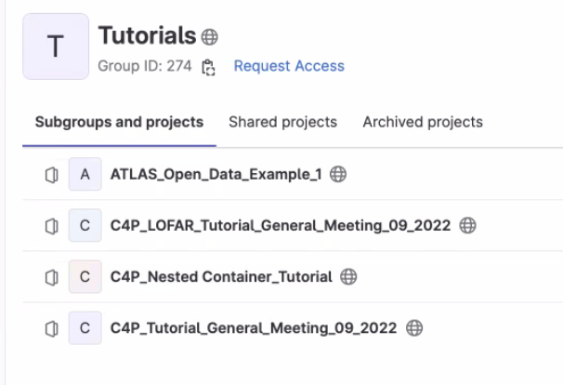
Collection of use cases TA2-4 (2)
J. Mohr (TA3): brought 4 use cases
Remark Thomas: 1 or 4 (→ Olaf)?
Joe’s preference: probably 1 because of Nicola’s plans. 3 also nice – but how broadly useful?
M. Hoeft (TA2): Tutorials around commissioning work flows
Needed to test C4P functionality and links to S4P
Have 4 tutorials at hand for test – e.g. carry out larger computing jobs (Matthias)
Manuel – nested contained tutorial for simplified Higgs analysis in CMS with data in HEPstorage.
Question: What would make P4N infrastructure attractive for users? Look for things computing heavy that you can’t do on your laptop. And make things simpler for the user!
Test and expand commissioning workflows while trying to increase scale (in TA2) and binding in TA3 tools.
Joe: Complexity of TA2 tools doesn’t matter as long as hidden behind portal

Slide 3
Collection of use cases TA2-4 (3)
O. Kazcmarek: Heavy quark diffusion RDP in P4N
Lattice project using HPC resources in EU and US; could profit from PUNCH a lot if all running in PUNCH
All data and software published
Project could cover all TA2-TA4 – and TA3 is already part of the project developing software required.
Harry: How will open data benefit any community but lattice?
A. Geiser: demonstrate HEP workflow on SDP that can not be done elsewhere
All required ingredients around – put it together.
ATLAS +CMS combined at the basic data level by designing common format!
Blueprint for future combined analysis.

Slide 4
Discussion
Selection
Decision to focus Nicola’s and Joe’s use case on radio imaging first → ask for input presentation to trigger discussion for next meeting (10 min)
Of course the other use cases need to be pursued equally. Focus shall involve all TAs, and the TA leads are always required to decide who from their domain needs to participate (WP leads, postdocs, …)
Work out for all (6) use cases:
Interactions between TAs
Impact on SDP development
Define benefits for PUNCH in general
Define brief “user story” for reporting – a few lines
Next meeting
5 July, 9-10

