Slide 1
Effect of Charge on Fragmentations of Biomolecules in the Gas Phase
Safa Osman, Summie 2023 (FS-BIG)
Deutsches Elektronen-Synchrotron DESY. Hamburg, September 6th 2023
Group Leader: Professor Sadia Bari
Supervisor: Juliette Leroux

Slide 2
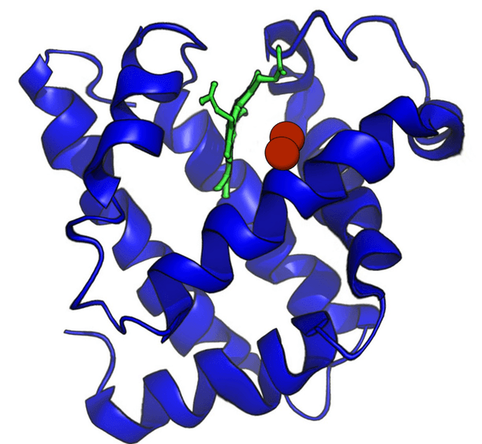
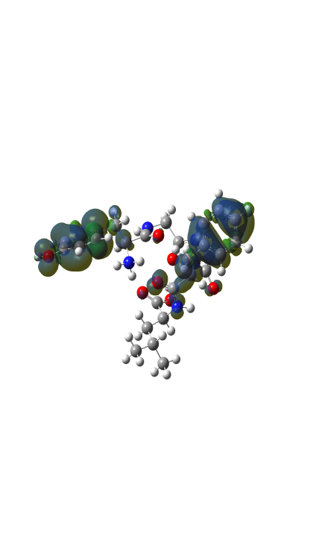
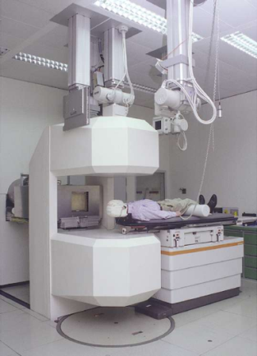
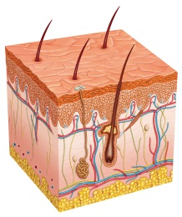
Motivation of the FS-BIG Group
To Understand the intrinsic physical properties of biomolecules, by investigating their structure and behavior using photon sources, leading to better understanding of their function
Intrinsic: Means belonging naturally and fundamentally (to the molecule in question) -> Since in nature elements come together and make a compound, instead of single elements floating about. Making a community!
Such an understanding leads us to answering fundamental and diverse questions from our lives, such as:
How life was formed
How would a radiation treatment affect cancer and healthy tissues
Formation
Cause ⬄ Treatment

Slide 3
What Does It Take To Understand A Molecule? And can one get into its head?
Answer: Perhaps yes!
Isolate molecules in gaseous form -> excite them (UV photons) and then probe them
Detect the fragments using a mass spectrometer
This requires a sophisticated experimental setup, such as the electrospray ionisation (ESI) mass spectrometer built by Professor Sadia Bari's team
Not a trivial process, and two separate Nobel Prizes have contributed to its realisation. For example, Wolfgang Paul received the Nobel Prize for the ion trap (Chairman at DESY, Hamburg, 1970 to 1973)

Slide 4
Experimental (mobile) Setup: Electrospray ionization (ESI) Mass Spectrometer
The take home message: You insert the desired molecule into the gas phase using an electrospray source and the setup would tell us the mass-to-charge-spectrum (m/z) of the inserted compounds and by analysing such a spectrum one can obtain the chemical composition to a good level of accuracy.
www.freepik.com

Slide 5
Electrospray Ionization (ESI) Mass Spectrometer
- ESI: Transfers ions from a solution to the gas phase (magic!)
- Funnel: Directs and focuses ions into the setup
- Octopole Ion Guide(s)
- Quadrupole Mass Filter: Control point to filter the desired ions based on their m/z from the many species produced by the ESI source

Slide 6
Electrospray Ionization (ESI) Mass Spectrometer
Paul Trap: Uses an RF field to confine and trap ions up to a sufficiently high density.
Time of Flight (TOF) Mass Spectrometer: After the Paul trap the ions fly into the TOF and depending on their time-of-flight their m/z can be determined, allowing for fragment identification
Photon Source: Utilised to fragments molecules in the trap (UV)

Slide 7
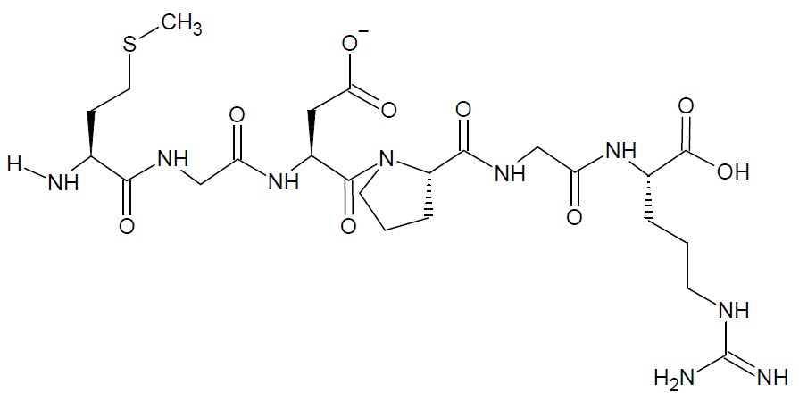
Summer Project: To Understand the Effect of Charge on Fragmentations of Biomolecules in the Gas Phase
Overarching Question: Would the same molecule with 1 less or 1 more proton, subjected to the same experimental conditions break down and fragments the same way?
- Neutral molecule (Parent) Model Peptide MGDPGR utilised: A peptide is a sequence of amino acids linked with a covalent bond (eg below)
If one proton is added-> MGDPGR+1H
If one proton is removed-> MGDPGR-1H

Slide 8
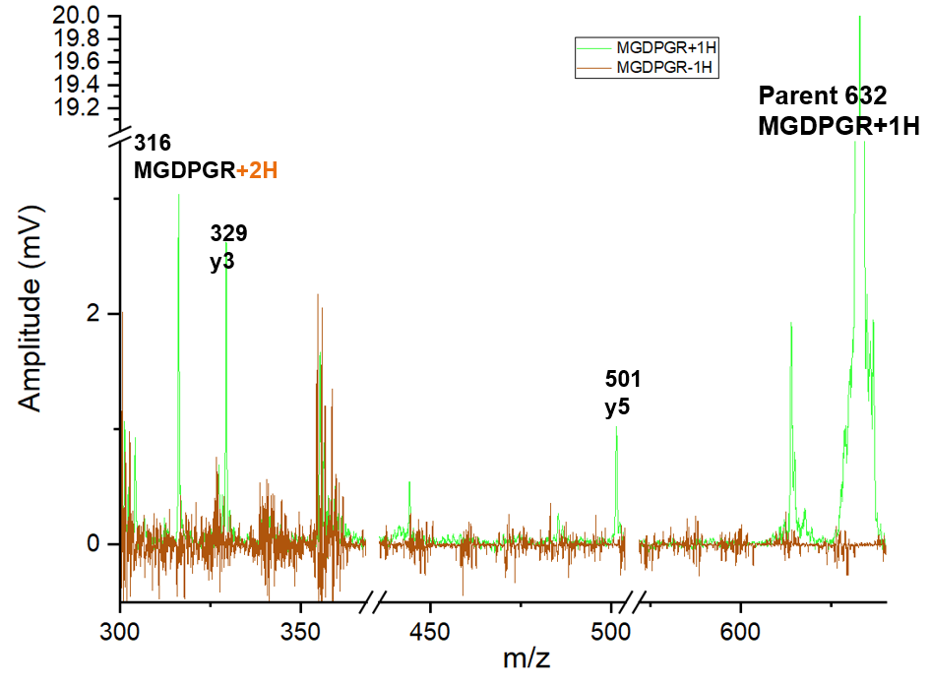
Results
- On the RHS we see the highest peak -> Parent of MGDPGR+1H (Parent of MGDPGR-1H not visible due to detector setup)
- Positive charge molecule has multiple visible peaks (No reliable fragments are seen for MGDPGR-1H)
[MGDPGR+1H]²⁺

Slide 9
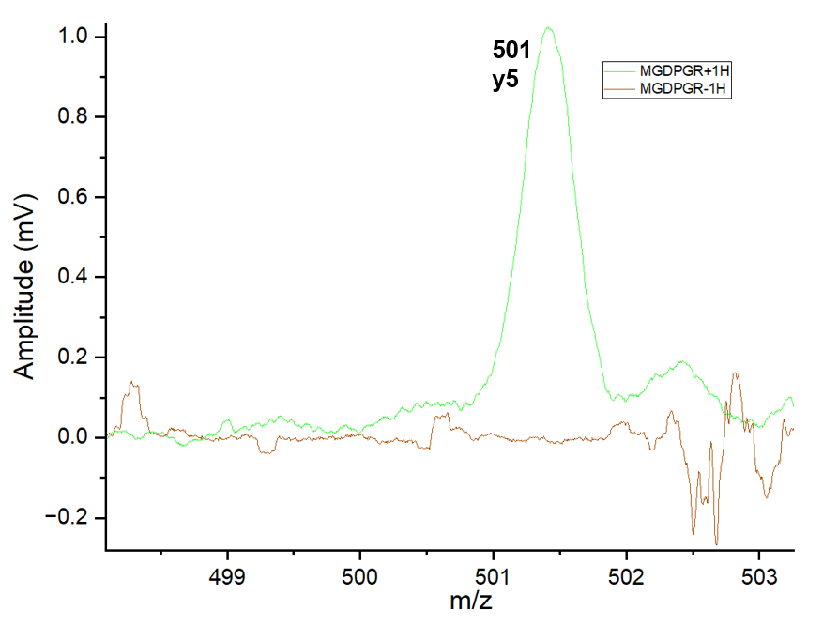
Results
Further example: Clear prominent fragment from
the breaking of MGDPGR+1H, with no fragments at all from MGDPGR-1H for this m/z region

Slide 10
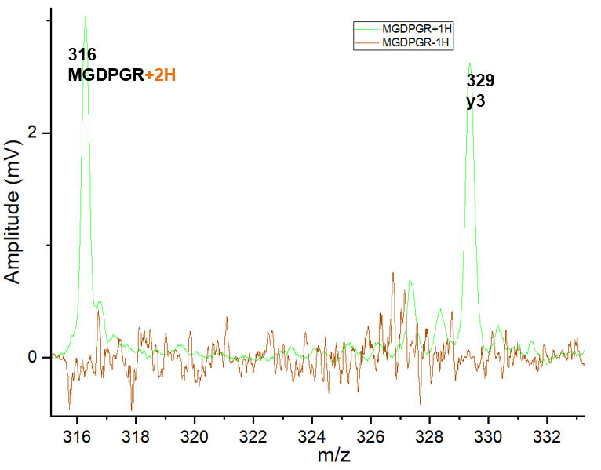
Concluding Discussion
Overarching Question (Revisited): Would the same molecule with 1 less or 1 more proton, subjected to the same experimental conditions break down and fragments the same way? NO, peptide of the same molecules but different charge state fragments in different ways
Why could this be the case? A hypothesis is impeded within the fundamental process of ionisation
When we ionise a molecule we remove an electron, and the molecule becomes more positive. Therefore:
MGDPGR-1H -> MGDPGR (neutral fragment, hence undetectable)
- MGDPGR+1H -> [MGDPGR+1H]²⁺ (charged and detectable)
[MGDPGR+1H]²⁺

Slide 11
Outlook
What is Next?
Another question to be investigated further is: Whether it is possible to remove two (or more) electrons from a negatively charged ion, such as for MGDPGR-1H to be transformed to MGDPGR+1H, giving rise to double ionization. So far, this was not witnessed during our current experiments
This project has the potential to be extended to molecules with higher charges, and upon their understanding we enhancing our understanding of the world around us!

Slide 12
A sincere thank you to all the people who made this summer internship possible: - Administrative and scientific staff - The professors for teaching - The summer students who made this a home away from home - The team at FS-BIG (Sadia, Lucas, Juliette, Bart, Aarathi, Laura and Carlos)

