Slide 1
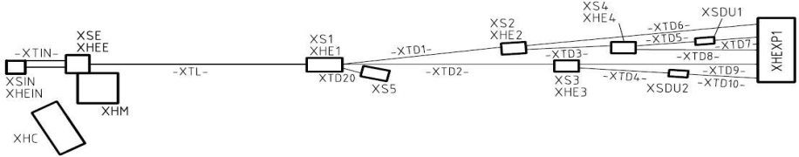
SASE Racks
Brandschutz / Hr. Hanstedt
Thermal Stabilisation
Not Aus
Lüfter
Positionen von Racks
Bessere 3D Bildern

Slide 2
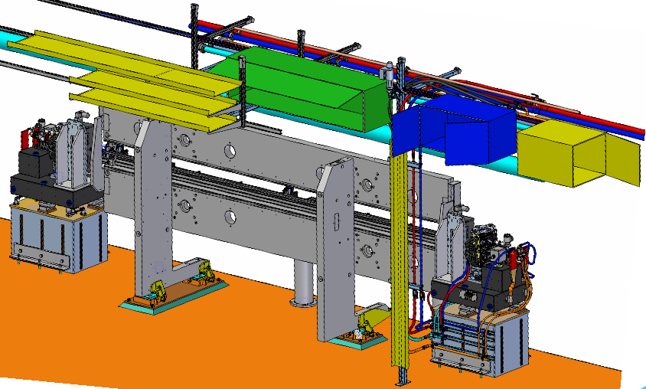
SASE Racks

Slide 3
SASE Racks
Undulator rack Intersection rack Machine rack
Diagnose: 2 Cabinets pro 4 Undulators
  (Temperature stability ~0.1 K)
Vacuum: 1 Cabinet pro 4 Undulators
Fire protection system
SASE 1: 33
SASE 2: 37
SASE 3: 21
24,4 m
6,1 m
Diagnostic
Vacuum
Diagnostic
Diagnostic
Vacuum
Diagnostic
Diagnostic
Vacuum
Diagnostic
IT

Slide 4

SASE 1
SASE 1: 33
SASE 2: 37
SASE 3: 21
SASE 1: 2212,94 m – 2420,94 m 208 m Ø 5,2 m
Diagnostic
Vacuum
Diagnostic
Diagnostic
Vacuum
Diagnostic
Diagnostic
Vacuum
Diagnostic
Diagnostic
Vacuum
Diagnostic
Diagnostic
Vacuum
Diagnostic
Diagnostic
Vacuum
Diagnostic
Diagnostic
Vacuum
Diagnostic
Diagnostic
Vacuum
Diagnostic
Diagnostic
33 Undulators
11 Racks with fire protection modules

Slide 5
SASE 2
SASE 1: 33
SASE 2: 37
SASE 3: 21
SASE 2: 2212,75 m – 2472,55 m 259.8 m Ø 5,2 m
Diagnostic
Vacuum
Diagnostic
Diagnostic
Vacuum
Diagnostic
Diagnostic
Vacuum
Diagnostic
Diagnostic
Vacuum
Diagnostic
Diagnostic
Vacuum
Diagnostic
Diagnostic
Vacuum
Diagnostic
Diagnostic
Vacuum
Diagnostic
Diagnostic
Vacuum
Diagnostic
Diagnostic
Vacuum
Diagnostic
Diagnostic
37 Undulators
13 Racks with fire protection modules

Slide 6
SASE 3
SASE 1: 33
SASE 2: 37
SASE 3: 21
SASE 3: 2787,73 m – 2943,68 m 155,95 m Ø 4,5 m
Diagnostic
Vacuum
Diagnostic
Diagnostic
Vacuum
Diagnostic
Diagnostic
Vacuum
Diagnostic
Diagnostic
Vacuum
Diagnostic
Diagnostic
Vacuum
Diagnostic
Diagnostic
21 Undulators
7 Racks with fire protection modules

Slide 7
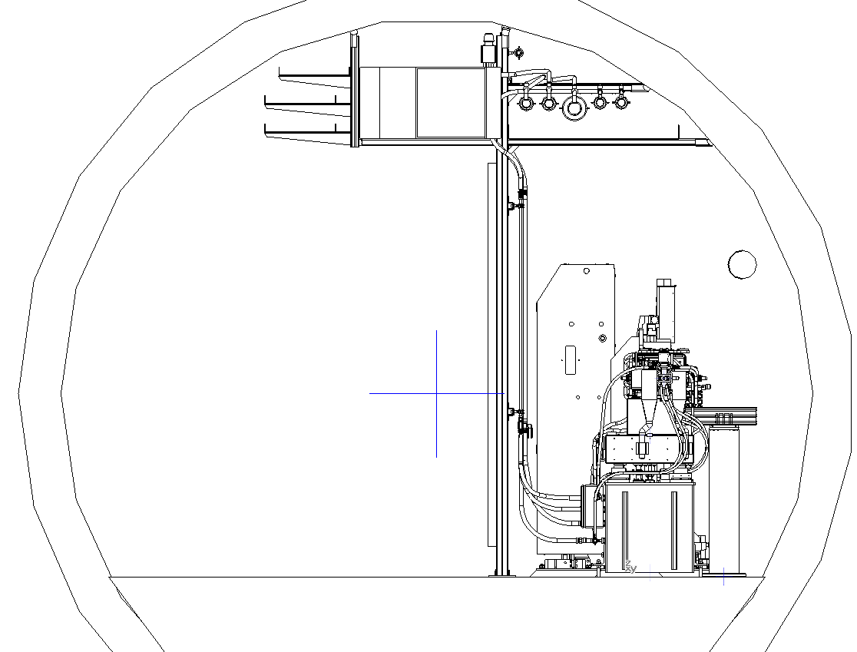


SASE Racks
„The doors is equipped with open/close sensors. One sensor is to switch on the lighting inside the rack and the other one is to disable the fire-extinguishing system when the door is open.”
„Each rack is equipped with 32A, 3 phases “Emergency Main Switch”…
The emergency switch must be secured with a lock in case it is switch off. It is necessary to avoid accidental power-on during the maintenance in the rack.”

Slide 8
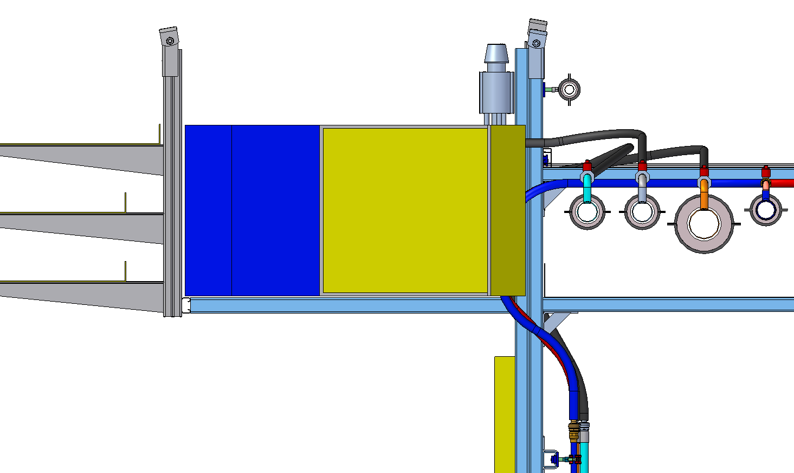
SASE Racks
001
2160,79 m - 2212,75 m (T1)
The racks are no longer fixed on the ceiling (needs special fixation plates in the racks = expensive)
The racks are located on an anchor bar, which are connected to the water and energy supports
undulator rack : 2000mm x 500mm x 500mm
intersection rack : 1000mm x 500mm x 500mm
machine rack : 800mm x 600mm x 500mm

Slide 9
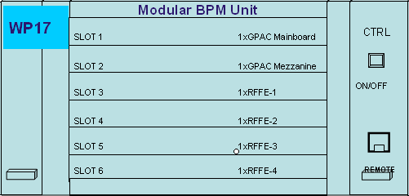
SASE Racks
No shielding
Cooling by the use of tunnel air
Requirements for the temperature stability of the tunnel air are 0.1 K but …
800 mm
400 mm
5 RU
500 mm
Place required for:
Fire detection System ……… 1 RU
BPM Unit ……………………. 6 RU
Machine Control ……………..7 RU
Patch panels …………………2 RU
___________
16 RU (~ 70 cm)
10-11 RU (?)
Machine rack : 800mm x 600mm x 500mm

Slide 10
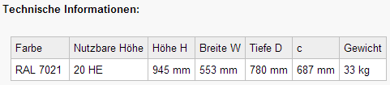
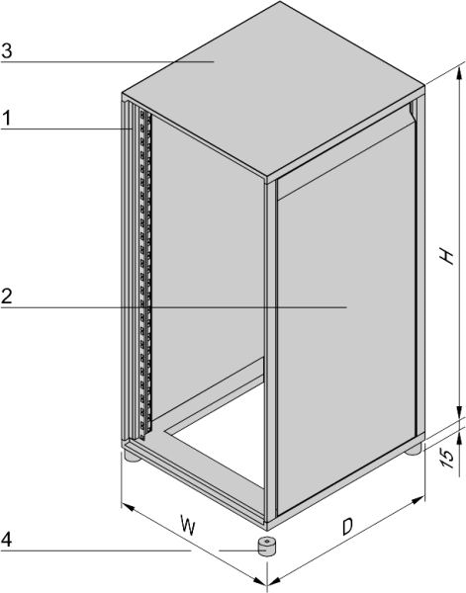

SASE Racks
Schroff 10230-202
800 mm
1000 mm
WP28
Accelerator Control System
Diagnose - 6 RU
Lüftern - 1 RU
Diagnose - 6 RU
Brandschutz - 1 RU
AC - 7 RU
Nicht besetzt - 2 RU
Lüftern - 1 RU

Slide 11
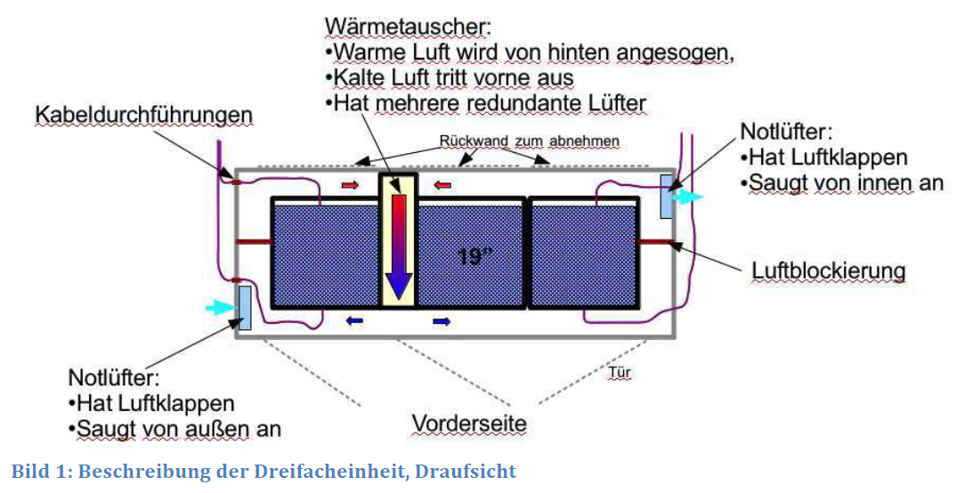
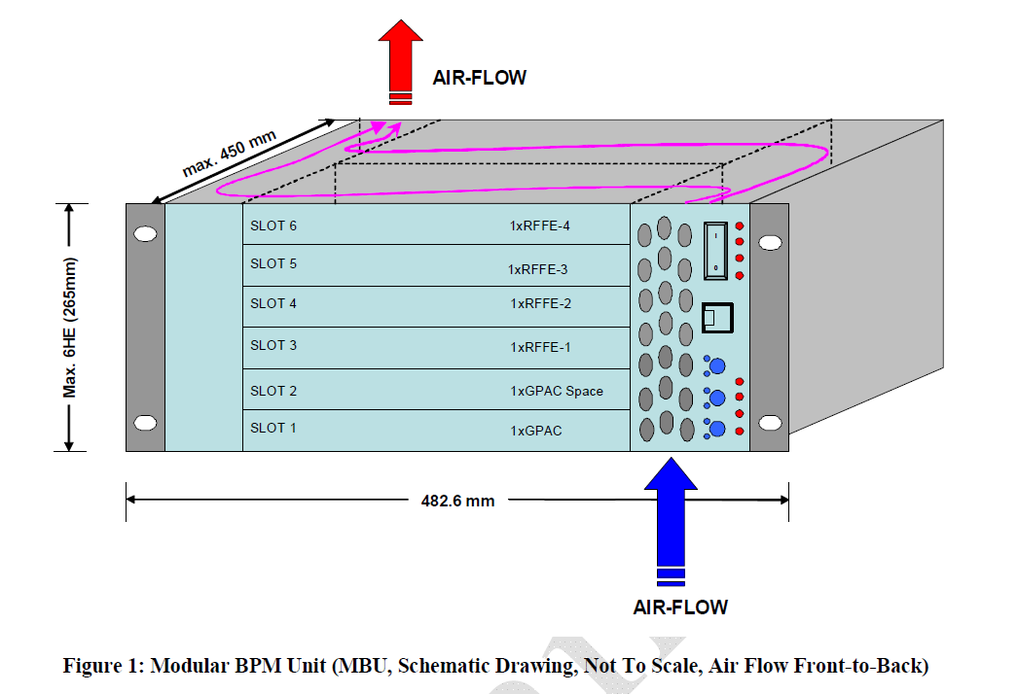
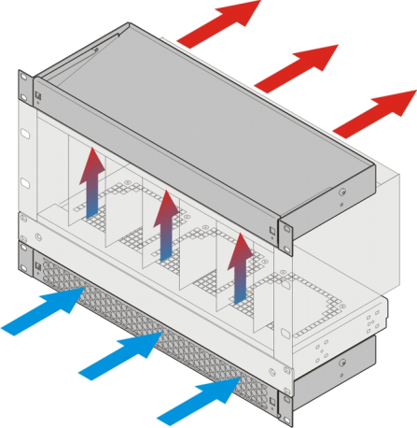

Slide 12
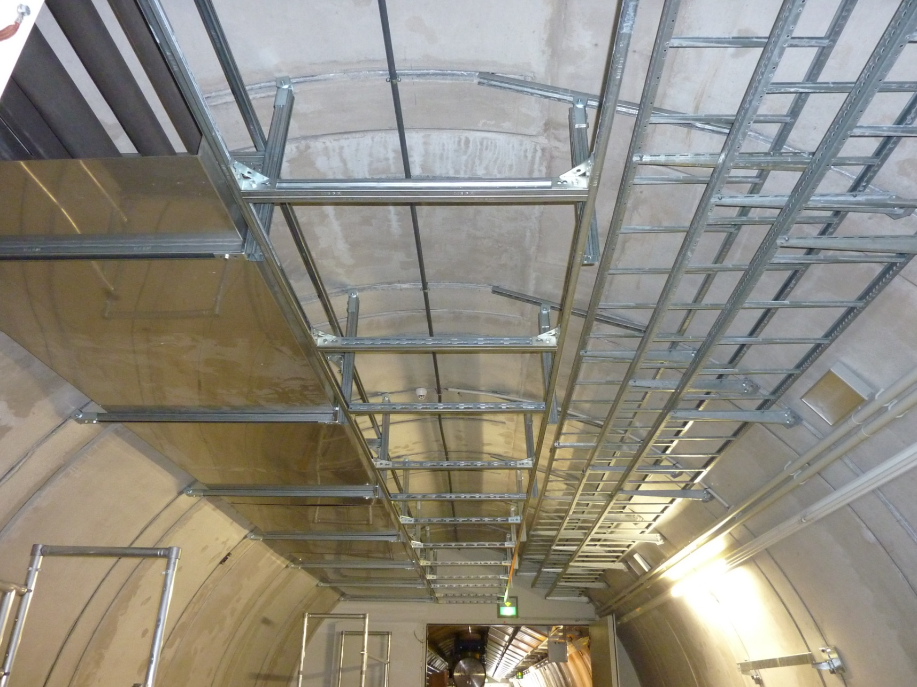

Slide 13



Thank You !

