Slide 1
Future Collider News.
Subtitle of Presentation
Benno List
FC@DESY Meeting 7.7.23

Slide 2
Workshop Dates
July 11/12 2nd Reconstruction WS upcoming, several contributions from DESY: https://indico.cern.ch/event/1283129
July 15 deadline for ECFA workshop in October https://indico.cern.ch/event/1283859/ :
abstract submission
Key4Hep tutorial registration
See https://indico.cern.ch/category/14055/
July 11: Open Lab Director Group meeting: https://agenda.infn.it/event/35700/
July 12: ECFA Plenary https://indico.cern.ch/event/1292031/
Open Physics Meeting July 13 https://agenda.linearcollider.org/event/10069/
EAJADE Workshop: Sustainability in Future Accelerators https://sites.google.com/huhep.org/wsfa2023/home / https://indico.desy.de/event/39980/

Slide 3
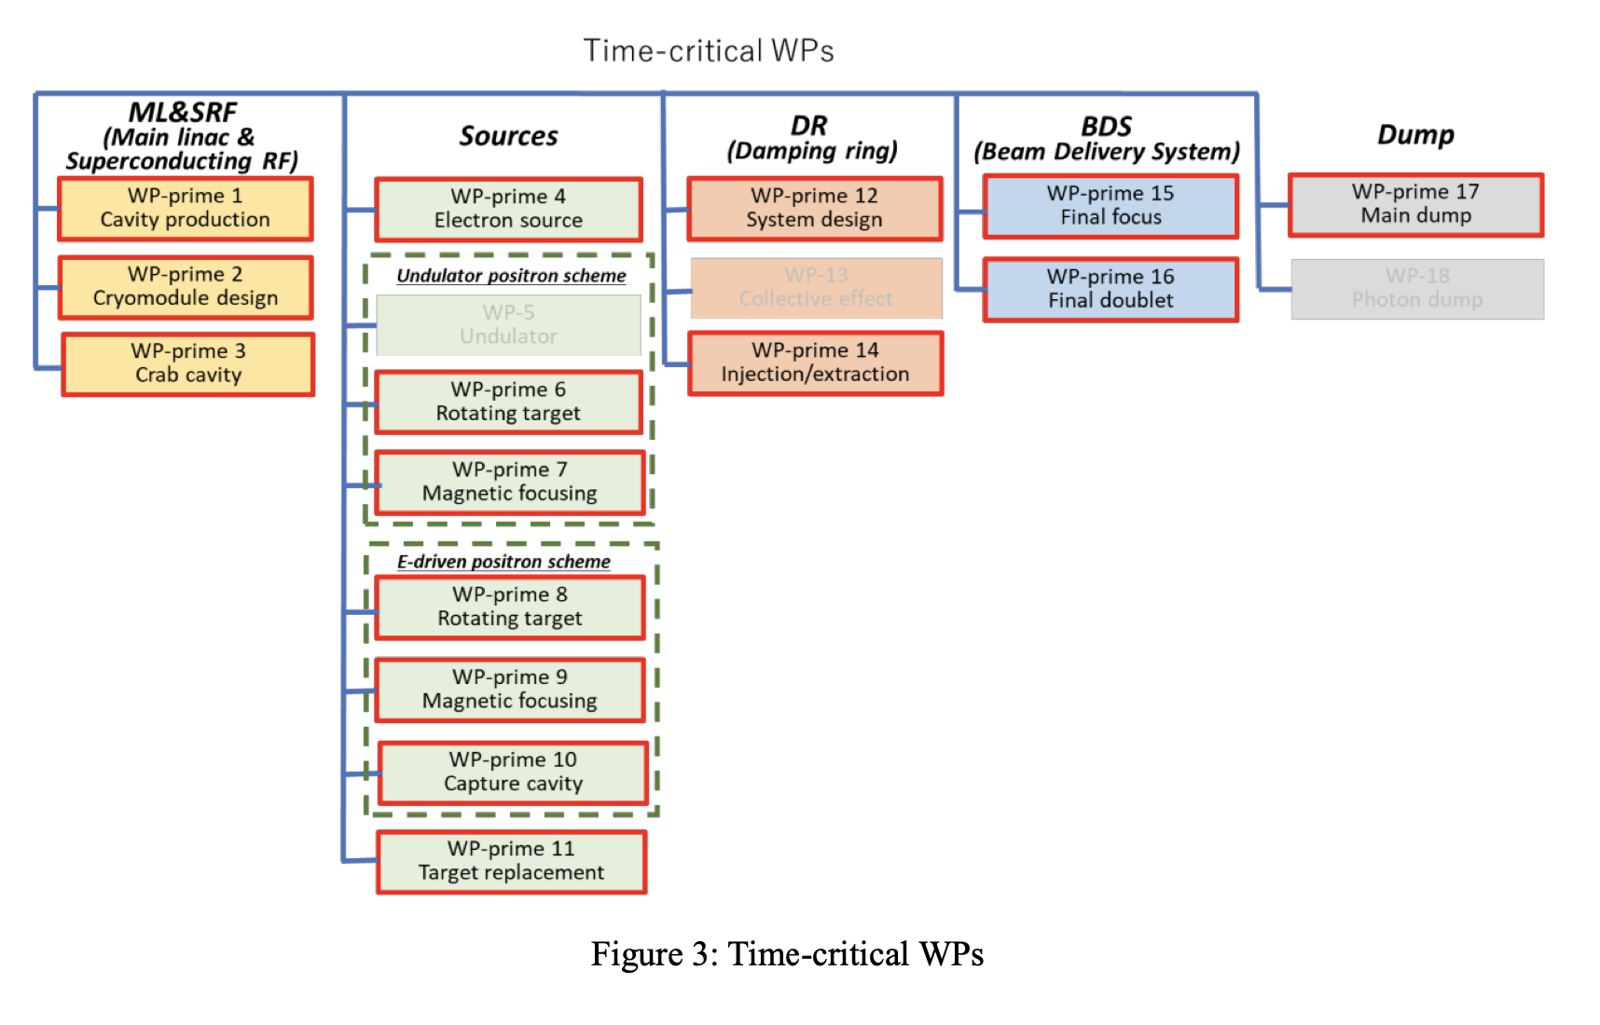
ITN Framework Signing
Today: Signing of ITN Agreement between CERN and KEK
For list of Work Packages, see https://agenda.linearcollider.org/event/9649/attachments/38003/60567/Time-Critical_WPsV8b.pdf

