Slide 1
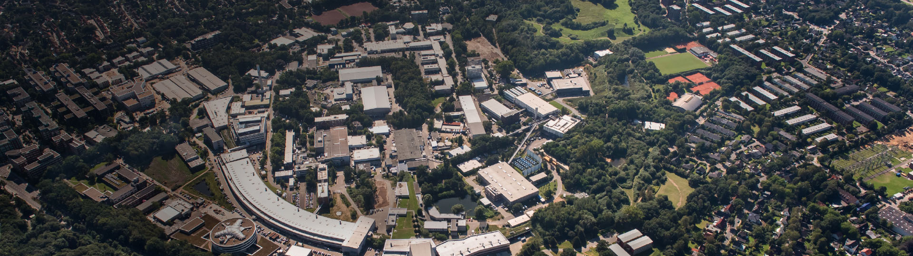

DESY Summer Student Program 2023: Welcome Session
Introduction to the Program
Olaf Behnke, Carolin Leao Grötzinger, Friederike Januschek, Ute Micheelsen, Britta Niemann, Andreas Przystawik, Andrea Schrader, Nicholas Styles
DESY Hamburg, 18.7.2023

Slide 2
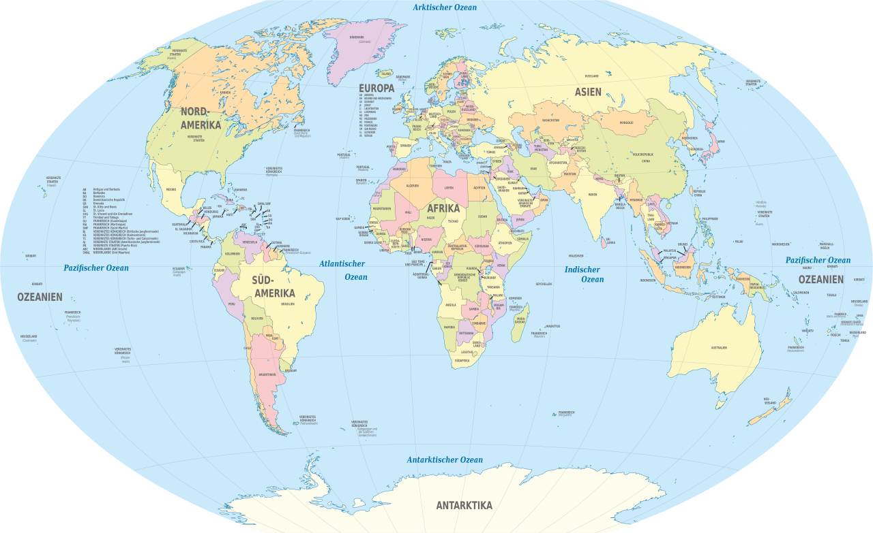
Welcome!
Diversity is our strength!
63 Summer students at DESY Hamburg come from 23 Nations :
  Austria (AT): 1
  Canada (CA): 1;
  China (CN): 2
  Cuba (CU): 1
  Czech Republic (CZ): 1
  Germany (DE): 8
  Egypt (EG): 1
  Spain (ES): 6
  United Kingdom (GB): 1
  Ghana (GH): 1
  Israel (IL): 1
  India (IN): 2
  Italy (IT): 21
  Japan (JP): 1
  Nigeria (NG): 1
  Netherlands (NL): 1
  New Zealand (NZ): 1
  Poland (PL): 3
  Russia (RU): 1
  Sweden (SE): 2
  Slovakia (SK): 1
  Thailand (TH): 4
  Turkey (TR): 2
  United States of America (US): 2

Slide 3
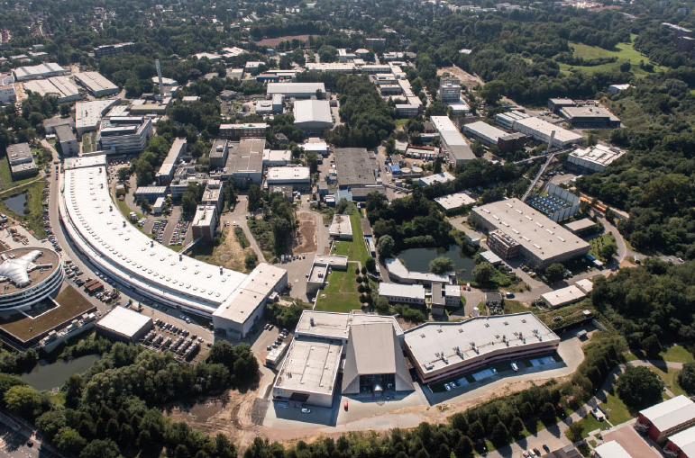
Deutsches Elektronen-Synchrotron DESY
A research centre of the Helmholtz Association
A publicly funded national research centre
Established in Hamburg on 18 December 1959
Locations: Hamburg and Zeuthen (Brandenburg)
Base budget: 349 million euros
Employees: approximately 3000, including 1300 scientists
Guest scientists: more than 3000 from over 40 countries each year
Young scientists: approximately 500 doctoral candidates and postdocs, a number of master students

Slide 4
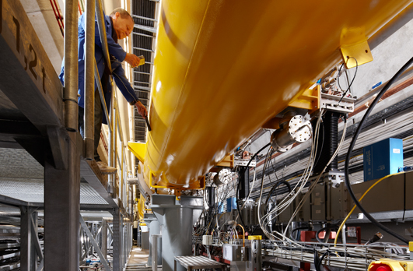

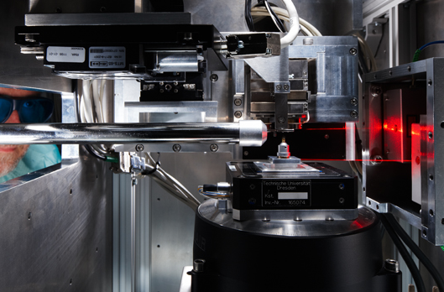


Research at DESY
DESY research is extremely diverse, research divisions are:
  High Energy/Particle Physics
  Photon Science
  Accelerators
  Astroparticle Physics
Key to research at DESY are also its large-scale infrastuctures
  PETRA III ➔PETRA IV
  FLASH
  European XFEL
  IDAF

Slide 5
DESY and XFEL Tours
Please register and learn more!
DESY Tours: July 24th and 25th; 2-4 pm, 30 students each
  A footwalk tour is organised around the DESY site, at the meeting point you will be split into two groups. The tour comprises visits of the HERA hall west, PETRA III etc.
  https://indico.desy.de/event/40247/
  https://indico.desy.de/event/40248/
  meeting point: Foyer of Building 1
  please register until Friday!
XFEL Tour: August 14th, 9am -1 pm
  We will do a tour of the XFEL experimental site in Schenefeld. The tour includes an introductory talk and a visit to the experiments.
  https://indico.desy.de/event/40492/

Slide 6
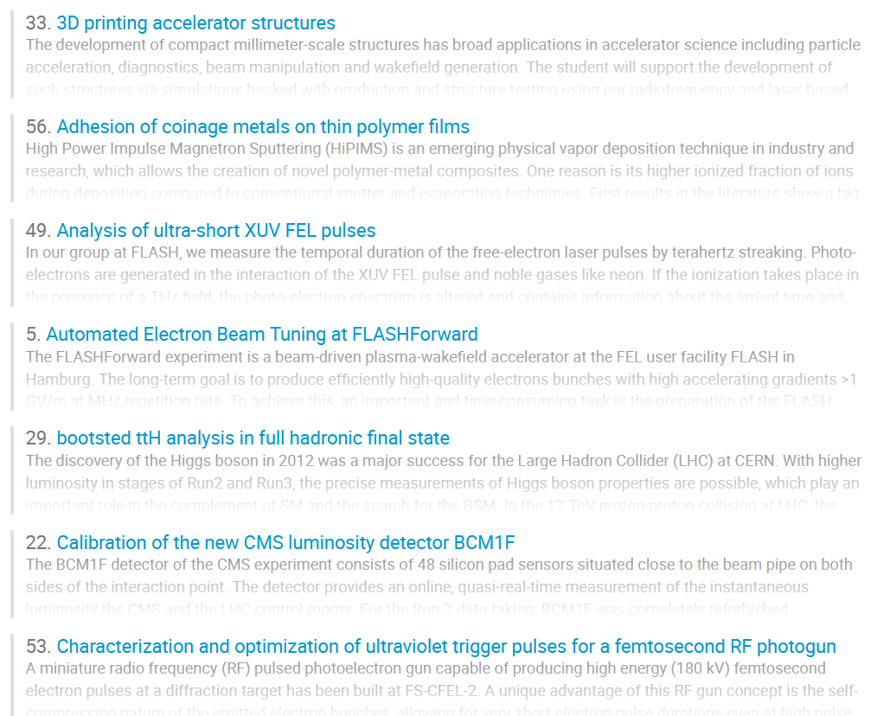
Research Projects
Solid-state physics and nanoscience
Astroparticle physics analysis and observations
Soft-matter sciences
Computing
Instrumentation for Astroparticle Physics
Program A: Photon Science
Program B: Research in Elementary Particle Experiments, Accelerators, Theory of experimental particles and Computing, Experiments in Elementary Particle Physics
Program C: Research in Astroparticle Physics
Physics analysis (software-oriented)
Research on Accelerators
Theory of Astroparticle Physics
Lasers and optics
Theory and computing
Theory of Elementary Particles
Development of experimental techniques
Data processing (software-oriented)
Molecular sciences
Development of experimental equipment (hardware-oriented)

Slide 7
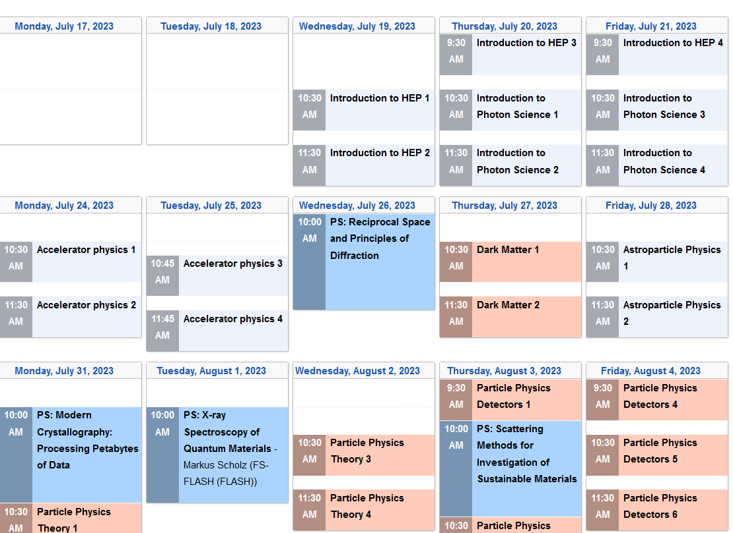
Lecture Program
Please attend!
The lecture program consists of lectures providing introductions and overviews on selected key topics of DESY research in Particle and Astro-Particle Physics, Photon Science, as well as in Accelerators. The lectures cover both experimental and theory aspects.
https://indico.desy.de/event/39610/
Please check Indico for changes of time and venue.
Everybody should attend all common lectures and the respective lectures for Program A or B.

Slide 8
Your work at DESY
Your weekly working time of 39 hours will be a combination of the lecture time, the work on your work project and other things like group meetings etc
All students should have the chance to present their project work and results at least at once to their DESY group (e.g. towards the end of the project)
Everybody is expected to write a report on their project (about 10 pages) at the end of the program
General recommendation for project work: don’t be shy, be pro-active and don’t hesitate to ask your supervisors questions and give feedback!
Summer Student Session: https://indico.desy.de/event/40249/ with presentations from some of you:
  Wednesday Sep 6 - Thursday Sep 7, 09:45 - 12:30, Main Auditorium Bld. 5

Slide 9
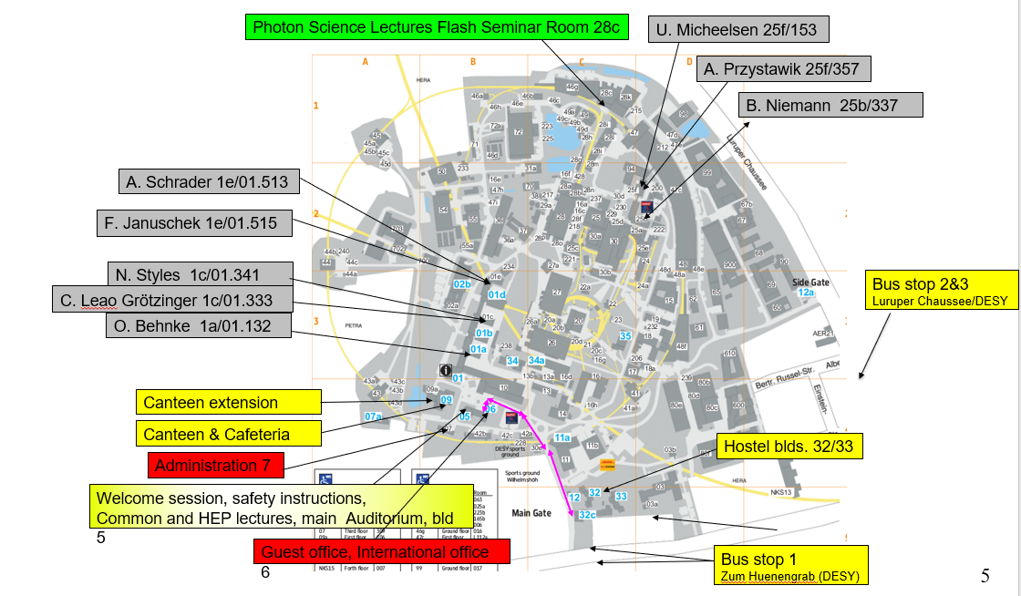
Places you should know
For reference

Slide 10
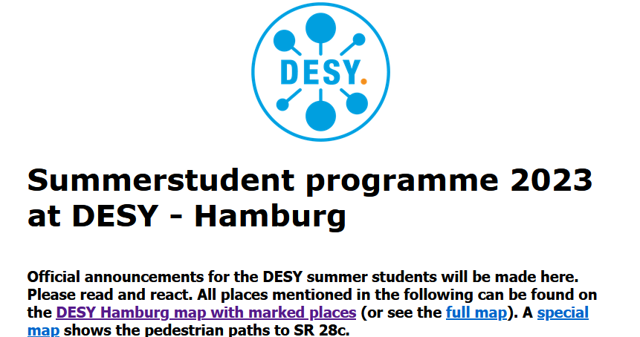
Places you should know
For reference
https://www.desy.de/f/students/summer_home_2023.html

Slide 11
People you should know
Your supervisors and group
After this meeting, you will meet your supervisors, who will support you with your project work, but also with some more general issues
The supervisors will be your main point of contact – do not hesitate to ask them questions!
Work project technical support: All support is provided locally by the project supervisors and their respective DESY groups, system administrators, etc. ➔ You will be integrated in the DESY groups like normal researchers, for work related questions ask your supervisors or group secretaries!
Unless you have arranged differently your supervisor will fetch you around 11h00 near the DESY auditorium. Probably they will take you to lunch at the DESY canteen. Your supervisor will introduce you to their group, will show you your work place/office and is responsible for all work matters in their group.

Slide 12
People you should know
The Program Organising Team
We are a group of people from the particle physics department (B projects) and photon science department (A projects) of DESY
Particle Physics: Olaf Behnke, Carolin Grötzinger, Friederike Januschek, Andrea Schrader, Nicholas Styles
Photon Science: Ute Micheelsen, Britta Niemann, Andreas Przystawik
Please contact us in case of any program-related issues, administrative or general
Write an email to: summie-org@desy.de

Slide 13
Welcome session
https://indico.desy.de/event/40320/
10:00-10:10 Gathering in the Foyer
10:10-10:40 Welcome Talk in the Lecture Hall
10:40- ca.11:00 Handling of administrative procedures in the Foyer
  General check-in (if you have not yet done it) and get your welcome bag (all)
  Personnel Department (all)
  International office (all non-German citizen)
  Travel Reimbursement: Please hand in the travel reimbursement sheet here or at the DESY travel department: C. Tornau, bld 7/405. We recommend to do that within few days after the program starts. For questions ask here or write to christina.tornau@desy.de afterwards
11:00-11:30 Students meet their supervisors in front of the auditorium/in the Foyer
14:30 for B students (HEP): General Safety instructions in the auditorium (for Photon Science students will be arranged for separately)
Right now ongoing
Right now ongoing
Be back here! Sign form!

Slide 14
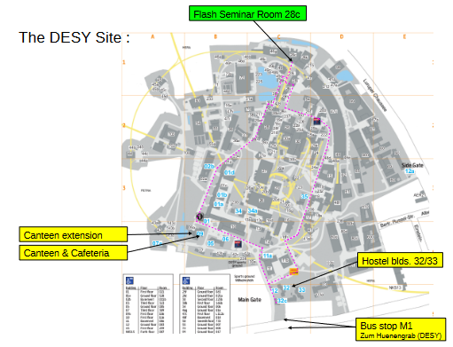
Welcome Coffee & Cake
Please join us for a Welcome Coffee and Cake today at 4 pm in the FLASH Seminar Room, building 28c
Map available from the Webpage: https://www.desy.de/f/students/2023/map_terascale_stat_23.pdf
Great opportunity to meet the other Summies and ask questions to the organisers!

Slide 15

Welcome Dinner
Friday 28 July, 18:00 - 22:00, Flash SR 28c:
Welcome Dinner with buffet and drinks. The summer students from Zeuthen will join us.
Welcome Dinner

Slide 16
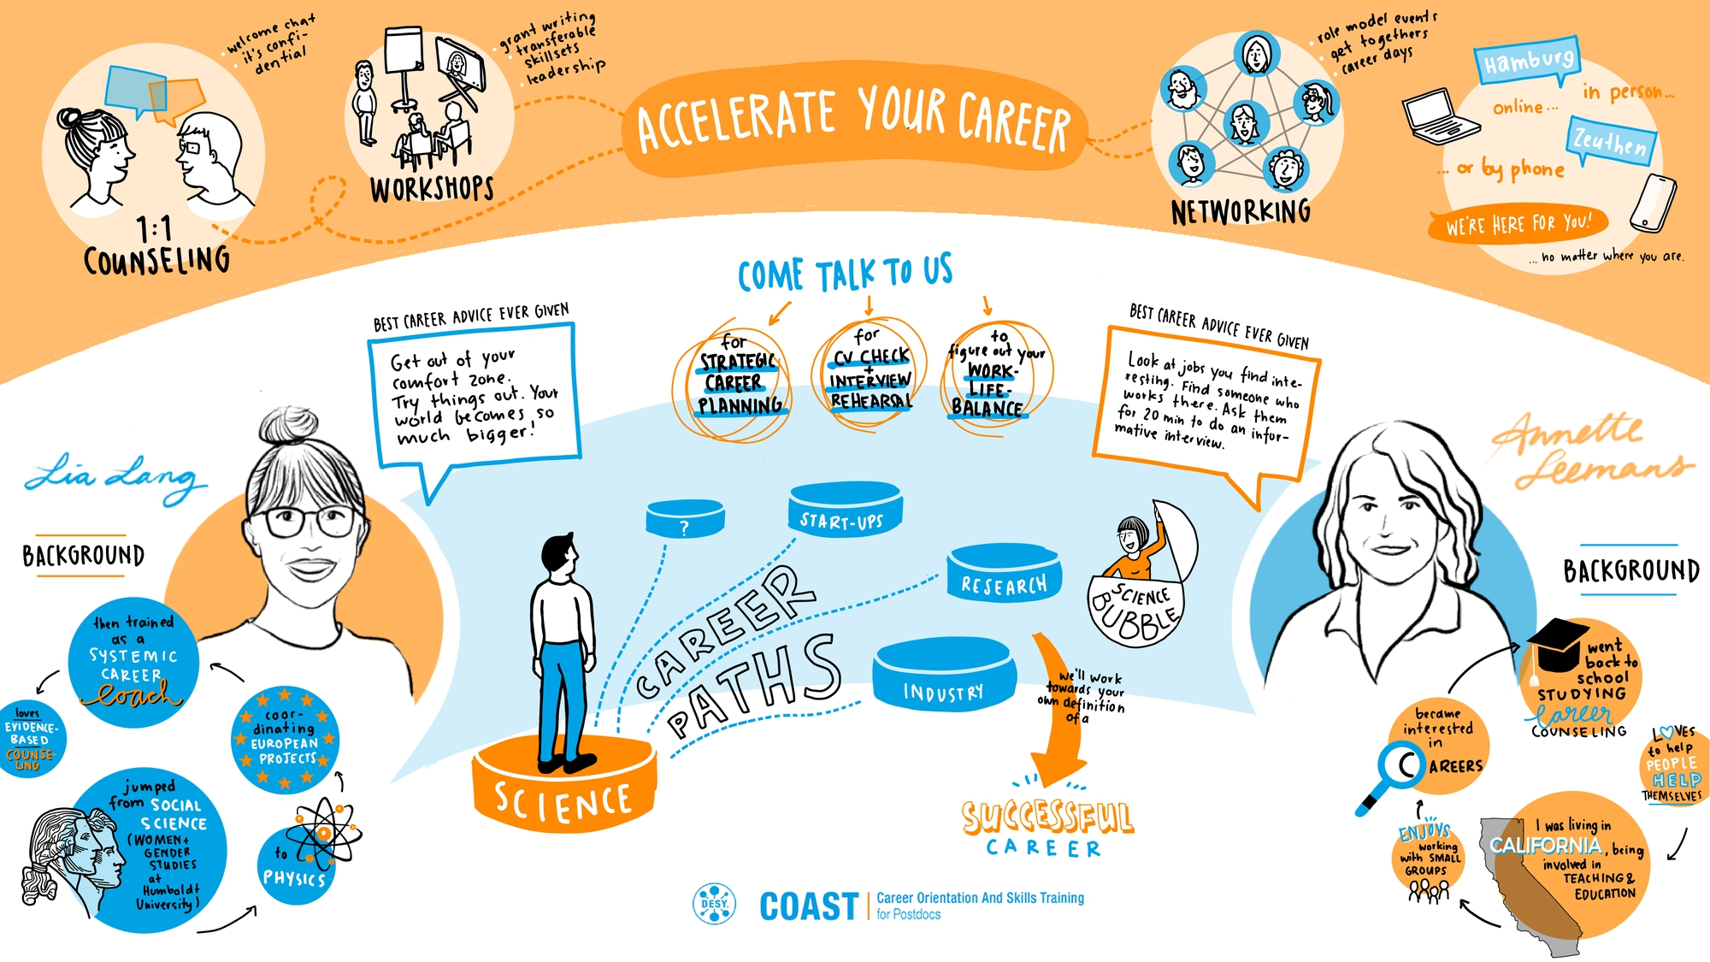
Career Workshop: Create a Career That Fits
Tuesday August 8th , 14:00-16:30
https://indico.desy.de/event/40256/
Aims:
  Create awareness on strategic career planning
  Reflect on your own expertise and values
  Use tools to help yourself
  Know the power of peer/horizontal networks
  Have fun!
No preparation needed. Please sign up if you know you can attend the complete workshop.
Registration will be open/available on this page from july 26 - Aug 4

Slide 17
Miscellaneous
Practical information on the DESY campus ➔ DESY booklet https://welcome-services.desy.de/sites2009/site_guest-services/content/e56138/DESY-Welcome-Booklet-2022_eng.pdf
A photo of the summer students will be taken after the first lecture.
WLAN: Science Hotspot or Eduroam and DESY (for DESY devices)
Hostel: Missing equipment (kitchen, cleaning, etc.) or other requests/complaints ➔ don’t hesitate to email hostel.service@desy.de (or visit them in their office 06/118)
DESY salary payment end of August and in September: hostel accommodation costs are deduced so total amount of paid out money may appear to be not so high
Sickness: In case you get sick and cannot work, please inform your group assistant and supervisor.
Drinking water: in Germany you can drink the water from the tab, it has highest purity, better than mineral water, no need to boil it

Slide 18
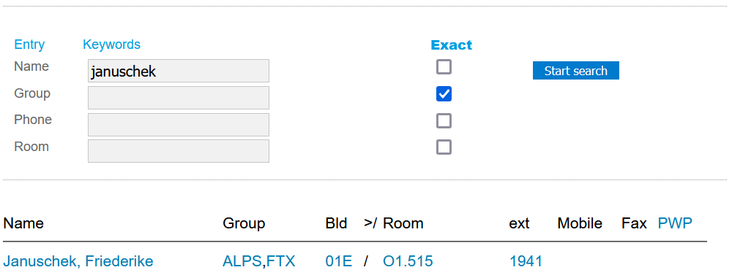
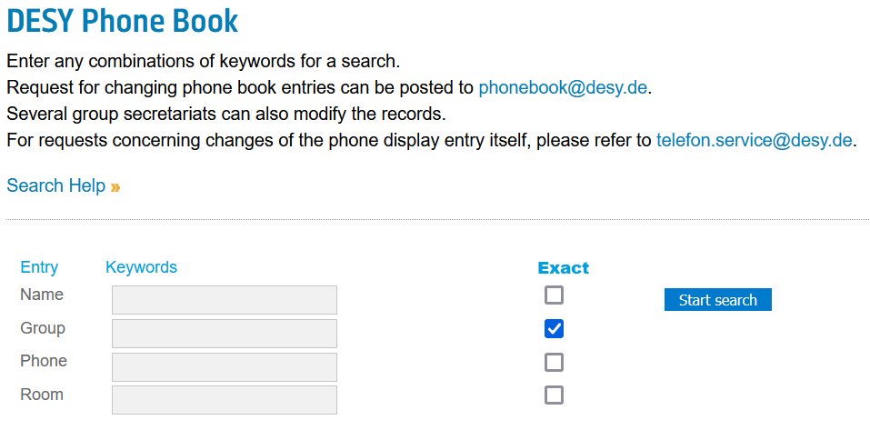
Communication
Summie Internal and Self-Organised:
  WhatsApp: https://chat.whatsapp.com/B7dvb3sFO1Y01Q99vAAc2d
  DISCORD: https://discord.gg/U7RFa5Uvw2
With us:
  Email Summie-org@desy.de
  https://www.desy.de/f/students/summer_home_2023.html
  https://summerstudents.desy.de/hamburg/
DESY Phonebook:
https://www.desy.de/pbook?lang=eng
Four digits when calling internal
0+number, when external
Might need to call 11 for international call

Slide 19
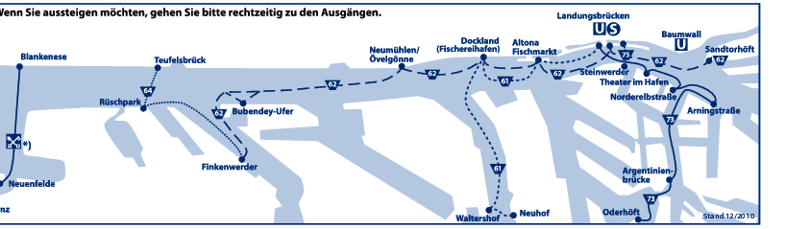
Public Transport
Bikes: at DESY there are Stadtrad stations http://stadtrad.hamburg.de
"Deutschlandticket“: includes not only the public transport in all Germany, but also regional trains (all trains execept InterCity [IC], EuroCity [EC], or InterCity-Express [ICE]) for 49€ per month (full calendar month!). Subscription only. All further information can be found here.
Alternatives within Hamburg are single trip tickets (3.60€), 9am day tickets (valid for any number of trips the whole day between 9am and 6am the next day, 7.10€), 9am group tickets (valid for up to 5 persons, 13.40€), or week tickets (29€ per week).
Discover Hamburg with a boat – take ferry line 62, you can use standard public transport tickets
Deutschland Ticket
Information about the Hamburg public transport (HVV) ➔ see also Welcome bag

Slide 20
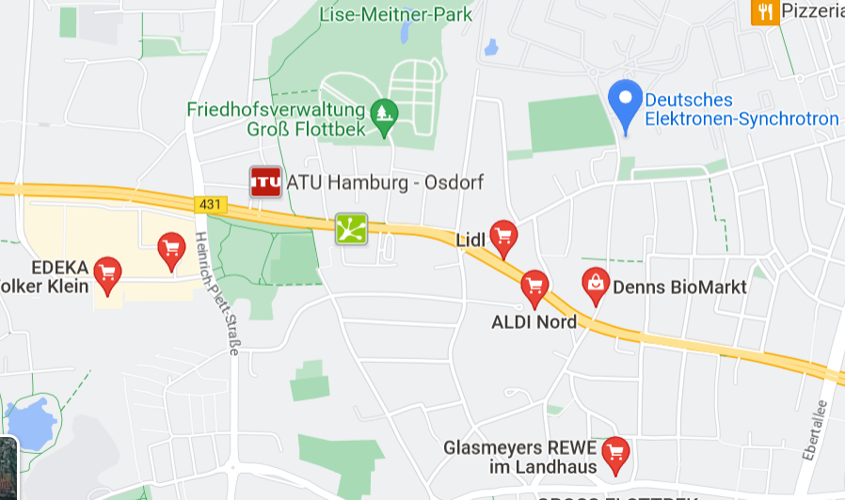
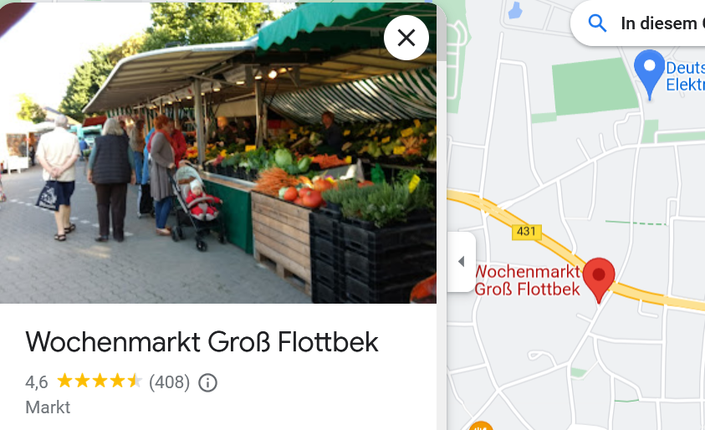
Shopping
Supermarkets and Shopping Centers
Several supermarkets in the vicinity: General shop opening hours:
  Mo-Sa ~07-2x, x=0-3 Su only few convenience stores opened e.g. in Altona railway station
Weekly market: we + sa 08-13 ➔ fresh products (more expensive)
Nearest shopping center: Elbe Einkaufszentrum
Many shops at and around Altona station

Slide 21
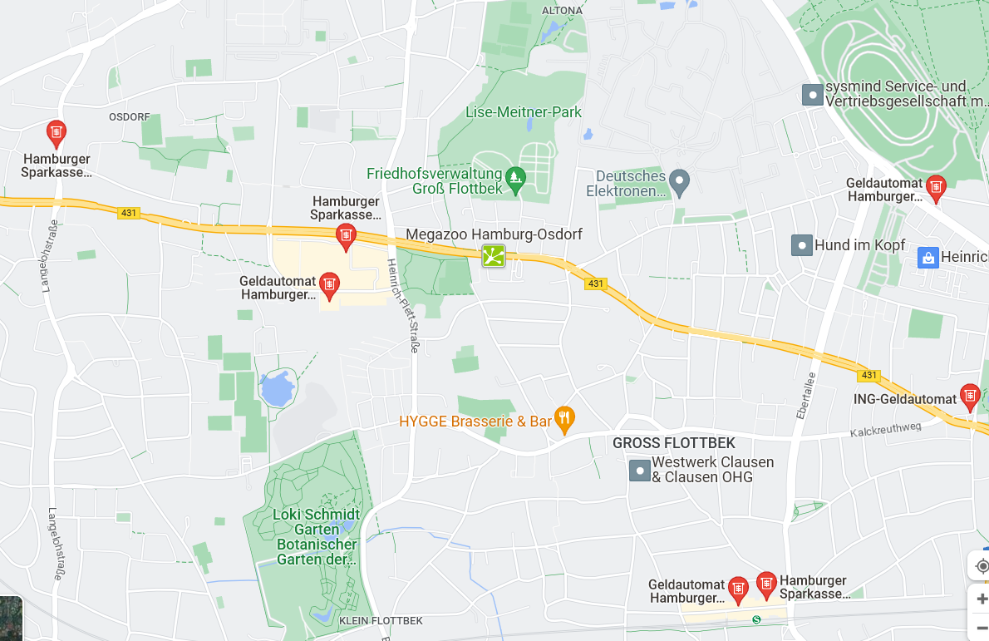
ATMs (selection)/Cash Check
To cash your cash check:
Haspa Bank at Elbe-Einkaufszentrum:
Mo.-Fr. 10.00-18.00 Uhr
SA. 10.00-16.00 Uhr
Lunch break 13.00-14.00 Uhr
E-Mail: haspa@haspa.de
http://www.haspa.de
+49-40-3579-7799

Slide 22
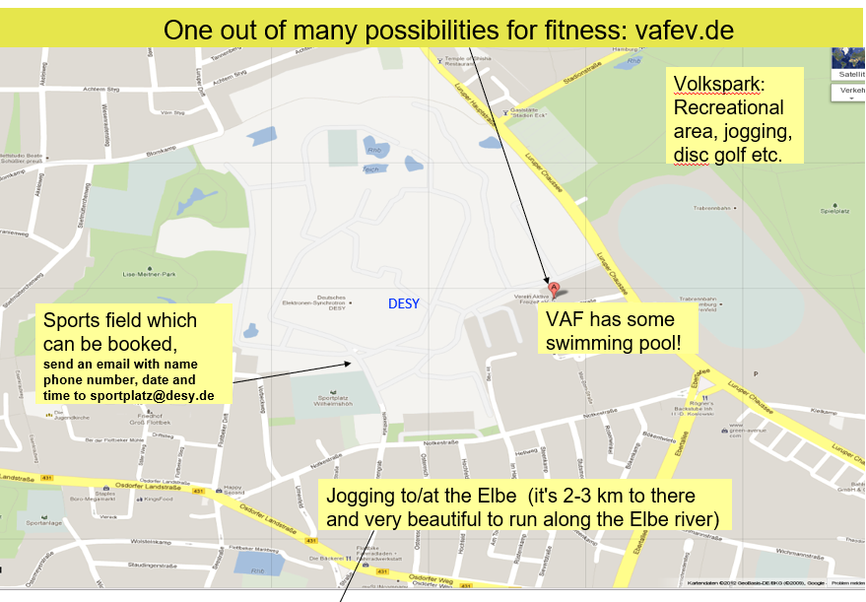
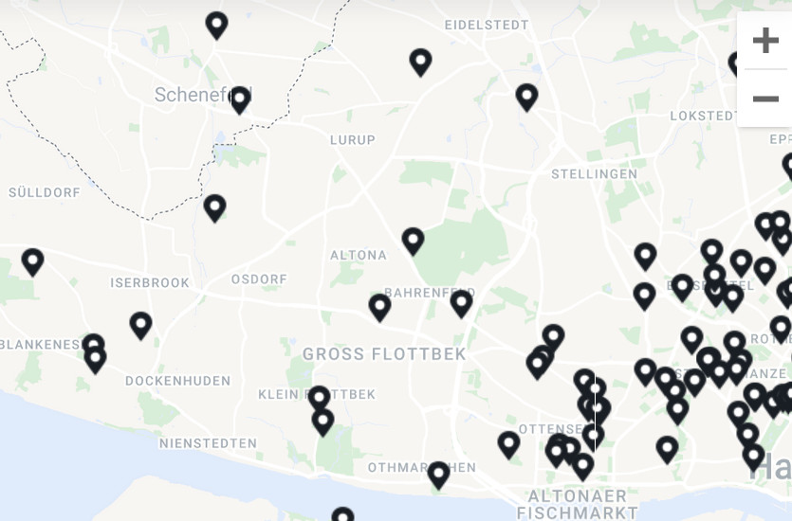
Sports
Many sports possibilities at DESY and beyond: e.g. VAF, but also many options e.g. with urbansportsclub
Swimming pools: see www.baederland.de
VAF special offer until end of July:
Studio summer promotion: first sweat, then jump into the refreshing water! Until July 31, 2023, newcomers train for one month for only 55,- Euro. The offer also includes swimming & sauna. For 11 euros, the gym subscription with 60 different sports and health courses can be booked. The action is available for booking in the studio directly. The month starts counting from your first day of booking as long as it lies before 31 July! ➔ www.vafev.de

Slide 23
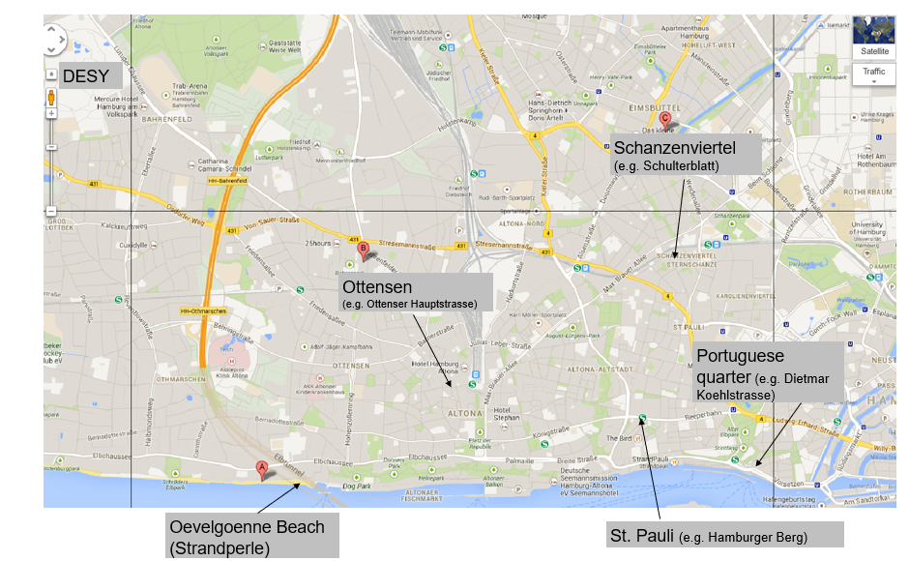
Cool Places ➔ also ask your colleagues

Slide 24
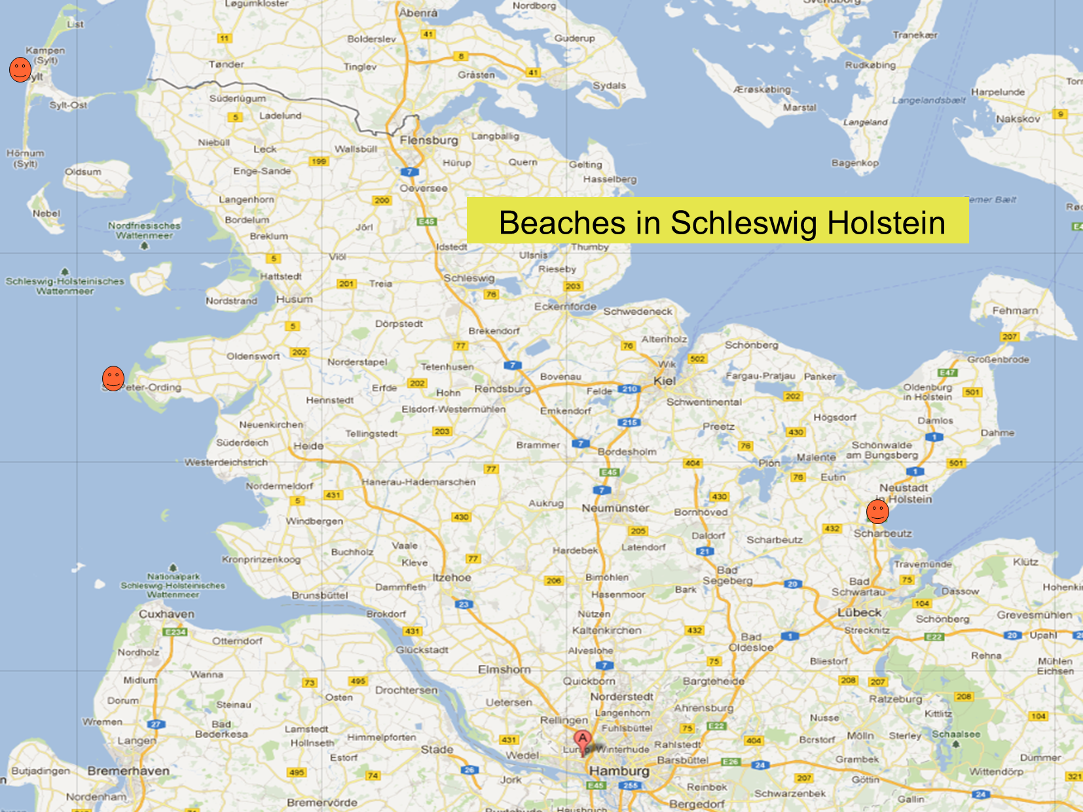
Cool Places
Beaches

Slide 25
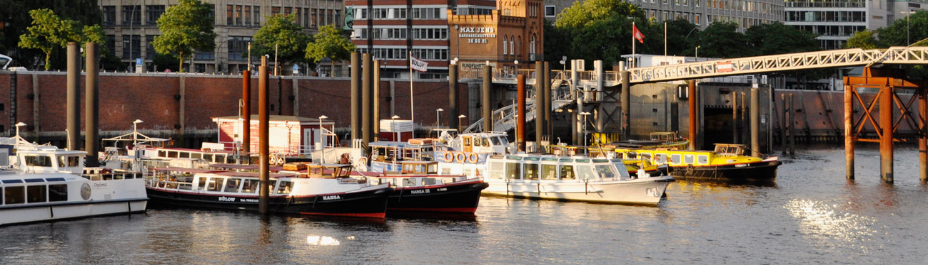
Sightseeing - Harbour Boat Trip
We will do a special two hours harbour round trip with a 'Barkasse' ship, where you will learn about the Hamburg harbour history, working place and globalisation and will see many interesting parts of the harbour and ships.
More information at: https://indico.desy.de/event/40250/
Cost will be about 5,- Euros per person. Registration is closed. The starting point of the tour in the harbour can be found here

Slide 26
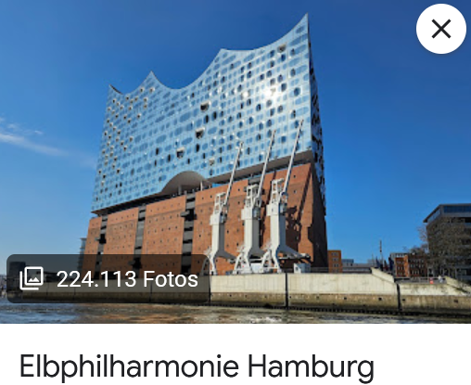
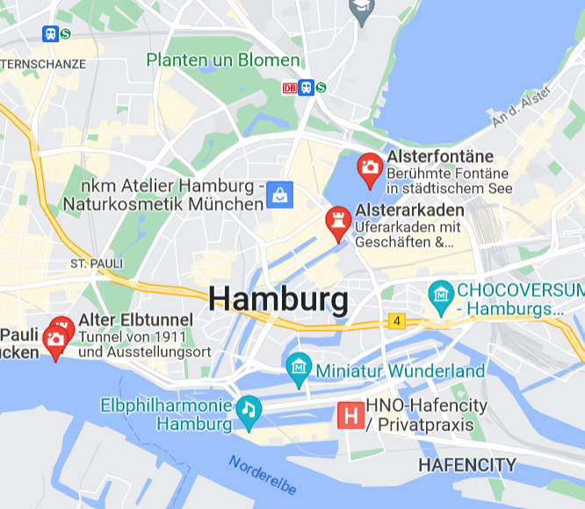
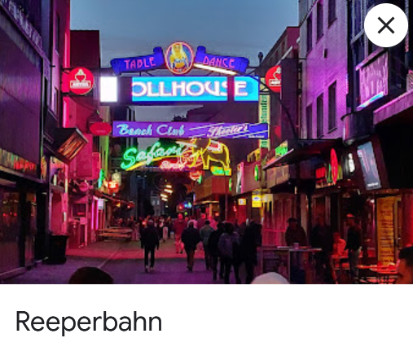
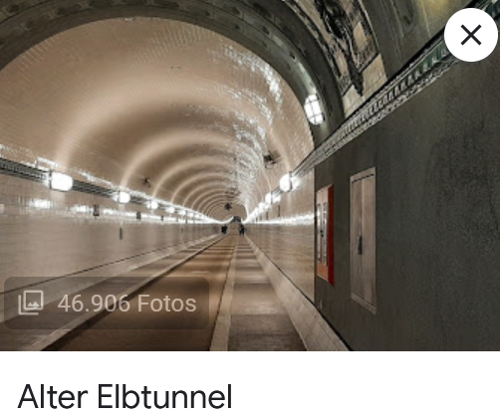
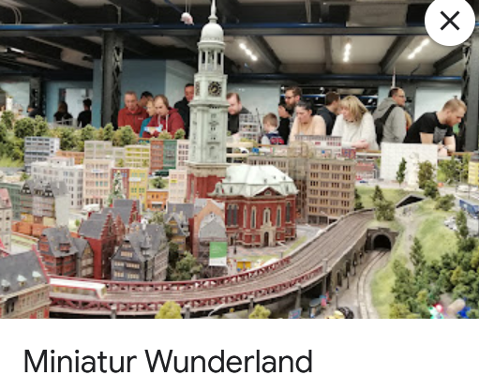
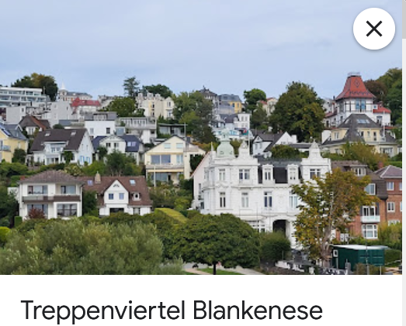
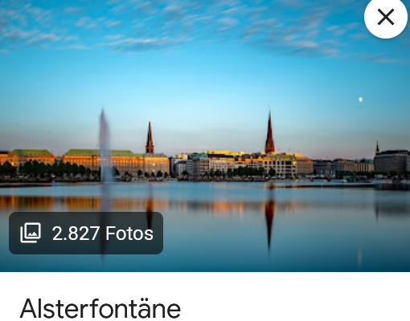
Sightseeing
Harbour
Alster
Elbphilharmonie
Elbe
Reeperbahn
Michel
Alter Elbtunnel
Miniaturwunderland
Treppenviertel Blankenese
….

Slide 27
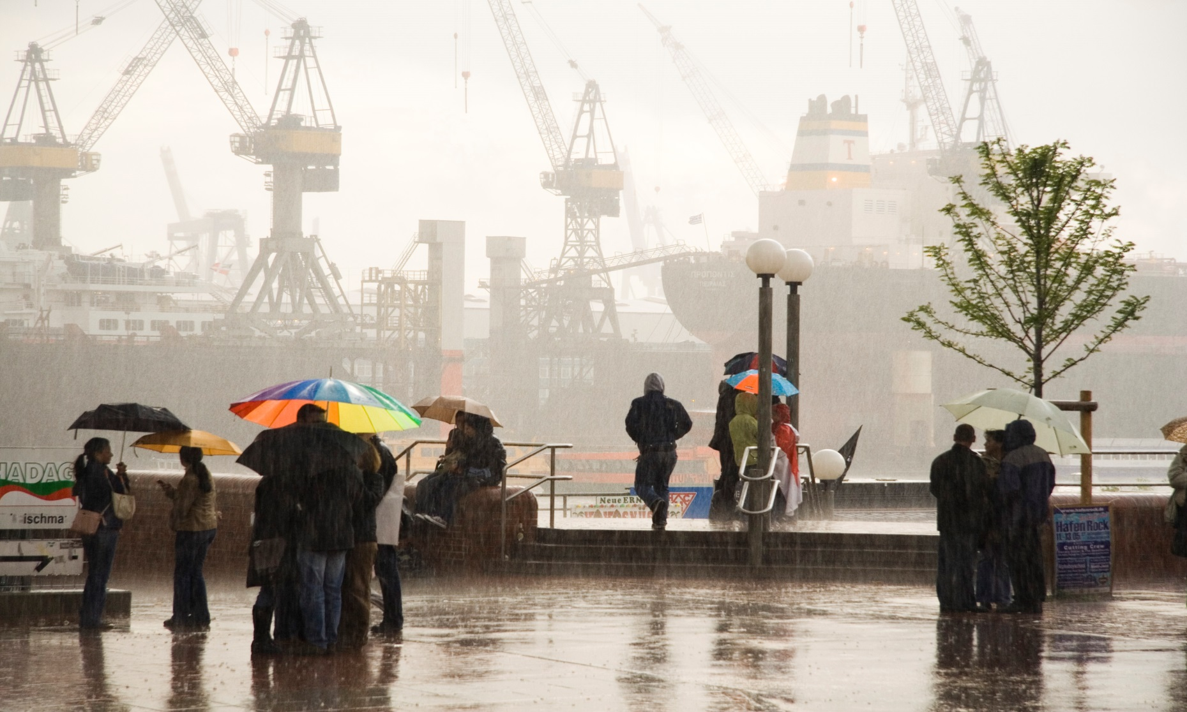
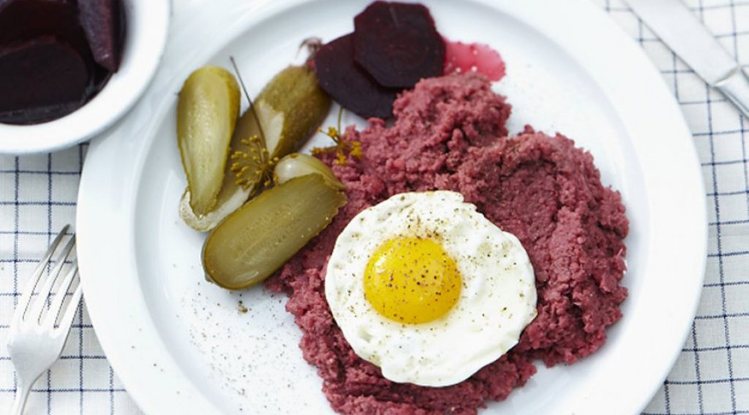
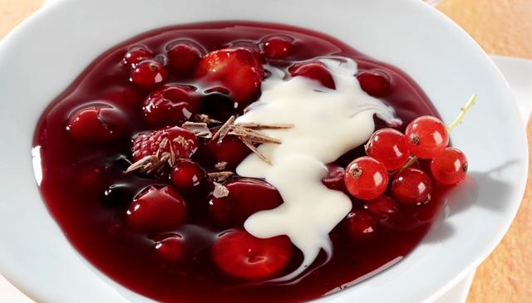
Sightseeing
Food and Weather
Labskaus
Rote Gruetze mit Vanillesauce

Slide 28
Summary
https://www.desy.de/f/students/summer_home_2023.html
summie-org@desy.de

Slide 29
Backup

Slide 30
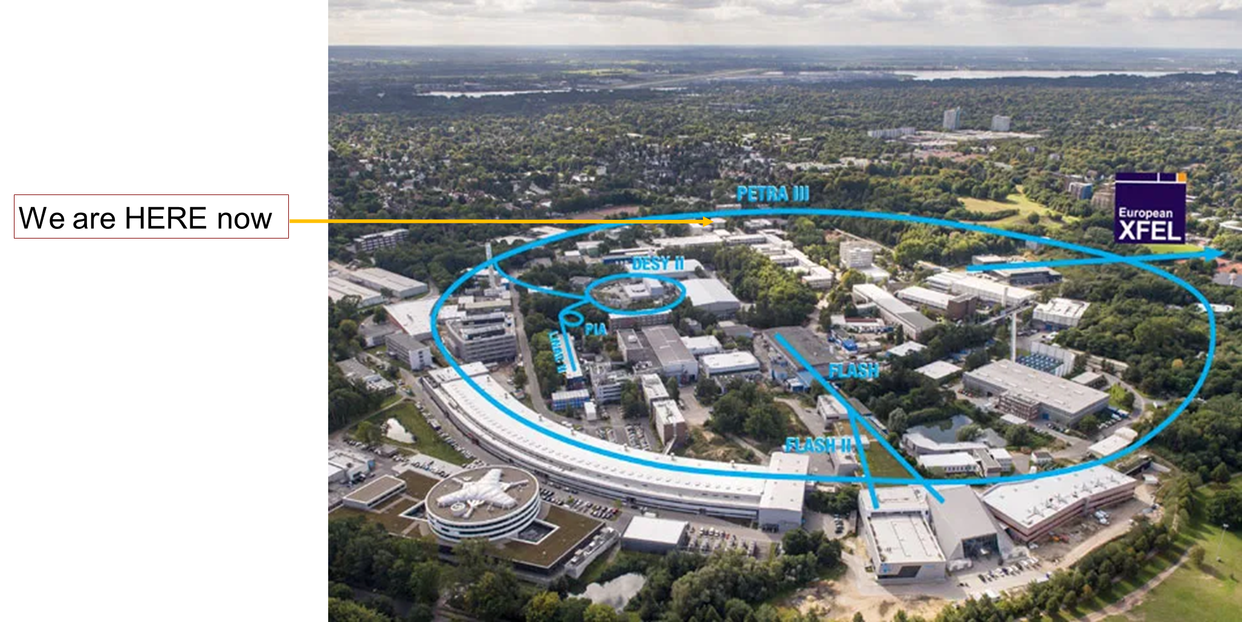
Where are we?

Slide 31
Questions? Problems? Feedback?
Don‘t hesitate to contact us!
Please ask us
  Right now
  Afterwards
  Or
summie-org@desy.de

