Slide 1
ARES Operation Meeting
Summary of week 26 / 2023 – Machine development week
Willi Kuropka, on behalf of the ARES crew

Slide 2
Summary of week 26
Mon. 26.6. | Tue. 27.6. | Wed. 28.6. | Thu. 29.6. | Fri. 30.6.
TDS water(?) Gun RF station is back Adjusting LLRF settings to shorter pulse width | Adjust main timing for Gun/TWS1 to get maximum beam momentum PDE spectrometer dipole measurements (Hysteresis) Measure deviation of beam position in dependence on longitudinal position along linac Measure magnetic fields in a number of positions along the beamline Configured FSM for TWS1 and TWS2 with Olaf Hensler | Disconnected the PDE corrector coil Repeat deviation measurement from Tue – no change Setting up STRIDENAS WP including recovery of gun LLRF settings Magnetic field measurements of the correctors with PDE current on/off | Orbit feedback setup GUN RF station check about bottle neck – klystron is in saturation, pre-amp appears to be not too far from its limit STRIDENAS big board dark charge characterization | Gun klystron conditioning Testing WP with shorter gun modulator HV pulse for this week
 |  | Gun klystron in saturation with recent charge voltage, STRIDENAS WP gun gradient not possible | Gun klystron arcing again in the afternoon Repeated klystron conditioning
Tunnel open
Achievements
Difficulties
Notes

Slide 3
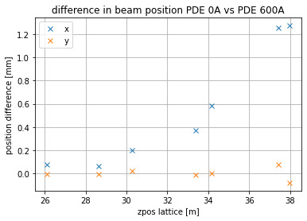
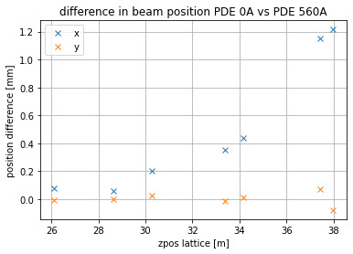
PDE current on/off measurements, ballistic WP
Why: Inconsistent beam momentum measurements, PDE current dependent position deviation observed
Magnetic field measurements summary:
  Position deviations did not change at all after disconnecting the PDE corrector coil
  BC magnets do not correlate with PDE current
  DLMCHM2 strongly correlates with PDE current (750uT), no other corrector does
  At DLBCSE1 (Screen station) still 100uT correlation, smaller correlation in the region between TDS and PDE
  Quadrupoles still to be measured
  Hysteresis still to be compared

Slide 4
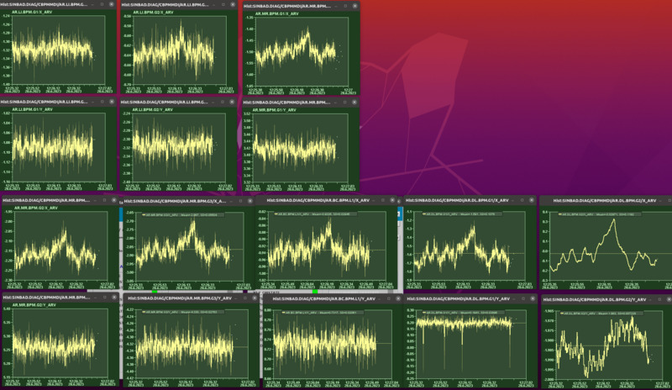
Position oscillation along the beamline
Clearly visible correlation starting right after the TWS2
Maybe even after TWS1
Should be checked at higher charge fo better BPM readings

Slide 5
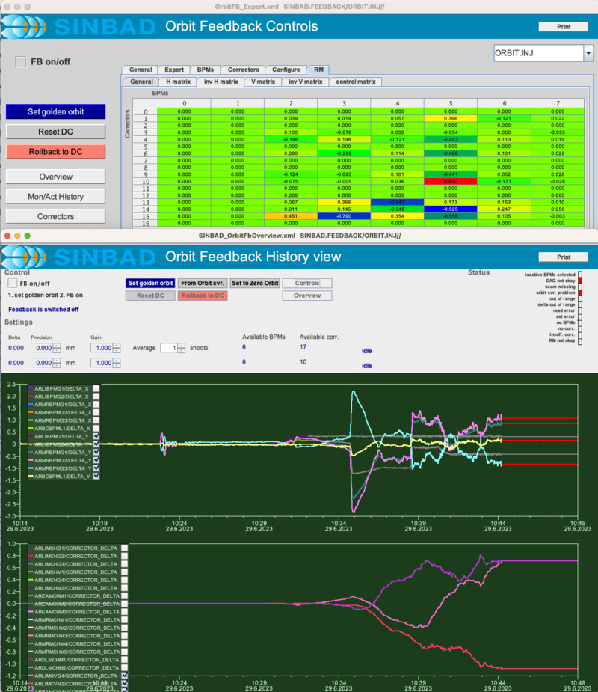
Orbit feedback
Orbit feedback server configured and tested

Slide 6
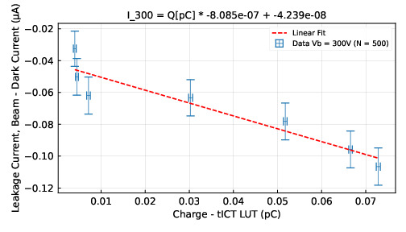
STRIDENAS dark charge measurement
Data analysis in progress, reference measurement with beam

Slide 7
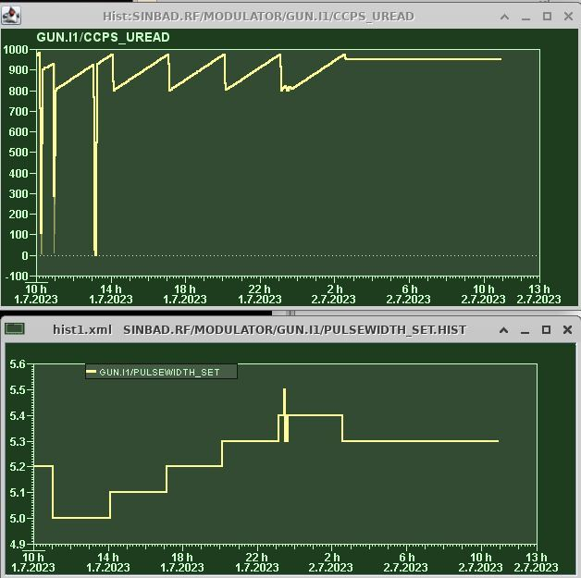
Gun RF station klystron conditioning
Appears to be stable for now
Significantly reduced HV pulse width and charge voltage
Adjusted LLRF settings for 64MV/m gun gradient
Further investigation necessary, especially on LLRF settings for higher gradient WPs
Maybe more conditioning necessary…

Slide 8
Work in the Tunnel, plan for the week
Today
  Precision water cooling TDS by MKK4
  LUXE setup installation and test in FL section
LUXE Cherenkov detector experiment
  Beam intensity scans
  Beam momentum scans

Slide 9
Schedule
Week 27
Date | Shift Leader
03.07.
04.07. | Hannes/Max
05.07. | Frank/Hannes
06.07. | Hannes/Florian
07.07. | Thomas/Max
If you want to learn or join the shift: please give the shift leader a call (BKR 2840 / SINBAD Box 2454)

