Slide 1

WP-2
High performance RF systems
L. Monaco and E. Cenni
28 September 2023, KEK
EAJADE – General Meeting

Slide 2
Outline
Work program
Status of deliverables
Status of WP2 secondments
Results and highlights so far
Open questions

Slide 3
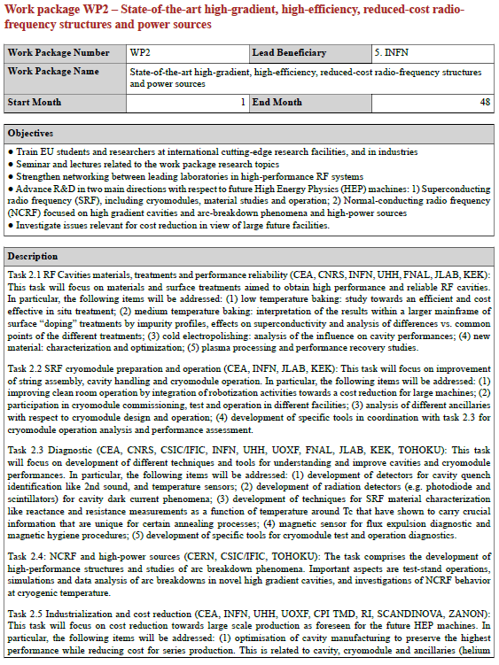
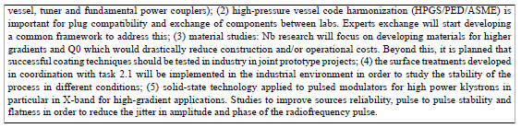
From the updated Pivot table, in total (63->54) months
Participants:
CNRS (8), CEA (13), INFN (15), UHH (17), IFIC (9), CERN (1)
Task 2.5 will benefit from results obtained in other tasks, in terms of cost reduction, sustainability, etc.
WP4 topics synergic with WP2 tasks

Slide 4
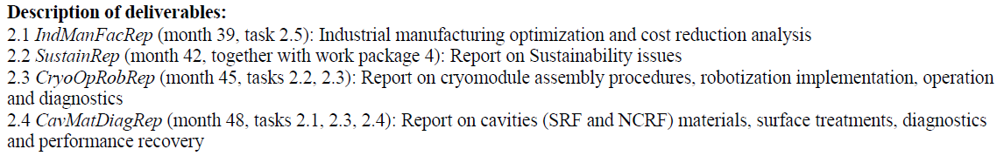
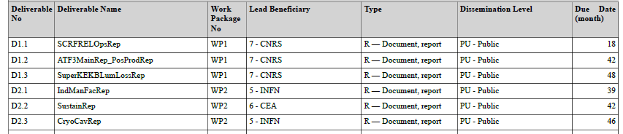
Deliverables & Time scale
Deliverables
Note: Deliverables 2.3&2.4 have been merged as D2.3 CryoCavRep (month 46, tasks 2.1, 2.2, 2.3, 2.4)
Task 2.1: RF cavities materials, treatments and performance reliability
Task 2.2: SRF cryomodule preparation and operation
Task 2.3: Diagnostic
Task 2.4: NCRF and high-power sources
Task 2.5: Industrialization and cost reduction

Slide 5
Secondments balance per institutes (2023)
Beneficiary | Secondments | Host institute | Main Topic
INFN | /
CNRS | 0.5 month | FNAL | Cavity materials R&D
 | 0.5 month | FNAL | Plasma processing
CEA | 1 month | KEK | Cavity fabrication, cost reduction and diagnostics
UHH | /
Task 2.1:
  UHH -> KEK, Postdoc 1 month, Q3/Q4 2023
  CRNS -> KEK, Staff 1 month, from Q4 2023
  INFN-LASA -> Jlab, Staff ½ month, from Q2/Q3 2023
Task 2.3:
  CEA -> KEK, staff 1 month, Q3 2023
Task 2.5:
  INFN -> Scandinova, staff ½ in Q4 2023 or Q1 2024
Main reasons of not done secondments:
  UHH: PhD student has problematic Nationality (Iran and Russia)
  INFN: burocratic issue on fund allocation (expected in October)

Slide 6
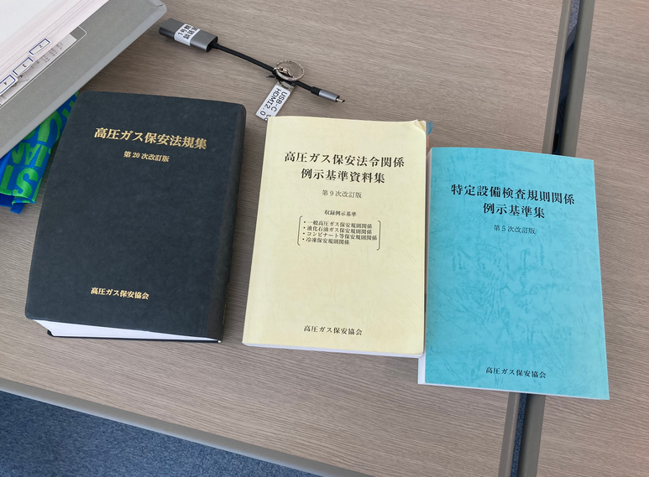

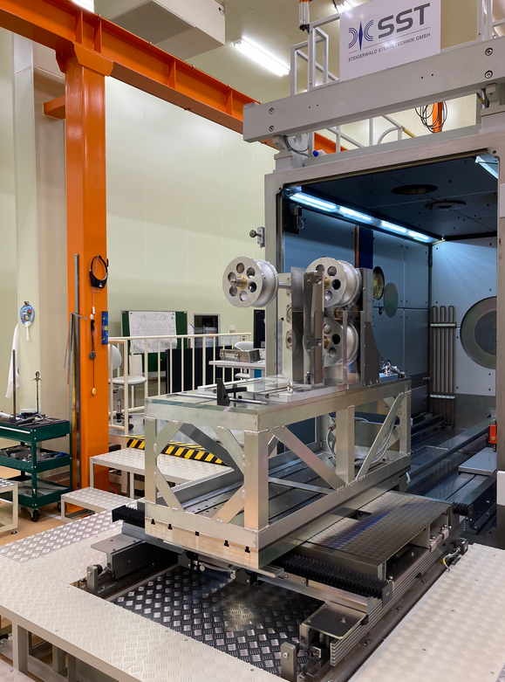
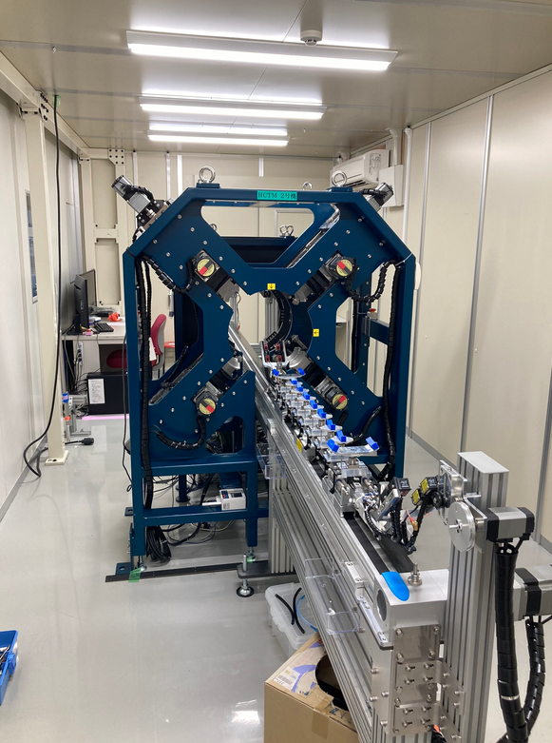
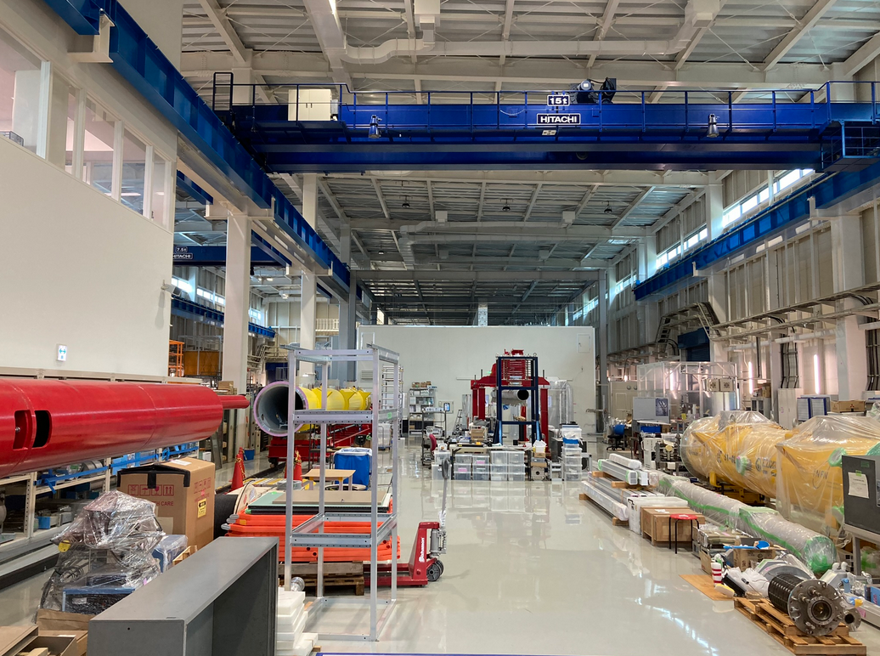
Summary of activities at KEK
ITN collaboration:
  HPGS study for cavity manufacturing in Europe
  Cavity preparation discussion and study plan
Cavity fabrication facility (CFF)
  Dumbbell preparation for electron beam welding
  COI facility visit (clean room, HPR, bunker location)

Slide 7
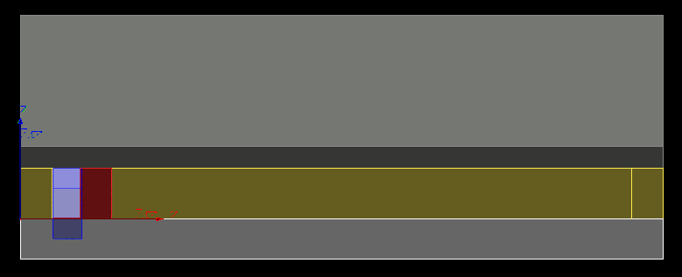

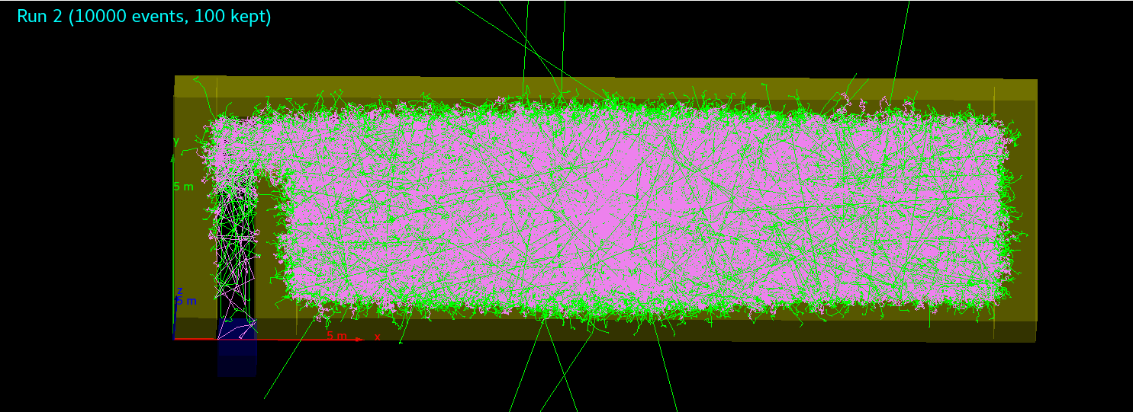
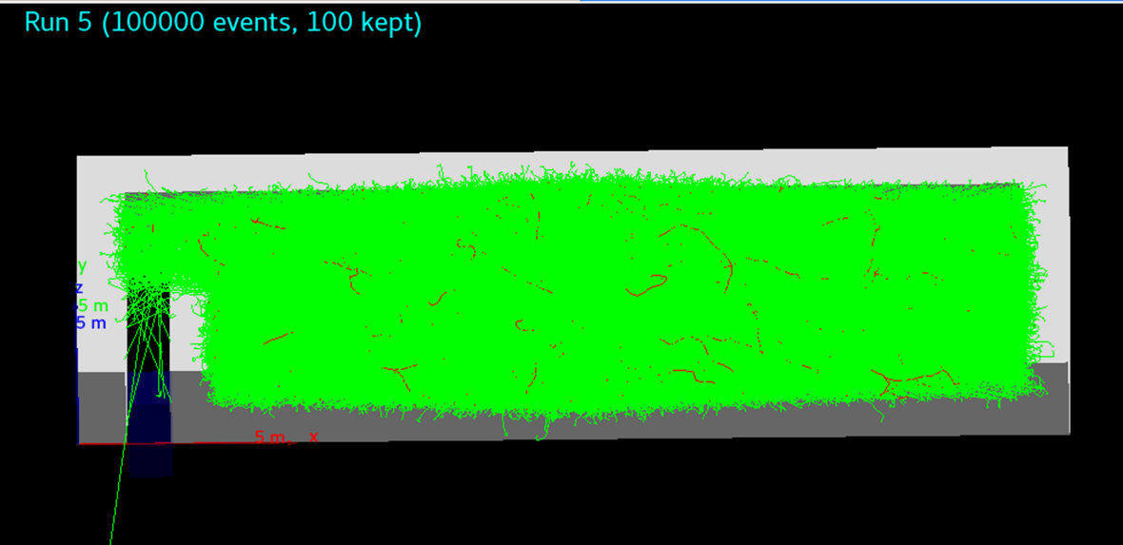
Summary of activities at KEK
Preliminary design evaluation for Cryomodule Test Facility in (COI):
  Maze study
Image color code:
Gray: Roof and Floor
Yellow: side walls
Red: Inner wall
Purple: Source
Transparent blue: “detector door”
Source
1MeV neutrons
1MeV gamma

Slide 8
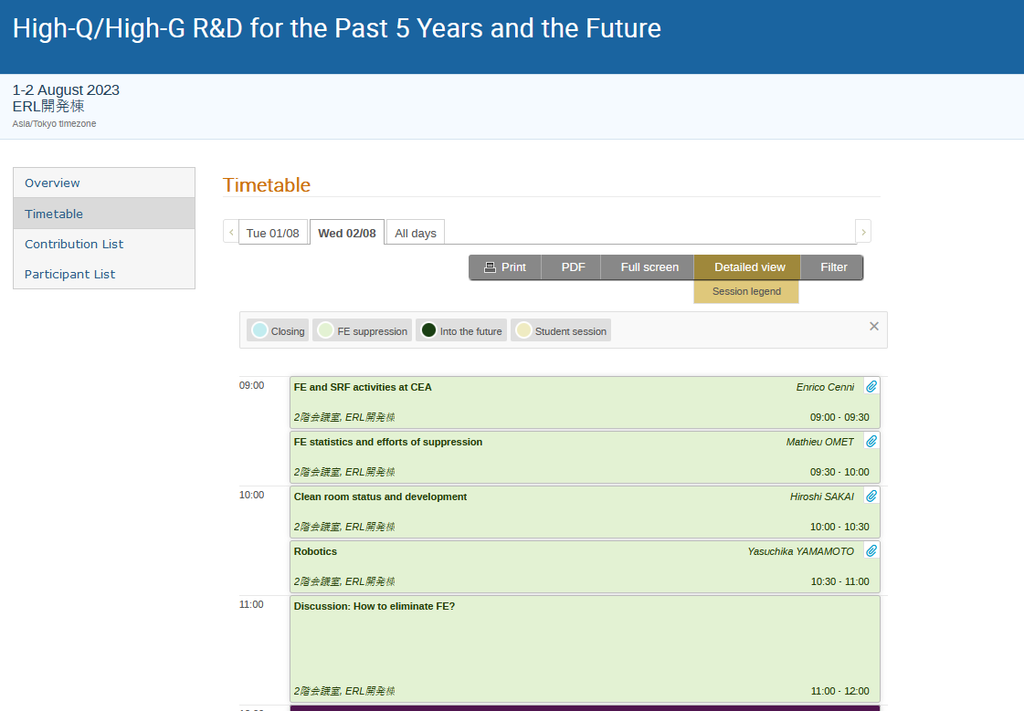

Summary of activities at KEK
2 days Workshop with KEK SRF group

Slide 9
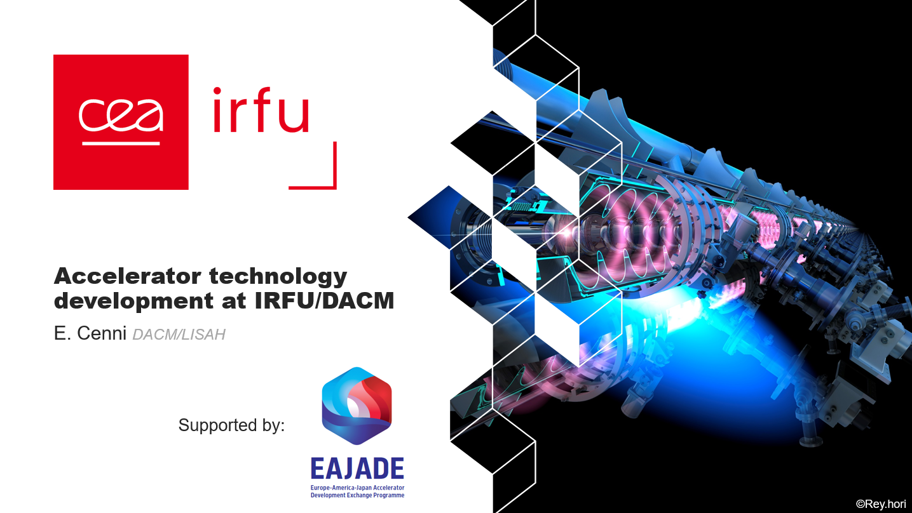
Summary of activities at KEK
Seminar for the KEK SRF group
Dissemination:
Talks and seminars will be uploaded on Zenodo

Slide 10
Secondments outlook per institutes (2024)
Beneficiary | Secondments | Host institute | Main Topic | Quarter
INFN | 1 month | KEK | Cavity fabrication and cost reduction | 3
 | 1 month | KEK | Cavity fabrication, cost reduction and sustainability (WP2/WP4) | 3
 | 1 month | FNAL | Cavity fabrication and magnetic shielding | /
 | 0.5+0.5 month | Jlab/FNAL | Cavity fabrication and diagnostic | /
CNRS | 0.5 month | KEK | Cavity materials R&D | /
 | 0.5 month | FNAL | Plasma processing | /
CEA | 1 month | KEK | Cavity fabrication, cost reduction and diagnostics | 3
 | 1 month | FNAL | Cavity material R&D and testing | /
 | 2 month | FNAL | Clean room operation and cryomodule assembly | 1
UHH | 1 months | KEK | HighQ/HighG R&D | 1-2
 | 1-2 months | Jlab | QPR for SRF characterization | 2-3
 | 1 months | FNAL | HighQ/HighG R&D | 3-4

Slide 11
Planned works for 2024
FNAL (2.1 / 2.3)
TJNAF (2.3)
KEK (2.1 / 2.3)
Participate in first test of prototype cavity (2023)
Join annealing studies to push for higher Q₀ & E_{acc}
Joint study with new cavity test procedure on interstitial oxygen contribution
Support hardware commissioning of new sample test resonator
Share „calibration sample“ and discuss results
Test own multilayers coated with ALD at H_{c1} measurement system at KEK
Study ALD system at KEK and support next steps in their R&D

Slide 12
Schedule
Q2 or Q3 2024
PhD Student to TJNAF
Task 2.3
QPR for SRF characterization
1-2 person month
Q4 2023
PhD Student to FNAL
Task 2.1 & 2.3
High Q / High G R&D
1-2 person month
Q3 or Q4 2024
PhD Student to FNAL
Task 2.1 & 2.3
High Q / High G R&D
1 person month
Q1 or Q2 2024
Postdoc or PhD student to KEK
Task 2.1
High Q / High G R&D
1 person month

Slide 13
Open Questions
Due to the general increase of costs, a re-evaluation of the EU fund can be expected (more money or the same budget but for fewer secondments)? (e.g. Flight fare increase)
Which documents are needed to justify the secondments with respect to the EU project officer? receiving an institute report is enough? (Do we need a flight ticket receipt?)

