Slide 1
WP-3 Special technologies, devices and systems performance
N. Fuster (IFIC, CSIC-UV)
28th September 2023
EAJADE general meeting

Slide 2
Outline
WP-3 overview
WP-3 group by group activities
WP-3 secondments status
WP-3 tasks and deliverables overview
WP-3 results and highlights so far

Slide 3
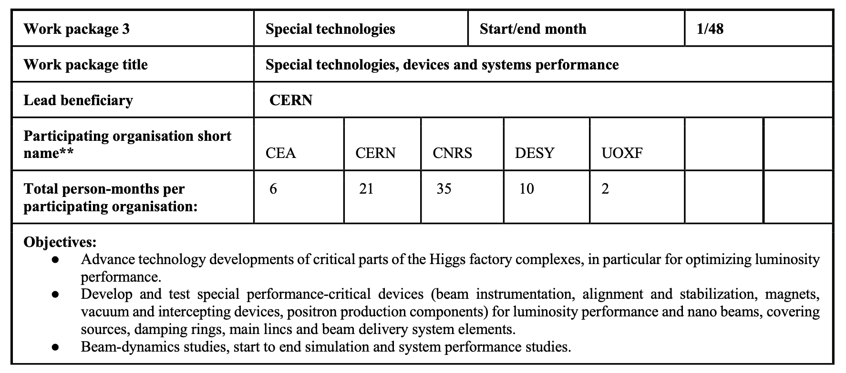
WP-3 overview
Objectives:
Advance technology developments of critical parts of the Higgs factory complexes, in particular for optimizing luminosity performance
Develop and test special performance-critical devices (beam instrumentation, alignment and stabilization magnets, vacuum and intercepting devices, positron production components) for luminosity performance and nano beams, covering sources, damping rings, main linac and beam delivery system elements
Beam-dynamics studies, start to end simulation and system performance studies
IFIC/CSIC
TOTAL
7
81
**Updated after the discussion on the first EAJADE kick-off meeting (30th March 2023).

Slide 4
WP-3 overview
Task 3.1: Final Focus and interaction point, collimation and magnets, luminosity devices and MDI studies
Participating organizations: CERN, CNRS, DESY, UOXF, CEA, IFIC/CSIC, 44 + 7 months
Secondments to KEK, BNL, SLAC and FNAL
Studies and hardware developments for circular and linear colliders covering critical devices for providing high-luminosity (alignment and stability systems, FF magnets, collimators, diagnostics…)
Deliverable3.2: LumiPerfFCCRep (month 42): Report on luminosity performance and margins for the Higgs factory proposals
Task 3.2: Beam dynamics, start-to-end simulations, polarization/polarimetry including hardware concepts
Participating organizations: CERN, CNRS, DESY, 30 months
Secondments to KEK, BNL, SLAC and UVIC
Start-to-end simulations and parameters optimization studies of Higgs factories, including polarization and polarimetry, and luminosity measurements and accuracy
Deliverable3.1: OptParHiggsRep (month 36): Optimized parameters for Higgs factories including polarization studies
**CEA assigned 6 months within WP3, but no associated task specified on the proposal

Slide 5
WP-3 Group by group activities
CEA, 6 PM: KEK, FNAL, SLAC
Machine learning studies for BPMs improved performance (KEK, FNAL, SLAC) -> task 3.1
Secondments planned at SuperKEKB in the first half of 2024
Collaborations and work plan at the US laboratories are under discussion
Lab. | PM
FNAL | 3
SLAC | 2
KEK | 1

Slide 6
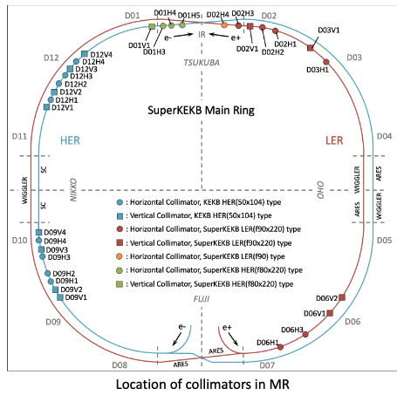
WP-3 Group by group activities
CERN, 21 PM (BNL, FNAL, KEK, Oxford)
(EIC) IR magnet developments and collimation (BNL, 4PM) -> task 3.1
Beam dynamics, optics correction and polarisation/polarimetry studies (BNL, FNAL, 10PM) -> task 3.1, task 3.2
Proposed specific agenda with US laboratories waiting for approval by the Department of Energy of the United States of America (DOE)
MDI, background control and collimation (KEK, 6PM) -> task 3.1
Several collaborations and topics for the secondments agreed
Beam-beam theories and simulations (starting in November/December 2023)
Collimation studies (starting at the end of 2023/beginning of 2024)
Lab. | PM
BNL | 8
FNAL | 6
KEK | 6
Oxford | 1

Slide 7
WP-3 Group by group activities
CNRS, 35 PM (BNL, KEK, UVIC, Oxford)
Specialised magnet development and related techniques (BNL, OXFORD, 7PM) -> task 3.1
Within FCC-ee project on IP quadrupoles vibration impact studies (starting in 2024)
Vibration and girders and luminosity impact studies (KEK, 6PM) -> task 3.1
Ground motion sensors recalibration and coherent ground motion studies (secondments planned for November 2023)
Compton polarimeter laser design and real time monitoring (KEK, UVIC, 12PM) -> task 3.2
Performance and integration studies are being finalized for integration in SuperKEKB (secondments planned for October 2023)
Monitoring and optimization of beam parameters and luminosity, and modelling, measurements and mitigation of beam loss induced background (KEK, 10PM) -> task 3.1, task 3.2
SuperKEKB diamond sensor recalibration and DAQ software improvements (secondments planned for September/October/November 2023)
Lab. | PM
KEK | 25
BNL | 6
UVIC | 3
Oxford | 1

Slide 8
WP-3 Group by group activities
DESY, 6 PM: FNAL, UVIC, KEK, BNL, SLAC?
Start-to-end simulations, polarization, operation, sustainability and plasma lenses studies (KEK/BNL/UVIC, 5PM) -> task 3.1, task 3.2
The topics for the secondments and the work plan are under discussion probably starting in 2024
Possibly changing some secondments at BNL/UVIC to SLAC
MDI studies (FNAL, 1PM) -> task 3.1
Lab. | PM
KEK | 3
BNL | 1
UVIC | 1
FNAL | 1
SLAC | ?
UHH, 4 PM (KEK)
Design and performance optimization studies and linear and non-linear beam dynamics studies (KEK, 4PM) -> task 3.1, task 3.2
Topics and work plan are under discussion
Lab. | PM
KEK | 4

Slide 9
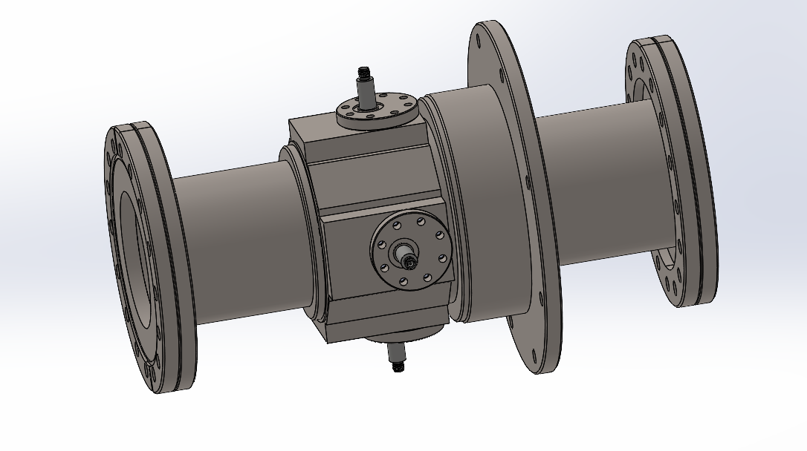
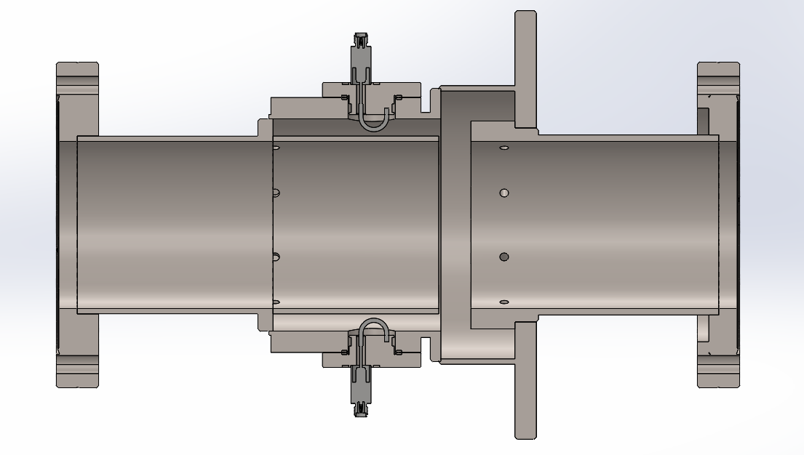
WP-3 Group by group activities
IFIC, 7 PM: KEK
Cold-cavity BPM R&D for the ILC main linac cryomodules (KEK, 7PM) -> task 3.1
Currently working on design and optimization studies
Secondments planned to start at the end of 2024
Lab. | PM
KEK | 7
3D model by C. Blanch

Slide 10
WP-3 Group by group activities
UOXF, 2 PM: KEK
Hardware for LCs (KEK, ATF2/3) -> task 3.1
Plans under discussion
Lab. | PM
KEK | 2

Slide 11
WP-3 secondments status
 | CEA |  | CERN |  | CNRS |  | DESY |  | UHH |  | IFIC |  | OXFORD
 | Tot. | Actual [Mon.] | Tot. | Actual [Mon.] | Tot. | Actual [Mon.] | Tot. | Actual [Mon.] | Tot. | Actual [Mon.] | Tot. | Actual [Mon.] | Tot. | Actual [Mon.]
FNAL | 3 |  | 6 |  | -- |  | 1 |  | -- |  | -- |  | --
BNL | -- |  | 6 |  | 6 |  | 1 |  | -- |  | -- |  | --
SLAC | 2 |  | -- |  | -- |  | -- |  | -- |  | -- |  | --
KEK | 1 |  | 8 | 1.2 | 25 | 2.8 | 3 |  | 4 |  | 7 |  | 2
UVIC | -- |  | -- |  | 3 |  | 1 |  | -- |  | -- |  | --
Oxford | -- |  | 1 |  | 1 |  | -- |  | -- |  | -- |  | --
TOTAL | 6 | 0 | 21 | 1.2 | 35 | 2.8 | 6 | 0 | 4 | 0 | 7 | 0 | 2 | 0
Several additional secondments are planned by CEA, CNRS and CERN to KEK by the end of 2023 and first half of 2024 but still not registered

Slide 12
WP-3 tasks and deliverables overview
Task 3.1: Final Focus and interaction point, collimation and magnets, luminosity devices and MDI studies
This task covers studies and hardware developments for colliders options, covering the devices critical for providing high luminosity collisions
Tentative list of activities:
ML BPMs performance studies (CEA)
IR magnets developments (CERN)
MDI, background control and collimation studies (CERN)
IP quadrupole vibration studies (CNRS)
Ground motion studies (CNRS)
Modelling, measurements and mitigation of beam loss induced background studies (CNRS)
MDI studies (DESY)
Cold cavity-BPM R&D studies (IFIC)
Hardware for LC R&D (Oxford)
Deliverable 3.2: LumiPerfFCCRep (month 42): Report on luminosity performance and margins for the Higgs factory proposals (CERN)

Slide 13
WP-3 tasks and deliverables overview
Task 3.2: Beam dynamics, start-to-end simulations, polarization/polarimetry including hardware concepts
These studies aim to define the performance goals for the collider options including polarization parameters and luminosity as well as the expected measurements accuracy for these parameters
Tentative list of activities:
Beam dynamics, optics correction and polarisation/polarimetry studies (CERN)
Compton polarimeter R&D (CNRS)
Beam parameters and luminosity monitoring and optimization (CNRS)
Start-to-end simulations, polarization and plasma lenses studies (DESY)
Design and performance optimization studies and linear and non-linear beam dynamics studies (UHH)
Deliverable 3.1: OptParHiggsRep (month 36): Optimized parameters for Higgs factories including polarization studies (CERN)

Slide 14
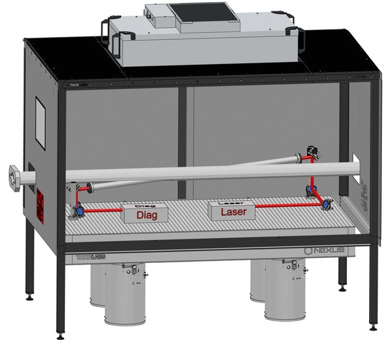
WP-3 results and highlights so far
Work plans and collaborations are developing well
Still, we need to check any overlap between WP1&WP3 now that the activities are better defined for most of the groups
CERN and CNRS started travelling within WP3 and several secondments are planned already for the end of 2023 and beginning of 2024 also for CEA
From these activities we can expect results in the coming months
As a highlight, it is worth mentioning the performance and integration studies of the Compton polarimeter being developed by the CNRS group, which are currently in the final stages
Thanks to F. Zomer

Slide 15
Thank you very much for your collaboration!

