Slide 1
EAJADE – Work Package 6 Management, Dissemination, Training, Knowledge Transfer, and Communication
EAJADE Annual Meeting 2023
Thomas Schörner
28 September 2023

Slide 2
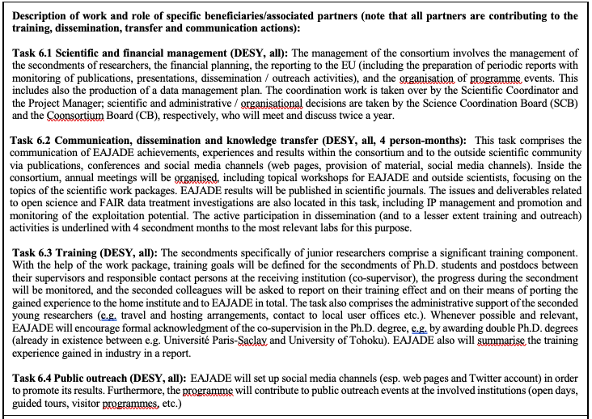
Summary

Slide 3
Deliverables

Slide 4
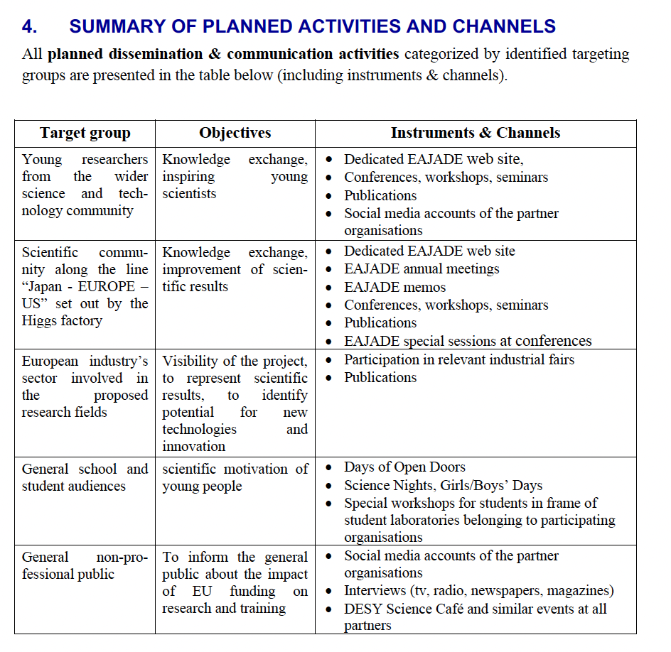
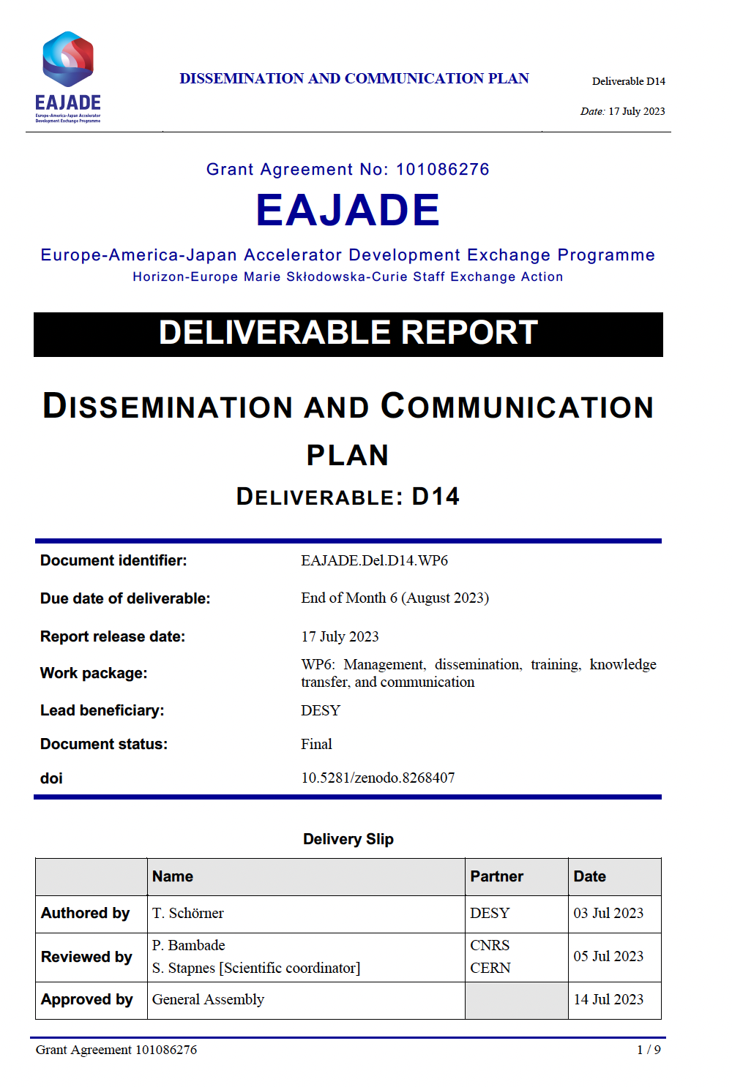
Deliverables
Dissemination and exploitation plan

Slide 5
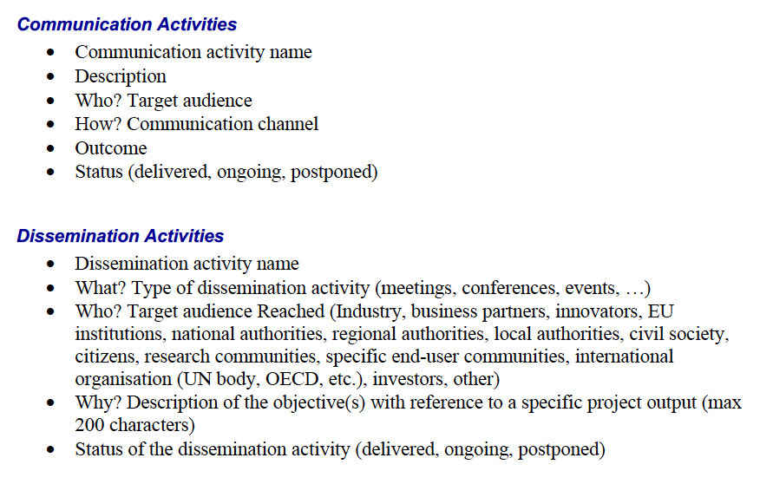
Deliverables
Dissemination and exploitation plan
“Questionnaire” sent to WP leads / CB members on 2 August 2023
Feedback only from Laura and Nuria
Anything else to report → will send reminder next week.

Slide 6
Deliverables
Dissemination and exploitation plan
Communication
Dissemination

Slide 7
Events
(co)organised by EAJADE, or with EAJADE contributions
So far – is there more?
EAJADE WSFA 2023
EAJADE general / annual / kick-off meetings
MDI/CFS workshop September 2023
EPSHEP23 contributions (posters)
…

Slide 8
Reminder: Acknowledgments in Talks and Papers
… for EAJADE support
Acknowledgement in publications
Please acknowledge the received EU funding in any publication which profited from EAJADE funding. We suggest the following acknowledgement text:
“This work was partially supported by the European Union’s Horizon Europe Marie Sklodowska-Curie Staff Exchanges programme under grant agreement no. 101086276.”
Acknowledgement in presentations
Presentations with EAJADE supported contents should also acknowledge the received EU support by showing the EU and EAJADE labels (see right side) and the text suggested below. A template slide is available via the cloud folder.
“This work was partially supported by the European Union’s Horizon Europe Marie Sklodowska-Curie Staff Exchanges programme under grant agreement no. 101086276.”

Slide 9
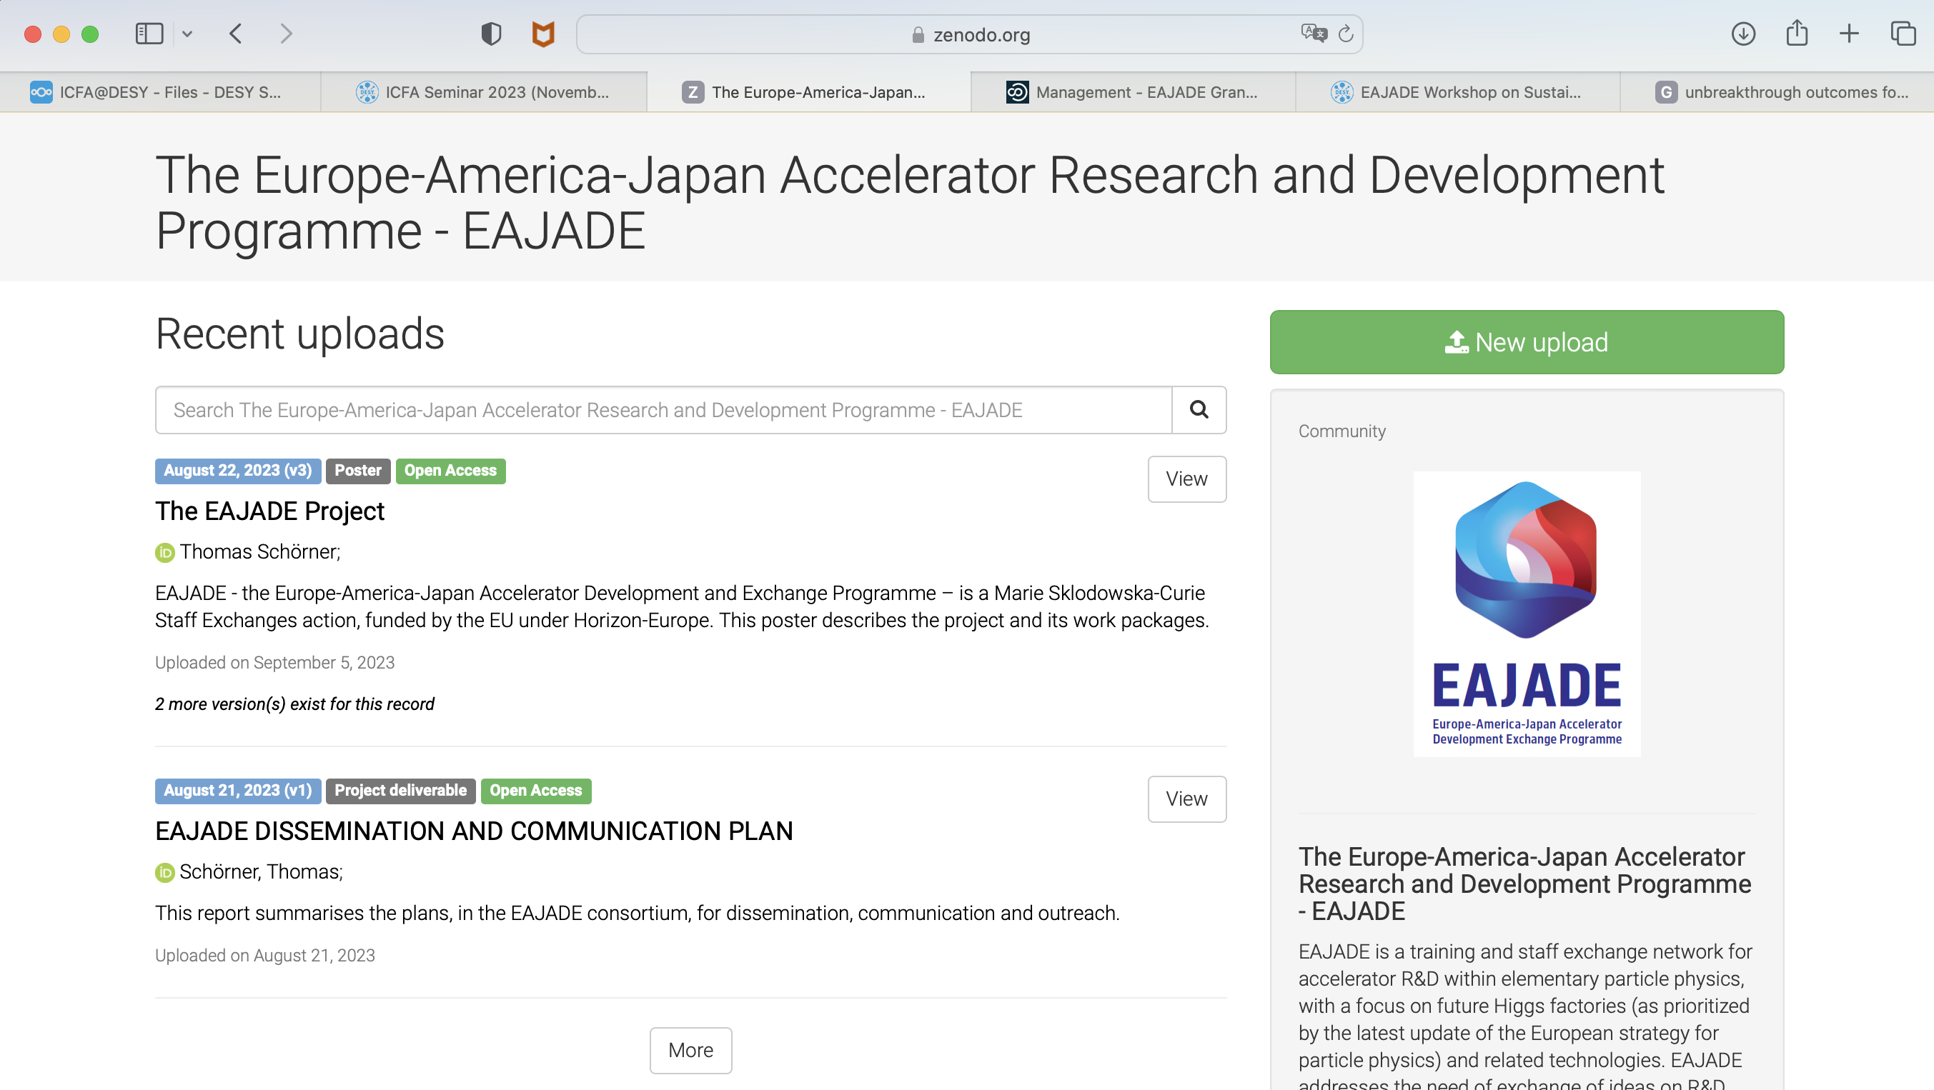
ZENODO Community

Slide 10
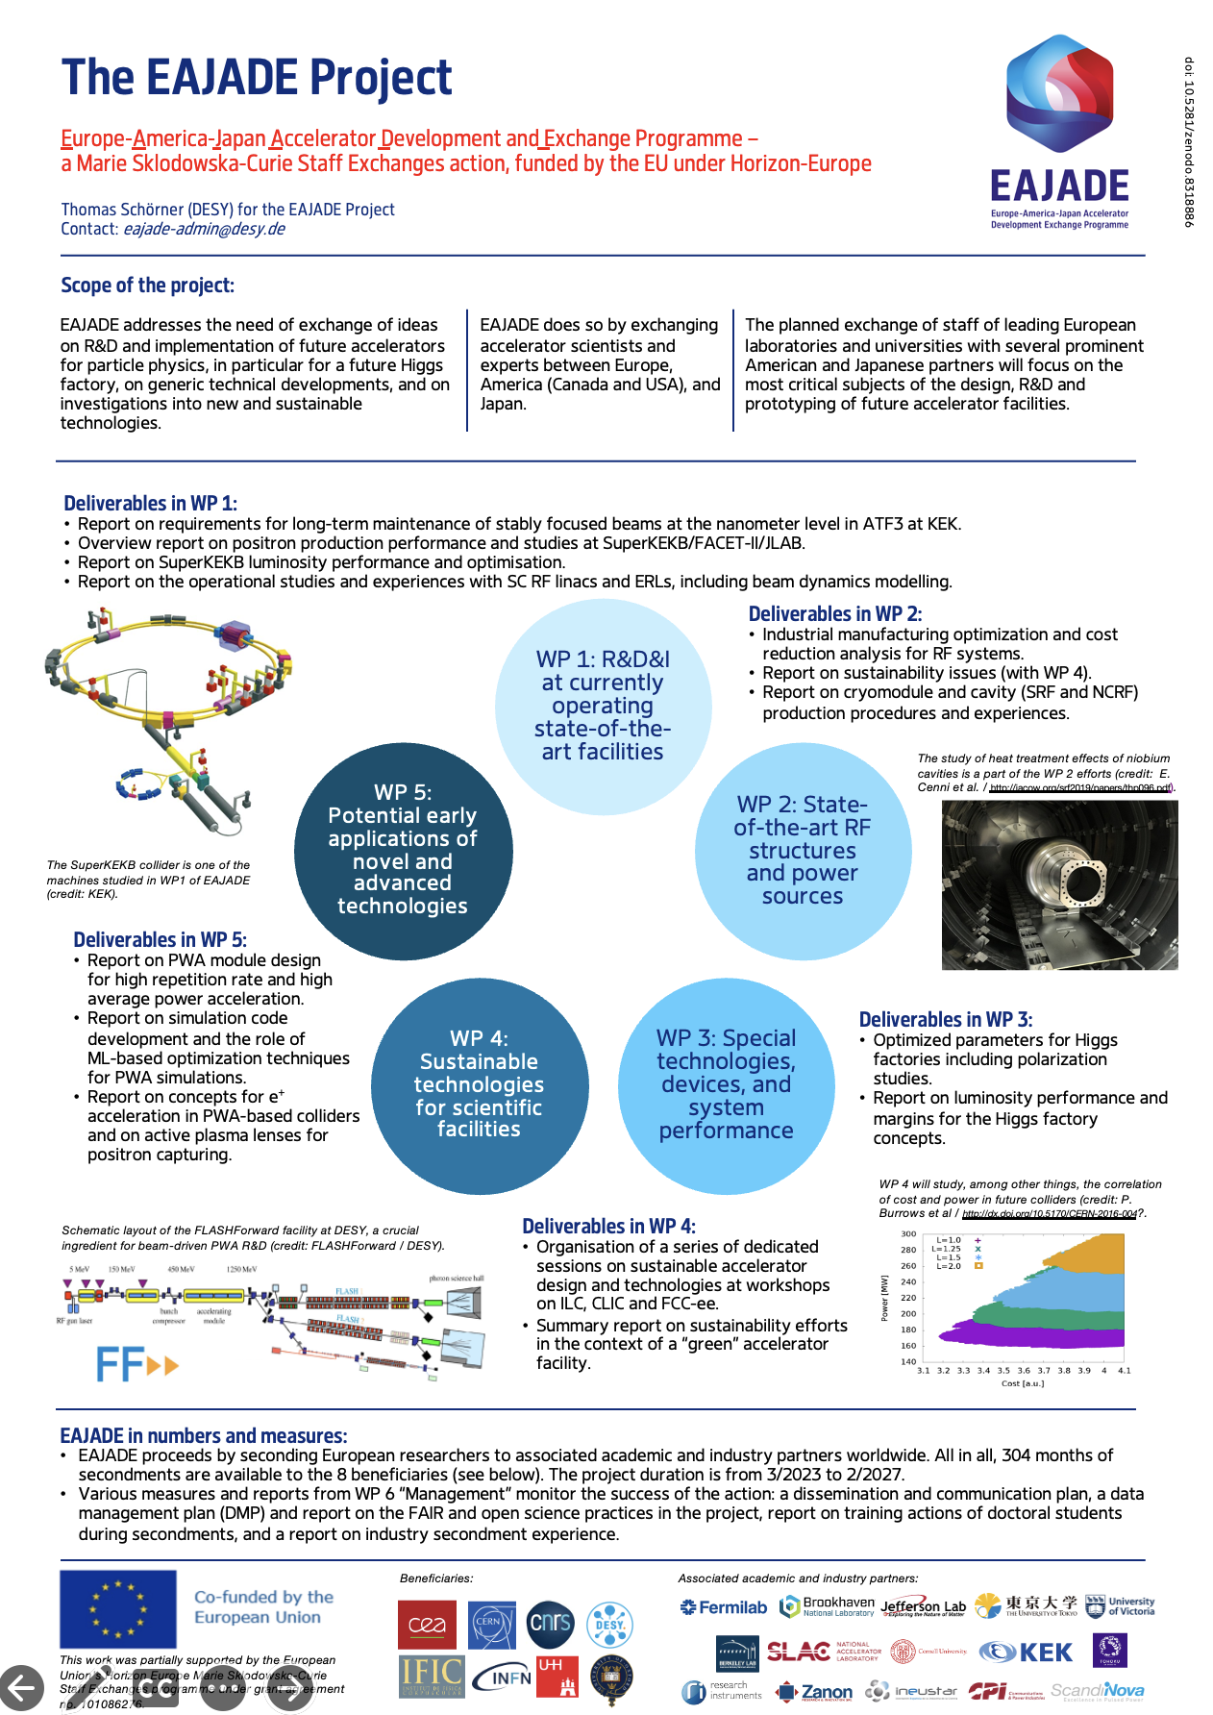
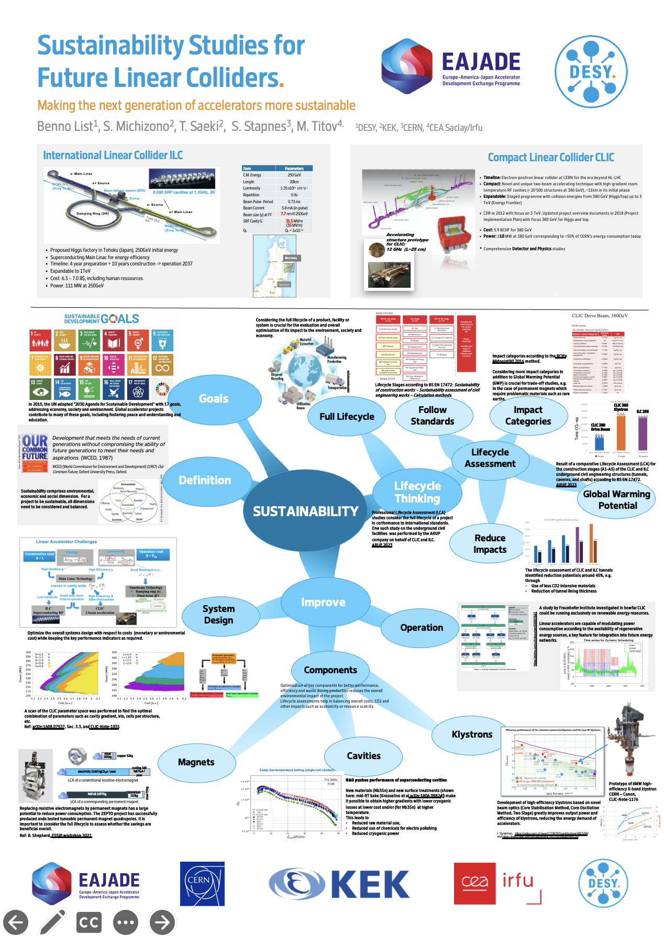
ZENODO Community
Please upload / link your papers / talks / posters and give ”EAJADE” tag!

Slide 11
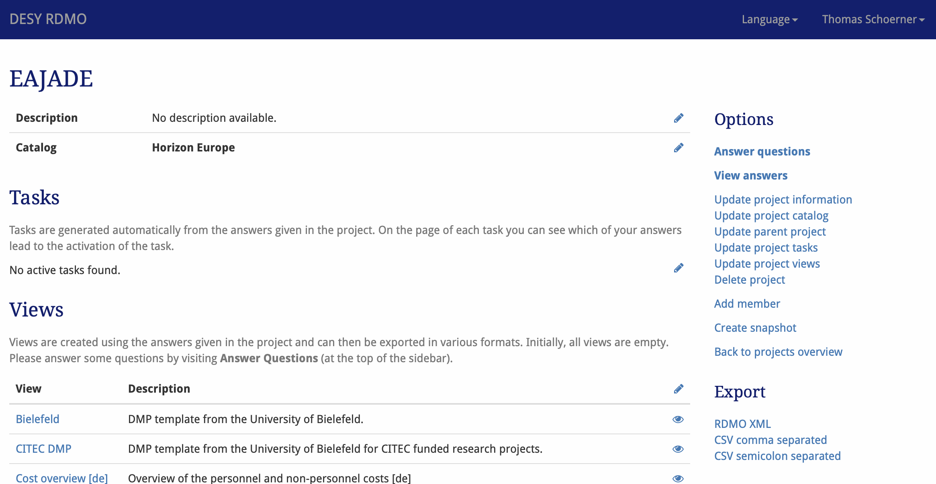
Deliverables
Data Management Plan (DMP) – due in August!!
Long story cut short:
We have to do it!
The long and complete way is tedious – use complex tool like rdmo (now instance at DESY) for complete DMP → failed because of lack of time and energy on my part and difficult input situation from the WPs.
Resorted to copying an accepted DMP from another EU project (Expands / Sophie Servan @ DESY) → sent out to WPs on 21 August
First feedback from Steinar and Philip in general, then from Jens and Laura / Enrico.
Missing WPs 1,2 (5)

Slide 12
Deliverables
Progress report 1 (months 13), mid-term meeting (months 18)
Progress report: will start in new year to collect all info that we so far have
Mid-term meeting – need to define in-person meeting with high attendance (at CERN) in ~October 2024.
Need solid and hopefully rather close-to-proposal secondment plan

Slide 13
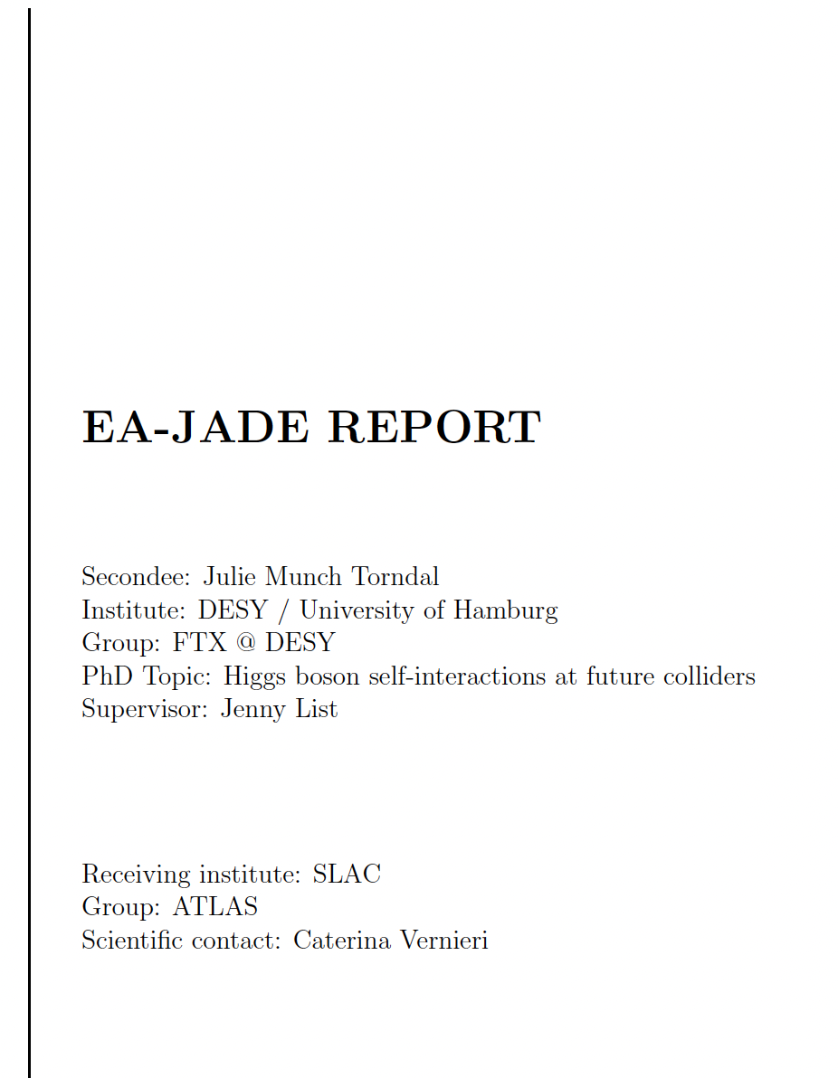
Deliverables
Industry Report, Ph.D. student training report (both months 48)
When and where do we attach industry sessions?
WSFA2023
…?
Report as summary of all activities (workshops, secondments to industry, industralisation experience from different projects, …)
Ph.D. training report: Remember to define Ph.D. training goals in secondment registrations, and to prepare Ph.D. training reports! → will be summarised at the end.

Slide 14
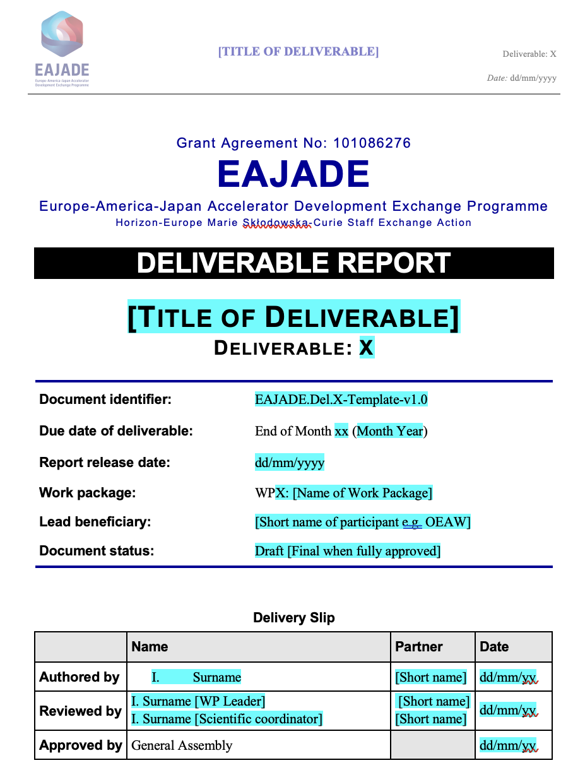
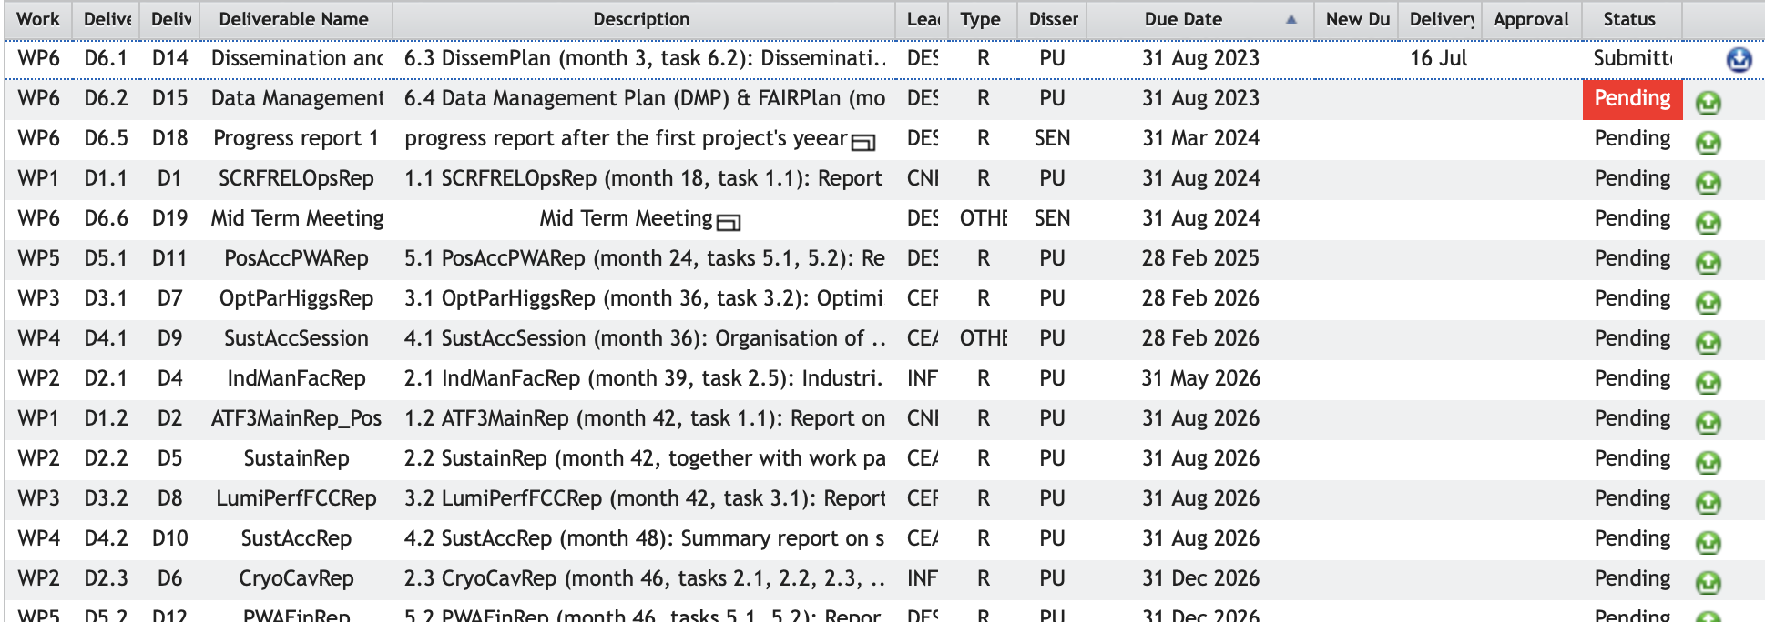
Deliverables
…. In general in all WPs … : no immediate hurry!

Slide 15
Training
OLD SLIDE!
… of junior EAJADE researchers
Training experience (quote from proposal)
EAJADE / WP6 will set up and monitor training goals for seconded Ph.D. students and postdocs
These secondees will be asked to report on their training effect and on the porting of their experience to their home institution / EAJADE in general.
Action items:
We need to organize administrative travel support for all secondees (information on housing, safety, visa etc. for the various receiving institutions).
EAJADE shall help to acknowledge double Ph.D. affiliation / co-supervision and joint degrees.
EAJADE will prepare an industry secondment experience report
We should take the training aspect serious and define “goals” for each secondment of junior researchers (and follow up).
→ Will prepare questionnaire on this, or relate it to INDICO registration page?
Additional ideas for training of young people:
Internship programme (→ common fund?)
Mentoring programme with small scientific projects to enrich the CVs (and our reporting)
Dedicated schools?
Masterclasses?
…
?
?

Slide 16
Meetings
… of EAJADE committees
Consortium Board (Thomas) and Science Coordination Board (Steinar) – together called General Assembly
Both meet twice a year (once at annual meeting in person, and once more probably virtually)
Suggest joint meetings, also with interested associated and industry partner representatives present → consider today’s meeting as combined SC and SCB meeting, will prepare minutes. → next virtual meeting around March / April 2024 → doodle soon
Funding-relevant decisions (e.g. on common fund) to be taken by beneficiaries (e.g. by CB) alone.

Slide 17
Summary
Questions?

Slide 18
Thank you!
Thomas Schörner
DESY FH
E-Mail: thomas.schoerner@desy.de
Phone: +49 40 8998 3429
https://www.eajade.eu
E-Mail: eajade-admin@desy.de

Slide 19
Backup

