Slide 1
EAJADE
- general meeting -
Steinar Stapnes
KEK 28.09.2023

Slide 2
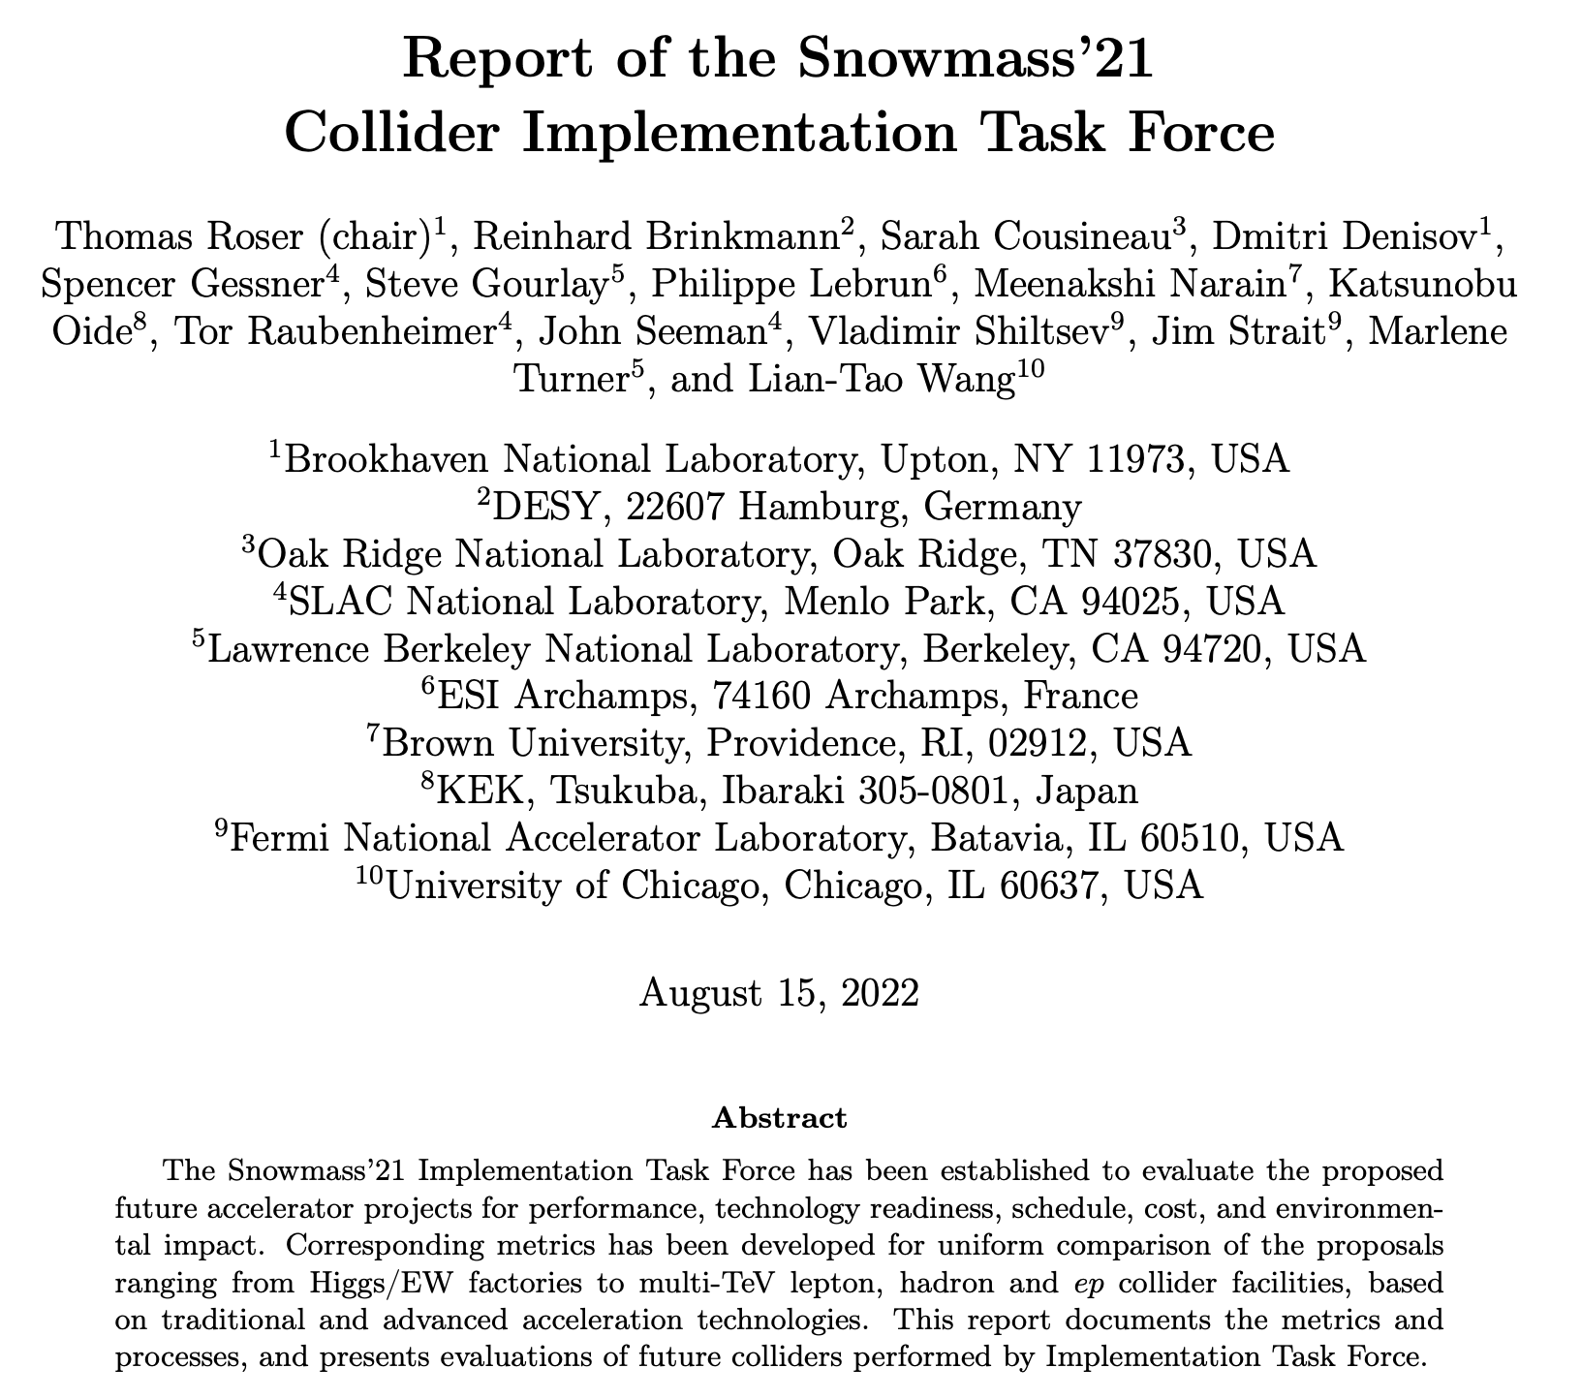

ESPP update 2018-19:
Higgs factory next – project studies
FCC feasibility study
R&D on technologies and projects
ESPP update 2025-26-27:
… to be done …
Interesting Implementation Task Force Report:
https://arxiv.org/pdf/2208.06030.pdf
Snowmass provided(s) an opportunity for formulating new ideas, intermediate reports, overviews – for the US and worldwide
All three “events” motivate Accelerator R&D

Slide 3
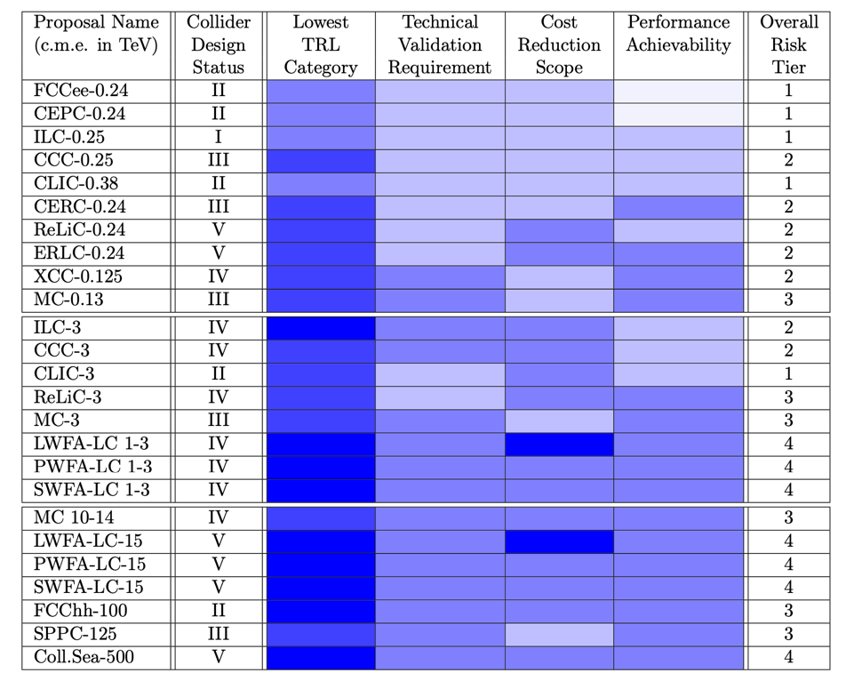
The collider landscape
(will concentrate on the light blue boxes on the right)
From the established Higgs factory studies to new ideas:
FCC-ee, CEPC, ILC, CLIC …. C3 ….. HALVF, several conceptual energy recovery and plasma options
Higgs-factory related R&D (examples):
Efficient RF, luminosity, dealing with synchrotron radiation (circular machines)
Beam-dynamics, beam–beam, lattices
“Nanobeams” from start to end
  Alignment, stability, damping, beam-instrumentation, vacuum and surface treatments, collimators, timing, etc
Positron production
Magnet stability and energy use
Timeline for R&D 5-15 years, to be implemented in Higgs factories
+ more
LDG acc. roadmap:
Relevant for Higgs factories but also to enable new accelerator concepts beyond the Higgs factories:
RF and HF magnets
Muon collider
Energy Recovery
Plasma
Timeline in some cases significantly longer than above
HF magnets enables FCC-hh and SppC
Muon collider project studies – enabled by RF and magnet studies
HALVF and other plasma concepts
Energy recovery based concepts
High(er) power proton-drivers

Slide 4
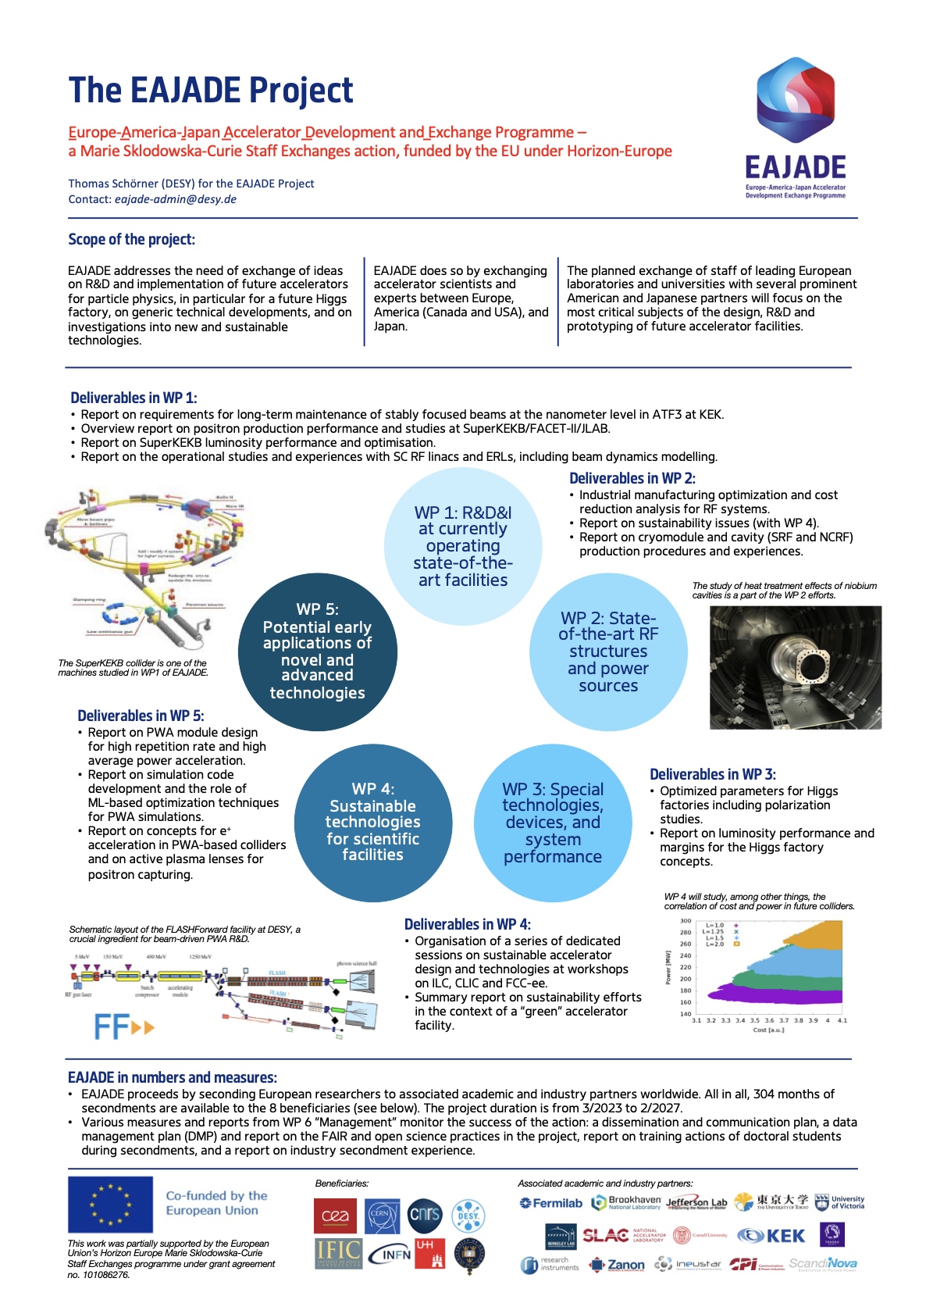
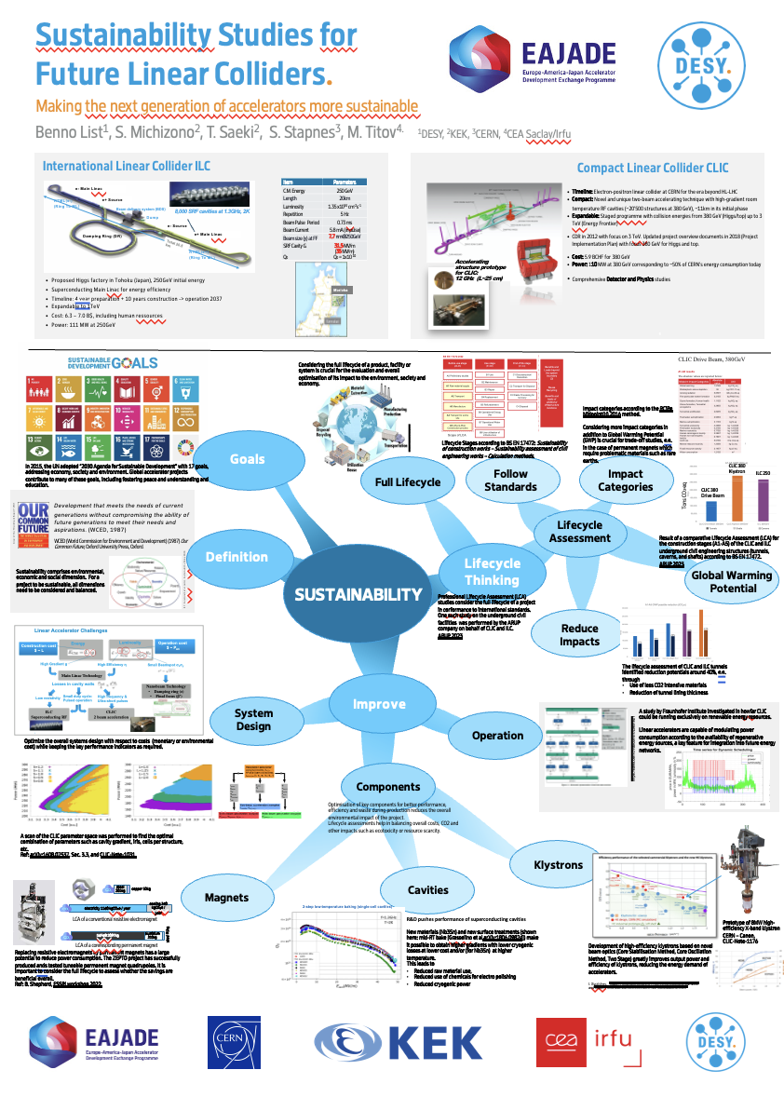
We have started
EAJADE poster EPS: Higgs factory R&D studies with US, Canada, Japan using facilities and exchanges (often students) (LINK)

Slide 5
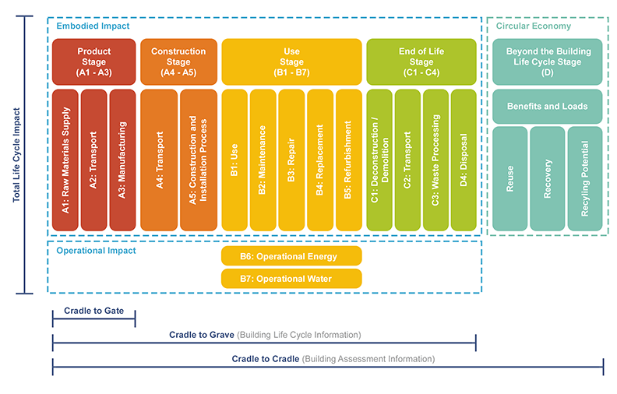
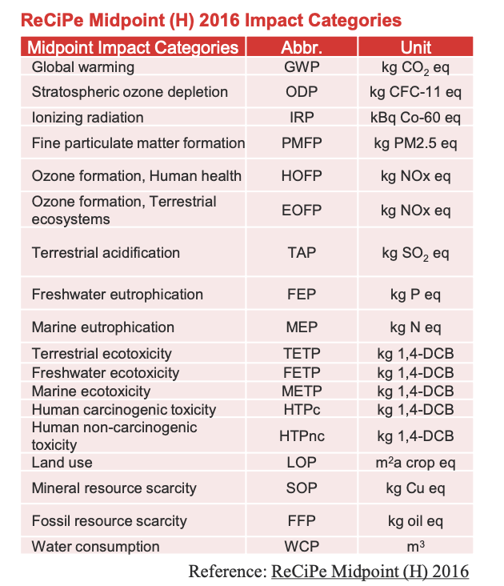
Context for R&D – and collaborations – I
Optimize with respect to:
Energy reach, luminosities, experimental conditions
Facility size and schedule
Costs and Power
Environmental Impact and Sustainability (we are learning what this means)
Keep in mind: This is not only more constraints but also a new opportunity for R&D, new ideas, collaboration
“Not enough to look at operation power and guess the CO2 from this power in ~2050 in your favourite country”

Slide 6
Context for R&D – and collaborations - II
Landscape of accelerators
The large markets are medical and industrial small accelerators (dominated by electron linacs and ion implantation)
Material and life-sciences: Synchrotron-sources (new or upgrades) and FELs, ESS (0.5 - 2B projects)
Research in particle and nuclear physics, LHC and HL, EiC, Neutrino “Factories”, Future colliders …
Whenever possible we benefit strongly from aligning to overall accelerator landscape – connected industry, connected laboratories
In some cases we can link to use of “our” key technologies in other fields, e.g. energy sector with HF magnets a very good example (fusion, power generators, etc)

Slide 7
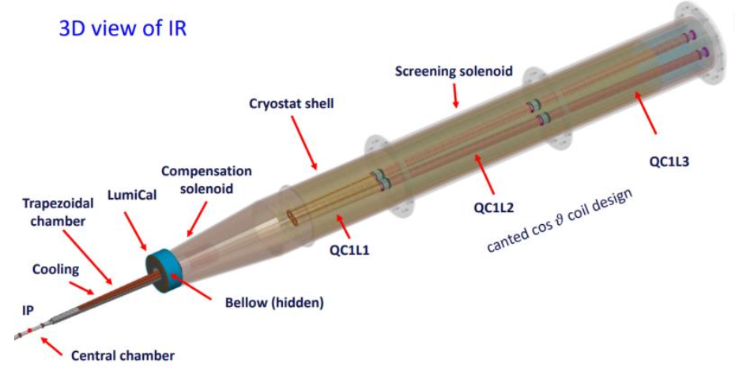
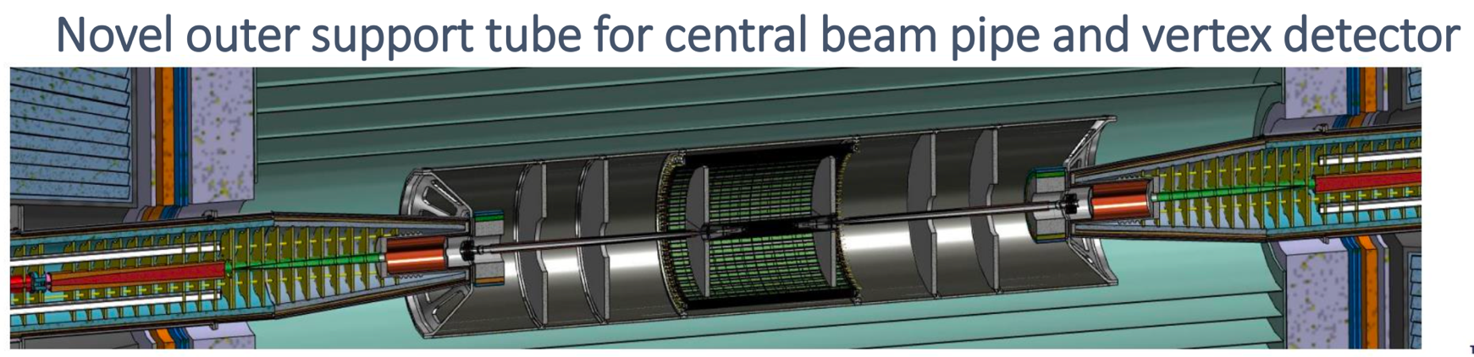
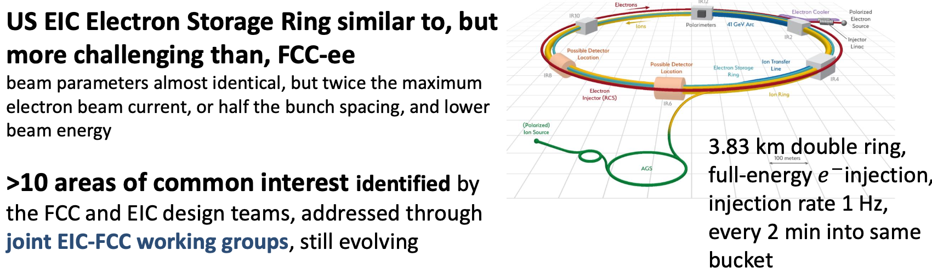
Examples for FCC
FCC-ee MDI examples, also studies of ID heat load distribution and beamstrahlung dump
US EIC Electron Storage Ring similar to FCC-ee
with beam parameters almost identical, but twice the maximum electron beam current, or half the bunch spacing, and lower beam energy.
>10 areas of common interest identified by the FCC and EIC design teams, addressed through joint EIC-FCC working groups, still evolving.
Beam Position Measurement (BPM) – e.g ~1000/arc
Beam Loss Measurement (BLM)
Beam Size Measurement
Bunch Length Measurement
Polarisation and energy calibration
Beamstrahlung photons
….
Planning to start from ‘realistic’ mechanical alignment and iterate with Beam-Based Alignment techniques to achieve ~10 um effective alignment.
From FCC week: Summaries of Benedikt, Raubenheimer, Zimmermann and Lefevre

Slide 8
The European ILC Technology Network activities
Personnel with interest and skills in European labs/Univ., local infrastructure.
Material funds as estimated (major/core part from KEK), in some cases complemented by local funding.
EAJADE, MC exchange project supporting Higgs factory personnel exchange to Japan and the US.
CERN LC, project office (within existing LC resources at CERN).
European ITN studies are distributed on five main activity areas:
Activity 1 with three SC RF related tasks
SRF: Cavities and Cryo Module according to ILC specs
Crab-cavities
In addition Main Linac elements: ML quads and cold BPMs
A2 Sources (e.g positrons)
Pulsed magnet
Wheel/target
A3 Damping Ring including kickers
Low Emittance Ring and kickers
A4 ATF activities for final focus and nanobeams
Instrumentation, steering, feedback, stability, alignment, wakefields etc
A5 Implementation including Project Office
Dump, CE, Cryo – earlier efforts at CERN, based on LHC experience
Sustainability, Life Cycle Assessment

Slide 9
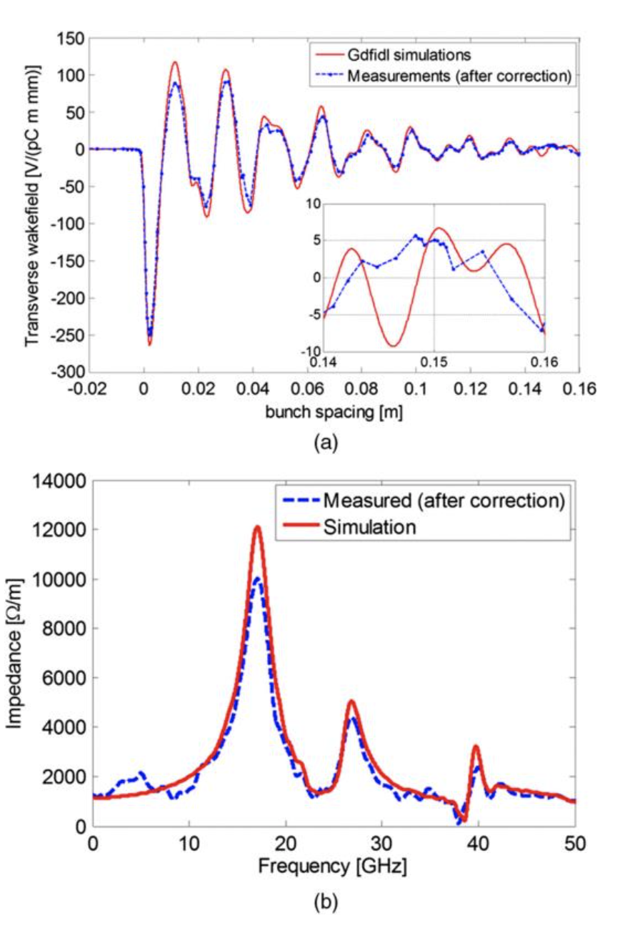
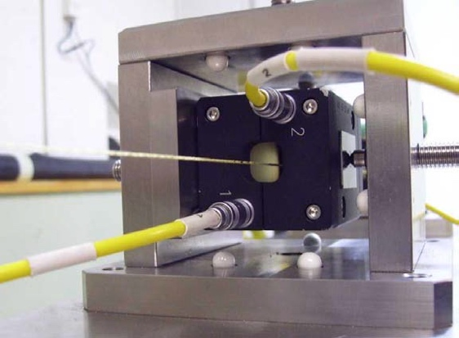
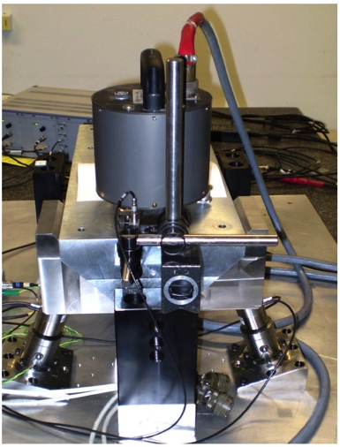
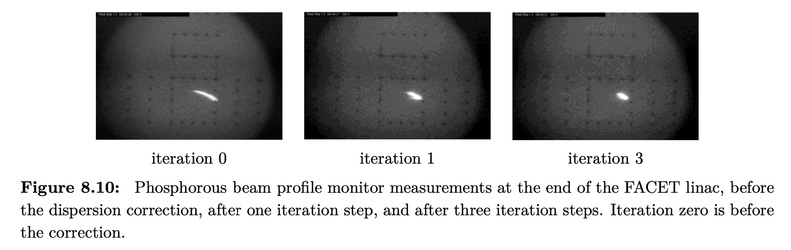
Low emittance generation and preservation in CLIC
Low emittance damping rings
Preserve by
Extraction kicker - prototyped
Align components (10 μm over 200 m)
Control/damp vibrations (from ground to accelerator)
Instrumentation performance and module studies
Beam based measurements
– allow to steer beam and optimize positions
Effect and mitigation of stray fields
Algorithms for measurements, beam and component optimization, feedbacks
Experimental tests in existing accelerators of equipment and algorithms (FACET at Stanford, ATF2 at KEK, CTF3, Light-sources)
Target and achieved emittance in existing and planned machines
2018
2008
Wake-field measurements in FACET
(a) Wakefield plots compared with numerical simulations.
(b) Spectrum of measured data versus numerical simulation.

Slide 10
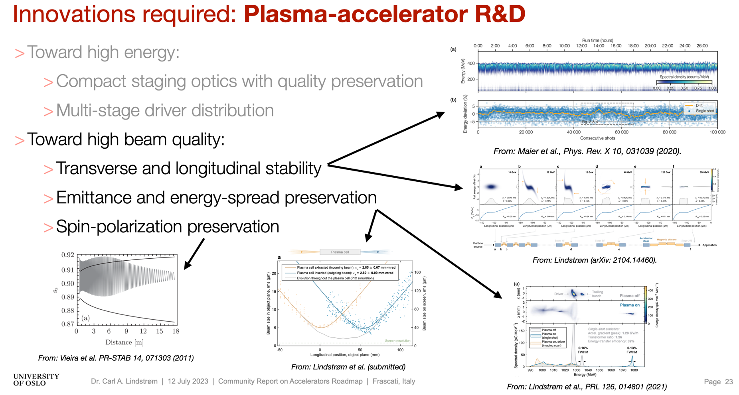
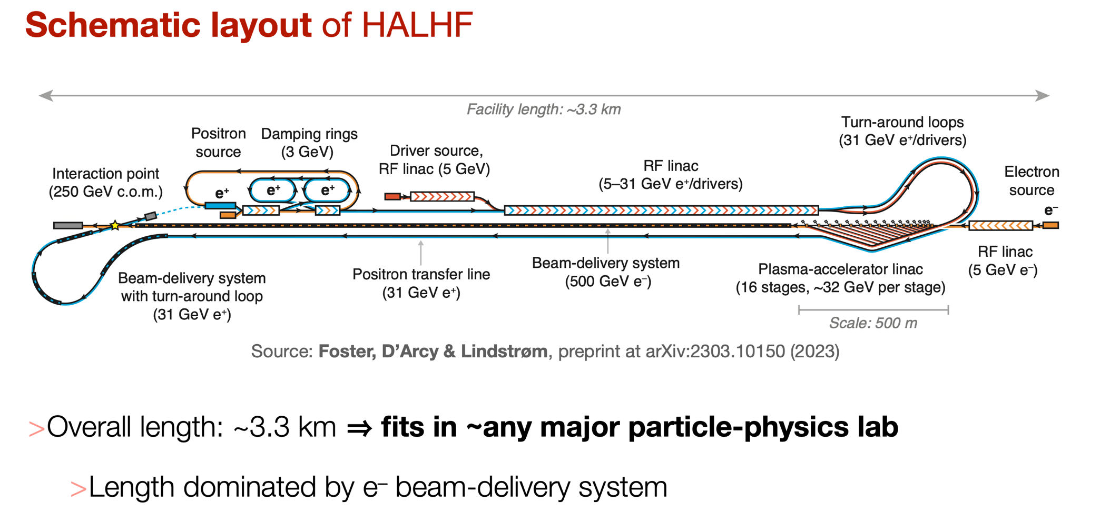
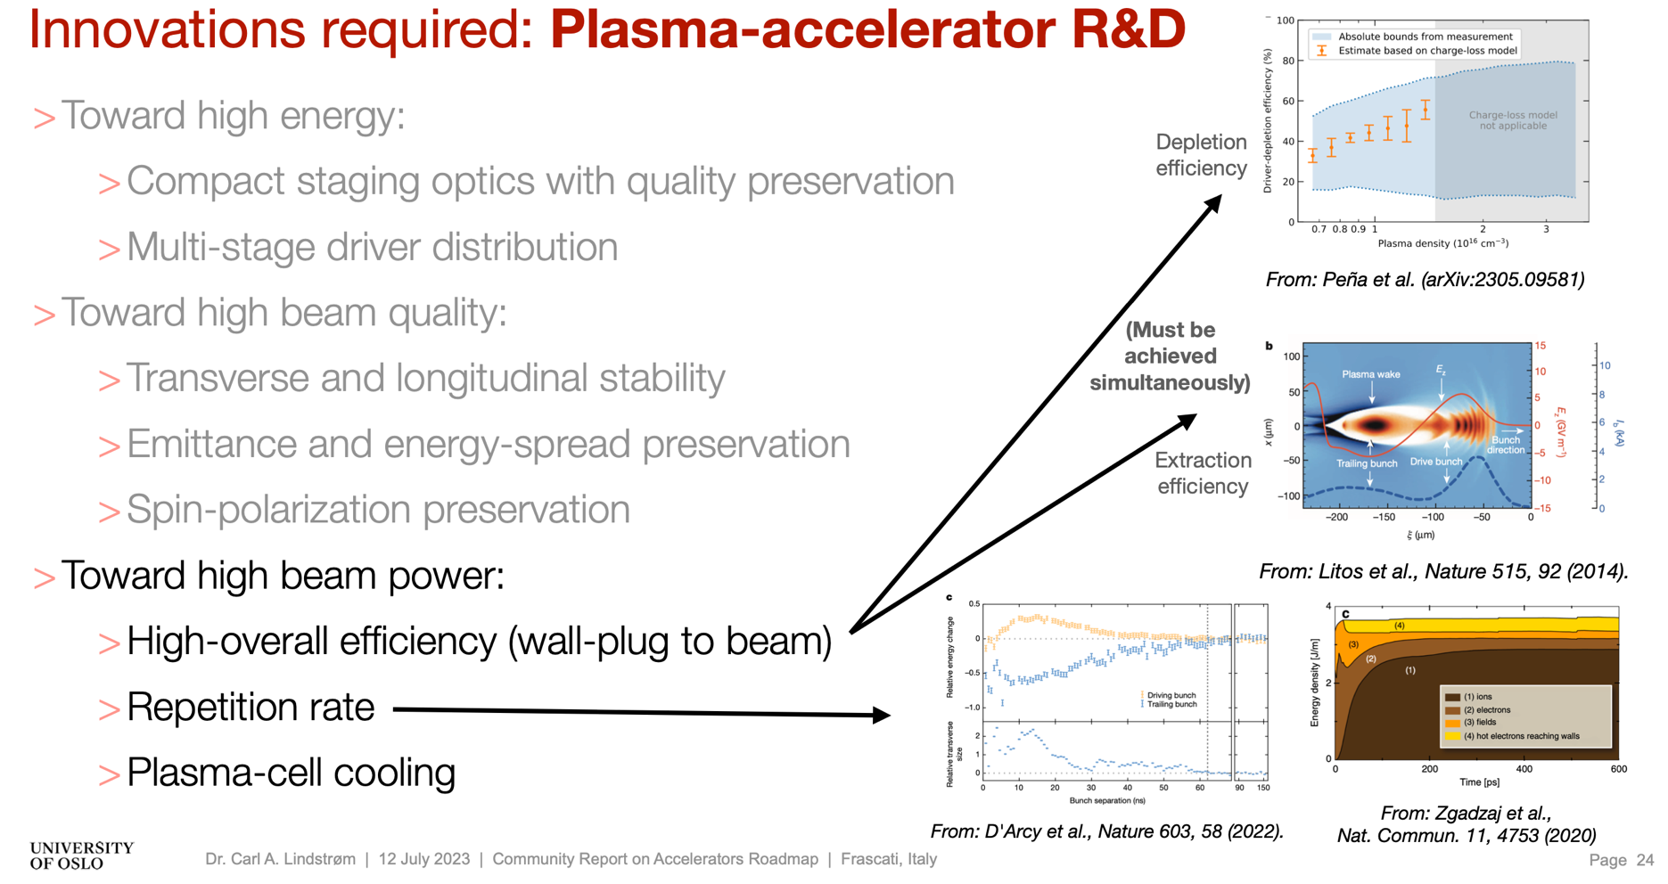
HALHF talk EPS (LINK)

Slide 11
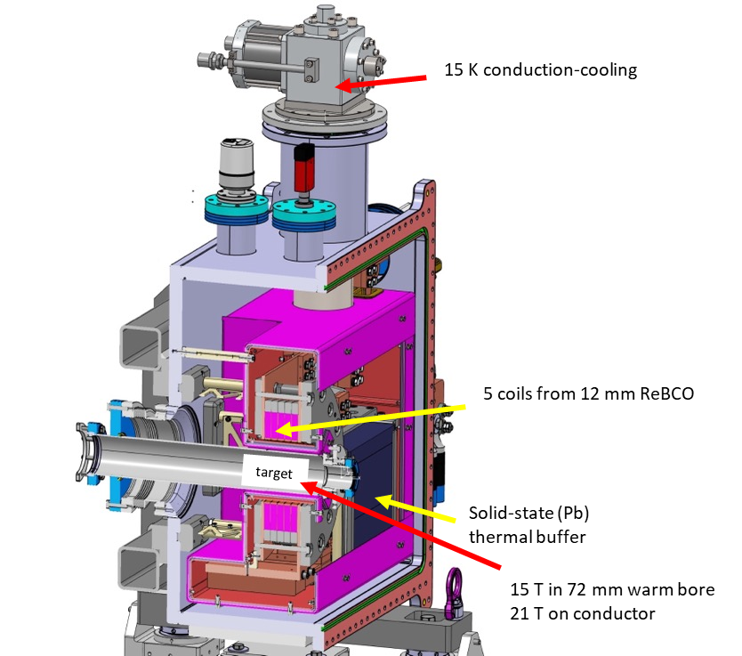
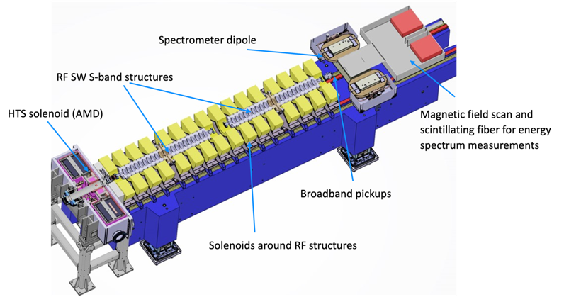
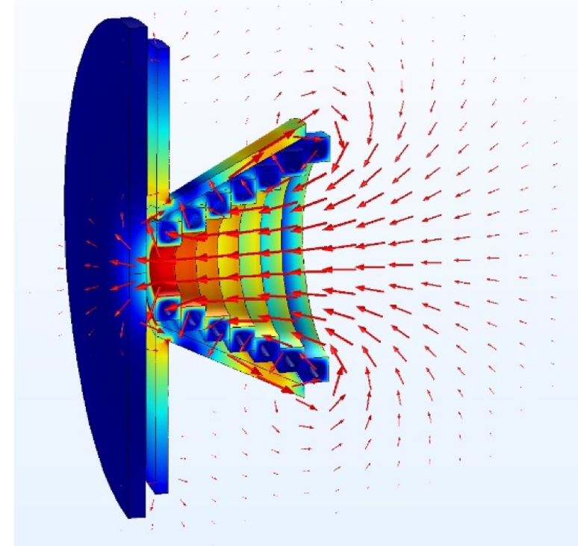
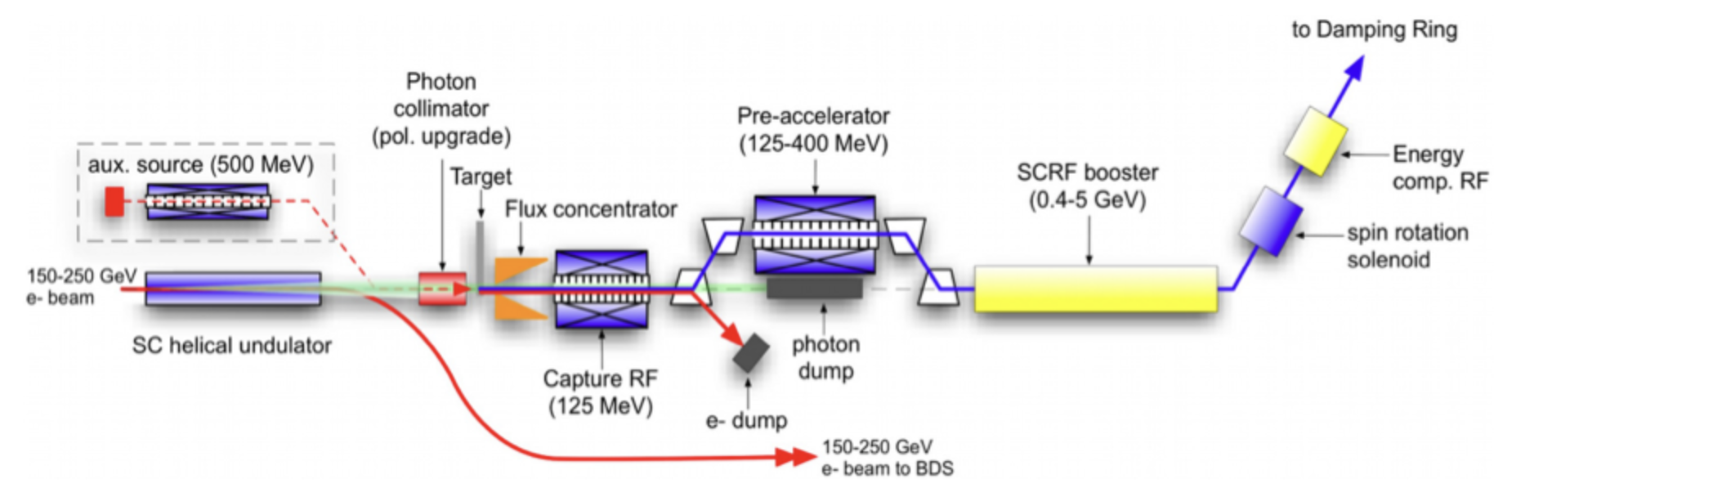
“All” Higgs factories have a positron programme
- a couple of R&D examples -
Positrons for FCC (LINK)
ILC concept and R&D, presentations in the parallel sessions here (LINK1 – more general than ILC), (LINK2 directly on ILC programme)
“Positron production experiment” at PSI’s SwissFEL,
beam tests from 2025/26
HTS NI target solenoid
Notes:
mention plasma lenses

Slide 12
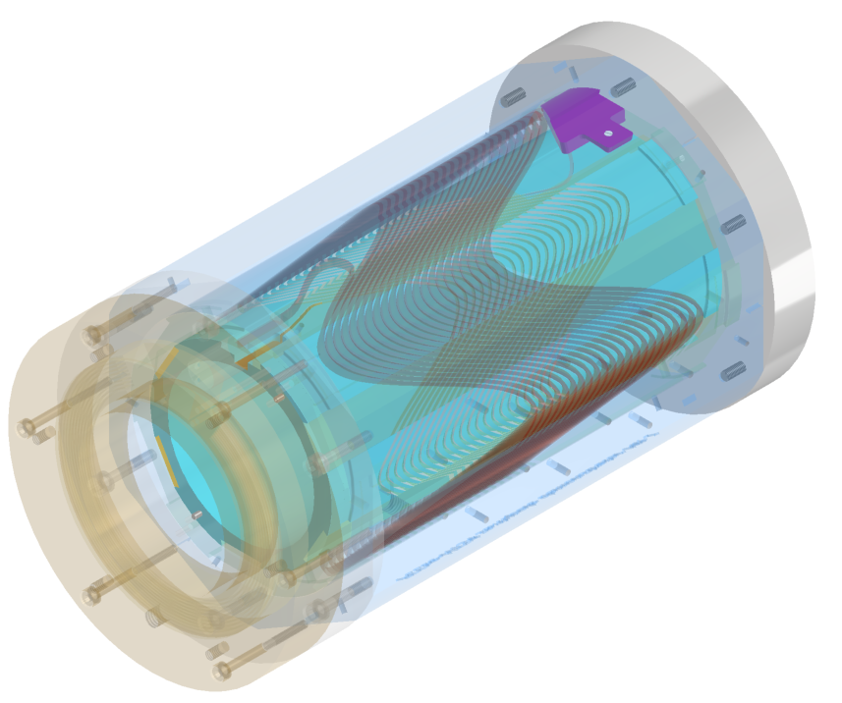
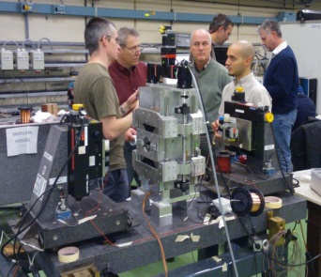
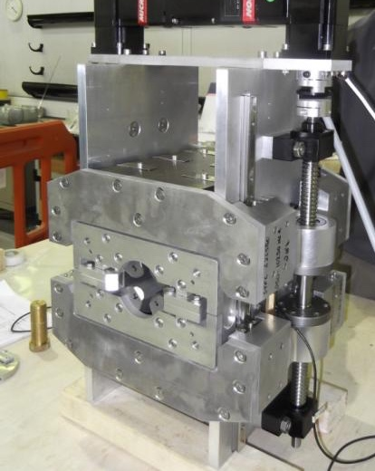
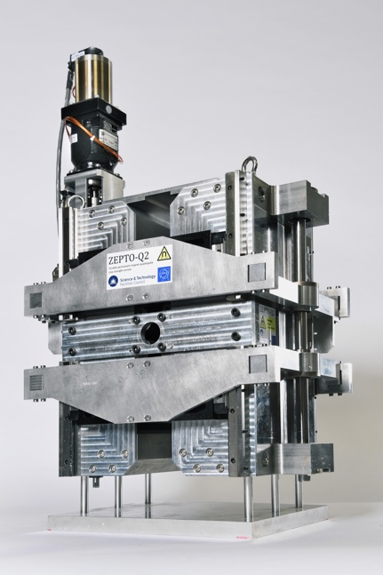
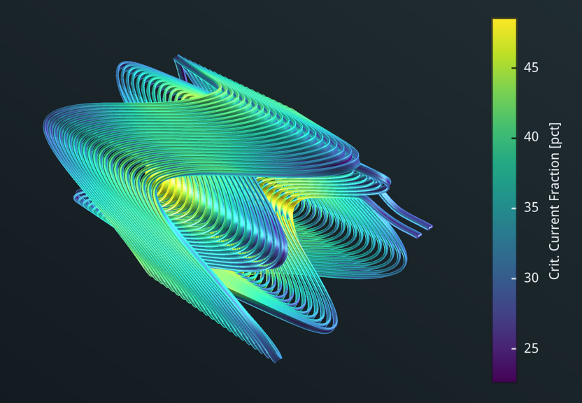
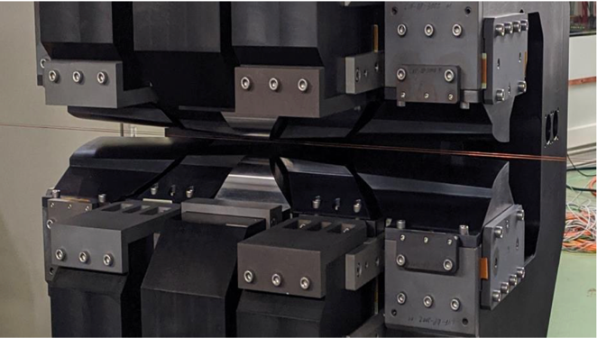
Low power magnets – in linear and circular Higgs – factories (and synchrotron source) - examples
ZEPTO (Zero Power Tuneable Optics) project is a collaboration between CERN and STFC Daresbury Laboratory to save power and costs by switching from resistive electromagnets to permanent magnets.
For CLIC the dominant power is in the drive-beam quadrupoles, successfully prototyped and tested as permanent (two different strengths) magnets, and also dipoles (in drivebeam turn arounds)
Longitudinal gradient dipole magnet for the CLIC DR (CIEMAT)
“HTS4” project within CHART collaboration
Nested SC sextupole and quadrupole.
HTS conductors operating at around 40K.
Cryo-cooler supplied cryostat
Produce a ~1m prototype by 2026
CAD design of HTS short
sextupole demonstrator based on CCT coils
“HTS4” potential
Power saving
Reduced length and increased dipole filling factor
Optics flexibility
From FCC-week (LINK)
doi:10.18429/JACoW-IPAC2018-MOPML048 CC-BY-3.0
12

Slide 13
EAJADE
Landscape has not changed since we wrote the EAJADE proposal
WP leaders fully active
We are all trying to get started, define project and local implementation rules
ITN implementation in Europe started, linking very naturally to EAJADE
HALHF helps to tie plasma studies more naturally into EAJADE
The successful energy recovery EU study (iSAS) also fit into the topics addresses in EAJADE
Being in Japan:
ATF and SuperKEKb important, ITN starting up, successful initiation of WP4 with this week’s WS in Morioka

