Slide 1
EAJADE Overview of Travel Situation Common Fund Issues
EAJADE Annual Meeting 2023
Thomas Schörner
28 September 2023

Slide 2
Secondment situation

Slide 3
Secondments – Target vs. Actual, and Budget
 |  | 100,0% | B E N E F I C I A R I E S (Target vs. Actual) -> |  |  |  |  |  |  |  | Total Target: |  | 304 | Total Actual: |  | 13,9
Timely Completion: |  | 14,4%
Tracking performance: |  | 4,6% | 1-DESY |  | 2-CERN |  | 3-IFIC |  | 4-UHH |  | 5-INFN |  | 6-CEA |  | 7-CNRS
 |  |  | TARGET | ACTUAL | TARGET | ACTUAL | TARGET | ACTUAL | TARGET | ACTUAL | TARGET | ACTUAL | TARGET | ACTUAL | TARGET | ACTUAL
USA | 3 | USA_08_Cornell | 0 | 0,0 | 0 | 0,0 | 0 | 0,0 | 0 | 0,0 | 0 | 0,0 | 0 | 0,0 | 3 | 0,0
 | 34 | USA_10_FNAL | 2 | 0,0 | 6 | 0,0 | 0 | 0,0 | 7 | 0,0 | 4 | 0,0 | 7 | 0,0 | 8 | 0,0
 | 15 | USA_11_BNL | 1 | 0,0 | 8 | 0,0 | 0 | 0,0 | 0 | 0,0 | 0 | 0,0 | 0 | 0,0 | 6 | 0,0
 | 35 | USA_13_LBNL | 24 | 1,3 | 0 | 0,0 | 0 | 0,0 | 4 | 0,0 | 6 | 0,0 | 0 | 0,0 | 1 | 0,0
 | 13 | USA_20_JLAB | 0 | 0,0 | 0 | 0,0 | 0 | 0,0 | 4 | 0,0 | 5 | 0,0 | 1 | 0,0 | 3 | 1,1
 | 10 | USA_22_SLAC | 1 | 1,3 | 6 | 0,0 | 0 | 0,0 | 0 | 0,0 | 0 | 0,0 | 2 | 0,0 | 1 | 0,0
 | 110 | USA_TOTAL | 28 | 2,6 | 20 | 0,0 | 0 | 0,0 | 15 | 0,0 | 15 | 0,0 | 10 | 0,0 | 22 | 1,1
JP | 5 | Japan_12_Tohoku | 1 | 0,0 | 0 | 0,0 | 0 | 0,0 | 0 | 0,0 | 0 | 0,0 | 2 | 0,0 | 2 | 0,0
 | 1 | JAPAN_14_Tokyo | 0 | 0,0 | 1 | 0,0 | 0 | 0,0 | 0 | 0,0 | 0 | 0,0 | 0 | 0,0 | 0 | 0,0
 | 168 | JAPAN_15_KEK | 6 | 0,9 | 31 | 2,5 | 26 | 2,0 | 10 | 0,0 | 12 | 0,0 | 12 | 1,6 | 71 | 3,1
 | 174 | JP_TOTAL | 7 | 0,9 | 32 | 2,5 | 26 | 2,0 | 10 | 0,0 | 12 | 0,0 | 14 | 1,6 | 73 | 3,1
CND | 4 | Canada_09_Victoria | 1 | 0,0 | 0 | 0,0 | 0 | 0,0 | 0 | 0,0 | 0 | 0,0 | 0 | 0,0 | 3 | 0,0
Switzerland |  | 2-CERN | 1 | 0,0 | 0 | 0,0 | 0 | 0,0 | 0 | 0,0 | 0 | 0,0 | 0 | 0,0 | 0 | 0,0
Sweden |  | SE_17_INDUSTRY_Scandinova | 0 | 0,0 | 0 | 0,0 | 0 | 0,0 | 0 | 0,0 | 1 | 0,0 | 0 | 0,0 | 0 | 0,0
Italy |  | ITALY_INDUSTRY_18_ZANON | 0 | 0,0 | 0 | 0,0 | 0 | 0,0 | 0 | 0,0 | 0 | 0,0 | 1 | 0,0 | 0 | 0,0
 |  | 5-INFN Frascati | 4 | 0,0 | 0 | 0,0 | 0 | 0,0 | 0 | 0,0 | 0 | 0,0 | 0 | 0,0 | 0 | 0,0
Germany |  | GERMANY_21_INDUSTRY_RI | 0 | 0,0 | 0 | 0,0 | 0 | 0,0 | 0 | 0,0 | 0 | 0,0 | 1 | 0,0 | 0 | 0,0
 |  | 1-DESY | 0 | 0,0 | 0 | 0,0 | 0 | 0,0 | 0 | 0,0 | 4 | 0,0 | 0 | 0,0 | 0 | 0,0
SP |  | SPAIN_19_INDUSTRY_INEUSTAR | 0 | 0,0 | 0 | 0,0 | 0 | 0,0 | 0 | 0,0 | 0 | 0,0 | 1 | 0,0 | 0 | 0,0
UK** |  | UK_16_UOXF | 1 | 0,0 | 1 | 0,0 | 0 | 0,0 | 0 | 0,0 | 0 | 0,0 | 0 | 0,0 | 1 | 0,0
 |  |  | 42 | 3,5 | 53 | 2,5 | 26 | 2,0 | 25 | 0,0 | 32 | 0,0 | 27 | 1,6 | 99 | 4,3
EC Maximum Grant Amount |  |  | 193.200,00 |  | 243.800,00 |  | 119.600,00 |  | 115.000,00 |  | 147.200,00 |  | 124.200,00 |  | 455.400,00
Common FUND (8%) |  |  | 15.456,00 |  | 19.504,00 |  | 9.568,00 |  | 9.200,00 |  | 11.776,00 |  | 9.936,00 |  | 36.432,00
Availible for secondments* |  |  | 177.744,00 |  | 224.296,00 |  | 110.032,00 |  | 105.800,00 |  | 135.424,00 |  | 114.264,00 |  | 418.968,00
**) 16 - THE CHANCELLOR, MASTERS AND SCHOLARS OF THE UNIVERSITY OF OXFORD to DESY: 8 Secondment-Months
*) Overheads still to be deducted depending on the sending organisation's rules
Total EU Contribution:
1.398.400
Assuming (as of March ‘23) total Common fund of 8%:
111.872

Slide 4
Secondments distributed over WPs & beneficiaries
Target (“Plan”)
Actual vs plan

Slide 5
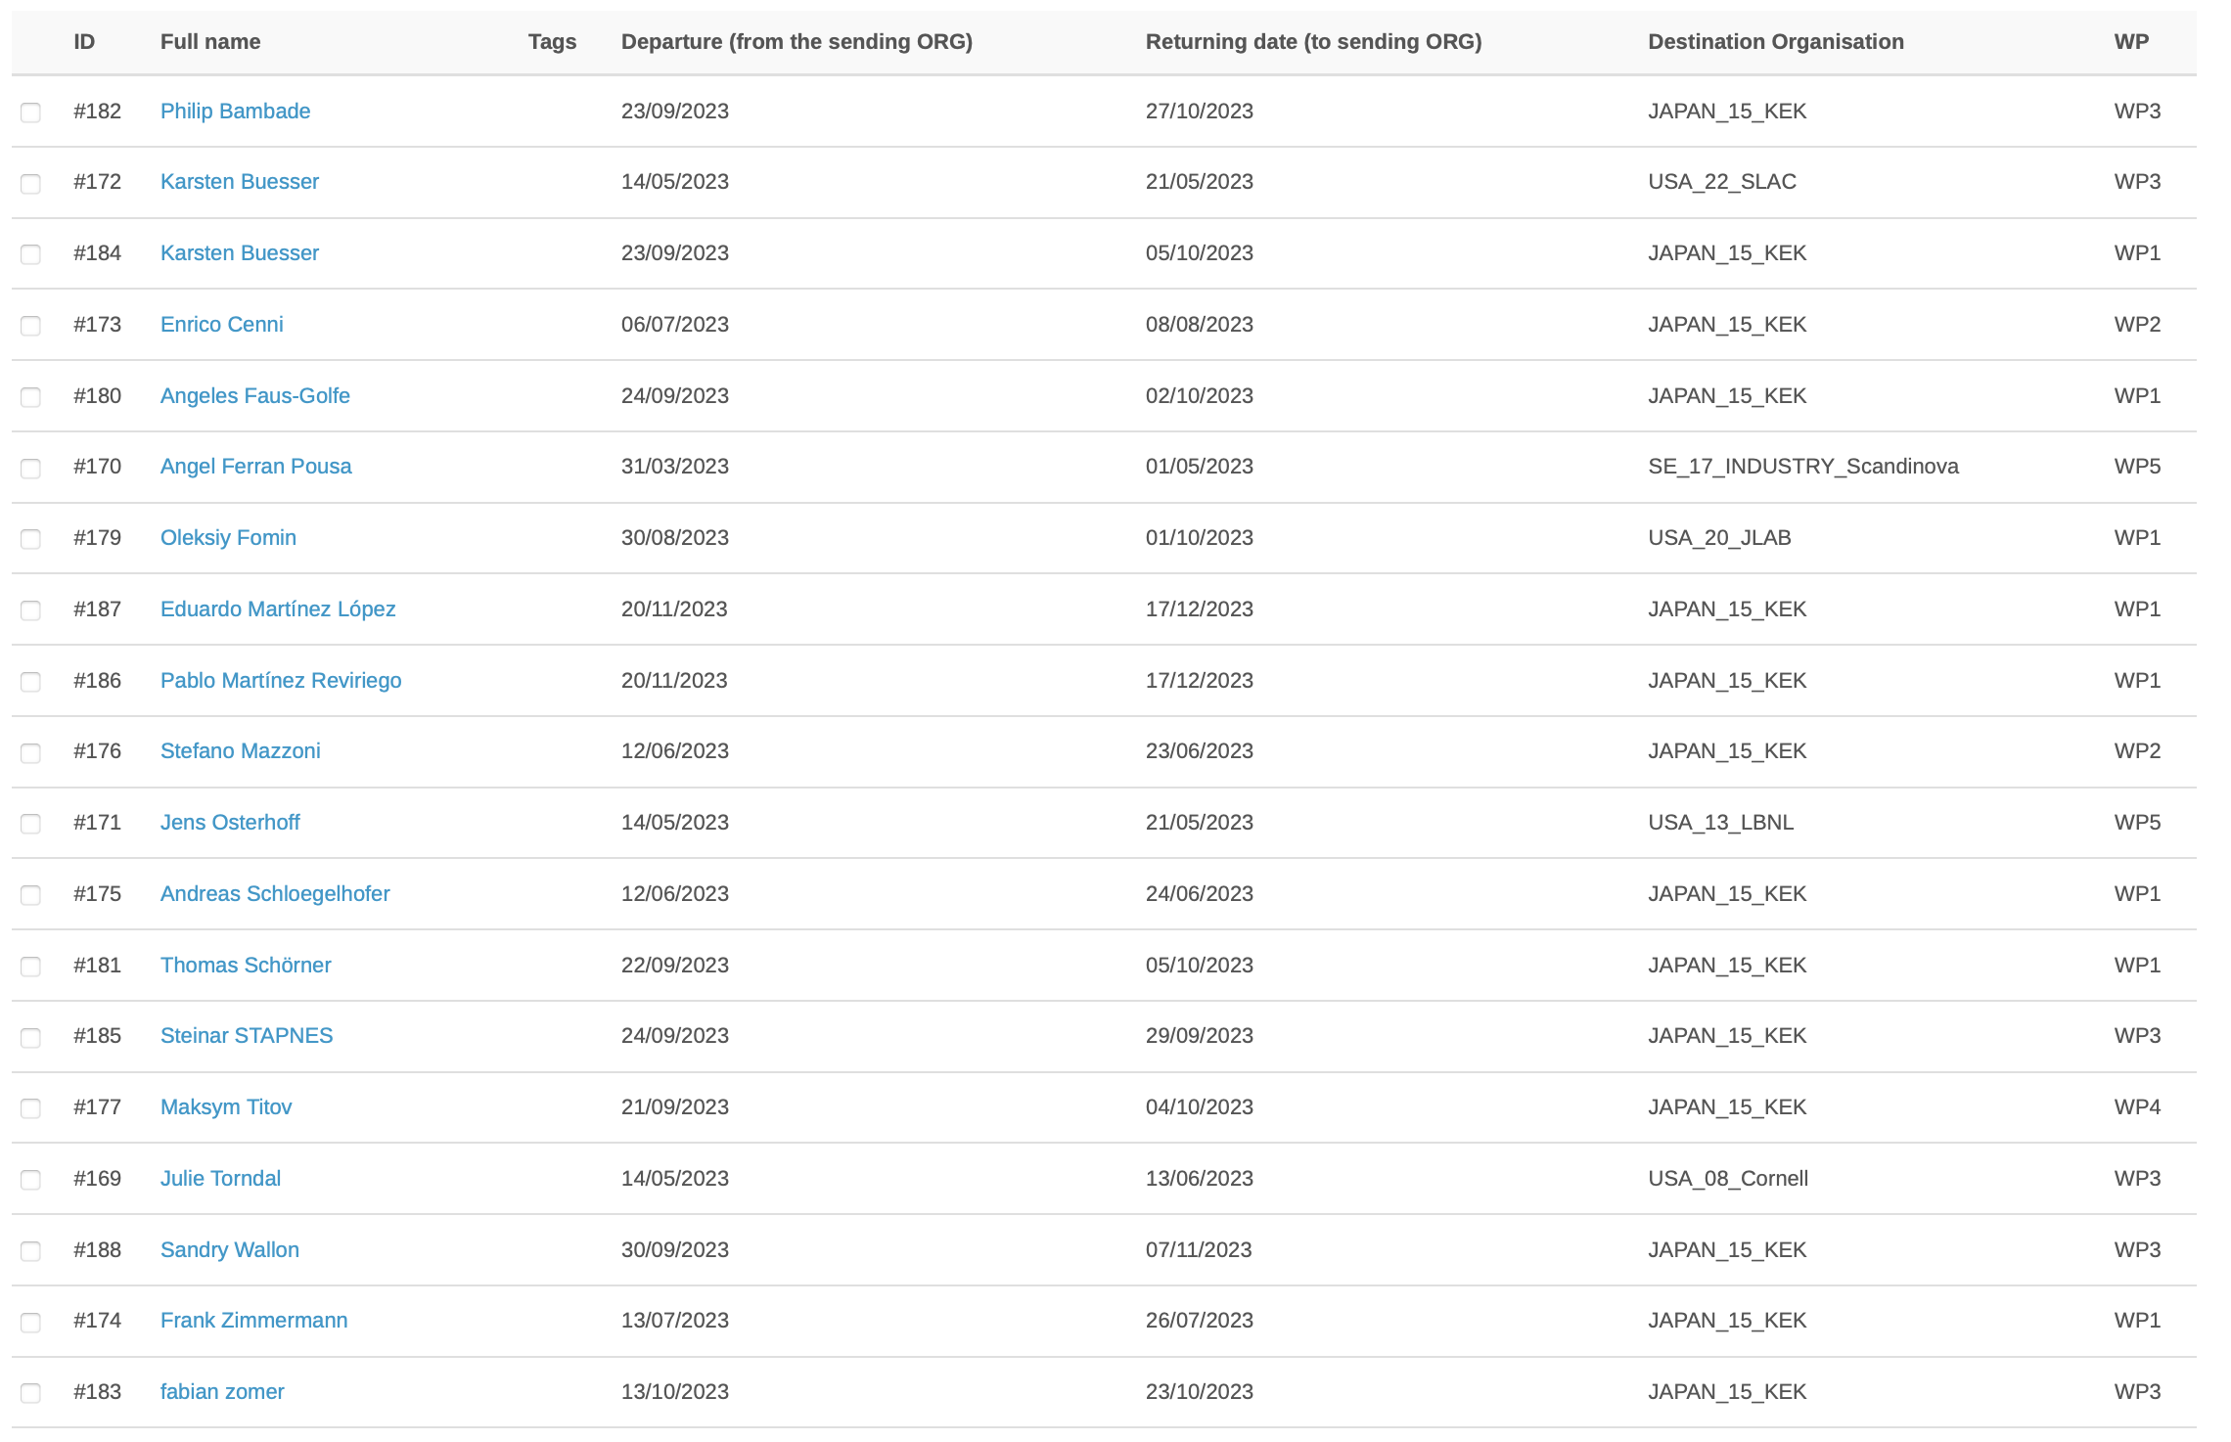
Extract from INDICO 20230927
Important:
Always register secondments in INDICO!
Always fill in all necessary forms (eligibility, Ph.D. goals / report, declaration of honour)
Read the guidelines!
WP leads: Provide planning outlooks for your travels on request to Natalia and Thomas → regular updates, helps to
Keep track of cash flow
Inform receiving insitutions of who is coming when.

Slide 6
Common fund situation

Slide 7
Recap: Pre- financing distribution taking into account 8% for common fund kept by DESY: / Back up
Plan March 2023
 |  | A | B | C | D
Participant short name | Country | Total EU Contribution | Participant's share | Prefinancing (60% ot EC contribution) | 8 % for Common Fund | Payment to Beneficiary C - D
1-DESY | Germany | 193.200 | 13,82% | 115.920,00 | 9.273,60 | 106.646,40
2-CERN | Switzerland | 243.800 | 17,43% | 146.280,00 | 11.702,40 | 134.577,60
3-IFIC | Spain | 119.600 | 8,55% | 71.760,00 | 5.740,80 | 66.019,20
4-UHH | Germany | 115.000 | 8,22% | 69.000,00 | 5.520,00 | 63.480,00
5-INFN | Italy | 147.200 | 10,53% | 88.320,00 | 7.065,60 | 81.254,40
6-CEA | France | 124.200 | 8,88% | 74.520,00 | 5.961,60 | 68.558,40
7-CNRS | France | 455.400 | 32,57% | 273.240,00 | 21.859,20 | 251.380,80
 |  | 1.398.400 | 100,00% | 839.040,00 | 67.123,20 | 771.916,80
News – final: DESY will not take responsibility for common fund because of tax liability fears!

Slide 8
Mail 20230925 Natalia
- BezueglicDeines Vorschlags zum Common Fund: Koennen wir denn - erstens unsere 5-8% fuer Reisen von Doktoranden innerhalb Europas nutzen (so habe ich Dich verstanden?) ja, falls der Gesamtbetrag an Ausgaben, was DESY für diese Kategorie verwendet innerhalb von 5-8% vom DESY(!)Budget liegt. Wir können die 5-8% praktisch für alles benutzen, falls wir eben nur "unser" Geld dafür in die Hand nehmen. - zweitens den Rest des Common Funds an zB CNRS schieben, damit die das verwalten? genau das war der Plan unter Option B (shared management)

Slide 9
Consortium Agreement & Common Fund
Possible actions: 1) Treat common fund outside of the consortium agreement (CA) so that we can go for its signature
In CA: “… intend to set up common fund …”
If we want and manage to, include appendix to CA.
2) Hand over the management of the CF to other partner or distribute the CF duty between several beneficiaries (or only one) → who? CERN? INFN? CNRS?
3) Distribute the money to all partners according to what they can / want to do … (maybe reduce from 8 to 5%?)
4) Search for another solution/approach → no CF at all?
➔ What measures exactly do we want to sponsor? I have not yet heard any proposal.

Slide 10
Possible shared management of the CF
Common Fund 8% (368EUR per completed secondment-month => 4.232EUR* for Travel) | 2023 | 2024 | 2025 | 2026 | 2027 | Sum
Staff training events (school organised by EAJADE or support for attandance by other specialised events) | 6.400,00 € | 9.400,00 € | 9.400,00 € | 9.400,00 € | 3.400,00 € | 38.000,00 €
Support for students (co-supervised PhD students attending conferences) | 2.000,00 € | 2.800,00 € | 2.800,00 € | 2.800,00 € | 1.472,00 € | 11.872,00 €
Management | 750,00 € | 1.000,00 € | 1.000,00 € | 1.000,00 € | 250,00 € | 4.000,00 €
Annual project meetings & Kick-Off & Mid Term | 7.100,00 € | 9.600,00 € | 9.600,00 € | 9.600,00 € | 2.100,00 € | 38.000,00 €
Associated partners | 3.000,00 € | 5.000,00 € | 5.000,00 € | 5.000,00 € | 2.000,00 € | 20.000,00 €
TOTAL | 19.250,00 € | 27.800,00 € | 27.800,00 € | 27.800,00 € | 9.222,00 € | 111.872,00 €
To be covered by DESY directly to travellers out of DESY share
Other partner/s
Disadvantages :
shared management is time-consuming , sometimes non-transparent
Is difficult to ensure that, in sum, all partners spent ~same amount for common activities

Slide 11
Thank you!
Thomas Schörner
DESY FH
E-Mail: thomas.schoerner@desy.de
Phone: +49 40 8998 3429
https://www.eajade.eu
E-Mail: eajade-admin@desy.de

Slide 12
Backup

