Slide 1
Time-to-digital converter (TDC) in CMOS technology – overview and design example
Juli 2023
Outline
Introduction
Application
Classification
Types of sampling TDCs
Characterization
Design Example
Summary

Slide 2
Introduction
TDC
Key components of time-mode circuits
Enablers for digital processing of analog signals encoded in time
translates the analog time interval into a digital value
digital signals are far more robust against noise and coupling than analog signals
Applications
Classification
Precise time-interval measurements
Time-of-flight measurements
Act as phase detector in all-digital phase-looked loops (ADPLLs)
Positron emission tomography (PET)
Light detection and ranging (LiDAR)
…
Sampling TDC
Noise-shaping TDC
Stochastic TDC
J. Szyduczyński, D. Kościelnik, M. Miśkowicz,
Time-to-digital conversion techniques: a survey of recent developments.
Measurement, 214, 2023, 112762,
https://doi.org/10.1016/j.measurement.2023.112762.

Slide 3
Introduction
Comparison
TDC
ADC
Time-interval counting
a sampler and a quantizer
The sampler evaluates the input signal at discrete time instances.
The quantizer maps the resulting continuous values to discrete ones.
Both together result in a digital signal representation.
n-bit TDC
Start
1010…
Stop
∆t
quantizing
∆t_{LSB}
$$∆t=No. ∗∆tLSB$$
$$∆tLSB=\frac{T}{2^{n}}$$
LSB = least significant bit
sampling

Slide 4
Introduction
Sampling TDC overview
coarse TDC
Counter TDC
direct time-to digital conversion
counting of clock cycles (< 1GHz)
for low time resolution > 1ns
large measuring range
fine TDC
for high time resolution < 1ns
small measuring range
analog
ramp interpolator
digital
delay lines
Vernier delay lines
Successive-approximation
Pulse-shrinking
I_{constant}
N*T_{Clk}
start/stop
reset
V_{ramp}
ADC
C
∆T_{Start}
T_{In}
∆T_{Stop}
Start
T₀
T₀
T₀
T₀
V
V_{ramp}
T_{In}
S
Q
S
Q
S
Q
S
Q
Stop
R
R
R
R
reset
t
Start/stop
Successive delaying of start through a DL
Time comparator records the order in which the events arrive
Result in thermometer code
T_{In}
sampling
quantizing
Notes:
The analog-based TDC precision depends on the linearity of the TVC and the resolution of VDC .
Analog-based TDCs attracts less attention in modern CMOS processes because it does not take advantage of downscaling of CMOS technology.
The analog-based TDCs usually suffer from substantial power consumption, high cost due to large silicon area occupied by capacitors, large temperature drift, and decreasing voltage resolution.

Slide 5
Introduction
Delay-line based TDCs
Vernier delay lines
Successive-approximation
Pulse-shrinking
T_{m}
C_{n-1}
C_{n-2}
C₁
C₀
Start
T₀
T₀
T₀
T₀
Start
T_{m}
T_{Sn-2}=2^{n-2}T₀
∆T
2∆T
T_{In}
S
Q
S
Q
S
Q
S
Q
Start/Stop
R
R
R
R
S
Q
S
Q
R
R
t_{r2}, t_{f2}
t_{r1}, t_{f1}
t_{r2}, t_{f2}
Stop
/Q
/Q
T_{In}
t_{r1}, t_{f1}
t_{r1}, t_{f1}
t_{r2}, t_{f2}
T‘₀
T‘₀
T‘₀
T‘₀
S
Q
S
Q
S
Q
Stop
T_{m}
R
R
R
T_{In}
T_{m}
T_{Rn-2}=2^{n-2}T₀
Resolution:
$$∆T0=T0 −T^{′}0$$
T₀
b_{n-1}
b_{n-2}
b₁
b₀
Start
8T₀
achieving a sub-gate delay TDC resolution
T_{In} in the form of a pulse is gradually shrinked until it ceases to exist
unit cells with the different rising (t_{r}) and falling (t_{f}) transition time
use of differential delays of two delay lines with slightly different propagation latencies (T₀ and T’₀)
Better resolution than delay line, but increased number of delay components
<T₀ (LSB)
T_{In}
2T₀
Stop
4T₀
b₄
b₃
b₂
b₁
b₀
1
0
0
1
0
Binary-weighted latencies enables reduction of number of conversion steps
Delaying 2 events by binary-scaled latencies, such that both events coincide in time at the end of conv.
Feedforward SA-TDC shown
sensitive to errors due to metastability of time comparator (RS-flipflop)
Notes:
Metastability is a general problem of TDCs of any type. But in the SA-TDCs, the metastability implies gross conversion errors especially if it occurs at the evaluation of one of the most significant output bits. By comparison, in the delay line TDCs with uniform delays, the metastability results in the possible error just on the state of the LSB.

Slide 6
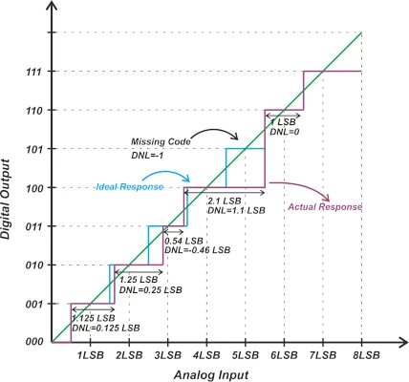
Introduction
TDC performance characterization – Nonlinearity
DNL
differential nonlinearity
Deviation of the step width from the ideal value
Transfer function response
Ramp input
$$DNL\left(n\right)=\frac{width\left(n\right)−widthideal }{widthideal}$$

Slide 7
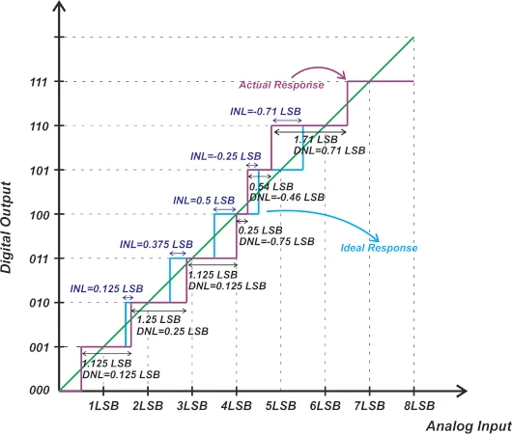
Introduction
TDC performance characterization – Nonlinearity
INL
integral nonlinearity
Deviation from a linear fit or
deviation of code transitions from their ideal values
→ cumulative sum of DNL
Transfer function response
Ramp input
INL = 0 LSB
INL = -0.9 LSB
$$INL\left(t\right)=yLine(t)−n(t)$$
$$INL\left(n\right)=\frac{Ta\left(n\right)−Tideal(n) }{widthideal}$$
$$INL\left(n\right)=\sum_{i=1}^{n−1}{DNL(i)}$$
INL = 0.4 LSB

Slide 8
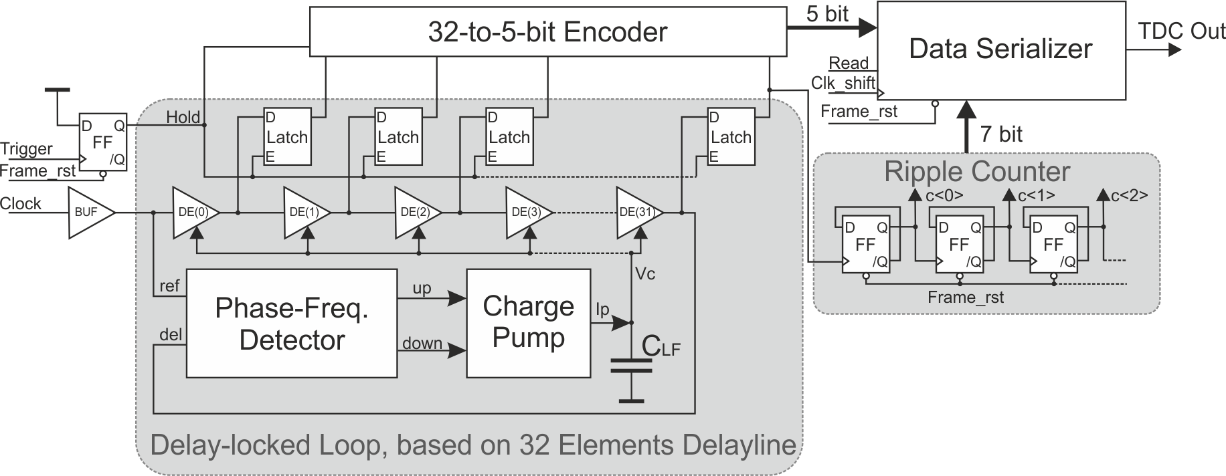
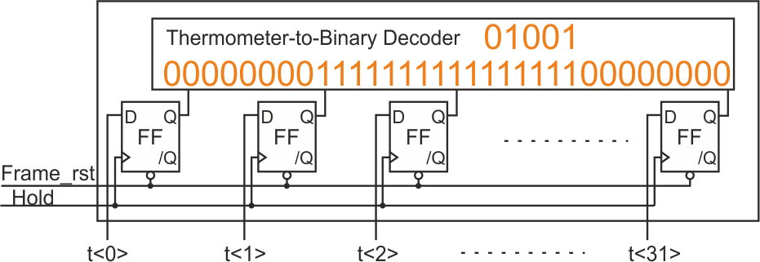
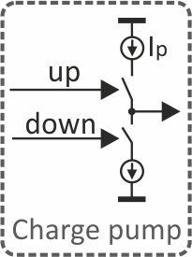
Design in 130-nm CMOS Process from Global Foundry
Combination of delay-line locked loop TDC and counter TDC
Multi-level TDC
5-bit fine and 7-bit coarse TDC
DLL as fine TDC: 32 elements delayline in a loop, locked to a reference clock
Ripple Counter as coarse TDC: increments after each DLL cycle
Encoder
DLL output is in thermometer code
Encoder output in binary code
Clock
ref
up
Frame reset
Phase-Frequency
Detection
del
down

Slide 9
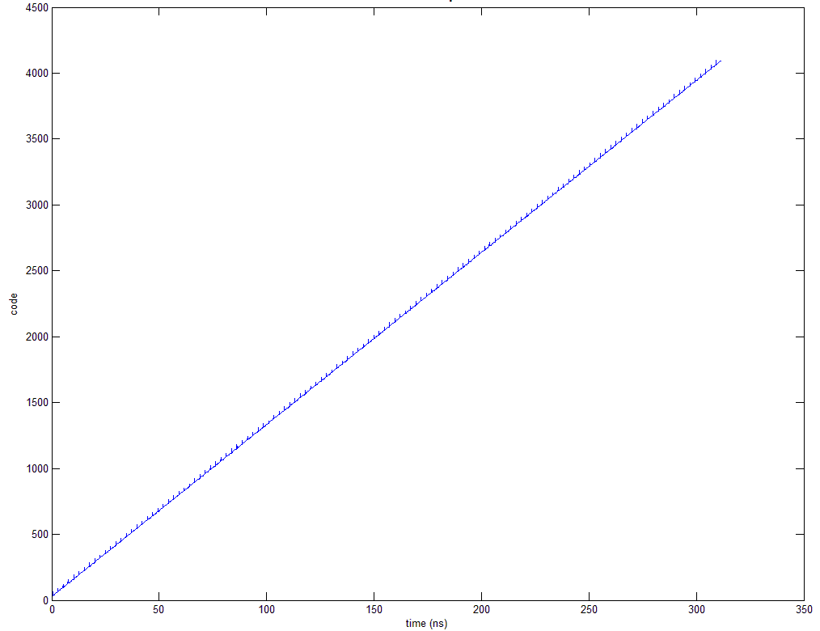
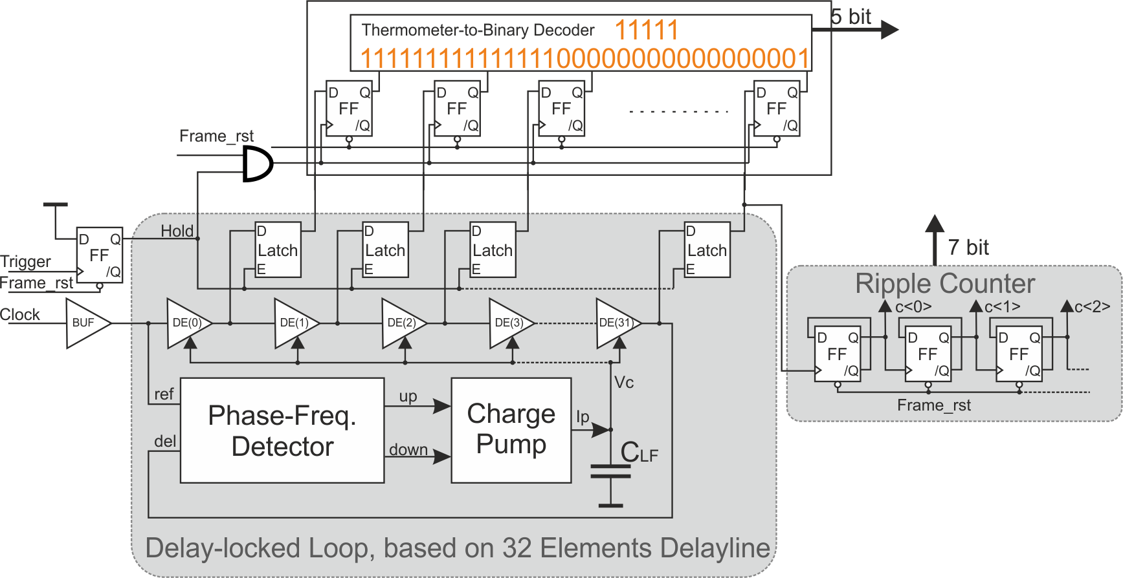
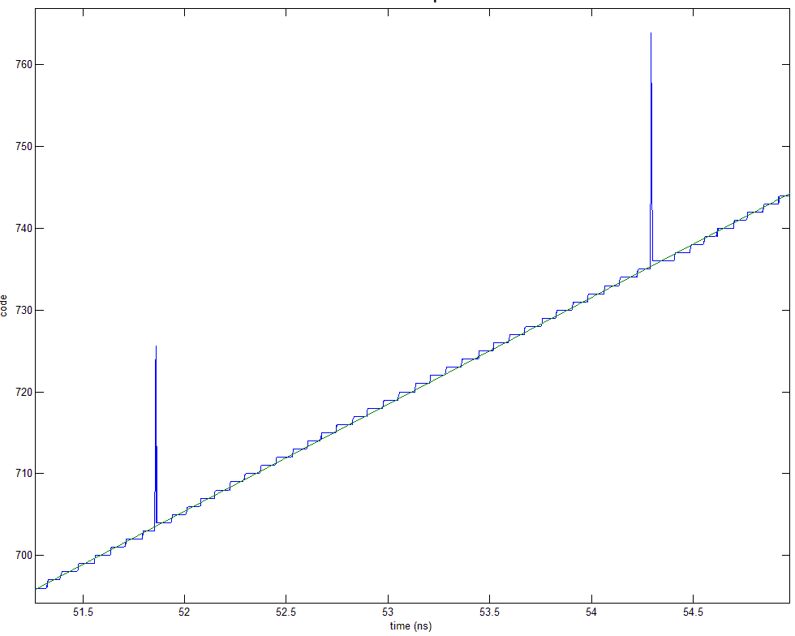
Design in 130-nm CMOS Process from Global Foundry
Output
Solution: include delay
20-ps time conflict, caused by registers setup/hold time
+1
20-ps long spike of 32 bins
TDC is designed for target frequency 408 MHz
small bug, caused by registers setup/hold-time
mean bin width (77.2 ps) is in good agreement with ideal value (76.6 ps)
upper limit ≤450 MHz

Slide 10
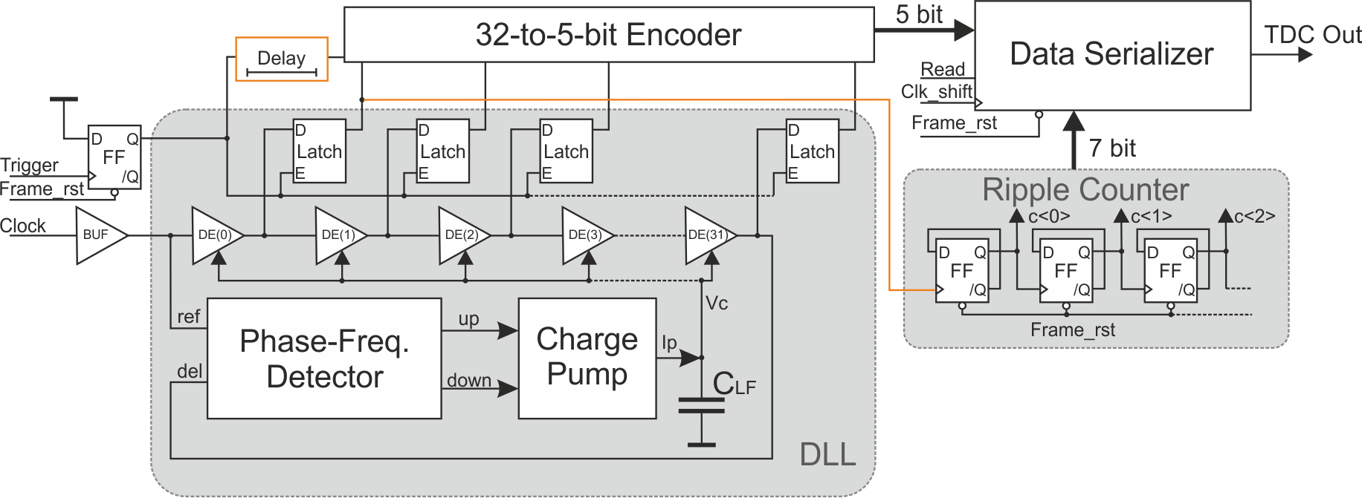
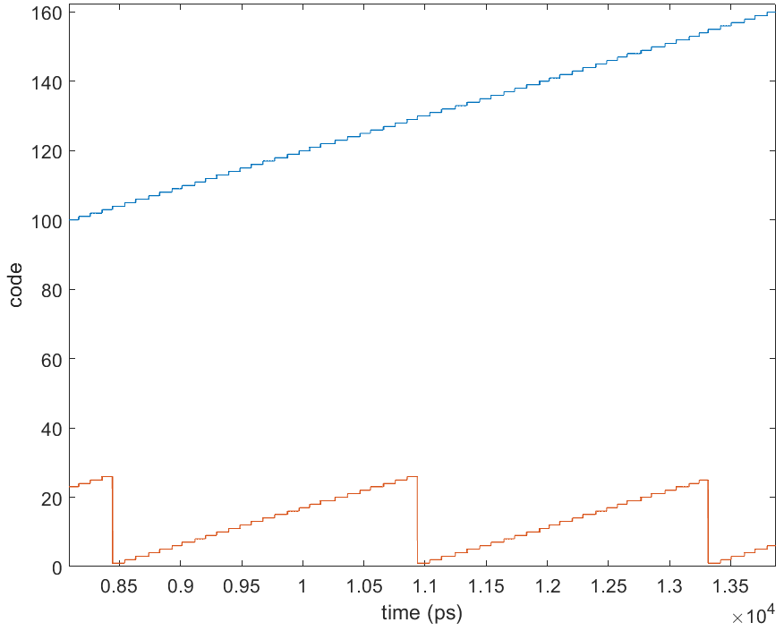
Design in 150-nm CMOS Process from LFoundry
Combination of delay-line locked loop TDC and counter TDC
resulting transfer function
Delay include
Incrementation after first delay element
Modification in encoder for the case that DLL doesn’t work properly

Slide 11
Design in 150-nm CMOS Process from LFoundry
Combination of delay-line locked loop TDC and counter TDC
resulting transfer function
Delay include
Incrementation after first delay element
Modification in encoder for the case that DLL doesn’t work properly
This case happened
only 25 fine bins
vulnerable to PVT variations

Slide 12
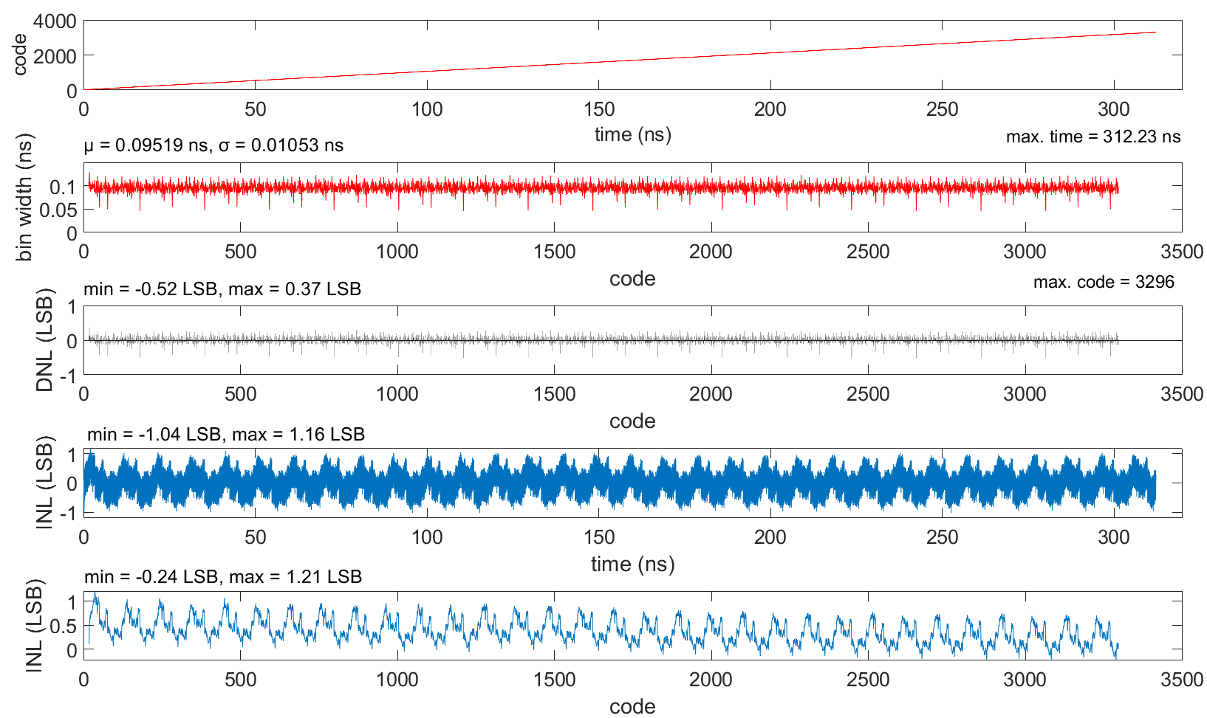
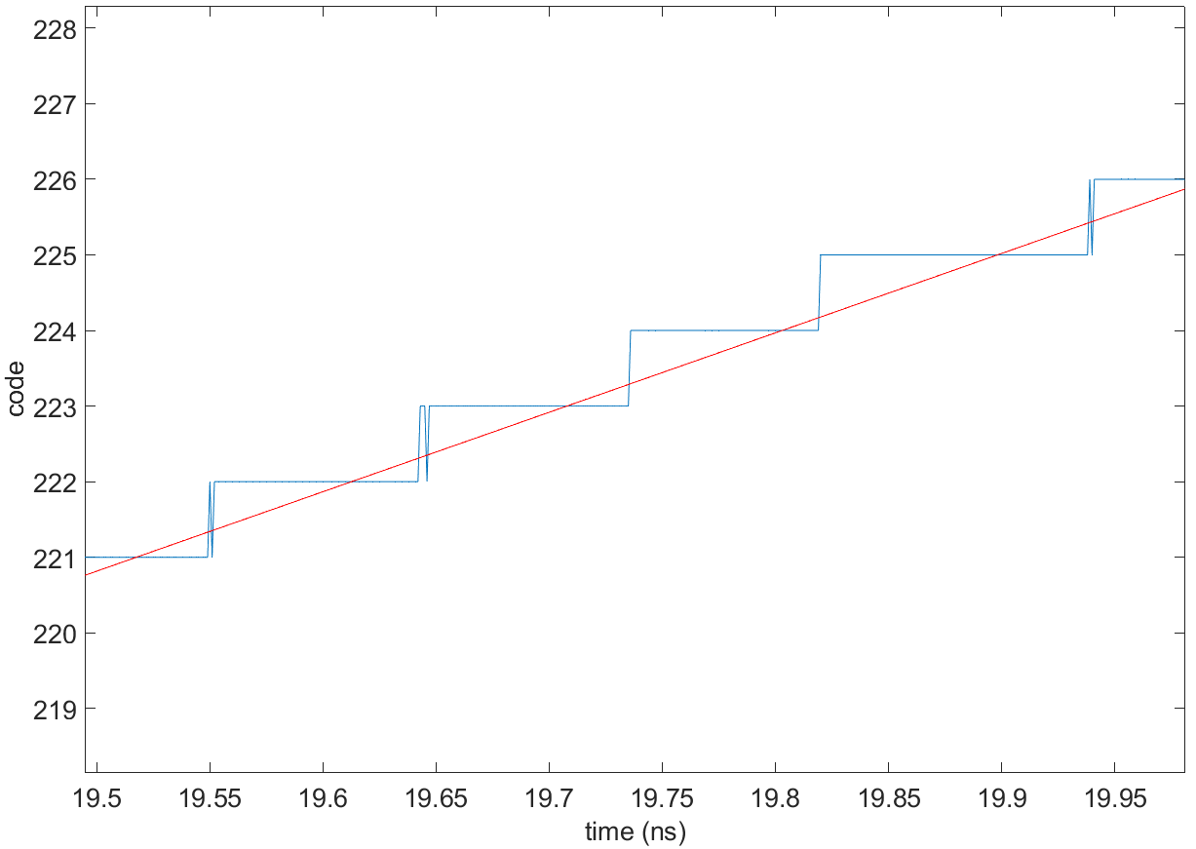
Design in 150-nm CMOS Process from LFoundry
Output
$$n(t)$$
$$yLine(t)$$
bin width
$$DNL\left(n\right)=\frac{width\left(n\right)−widthideal }{widthideal}$$
$$INL\left(t\right)=yLine(t)−n(t)$$
$$INL\left(n\right)=\sum_{i=1}^{n−1}{DNL(i)}$$

Slide 13
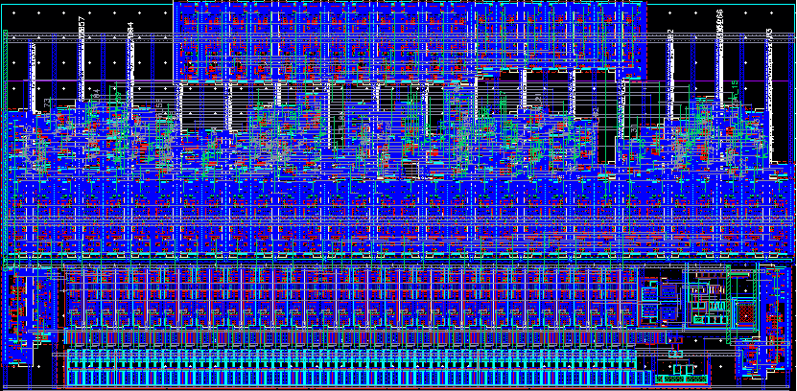
Design in 150-nm CMOS Process from LFoundry
Layout
Data serializer
Counter
157 µm
synthesized Thermometer-to-binary Encoder
Encoder
78 µm
Register
DLL
Charge pump with Loop Filter
Delay line
Latches
Phase-Frequency Detector

Slide 14
Summary
TDC
Overview of TDC types
Many applications for HEP experiments
Design example for dSiPM project
TDC design is challenging
Measurements can differ from simulations

