Slide 1
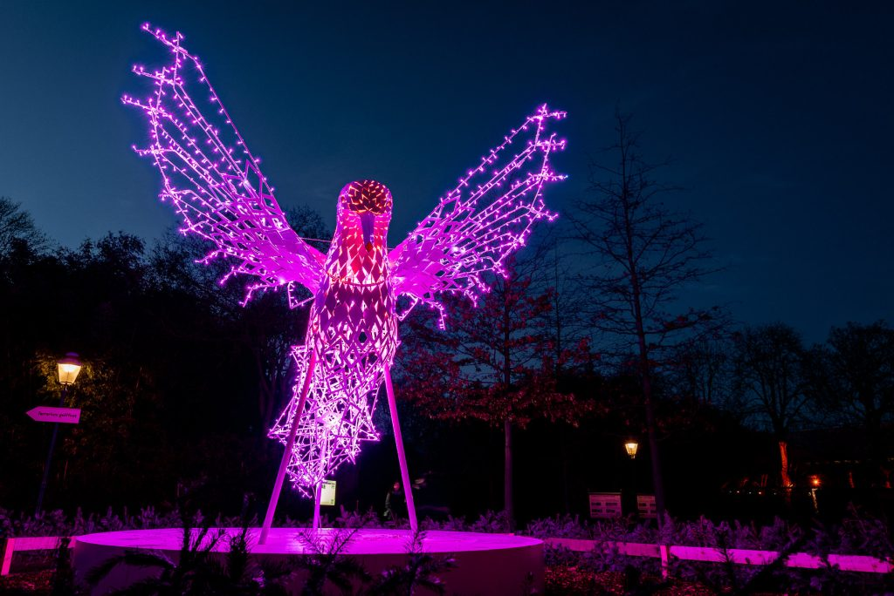
Laser-Particle Acceleration in DMA
Institute of Radiation Physics· Laser-Particle Acceleration · Dr. Hans-Peter Schlenvoigt · hp.schlenvoigt@hzdr.de · www.hzdr.de

Slide 2
Laser-Particle acceleration: Mainly ARD ST4
Part of a global community
DESY, GSI, HI Jena, HZDR in HGF, + HHU, LMU, MBI, U Hamburg
HGF partners in MT-ARD-ST4
Research purpose
Exploring particle acceleration in laser-driven plasma
On fundamental level (regimes) and towards applications (control, stability, scalings, efficiency)
Exploiting unique properties of primary and secondary radiation
Ultra-short duration/high peak .., inherent synchronization, relatively compact
Electron acceleration: betatron sources, FEL drivers, plasma acceleration drivers
Ion acceleration: WDM, radiobiology

Slide 3
Data aspects
Source rates, averages
Experimental facilities
Older facilites often organically grown, no overarching control and acquisition system (thousand islands)
Newer facilites often control system, extended towards DAQ
10s of diagnostics (~Mpx): 100 MB/shot
(10s-)100s-10.000s shots per day; on demand .. 10 Hz ; 2 weeks run per month; 100 days/year
10 GB – 1TB per day, 1TB – 100 TB per year; up to 1 GB per second
Simulations
Bound to HPC cluster constraints, job scheduling, fast data transfer needed
Easily 10 - 100s TB raw per simulation, swift analysis for reduction needed

Slide 4
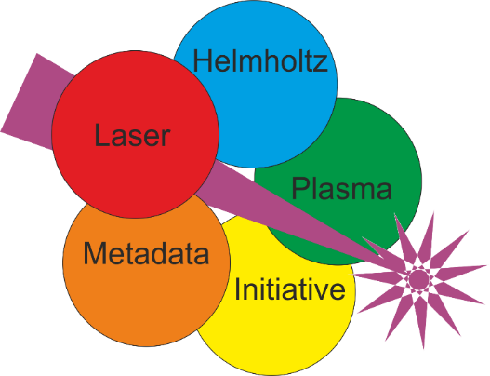
Data aspects
Current developments
Laser
Experiment
Simulation
Publication
Methods
Global community

Slide 5
Recap and discussion points
Any suggestion/solution must scale to global community, not only HGF
Experimental data poorly organized, maily human-readable, no Big Data, hence no AI
Simulation data has more options, not every code supports all formats
Data standards are needed / to be developed further for that domain
Domain-specific (?) indices of data publications, like in Astronomy
Large data: transfer or provide analysis capabilities? Funding and access policies?

Slide 6
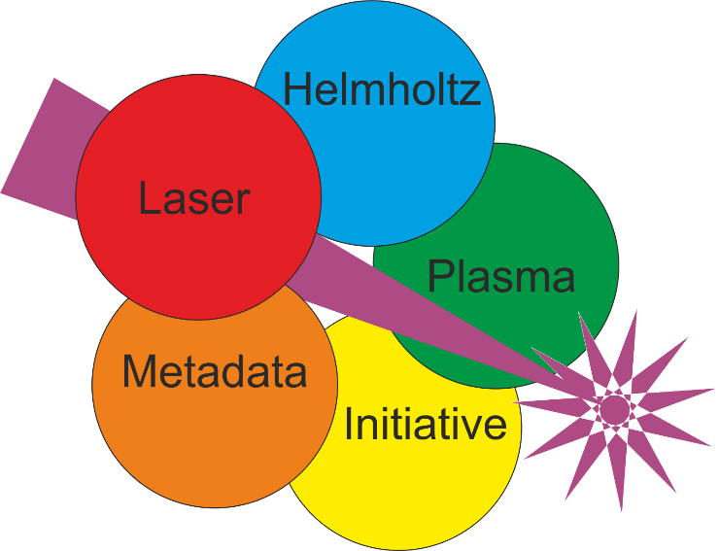
HELPMI organization and main goals
HI Jena, GSI and HZDR (improved upon previous call’s proposal)
EUR 200k additional funding from IVF for 24 months, starting April 2023
Develop vocabulary for laser-plasma experimental data
Adopt NeXus format (from PaN experimental community)
Apply to openPMD format
Data format is hierarchy of keys and values (N-dim)
Vocabulary is independent/generic list of keys (and attributes), but
Community-defined meaning of keys
Human- and Machine-readable implementation, extensible for future developments

Slide 7
External projects
DAPHNE4NFDI
Data from Photon and Neutron Experiments
+1 staff, otherwise Th. Kluge, HPS, …
Context: XFEL and ion experimental data
HMC call (Helmholtz Metadata Collaboration) 2022: HELPMI
HI Jena, GSI and HZDR
Generate vocabulary of laser-plasma experimental data
Adopt NeXus format (from PaN experimental community)
Apply to openPMD
Some work under the hood needed
Some parallel developments at LBNL and LMU in terms of experimental data → openPMD

Slide 8
HZDR Campus strategy

Slide 9
FWKT schemas
Analyze workflow, dataflow,… to design interfaces

Slide 10
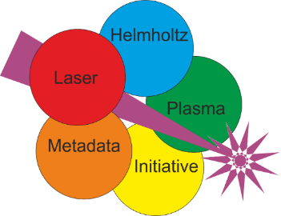
Data
Tools
and
automation
Domain-specific standard
Data repository
Electronic Lab Documentation
Simulations
Experiments
Metadata
Metadata catalogue

