Slide 1
SLAC Besuch 06.06.11 – 01.07.11
Notes:
Before you start editing the slides of your talk change to the Master Slide view: Menu button “View”, Master, Slide Master:
Edit the following 2 items in the 1st slide: 1) 1st row in the violet header: Delete the existent text and write the title of your talk into this text field 2) The 2 rows in the footer area: Delete the text and write the information regarding your talk (same as on the Title Slide) into this text field.
If you want to use more partner logos position them left beside the DESY logo in the footer area Close Master View

Slide 2
SLAC Besuch: 06.06.2011 – 01.07.2011
Inhalt:
Zweck der Reise
Kurzer Überblick LCLS (Linac coherent light source)
MCC (Machine Control Center)
Operating
Zusammenfassung

Slide 3
SLAC Visit 06.06.11 – 01.07.11
Zweck
Teilnahme am LCLS Beschleuniger Betrieb
Kennenlernen der Schicht Organisation, der Betriebsabläufe und der Unterschiede zu DESY.
Mögliche Bewertung des LCLS Betriebes in Hinblick auf den XFEL. (schwierig)
Notes:
Before you start editing the slides of your talk change to the Master Slide view: Menu button “View”, Master, Slide Master:
Edit the following 2 items in the 1st slide: 1) 1st row in the violet header: Delete the existent text and write the title of your talk into this text field 2) The 2 rows in the footer area: Delete the text and write the information regarding your talk (same as on the Title Slide) into this text field.
If you want to use more partner logos position them left beside the DESY logo in the footer area Close Master View

Slide 4
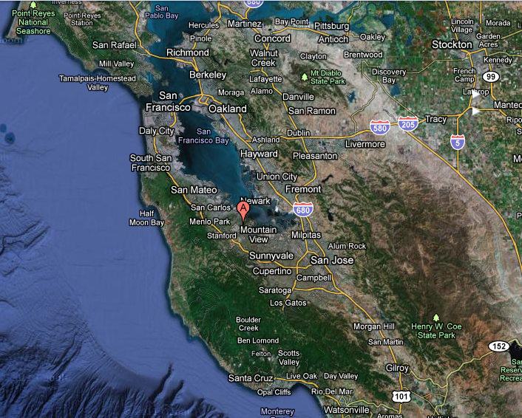
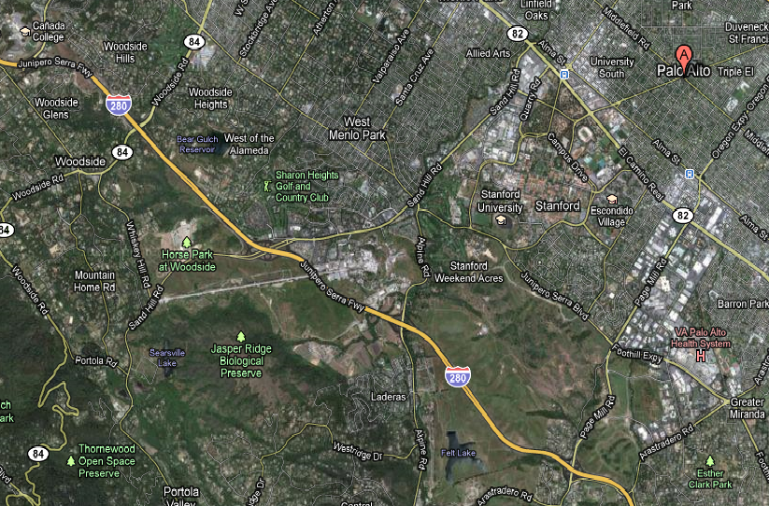
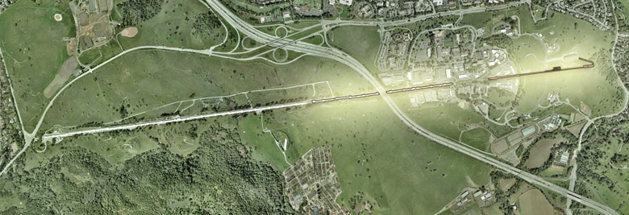
SLAC Besuch 06.06.11 – 01.07.11
Notes:
Before you start editing the slides of your talk change to the Master Slide view: Menu button “View”, Master, Slide Master:
Edit the following 2 items in the 1st slide: 1) 1st row in the violet header: Delete the existent text and write the title of your talk into this text field 2) The 2 rows in the footer area: Delete the text and write the information regarding your talk (same as on the Title Slide) into this text field.
If you want to use more partner logos position them left beside the DESY logo in the footer area Close Master View

Slide 5
SLAC Besuch 06.06.11 – 01.07.11
Injector specials:
Ti:Sapphire YAG pumped laser 780nm (infrared)
Watercooled 2-cell Cu Gun Cavity
Notes:
Before you start editing the slides of your talk change to the Master Slide view: Menu button “View”, Master, Slide Master:
Edit the following 2 items in the 1st slide: 1) 1st row in the violet header: Delete the existent text and write the title of your talk into this text field 2) The 2 rows in the footer area: Delete the text and write the information regarding your talk (same as on the Title Slide) into this text field.
If you want to use more partner logos position them left beside the DESY logo in the footer area Close Master View

Slide 6
SLAC Besuch 06.06.11 – 01.07.11
Notes:
Before you start editing the slides of your talk change to the Master Slide view: Menu button “View”, Master, Slide Master:
Edit the following 2 items in the 1st slide: 1) 1st row in the violet header: Delete the existent text and write the title of your talk into this text field 2) The 2 rows in the footer area: Delete the text and write the information regarding your talk (same as on the Title Slide) into this text field.
If you want to use more partner logos position them left beside the DESY logo in the footer area Close Master View

Slide 7
SLAC Besuch 06.06.11 – 01.07.11
Typische Parameter des LCLS
Linac Energy [GeV] | X-Ray [eV] | λ [nm]
3.6 | 600 | 2.1
4.1 | 740 | 1.7
9.0 | 3600 | 0.34
15.6 | 9420 | 0.13
Notes:
Before you start editing the slides of your talk change to the Master Slide view: Menu button “View”, Master, Slide Master:
Edit the following 2 items in the 1st slide: 1) 1st row in the violet header: Delete the existent text and write the title of your talk into this text field 2) The 2 rows in the footer area: Delete the text and write the information regarding your talk (same as on the Title Slide) into this text field.
If you want to use more partner logos position them left beside the DESY logo in the footer area Close Master View

Slide 8
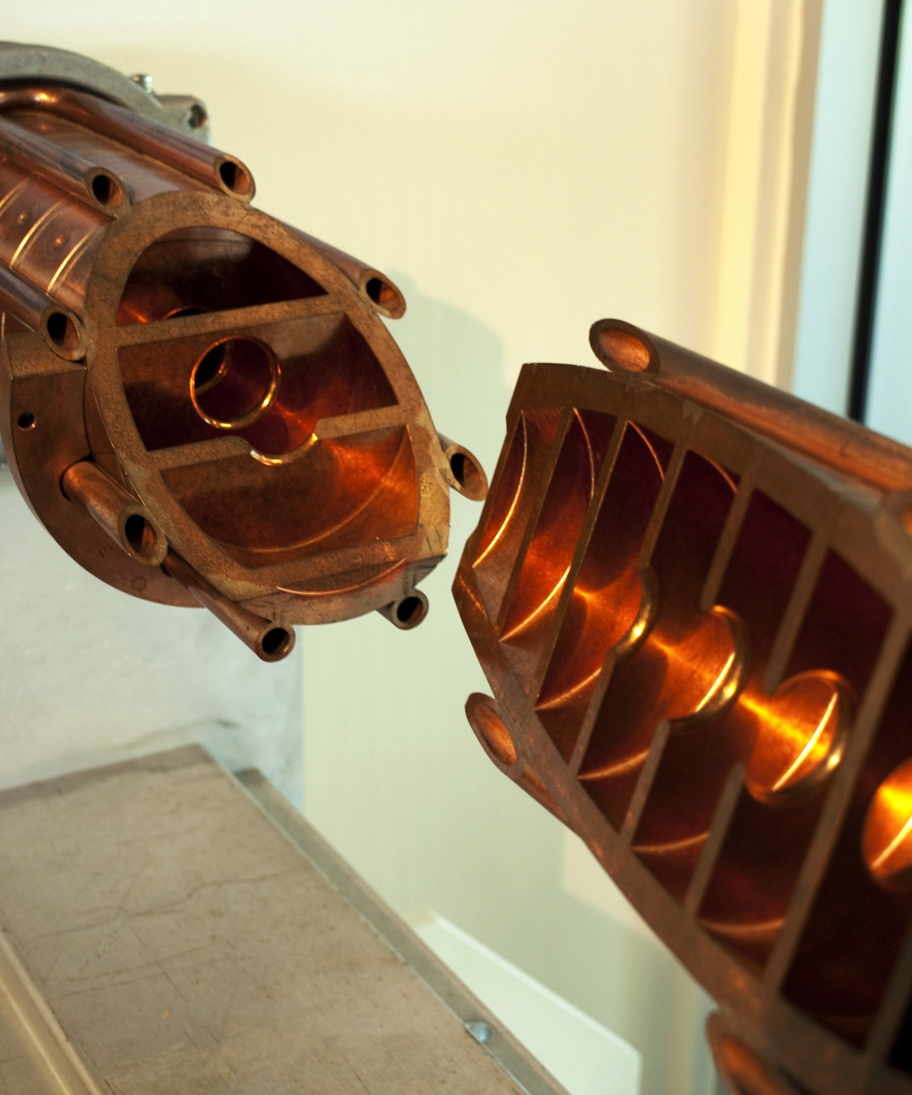
SLAC Besuch 06.06.11 – 01.07.11
S-Band Struktur
Notes:
Before you start editing the slides of your talk change to the Master Slide view: Menu button “View”, Master, Slide Master:
Edit the following 2 items in the 1st slide: 1) 1st row in the violet header: Delete the existent text and write the title of your talk into this text field 2) The 2 rows in the footer area: Delete the text and write the information regarding your talk (same as on the Title Slide) into this text field.
If you want to use more partner logos position them left beside the DESY logo in the footer area Close Master View

Slide 9
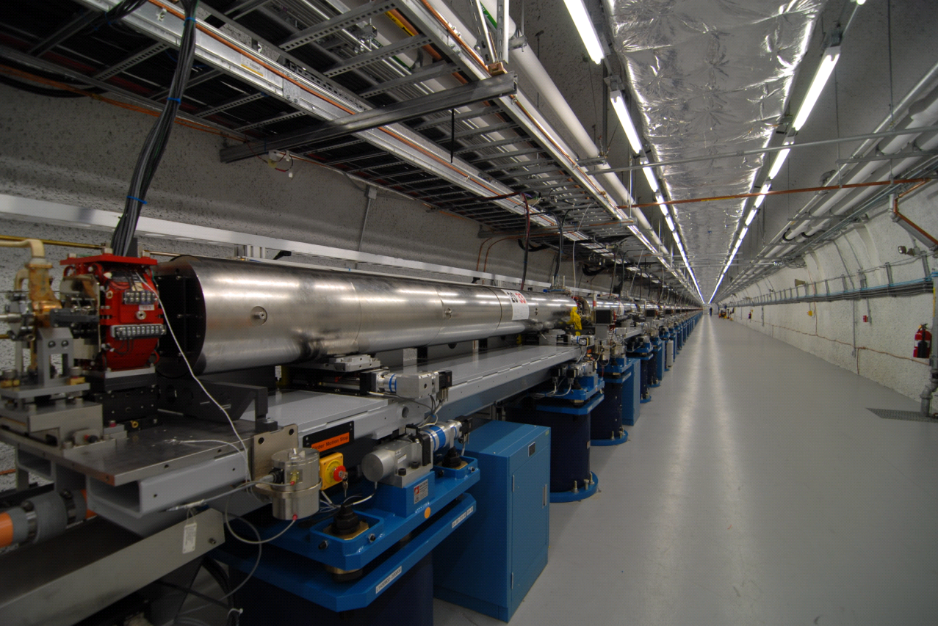
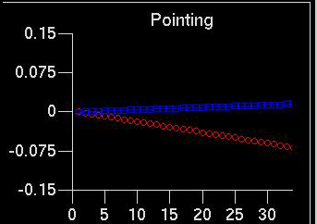
SLAC Besuch 06.06.11 – 01.07.11
33 Undulatoren
Austausch eines Undulators dauert ca. 1 h.
Notes:
Before you start editing the slides of your talk change to the Master Slide view: Menu button “View”, Master, Slide Master:
Edit the following 2 items in the 1st slide: 1) 1st row in the violet header: Delete the existent text and write the title of your talk into this text field 2) The 2 rows in the footer area: Delete the text and write the information regarding your talk (same as on the Title Slide) into this text field.
If you want to use more partner logos position them left beside the DESY logo in the footer area Close Master View

Slide 10
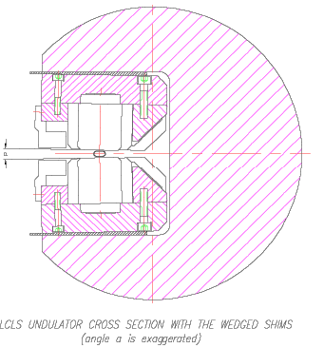
SLAC Besuch 06.06.11 – 01.07.11
Bewegungsrichtung
Feststehender Spalt mit Taper
Strahl
Taper Winkel: 4.5mrad
1 mm Bewegung bedeutet Änderung um 4.5 µm im Spalt und 8.2 Gauss
Notes:
Before you start editing the slides of your talk change to the Master Slide view: Menu button “View”, Master, Slide Master:
Edit the following 2 items in the 1st slide: 1) 1st row in the violet header: Delete the existent text and write the title of your talk into this text field 2) The 2 rows in the footer area: Delete the text and write the information regarding your talk (same as on the Title Slide) into this text field.
If you want to use more partner logos position them left beside the DESY logo in the footer area Close Master View

Slide 11
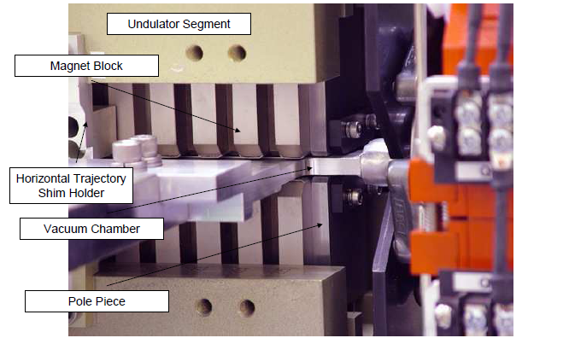
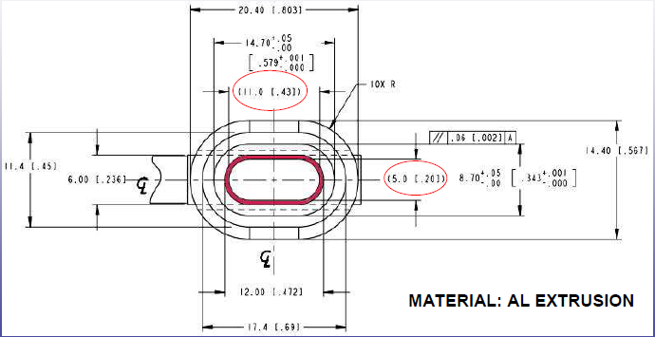
SLAC Besuch 06.06.11 – 01.07.11
3729 Permanentmagnete
Undulator Feld: 1.325 T
Undulator Spalt: 6 mm
$$λ_{rad}=\frac{λ_{u}}{2γ^{2}}\left(1+\frac{K^{2}}{2}\right)$$
$K=0.934∗B_{u}∗λ_{u}$
$$0<K<3.7$$
$$λ_{u}=3 cm$$
Notes:
Before you start editing the slides of your talk change to the Master Slide view: Menu button “View”, Master, Slide Master:
Edit the following 2 items in the 1st slide: 1) 1st row in the violet header: Delete the existent text and write the title of your talk into this text field 2) The 2 rows in the footer area: Delete the text and write the information regarding your talk (same as on the Title Slide) into this text field.
If you want to use more partner logos position them left beside the DESY logo in the footer area Close Master View

Slide 12
SLAC Besuch 06.06.11 – 01.07.11
Notes:
Before you start editing the slides of your talk change to the Master Slide view: Menu button “View”, Master, Slide Master:
Edit the following 2 items in the 1st slide: 1) 1st row in the violet header: Delete the existent text and write the title of your talk into this text field 2) The 2 rows in the footer area: Delete the text and write the information regarding your talk (same as on the Title Slide) into this text field.
If you want to use more partner logos position them left beside the DESY logo in the footer area Close Master View

Slide 13
SLAC Besuch 06.06.11 – 01.07.11
LCLS MCC Main Control Center
Notes:
Before you start editing the slides of your talk change to the Master Slide view: Menu button “View”, Master, Slide Master:
Edit the following 2 items in the 1st slide: 1) 1st row in the violet header: Delete the existent text and write the title of your talk into this text field 2) The 2 rows in the footer area: Delete the text and write the information regarding your talk (same as on the Title Slide) into this text field.
If you want to use more partner logos position them left beside the DESY logo in the footer area Close Master View

Slide 14
SLAC Besuch 06.06.11 – 01.07.11
Struktur von MCC
Accelerator Operations and Safety Division
AOS Manager (1)
AD Safety Office (2)
Operation Staff (7), EOIC Manager, Operator Manager
Accelerator Directorate (8) (Hallen-Ing.)
EOIC (7) Schichtleiter
MCC Operators (12)
SPEAR3 (5)
Notes:
Before you start editing the slides of your talk change to the Master Slide view: Menu button “View”, Master, Slide Master:
Edit the following 2 items in the 1st slide: 1) 1st row in the violet header: Delete the existent text and write the title of your talk into this text field 2) The 2 rows in the footer area: Delete the text and write the information regarding your talk (same as on the Title Slide) into this text field.
If you want to use more partner logos position them left beside the DESY logo in the footer area Close Master View

Slide 15
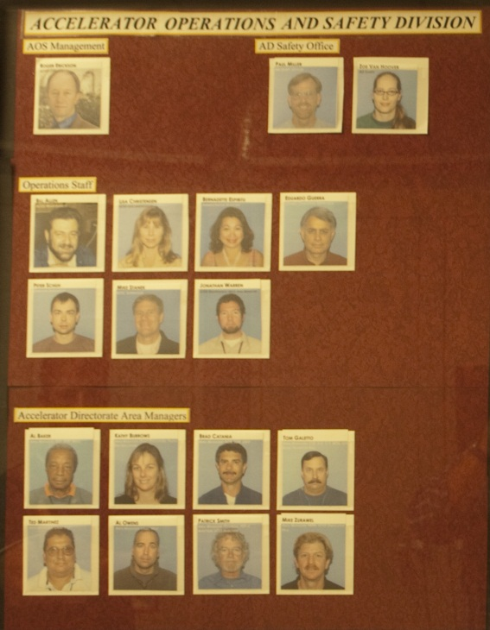
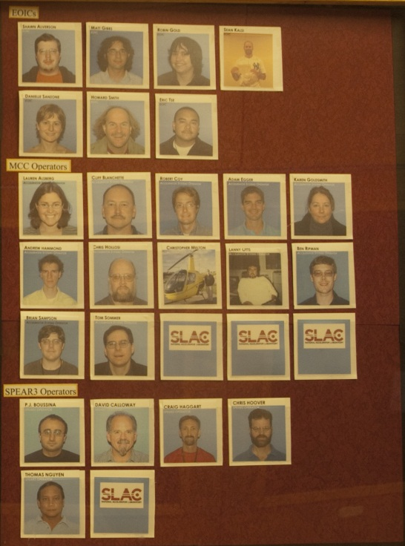
SLAC Besuch 06.06.11 – 01.07.11
Operations Staff Manager für EOICs:
Schichtplan für EOICs
Training
Kontakt Person
EOIC Supervisor
Kommunikation mit Hallen- Ing. (Area Managers)
Operations Staff Manager for Operators
Supervisor für Operateure
Training
Schichtplan für Operateure
Unterstützung der Operateure im Schichtdienst.
Operations Staff Manager (M.Bieler)
Notes:
Before you start editing the slides of your talk change to the Master Slide view: Menu button “View”, Master, Slide Master:
Edit the following 2 items in the 1st slide: 1) 1st row in the violet header: Delete the existent text and write the title of your talk into this text field 2) The 2 rows in the footer area: Delete the text and write the information regarding your talk (same as on the Title Slide) into this text field.
If you want to use more partner logos position them left beside the DESY logo in the footer area Close Master View

Slide 16
SLAC Besuch 06.06.11 – 01.07.11
2.6 Timing System
Trainee
First, review the available documentation that pertains to the subject matter detailed in the following list.
Some documents are available on-line and paper copies are located in the MCC control room and the MCC
library.
Next, ask your Trainer any questions about the following items.
Finally, as you become familiar with the items at the ASO-3 level, initial the corresponding underlined
space ( __ ).
Trainer
After the trainee has demonstrated an understanding of the items in this section at the ASO-3 level,
complete the corresponding signature block.
____ Linac system overview
____ Linac fiducials
____ Master Oscillator (MO)
____ Main Drive Line (MDL)
____ FIDOs
____ Linac PDUs
____ Master Pattern Generator (MPG/MP00)
____ SLCNET / Micro PNET boards
____ Simple Timing Buffer (STB)
____ PSK
____ TGAS modules
____ LTM
____ PEP timing distribution
____ PEP master oscillator
____ PEP fiducial generator
____ Timing Phase Lock and Distribution (TPLD) chassis
____ PEP PDUs
____ Injection / Ring fiducial
____ Single / Train pulse mode
____ Timing resolution
____ PEP synchronization
____ Master/slave relationship
____ Master oscillator clock
____ Fiducials
____ Bunch injection timing
____ Fiducial shift
____ Master oscillator phase shift
____ MPG synchronization feedback
____ Bunch Injection Controller (BIC)
____ Bit 3 board
____ HER / LER quanta
____ PEP bucket number
Professionelle Schichtmannschaft (Dauerschichtgänger)
Operateure kommen nicht aus den Gruppen
1 EOIC (Schichtleiter) + 2 Ops + 1 Back-Up, kein Back-Up am Wochenende
100 % Schicht (inklusive „back-up“ -> Zeit für Projektarbeit)
Projekte: Überwiegend Software Wartung und Training
Aufgaben und Pflichten: Anwesenheit, Teilnahme an den Schichtmeetings (EOIC),LCLS operating, Kommunikation mit den Nutzern und techn. Gruppen, CATERing (Comprehensive Accelerator Tool for Enhancing Reliability),
FEL Strahljustage (FEL Beamlines gehören zum Linac), GMD Kalibrierung
Training: 3 Level mit unterschiedlichen Schwierigkeitsgraden + Test
Beispiel: timing system (Höchstes level !)
EOIC: Am Wochenende: Owl-Shift + day-shift bis Mittags (12h!)
Notes:
Before you start editing the slides of your talk change to the Master Slide view: Menu button “View”, Master, Slide Master:
Edit the following 2 items in the 1st slide: 1) 1st row in the violet header: Delete the existent text and write the title of your talk into this text field 2) The 2 rows in the footer area: Delete the text and write the information regarding your talk (same as on the Title Slide) into this text field.
If you want to use more partner logos position them left beside the DESY logo in the footer area Close Master View

Slide 17
SLAC Besuch 06.06.11 – 01.07.11
Auszug aus dem EOIC Schichtplan
DAY 07:45– 16:00 | SWING 15:45 – 24:00 | OWL 23:45 – 08:00 | OFF
X
X
X
X
 |  |  | X
 |  |  | X
 |  |  | X
X Back Up
X Back Up
X Back Up
X Back Up
X Back Up
 |  |  | X
 |  |  | X
 | X Back Up
 | X
 | X
 | X
 | X
 | X
DAY 07:45 – 16:00 | SWING 15:45 – 24:00 | OWL 23:45 – 08:00 | OFF
 | X
 | X Back Up
 |  |  | X
 |  |  | X
 |  |  | X
 |  |  | X
 |  |  | X
 |  | X
 |  | X
 |  | X
 |  | X
 |  | X
 |  |  | X
 |  |  | X
 |  |  | X
X Back Up
X Back Up
X
X
X
Notes:
Before you start editing the slides of your talk change to the Master Slide view: Menu button “View”, Master, Slide Master:
Edit the following 2 items in the 1st slide: 1) 1st row in the violet header: Delete the existent text and write the title of your talk into this text field 2) The 2 rows in the footer area: Delete the text and write the information regarding your talk (same as on the Title Slide) into this text field.
If you want to use more partner logos position them left beside the DESY logo in the footer area Close Master View

Slide 18
SLAC Besuch 06.06.11 – 01.07.11
Auszug aus dem Operator Schichtplan
DAY 07:45 – 16:00 | SWING 15:45 – 24:00 | OWL 23:45– 08:00 | OFF
X
X
X
X
X
 |  |  | X
 |  |  | X
 |  |  | X
 |  |  | X
 | X
 | X
 | X
 | X
 | X
 | X
 | X
 | X Back Up
 | X Back Up
 | X Back Up
 |  |  | X
DAY 07:45 – 16:00 | SWING 15:45 – 24:00 | OWL 23:45 – 08:00 | OFF
 |  |  | X
 |  |  | X
 |  |  | X
 |  | X
 |  | X
 |  | X
 |  | X
 |  | X
 |  | X
 |  | X
X Back Up
X Back Up
X Back Up
 |  |  | X
 |  |  | X
X
X
X
X
X
Notes:
Before you start editing the slides of your talk change to the Master Slide view: Menu button “View”, Master, Slide Master:
Edit the following 2 items in the 1st slide: 1) 1st row in the violet header: Delete the existent text and write the title of your talk into this text field 2) The 2 rows in the footer area: Delete the text and write the information regarding your talk (same as on the Title Slide) into this text field.
If you want to use more partner logos position them left beside the DESY logo in the footer area Close Master View

Slide 19
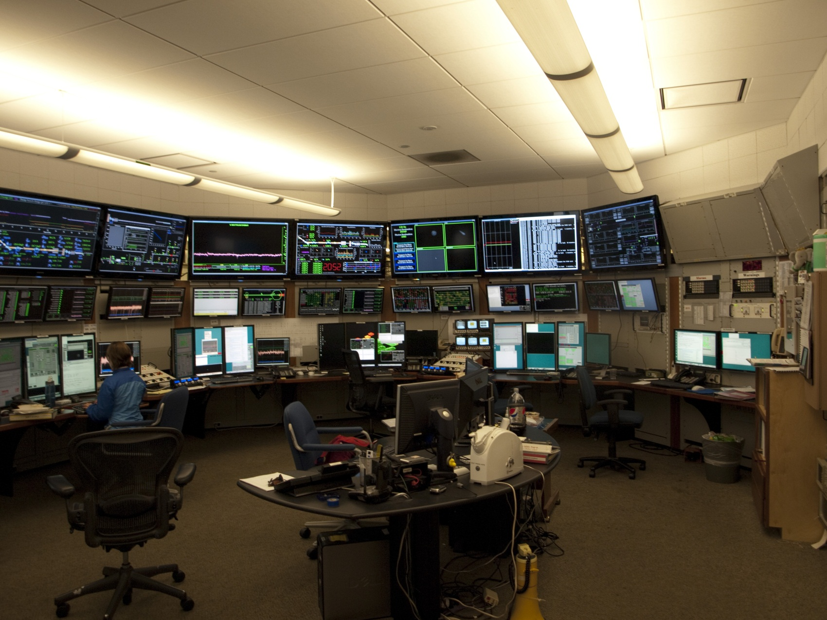
SLAC Besuch: 06.06.11 – 01.07.11

Slide 20
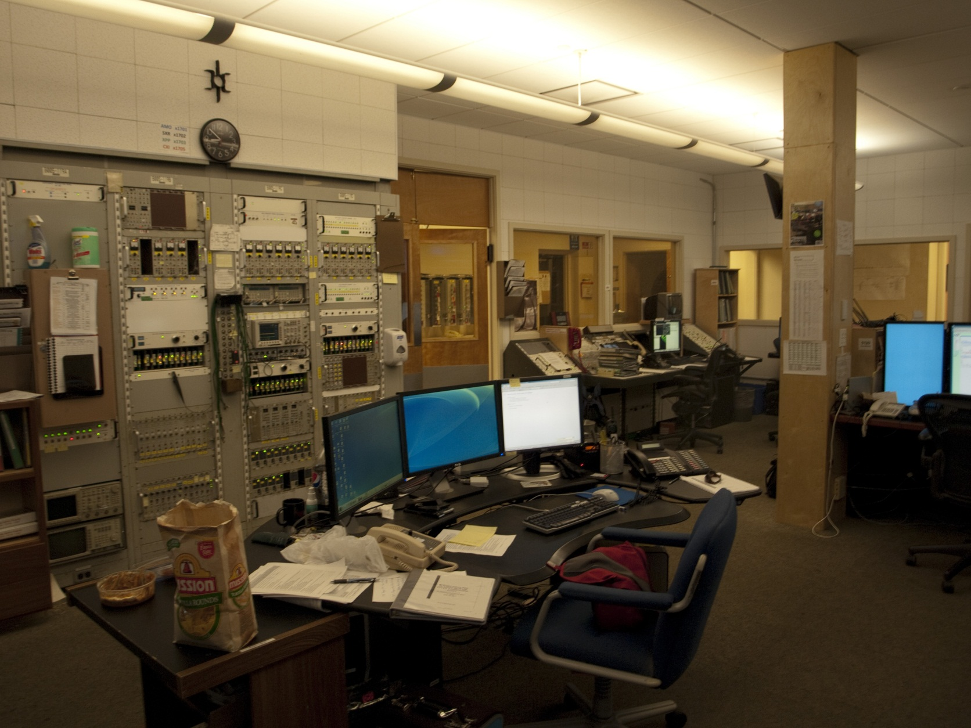
SLAC Besuch 06.06.11 – 01.07.11
Unterschied zu DESY:
Kommunikation und Organisation mit den techn.Gruppen ausschl. über EOIC
Wissenschaftler (Maschinen-Koordinatoren) machen nahezu kein aktives Operating

Slide 21
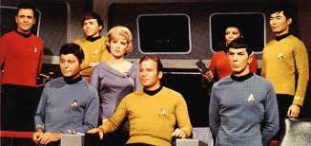
SLAC Besuch 06.06.11 – 01.07.11
Operating
?!
Thank God
It‘s 15:00
Gun-Window might be broken !
1750 ?
Don‘t forget
the logbook
entries
It wasn‘t me!
I didn‘t touch
Anything !
Fascinating !
What the heck ?!

Slide 22
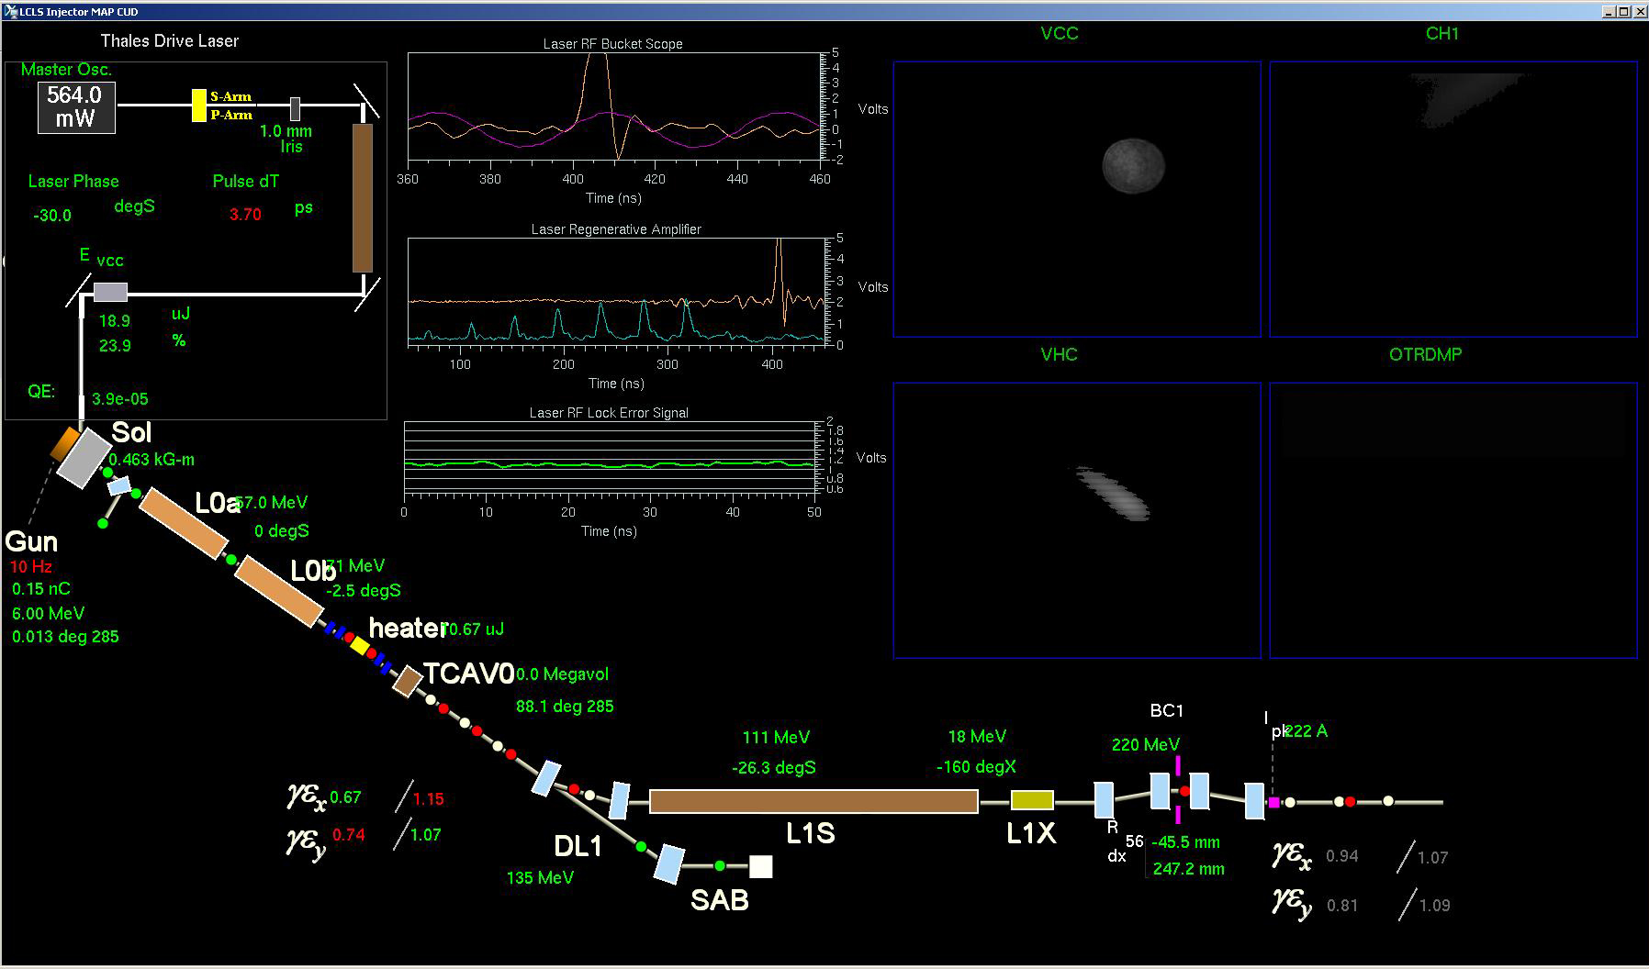
SLAC Besuch 06.06.11 – 01.07.11
„Daten-Alterung“ wird auf Displays sichtbar gemacht
Hellgrün:Aktuell
Dunkelgrün: Älter
Grau: Out of Date (älter 24 h)
Notes:
Before you start editing the slides of your talk change to the Master Slide view: Menu button “View”, Master, Slide Master:
Edit the following 2 items in the 1st slide: 1) 1st row in the violet header: Delete the existent text and write the title of your talk into this text field 2) The 2 rows in the footer area: Delete the text and write the information regarding your talk (same as on the Title Slide) into this text field.
If you want to use more partner logos position them left beside the DESY logo in the footer area Close Master View

Slide 23
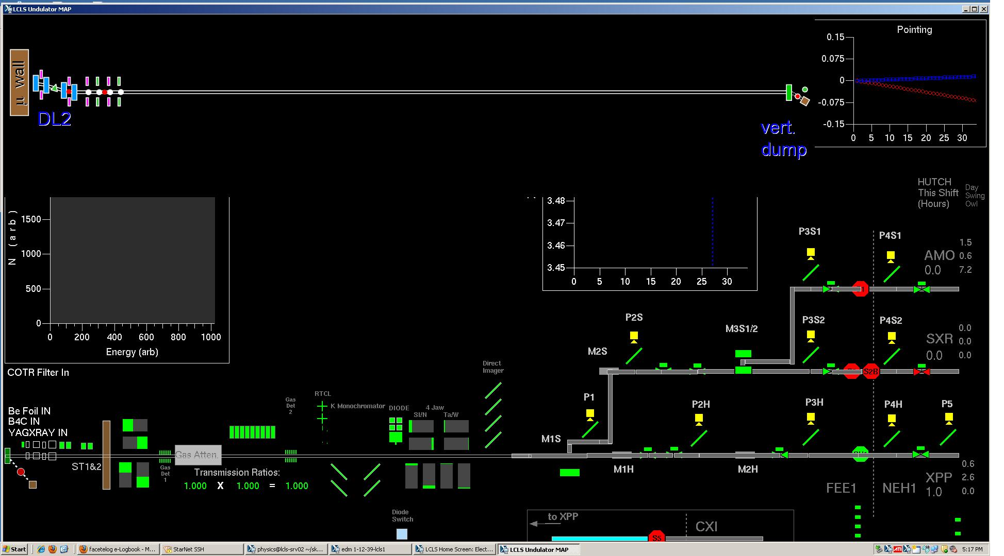
SLAC Besuch 06.06.11 – 01.07.11
Notes:
Before you start editing the slides of your talk change to the Master Slide view: Menu button “View”, Master, Slide Master:
Edit the following 2 items in the 1st slide: 1) 1st row in the violet header: Delete the existent text and write the title of your talk into this text field 2) The 2 rows in the footer area: Delete the text and write the information regarding your talk (same as on the Title Slide) into this text field.
If you want to use more partner logos position them left beside the DESY logo in the footer area Close Master View

Slide 24
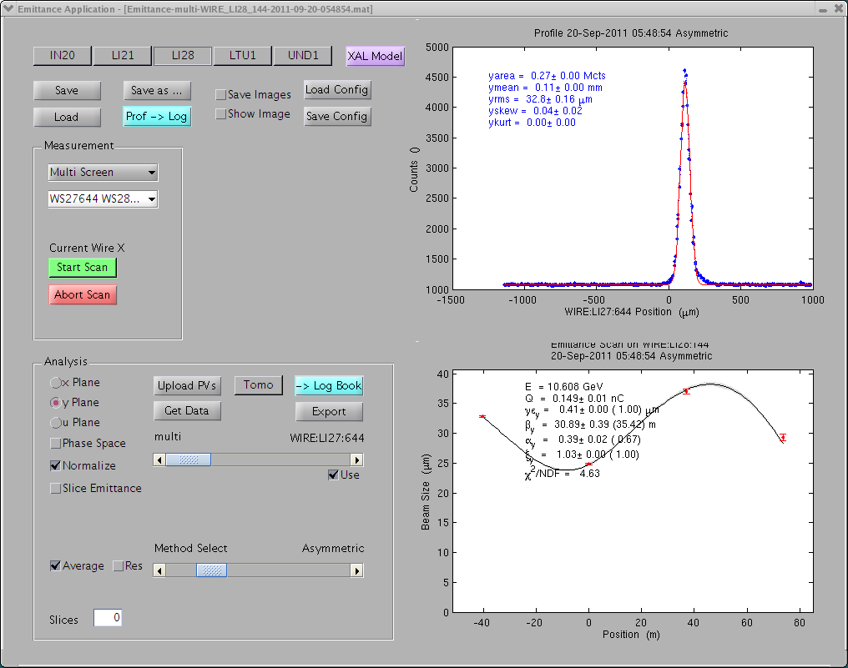
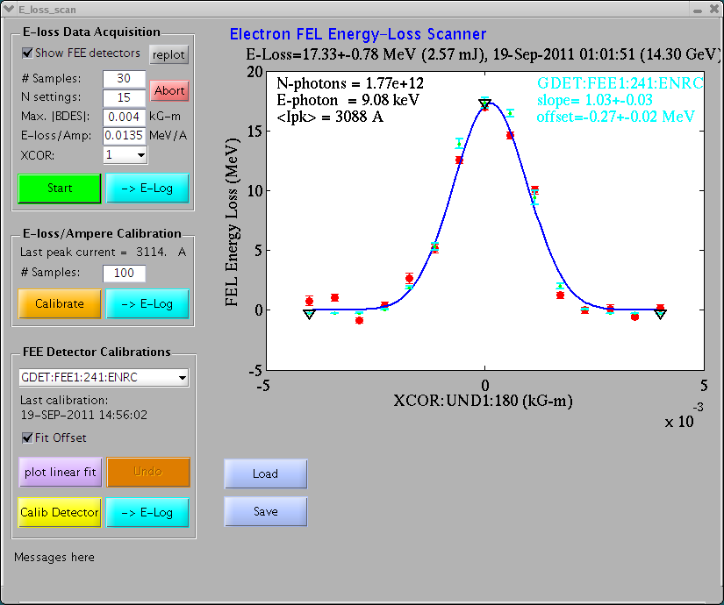
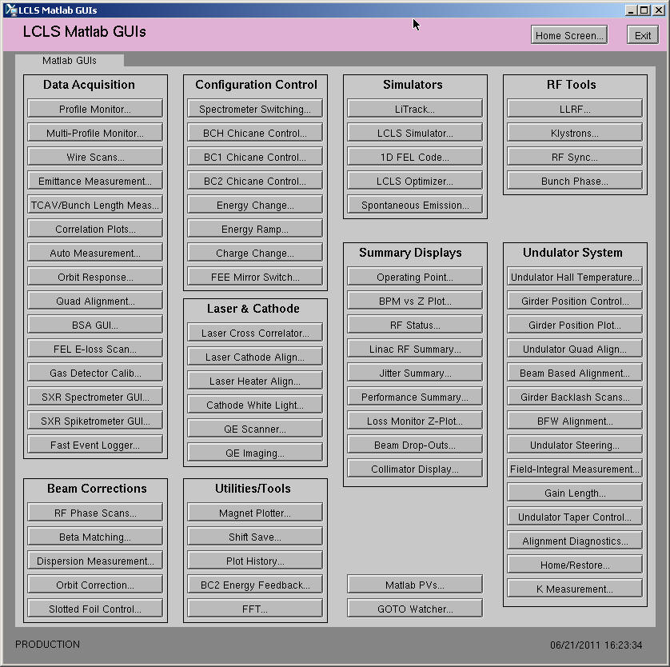
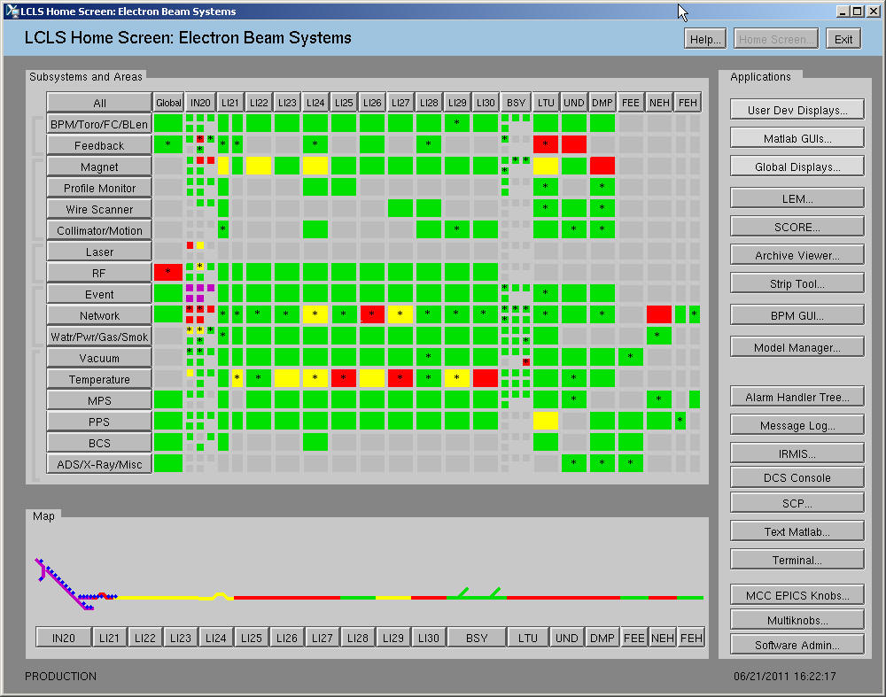
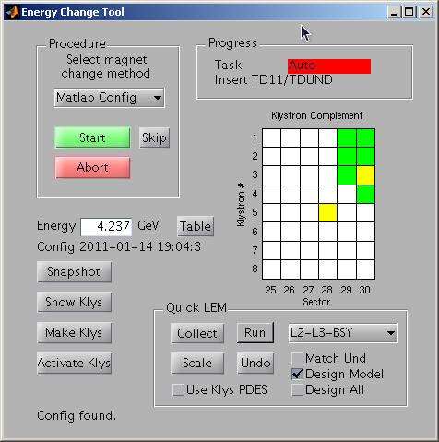
SLAC Besuch 06.06.11 – 01.07.11
Controlsystems: EPICS,Java-based,Matlab
LCLS Home screen
Notes:
Before you start editing the slides of your talk change to the Master Slide view: Menu button “View”, Master, Slide Master:
Edit the following 2 items in the 1st slide: 1) 1st row in the violet header: Delete the existent text and write the title of your talk into this text field 2) The 2 rows in the footer area: Delete the text and write the information regarding your talk (same as on the Title Slide) into this text field.
If you want to use more partner logos position them left beside the DESY logo in the footer area Close Master View

Slide 25
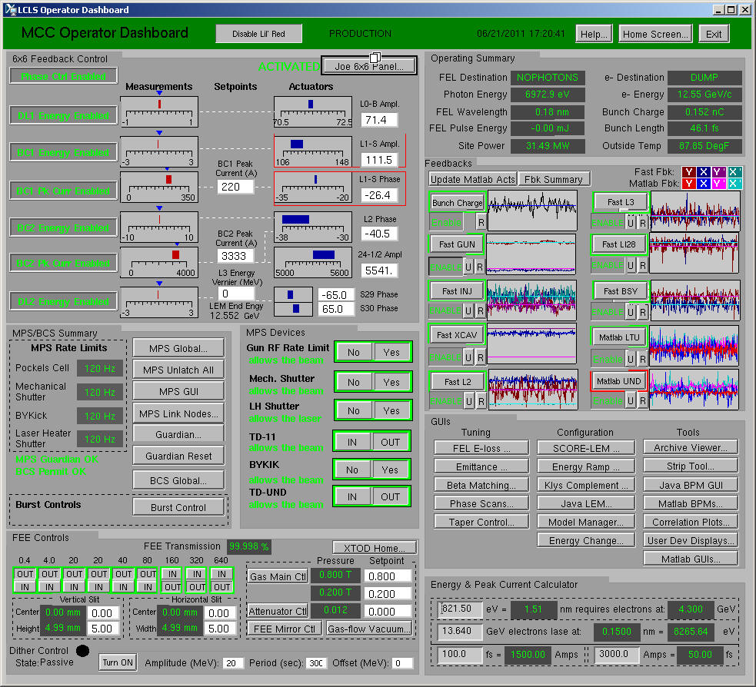
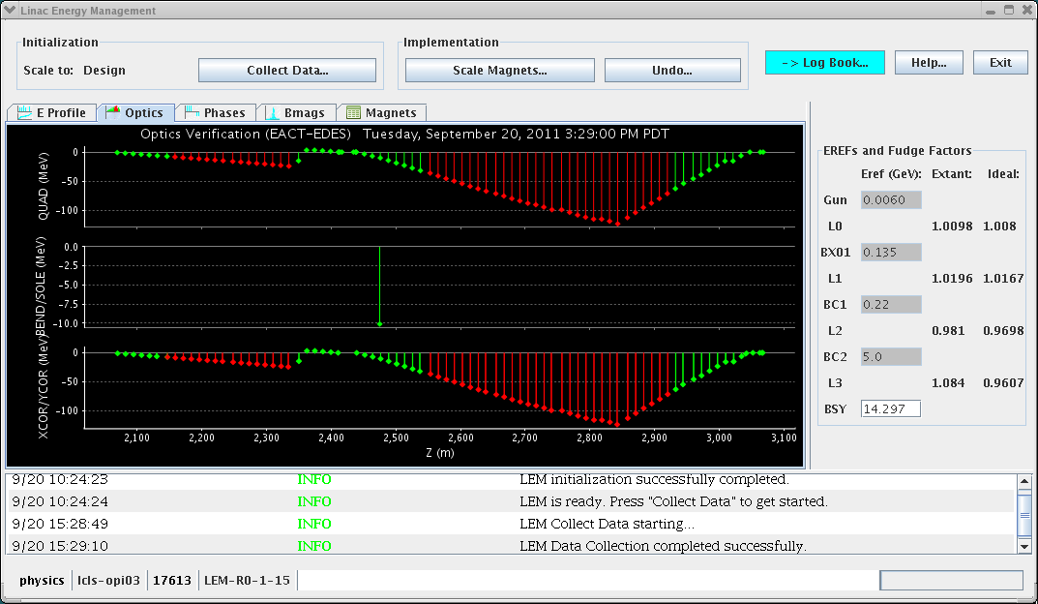
SLAC Besuch 06.06.11 – 01.07.11
LEM = linac energy management
Dieses Programm passt die Quadrupolströme dem tatsächlich existierenden Klystron-Energie-Profil an. Wird bei jedem Wellenlängenwechsel angewendet, sobald ausgewählt ist, welche Klystrons bei der neuen Wellenlänge "mitspielen" dürfen).
Dashboard
Notes:
Before you start editing the slides of your talk change to the Master Slide view: Menu button “View”, Master, Slide Master:
Edit the following 2 items in the 1st slide: 1) 1st row in the violet header: Delete the existent text and write the title of your talk into this text field 2) The 2 rows in the footer area: Delete the text and write the information regarding your talk (same as on the Title Slide) into this text field.
If you want to use more partner logos position them left beside the DESY logo in the footer area Close Master View

Slide 26
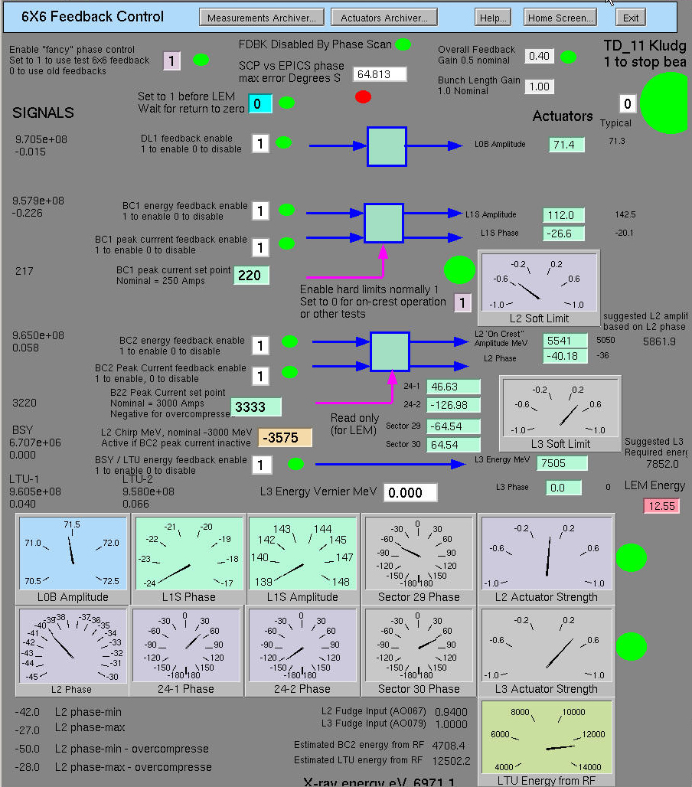
SLAC Besuch 06.06.11 – 01.07.11
6 mal 6 Feedback
6 Messwerte ( Energie)
6 Stellwerte (Amplitude, Phase)
Feedbacks können je nach Maschinen
Zustand separat zu oder abgeschaltet
werden.
-> Raimund
Notes:
Before you start editing the slides of your talk change to the Master Slide view: Menu button “View”, Master, Slide Master:
Edit the following 2 items in the 1st slide: 1) 1st row in the violet header: Delete the existent text and write the title of your talk into this text field 2) The 2 rows in the footer area: Delete the text and write the information regarding your talk (same as on the Title Slide) into this text field.
If you want to use more partner logos position them left beside the DESY logo in the footer area Close Master View

Slide 27
SLAC Besuch 06.06.11 – 01.07.11
Feedbacks: So ähnlich jetzt auch bei FLASH (XFEL)
Bunch Charge Feedback
Orbit Feedbacks:
Fast Gun Feedback
Fast Injector Feedback (LOA and LOB)
Fast XCAV Feedback
Fast L2,L3, L28
Fast BSY,LTU,UND
Energy Feedbacks: (6 x 6)
DL1 wirkt auf die LOB Amplitude
BC1 peak current feedback BC1 energy feedback
wirkt auf L1S Amplitude und Phase
BC2 energy feedback BC2 peak current feedback,
wirkt auf L2 Amplitude and Phase
BSY/LTU energy feedback wirkt auf L3 Amplitude und Phase
Notes:
Before you start editing the slides of your talk change to the Master Slide view: Menu button “View”, Master, Slide Master:
Edit the following 2 items in the 1st slide: 1) 1st row in the violet header: Delete the existent text and write the title of your talk into this text field 2) The 2 rows in the footer area: Delete the text and write the information regarding your talk (same as on the Title Slide) into this text field.
If you want to use more partner logos position them left beside the DESY logo in the footer area Close Master View

Slide 28
SLAC Besuch 06.06.11 – 01.07.11
Energieänderung (als Beispiel) 4 GeV 13 Gev Linac Energie
Änderungen nur ab downstream BC2, Strahl nur bis Beamstopper bei BC2
Magnetströme- und HF – Parameter einstellen
Laden Feedback Sollwerte
Strahl bis zur Undulator Strecke. Orbit und Energie Feedbacks einschalten.
Strahl durch den Undulator
FEL ja oder nein ? (SASE wird dort FEL genannt)
Strahl am Experiment ? Spiegel in korrekter Position?
Kalibrieren der GMDs, Aufgabe der Schichtmannschaft.
Energieänderung 13 Gev 4 Gev
Standardize (massage) der Magnete downstream BC2
Notes:
Before you start editing the slides of your talk change to the Master Slide view: Menu button “View”, Master, Slide Master:
Edit the following 2 items in the 1st slide: 1) 1st row in the violet header: Delete the existent text and write the title of your talk into this text field 2) The 2 rows in the footer area: Delete the text and write the information regarding your talk (same as on the Title Slide) into this text field.
If you want to use more partner logos position them left beside the DESY logo in the footer area Close Master View

Slide 29
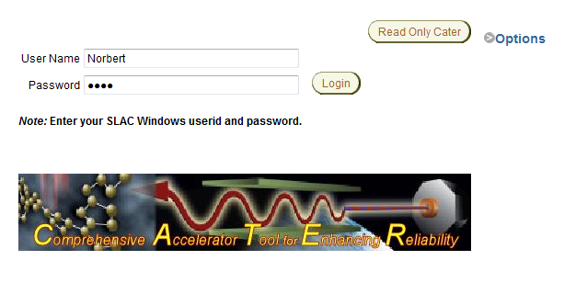
SLAC Besuch 06.06.11 – 01.07.11
Logbook(s):
- Das „DESY“-Log: DOOCS elog vom DESY wird von Wissenschaftlern für Einträge
genutzt, die sich nicht direkt auf das LCLS Operating beziehen.
- MCCelog: LCLS technisches Log. In Regel machen EOICs hier Einträge.
es wird zur Schichtdokumentation und für die Schichtübergaben genutzt.
- CATER: Comprehensive Accelerator Tool for Enhancing Reliability
Notes:
Before you start editing the slides of your talk change to the Master Slide view: Menu button “View”, Master, Slide Master:
Edit the following 2 items in the 1st slide: 1) 1st row in the violet header: Delete the existent text and write the title of your talk into this text field 2) The 2 rows in the footer area: Delete the text and write the information regarding your talk (same as on the Title Slide) into this text field.
If you want to use more partner logos position them left beside the DESY logo in the footer area Close Master View

Slide 30
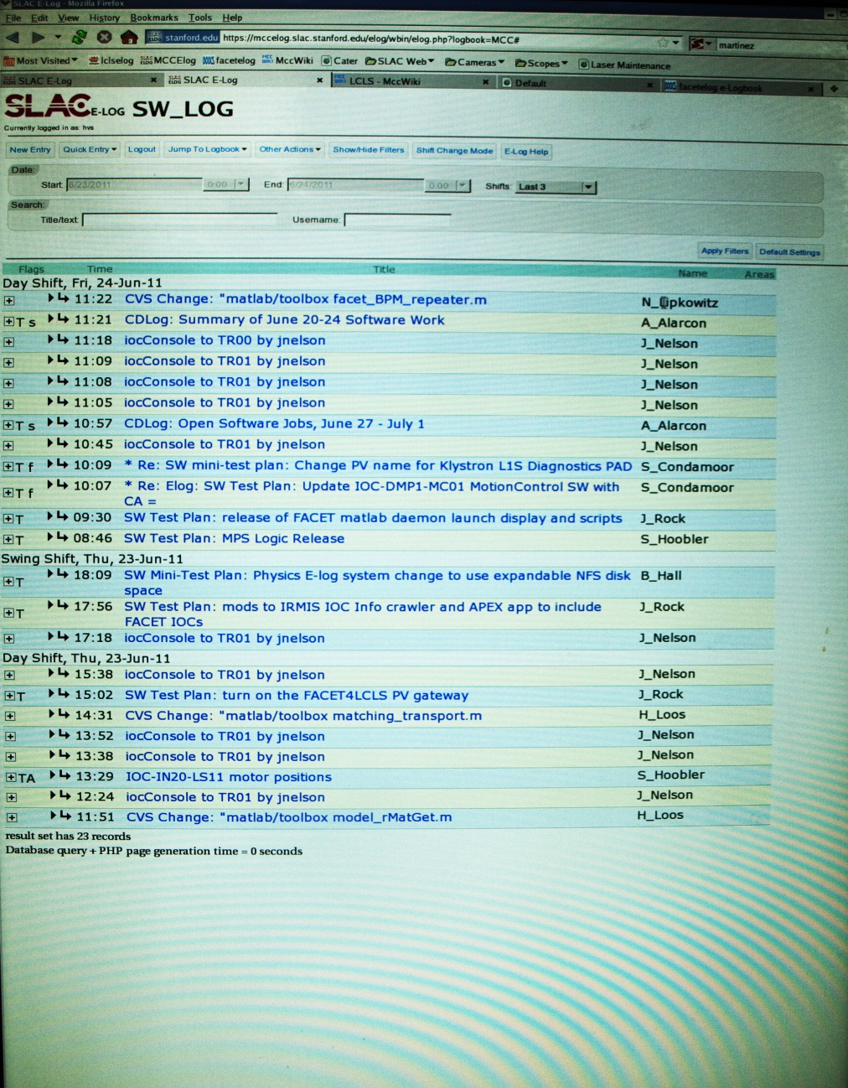
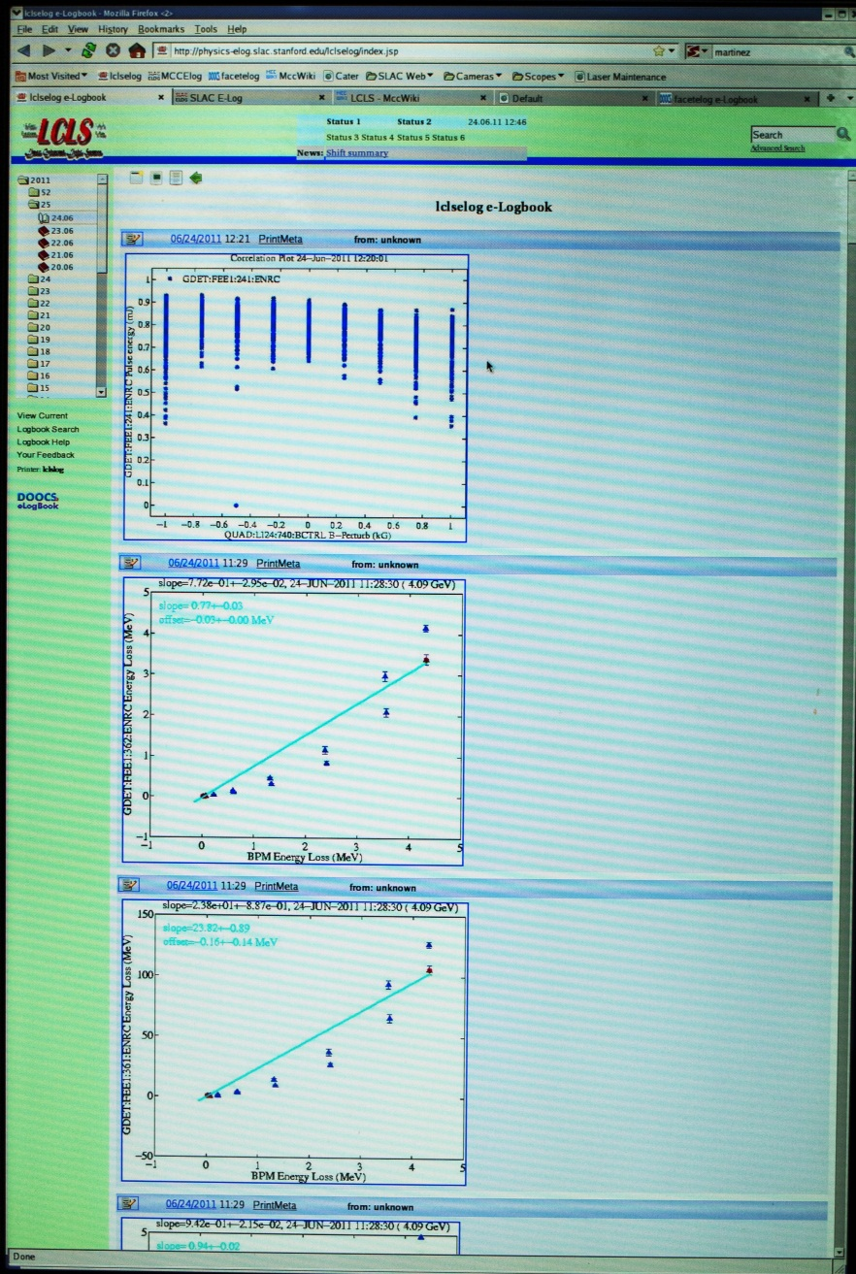
SLAC Besuch 06.06.11 – 01.07.11
Notes:
Before you start editing the slides of your talk change to the Master Slide view: Menu button “View”, Master, Slide Master:
Edit the following 2 items in the 1st slide: 1) 1st row in the violet header: Delete the existent text and write the title of your talk into this text field 2) The 2 rows in the footer area: Delete the text and write the information regarding your talk (same as on the Title Slide) into this text field.
If you want to use more partner logos position them left beside the DESY logo in the footer area Close Master View

Slide 31
SLAC Besuch 06.06.11 – 01.07.11
Zusammenfassung (Operating)
Hoher Automatisierungsgrad durch zahlreiche Feedbacks (global) (jetzt auch bei uns)
Hoher Ausbildungsstand und Motivation der Operateure
durch permanentes Training und ständigem Support von der MCC Leitung.
Einbindung der Operateure bei GUI Entwicklung, Operating-tools etc. (Programmieren in Back-up Zeit). Vertrautheit mit der Maschine groß.
Kommunikation zwischen Usern und Ops. durch regelmäßige meetings.

Slide 32
SLAC Besuch 06.06.11 – 01.07.11
Ausblick:
Wie wird es beim XFEL ?
Wunsch der Operateure:
Möglichst frühe Einbindung der Operateure in Planung und Organisation des Schichtbetriebes und des Operatings
Training,Training,Training….

Slide 33
SLAC Besuch 06.06.11 – 01.07.11
Vielen Dank für Eure Aufmerksamkeit !

