Slide 1
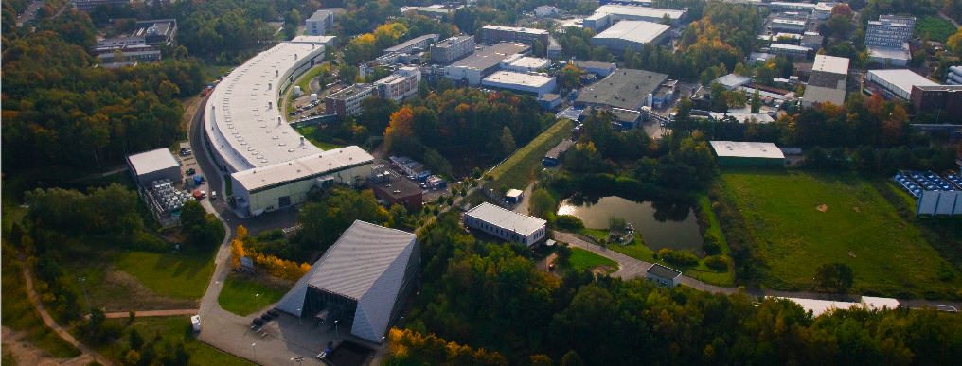
Scientific Highlights @ P10 PETRA III
Michael Sprung
Beschleuniger Betriebsseminar 2011
Groemitz, 26-29.09.2011

Slide 2
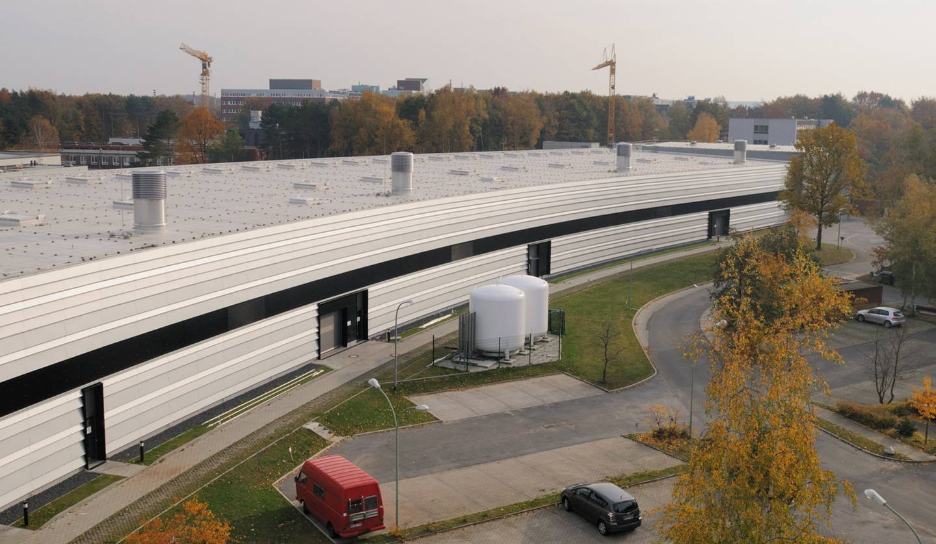
Übersicht
Warum eine Kohärenz Beamline @ PETRA III?
Einführung zu P10
Wissenschaftliche Aktivitäten bei P10
  Coherent diffractive imaging (CDI)
  X-ray photon correlation spectroscopy (XPCS)
Weitere wissenschaftliche Beispiele
Zusammenfassung

Slide 3
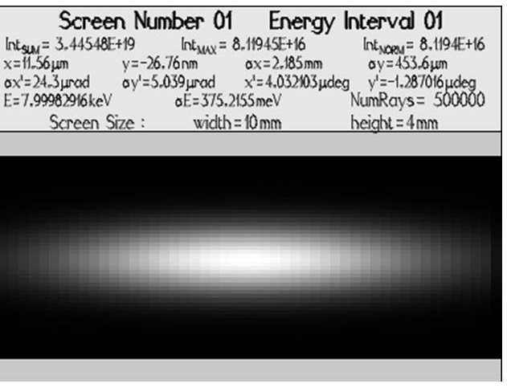
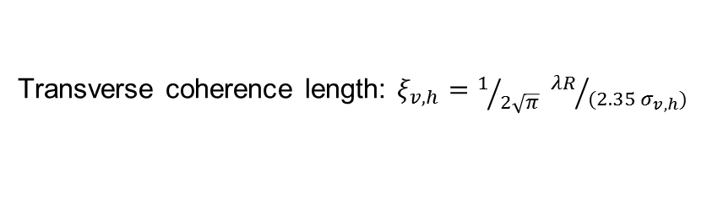
Warum eine kohärente Beamline bei PETRA III?
Der kohärente Fluss ist proportional zur Brillianz: Fc ~ λ²/2 · B
Low beta Quelle: ~14 x 84 µm² (FWHM)
Transverse coherence length: $ξ_{v,h}=1/{2\sqrt{π}} {λR}/{(2.35 σ_{v,h})}$
ξ_{v,h} ~ 270 x 45 µm² (FWHM)
(@ 90m, 8keV)
Der kohärente Anteil von PETRA III ist grösser als an anderen Synchrotrons (e.g. ESRF, APS, …)!

Slide 4
Kohärenz Beamline P10 von PETRA III: Einführung
The Coherence Beamline P10 specializes in facilitating coherent x-ray scattering techniques in the medium-hard x-ray range (5—20keV).
Scientifically the aim is to investigate structures and dynamics on nanometer length scales. The two main experimental techniques are X-ray Photon Correlation Spectroscopy (XPCS) and Coherent Diffraction Imaging (CDI).
Theoretical longitudinal coherence length and coherent flux @ P10
Δλ/λ | ξ_{l} | Flux_{coh} | Energy
6·10⁻³ [pink beam, 1st harmonic] | 0.025µm | 1.4·10¹³ | 8keV
1·10⁻⁴ [Si(111)] | 1.5µm | 2.3·10¹¹ | 8keV
3·10⁻⁵ [Si(311)] | 5.0µm | 6·10¹⁰ | 8keV
2·10⁻³ [pink beam, 3rd harmonic] | 0.054µm | 1.4·10¹² | 12keV
However, without focusing only a tiny fraction (~1/1000) is usable!!!

Slide 5
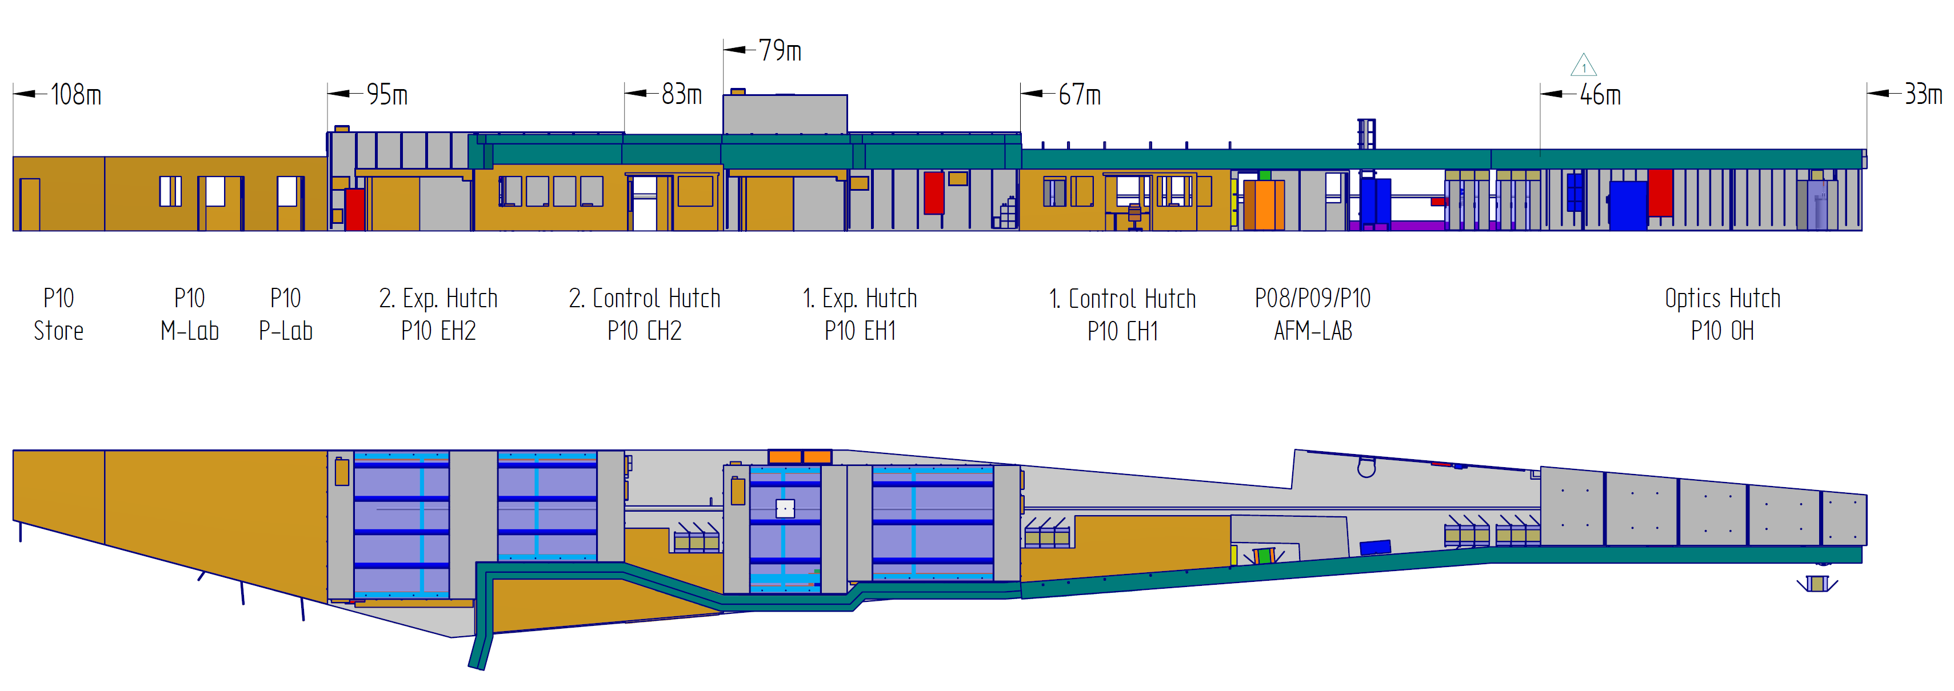
Kohärenz Beamline P10: Übersicht
1 x Optikhütte
2 x Experimentelle Hütten (12m)
2 x Kontrolräume
1 x Probenpräparationsraum
1 x Mechanisches Labor
1 x Elektronisches Labor
1 x AFM Labor

Slide 6
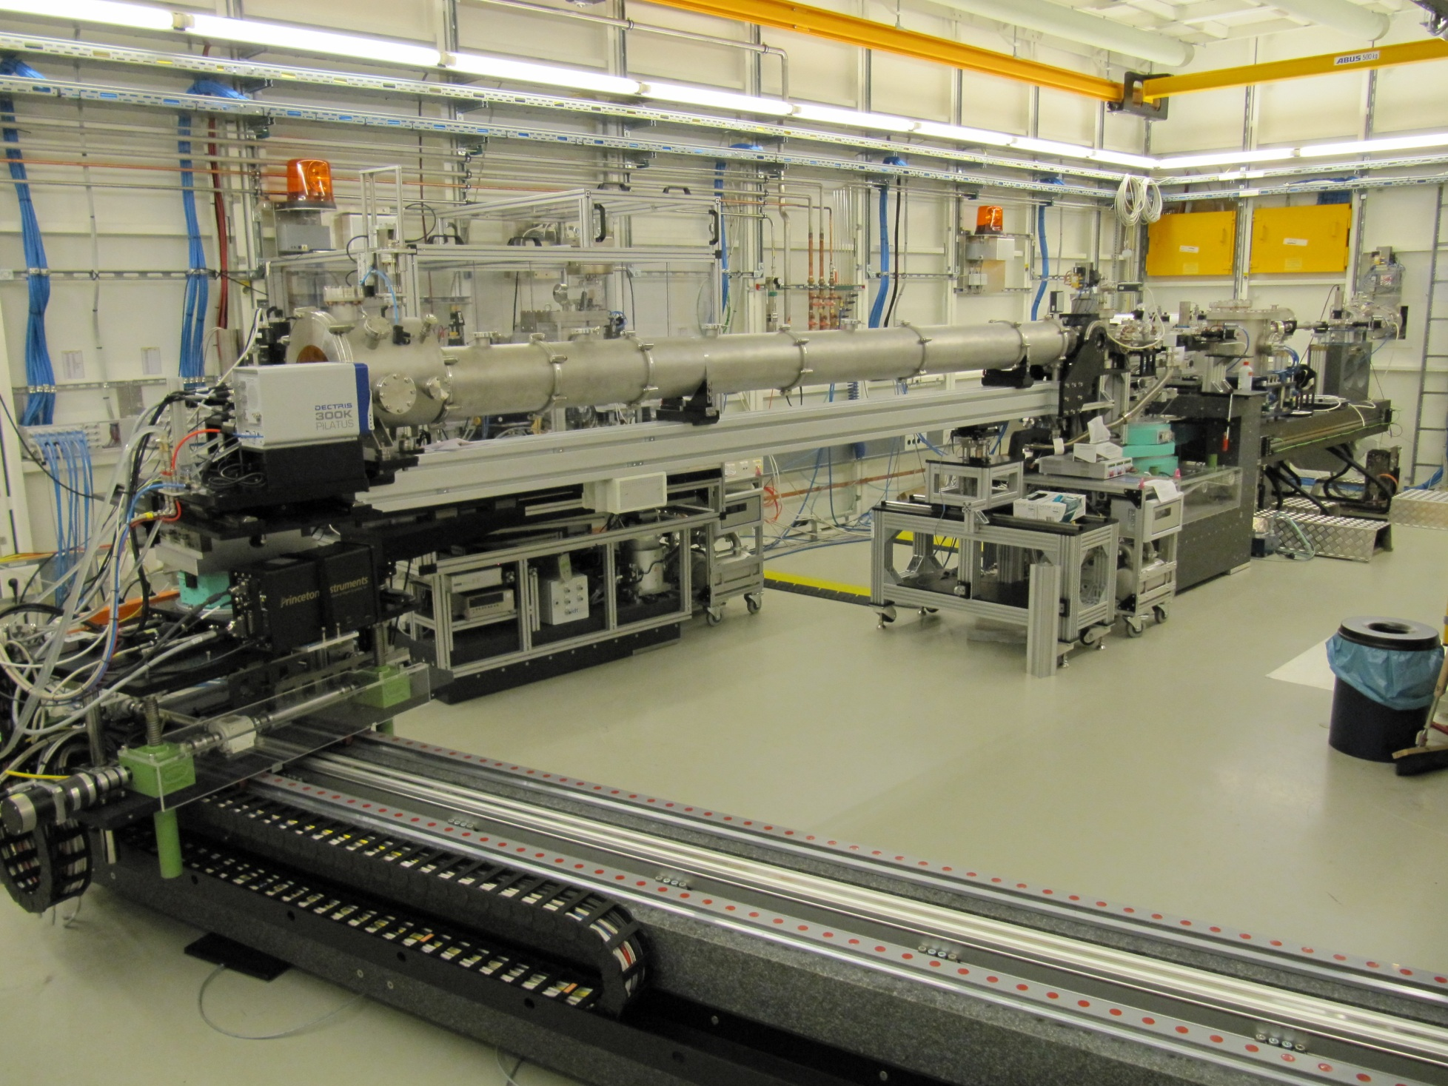
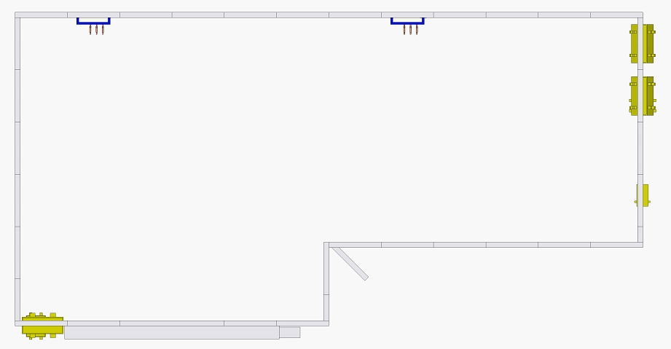
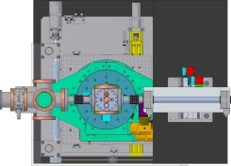
2. Experimentierhütte EH2 bei P10
95m
83m
The standard setup
Optics
KB

Slide 7
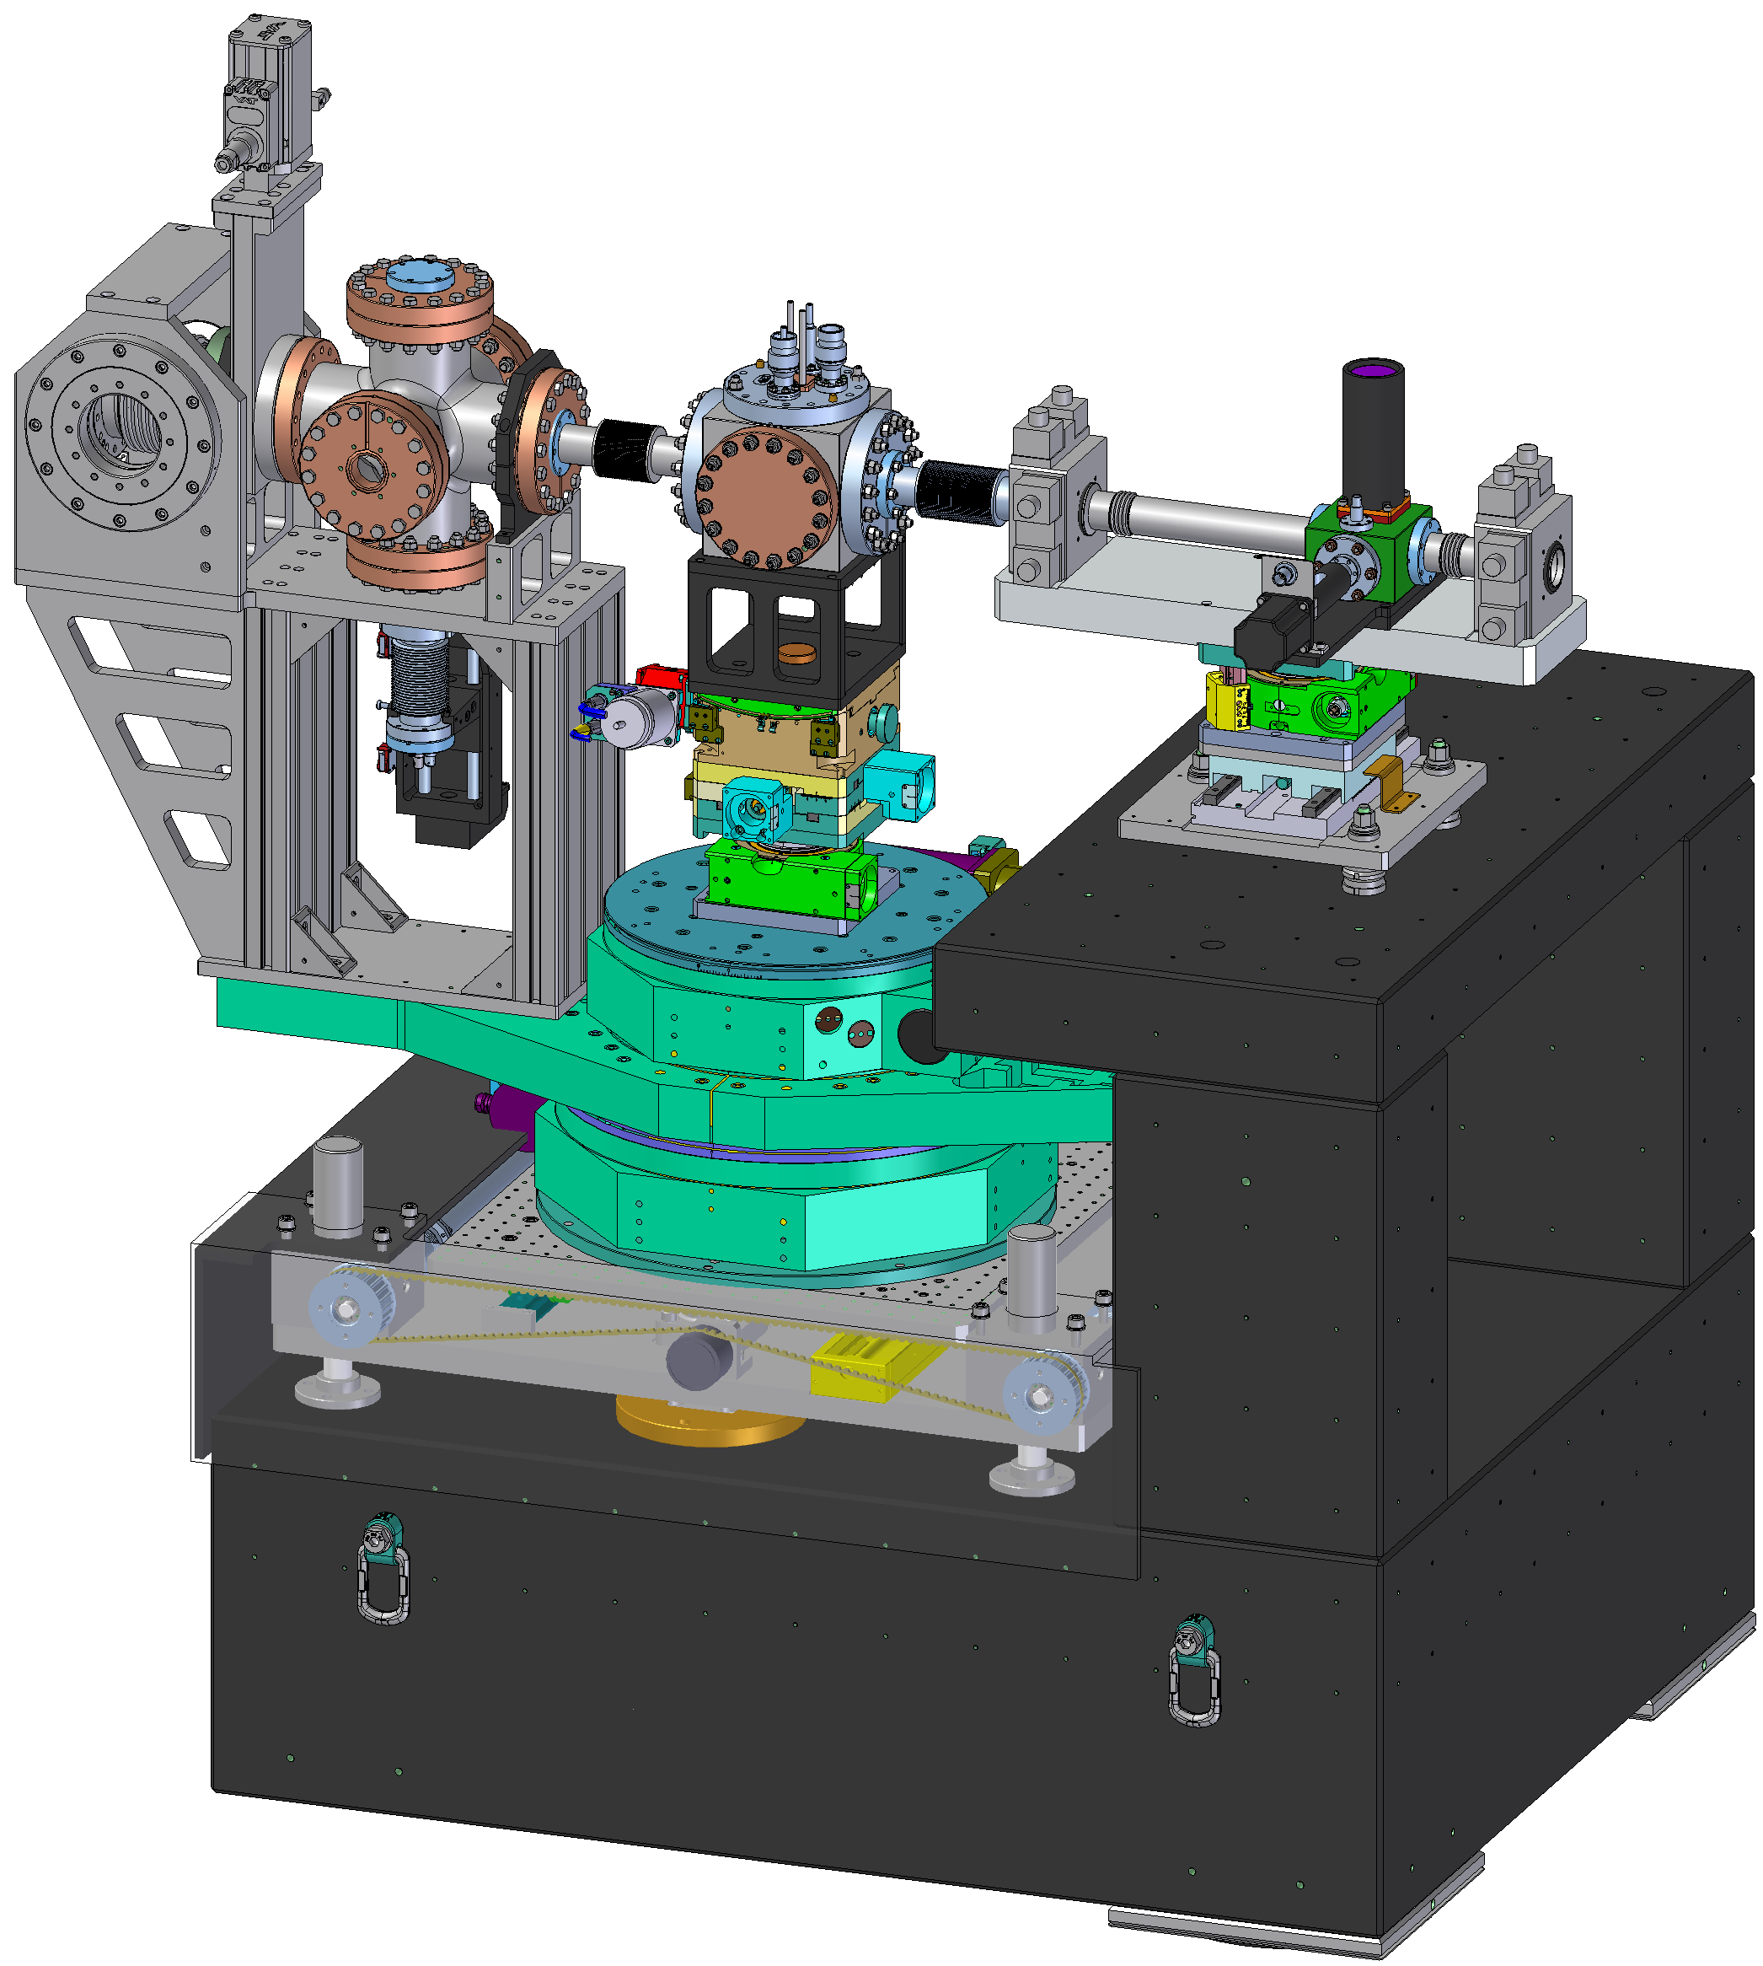
Das Standardsetup von P10: Übersicht
The standard setup consists of a Huber 4-circle diffractometer sitting on a heavy granite based table. In its final configuration it will be possible to scatter horizontally to ~30°.
The samples will be placed into a DN100 cube. Different experiments can be easily integrated by designing independent inserts for this cube.
It is possible to operate this setup fully vacuum integrated. If needed the vacuum environment can be replaced by a large variety of other setups.
The standard setup will exhibit a sample to detector distance of 5.0m. Flight path as well as the multi-purpose detector holder will sit on 3m long translation stages.

Slide 8
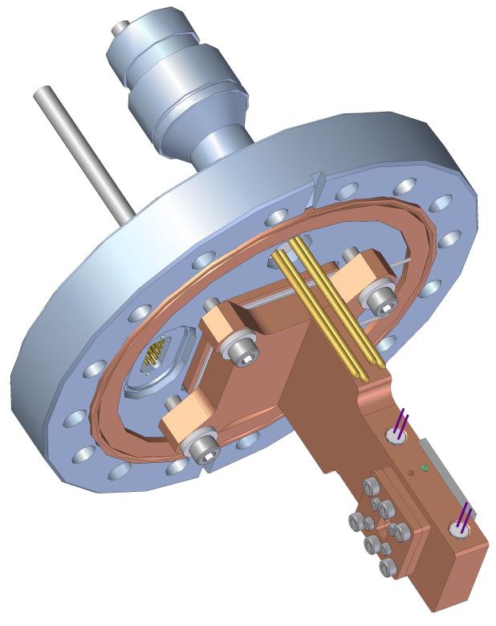
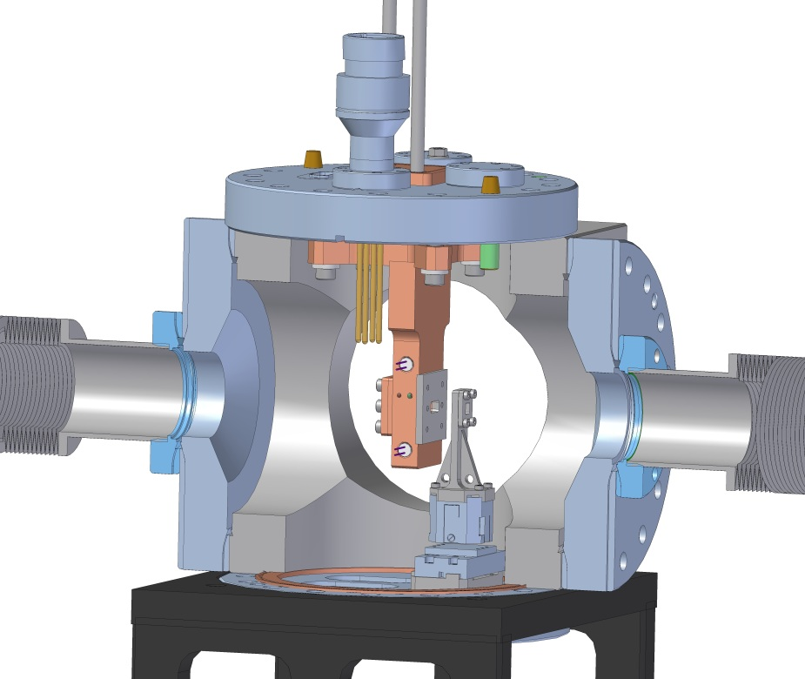
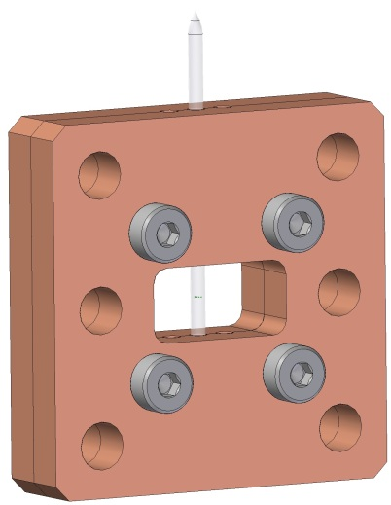
Das Standardsetup: Experimentelle Einsätze
SAXS and Reflectivity inserts with a heating and cooling option based on Peltier elements and resistive heaters covering the temperature range from -30°C — 200°C.
SAXS and Reflectivity inserts with a combination of cryogenic cooling and resistive heaters covering the temperature range from -150°C — 50°C.
CDI setup based on Attocubes (XYZ and Rot Z)
An independent guard slit insert based on an Attocube YZ translation stage directly before the sample.
other possibilities:
  stress-strain insert
  flow insert
  ptychography insert
  …

Slide 9
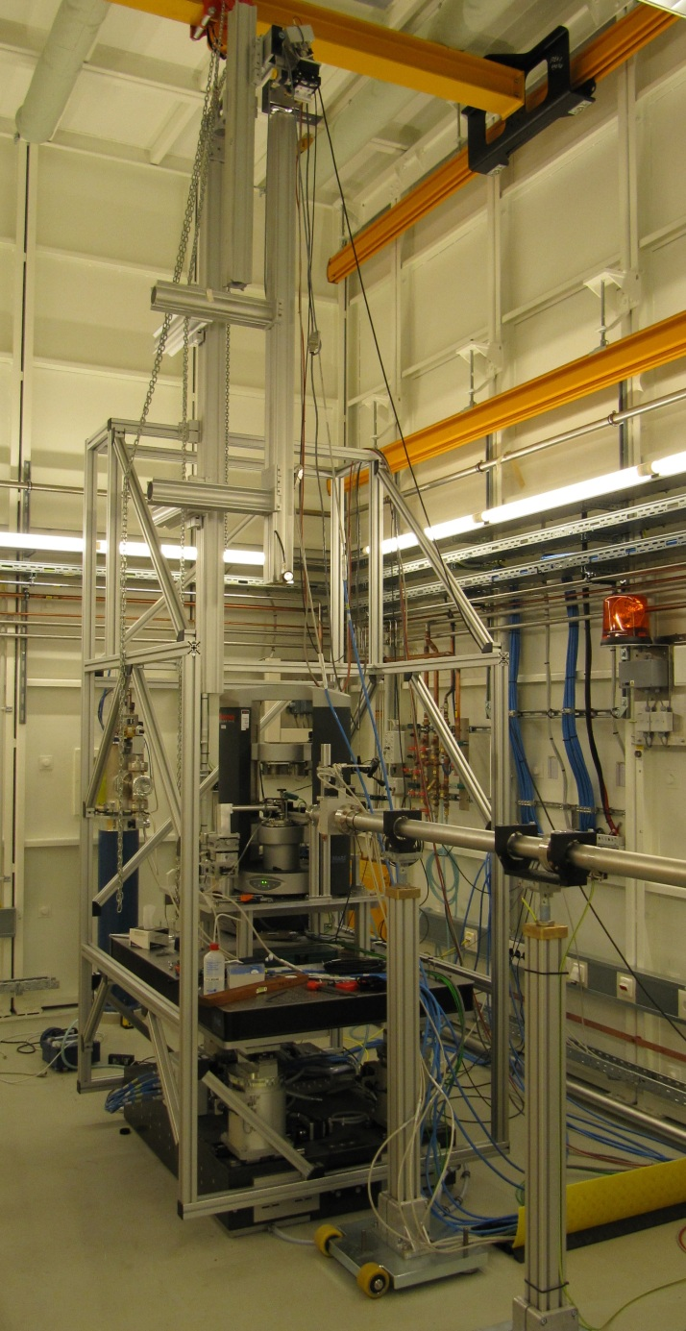
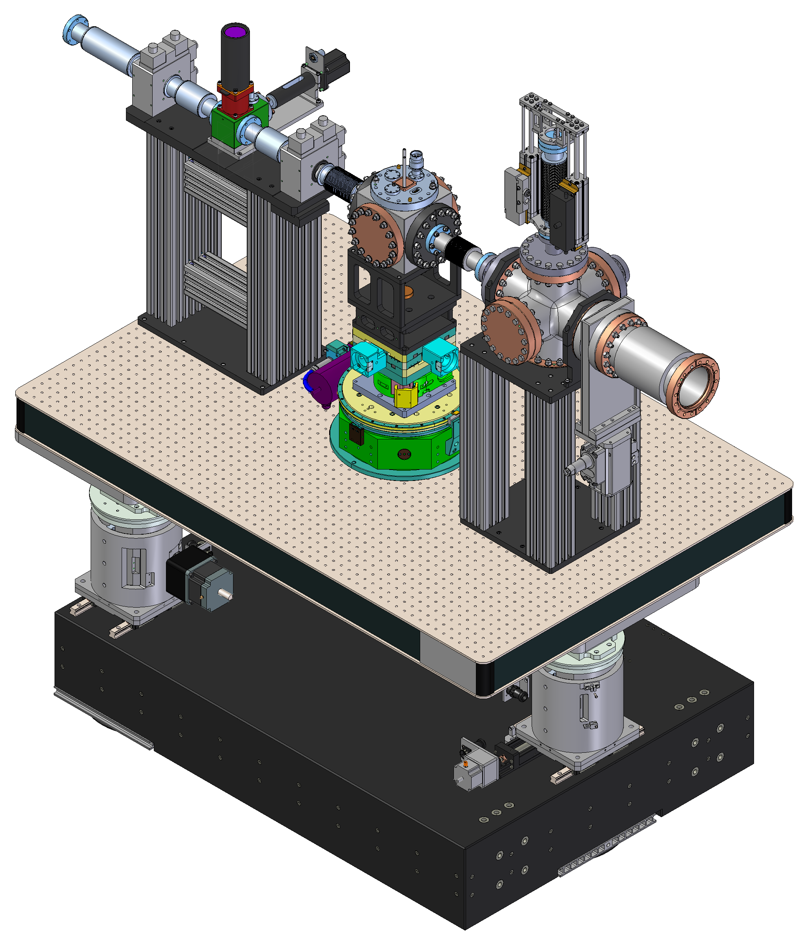
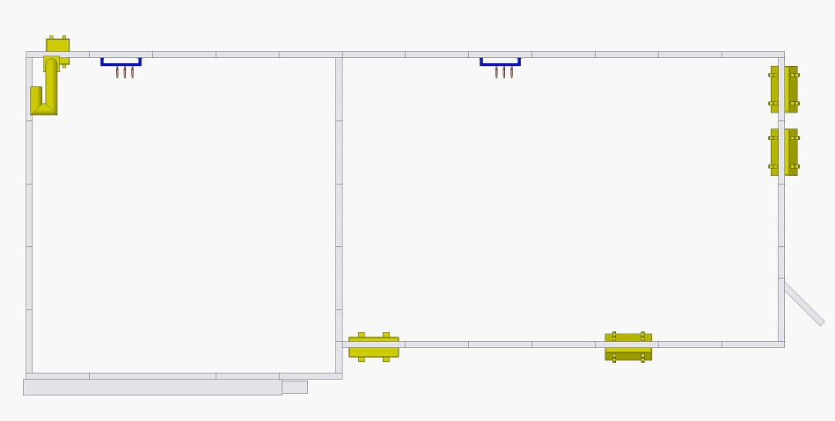
1. Experimentierhütte EH1 von P10
<1500mm
Rheology setup (PI Bernd Struth):
Plate-Plate geometry
Vertical scattering geometry
(currently) incoherent scattering
Pilatus 100K detector
79m
67m
2Theta-vertical
Soft Matter SAXS setup (late 2011):
up to 20m sample- detector distance
compatible with standard setup
strongly limited Q range
easily removable to allow other setups
5-axis table up to 500kg loads
Theta-vertical
>1300mm
Large Q setup (summer 2012):
6-circle diffractometer
compatible with ARS cryostats
open Chi circle
>610mm
Chi
NBS
D1
Rheo
6-circle
USAXS
Optics
C
>80mm
Phi
Bernd Struth
>620mm
Sample XYZ
Theta-horizontal
2Theta-horizontal
yz-table + leveling option

Slide 10
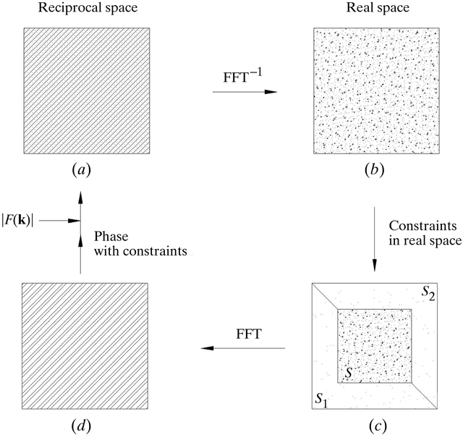
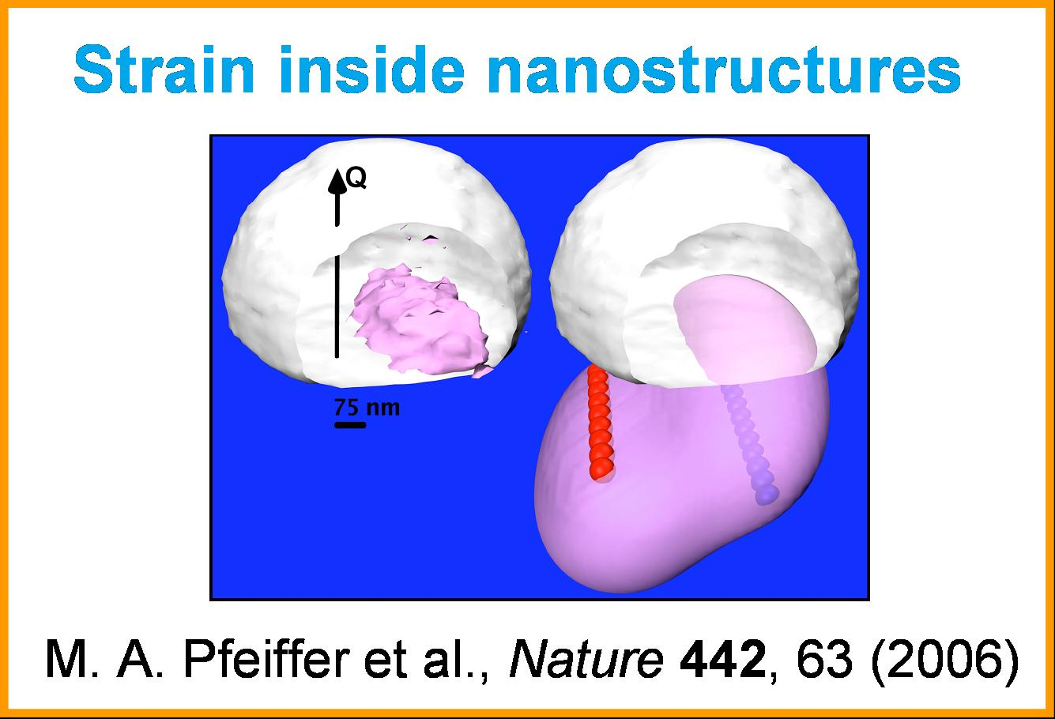
Coherent Diffraction Imaging
High resolution images of small structures
Coherent diffraction imaging techniques aim to reconstruct the real-space structure of objects from its diffraction pattern (reciprocal space) by the use of constraints and phase-retrieval algorithms (e.g. Gerchberg-Saxton-Fienup).
Ptychography
Holographic imaging
…

Slide 11
The nanofocus / waveguide setup
The Göttingen iBox endstation @ P10/PETRA III for Holo-Tomography
→ 11
Scatterless Slits
Kirkpatrick-Baez mirrors
Monitor
Front side microscope
Waveguide motions
Sample motions
Back side microscope
Detector bench
Cryogenic cold stream

Slide 12
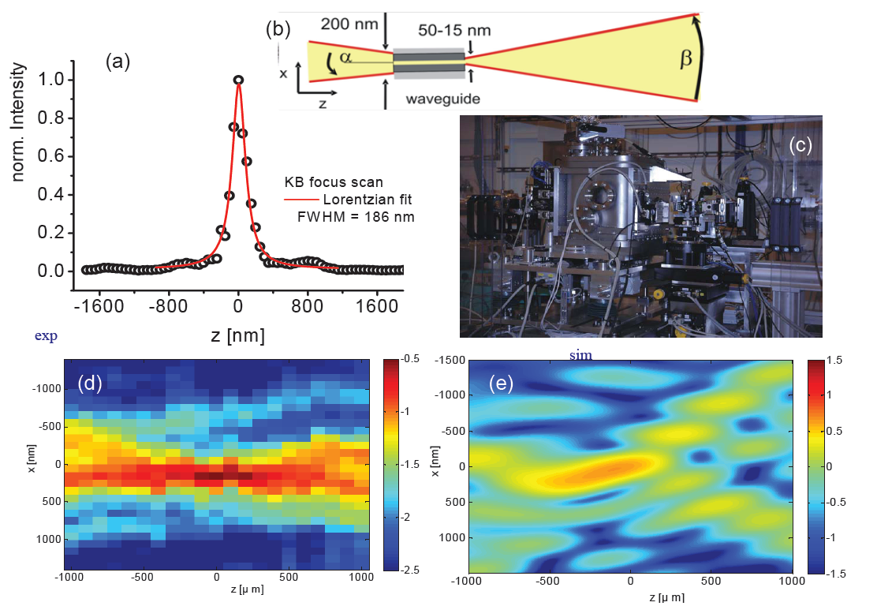
The nanofocus / waveguide setup: First results
(Coherent) Flux before waveguide ~ 1—5 ·10¹⁰ photons/s

Slide 13
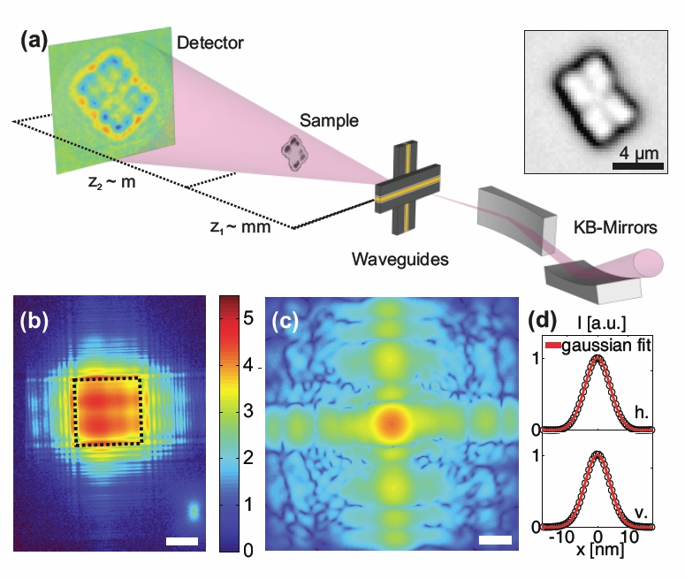
CDI of cells of bacterium ‘Deinococcus radiodurans‘: Schematics

Slide 14
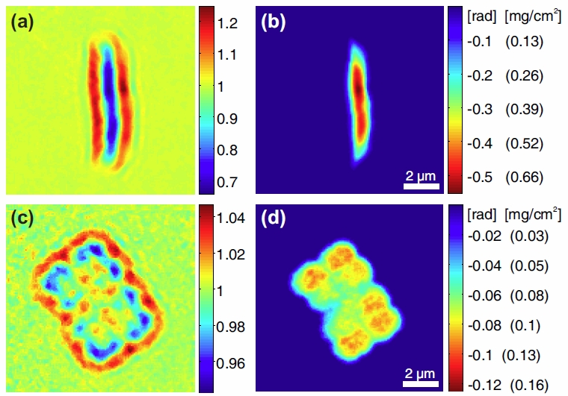
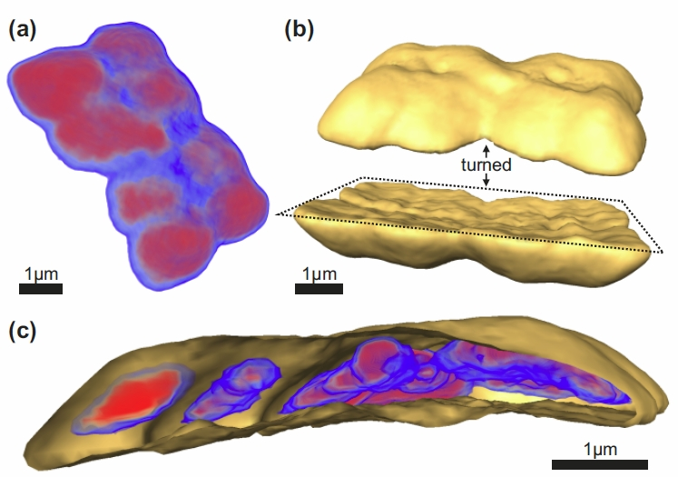
CDI of cells of bacterium ‘Deinococcus radiodurans‘: Results
Low dose experiments on D. radiodurans

Slide 15
X-Ray Photon Correlation Spectroscopy
XPCS is an extension of Dynamic Light Scattering and it utilizes
coherent x-rays to study slow (collective) dynamics at small length scales.
If coherent light is scattered from a disordered system it gives rise to a random (grainy) diffraction pattern, known as ‚speckle‘. Such a speckle pattern is an interference pattern and related to the exact spatial arrangement of the scatterers in the disordered system.
Disorder yields a speckle pattern … Time evolution of disorder yields a time-varying speckle pattern
Time autocorrelation of the fluctuating intensity at a particular wave-vector transfer yields characteristic sample fluctuation time (τ) at a particular length scale

Slide 16
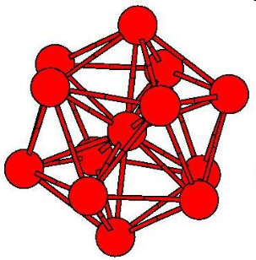
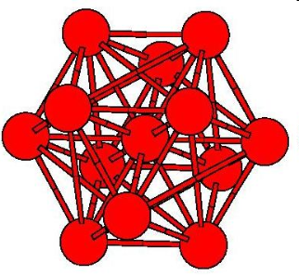
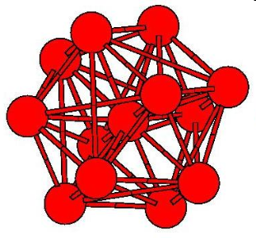
Hidden local symmetries in disordered matter
Coherent Scattering: Scientific opportunities
Can coherent x-ray scattering help to gain a better understanding of the glass transition?
Two popular glass forming scenarios are:
(a) general tendency towards icosahedral order, but locally favored structures cannot fill space
(b) general tendency towards crystalline order, but frustration effects prevent crystallization due to locally favored structures
icosahedral structures can not fill space
but may be energetically favored in liquids
“locally favored structures (lfs)”
fcc and hcp structures can fill up space
and form crystals
P. Wochner et al., PNAS 106, 11511 (2009)

Slide 17
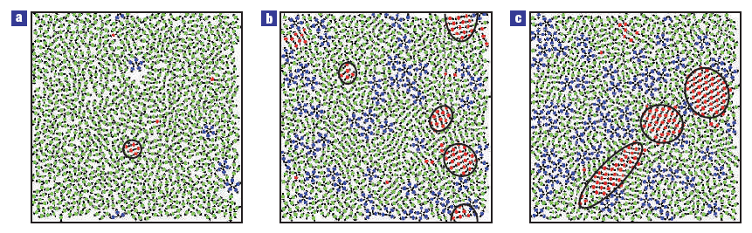

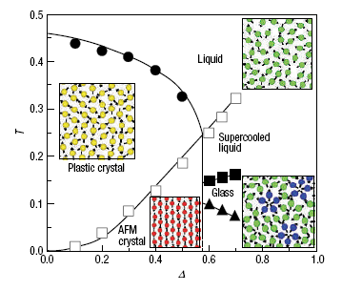
Coherent Scattering: Scientific opportunities
Hidden local symmetries in disordered matter
MD simulations – snapshot of liquid structures
Shintani & Tanaka Nature Physics 2, 200 (2006).
Dynamic heterogeneity
Slower regions ➔ higher degree of order
characteristic length and the lifetime increase on cooling.
Tanaka et al. Nature Mat. 9, 324, 2010

Slide 18


Hidden local symmetries in disordered matter
Coherent X-Rays: Scientific opportunities
Fourier
Transformation
Ensemble
average
P. Wochner et al., PNAS 106, 11511 (2009)

Slide 19
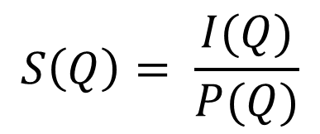
XCCA @ P10
S(Q) : structure factor
I(Q) : intensity
P(Q) : particle form factor
Sample | R | ΔR/R | φ | S(Q_{max}) | Q_{max}
 | nm | % | vol fraction |  | nm⁻¹
HS 1 | 71.0 | 16.6 | 0.56 | 1.9 | 0.051
HS 2 | 92.5 | 10.4 | 0.57 | 2.2 | 0.040
HS 3 | 126.6 | 6.6 | 0.56 | 2.1 | 0.030
HS 4 | 126.6 | 6.6 | 0.52 | 2.7 | 0.028
Glassy phase
Partially crystalline

Slide 20
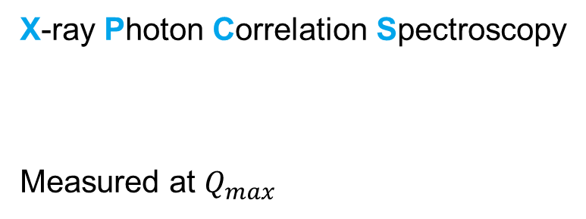

XCCA @ P10
$${\text{g}}_{2}−1$$

Slide 21
XCCA @ P10

Slide 22
XCCA: Relaxation time and bond-order
The more ordered – the slower
D denotes the fragility index (here D=6)
τ₀ the microscopic time (here τ₀ = 1).
d the spatial dimensionality (here, 2/d=0.63)
➔
This relation supports the scaling argument.

Slide 23
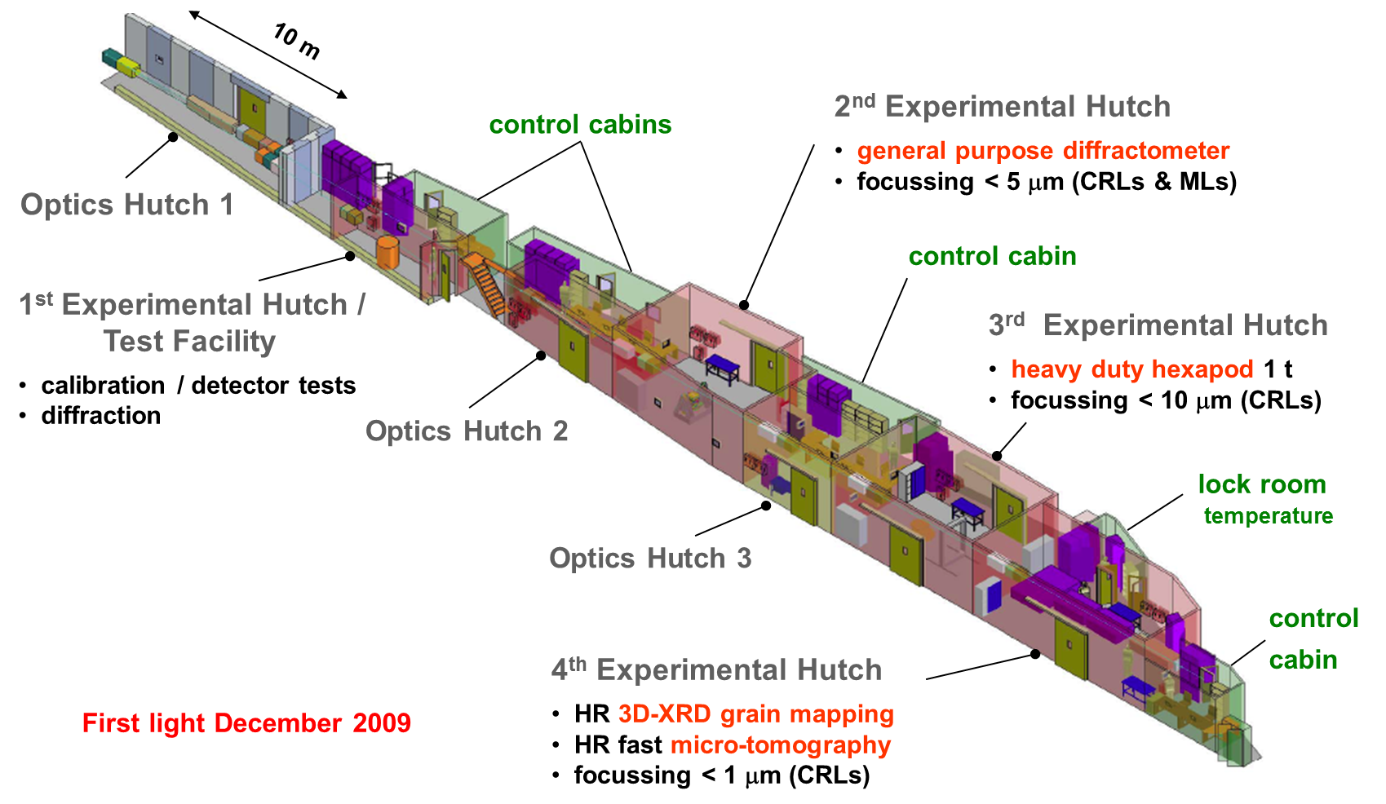
More scientific examples: P07
High energy materials science (HEMS): Layout

Slide 24
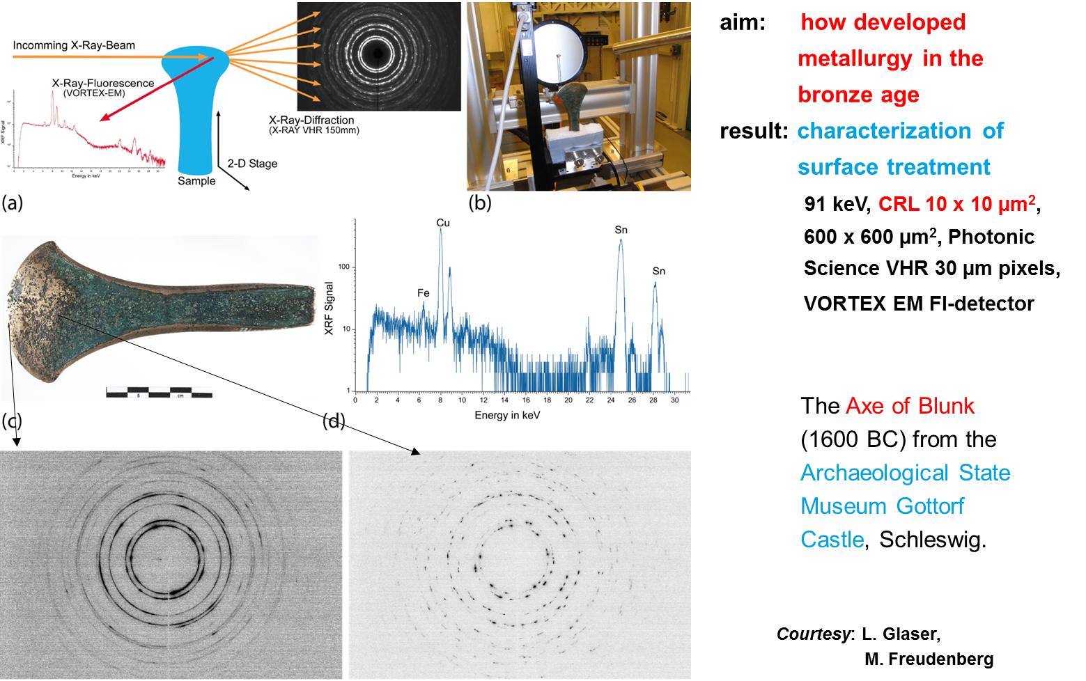
More scientific examples: P07

Slide 25
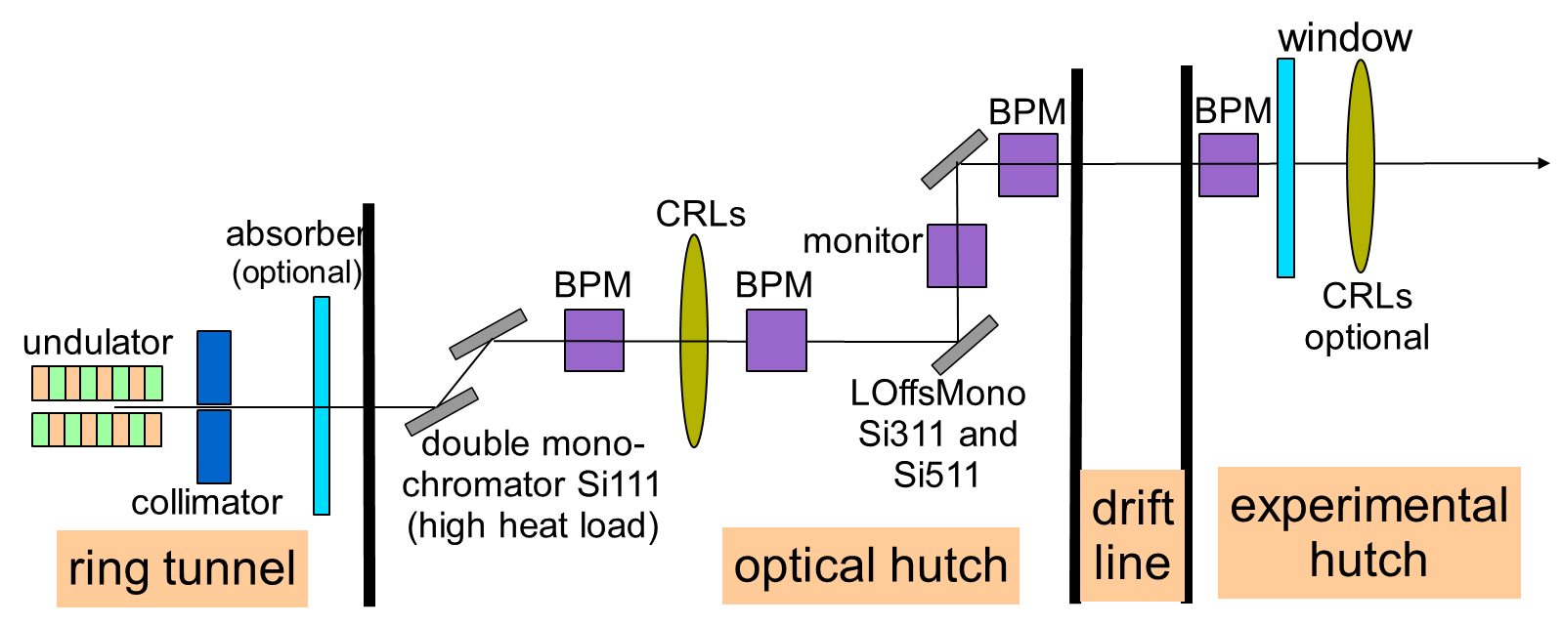
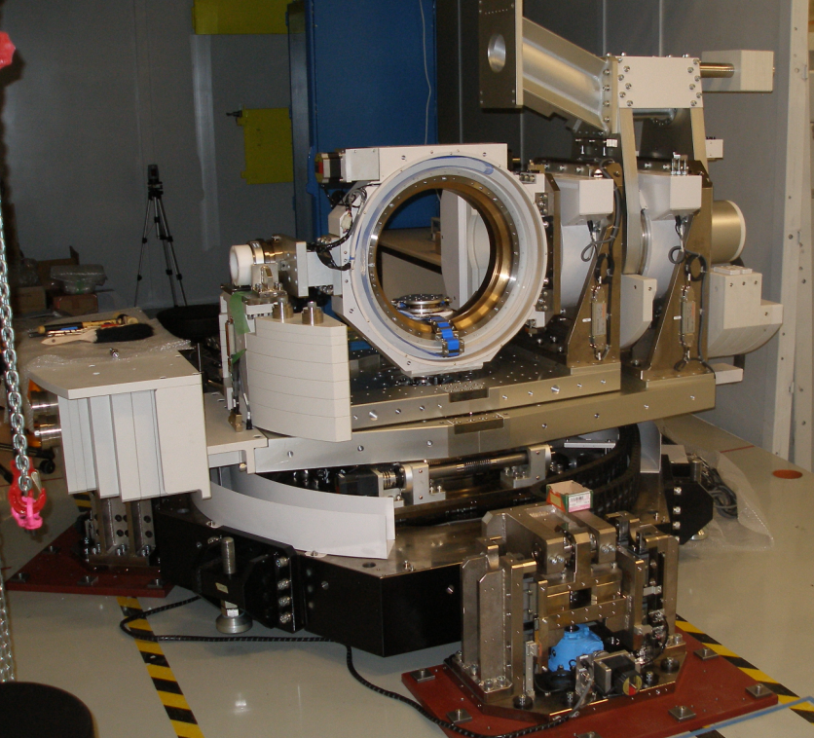
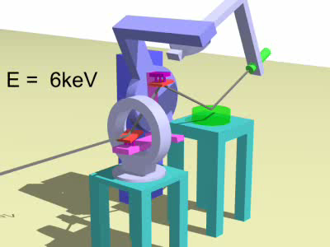
More scientific examples: P08
Two experimental setups:
High resolution difraction (top)
Liquid surface scattering (left)

Slide 26
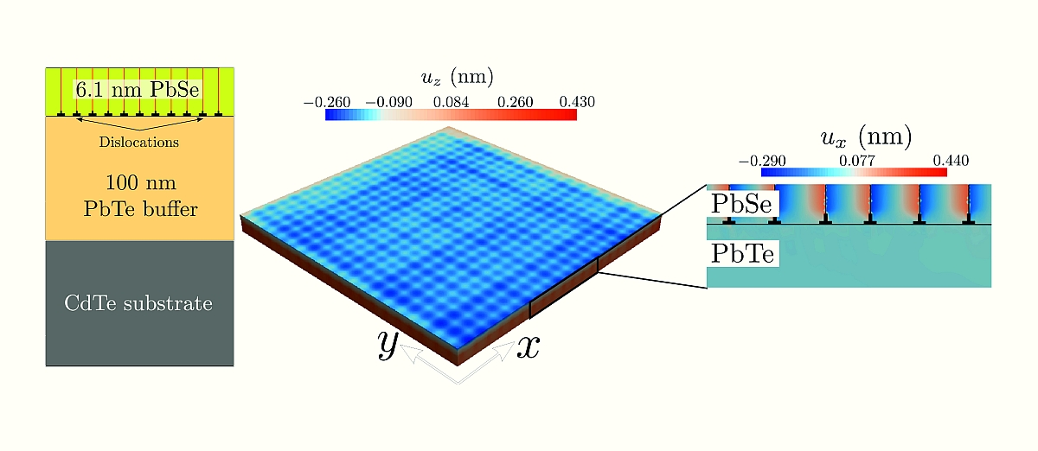
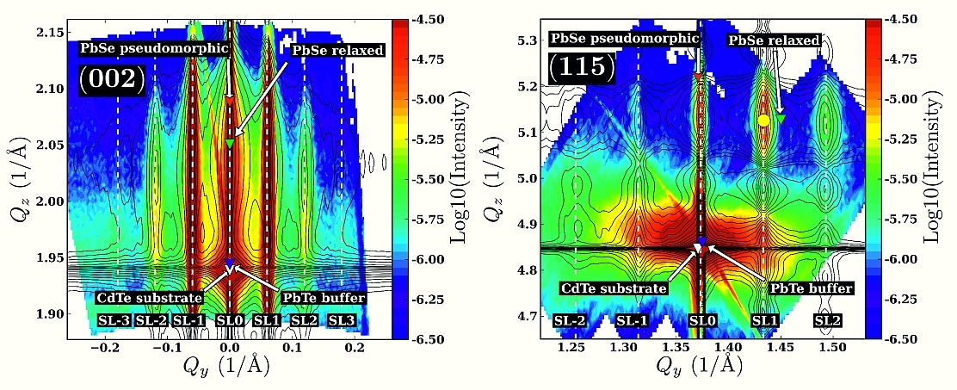
More scientific examples: P08
Periodic dislocations in thin PbSe films
Wintersberger et al. Appl. Phys. Lett. 96, 131905 (2010)

Slide 27
Zusammenfassung
PETRA III bietet großartige wissenschaftliche Möglichkeiten
an 14 spezialierten Undulator Beamlines!
Alle diese Beamlines benötigen eine ‘perfekt’ laufende Maschine
um ihr volles Potential auszuschöpfen!
P10 fördert die Entwicklung und Ausnutzung kohärenter
Streumethoden
Kohärente Streumethoden sind eine neue Möglichkeit um
interessante wissenschaftliche Fragestellungen anzugehen

Slide 28
Acknowledgements
All members of the Coherence Beamline
HASYLAB Coherent Scattering Group
PETRA III project team
HASYLAB optics group
Thank you for your attention!

Slide 29
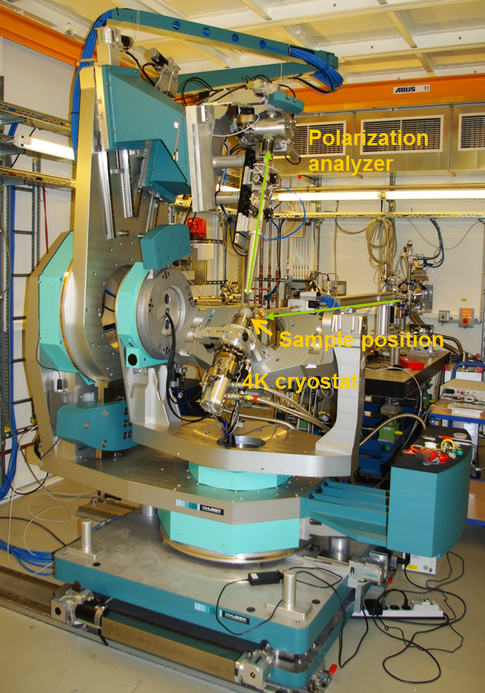
More scientific examples: P09
Resonant Scattering and Diffraction Beamline P09
Energy range: 2.7 – 24 keV
Variable incident polarization and
analysis of scattered polarization
(rotated linear or circular)
8-circle (Psi) diffractometer for
resonant scattering and diffraction
experiments
Horizontal or vertical scattering
geometry
Low temperatures down to 1.7 K
Point detectors and area detector used
quasi simultaneously

Slide 30
Why different bunch modes?
Interesting region for P01 & P04 experiments
Bad region!
Good region
for P10
Peak at 1.29E-7 sec
S = v/t
v = c
= 3.0E8 m/sec x 1.29E-7 sec
= 38.7 m
2304 m / 38.7 m = 59.7 Bunches

Slide 31

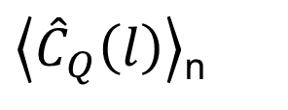
Simulations of Simple Model Disordered Structures
Fourier transform (FT) of C_{Q}(ϕ)
average over n different ensembles

Slide 32
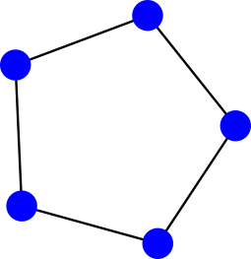

Simulations of Simple Model Disordered Structures
N=1600 Pentagons
Grid: 3000x3000
Number of different
ensembles: n= 1000

Slide 33
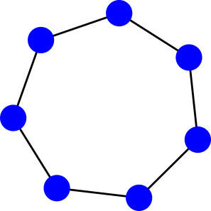
Simulations of Simple Model Disordered Structures
400 Pentagons
400 Heptagons
Grid: 3000x3000
Number of different ensembles:
n= 1000

Slide 34
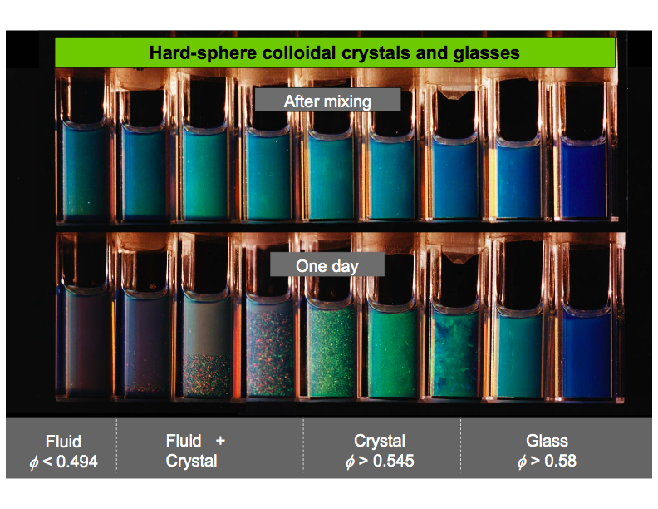
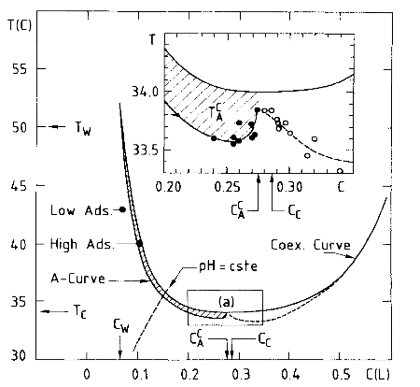
1) How a liquid becomes a glass both on cooling and on heating!
Coherent X-Rays: Scientific opportunities
Phase transitions in colloidal suspensions
Silica spheres in water-lutidine
D. Beysens & D. Esteve, Phys. Rev. Lett. 54 (1985) 2123.
V. Gurfein, D. Beysens & F. Perrot, Phys. Rev. A 40 (1989) 2543.
D. Pontoni, T. Narayanan, J-M. Petit, G. Grubel, and D. Beysens, PRL 90, 188301 (2003).

Slide 35
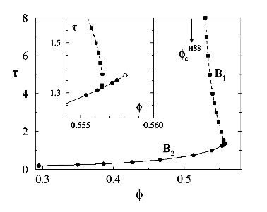
Predictions of MCT
Coherent Scattering: Scientific opportunities
1) How a liquid becomes a glass both on cooling and on heating!
HS glass
A colloidal glass with hard-sphere (HS) repulsions may be melted by switching on a short-ranged attractive interaction.
Such a melted glass may be re-vitrified upon further increase in the attraction.
There can exist a sharp transition between a HS glass and an “attractive” glass, accompanied by a sudden change in elastic properties.
Density fluctuations decay logarithmically versus time, in the liquid where attractive and repulsive arrest mechanisms compete.
liquid
“attractive” glass
Mode coupling theory phase diagram for sticky hard spheres plotted vs. stickiness (τ) and volume fraction (φ)
From L Fabbian, W Götze F Sciortino, P Tartaglia, F Thierry, Phys. Rev. E 59, R1347 (1999).

Slide 36
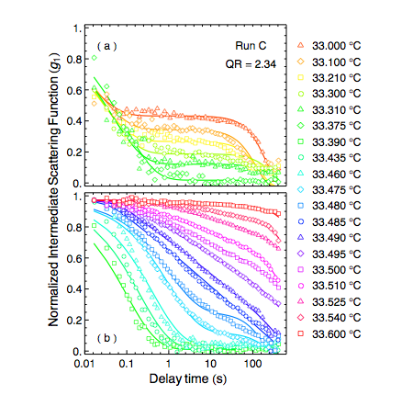
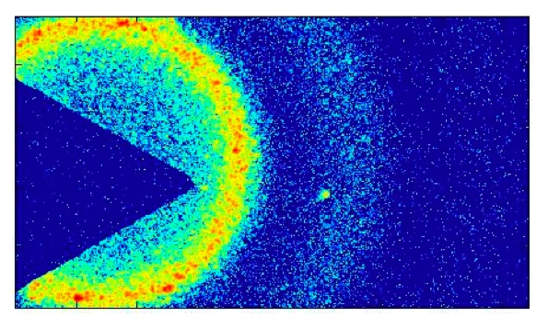
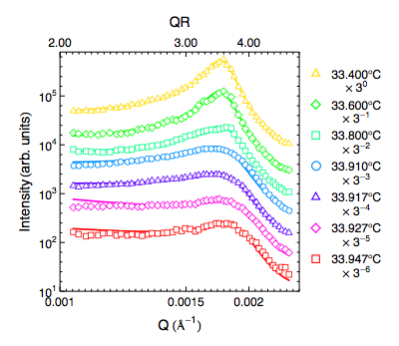
1) How a liquid becomes a glass both on cooling and on heating!
Coherent Scattering: Scientific opportunities
Coherent small-angle x-ray scattering (Coherent SAXS)
150 ms exposure -- 200 nm radius silica spheres
Xinhui Lu, S. G. J. Mochrie, S. Narayanan, A. Sandy, M. Sprung, PRL 100, 045701 (2008)

Slide 37
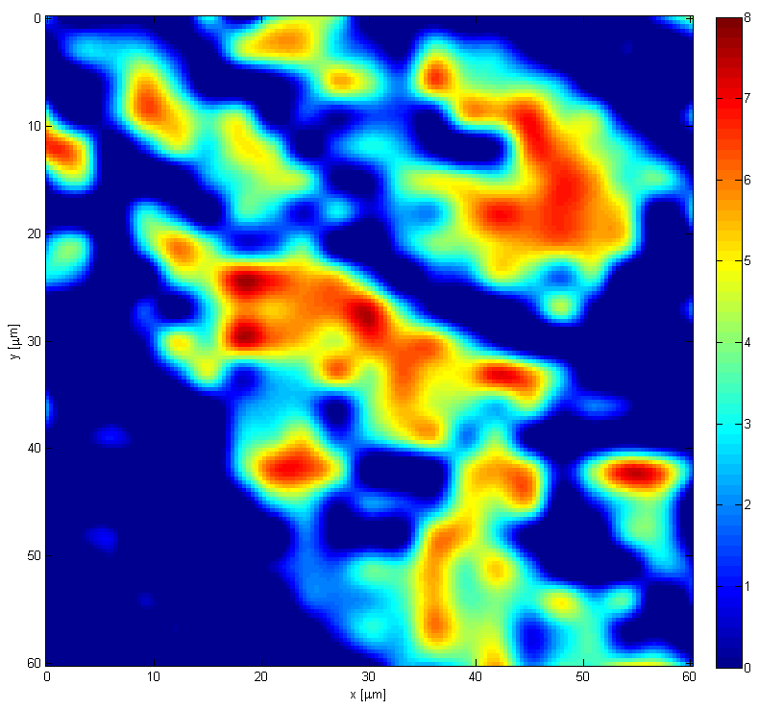
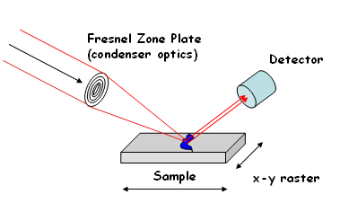
2) Direct measurement of antiferromagnetic domain fluctuations
Coherent Scattering: Scientific opportunities
Microscopic Magnetic Domains in Chromium:
[0, 0, 2-2δ] Charge-density wave satellite
Scanning X-ray Microscopy:
bulk probe (micron-sized
penetration depth)
spin, charge, lattice
and chemical sensitivity
10 μm

Slide 38
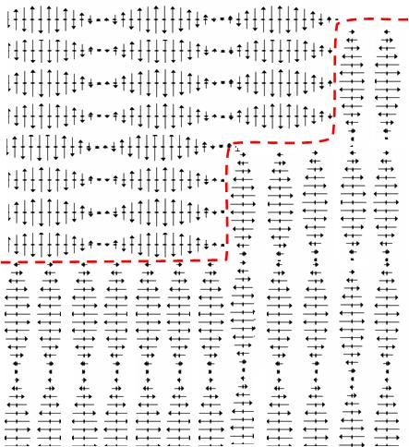
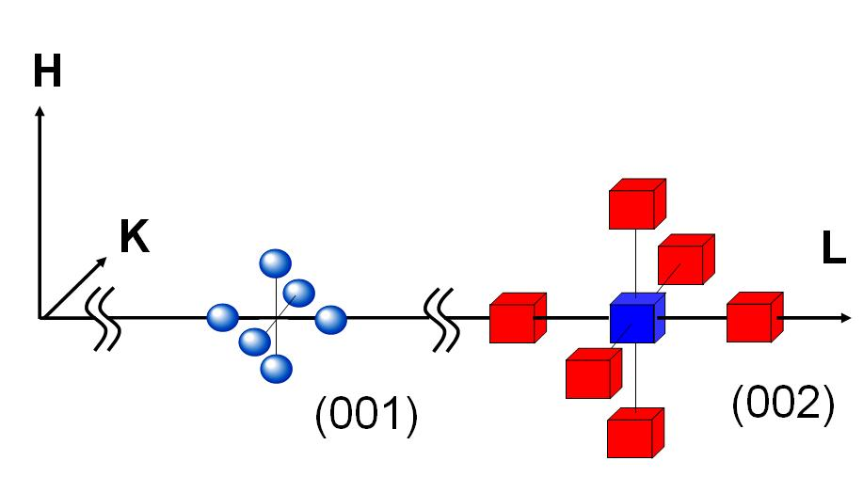
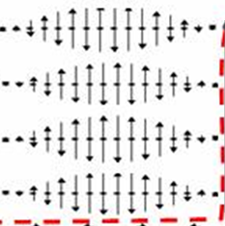
2) Direct measurement of antiferromagnetic domain fluctuations
Coherent Scattering: Scientific opportunities
2
λ
1
3
2
2
1
3
1
Real Space:
elemental switching block
(V=(λ/2)³, λ=3-4 nm)
Momentum Space:
transfer of intensity from satellites 1 to 2 due to switch

Slide 39



2) Direct measurement of antiferromagnetic domain fluctuations
Coherent Scattering: Scientific opportunities
Experimental setup @ 8ID-G
Charge Density Wave
(at 4K; 6 hours total)
Quasi-static Bragg speckle
(line scans from 2D image):
X-ray Bragg speckle
(6-hr average)

Slide 40



2) Direct measurement of antiferromagnetic domain fluctuations
Coherent Scattering: Scientific opportunities
XPCS data
Classical Arrhenius model
Quantum Tunneling model:
O. G. Shpyrko et al., Nature 447, 68 (2007)

Slide 41

Real space images of colloidal crystals
Group of I. Vartaniants/DESY
Experiment led by J. Gulden
Energy: 7.9 keV
Samples: colloidal crystals below 10 μm size
Flux: ~10⁸ on 10×10 μm² spot
Sample detector distance: 5 m
Detector: 20×20 μm² pixel size, 1340×1300 pixels
Maximum resolution: 60 nm
Goal of the experiment is to get a full 3D image of colloidal crystals

Slide 42





Optimizing the combination Pilatus–Standard Setup
Pilatus pixel size is very large!
→ beam size has to be small
to produce large speckles!
The vertical transversal coherence length is 6x larger than the horizontal one at P10!
prefocusing only the vertical direction
match vertical and horizontal coherence length at the position of the secondary lens!
The beam size should be ~4µm for a sample—detector distance of 5.0m
Focusing is needed to use the full coherent flux !
The loss would be 1/3750!!!

