Slide 1
ECal. Hit Visualizations
10TeV Detector Meeting, 8/3
Micah Hillman
University of Tennessee, Knoxville

Slide 2
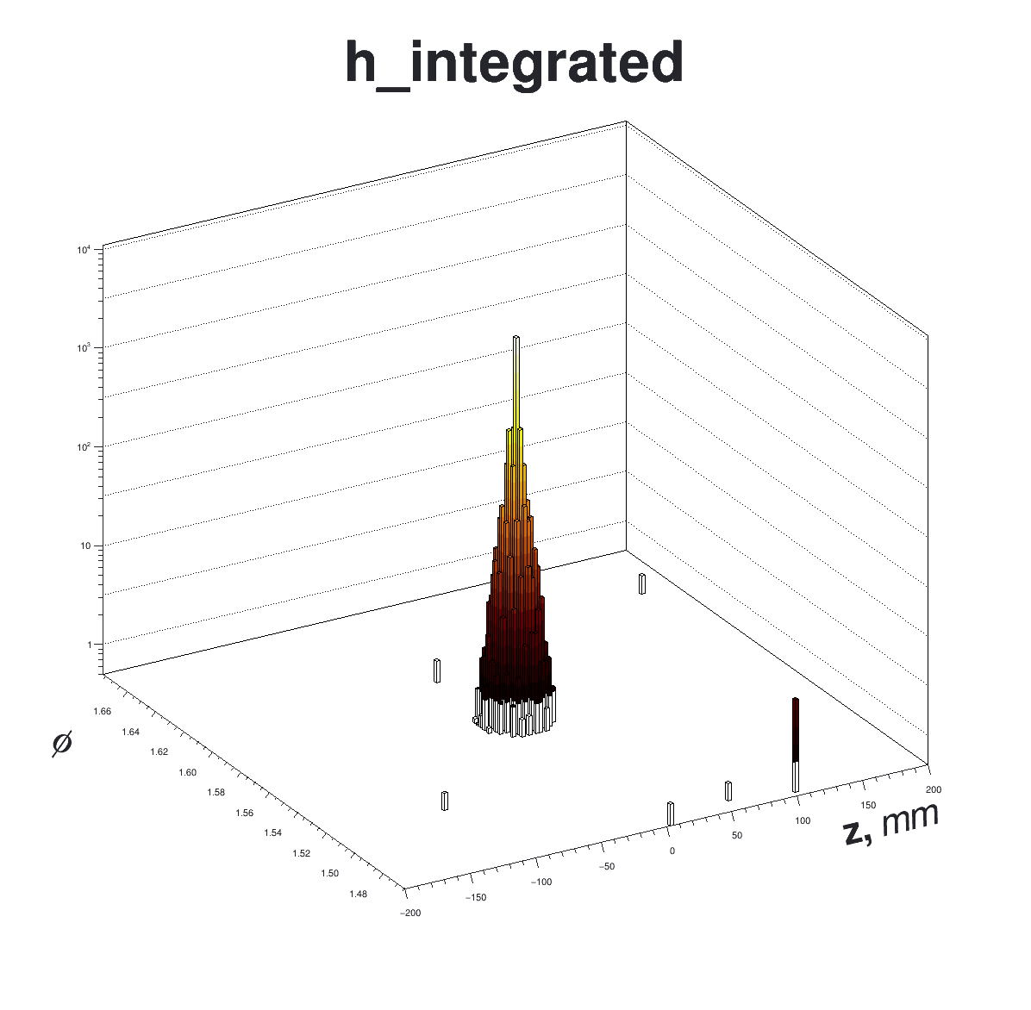
φ vs. z with BIB
Integrated Over All Layers
Gives a good representation of the integrated ‘shape’ of a hit.
Good for basic demonstration.
Does not yield insight into shower evolution.
All events in sample have the same BIB overlay, but I will look at the new samples.
Data in /collab/project/snowmass21/data/muonc/fmeloni/LegacyProductions/DataMuC_MuColl10_v0A/photonGun_1000/recoBIB.
Fig. 1. phi vs. z integrated over all detector layers for a single digitized 1TeV photon hit in the ECal. The z-axis is weighted by energy.

Slide 3
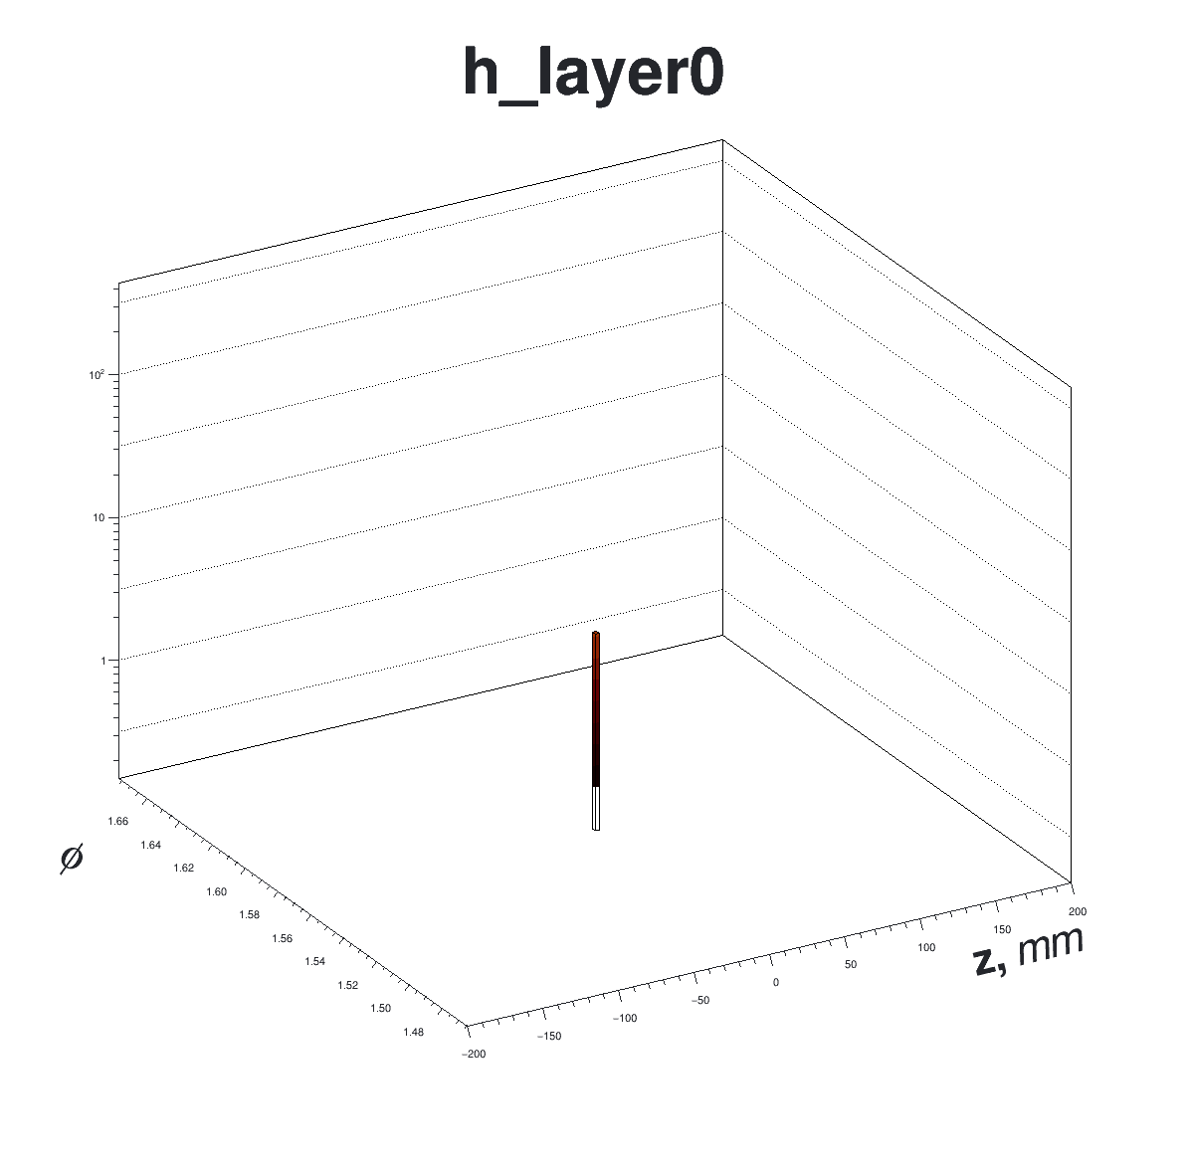
φ vs. z with BIB
Animated by Layer
Demonstrates time-evolution of energy deposition.
BIB seems sparse, but this is likely due to a large energy threshold (70MeV) intrinsic to our digitization.
  Working on similar visualizations with sim. data overlayed with BIB. These will have lower thresholds.
Fig. 1. phi vs. z by layer for a single digitized 1TeV photon hit in the ECal. The z-axis is weighted by energy.

Slide 4
φ vs. z with BIB
More Ideas
Larry suggested making a 3D, static version, with the z-axis representing layer number.
  Could be a more intuitive solution for demonstrating energy deposition.
  Might look something like this —>
    Highly spatial, good representation of shower shape.

Slide 5
Next Steps
Finalize these plots.
Again, characterize BIB deposition per-cell, and establish a new threshold based on this value. (For real this time).
  Characterize the impact of this cut on the energy resolution of the detector.

