Slide 1


Close-out – Annual Meeting MT-ARD-ST3
Advanced beam control, diagnostics & dynamics
Erik Bründermann (Spokesperson ST3, KIT)
Florian Burkart (Spokesperson ST3, DESY)
Center contacts: Thorsten Kamps (HZB), Michael Kuntzsch (HZDR), Peter Forck(GSI)
27.06.2025, 12:00 – 13:00
13th ARD-ST3 Meeting MT Days, DESY / Zeuthen
Thanks to the local organizing committee

Slide 2
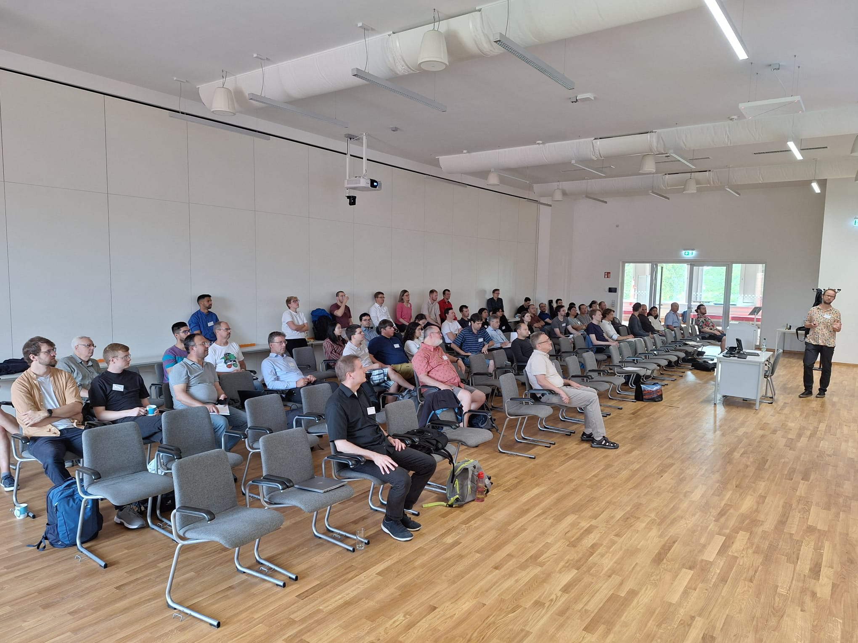
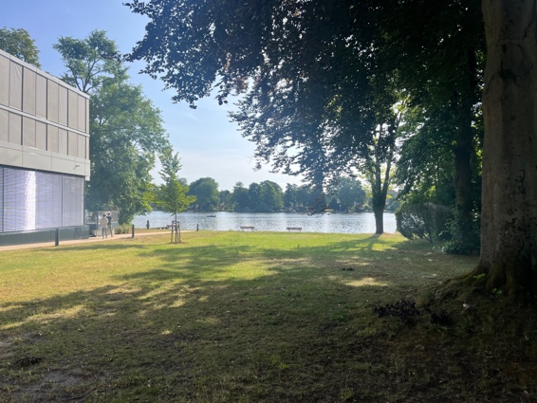
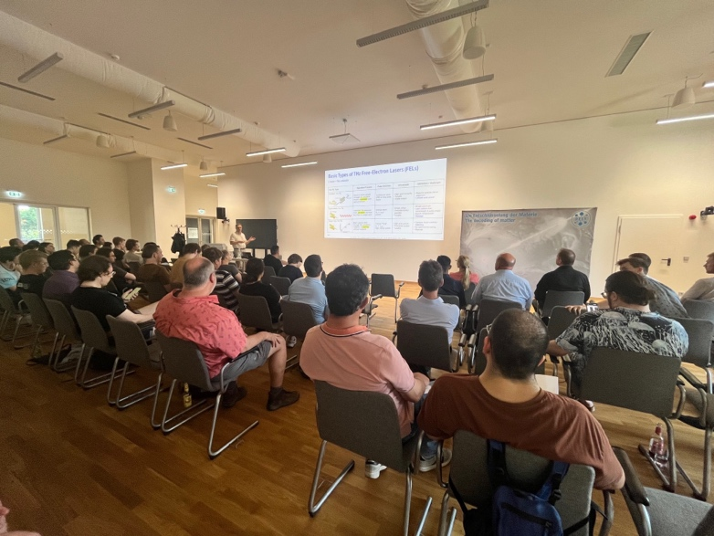
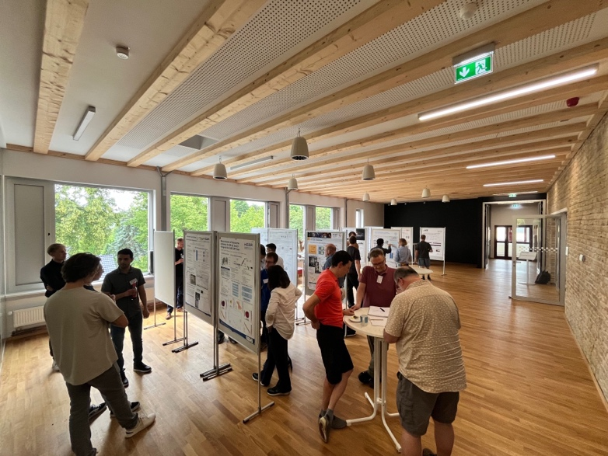
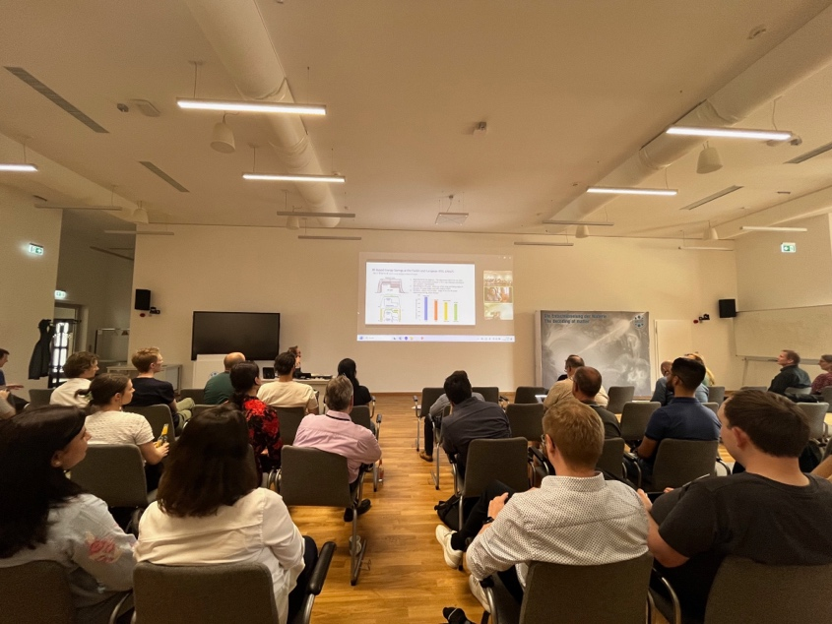
Some impressions

Slide 3


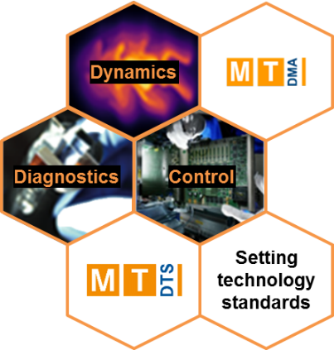
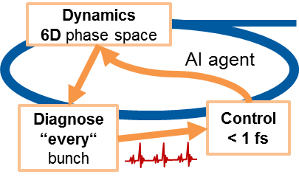











ST3 – Advanced beam control, diagnostics & dynamics
Heartbeat of Matter – Faster, more throughput at highest precision.
Control of extreme beams at the forefront of technology
Connecting Sub-Topics and
being a hub to DTS and DMA
2015
2020/21
→
2027
Custom & Extreme Beams
Extreme dynamic range
Custom & Extreme Beams
Extreme dynamic range
Dynamics code
micro-bunching
instabilities
OCELOT
INOVESA
+ (AI) Artificial
Intelligence
XUV seeding
nm
→
Diagnostic rates
Frames/second
→
Synchronization
in accelerators
fs
→
Advanced beam control
Advanced beam control
Attosecond metrology
Time-resolved
fs
→
Attosecond metrology
indico.desy.de/event/40831/page/4669-vision

Slide 4







ARD in PoF V
Continuous development of very successful ARD topic structure
2028 – 2034 PoF V
2021 – 2027 PoF IV
5 centres & 2 Institutes
ST1
Advanced CW SRF-Systems
SRF systems for sustainable applications
ST2
New Concepts and Prototypes for Maximizing the Performance of Hadron & Electron Accelerators
Efficient and High-Performance Hadron & Electron Accelerators
R&D for outstanding
science & technologies
ST3
Advanced Beam Control, Diagnostics and Dynamics
Advanced Beam Control, Diagnostics and Dynamics
ST4
Ultra Compact, Novel Accelerators and their Applications
Ultra Compact, Novel Accelerators Plasma based Accelerators and their Applications
tbd!
Contribution to Competence Team
Optical Technologies (OPT)

Slide 5
Title of ST3 should be changed after 7 years
how to be even more advanced ??
Advanced Beam Control, Diagnostics and Dynamics
6D Beam Dynamics, Diagnostics and intelligent Beam Control
What challenges do you see for PoF V?
What are your wishes?
What would help you?

Slide 6
ARD in PoF V
Central ARD mission in one sentence
Accelerator Science and Technology for
highest performance and sustainability

Slide 7
Next steps towards PoF V
strategic evaluation in 2026
1.7. – Start - Kick-off meeting in Kassel
end of September – first draft programm/topics
Mid December – complete draft (close to final version) to MB Materie
Jan/Feb – several reviews/correction rounds
Mid March – hand in at Helmholtz office Berlin
End March – report goes to reviewers
April/May – Rehearsals
26.-29.5.2026 – Strategic Evaluation Matter (Berlin-Buch)

Slide 8
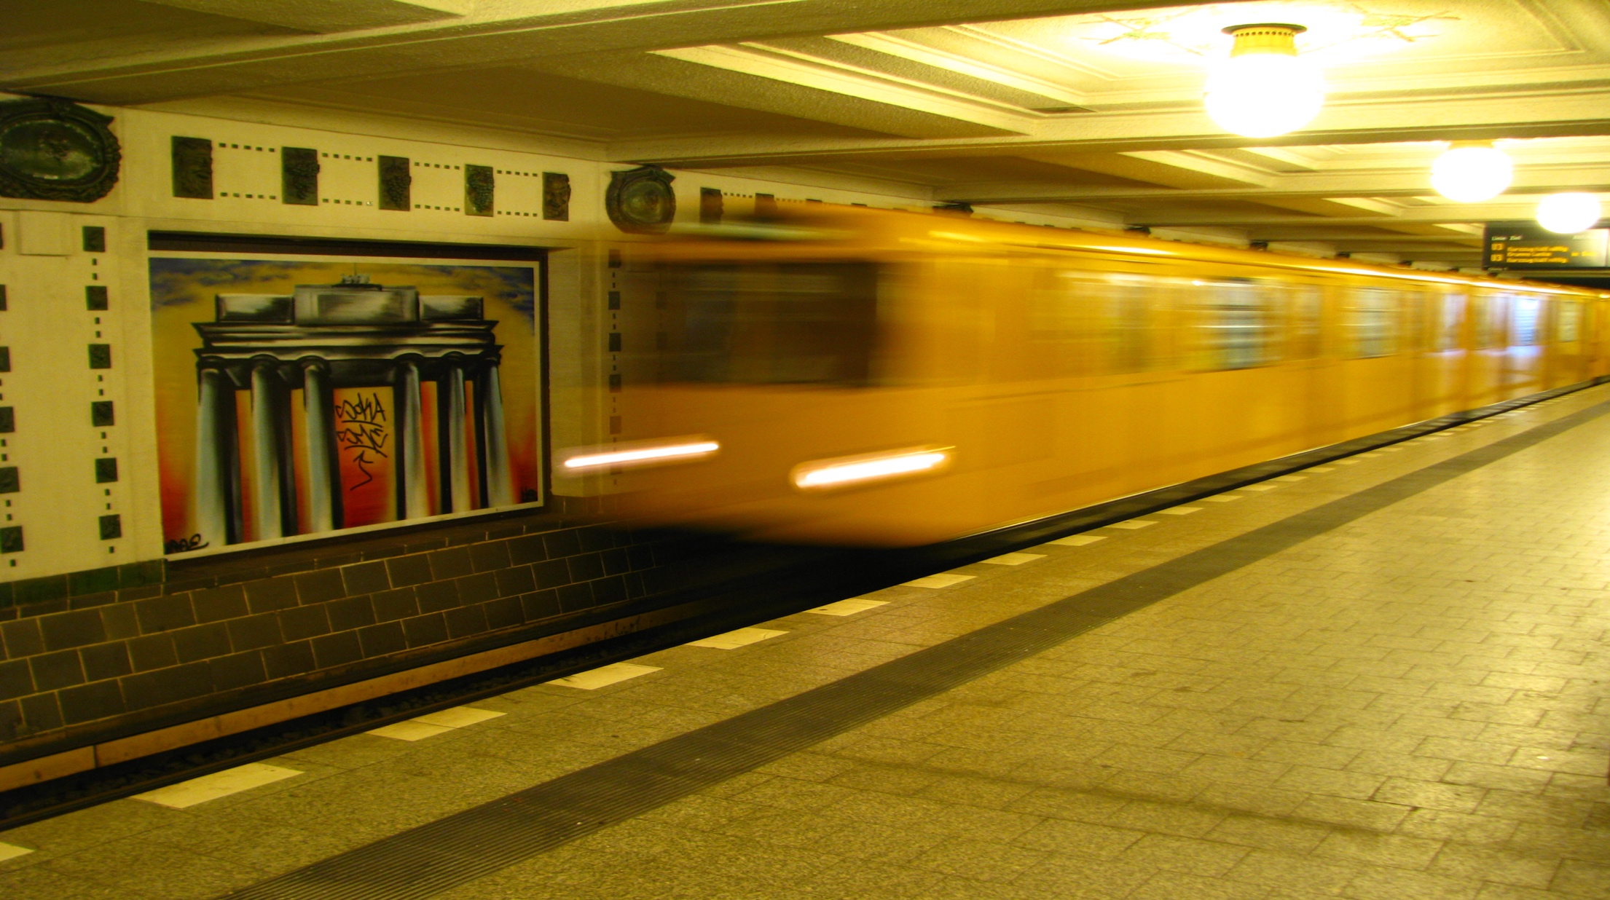
It is a long way to PoF V!
But there will always be a sunrise in the morning and light at the end of the tunnel.
The PoF V train is on full speed!
Caution at the platform edge ;)

Slide 9

13th ARD ST3 annual meeting in Zeuthen
in numbers
67 participants
29 talks
32 speed-talks
Tutorial: “THz generation and diagnostics”
Tutorial: "Energy efficient accelerator operation"
Pre-Workshop: “Medical application”
if you have ideas / wishes for tutorials / pre-workshops…
let us know!

Slide 10
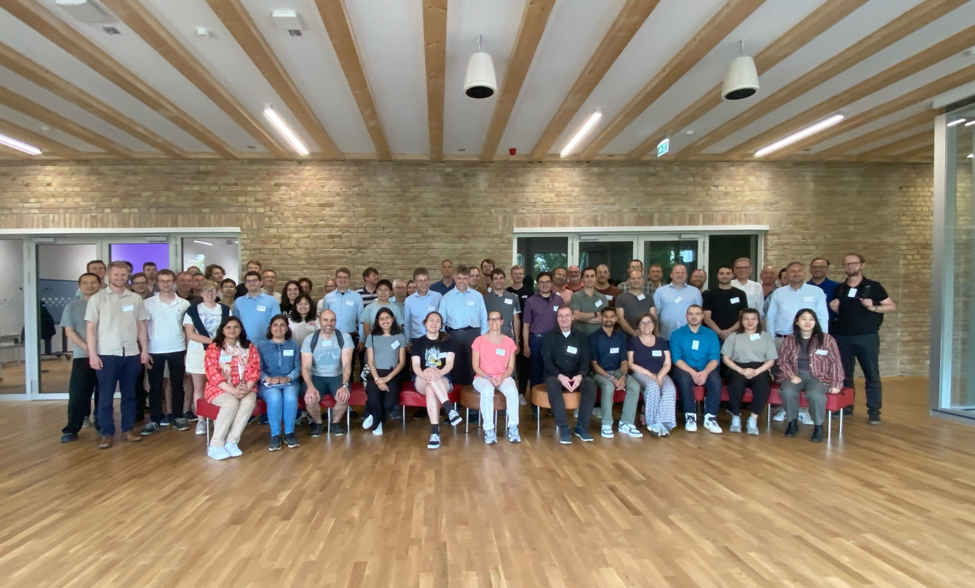
Thanks a lot
local organizing committee (Anne, Julia)
DESY campus Zeuthen for hosting us
all speakers
all poster presenters
chairs of the sessions
and YOU

Slide 11
Have a safe journey home!
See you in Karlsruhe!

